Slide 1
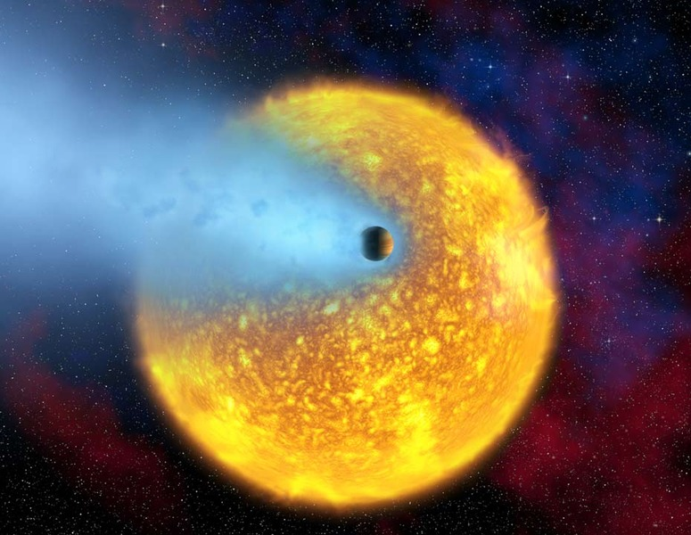
…with Amateur Equipment
Dale E. Gary
New Jersey Institute of Technology

Slide 2
Outline
Current knowledge of extrasolar planets (exoplanets)
Methods of detection
The transit method
Professional and amateur observations
What you need to detect transits
How to submit your measurements

Slide 3
Outline
Current knowledge of extrasolar planets (exoplanets)
Methods of detection
The transit method
Professional and amateur observations
What you need to detect transits
How to submit your measurements

Slide 4
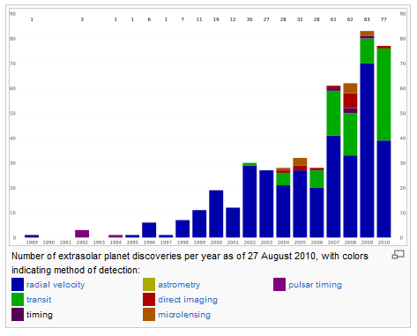
Number of Known Exoplanets
As of 2010 Aug. 27, there are 490 confirmed detections of exoplanets, yet the first exoplanet around an ordinary star was announced only in 1995.
The pace of new discoveries is growing ever faster, due in part to organized groundbased efforts and in part to new space missions.
Most of the known exoplanets are “hot Jupiters” orbiting very close to their parent star, but the size distribution is skewed by the sampling bias inherent in the detection methods, which will be discussed later.

Slide 5
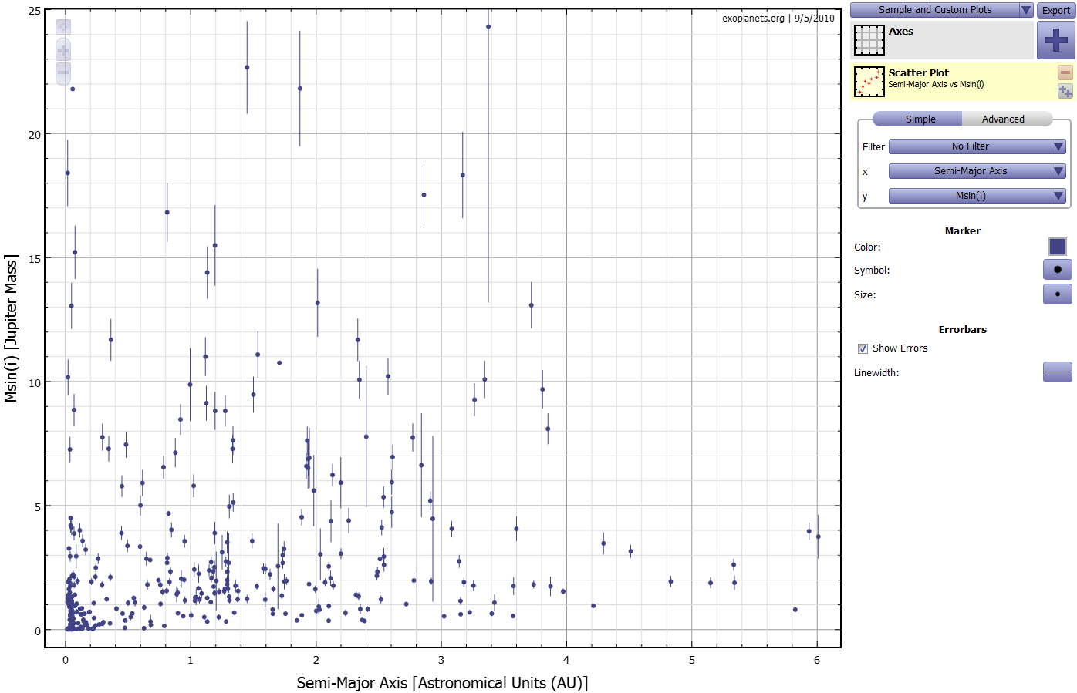
Exoplanet.Org
http://exoplanets.org/exoplot/exoPlot.html
radial
velocity
v sin i
true
velocity
v
i

Slide 6
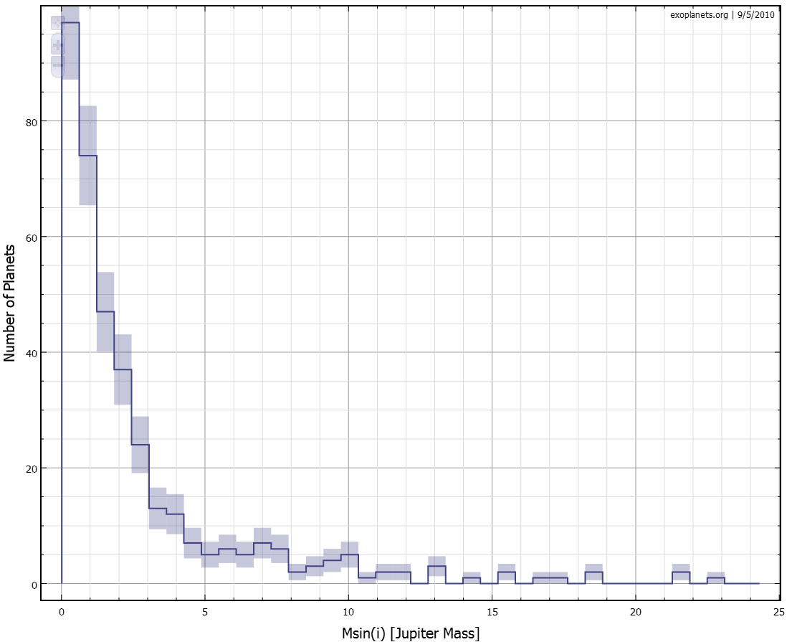
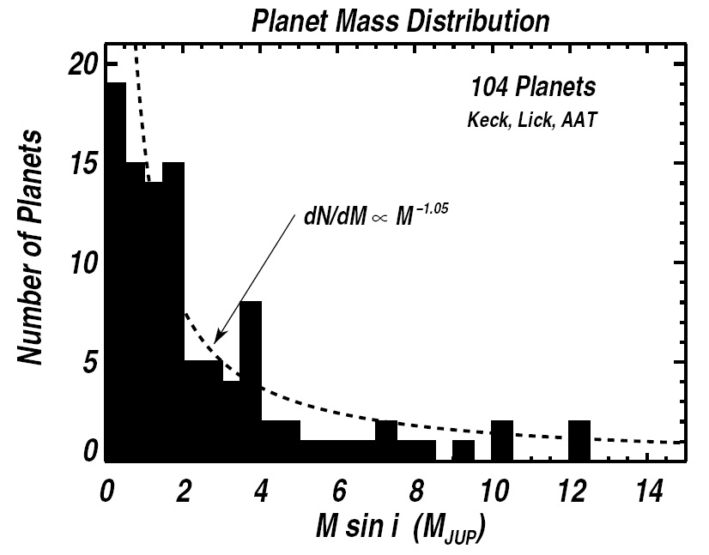
Characteristics of Known Exoplanets
Results from 104 planets, in 2005 paper by Marcy, Butler et al.
Most planets are small—strongly increasing toward lower masses

Slide 7
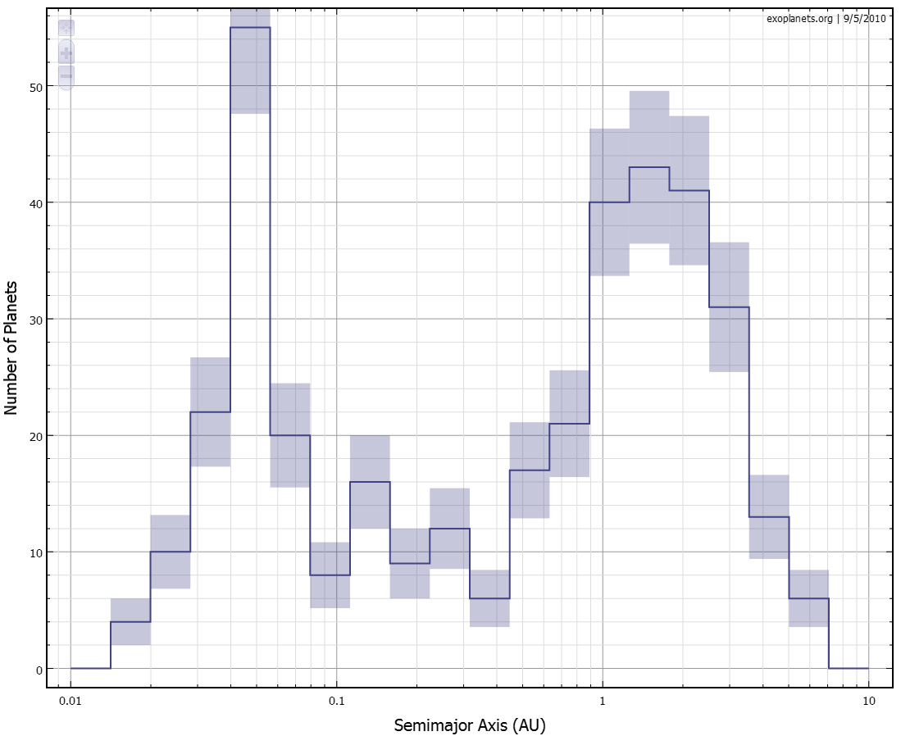
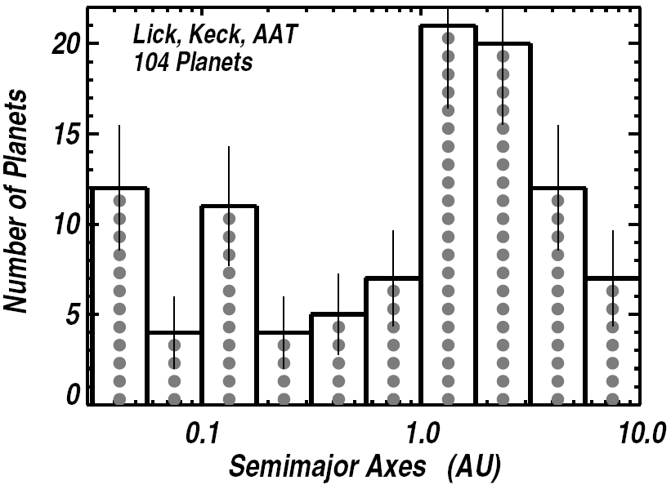
Characteristics of Known Exoplanets
Results from 104 planets, in 2005 paper by Marcy, Butler et al.
Number of planets grows with distance from central star

Slide 8
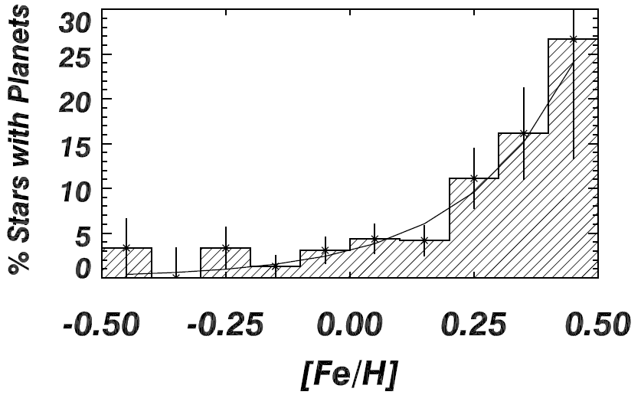
Characteristics of Known Exoplanets
Results from 104 planets, in 2005 paper by Marcy, Butler et al.
Percent of stars with planets grows rapidly with “metallicity.”

Slide 9
Astro2010 White Papers
25 out of 81 papers
submitted to
Planetary and star
Formation Panel
were about exoplanets
3. A Census of Explanets in Orbits Beyond 0.5 AU via Space-based Microlensing
8. Comparative Planetology: Transiting Exoplanet Science with JWST
13. Exoplanet Forum: Transit Chapter
14.Finding and Characterizing SuperEarth Exoplanets Using Transits and Eclipses
17. From Discovery to Understanding: Principles for Maximizing Scientific Return on Exoplanet Research
19. The Demographics of Extrasolar Planets Beyond the Snow Line with Ground-based Microlensing Surveys
20. MARVELS: Revealing the Formation and Dynamical Evolution of Giant Planet Systems
23. Discovering and Characterizing the Planetary Systems of Nearby Stars
26. High-Accuracy Measurements of Variations in Transit Timing: A New Method for Detecting Terrestrial-Class Extrasolar Planets
29. The Direct Approach to Finding Earth-Like Planets
31. Seeing another Earth: Detecting and Characterizing Rocky Planets with Extremely Large Telescopes
37. Exoplanet Characterization and the Search for Life
41. No Planet Left Behind: Investigating Planetary Architecture and Diversity with SIM Lite
46. Characterizing Extrasolar Planetary Systems
50. Direct detection and spectroscopic characterizatoin of extrasolar planets
57. Understanding Habitability and Characterizing ExoEarths: The Role of Debris Disks
65. From Protostars to Planetary Systems: FUV Spectroscopy of YSOs, Protoplanetary Disks and Extrasolar Giant Planets
66. Astrometric Detection of Earthlike Planets
67. Direct Detection of Earths and the Need for High Angular Resolution
68. Direct Detection and Spectroscopy of Exo-Earths; The Need for High Angular Resolution and Other Observational Requirements
70. Study of Planetary Systems and Solar System Objects with JWST
72. Exoplanet Molecular Spectroscopy
75. Characterization of Extra-solar Planets with Direct-Imaging Techniques
76. Looking for New Earth in the Coming Decade with Direct Imaging
77. The Detection of Habitable Earth-Mass Planets Using Ground-based Optical Telescopes and Precision Radial Velocities

Slide 10
Outline
Current knowledge of extrasolar planets (exoplanets)
Methods of detection
The transit method
Professional and amateur observations
What you need to detect transits
How to submit your measurements

Slide 11
Methods of Detection
Most exoplanets originally were discovered by radial velocity technique.
Currently, the transit method is coming on strong, and as of last month was about the same as radial velocity.
With new space missions, transits may pop into the lead.
Other methods are less important by comparison.

Slide 12
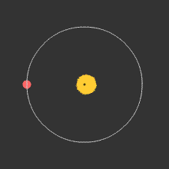
Radial Velocity Method
A planet orbiting a star causes both star and planet to orbit their center of mass.
This method is most sensitive for very massive and close-in planets.
Thus, it selects for hot Jupiters.
Here is a nice video showing the shifting spectral lines on which the measurements are based: http://vimeo.com/14390954
It also, as noted before, gives lower limits on mass (M sin i).
This method works at any distance, but requires a relatively bright star.

Slide 13
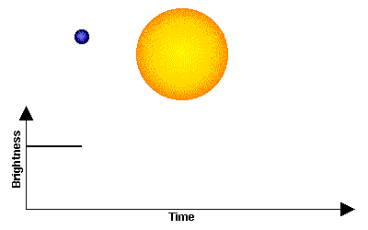
Transit Method
For highly inclined orbits (i ~ 90º), there is a chance that a planet will cross in front of a star.
Most sensitive for very close-in planets (inner planets are more likely to transit for given inclination).
Also somewhat more sensitive for larger planets (dip in light level is greater for larger planets). Again, hot Jupiters!
It gives better estimate of mass, because inclination can be determined.
This method works at any distance, but is limited by brightness of the primary star.
no transit
transit

Slide 14
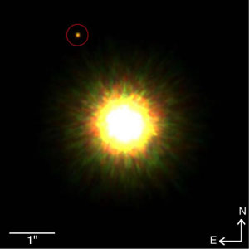
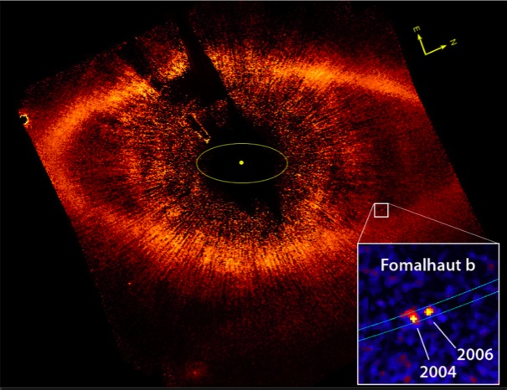
Direct Imaging Method
For a handful of nearby stars, planets have been directly imaged.
Complementary method to the others: better for more distant planets, can get orbit and hence true mass (but have to see it move over time—may take a few years).
More sensitive for larger planets.
Can image proto-planetary disk, as for Fomalhaut.
Gemini with AO
Hubble ACS Camera

Slide 15
Timing and Astrometry Methods
The timing method involves measuring transiting planets, or even eclipsing binaries, and noting fluctuations in the timing of the eclipses/transits, which must be due to a third body (or more) .
Pulsar timing is similar, but makes use of the exquisite timing available from the rotation of a pulsar.
Astrometry involves measuring variations in the position of a star and inferring the existence of a perturbing planet.
These have all been successfully used, but yield only a small number of discoveries.

Slide 16
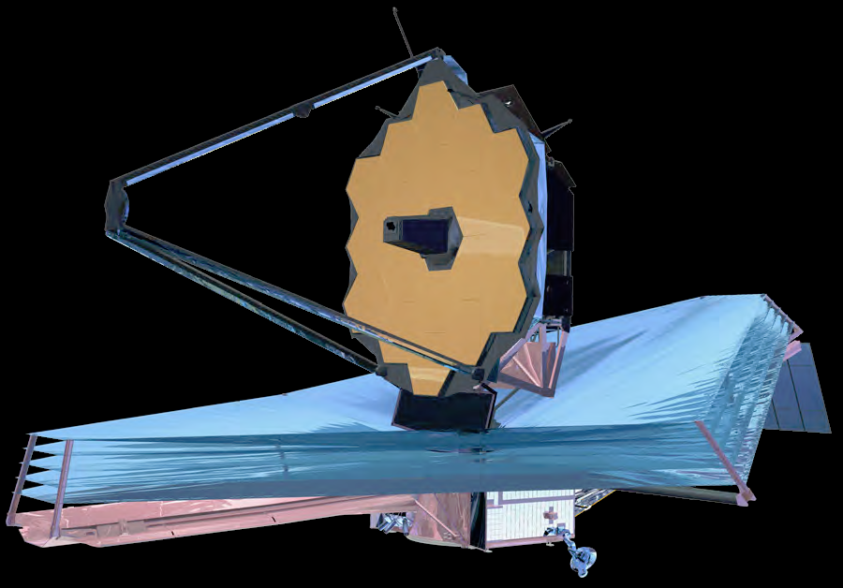
Follow-up Observations
Once a planet is discovered, other observatories can be used to learn more through accurate observations.
For example, the James Webb Space Telescope will use IR observations and spectroscopy to determine better light-curves, look for organic molecules or water, and perhaps find perturbations that point to other planets in the stellar system.

Slide 17
Outline
Current knowledge of extrasolar planets (exoplanets)
Methods of detection
The transit method
Professional and amateur observations
What you need to detect transits
How to submit your measurements

Slide 18
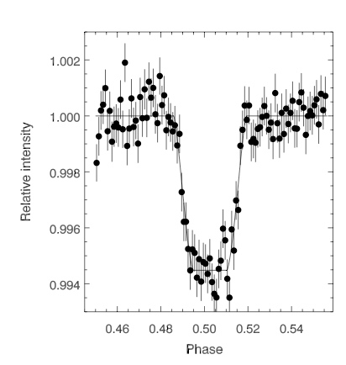
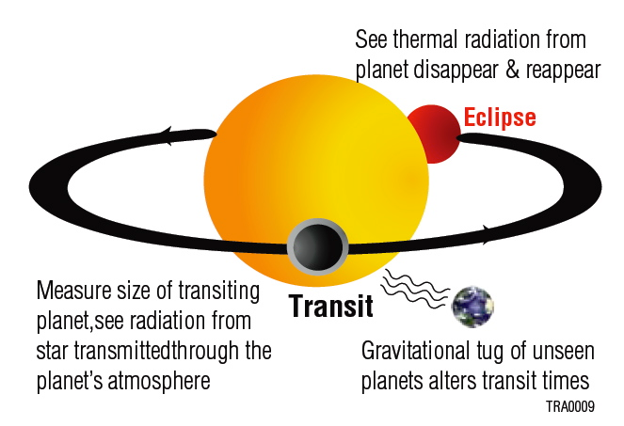
Transit Method in Action
Note
0.6%
drop
Example of a Spitzer exoplanet detection, the secondary eclipse of HD 189733b (Deming et al. 2006). By detecting the eclipse Spitzer is able to make a direct measurement of the IR flux from the planet.

Slide 19
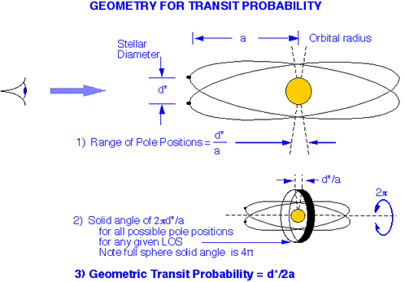
Transit Geometry

Slide 20
Transits for Our Solar System
Transit Properties of Solar System Objects
Planet | Orbital Period P (years) | Semi- Major Axis a (A.U.) | Transit Duration (hours) | Transit Depth (%) | Geometric Probability (%) | Inclination Invariant Plane (deg)
Mercury | 0.241 | 0.39 | 8.1 | 0.0012 | 1.19 | 6.33
Venus | 0.615 | 0.72 | 11.0 | 0.0076 | 0.65 | 2.16
Earth | 1.000 | 1.00 | 13.0 | 0.0084 | 0.47 | 1.65
Mars | 1.880 | 1.52 | 16.0 | 0.0024 | 0.31 | 1.71
Jupiter | 11.86 | 5.20 | 29.6 | 1.0100 | 0.089 | 0.39
Saturn | 29.5 | 9.5 | 40.1 | 0.75 | 0.049 | 0.87
Uranus | 84.0 | 19.2 | 57.0 | 0.135 | 0.024 | 1.09
Neptune | 164.8 | 30.1 | 71.3 | 0.127 | 0.015 | 0.72
 | P²M*= a³ |  | 13sqrt(a) | %=(d_{p}/d*)² | d*/D | phi

Slide 21
Outline
Current knowledge of extrasolar planets (exoplanets)
Methods of detection
The transit method
Professional and amateur observations
What you need to detect transits
How to submit your measurements

Slide 22
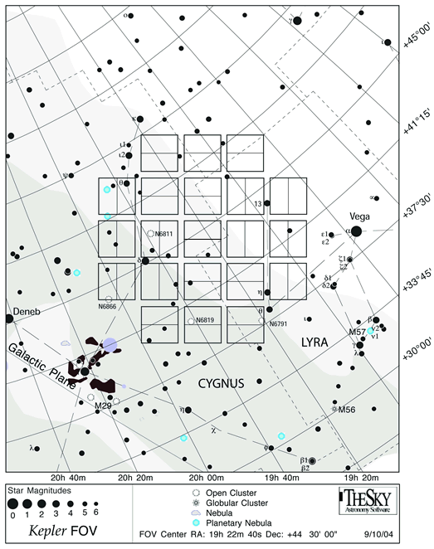
Kepler
Field of view, in the constellations Cygnus/Lyra.
21 CCDs—each 5 degrees square
Note brightest stars fall in gaps between CCDs.
Note several clusters, which permits some interesting stellar rotation vs. age studies.

Slide 23
Expected Kepler Results
Terrestrial inner-orbit planets based on their transits:
About 50 planets if most have R ~ 1.0 R_{e}
About 185 planets if most have R ~ 1.3 R_{e}
About 640 planets if most have R ~ 2.2 R_{e} (Or possibly some combination of the above)
About 12% of the cases with two or more planets per system
Giant inner planets based on the modulation of their reflected light:
About 870 planets with periods less than one week
Giant planets based on their transits:
About 135 inner-orbit planets along with albedos for 100 of these planets
Densities for 35 of the inner-orbit planets, and
About 30 outer-orbit planets.

Slide 24
Kepler Results (so far)
 | Planetary Characteristics |  |  |  |  |  | Planetary Orbit
Name | Mass |  | Radius |  | Density | Temp. | Duration | Period | a | e | i | Distance
 | Jupiter masses | Earth masses | Jupiter radii | Earth radii | g/cm³ | Kelvin | hours | days | AU |  | degrees | parsecs
The first 3 planets listed were discovered by Kepler team members using ground-based observations.
TrES-2 | 1.199 |  | 1.272 |  |  |  |  | 2.47061 | 0.03556 | 0 | 83.62 | 220
HAT-P-7 b | 1.8 |  | 1.421 |  |  | 3160 |  | 2.20473 | 0.0379 | 0 | 84.1 | 320
HAT-P-11 b | 0.081 |  | 0.452 |  |  |  |  | 4.88780 | 0.053 | 0.198 | 88.5 | 38
Kepler confirmed planet count: 7
Kepler 4b | 0.077 |  | 0.357 |  | 1.91 | 1650 | 3.623 | 3.2135 | 0.04558 | (0) | 89.76 | 550
Kepler 5b | 2.114 |  | 1.431 |  | 0.894 | 1868 | 4.370 | 3.5485 | 0.05064 | (0) | 86.3
Kepler 6b | 0.669 |  | 1.323 |  | 0.352 | 1500 | 3.625 | 3.2347 | 0.04567 | (0) | 86.8
Kepler 7b | 0.433 |  | 1.478 |  | 0.166 | 1540 | 5.254 | 4.8855 | 0.06224 | (0) | 86.5
Kepler 8b | 0.603 |  | 1.419 |  | 0.261 | 1764 | 3.438 | 3.5225 | 0.0483 | (0) | 84.07 | 1330
Kepler 9b | 0.252 |  | 0.842 |  | 0.524 | 740 |  | 19.24 | 0.14 | (0) |  | 700
Kepler 9c | 0.171 |  | 0.823 |  | 0.383 | 540 |  | 38.91 | 0.225 | (0) |  | 700
Earth and Jupiter for comparison:
Earth | 0.00314 | 1.000 | 0.089 | 1.000 | 5.515 | 255 |  | 365.25 | 1.000 | 0.016
Jupiter | 1.000 | 317.82 | 1.00 | 11.21 | 1.33 | 124 |  | 4330.60 | 5.204 | 0.0484
700 planet candidates, 7 confirmed

Slide 25
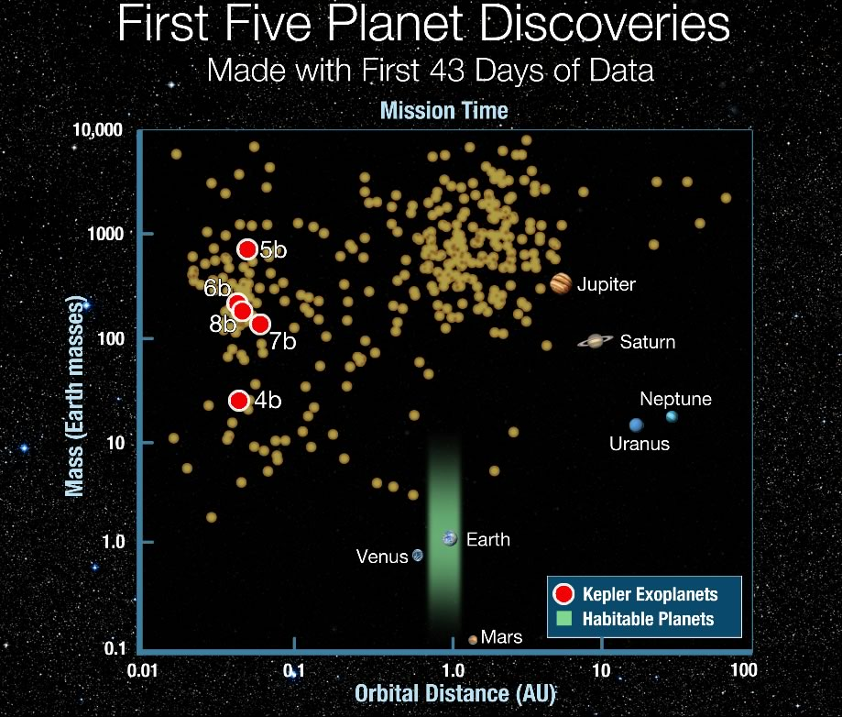
Kepler Discoveries
It is clear that Kepler has so far discovered a few of the easier candidates, with short periods and large masses (large light dips).
Longer sequences of data are needed to move to the right in the diagram.
The goal is to move to the lower right, and find Earth-like planets in a habitable zone.

Slide 26
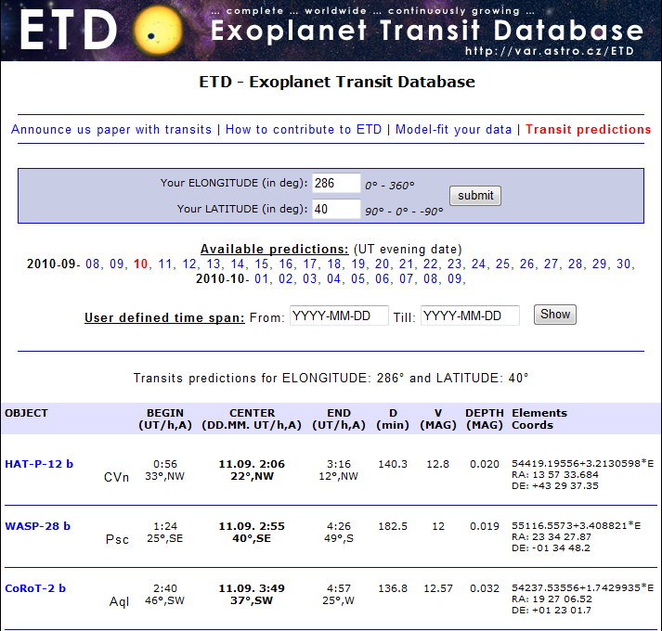
Exoplanet Transit Database
If you want to observe some transits for yourself, you will want to use the ETD (http://var2.astro.cz/ETD/index.php).
Click on Transit predictions, enter your longitude and latitude, and it will tell you what transits are visible tonight.
Here, HAT-P-12 b is transiting at 2:06 UT (10:06 pm) with a depth of 0.02 V magnitudes.

Slide 27
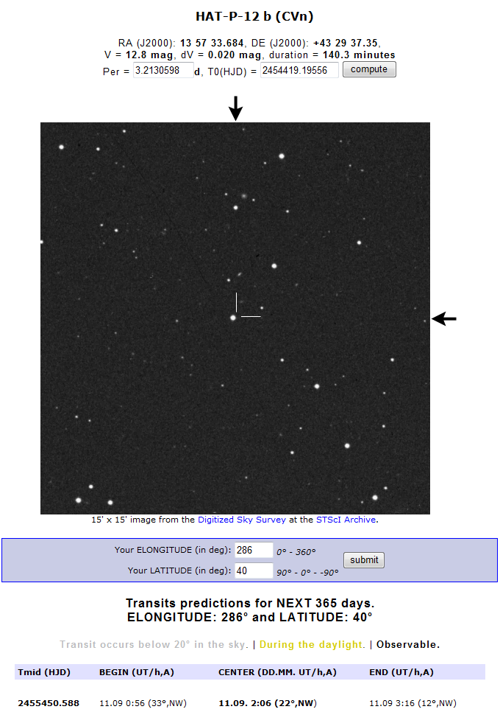
ETD (cont’d)
Click on the HAT-P-12b link, and it will give you a finder chart and further information.
You can also find information about past observations.
Let’s look at TrES-3 b (which happens to be one that I observed at Jenny Jump and submitted data for).

Slide 28
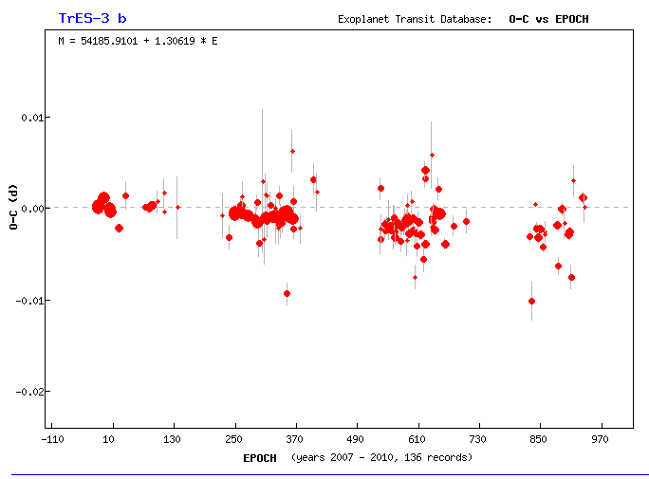
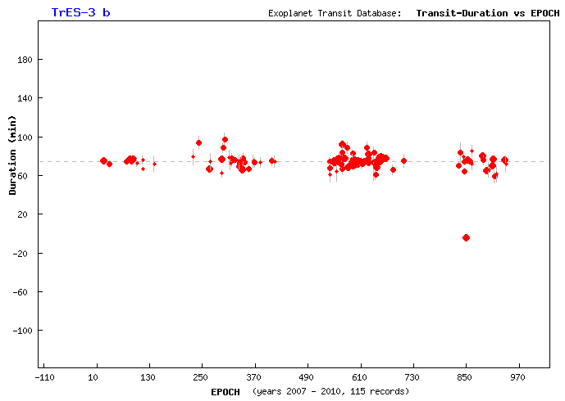
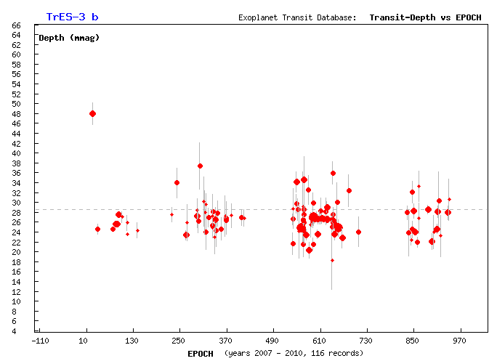
TrES-3 b
Here are some charts of relevant information gathered from past observations (many by amateurs).
O-C (observed minus calculated) may over the long term show variations in timing attributable to additional unknown planets. Here, the transits appear to be happening slightly earlier than a perfectly periodic orbit would predict.
Duration—looks constant.
Depth of the dip (mmag) also looks constant.

Slide 29
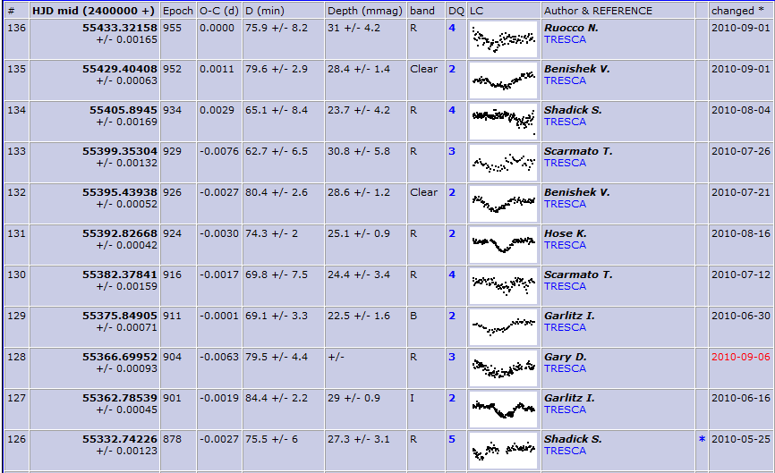
TrES-3 b
Click on TRESCA

Slide 30
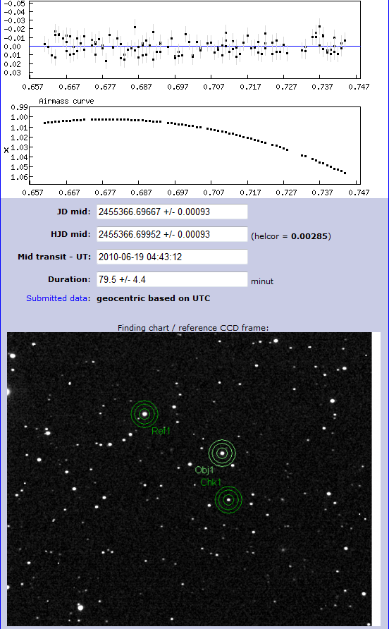
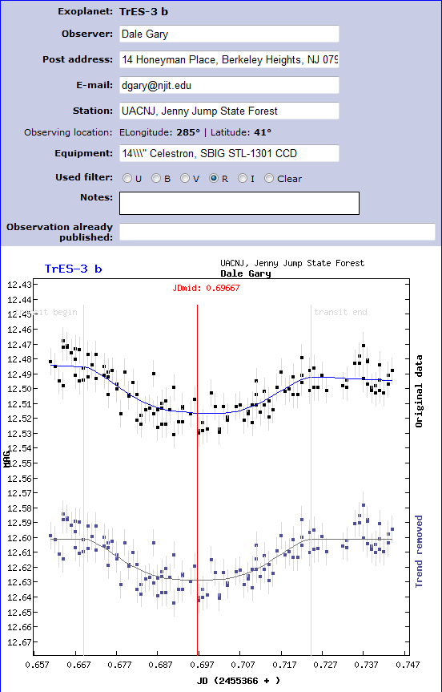
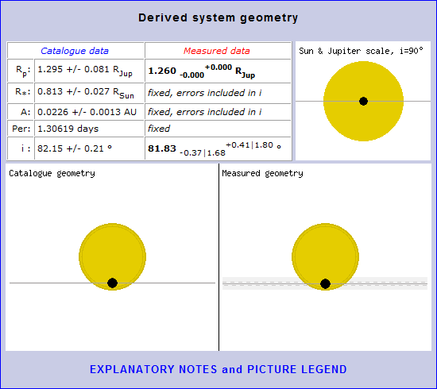
TrES-3 b
This shows my observer information, the raw data, and the fit.
The lower plot is “detrended.”
Further down the page is the residual noise in the measurement, the “airmass” curve based on the altitude of the star that night, the fit parameters for transit midpoint and duration, and finally a “finder” chart that I uploaded showing the photometry I did.
Lastly, is an interesting plot showing the transit geometry for the system.

Slide 31
Outline
Current knowledge of extrasolar planets (exoplanets)
Methods of detection
The transit method
Professional and amateur observations
What you need to detect transits
How to submit your measurements

Slide 32
Requirements for Detecting Exoplanets
Detecting exoplanet transits is certainly within reach of amateurs with the proper equipment.
You need a relatively large aperture telescope. I found that my 10” was really too small, and the AAI 14” telescope was much better. However, the Malpas Observatory is there at JJ, and other telescopes of similar size are available.
You also need a cooled CCD camera. Large format is not needed, since one only needs the star of interest, and a few other stars of sufficient brightness for reference stars. Probably the noise in an uncooled CCD camera is too high (at least with a 14” scope).
You need software to allow image registration and relative photometry. I use MaxIm DL, which works well.

Slide 33
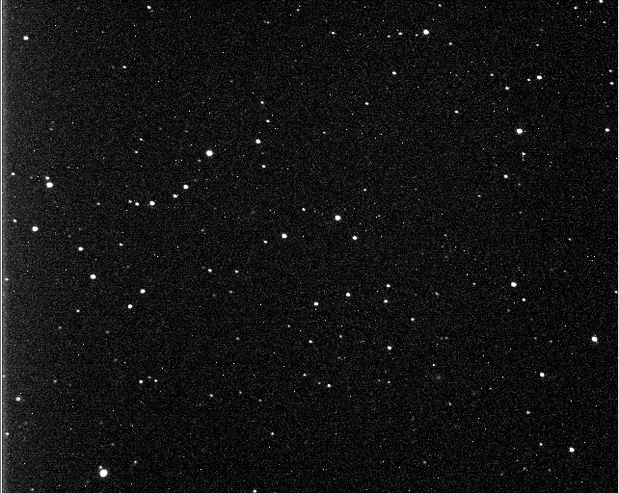
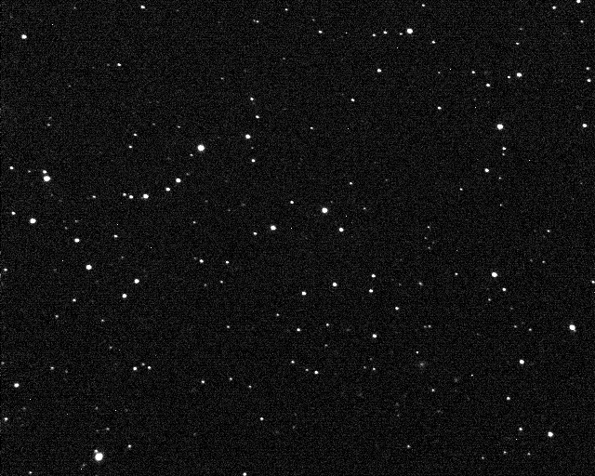
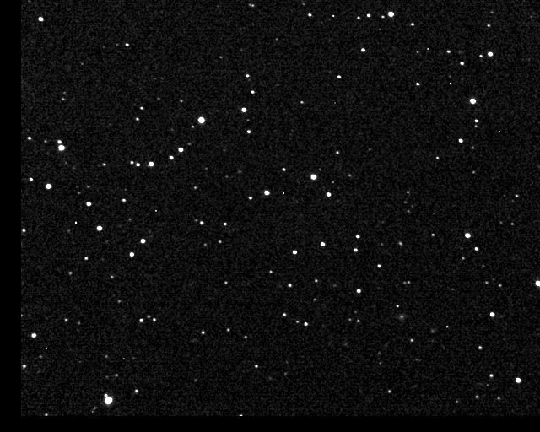
Basic Procedure
Using the finder chart, you must first point the telescope at the right location, mount the camera and focus it, and then take an image and verify the pointing. These are steps needed for any kind of astrophotography, and I strongly recommend that you invest time in gaining experience with astrophotography before jumping into exoplanet detection.
After getting your first image and verifying pointing, you will then take multiple exposures, each of which will provide a single point of your light curve.
Here is a single (uncalibrated) image of TrES-3
And that same frame calibrated.
The last step is to register all of the frames to a single reference.

Slide 34
Photometry
Once all of the frames are calibrated and registered, the last step is to analyze the brightness of the primary (TrES-3).
We will use a technique called relative photometry, by choosing a reference star in the same field as the target star.
The MaxIm DL photometry analysis involves choosing three circles centered on the target, reference, and optionally a check star.
The inner circle is called the aperture.
The second circle is the gap.
The outer circle is the annulus.
The software adds up all DN within the annulus,
averages, and subtracts from the sum of the aperture.

Slide 35
Choices for TrES-3
Note the gap was chosen to avoid the star near the reference star.
The check star is just to ensure that the chosen reference star is not variable.
Note that if the color of the reference star is too different from TrES-3, errors in photometry can result due to color-dependent air mass extinction.

Slide 36
Outline
Current knowledge of extrasolar planets (exoplanets)
Methods of detection
The transit method
Professional and amateur observations
What you need to detect transits
How to submit your measurements

Slide 37
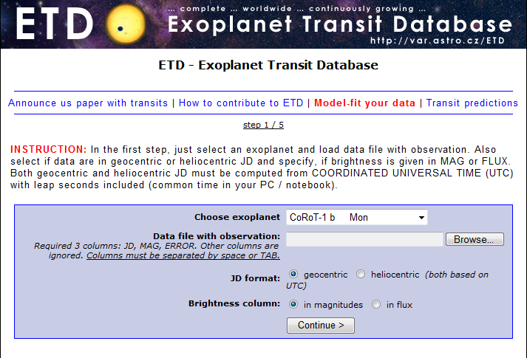
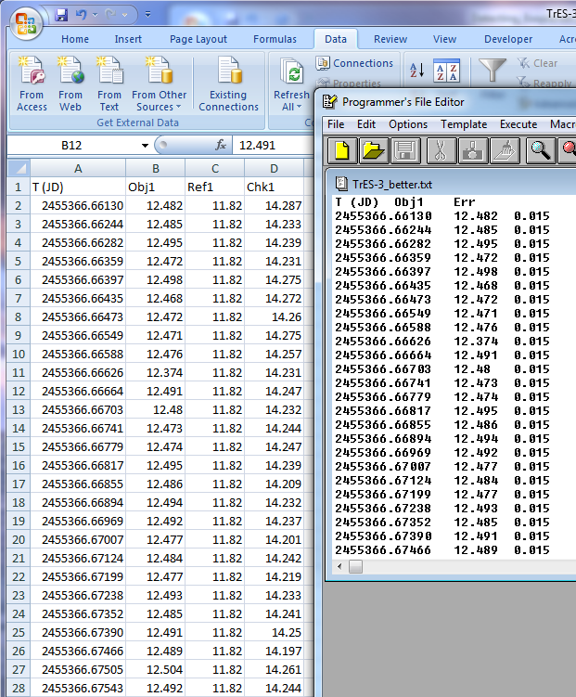
Submitting Observations to ETD
After doing the photometry, MaxIm DL allows you to save the results as an Excel file.
The ETD site wants the data as three columns, with time (JD), object magnitude, and error. To get the latter, I just calculated the RMS error of the measurements and used the same value for each of the measurements.
To submit the data, choose Model-fit your data from the ETD menu.
There are 5 easy-to-follow steps.

Slide 38
Conclusion
The detection and study of exoplanets is really taking off, and will lead to a huge leap in our understanding of how solar systems form, how ubiquitous they are, and ultimately may answer the question, are we alone in the universe.
It is an exciting time, and amateurs with ordinary amateur equipment can make a contribution.
It is a lot of fun to be part of the process in some small way.
I hope I have demonstrated that this is worth pursuing, and will be happy to share my meager knowledge.
For some excellent advice by a more experienced amateur, check out the freely downloadable book by Bruce Gary (no known relation) at http://brucegary.net/book_EOA/x.htm entitled: Exoplanet Observing for Amateurs.

