Slide 1
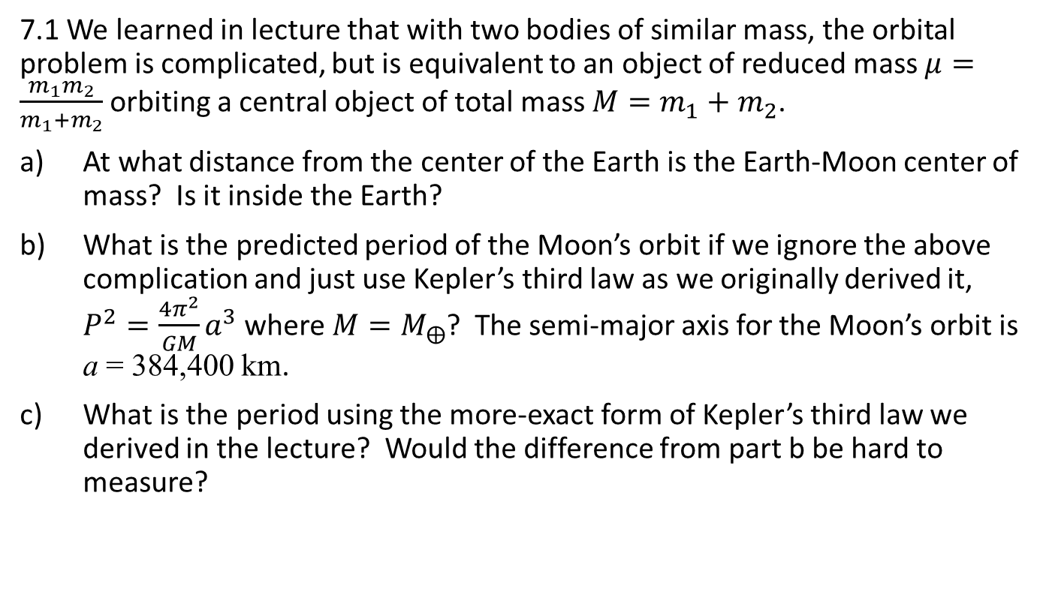
Homework, Chapter 2, Lecture 7
7.1 We learned in lecture that with two bodies of similar mass, the orbital problem is complicated, but is equivalent to an object of reduced mass $μ=\frac{m_{1}m_{2}}{m_{1}+m_{2}}$ orbiting a central object of total mass $M=m_{1}+m_{2}$.
At what distance from the center of the Earth is the Earth-Moon center of mass? Is it inside the Earth?
What is the predicted period of the Moon’s orbit if we ignore the above complication and just use Kepler’s third law as we originally derived it, $P^{2}=\frac{4π^{2}}{GM}a^{3}$ where $M=M_{⨁}$? The semi-major axis for the Moon’s orbit is a = 384,400 km.
What is the period using the more-exact form of Kepler’s third law we derived in the lecture? Would the difference from part b be hard to measure?

