Slide 1
Physics 320: Introduction to the Solar System (Lecture 1)
Dale Gary
NJIT Physics Department

Slide 2
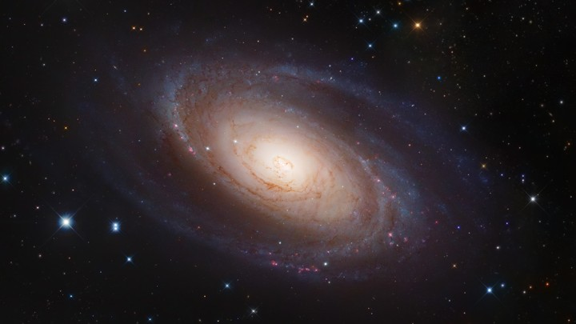
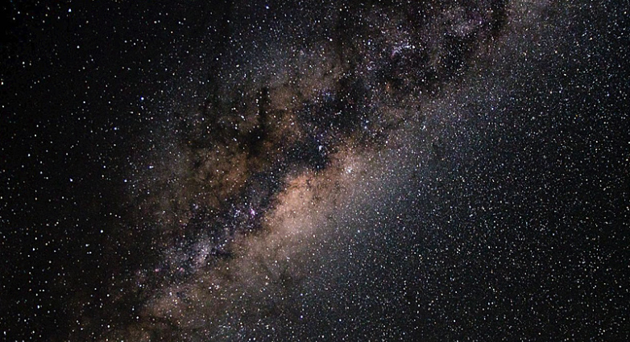
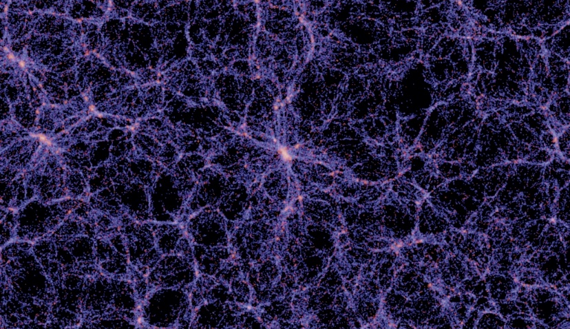
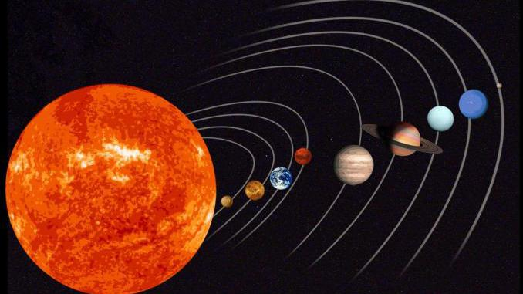
What is the Solar System?
Some common astronomical terms:
Galaxy
Universe
Solar System
The name “Solar System” has something to do with the Sun (note capitalization)
What constitutes the solar system? What defines its “edge” or boundary?
Sum of objects orbiting the Sun (e.g. planets, asteroids, comets)?
Region dominated by the solar wind (particles, magnetic fields)?
Region dominated by the Sun’s gravity?
Region dominated by the Sun’s light?
There is no single right answer, but each of these can be important depending on the context.

Slide 3
What is the Solar System Made of?
The Sun
The Planets
The Asteroid Belt
Other Asteroids
Comets
Meteroids
Dust
Elementary Particles
Magnetic Fields

Slide 4
Solar and Planetary System Astrophysics
The language of physics is mathematics:
We will be using the somewhat more advanced language of algebra, trigonometry, calculus, and even a bit of simple differential equations. I hope and expect that you have learned this language well, although we will go over some of it in review as we go along.
Philosophy is written in this grand book, the universe, which stands continually open to our gaze. But the book cannot be understood unless one first learns to comprehend the language and to read the alphabet in which it is composed. It is written in the language of mathematics, and its characters are triangles, circles, and other geometric figures, without which it is humanly impossible to understand a single word of it; without these, one wanders about in a dark labyrinth.
Galileo in The Assayer.

Slide 5
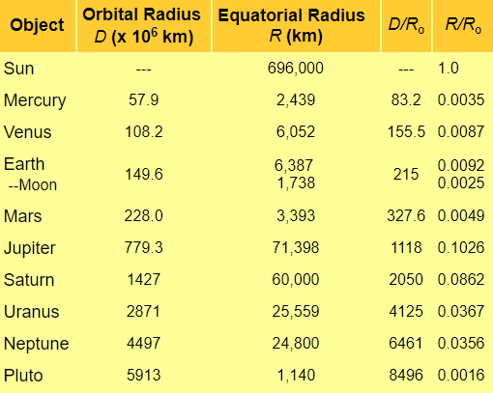
The Sun and Planets
The Sky Live 3D Solar System
List of Objects
Sun
Mercury
Venus
Earth
Mars
Jupiter
Saturn
Uranus
Neptune
Pluto (dwarf planet)

Slide 6
The Thousand-Yard Model
Let’s choose a scale of 1-inch = 100,000 miles, so that our Sun, with its diameter of 860,000 miles, will be about 8.6” in diameter.
We will build a scale model of the solar system using this scale.
Homework:
In 2016, a new exoplanet system, Trappist 1, was discovered. Create a table giving the scale model for Trappist 1, using the information on the system here: http://www.trappist.one/#system. In the tables, use Radius for Trappist-1A (the star), and use Semi-major axis and Radius for Trappist-1b – Trappist-1h (the planets). Your table should have the following columns:
Object name
Semi-major axis in km (for each planet, blank for the star)
Radius in km
Distance in paces (yards), using the scale model (blank for the star)
Radius in inches, using the scale model
Fruit or nut that could represent the object, using the scale model
Briefly state some important differences between the Trappist 1 system and our own solar system.

