Slide 1
Physics 320: Formation of Protostars (Lecture 9)
Dale Gary
NJIT Physics Department

Slide 2
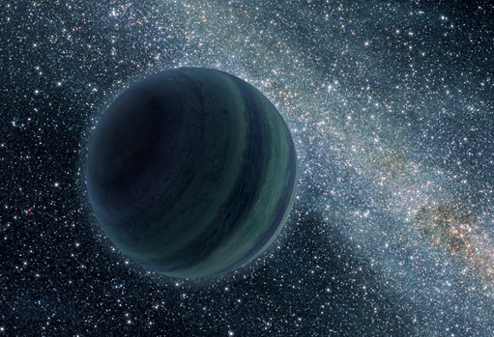
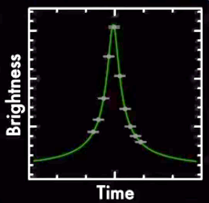
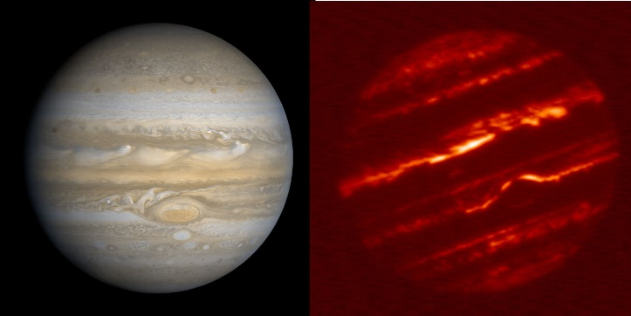
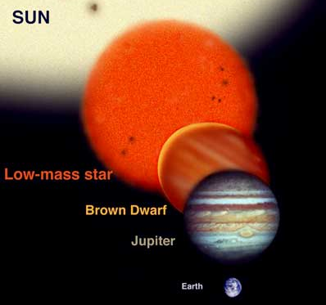
What is a Star?
You may wonder how we decide between various objects such as stars and planets. Here are some possible statements that may seem reasonable to distinguish them:
Planets orbit around stars (not necessarily)
Stars shine by their own light, planets reflect light (not entirely correct)
Stars are much bigger than planets (Not always. Some "stars" [brown dwarfs] are barely larger than Jupiter)
In fact, none of these properties is sufficiently unique to use to classify when an object is a star or planet. The single distinguishing factor that defines a star is the occurrence of nuclear fusion. Nuclear fusion is the fusing (combining) of two atomic nuclei to form a heavier atomic nucleus, giving off a tremendous amount of energy. In the center of a star the gravitational force due to the outer layers of the star keep the energy from escaping immediately, so the fusion process continues steadily over billions or even 10's of billions of years. If an object is large enough that nuclear burning of some type occurs, it is called a star. Brown dwarfs, intermediate between a planet and a true star, do have nuclear burning, but of deuterium rather than hydrogen.
Credit: NASA JPL
Credit: Gemini Observatory
by Jon Lomberg

Slide 3
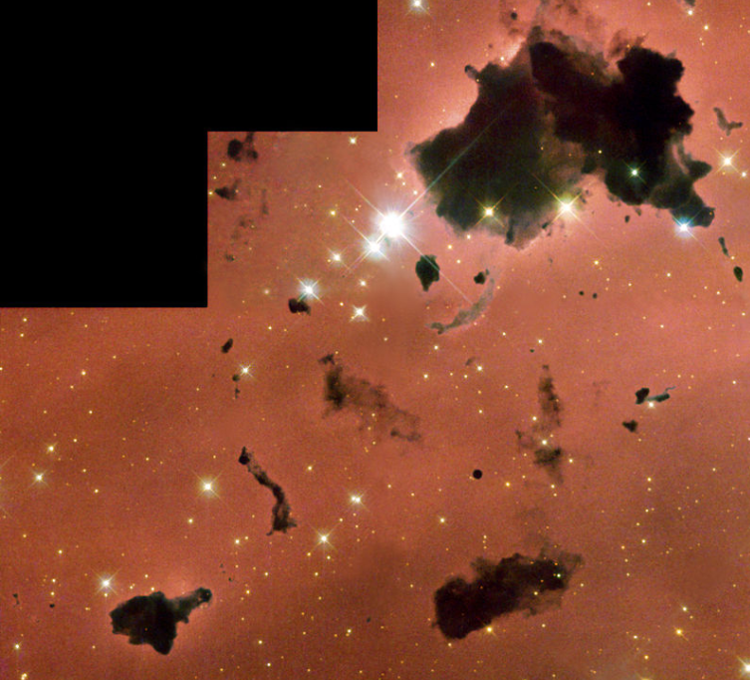
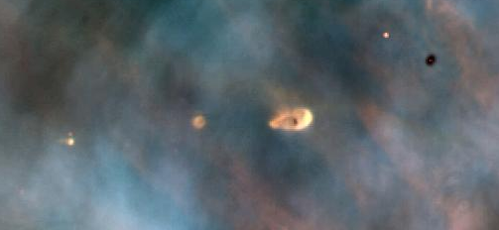
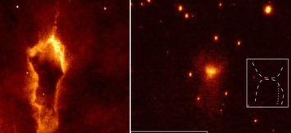
How to Make a Star
To make a star, we have to collect enough mass in a small enough region of space that the temperature and pressure grows high enough to begin nuclear fusion. The material to make a star comes from the gas and dust of the interstellar medium (ISM). It is gravity that provides the force needed to keep the object in one piece and cause it to shrink over time until it "ignites." An object that has enough mass to be a star, and is on its way to becoming dense enough and hot enough for nuclear fusion, is called a protostar. It is not yet a star, but given enough time it will become one.
Planetary systems are born during or just after the period of collapse of the protostar, and it is this process that we will examine in detail in this lecture.
Before we begin, it is important to realize that we can look out into space and see examples of objects that are in various protostar stages. Although our discussion will make it sound as if the process is orderly, in fact the protostellar objects we see can be extremely complex.
Scientists are still actively studying this important but not completely understood phase of stellar evolution.
Sahai et al. 2012 (Ap J Letters 761, 2)

Slide 4
Virial Theorem and Collapse
See section 2.4 for a general proof of the Virial Theorem
You will recall that at the end of the orbital mechanics lecture we derived an expression for the total energy of a bound orbit:
It is interesting that, for a circular orbit, since a = r, $K=E−U= −G\frac{Mμ}{2r}+G\frac{Mμ}{r}=G\frac{Mμ}{2r}=−U/2.$ This is a particular example of a general theorem, the Virial Theorem, that for a system in equilibrium:
This also means that $E=K+U=−\frac{1}{2}U+U=\frac{1}{2}U$. So another expression for the Virial Theorem:
This means that, when averaged over time (which is what the <> brackets mean), a system that changes from one equilibrium to another gains an amount of kinetic energy that is half of the released potential energy. What do we mean by released potential energy? Let’s calculate U for a spherical cloud.
Imagine that we start with a spherical cloud of gas (its density does not have to be uniform, but must depend only on radius, so that we can consider uniform spherical shells, as we did before).
The force on an element of mass dm within the cloud is $dF=G\frac{M_{r}dm}{r^{2}}$, where M_{r} is the total mass interior to the shell the mass dm is on.
The potential energy of this element of mass is $dU=−G\frac{M_{r}dm}{r}$. The mass of an entire spherical shell is just $dm=4πr^{2}ρdr$, where $4πr^{2}$is the area of the shell, $dr$ is its thickness, and $ρ$ is its mass density.
$$E=−G\frac{Mμ}{2a}$$
$$2\left\langle K\right\rangle +\left\langle U\right\rangle =0$$
$$\left\langle E\right\rangle =\frac{1}{2}\left\langle U\right\rangle$$

Slide 5
Virial Theorem and Collapse, continued
The potential energy of this entire shell is then $dU=−G\frac{M_{r}4πr^{2}ρ}{r}dr$. Thus, the total potential energy of the cloud is just the integral over radius, out to the edge of the cloud at radius R.
The value of this integral depends on the manner in which the density varies with radius, but a “reasonable” approximation is to let density be constant, and equal to the average density of the cloud. This will somewhat over-estimate the true value for a centrally condensed cloud.
The average density is just total mass / total volume $\left\langle ρ\right\rangle =M/{\left(\frac{4}{3}πR^{3}\right)}$, so we approximate $M_{r}=\frac{4}{3}πr^{3}\left\langle ρ\right\rangle$, to get
Substituting the value of $\left\langle ρ\right\rangle$ back into this result, we have , where the approximation sign is to remind us that we are only estimating the density.
By the virial theorem, then, the total energy is:
$$U=−4πG\int_{0}^{R}{M_{r}ρrdr}$$
$$U=−4πG{\frac{4}{3}π\left\langle ρ\right\rangle }^{2}\int_{0}^{R}{r^{4}dr}=−\frac{16}{15}π^{2}G{\left\langle ρ\right\rangle }^{2}R^{5}$$
$$U≈−\frac{3}{5}\frac{GM^{2}}{R}$$
$$E≈−\frac{3}{10}\frac{GM^{2}}{R}$$

Slide 6
Interpretation for a Collapsing Cloud
The self-gravitating cloud in equilibrium has a potential energy $U=−\frac{3}{5}\frac{GM^{2}}{R}$, and a total energy $E=−\frac{3}{10}\frac{{GM}^{2}}{R}$.
When the cloud shrinks to a smaller radius R’ < R, the potential energy decreases (becomes more negative), but the total energy decreases only half as much. That energy difference has to go into kinetic energy, which means that the cloud heats up (the individual particles in the cloud gain energy and move faster).
This is a potential problem—the heating of the cloud could create a gas pressure that counteracts the collapse, and actually halt it. Whether it does or not depends on the Jeans Criterion: $2K<\left|U\right|$. Note:
For an ideal gas, the internal kinetic energy is $K=\frac{3}{2}NkT$, where N is the total number of particles, k is Boltzmann’s constant (1.38×10⁻²³ J K⁻¹), and T is the gas temperature. For a cloud of mass M_{c} made entirely of hydrogen, we would have $N=\frac{M_{c}}{m_{H}}$, but since there could be other constituents in the cloud, we instead use the symbol μ to represent the mean molecular weight of the atoms of the cloud (so each He atom would contribute 4 m_{H}). NB: this μ is NOT the same as the reduced mass we used earlier! Then $N=\frac{M_{c}}{{μm}_{H}}$.
The Jeans Criterion then says $\frac{3M_{c}kT}{μm_{H}}<\frac{3}{5}\frac{GM_{c}^{2}}{R_{c}}$. But let’s write this in terms of density: $ρ_{0}=\frac{M_{c}}{\frac{4}{3}πR_{c}^{3}}$.
$2K+U=0$ equilibrium
$$2K+U>0 cloud expands$$
$$2K+U<0 \text{cloud} \text{collapses}$$

Slide 7
Jeans Criterion
So, replacing $R_{c}={\left(\frac{3M_{c}}{4πρ_{0}}\right)}^{1/3}$, we see that collapse can occur if the cloud mass is greater than the Jeans Mass $M_{c}>M_{J}$, where
Or, equivalently, the minimum radius for collapse of a cloud of density $ρ_{0}$ is the Jeans Length $R_{c}>R_{J}$, where
This says if you have a sufficiently massive cloud (or equivalently a big enough one), it will collapse. But notice that the criterion depends on the temperature of the cloud, so we expect only cold clouds to collapse—the colder the better.
Example: For a hydrogen cloud with 10% helium (by number), of temperature T = 10 K, and density ρ₀ = 10⁻¹⁶ kg m⁻³, how big would it have to be in order to collapse? What is the corresponding Jeans Mass?
The mean molecular weight for 10% He and 90% H is $μ=\frac{\left(0.1\right)4m_{H}+(0.9)m_{H}}{m_{H}}=1.3$, so
The Jeans Mass is $M_{J}=1.61×{10}^{31} \text{kg} ≈8 M_{⨀}$. Note, you get the same answer with $M_{c}=\frac{4}{3}πR_{c}^{3}ρ_{0}$.
$$M_{J}≈{\left(\frac{5kT}{Gμm_{H}}\right)}^{3/2}{\left(\frac{3}{4πρ_{0}}\right)}^{1/2}$$
$$R_{J}≈{\left(\frac{15kT}{4πGμm_{H}ρ_{0}}\right)}^{1/2}$$
$$R_{c}>\sqrt{\frac{15(1.38×{10}^{−23}{\text{J} \text{K}}^{−1})(10 \text{K}\text{)}}{4π(6.67×{10}^{−11}\text{N}{\text{m}}^{2}{\text{kg}}^{−2})(1.3∗1.67×{10}^{−27}\text{kg}\text{)(}{10}^{−16}{\text{kg} \text{m}}^{−3})}}=3.37×{10}^{15} \text{m}=0.11 \text{pc}$$

Slide 8
Free-Fall Collapse Time
The text goes into two pages of complicated math to estimate the time for the cloud to collapse. However, there is a far easier and more intuitive wave to arrive at the same number.
The estimate is for the special case of a non-rotating cloud, and requires that the particles of the cloud do not collide (collisions will bring in the physics of gas pressure, which is ignored for now).
In the case of such a non-rotating cloud, all of the particles can be considered initially at rest with respect to the center, and once the gravitational force begins to take effect, each particle can be considered to be in a long, narrow elliptical orbit (eccentricity e ~ 1). It will fall from its initial radius to the center in a “free-fall” time equal to half the Keplerian period of such an orbit, $P=2t_{\text{ff}}={\left[{\left({4π^{2}}/{GM}\right)a}^{3}\right]}^{1/2}$. But note that the semi-major axis is a = r/2. As before, we relate the mass with the average density $M_{r}=\frac{4}{3}πr^{3}\left\langle ρ\right\rangle$ to get
What is interesting is that every particle in the cloud takes exactly this same amount of time (because the inner particles feel less gravitational attraction, but have a smaller distance to fall). So this type of collapse is called homologous collapse.
Example: What is the free-fall time for collapse of the cloud in the previous example?
Putting in the numbers, one gets 2.1x10⁵ years. That is quite fast, once the collapse starts!
$$t_{\text{ff}}={\left[\left(\frac{π^{2}}{Gρ_{0}}\frac{3}{4πr^{3}}\right){\left(\frac{r}{2}\right)}^{3}\right]}^{1/2}={\left(\frac{3π}{32}\frac{1}{Gρ_{0}}\right)}^{1/2}$$

Slide 9
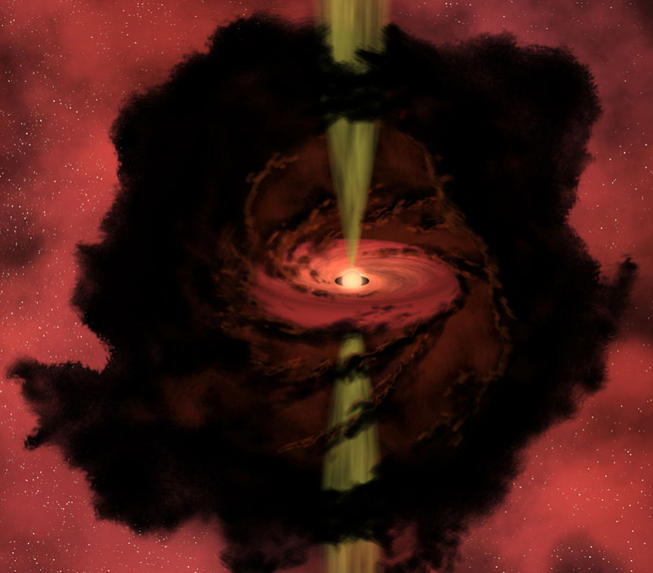
Conserved Quantities During the Collapse
In our estimates we ignored rotation (among other things), and this is probably a good approximation at first. However, if (as is almost certainly the case) the cloud has any sort of net rotation (basically just an imbalance of angular momentum added up over all of the particles), then that rotation rate will be amplified greatly during the collapse.
To see why, consider that angular momentum of a system is conserved, so a particle of mass m with initial radius r_{i} and velocity $v_{i}$ will have a final radius and velocity given by $L_{i}=mr_{i}v_{i}=L_{f}=mr_{f}v_{f}$. Thus, if it is initially at a radius of 10¹⁵ m, with a rather slow speed of 1 m/s, by the time it reaches a distance of 10⁹ m, its speed is $v_{f}=v_{i}\frac{r_{i}}{r_{f}}=1 \text{m} {\text{s}}^{−1}\frac{{10}^{15} \text{m}}{{10}^{9} \text{m}}=1000 km {\text{s}}^{−1}$.
All of the particles in the cloud do something similar, so that the entire cloud should end up spinning at a very fast rate after the collapse. In fact, we do see a lot of angular momentum in the protostars and their disks, which is a key ingredient in the quest to understand where planetary systems come from.
Another conserved quantity during the collapse is magnetic flux, $Φ=\int{B⋅dA}$. If we consider the cloud to have a circular cross-sectional area, and constant B over that area, then $Φ_{i}=B_{i}r_{i}^{2}=Φ_{f}=B_{f}r_{f}^{2}$, so the amplification is even greater.

Slide 10
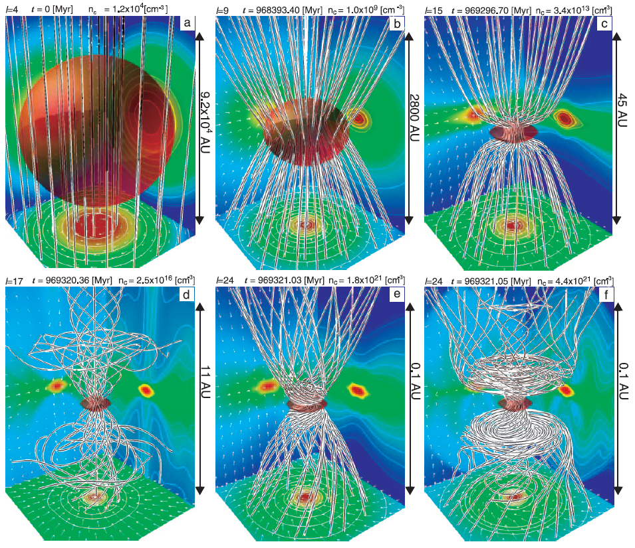
Concentration of Magnetic Field
Even if the initial magnetic field strength is really low, say $B_{i}=1 \text{nT}$, then for the radius factor we used before,
$B_{f}=B_{i}{\left(\frac{r_{i}}{r_{f}}\right)}^{2}={10}^{−9} \text{T}{\left(\frac{{10}^{15} \text{m}}{{10}^{9} \text{m}}\right)}^{2}1000 \text{T}$!
The diagrams at right show one model for the large increase in B for the collapsing cloud.
In fact, such extreme amplification of the magnetic field is not actually seen, so there must be some dissipation mechanism.
It is believed that the field interacts with the protoplanetary disk, slowing the star, speeding up the disk, and reducing the magnetic flux.
Note that the magnetic field has an associated pressure that, like the gas pressure, must be overcome in order for collapse to occur.

Slide 11
Overview of the Collapse Process
Putting all of what we just covered into a more narrative form:
The interstellar medium consists of gas and dust that comes partly from left-over material from the birth of the universe (H and He), enriched by later generations of stars that produced heavier elements.
In many places in the Milky Way galaxy, the interstellar medium grows denser and colder with time, with the energy radiated away partly by the gas, but mainly by the dust, to form nebulae.
Where the nebulae become cold and dense enough, molecules form (i.e. the nebulae become molecular clouds).
In some regions of the molecular clouds that become cold (10 K) and dense (10⁻¹⁶ kg m⁻³) enough, gravity can build a slight edge over the gas pressure, and regions of order 0.1 pc (Jeans Length) in size can begin to fall towards a “center,” forming a collapsing cloud of mass around the Jeans Mass.
In the free-fall scenario, the collapse can take place within hundreds of thousands of years, although eventually the gas and dust particles become dense enough that collisions can become important.
At that stage, the cloud heats up due to the kinetic energy (~U/2) released by the decreasing potential energy (U = −GM²/R). Notice that the total energy E also decreases according to the Virial Theorem, and this energy has to be radiated away. So the collapsing cloud becomes both luminous and hot, forming a proto-star.
Any tiny rotation of the material making up the initial cloud, or any embedded magnetic field, are hugely amplified during the collapse, so that the resulting proto-stellar object is highly magnetized and rapidly rotating.
The outer parts of the cloud form a rapidly rotating disk (a proto-planetary disk), and cannot fall onto the central object due to its high angular momentum.

Slide 12
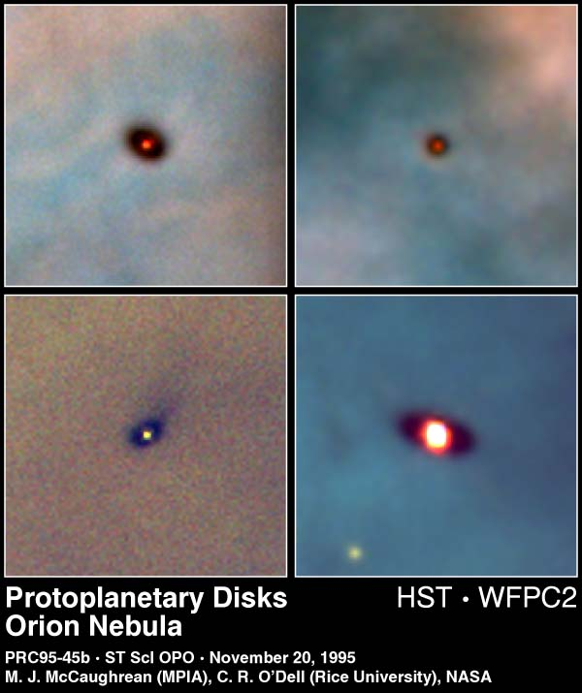
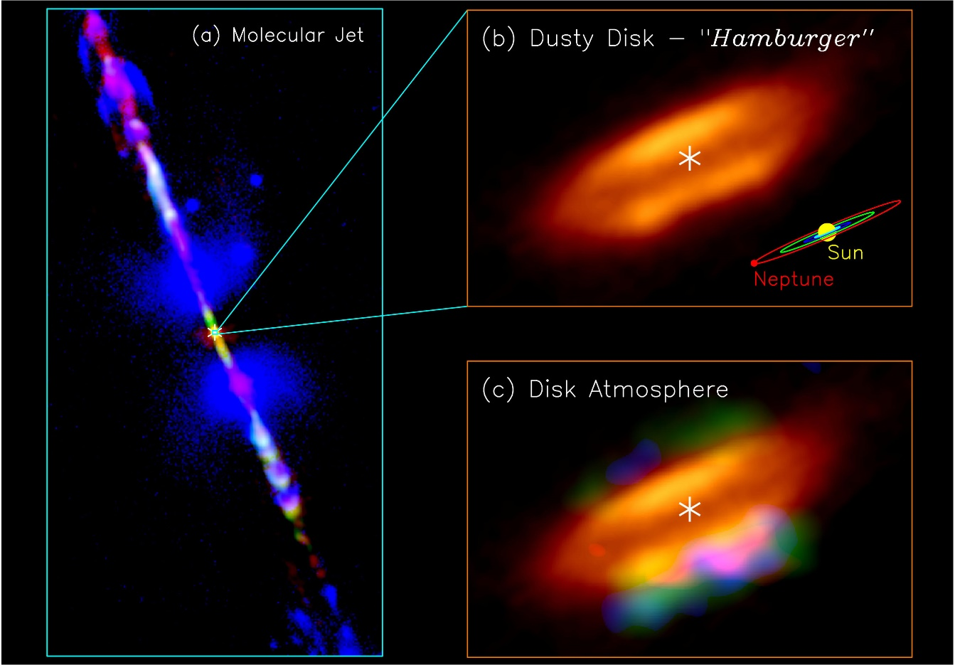
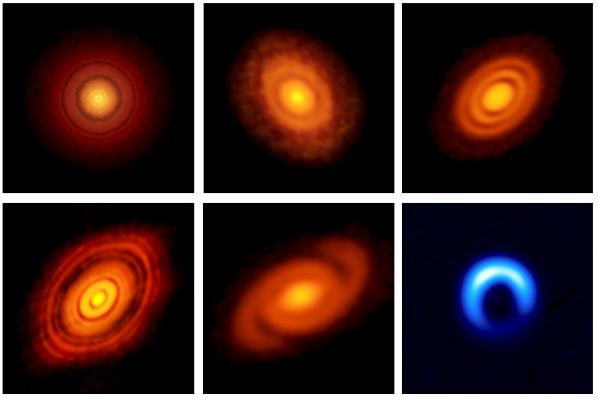
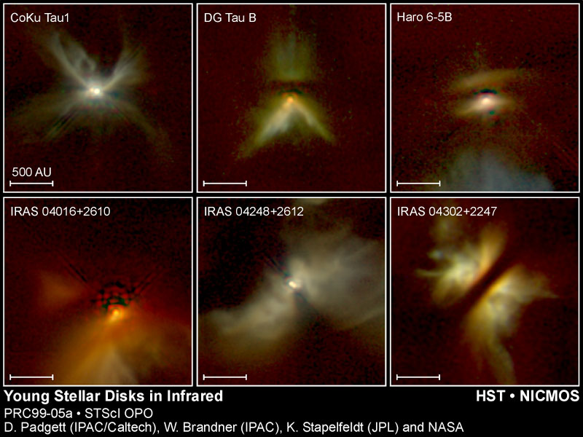
Observational Evidence
O-B Associations (clusters of massive stars associated with nearby molecular clouds)
Young stellar objects (YSOs) with huge enshrouding nebulae and thick disks.
More evolved objects with proto-stellar cores and proto-planetary disks.
Nearby objects seen with high resolution millimeter radio emission can pierce the dust and see the inner detail.
Gaps in the disk are likely regions where a new planet is forming.
In some objects, the strong magnetic fields that align with the poles of the new star can be seen to cause “jets” of molecules.

Slide 13
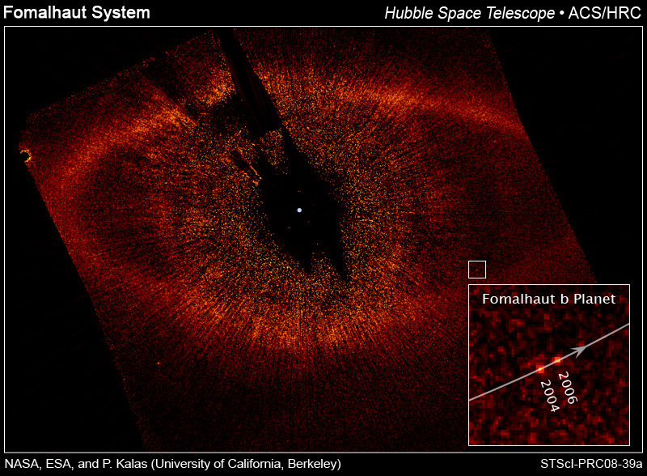
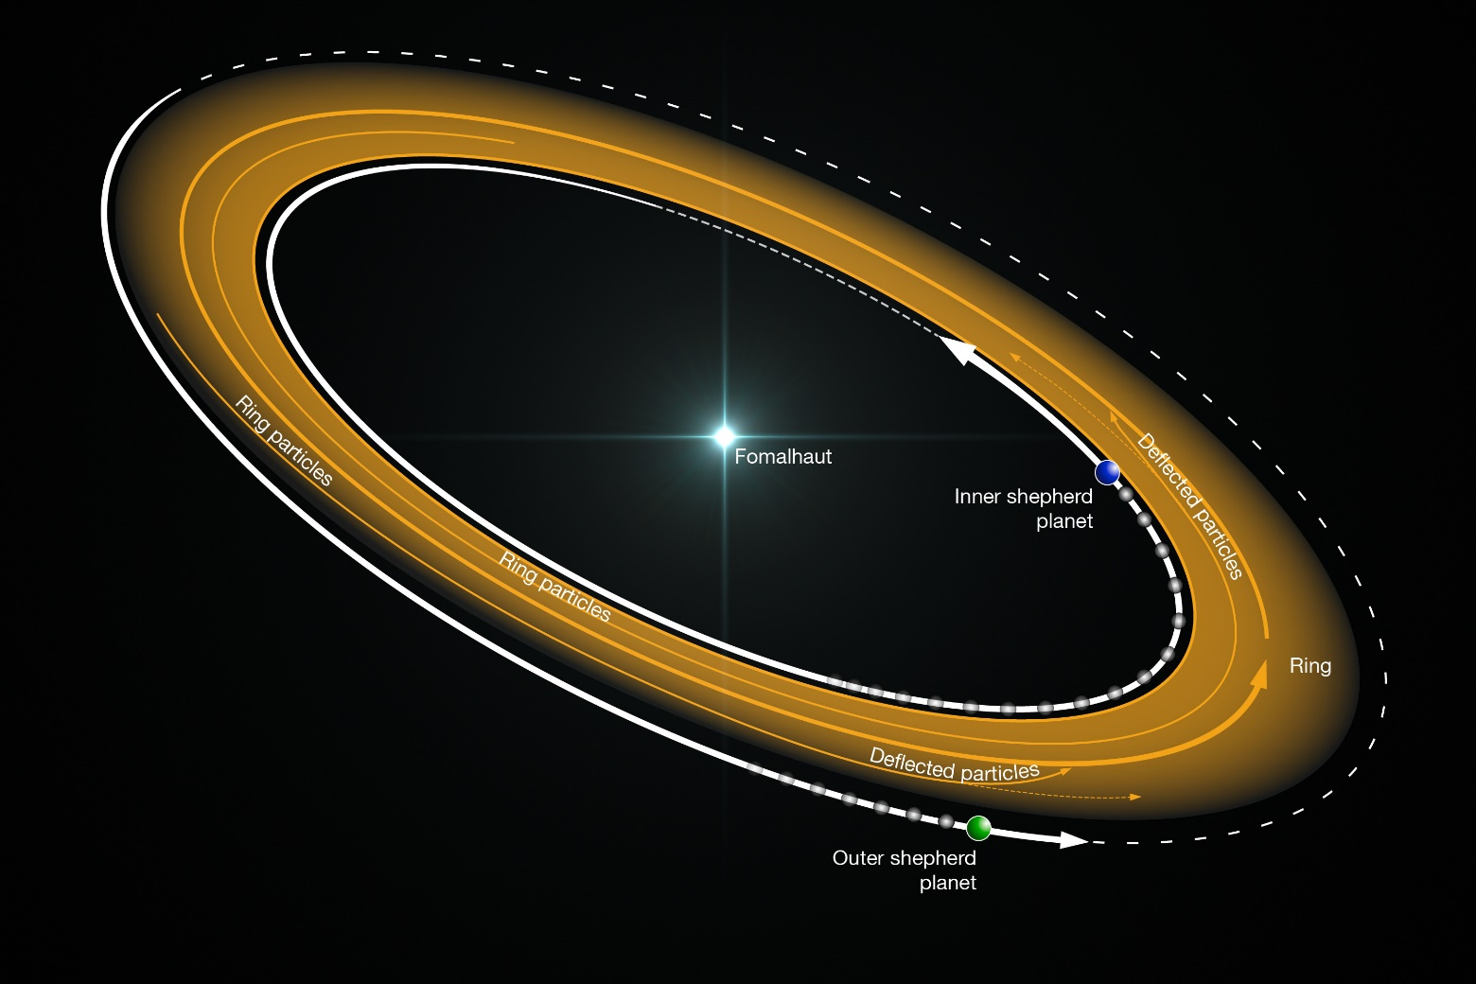
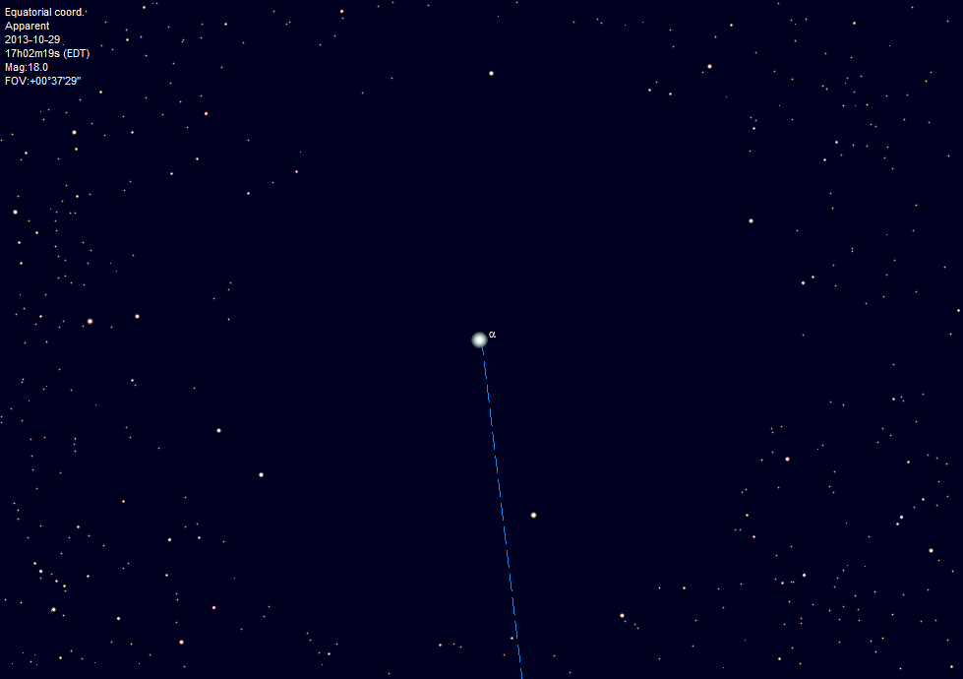
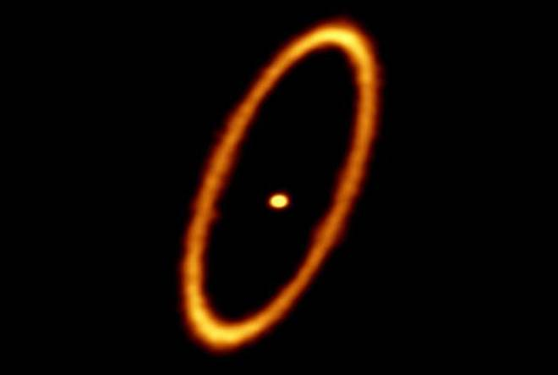
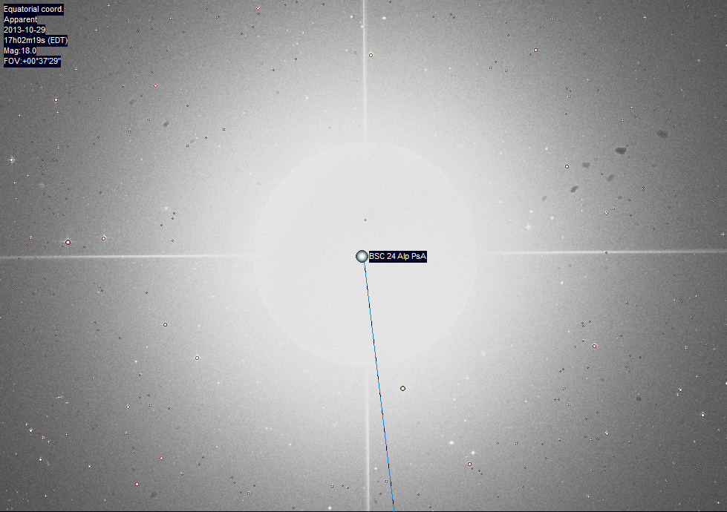
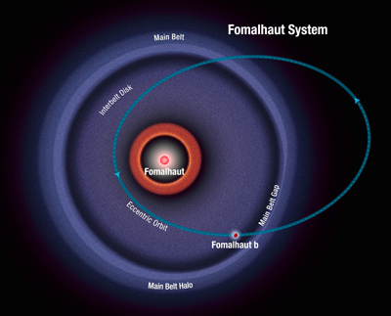
Difficulty in Making the Observations
You should understand that the great images you are seeing can be very difficult to get.
The star Fomalhaut is about 430 million years old, in the constellation Pisces Austrinus. You can see it in the southern fall sky, around this time of year.
When one tries to zoom in on the star with a large telescope, in order to resolve its protoplanetary disk, the star is blindingly bright.
A specially designed mask has to be put in front of the star that reduces the light AND the diffraction pattern, to reveal the disk.
A planet was discovered in the disk! But…
ALMA radio observations have revealed that the disk is really a ring, with two “sheparding” planets needed to stabilize it.

Slide 14
What We’ve Learned
You should be able to state in words what the Virial Theorem is, a relationship between kinetic and potential energies that applies to a system in equilibrium: or equivalently →
You should be familiar with the implications of the Virial Theorem for cloud collapse: the cloud must shed half of the released gravitational potential energy during collapse (through radiation), and will heat up tremendously due to release of the other half as kinetic (thermal) energy.
We learned that the potential energy of a cloud of radius R is given by and total
The process of collapse starts when the cloud exceeds the Jeans Mass, or equivalently the Jeans Length:
You can estimate the time for the collapse by considering the free-fall time (the time of ½ a Keplerian orbital period for an individual particle):
You should know the two quantities, angular momentum and magnetic flux, are conserved during the collapse, which causes the cloud spin rate to increase by the ratio of the radii, and the magnetic field strength to increase by the square of the ratio of radii.
You should know the basic steps in the overview of the collapse process, and be familiar with observational evidence in support of the scenario.
$$\left\langle E\right\rangle =\frac{1}{2}\left\langle U\right\rangle$$
$$2\left\langle K\right\rangle +\left\langle U\right\rangle =0$$
$$U≈−\frac{3}{5}\frac{GM^{2}}{R}$$
$$E≈−\frac{3}{10}\frac{GM^{2}}{R}$$
$$M_{J}≈{\left(\frac{5kT}{Gμm_{H}}\right)}^{3/2}{\left(\frac{3}{4πρ_{0}}\right)}^{1/2}$$
$$R_{J}≈{\left(\frac{15kT}{4πGμm_{H}ρ_{0}}\right)}^{1/2}$$
$$t_{\text{ff}}={\left(\frac{3π}{32}\frac{1}{Gρ_{0}}\right)}^{1/2}$$
$$v_{f}=v_{i}\frac{r_{i}}{r_{f}}$$
$$B_{f}=B_{i}{\left(\frac{r_{i}}{r_{f}}\right)}^{2}$$

