Slide 1
Physics 320: Formation of Planets (Lecture 11)
Dale Gary
NJIT Physics Department

Slide 2
Our Solar System
As scientists thought about how planetary systems are formed they began by considering the only example we had before 1995--our own solar system. When we look at our solar system in the "modern" sense as defined by Copernicus and Kepler, we immediately see several interesting patterns:
The inner four planets, Mercury, Venus, Earth and Mars, are all small and rocky.
The next four planets, Jupiter, Saturn, Uranus and Neptune, are all gas giants.
All planets orbit the Sun in the counterclockwise direction (right-hand rule) as seen from above the ecliptic. This is called direct motion. The opposite direction is called retrograde. The Sun also rotates in this same direction.
The orbital planes lie very close to the ecliptic plane for all planets (except Pluto). The angle of the orbital plane is called the inclination.
The orbits of the planets are nearly circular. The eccentricities are all less than 0.1 except for Mercury and Pluto.
The rotations of the planets are also direct (counterclockwise) except for Venus (which is slowly retrograde) and Uranus (which is almost rolling around its orbit). The angle of the spin axis to the planet's orbital plane is called the obliquity.
The separation between planets in our solar system seems to follow a pattern (Bode's Law), which intrigued Kepler (Music of the Spheres)
The question we can ask is how much of these seemingly striking patterns are universal and tell us something about the formation of planetary systems, and how much of it is a result of random processes, in which other planetary systems will show completely different details?

Slide 3
Formation of Our Solar System
Angular Momentum Distribution
Let's start with items 3, 4 and 5. These items seem to be accounted for by the idea that the initial cloud from which the solar system formed had a slight rotation (non-zero angular momentum). Recall that angular momentum cannot be destroyed, so any initial angular momentum will cause the protostar to rotate ever more rapidly as it collapses. This same rotation will cause the outer parts of the cloud to form a disk, and planets forming within that disk will have circular orbits and all lie in the same plane (the plane of the disk). Thus, this single idea seems to account for all three items 3-5 (except for Mercury and Pluto—very non-circular orbits), and we might expect all solar systems to have planets that orbit in the same direction. See this interesting counter-example.
Item 6 is a little more tricky. It may seem natural that planets will form with the same sense of rotation as their orbital direction, which is also a consequence of conservation of angular momentum, and models of the behavior of disks seems to bear this out. But if so, why is the obliquity of the planets so different, especially Venus and Uranus? The answer seems to involve the details of the formation of the planets themselves, which we will discuss in more detail shortly.
There is much more angular momentum in the planets (99%) than in the Sun itself (1%). The angular momentum seems to have been redistributed so that the Sun lost much of its angular momentum and the protoplanetary disk gained it. This could be due to magnetic field interactions.
Circular orbits in a plane, with CCW rotation

Slide 4
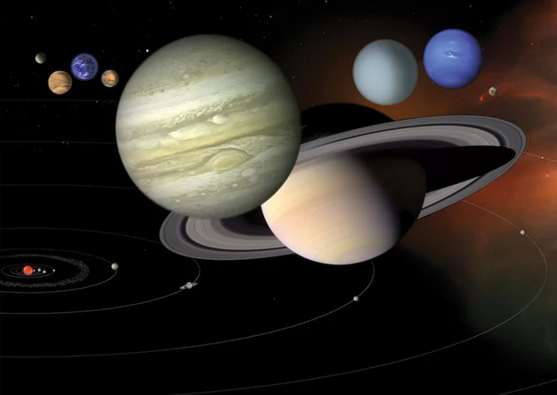
Formation of Our Solar System, continued
Temperature Gradient in the Solar Protoplanetary Nebula
Now let's take a look at items 1 and 2: inner planets are small and rocky, outer planets are gas giants.
During the collapse of the protoplanetary cloud, the inner parts would naturally heat up (conversion of potential energy into kinetic energy), while the outer parts would remain relatively cold.
As the density of the cloud/disk increases, the dust and gas of the nebula would begin to cluster into larger flakes, but in the inner part of the nebula the volatiles (gases) would not form liquids or ices, because of the high temperature. Thus, we can certainly expect that the inner solar system would be volatile-poor and the planets that form would be largely rocky or contain metals.
When we model the conditions of the solar nebula, we find that the temperature reaches the "snow line," where water ice can form, just inside the orbit of Jupiter, and outside this orbit ices and liquids can exist. Planets are formed slowly from a coalescence (accretion) of the flakes of rock and metal in the inner solar nebula, or rock, metal and ices in the outer solar nebula. Thus, one might reasonably expect planets beyond the snow line to grow faster.
Once a planet exceeds a critical size, its gravity is strong enough to hang on to gases as well. The inner rocky planets apparently never grew large enough to attract the gas of the solar nebula directly, so they stayed small. The outer gas giants grew large enough, because of the existence of ices in their vicinity, to accrete the gas of the nebula directly, after which time they would have been able to grow rapidly.

Slide 5
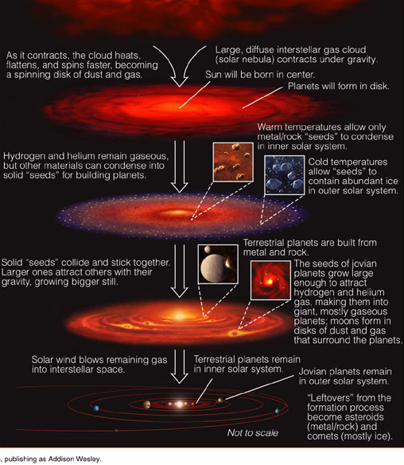
Formation of Our Solar System, continued
Temperature Gradient in the Solar Protoplanetary Nebula
It is interesting that the larger planets would have had their own "planetary" system of moons forming in similar disks around each of them. The Galilean Moons of Jupiter make a nice example of this, with the inner moon, Io, being entirely rocky while the outer moons Europa, Ganymede and Callisto become progressively more icy.
The scenario depicted at right, then, seems to account quite naturally for the main characteristics of our solar system, items 1-6, with a few exceptions like the obliquity of Venus and Uranus. It was once thought that item 7, too (planet spacing, i.e. Bode’s Law), might be explained as a natural consequence of the formation of the planets, given some kind of increasing radius of influence as the planets formed.
Copyright © 2004, Pearson Education, publishing as Addison Wesley

Slide 6
More Characteristics of the Solar System
Given the above scenario, we should see if it can also account for some other observed details:
The rocky planets and our Moon show evidence of heavy bombardment by large objects that left highly cratered surfaces. This is true of Mercury, the Moon, and Mars. By careful dating and other evidence, it is clear that this bombardment was mainly isolated to a specific period of time roughly 700 Myr after the formation of the Moon.
The Earth, and perhaps Mars, has lots of water.
There are many smaller bodies (the asteroids in the asteroid belt, Kuiper-belt objects, and comets) that we have to account for.
There are some known timescales we have to account for:
The protostellar object and disk must form roughly 10⁵ years after collapse begins.
Protostars go into a period of intense outward mass loss in the form of a violent wind between 10⁵ and 10⁷ years after they form. This suggests that any material in a protoplanetary disk is swept clear after about 10 Myr, so the planets better be formed by then!
The oldest meteorites are 4.566 Gyr old, while the Sun itself is 4.57 Gyr (according to models), so meteorites must have formed quickly.
Ages of rocks returned from the Moon, or ages of Martian meteorites, show that both bodies must have solidified no more than 100 Myr after the collapse of the nebula.
The lunar surface underwent a spike of bombardment 700 Myr after the Moon formed.

Slide 7
Formation Mechanisms
One way or another, planets must form from the nebula fairly quickly. There are two competing formation mechanisms: 1) direct gravitational instability (a top-down mechanism) that builds planets by forming them directly from a local condensation in the nebula, and 2) accretion (a bottom-up mechanism) that builds planets starting with small flakes growing into larger bodies through collisions.
We can estimate the size of the region (called the Hill Radius) around a fledgling protoplanet (a planetesimal) that is influenced by its gravity as follows: The period of a planet around the Sun is given by Kepler's 3rd Law $P\sim 2π{\left(a^{3}/GM_{⊙}\right)}^{1/2}$. Likewise, consider the radius at which the orbital period of a test particle around a protoplanetary mass M, is the same as the period of the protoplanet around the Sun, $P\sim 2π{\left(R_{H}^{3}/GM\right)}^{1/2}$, where $R_{H}$ is the radius of the orbit, called the Hill Radius. Equating these two periods, we can solve for the Hill radius
The significance of this is that if a test particle comes within the radius $R_{H}$ of a planetesimal of mass M, it can become gravitationally bound and the planetesimal will continue to grow. Rather than working with mass, it is possible to convert this to a ratio of densities
Planet orbital period P
R_{H}
$$R_{H}={\left(\frac{M}{M_{⊙}}\right)}^{1/3}a$$
Test particle orbital period P
M
2 R_{H} (width of gap)
Image credit: Frédéric Masse.
$$R_{H}={\left(\frac{ρ}{ρ_{⊙}}\right)}^{1/3}\frac{R}{R_{⊙}}a$$

Slide 8
Formation Mechanisms, continued
This Hill radius is generally much bigger than the radius R of the planetesimal, meaning that the planetesimal has access to a large volume of space. Consider that the planetesimal will orbit and eventually come into contact with anything within that radius around the entire orbit, which makes a considerable volume of the nebula available. Thus, planetesimals can grow surprisingly fast (of order 10⁶ yr).
A large planet like Jupiter, beyond the snow line, would have grown a core by the accretion method until it was perhaps $10\text{−}15 M_{⨁}$. At that point, it becomes massive enough to attract and hang onto gases such as helium and hydrogen, and could then grow much more rapidly. Jupiter would grow until the gas was depleted, again taking perhaps 10⁶ yr. More distant planets (Saturn, Uranus, Neptune) are progressively smaller mainly because the solar nebula's density would decrease outward.
In the inner solar system, the last stages of accretion would have involved collisions between very large bodies. The Earth's Moon is thought to be the remnant of a body the size of Mars hitting the proto-Earth, stripping off mainly the outer crust of Earth which then collected into the Moon. It was during these very large collisions that rotation axes could get knocked helter-skelter. This could explain the upside-down Venus and sideways Uranus.
After 10⁷ yr, the planets would have largely stopped growing, and the terrestrial planets would have been completely molten and devoid of any volatiles (no water). By that time, the Sun ignites (starts nuclear fusion of H -> He), and enters the intense T Tauri stage that sweeps the remaining dust and gas away.

Slide 9
Other Solar Systems
The above scenario is probably about right, but it was developed before we had observations of other solar systems. With the tremendous number of examples we have now, we can ask how they agree with our solar system, and how they differ.
A major surprise is the number of "hot Jupiters," which are found very close to their host star in a region well inside the snow line, where they could not have formed by the scenario just described. This has forced scientists to consider other other processes. It is now known that giant planets can actually move inward or outward in orbital radius, so the "hot Jupiters" are formed initially in one location, and migrate inward to where we see them now.
There are two main migration mechanisms that have been proposed and confirmed with numerical simulations. So-called Type I migration involves density waves set up in the nebula due to gravitational interaction (see similar density waves in Saturn's rings). This can lead to hot Jupiters. There is also a slower Type II migration that occurs within gaps of the nebula where density waves are no longer relevant. And finally, interactions with planetesimals just inside the orbit of a planet can cause the planet to give up angular momentum and scatter the planetesimals and itself therefore migrate outward.

Slide 10
Planetary Migration
The Nice Model, Gomes et al. 2005.
Simulations suggest that Jupiter formed about 0.5 AU farther from the Sun, and migrated inward, while Saturn formed perhaps 1 AU closer to the Sun and migrated outward. During these migrations, the two gas giants would have moved through a critical 2:1 orbital resonance.
Such a resonance would have meant that Jupiter's and Saturn's gravitational influence would have combined in the same way periodically on every other Jupiter orbit, causing significant perturbations in the surrounding sea of planetesimals.
The simulations suggest that this would occur about 700 Myr after the formation of the inner planets and the Moon, so that this orbital resonance could have caused the bombardment that led to the craters seen on Mercury, Mars and the Moon.
This same bombardment would have brought large amounts of water to the now cooling Earth (and apparently also Mars), accounting for our present-day oceans.
A similar migration of Neptune outward would have scattered the Kuiper Belt objects and forced some of them in the 3:2 resonance we see today (including Pluto). A huge number of them (perhaps trillions) would have been ejected from the solar system into a vast cloud of objects (Oort Cloud) as many as 50,000 AU from the Sun, from which the long-period comets are seen to come from today.

Slide 11
What We’ve Learned
You should know the seven distinct patterns our solar system shows, which need to be explained by any solar system formation model: (1-2) inner terrestrial vs. outer gas giant planets, (3-5) circular orbits in a plane, orbiting CCW, (6) planet rotations also (mostly) CCW (obliquity), and (7) planetary spacings.
You should be familiar with the explanations for these: (1-2) temperature gradient in proto-planetary nebula, (3-5) planet formation in disks, (6) conservation of angular momentum, although somewhat randomized by planetesimal collisions, and (7) apparently just an accident—other solar systems do not obey such spacings.
You should also know the basic formation stages of the early solar system, from flakes to planetesimals to planets, with all planets growing first by accretion, and the outer planets then accumulating gas.
You should understand how the Hill Radius comes about, and how to use it in a calculation
You should know the basic timescales for important events in the solar system history, such as cloud collapse (~100,000 y), rapid creation of meteor-sized objects (< 1 My), planets and smaller bodies formed by 10 My, beginning of planetary migration that caused the early bombardment of the solar system (~700 My).
You should know the role of exoplanet discoveries in the forcing scientists to confront planetary migration, and how that migration explains today’s Kuiper belt and Oort Cloud.
$$R_{H}={\left(\frac{M}{M_{⊙}}\right)}^{1/3}a ={\left(\frac{ρ}{ρ_{⊙}}\right)}^{1/3}\frac{R}{R_{⊙}}a$$

