Slide 1
Physics 320: Physical Characteristics: Temperatures and Ages (Lecture 13)
Dale Gary
NJIT Physics Department

Slide 2
Surface Temperatures—Albedo
Before we begin to discuss individual planets, let us take a look at the general situation with regard to surface temperatures of planets, relative to the temperature of the central star. An important property of a planet is its albedo.
This is the fraction of sunlight reflected from the surface, relative to the amount striking the surface:
$$A = amount reflected / amount incident$$
There are two types of albedo, depending on how they are used. When discussing energy considerations, we will use the bond albedo, which refers to the fraction of energy reflected (the rest is absorbed). When discussing how bright a reflective body appears, we will use the geometric albedo, which refers to the fraction of sunlight reflected back to us.
A perfectly reflective planet would have an albedo of 1, while a completely black planet would have an albedo of 0. The table at right lists the albedos of the planets, where you can see that it varies from very dark (0.088 bond albedo for Mercury) to very bright (0.76 for cloud-covered Venus). The gas giants have albedos near 0.5. Earth's albedo is highly variable (due to clouds), but averages around 0.37. Saturn's moon Enceladus has an albedo above 1 (1.4)! Keep in mind that albedo numbers are difficult to calculate, and vary quite a bit in different references.
Planet | Geometric | Bond
Mercury | 0.142 | 0.088
Venus | 0.689 | 0.76
Earth | 0.434 | 0.306
Mars | 0.170 | 0.25
Jupiter | 0.538 | 0.503
Saturn | 0.499 | 0.342
Uranus | 0.488 | 0.300
Neptune | 0.442 | 0.290
https://en.wikipedia.org/wiki/Albedo

Slide 3
Surface Temperatures—Incident Flux
We can measure the amount of light reflected from a planet, but how do we know the amount striking it? The light, of course, originates at the Sun, which radiates as a blackbody of temperature about $T = 5800 K$. Recall that the blackbody spectrum peaks at a wavelength that depends only on temperature:
$$λ_{max}[m]=2.898×{10}^{−3}/T$$
This is called Wien's Law. The Sun's spectrum peaks around 500 nm. The spectrum of an object at room temperature (about 290 K) peaks in the infrared (about 10 μm). Thus, we can tell the surface temperature of a planet by measuring its blackbody spectrum. Recall also that a blackbody spectrum has a total energy flux $F$ (energy per unit area per unit time) given by the Stefan-Boltzmann Law
$F = σT4 W/m2, where σ = 5.67×{10}^{−8} Wm^{−2}K^{−4}$.
Since we know the energy flux from the Sun, we can calculate the blackbody temperature one would expect at the surface of a planet from its distance from the Sun, and its bond albedo $A$. It should be obvious that the energy flux from the Sun integrated over an entire sphere centered on the Sun (called the Luminosity) is the same no matter how big the sphere is. Therefore, $4πR_{⨀}^{2}σT_{⨀}^{4}= 4πr_{p}^{2}σT_{p}^{4}$, where $rp$ is the distance of the planet from the Sun, and $Tp$ is the corresponding temperature at that distance if all of the energy were absorbed by the planet ($A = 0$). Since some of the energy is reflected ($A > 0$), then the temperature of the planet will be less than this. We can take this into account by including a factor $(1 − A)$, so the relation becomes:
$$4πR_{⨀}^{2}{σT}_{⨀}^{4}= 4πr_{p}^{2}(1−A)σT_{p}^{4}$$

Slide 4
Surface Temperatures for Two Cases
Solving $4πR_{⨀}^{2}{σT}_{⨀}^{4}= 4πr_{p}^{2}(1−A)σT_{p}^{4}$ for the sub-solar temperature of the planet, $Tp = Tss$, we have
$(rp=distance from Sun to planet, in AU)$.
For a planet that rotates slowly, or has little atmosphere, the sub-solar temperature is the relevant one to use. However, when the planet is rotating rapidly, or has a substantial atmosphere, the redistribution of energy must be taken into account. When this is done, one gets the equilibrium blackbody temperature:
$(rp=distance from Sun to planet, in AU)$.
In most cases, surface temperatures match the appropriate temperature calculated above, but Venus and Jupiter disagree. Venus has extra heating due to the greenhouse effect, while Jupiter has some internal heat source. We will discuss both of these later.
So for Mercury, which is at $rp = 0.387 AU$ (semi-major axis), and has a very low (bond) Albedo of about $0.088$, its sub-solar temperature is predicted to be about $619 K$, while its equilibrium temperature would be about $466 K$. These agree pretty well with accepted values of maximum temperature at the equator (about $700 K$) and average temperature ($340 K$), keeping in mind that Mercury has a rather high eccentricity of $0.206$, and it spends more than half of its time farther away that $0.387 AU$. However, on the dark side of Mercury the equator temperature can be as low as $100 K$ $(−173 C, or −279 F$).
Just keep in mind when doing these calculations that you have to decide whether to use the sub-solar or equilibrium temperature, depending on whether the planet is rotating fast or slow (or thick atmosphere).
$$Tss = 394 {\left(1−A\right)}^{1/4}r_{p}^{−1/2} K,$$
$$Teq =279 {\left(1−A\right)}^{1/4}r_{p}^{−1/2} K,$$

Slide 5
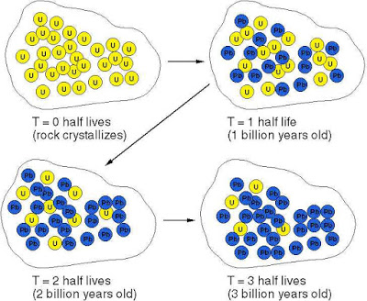
Determining Ages
We can date the Earth by using radioactive decay of atoms. Atoms come in many isotopes, all having the same number of protons, but different numbers of neutrons. When an isotope has a lot of neutrons, it can be stable over a long period of time, billions of years, but still have some probability to decay to a more stable isotope. An important example is ²³⁸U (a Uranium isotope with 238 nucleons--protons+neutrons), which decays to ²⁰⁶Pb with a half-life of 4.5 billion years. This means that 1/2 of a sample of ²³⁸U will decay into ²⁰⁶Pb in 4.5 billion years.
Thus, one can take a sample of rock and compare the ratio of these two isotopes to get the age of the rock. This works because ²⁰⁶Pb is a rare isotope in nature, so one can be quite sure that the rock had essentially none when it was first created.
Another pair of isotopes that is important for dating rocks is ⁴⁰K, which decays into the inert noble gas ⁴⁰Ar with a half-life of 1.3 billion years. When a rock is remelted, the Ar escapes and the clock is reset, so the age one measures is the age since the last melting of the rock.

Slide 6
Dating with Radioactive Decay
When atoms decay, the change in the number is proportional to the number that exist (i.e., some fraction decay in a time 𝑑𝑡). The fraction is given by a constant of proportionality 𝜆. The governing equation is 𝑑𝑛=−𝜆𝑛 𝑑𝑡, which can be rewritten 𝑑𝑛∕𝑛=−𝜆 𝑑𝑡.
The equation ${dn}/n=−λ dt$can be easily integrated to give:
$$\ln{n}=−λt+const$$
The constant can be found by considering the initial conditions at time $t = 0$. The solution is that the rock sample starts out a number $n0$ at $t = 0$, so the final equation can be written:
$$n=n_{0}e^{−λt}$$
We can express the time constant $1/λ$ in terms of the half-life $τ$, by solving for the time $t≡τ$ when the number of atoms left is half the original amount, i.e. $n=\frac{n_{0}}{2}$.
$\frac{n0}{2}=n_{0}e^{−λτ}⇒τ=\frac{\ln{2}}{λ}=\frac{0.693}{λ}$.
Example: A rock has a ratio ⁴⁰Ar to ⁴⁰K of 1 to 4. How old is the rock, given that the half-life is 1.3 billion years?
This means that 1 out of 5 ⁴⁰K atoms have decayed to ⁴⁰Ar, so $n/n0 =\frac{4}{5}$. Our equation then becomes:
$\frac{4}{5}=e^{−0.693t/τ}$.
Solving for $t$, we get $t = 0.322 τ = 420 million years$.

Slide 7
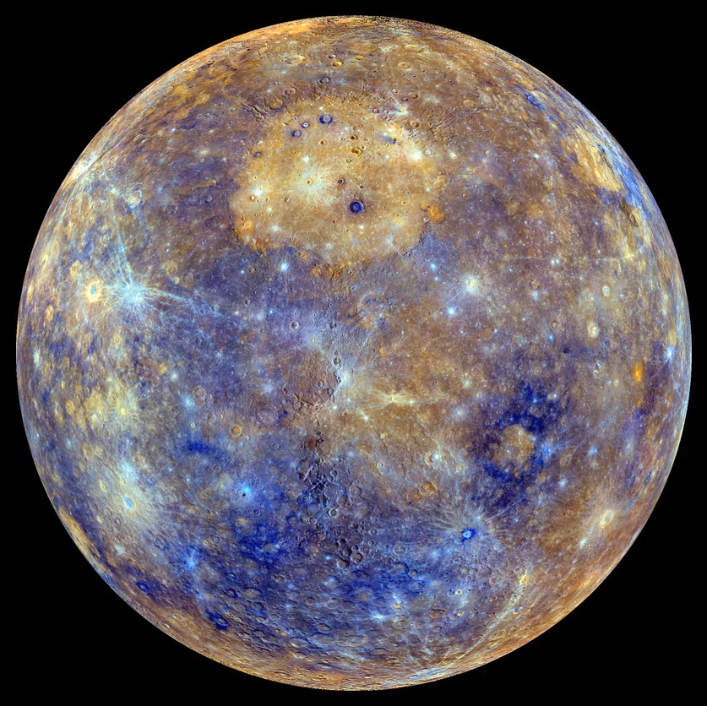
Closer Look at Mercury
Physical characteristics: One solar day is 2 Mercury years long! One sidereal day is $P = 58.7 days$, while one year is $T = 88 days$ (2:3 ratio). Similar to the expression we had for synodic orbital periods, the synodic rotation period is found by:
$$\frac{1}{S}=\frac{1}{P}−\frac{1}{T}=\frac{1}{58.7 d}−\frac{1}{88.0 d} = 0.00567 / day$$
So the solar day is $S = 176 days$, which is exactly $2T$.
Mercury's bulk density is $5420 kg/m3$, about the same as for Earth, but this turns out to be a puzzle. Mercury is much less massive than Earth, so its gravity cannot squeeze rock to high density. Thus, it must be made of naturally high density material—metals. We infer a large metallic core (about 75% of the radius) covered with a rocky mantle. One possibility is that Mercury was once much larger, but suffered a massive collision that made it lose most of its outer mantel (Wikipedia article, Messenger link).
We already calculated the sub-solar temperature for Mercury:
$Tss = 394 {(1−A)}^{1/4} r_{p}^{−1/2}= 394 (0.98){(0.307)}^{−1/2}= 689 K (at perihelion)$.
Yet during the long solar night, the dark-side temperatures drop to $100 K$.
Mercury Messenger enhanced-color photo
Such images reveal something about the mineral makeup of the surface, as do images like this one of the crater Degas.

Slide 8
Mercury Surface and Atmosphere
The Mercury Messenger spacecraft arrived at Mercury in March 2011, and stayed in orbit for 4 years, making the most detailed maps and analysis of the planet ever. As you can calculate, going to Mercury is energetically expensive! The Messenger mission had to use several planetary encounters (with Earth, Venus, and Mercury) to reduce speed enough to get into Mercury orbit. The Messenger mission had 7 key questions it attempted to answer.
An earlier flyby mission, Mariner 10, discovered a very weak, but present, magnetic field of $300 nT$ (nanotesla). Earth's magnetic field is some $40000 nT$, more than $100$ times larger than Mercury. Still, this is large enough to deflect the solar magnetic field and solar wind, creating a small magnetosphere. Messenger mapped the magnetic field and found the surprising result that its center is offset some 20% of Mercury's diameter toward the north. It was not clear until recently where such a magnetic field would come from, since Mercury rotates slowly, but recently it has been discovered that it has a liquid outer core, like Earth (although much thinner).
Mercury's atmosphere, more properly called an exosphere, is very thin and consists of sodium atoms that are released from the surface by particle radiation and hang around for awhile but ultimately escape. It is of scientific interest to know the distribution of this exosphere, and in particular its dawn-dusk asymmetry, which can be observed from Earth during a transit of Mercury. A transit occurred earlier this year (2016 May 9), and was observed with NJIT's Big Bear Solar Observatory (see video).
Map of sodium in Mercury’s atmosphere

Slide 9
BepiColombo ESA Mission
A new mission was launched just 5 days ago (2018 Oct 20), and is headed for Mercury.
From the ESA web site:
“The BepiColombo mission is based on two spacecraft:
a Mercury Planetary Orbiter (MPO); and
a Mercury Magnetospheric Orbiter (MMO)
Among several investigations, BepiColombo will make a complete map of Mercury at different wavelengths. It will chart the planet's mineralogy and elemental composition, determine whether the interior of the planet is molten or not, and investigate the extent and origin of Mercury’s magnetic field.
Once BepiColombo arrives in late 2025, it will help reveal information on the composition and history of Mercury. It should discover more about the formation and the history of the inner planets in general, including Earth.”
One of the goals of BepiColumbo is to test the hypothesis that Mercury formed much farther from the Sun, and moved to its current location later (perhaps during the planetary migrations). Messenger found lots of volatile-containing rocks on Mercury that cannot be accounted for if Mercury formed so close to the Sun.

Slide 10
What We’ve Learned
You should know the meaning of the word Albedo, and the difference between geometric and bond albedos and when to use them (geometric for observed brightness, bond for energy calculations).
You should be able to derive the expression for temperature of a planet based on the temperature of the primary star, the distance of the planet from the star, and the albedo of the planet. This comes from conservation of energy flux ($σT^{4}$), and the fact that energy flux is the same through the surface of a star and through a sphere of radius $rp$ that is the distance from star to planet.
You should be familiar with the two different expressions for planet temperature, sub-solar temperature and equilibrium temperature, and understand when to select one or the other as most appropriate, the only difference being in the temperature coefficient:
You should know the equation for radioactive decay in terms of time-constant $1/λ$ and half-life. You should know how to convert ratios of isotopes (parent and daughter products) into an age, given the decay half-life .
You should be familiar with the general characteristics of Mercury (hot, no atmosphere, but slight exosphere, dense [due to large metal core], cratered, weak and off-center magnetic field).
You should know that only three missions to Mercury have occurred—a flyby Mariner 10, an orbiter Messenger, and a new one now on the way, BepiColombo.
$$Tss = 394 {\left(1−A\right)}^{1/4}r_{p}^{−1/2} K,$$
$$Teq =279 {\left(1−A\right)}^{1/4}r_{p}^{−1/2} K,$$
$$n=n_{0}e^{−λt}$$
$$τ={\ln{2}}/λ$$

