Slide 1
Physics 320: Mars (Lecture 16)
Dale Gary
NJIT Physics Department

Slide 2
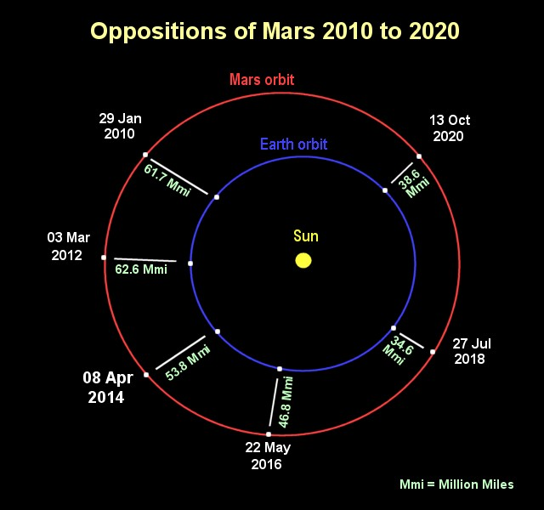
Mars Physiccal Characteristics
Mars' orbit ($a = 1.52 AU$) is considerably more eccentric than Earth's, with $e = 0.0934$. Thus, its opposition distance from Earth can change by $0.28 AU$, or $42 million km$. Thus, some oppositions are far better than others for observing the planet up close.
Missions to Mars have launch opportunities every other year, the next being July 2020.
Mars has seasons similar to Earth's, due to its spin axis inclination of $25°12′$, and its day is also similar to Earth's, with sidereal rate $24h 37m 22s$long.
Mars has two tiny moons, Deimos and Phobos, which are likely captured asteroids. We will discuss these in more detail when we discuss planetary moons, but as a homework problem showed, the inner-most moon, Phobos, is so low that it is only just outside the Roche limit and is moving inward.

Slide 3
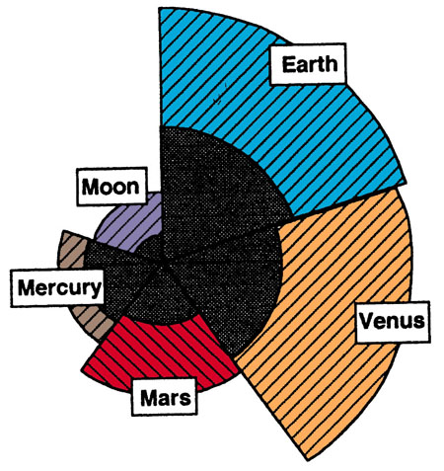
Bulk Density and Central Pressure for Mars
Mars' radius is $3394 km$, or $53\%$ of Earth's radius. That makes its volume $(0.53)3 = 15\%$ of Earth. Its mass, however, is only $11\%$ of Earth's mass, so its bulk density is about $3930 kg/m3$. This is considerably less dense than Earth ($5500 kg/m3$) and only slightly denser than the Moon ($3300 kg/m3$). Since the crust and mantle of Mars is probably the same as Earth, this argues for a smaller relative size for the iron core.
Using our expression for central pressure, we get
This is far less than Venus and Earth.
The figure at right is a comparison of the cores of the terrestrial planets and the Moon. Each wedge shows the relative scale of the indicated body and the proportion of mantle and core. Mars' core is a smaller fraction of its volume than the other terrestrial planets, while Mercury's core is the largest fraction of its volume.
$$P_{c}=\frac{2}{3}πG{\left\langle ρ\right\rangle }^{2}R^{2}≈1.4×{10}^{−10}{\left\langle ρ\right\rangle }^{2}R^{2}$$
$≈2.49×{10}^{10} Pa=249,000 atm$.
(from http://quartz.ucdavis.edu/~gel36/comparison.html)

Slide 4
Mars’ Atmosphere and Temperature
Mars' atmosphere is far thinner than Earth's ($0.006 atm$), yet it still supports high winds and clouds of both carbon dioxide and water, and it can form a frost of carbon dioxide ice on the ground. The atmosphere is $95\%$ carbon dioxide ($CO2$), a few percent nitrogen ($N2$) and argon ($Ar$), and only $0.1\text{-}0.4\%$ oxygen ($O2$). If you took all of the water out of the atmosphere at once and deposited it in a layer on the ground, it would only be $0.01 mm$deep. On Earth the equivalent number is typically several cm.
The albedo of Mars is quite low, at $0.15$, and its perihelion distance from the Sun $(\sim 1.38 AU)$ gives a peak subsolar temperature of $Tss = 394 {(1−A)}^{1/4} r_{p}^{−1/2}= 394 \left(0.96\right){\left(1.38\right)}^{−\frac{1}{2}} = 322 K$ (at perihelion).
This is close to the highest observed summer temperature of about $310 K$, which corresponds to a quite hot $37 C$, or $99 F$. However, Mars is a rapid rotator, so we should use the equilibrium temperature equation to get the typical temperature. If we use the typical distance of the semi-major axis of Mars' orbit, $1.52 AU$, we get: $Tss =279 {(1−A)}^{1/4} r_{p}^{−1/2}=279 \left(0.96\right){\left(1.52\right)}^{−\frac{1}{2}} =217 K$ (typical average).
This is $−56 C$, very cold indeed. And of course the day-night variation of this temperature can be $± 50 C$.
Likely we know more about Mars than any other planet besides Earth. This is due to the many missions to Mars, and the fact that Mars, unlike Venus, has a thin transparent atmosphere that allows us to see the surface.

Slide 5
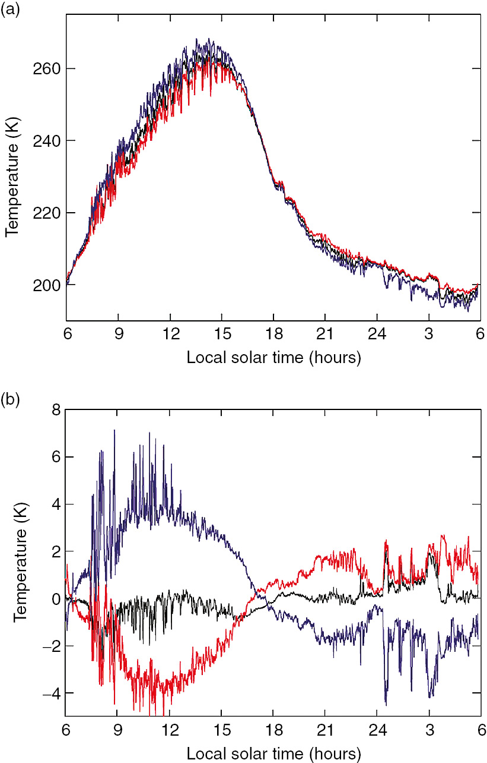
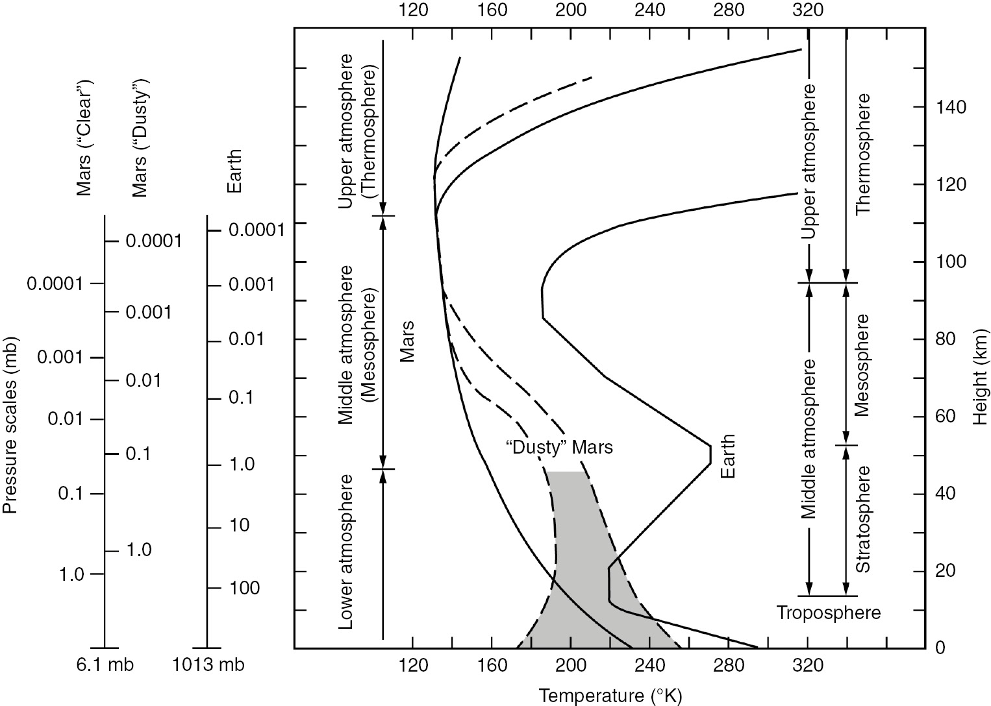
Diurnal Temperature Variation
The plot at upper right is the temperature variation over one day, at the Pathfinder lander site. Things heat up during the day, becoming hottest around 3 pm local time.
The different colors are from sensors at three different heights on Pathfinder’s mast, red (top), black (middle), and blue (bottom), so the temperature gets hotter near the ground during the day, but reverses at night.
The plot at left shows the temperature vs. height on Earth compared with Mars.
Two Mars curves are shown, one for a clear Mars atmosphere, and one when a dust storm is in progress.
Dust storms make Mars warmer for a time.

Slide 6
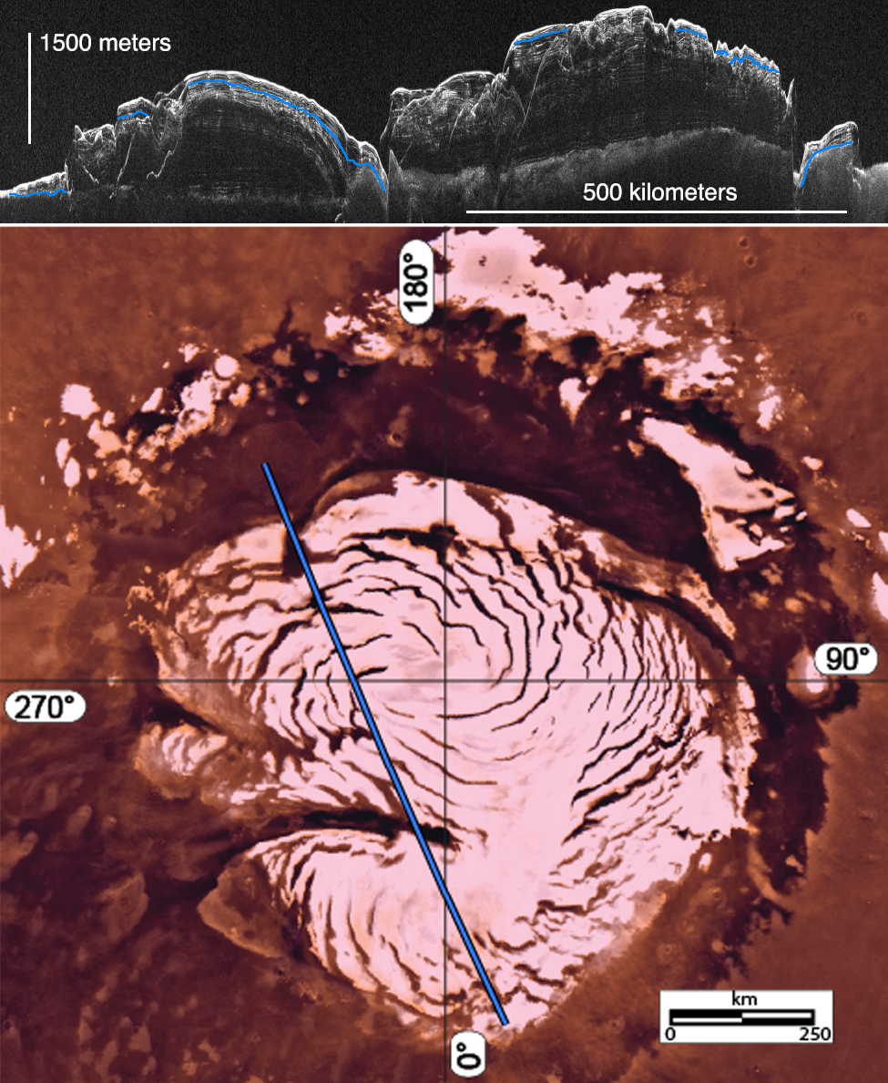
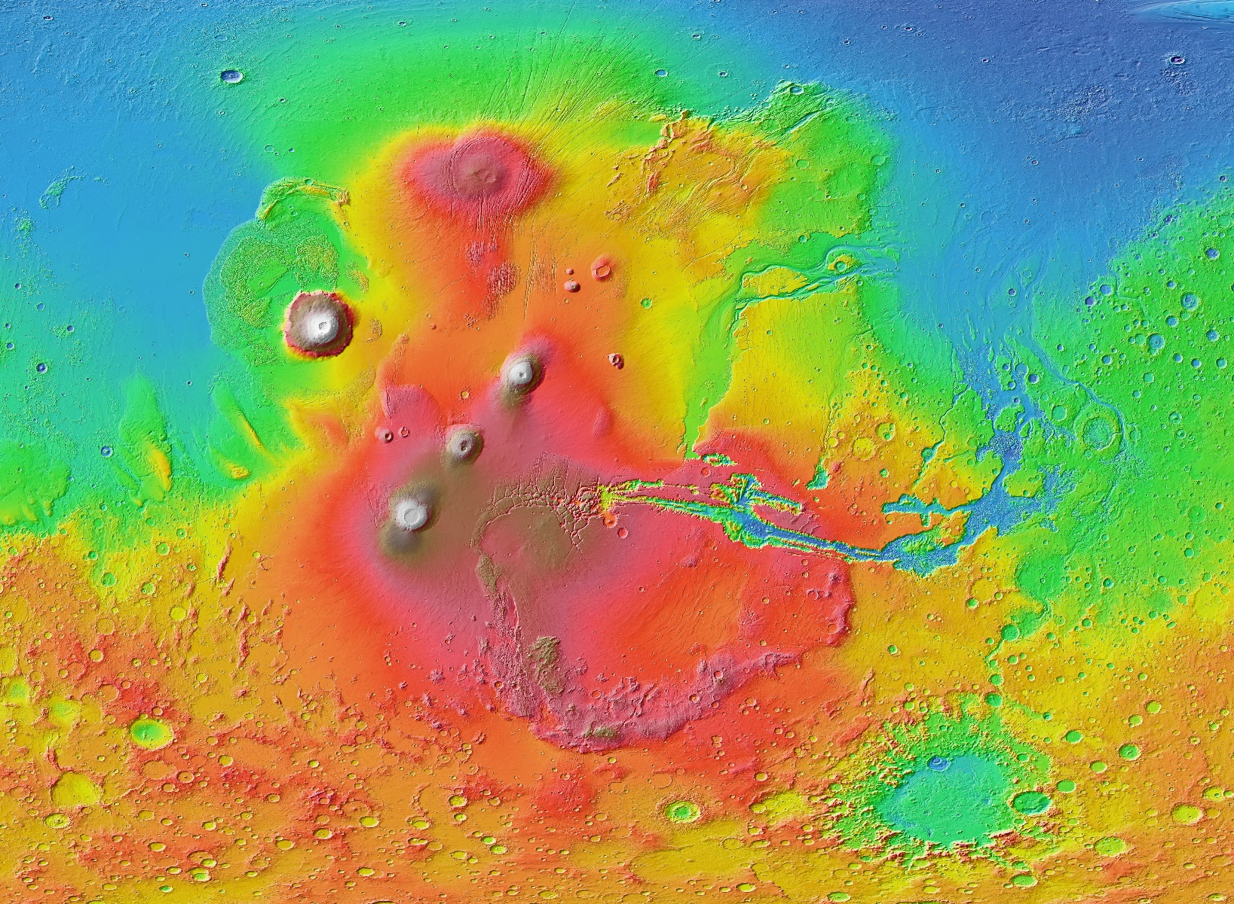
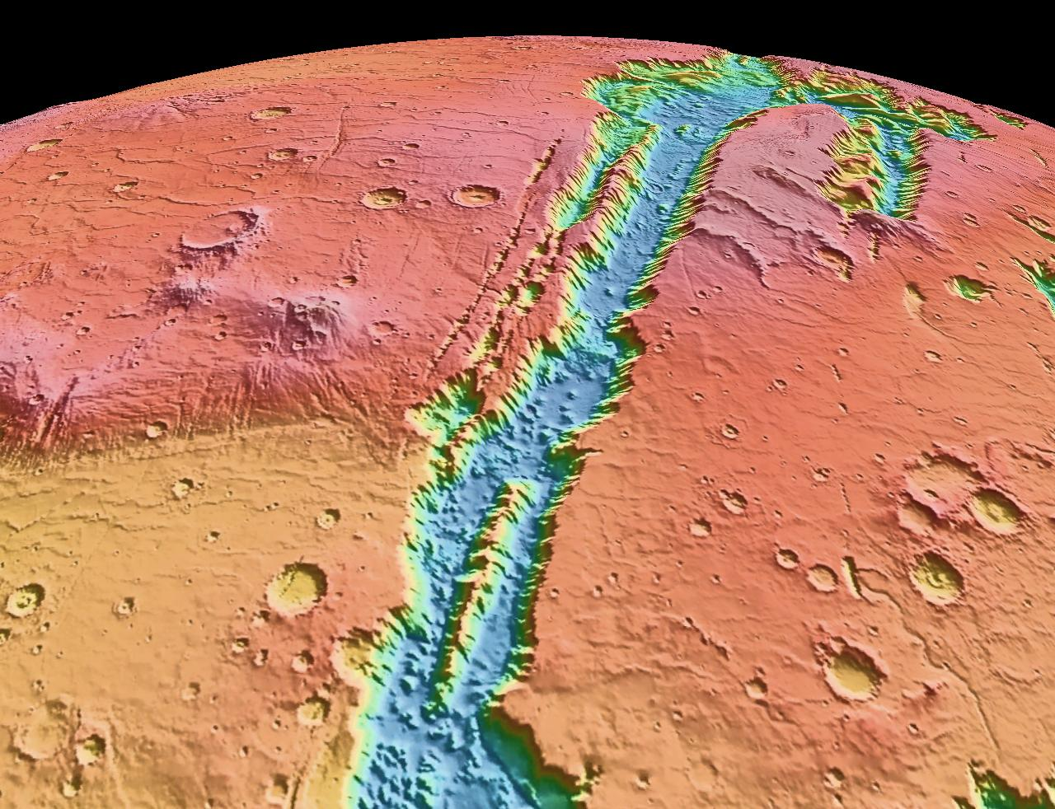
Some Mars Features
Valles Marineris
Polar Caps
Olympus Mons and other volcanoes
Other common surface features
Olympus Mons is the largest mountain in the solar system, 26 km high.
Its top could be said to stick out into space, well above most of Mars thin atmosphere.
Three other volcanos dot the Tharsis region of Mars, and Valles Marineras extends from it.
Mainly water ice, but has a layer of 1-8 m thick CO₂ ice that comes and goes due to the seasons.
During winter, they are constantly in the dark, and 25-30% of the entire Mars atmosphere condenses out at CO₂ ice.
Over 4000 km long
Thought to be a tectonic crack, possibly formed early on, then broadened by erosion

Slide 7
Mars Missions and Rovers
List of Mars Missions
Spirit Rover 2004-2010
Opportunity Rover 2004-2018
Curiosity Rover 2012-2018+
Future Missions
Space-X mission in 2024?

Slide 8
What We’ve Learned
You should be familiar with the relative sizes and densities of the four terrestrial planets, and their relative core sizes. Earth and Venus are very similar, while Mercury has an oversized core (for its size) and Mars has an undersized one.
You should know that Mars’ atmosphere is thin, with a high pressure (0.006 atm) at its surface, and its main constituent is CO₂, with trace amounts of Ar and N₂.
You should have an appreciation of the typical temperature, around $−50 C$, although noon-time temperatures can briefly soar to $+35 C$, and that the variation of temperature is similar to Earth, except much colder, and a much bigger swing between day and night.
A great deal is known about Mars due to the many Mars orbiters and landers. We looked at some major ones, Valles Marineris, the polar caps, and Olympus Mons.
We also surveyed many other common surface features.
We looked at the huge list of Mars missions, and in particular some of the rovers.
Humankind remains fascinated with Mars, and many future missions, possibly including a human colony are planned.

