Slide 1
Physics 320: Giant Planets (Lecture 17)
Dale Gary
NJIT Physics Department

Slide 2
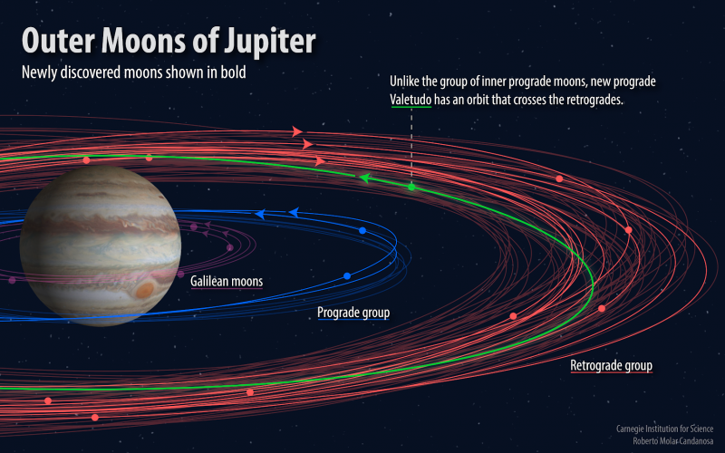
Jupiter’s Physical Characteristics
Jupiter's orbit ($a = 5.2 AU$) is beyond the "gap" of the asteroids. It takes almost 12 Earth years to circle the Sun once. Its eccentricity is a typical value for planets of the solar system, at $e = 0.0484$. Jupiter's axis is tilted only $1.3o$ out of the ecliptic, and it has the fastest rotation rate of all of the planets, at $9h 50m$.
Jupiter has four very large moons, all greater than $1500 km$ in diameter. These are called the Galilean moons because, as you know, they were discovered by Galileo as soon as he completed his telescope and turned it on the planet in 1610. Jupiter also has a large number of additional moons none of which are greater than $100 km$ in diameter. These are likely captured asteroids.
Jupiter's radius is $71,398 km$, or $11.2$ times Earth's radius. That makes its volume $(11.2)3 = 1400$times that of Earth. Its bulk density, however is only about $1330 kg/m3$. This is only slightly denser than water ($1000 kg/m3$).
Scientists reported the finding of 12 new moons around Jupiter. The moon orbits shown blue are in prograde (normal, CCW) directions. The orbits shown in red are retrograde. One of the newly discovered moons is bucking the trend, being prograde in the outer regions. Jupiter has 79 moons discovered so far.

Slide 3
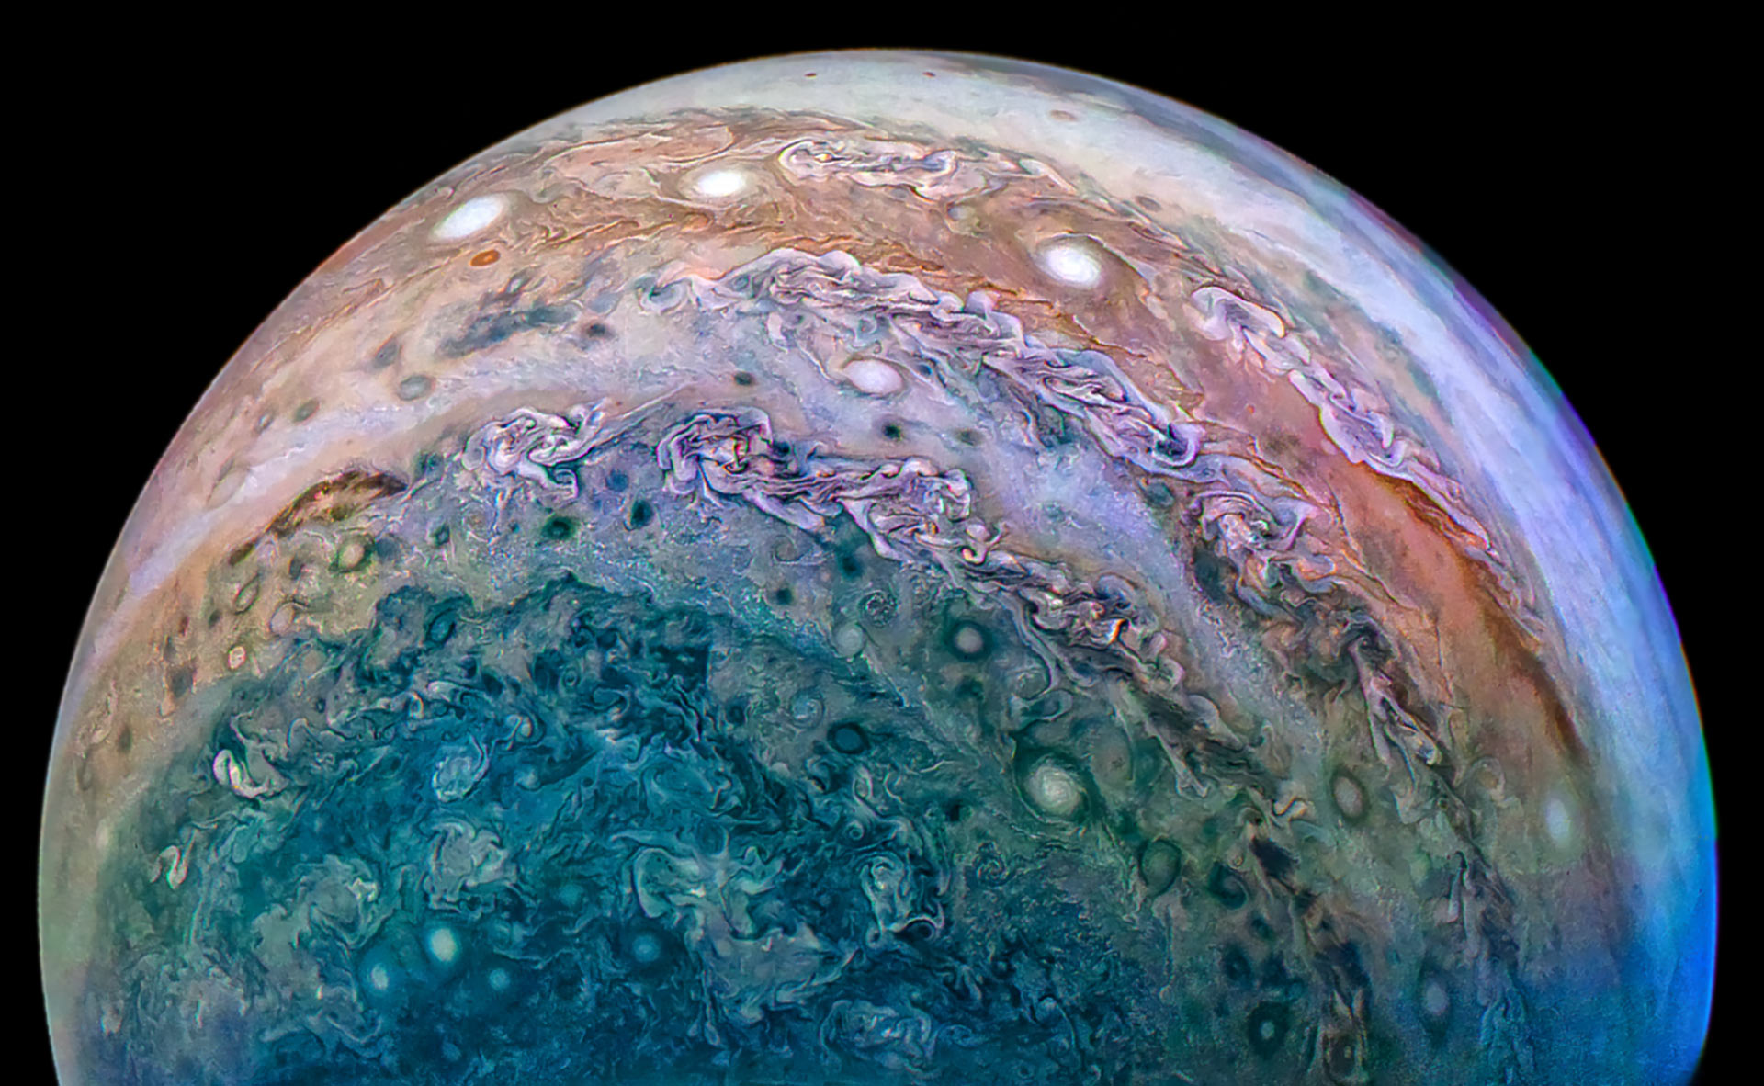
Jupiter’s Physical Characteristics
Jupiter is almost entirely made of gas, about $75\%$ by mass of hydrogen and $24\%$ helium, with only $1\%$ of heavier elements. This is almost exactly the composition of the Sun, giving an important clue to how Jupiter and the solar system formed.
Jupiter probably has a rocky core amounting to several Earth masses. That is a tiny proportion of Jupiter’s overall mass.
The next layer out from the core is liquid metallic hydrogen. This exotic form of hydrogen can only exist at pressures exceeding $4 million atm$. Let's use our method of estimating pressure from Lecture 15 to get the core pressure of Jupiter:
$$Pc = \left(\frac{2}{3}\right)πG\left\langle ρ\right\rangle 2 R2= 1.2×{10}^{12} Pa$$
Liquid metallic hydrogen consists of individual protons and electrons, where the electrons are able to flow freely like those in a metal.
Above this metallic layer is a layer of "ordinary" liquid hydrogen and helium, where the electrons are bound to the protons. This ordinary liquid extends all the way to near the surface, with a relatively thin layer of gas forming clouds in Jupiter's atmosphere.
Photo of one of Jupiter’s poles, taken by Juno. The Juno spacecraft was launched in 2011, and arrived at Jupiter in 2016. It is the first to orbit over Jupiter’s poles, so that it returns some unique pictures unlike what you might be used to. The weather patterns in Jupiter’s clouds are extremely complex.
~$12 million atm$.

Slide 4
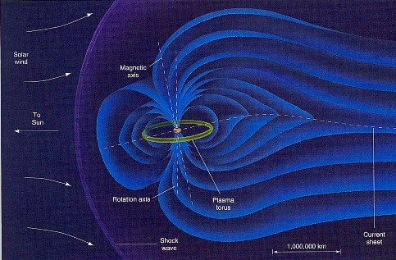
Jupiter’s Magnetic Field
The metallic hydrogen layer is the source of Jupiter's strong magnetic field -- $4×{10}^{−5} T$ at Jupiter's surface -- about the same as that at Earth's surface, but remember that Jupiter's surface is much farther out from the planet's center. Earth's magnetic field at the distance of Jupiter's surface, $RJ = 71,400 km$, is only
$B = B0{\left(r/R_{⨁}\right)}^{−3}=(4×{10}^{−5} T){\left(71400/6387\right)}^{−3}=2.86×{10}^{−8} T$.
So Jupiter's magnetic field is some $1400$ times larger than Earth's. This mammoth magnetic field traps huge numbers of energetic particles, so the particle radiation environment at Jupiter is extreme. Spacecraft have to be carefully hardened to withstand the radiation environment.
On the daylight side, the solar wind compresses Jupiter’s magnetosphere and limits its size. The size is determined by a balance in pressure in the solar wind and in the magnetosphere--the magnetosphere is compressed until an equilibrium is reached. The solar wind provides a gas at pressure, $P = nkT$, while inside the magnetosphere the pressure is mainly due to “magnetic pressure” $PB = B2/2μ_{0}$. where $μ_{0}=4π×{10}^{−7} H/m$is the magnetic permeability of free space.
Jupiter’s magnetosphere looks similar to Earth’s, but is vastly larger. Jupiter’s inner moon Io forms a plasma torus all around it’s orbit, due to the dust and gas from Io’s constant volcanic eruptions.

Slide 5
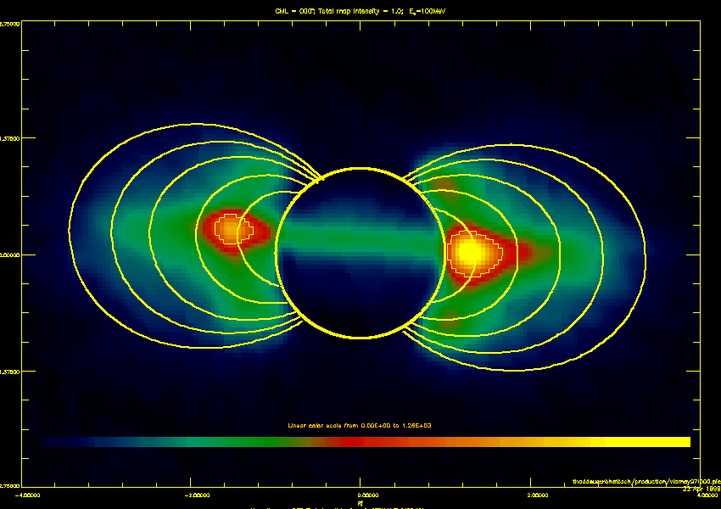
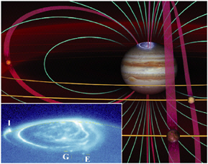
More on Jupiter’s Magnetic Field.
In the solar wind, we find that the gas pressure falls off as one over distance from the Sun squared: $P \sim 1/r2$. From this, we can estimate how much larger Jupiter's magnetosphere is than Earth's, by considering the ratio of gas pressures at Earth's and Jupiter's distance, and the ratio of magnetic pressures of Earth's and Jupiter's magnetic fields. This is one of the homework problems. The Earth's magnetic field extends to about $10R_{⨁}$, while Jupiter's magnetic field is about $17 RJ$ in size.
Jupiter’s radiation belts are also much bigger and more dangerous that Earth’s, and can even be imaged in radio waves from Earth. Here is a 21 cm radio observation from the Very Large Array radio telescope, with the size of the planet and inner magnetic fields lines drawn in. It wobbles due to the tilt of the dipole from the spin axis of Jupiter.
Jupiter has auroras, just like Earth, and for the same reason. The moon Io has a “footprint.”

Slide 6
Jupiter’s Temperature and Internal Heat
The albedo of Jupiter is quite high, at $A=0.52$, giving an equilibrium temperature of
$$Tss=279{\left(1−A\right)}^{1/4}r_{p}^{−1/2}=279 \left(0.84\right) {5.2}^{−1/2} =103 K.$$
The observed temperature of the cloud tops, however, is $130 K$ up to as much as $150 K$. This leads to the conclusion that Jupiter has an internal heat source, probably left over from its gravitational contraction.
The "self-gravitational" potential energy of a body is $U=−\frac{3}{5}{GM^{2}}/R$, which means that as a body contracts ($R$ decreases), the potential energy goes down (gets more negative). According to the virial theorem, half of this energy must be radiated away, and the rest goes into heating the body. During Jupiter's formation, it must have become extremely hot, and it is now slowly cooling down, but it appears from what we know that Jupiter may still be generating heat, perhaps continuing to contract slightly. How rapidly must it contract to produce the excess heat that we see? Recall the flux of a black body, $F = σT4 W m^{−2}$. This flux of energy, when considered over the entire surface area of a planet ($4πR^{2}$), gives the total luminosity, $L=4πR2σT4 W$.
We expect Jupiter to have a temperature of $T0=103 K$, but it actually has temperature $T=130 K$, so the excess energy per second is $L=4πR2σ\left(T4−T_{0}^{4}\right)=4π\left(7.14×{10}^{7}m\right)2\left(5.67×{10}^{−8}\right)\left(1304−1034\right)=6×{10}^{17}W.$
The luminosity from contraction should be that half of gravitational potential energy per unit time:
$L=\frac{1}{2}\frac{dU}{dt}=\frac{3}{10}\frac{GM^{2}}{R^{2}}\frac{dR}{dt}$ or $\frac{dR}{dt}=\frac{10LR^{2}}{3GM^{2}}=\frac{10\left(6×{10}^{17}W\right)\left(7.14×{10}^{7}m\right)2}{3(6.67×{10}^{−11})\left(1.9×{10}^{27}kg\right)2}\sim 1.3 mm/y$

Slide 7
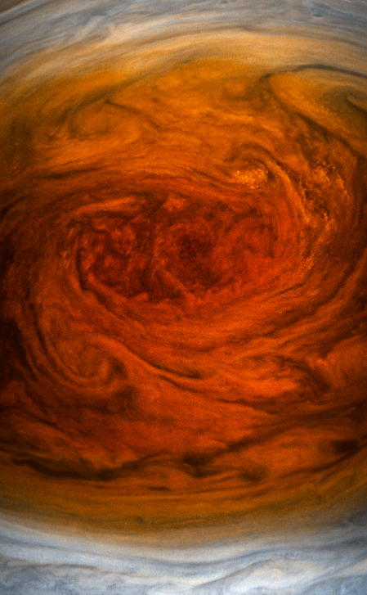
Jupiter Missions
Past Missions
Galileo
Jupiter Probe
The Galileo orbiter had an atmospheric probe that entered Jupiter's atmosphere in 1995 and radioed back information about the upper layers of clouds. An overview of the cloud geometry is shown here. It entered into a relatively dry part of Jupiter's atmosphere, and descended into the hotter layers beneath. Jupiter's cloud tops are the lighter areas, called zones, and are colder. Darker areas, called belts, are deeper layers seen through gaps in the whiter cloudes, and hence are hotter. Jupiter Pictures (great red spot)
Juno
List of missions

Slide 8
Other Gas Giants
Moving now out to the far reaches of the solar system, the separations of the planets get much larger. Jupiter is at $5.2 AU$, but Saturn is almost twice as far, at $9.54 AU$. This means it takes almost 30 years for Saturn to circle the Sun once. Uranus is again twice as far from the Sun as Saturn, at $19.2 AU$, and takes 84 years to circle the Sun. It is so far from the Sun that it cannot be seen easily with the naked eye. Therefore, it was not discovered until 1781, by William (Wilhelm) Herschel. He originally named the planet George! (Georgium Sidus, for King George III of England). Likewise, Neptune was discovered only in 1846, at a distance of 1.5 times the distance to Uranus, $30.1 AU$. It takes 165 years to circle the Sun once.
The discovery of Uranus was accidental, but the discovery of Neptune was a triumph of celestial mechanics. By studying the orbit of Uranus, an extremely tiny perturbation was discovered independently by J.C. Adams (1843) and U.J. Leverrier (1846). By using Newtonian celestial mechanics, they were able to predict the mass and orbit of the perturbing body. In 1846, Johann G. Galle found Neptune within 1º of its predicted location. However, Neptune's orbit diverged rapidly from the orbits predicted by the mathematicians, so if it had been searched for some years earlier or later, it would have been far from its predicted location.
In 1613, some 234 years before Neptune's discovery, Galileo's drawings of Jupiter showed an object near Neptune's predicted position, and he even detected a small motion of the object with respect to a nearby star. However, he failed to follow up on the discovery.

Slide 9
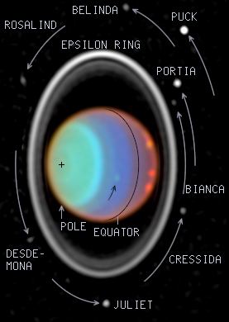
Other Gas Giants
All three of these gas giants have orbits of low eccentricity (Saturn and Uranus are nearly identical to Jupiter, with $e = 0.056$ and $0.048$, respectively, while Neptune is even lower at $0.009$), and low orbital inclination ($2.49o, 0.77o and 1.77o$, respectively). The inclination of their spin axes, however, are large: $26.7o, 98o, and 29o$. The $98o$ for Uranus, in fact, means that it is nearly lying flat in the ecliptic plane, as shown in the image below. This means that the Sun shines on one pole for 1/2 of its year (that's 42 Earth years), and then on the other pole for 42 Earth years.
All of these gas giant planets, including Jupiter, have ring systems, although only Saturn's rings are substantial enough to be seen from Earth. Jupiter's rings come directly from its moons, and are outside its Roche Limit. For Uranus and Saturn the rings are within the Roche Limit, and may be tidally disrupted bodies. The situation for Neptune is not so clear. We will discuss planetary ring systems in a later lecture.

Slide 10
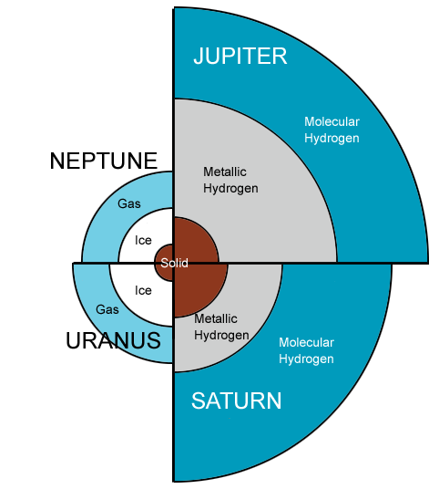
Comparison of Gas Giants
As the figure below shows, Jupiter and Saturn are far larger than Uranus and Neptune. The interiors of Jupiter and Saturn are similar, with a thick layer of molecular hydrogen, then a layer of metallic hydrogen at the depth where the pressure is sufficient $(> 4 million atm)$. The solid inner core is rock in the case of Jupiter, but is thought to be a mixture of ice and rock in the case of Saturn. The overall composition of Saturn is nearly the same as Jupiter, and hence the same as the Sun, but the lower pressure of Saturn means that the bulk density is actually less than that of water, at only $680 kg/m3$. Uranus and Neptune have bulk densities of $1240 kg/m3 and 1600 kg/m3$, respectively. It is interesting that the density falls at Saturn and then rises again as we go out from the Sun. This probably reflects a lower amount of hydrogen in the outermost planets, which instead are made up more of heavier ices. What scenario might cause this?

Slide 11
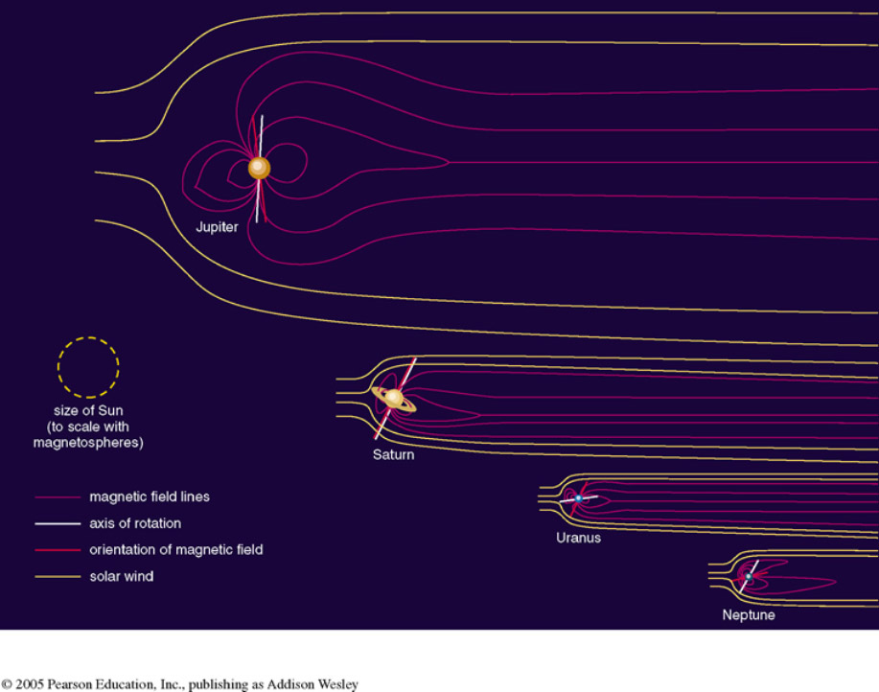
Comparison of Gas Giant Magnetospheres
We talked in some detail about Jupiter’s magnetosphere. The other gas giants also have magnetospheres, but much more modest in size. Each of them extends about 20 times the planet radius, in the direction toward the Sun.
It is possible to derive a general expression for the size of a magnetosphere from pressure balance of the solar wind on the magnetic pressure of the magnetic field. The expression gives the size of the magneto-sphere for a planet of size $Rp$, a distance $rp$ from the Sun, in terms of the planet’s surface field strength $Bs$, and the Earth’s surface magnetic field $B_{⨁}=4×{10}^{−5} T$:
$$R_{m}=10{\left(r_{p}B_{s}/B_{⨁}\right)}^{1/3}R_{p}$$
The surface field strengths for Jupiter and Saturn are $B_{s,Jup}\sim B_{⨁}$, and $B_{s,Sat}\sim {\frac{1}{2}B}_{⨁}$, respectively.
$$R_{m_{J}}≈17R_{J}$$
$$R_{m_{S}}≈16.7R_{S}$$
$$R_{m_{U}}≈21R_{U}$$
$$R_{m_{N}}≈24R_{N}$$

Slide 12
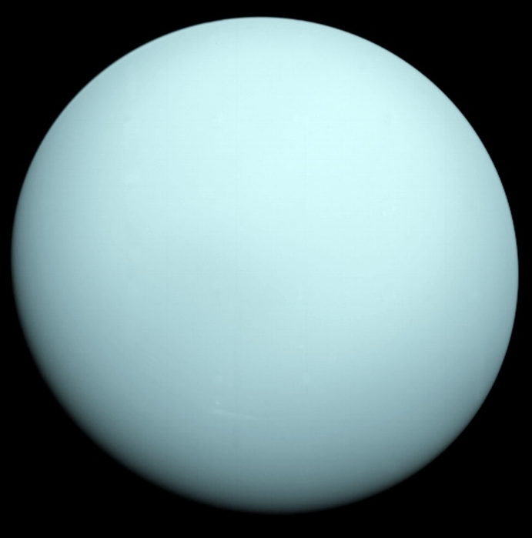
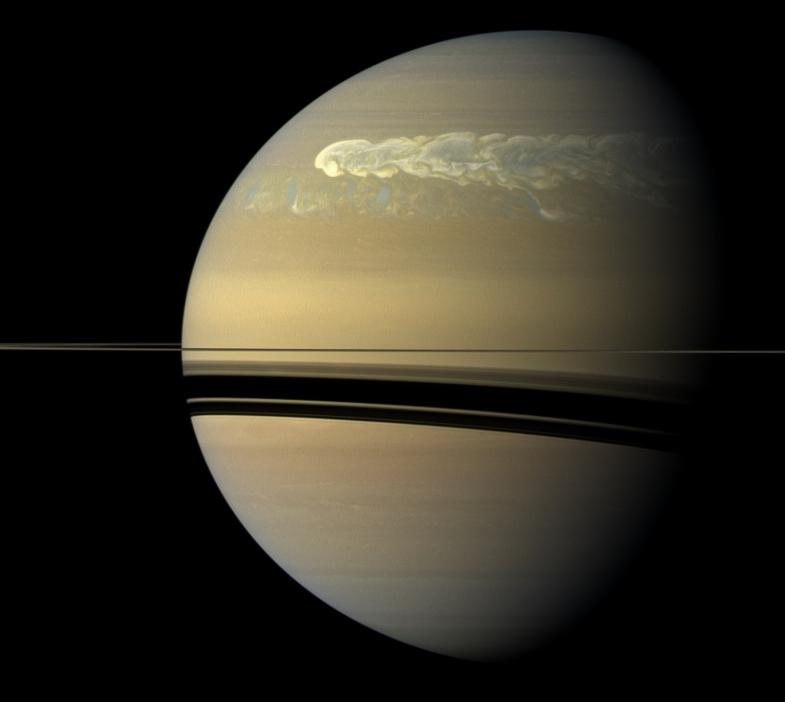
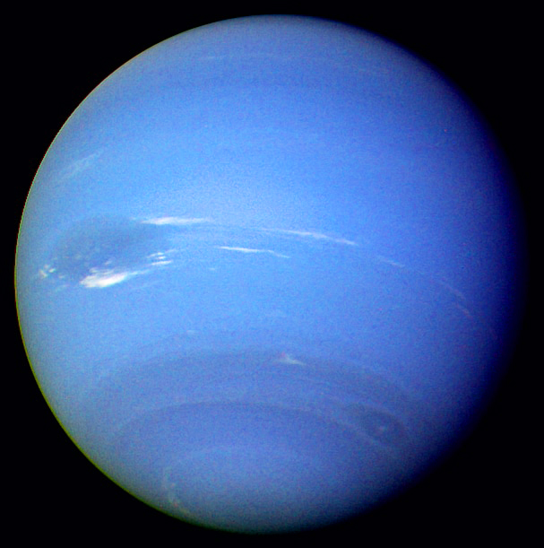
Outer-Planet Missions
Several flybys of Saturn occurred starting with Pioneer 11 in 1979, and the two Voyager flybys in 1980 and 1981. Only in 2004 did the first and only orbiter arrive at Saturn, the Cassini-Huygens spacecraft. We will discuss the planets rings and moons in some detail in a later lecture.
The only spacecraft to ever visit Uranus and Neptune was the Voyager 2 probe. Voyager 2 was launched on August 20, 1977, reached Uranus on January 24, 1986, and continued on to Neptune, flying past on August 25, 1989. We will also discuss more about the rings and moons of Uranus and Neptune later.
A temporary storm on Saturn

Slide 13
What We’ve Learned
You should be familiar with the idea that Jupiter’s internal heat is greater than can be accounted for from the Sun, and it may still be shrinking slowly, releasing additional heat from gravitational contraction.
You should know that the different gas giants have magnetospheres, and that their sizes are governed by the gas pressure from the solar wind ($P=nkT$) balancing the magnetic pressure ($PB=B2/2μ_{0}$) of the magnetosphere. The size of the magnetosphere $Rm$ can be estimated from this expression:
You should know the basic internal structure of the gas giants, particularly about the liquid metallic hydrogen that becomes highly conducting at a pressure of $4 million atm$. Both Jupiter and Saturn are massive enough to form metallic hydrogen.
You should be familiar with the fact that only one flyby probe has visited Uranus and Neptune, while both Jupiter and Saturn have had orbiters as well as flybys.
You should know that all four of the gas giants have ring systems, although only Saturn’s is easily visible from Earth. The others were discovered due to occultations of stars that passed behind them.
$$R_{m}=10{\left(r_{p}B_{s}/B_{⨁}\right)}^{1/3}R_{p}$$

