Slide 1
Liquid Crystals
Paul Dupiano
Mandeep Singh

Slide 2
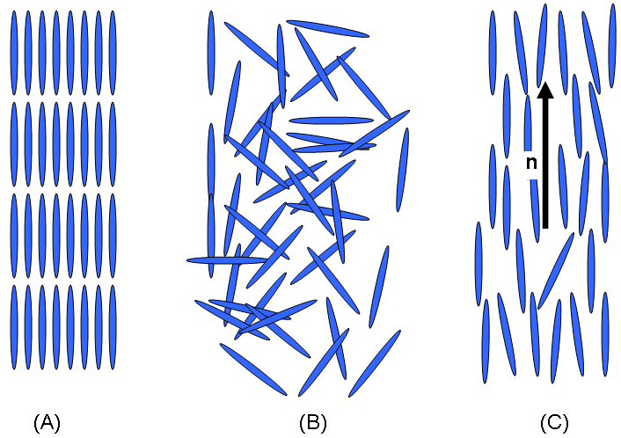
Liquid or Solid?
Liquid crystals are non-classical states of matter, which is somewhere between a liquid and a solid.
Flows like a liquid, but has orientational preference, depicted by n vector below

Slide 3
Types
Liquid crystals can be categorized and characterized by the type of ordering of the molecules.
The orderings are – Nematic, Smectic, Chiral, Blue, Discotic.
The above are phases of Thermotropic LCs only.
Thermotropic phases are temperature sensitive.

Slide 4
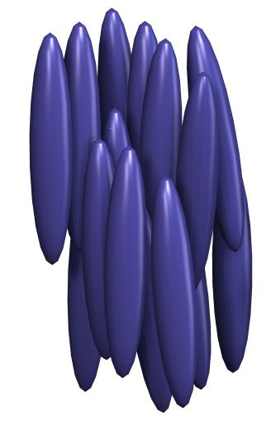
Nametic Phase
Nametic LCs are uniaxial i.e. have 1 perfered orientation.
The molecules, however, are scattered at random throughout the liquid solvent (mostly water).
This is because of the polarity of the molecule, which is possibly due to the carbon and nitrogen bond.

Slide 5
5CB/C₁₈H₁₉N
Thermotropic LC
Nematic between 18°C and 35°C
Due to relatively small size London dispersion forces are relatively low, but the compound is highly polar.
The polarity is the main cause for viscosity.
The 5CB LC has an anti-parallel local structure.

Slide 6
Anisotropic Properties
Properties are direction dependent
Sanding with and against the grain of wood

Slide 7
Liquid Crystals and Light Waves
Detected Phase Shift
Caused by Birefringence

Slide 8
Cross Polarizers
Unpolarized Light
Polarized Light in Z direction
Electric Field Perpendicular to 2nd Polarizer
No Light Passes Through

Slide 9
Cross Polarizers + Liquid Crystal
Phase shift Occurs
Electric field no longer perpendicular to Polarizer
Light Passes through
Same Principle in LCD

Slide 10
Defects
Bright Areas as expected
What do the dark areas represent?
No phase shift in light
Different phase shift from bulk
Phase shift Orientational Order

Slide 11
Defects Schematically
Central Defect affects other particles
Induced Dipoles
Based on Orientation
Orientational disorder greatest towards central point
Pinwheel Like appearance

Slide 12
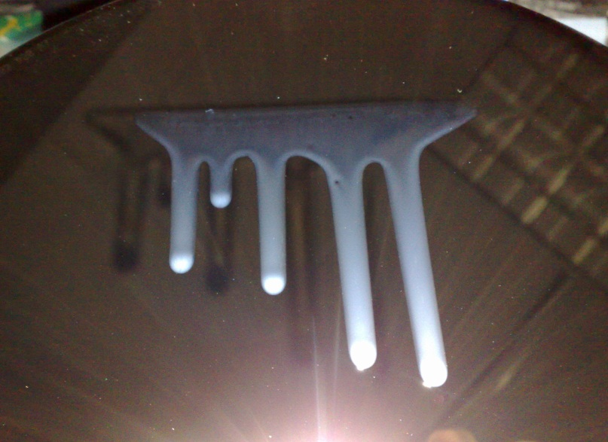
How to Model Liquid Crystals
Maeir-Saupe Theory
Focus on single particle
Generalize
As a Fluid
Non-Newtonian Fluid
Additional Properties
Accounts for Orientation

Slide 13
Experimental Study
Detecting Defects in Nematic Phase
Correlate Defects with forces affecting disorder
Observing the formation of instabilities
Correlate instabilities with model predictions
Promote the validity of new liquid crystal model

Slide 14
Liquid Crystals
- Experiments on Horizontal Surface

Slide 15
Defects in Liquid Crystals
Nematic order breaks the rotational symmetry during the isotropic phase
Singularities due to some odd boundary conditions or external field which do not permit uniform orientation

Slide 16
Point Defects
Scale: 4.2 mm
Notes:
Points defects are defects in which the directional orientation of the molecules cannot be determine. This defect is

Slide 17
Experiments on Horizontal Surface
Surfaces
Glass Slide
Silicon Wafer
Observed defects under the polarizing microscope
Rotated the polarizer to see the rotational disorder in the liquid crystal
Observed instabilities and instable spreading at comparatively lower relative humidity
Took pictures using high speed camera
Room Humidifier – after the failure of humidity stage
Room Heater
Humidity and temperature sensor
Notes:
main goal was to observe the defects and the instabilities in Nematic Liquid Crystals at varying temperature and relative humidity.

Slide 18
Experiments (Continue)
Different experiments to increase relative humidity
Slide covered with glass lid which was kept over the humidifier
Covered the whole microscope with plastic and kept humidifier on floor
Tried to humidify the whole room
Alcohol cotton on the edges of the slide

Slide 19
Instabilities
Different stages in Liquid Crystals at various temperatures and increasing humidity
Fingerings
Usually occur at higher temperature and humidity and start to develop at the boundary line
Temperature: between 24 and 28 degree Celsius
Relevant Humidity: between 60% and 80%
Instable spreading
Temperature: between 24 and 28 degree Celsius
Relevant Humidity: greater than 80%

Slide 20
Results – Silicon Surface
Silicon Wafer
Not any exciting behavior – opposite to what described in Poulard & Cazabat’s paper
No spreading but instabilities at 40% RH and 25 degrees
Scale: 4.5 mm
Instabilities on Silicon surface

Slide 21
Results – Horizontal Surface
Glass Slide
Stable spreading at 40% RH and 25˚C
Scale: 4.2 mm
Time = T2
Scale: 4.2 mm,
Time = T1
T2 > T1

Slide 22
Results – Horizontal Surface
Instable fingerings at 45% RH and 26˚C – cotton with alcohol covered
Scale: 4.2 mm
Scale: 4.2 mm
Zoomed version

Slide 23
Results – Horizontal Surface
Instable spreading at 90% RH and 28˚C – glass lid covered on the glass slide
Scale: 4.2 mm
Scale: 4.2 mm
Notes:
Can’t compare the results accurately of because of the use of alcohol and glass lid

Slide 24
Liquid Crystals
Inclined Plane

Slide 25
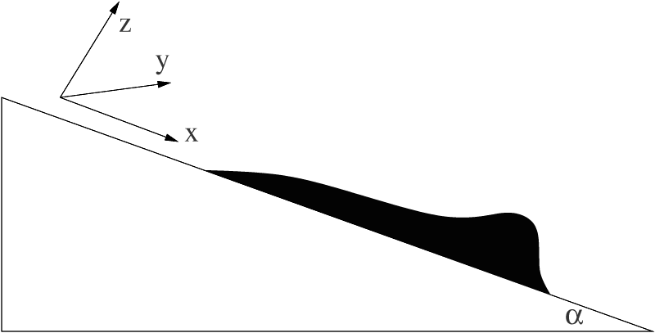
Spreading on inclined surface
Formation of instabilities
Accumulation of fluid on a strip
Formation of the droplets
Surface tension and gravity
Spreading down an incline surface.

Slide 26
Experiments on an Inclined Plane
Surfaces
Silicon Wafer
Liquid Crystals down an inclined plane
Depositing liquid crystals on surface
Different angles
Multiple fingers
Distance between the fingers and the distance travel
Observed behavior
Strange behavior of liquid crystals on an incline plane
Observed under the microscope after some time

Slide 27
Experiments (Continue)
Different methods applied
Micro-Syringe
Syringe and Glass Slide
Liquid crystals surrounded by alcohol cotton
Glass Slide passing against moving fluid
Glass slide, Silicon Wafer and Syringe
Single Glass Slide
Two Glass Slide
Pictures

Slide 28
Results - Inclined Plane
Silicon Wafer
Instabilities at a 45 degree angle
Notes:
Formation of droplets on nematic liquid crystals.

Slide 29
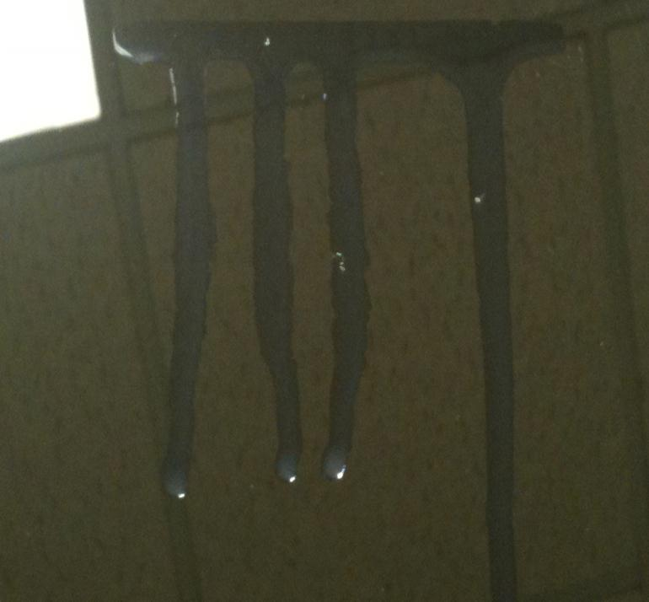
Results Inclined Plane
Strange behavior of Liquid Crystals down an inclined plane
Scale: 1.05mm
Notes:
This behavior could have occurred by some small perturbation on the system or by changes in the temperature or humidity.

Slide 30
Spreading down an incline
Spreading at 15º angle
Scale: 1.05mm
Notes:
Stable spreading down on an inclined plane.

Slide 31
Parameters of Equation and Estimations

Slide 32
Equation and Parameters
$\frac{∂h}{∂t}+\frac{∂}{∂x}\left[h^{3}\left(Ch_{xxx}−Bh_{x}\right)+Nh^{3}θ_{z}θ_{zx}+uh^{3}\right]=0$
C: surface tension
B: how fast the system wants to move
N: how we know it is liquid crystal
u: effects of gravity

Slide 33
Equations of Parameters
$C=\frac{δ^{3}γ}{μU}$
$B=\frac{δ^{3}ρgL^{2}}{μU}$
$L=\sqrt{\frac{γ}{ρg}}$
$N=\frac{2{(∆θ)}^{2}K}{ρgH^{3}}$
$U=\frac{δ^{3}ρgL^{2}}{μ}$

Slide 34
Reductions
Plugging L into U leaves:
$U=δ^{3}\frac{γ}{μ}$
Plugging U into C causes the following reduction:
$C=1$
Plugging U and L into B makes:
$B=1$
In the incline plane example, we use:
$B=u_{0}\cos{α}$ with $u_{0}=1$
instead because $α$ takes into consideration the angle of incline.

Slide 35
Numerical Values
Known Values
Surface Tension: $γ=3.5×{10}^{−2}\frac{kg}{s^{2}}$
Density: $ρ=1380\frac{kg}{m^{3}}$
Viscosity: $μ=4×{10}^{−2}\frac{kg}{m s}$
Gravity: $g=9.8\frac{m}{s^{2}}$

Slide 36
Scale Values
After substitutions:
$U=δ^{3}\frac{γ}{μ}=.875δ^{3}\frac{m}{s}$
$L=\sqrt{\frac{γ}{ρg}} m=0.0016m=1.6mm$
The value δ is a scale factor given by:
$H=δL$ where H is the height of the NLC and L is the capillary length above

Slide 37
Comparisons to Experiments
We take $δ=\frac{1}{10}$ , which is a good value based on our experimental data.
This yields:
$U=8.75×{10}^{−4}\frac{m}{s}=0.875\frac{mm}{s}$
Experimentally, we saw values of between:
$U=0.65\frac{mm}{s}$ and $U=11.5\frac{mm}{s}$
The difference in values come from the change in velocity as the liquid thins.

