Slide 1
Numerical Simulations
Motolani Olarinre
Ivana Seric
Mandeep Singh

Slide 2
Introduction
observe instabilities of fluid flowing down a vertical and down an inclined $\left(α=\frac{π}{4}\right)$plane
governing equation for film height is considered as follows:
$h_{t}+{\left[h^{3}\left(𝒞h_{xxx}−ℬh_{x}\right)+𝒩\left(m^{2}−hmm^{′}\right)h_{x}+𝓊h^{3}\right]}_{x}=0$

Slide 3
Method and BC’s
finite difference method
Crank–Nicolson method in time
second order discretization in space
Newton’s method
$h\left(0,t\right)=1, h_{x}\left(0, t\right)=0$
$h\left(L, t\right)=b, h_{x}(L, t)=0$

Slide 4
Numerical Results
Types of wave profiles:
Traveling wave solution
Convective instability
Absolute instability
Figure: Flow down the vertical plane (t=10). From top to bottom, N=16, 22, 27.

Slide 5
Stable traveling wave solution

Slide 6
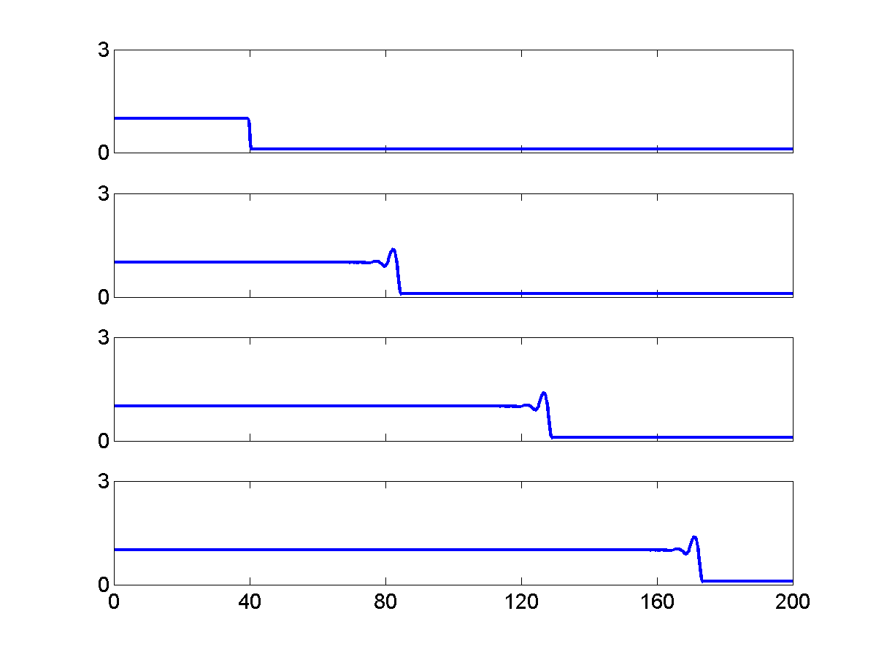
Stable traveling wave solution
$0<𝒩<18.6$.
dominant capillary ridge is present
constant front velocity
$U=(1+b+b^{2})𝓊$
Flow down the vertical plane (N=16). From top to bottom, t=0, 40, 80, 120.

Slide 7
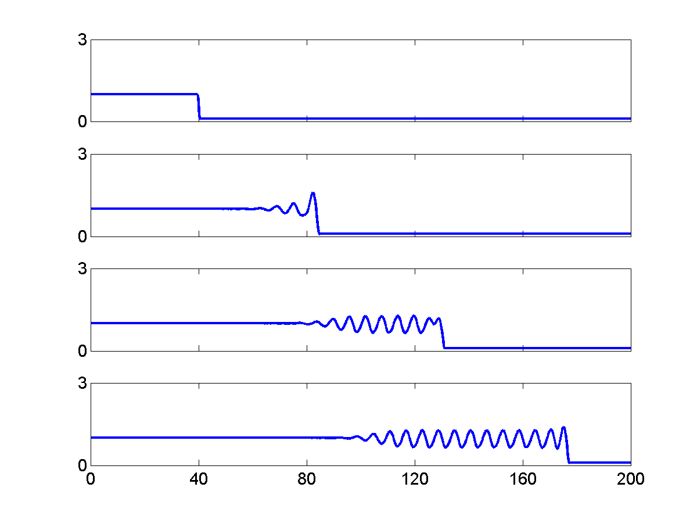
Convective instability
$18.6≤𝒩< 24.4$
Sinusoidal waves followed by a constant state
Waves are moving faster than the front
first wave reaches the front, it interacts and merges with it
Figure: N=22, flow down the vertical. From top to bottom, t=0, 40, 80, 120.

Slide 8
Convective instability

Slide 9
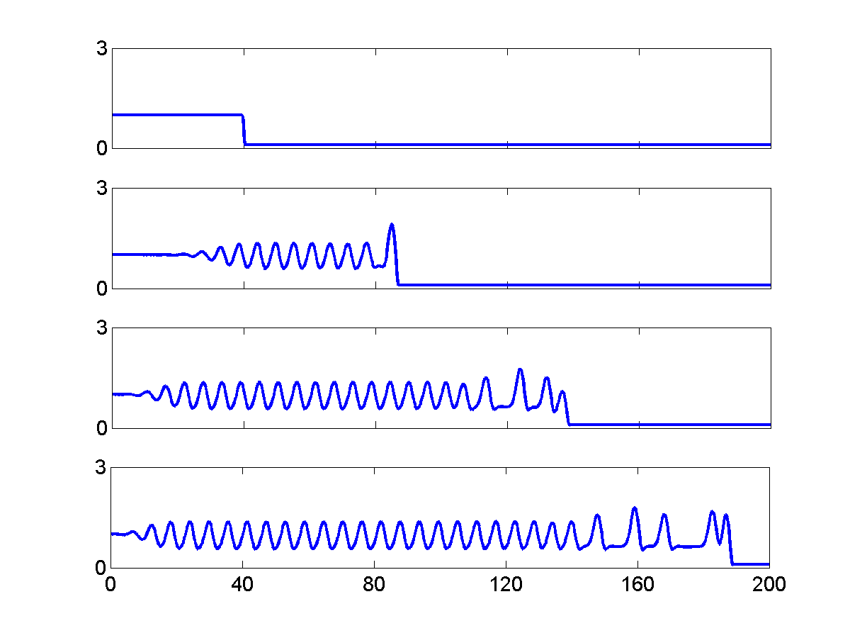
Absolute instability
$24.4≤𝒩$
Flat film disappears after sufficiently long time
Sinusoidal waves and solitary type waves
Figure: N=27, absolute instability. From top to bottom, t=0, 40, 80, 120.

Slide 10
Absolute instability

Slide 11
Critical values of $𝒩$ from LSA
Stable to convectively unstable${=𝒩}_{c1}$
Convective to absolute instability${=𝒩}_{c2}$
$$h_{t}+{\left[h^{3}\left(𝒞h_{xxx}−ℬh_{x}\right)+𝒩\left(m^{2}−hmm^{′}\right)h_{x}+𝓊h^{3}\right]}_{x}=0$$
$$ω_{r}=3𝓊k ω_{i}=−\left(𝒞k^{4}−\left(ℬ−𝒩\left(\frac{1−β^{\frac{3}{2}}}{{\left(β^{\frac{3}{2}}+1\right)}^{3}}\right)\right)k^{2}\right)$$
$${\left(\frac{x}{t}\right)}_{±}=3𝓊±1.62{\left(−ℬ+𝒩\left(\frac{1−β^{\frac{3}{2}}}{{\left(β^{\frac{3}{2}}+1\right)}^{3}}\right)\right)}^{\frac{3}{2}}$$

Slide 12
Speed of the left boundary
$${\left(\frac{x}{t}\right)}_{−}=3𝓊−1.62{\left(−ℬ+𝒩\left(\frac{1−β^{\frac{3}{2}}}{{\left(β^{\frac{3}{2}}+1\right)}^{3}}\right)\right)}^{\frac{3}{2}}$$
$$0<{\left(\frac{x}{t}\right)}_{−}<U=(1+b+b^{2})𝓊$$
 | $$α=\frac{π}{2}$$ |  | $$α=\frac{π}{4}$$
 | Num | LSA | Num | LSA
$$𝓝_{c1}$$ | 18.6 | 17.79 | 25.43 | 25.44
$$𝓝_{c2}$$ | 24.4 | 24.13 | 30.6 | 30.46

Slide 13
NUMERICS
In 2 dimensions, equation for the height of a liquid crystal reduces to:
$$h_{t}+C\frac{∂}{∂x}[h^{3}h_{xxx}]−B\frac{∂}{∂x}[h^{3}h_{x}]+N\frac{∂}{∂x}\left[\left(m^{2}−hmm^{′}\right)h_{x}\right]+U\frac{∂h^{3}}{∂x}=0$$
Discretization of the PDE is done by applying a centered finite difference based computational technique on the terms in the PDE
Methods used in 2D can be extended to 3D by repeating steps for additional space component

Slide 14
Finite Difference Discretization Procedure
Space discretization:
Surface tension term:
$$y_{i,t}={\left(a\left(y_{i−1},y_{i}\right)y_{\overline{x}x\overline{x},i}\right)}_{x}$$
Normal component of gravity term:
$${\left(\frac{∂}{∂x}h^{3}h_{x}\right)}_{i}≈\frac{1}{{∆x}^{2}}{\left(a\left(y_{i+1},y_{i}\right)y_{x,i}\right)}_{\overline{x}}$$
Parallel component of gravity term:
$${\left(\frac{∂h^{3}}{∂x}\right)}_{i}≈\frac{1}{2∆x}\left(y_{i+1}^{3}−y_{i−1}^{3}\right)$$

Slide 15
Finite Difference Discretization Procedure
Time discretization: Uses a $θ$ scheme. PDE is discretized as:
$\frac{y_{i}\left(t+Δt\right)−y_{i}(Δt)}{Δt}=θf_{i}\left(t\right)+\left(1−θ\right)f_{i}\left(t+Δt\right) , i=1,…….,N_{x}−1$
Specific $θ$ scheme used is that for which $θ=1/2$, the implicit second-order Crank- Nicholson scheme.
The Crank-Nicholson scheme produces a system of $N_{x}−1$ nonlinear algebraic equations, which can be linearized and solved by newton’s method.

Slide 16
Our Simulations
We ran simulations in FORTRAN using the following parameters:
C = 1, B = 0, N = 10, U = 1, b = 0.1, beta = 1.
These parameters indicate a liquid crystal flowing down a vertical surface (90 degree angle)
The output from our simulations were plotted and analyzed using MATLAB

Slide 17
Our Simulations
We ran simulations for two distinct cases:
Constant Flux: Uses a semi-infinite hyperbolic tangent profile for its initial condition. Simulates a case where an infinite volume of liquid is flowing.
Constant Volume: Uses a square hyperbolic tangent profile for its initial condition. Simulates a case where a drop is flowing.

Slide 18
Our Simulations
For each case, we sought to find out the wave length k with the maximum growth rate $σ$.
We ran simulations for k = 6, 8, 10, 12, 14, 16, 18 and 20.
We carried out growth rate analysis on the results of these simulations.
Lastly, we ran a simulation for a liquid crystal flowing down an incline using the following parameters: C = 1, B = $1/{\sqrt{2}}$, N = 30, U = $1/{\sqrt{2}}$, and the wave length k = 14

Slide 19
Growth Rate Analysis
Using linear stability analysis, we find that instability growth follows an exponential model $\left(A=A_{0}e^{σt}\right)$
All the simulations for this part (both constant volume and constant flux, for all different $λ$) were with parameters $c=1, N=10, u=1,$ and $B=0$.
Flow down a vertical surface.
All simulations were run until t = 10 and output files are created every 1 unit of time.

Slide 20
Growth Rate Analysis
The A values were calculated by subtracting the minimum of XZ profile at $\frac{y}{2}$ (where we expect the middle of the wave front to be) and the XZ profile at y = 0.

Slide 21
Growth Rate Analysis

Slide 22
Growth Rate Analysis
The growth rate, $σ$, was obtained using a linear fit for the model: $σt=\ln\left(\frac{A}{A_{0}}\right)$; $k=\frac{2π}{λ}$
Below are the computed growth rate values with 95% confidence.
$$λ=10$$
Linear model Poly1:
f(x) = p1*x + p2
Coefficients (with 95% confidence bounds):
p1 = 0.2078 (0.1544, 0.2611)
p2 = 2.435 (2.197, 2.674)
Goodness of fit:
SSE: 0.06028
R-square: 0.9525
$$λ=y_{max}$$ | $$k$$ | $σ$ (Constant Volume) | $σ$ (Constant Flux)
8 | 0.7854 | $$σ=0.129 \left(0.07001, 0.188\right)$$
10 | 0.6283 | $$σ=0.2078 (0.1544, 0.2611)$$ | $$σ=0.1593 (0.1152, 0.2033)$$
12 | 0.5236 | $$σ=0.1998 (0.141, 0.2585)$$ | $$σ=0.1593 (0.112, 0.2065)$$
14 | 0.4488 | $$σ=0.2386 (0.1728, 0.3043)$$ | $$σ=0.1477 (0.04715, 0.2482)$$
16 | 0.3927 | $$σ=0.206 (0.147, 0.2651)$$ | $$σ=0.1305 (0.03936, 0.2216)$$
18 | 0.3491 | $$σ=0.1752 (0.113, 0.2374)$$ | $$σ=0.07427 (−0.02718, 0.1757)$$
20 | 0.3142 | $$σ=0.1855 (0.1352, 0.2358)$$ | $$σ=0.07427 (−0.02718, 0.1757)$$

Slide 23
$σ vs. t$ for constant volume

Slide 24
$σ vs. t$ for constant flux

Slide 25
Growth Rate Analysis
The data obtained using the simulations did not exhibit exact behavior expected via LSA.
Similar analysis was done in the SIAM paper, where the author used only the data until t = 5.
Getting more output files from first few time units should give a better approximation for $σ$.
The comparison of the obtained data with experiment is not possible at the moment because no comparable data was obtained from the experiment.

