Slide 1
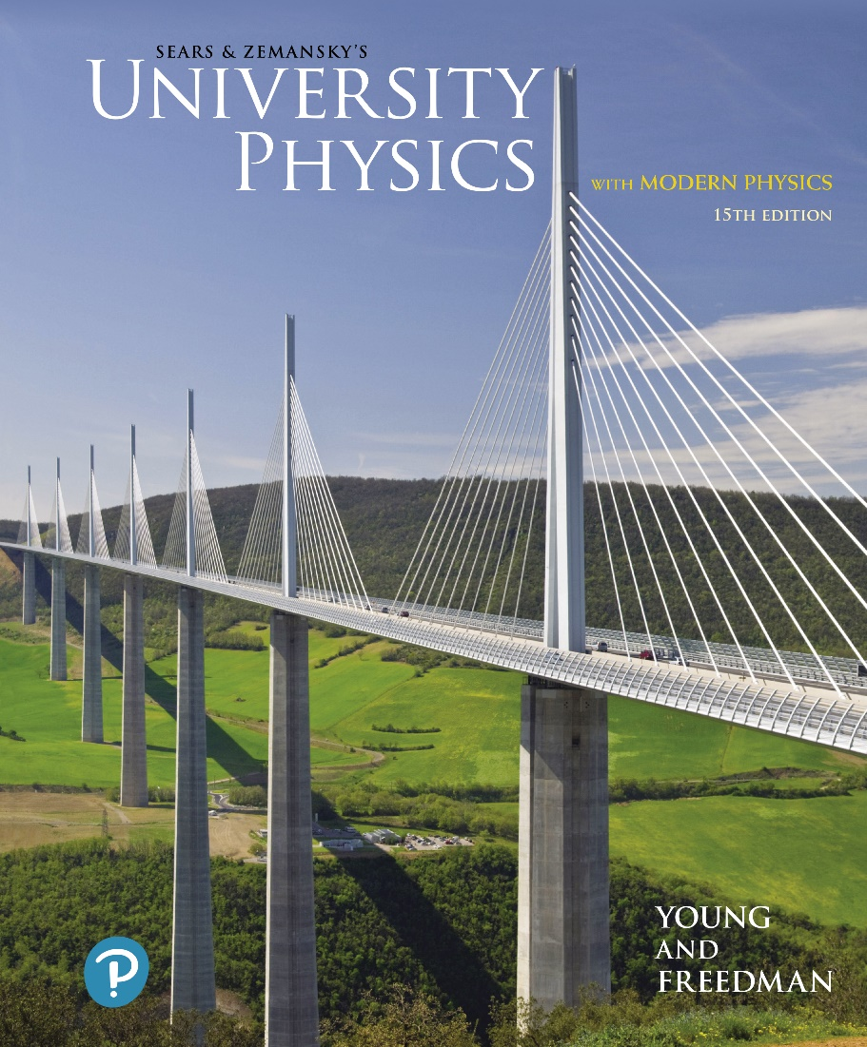
University Physics with Modern Physics
Fifteenth Edition
Chapter 1
Units, Physical Quantities, and Vectors
Copyright © 2020 Pearson Education, Inc. All Rights Reserved

Slide 2
Learning Outcomes
In this chapter, you’ll learn…
the four steps you can use to solve any physics problem.
three fundamental quantities of physics and the units physicists use to measure them.
how to work with units and significant figures in your calculations.
how to add and subtract vectors graphically, and using vector components.
two ways to multiply vectors: the scalar (dot) product and the vector (cross) product.

Slide 3
The Nature of Physics
Physics is an experimental science in which physicists seek patterns that relate the phenomena of nature.
The patterns are called physical theories.
A very well established or widely used theory is called a physical law or principle.

Slide 4
Solving Problems in Physics
All of the Problem-Solving Strategies and Examples in this book will follow these four steps:
Identify the relevant concepts, target variables, and known quantities, as stated or implied in the problem.
Set Up the problem: Choose the equations that you’ll use to solve the problem, and draw a sketch of the situation.
Execute the solution: This is where you “do the math.”
Evaluate your answer: Compare your answer with your estimates, and reconsider things if there’s a discrepancy.

Slide 5
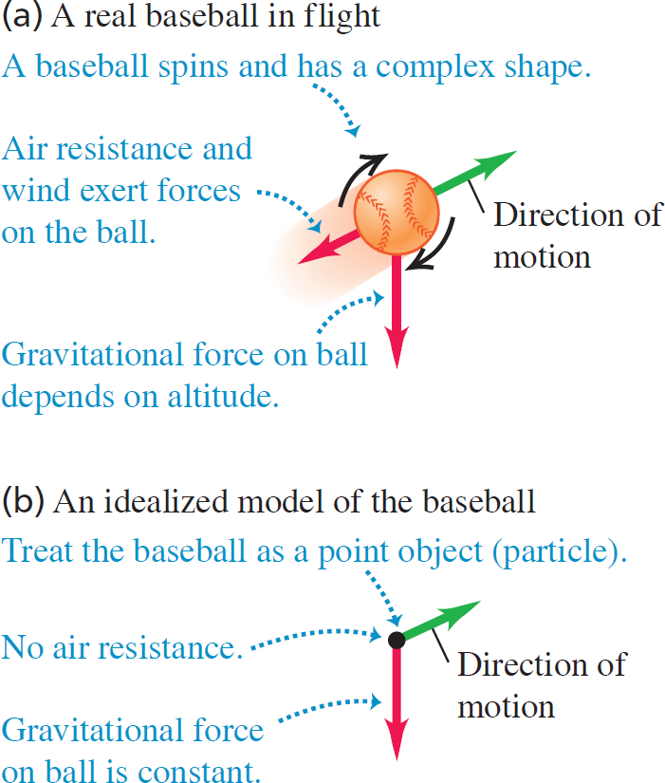
Idealized Models
To simplify the analysis of
a baseball in flight, we use
an idealized model.

Slide 6
Standards and Units
Length, time, and mass are three fundamental quantities of physics.
The International System (SI for Système International) is the most widely used system of units.
In SI units, length is measured in meters, time in seconds, and mass in kilograms.

Slide 7
Unit Prefixes
Prefixes can be used to create larger and smaller units for the fundamental quantities. Some examples are:
(size of some bacteria and living cells)
(a 10-minute walk)
(mass of a grain of salt)
(mass of a paper clip)
(time for light to travel 0.3 m)

Slide 8
Unit Consistency and Conversions
An equation must be dimensionally consistent. Terms to be added or equated must always have the same units. (Be sure you’re adding “apples to apples.”)
Always carry units through calculations.
Convert to standard units as necessary, by forming a ratio of the same physical quantity in two different units, and using it as a multiplier.
For example, to find the number of seconds in 3 min, we write:

Slide 9
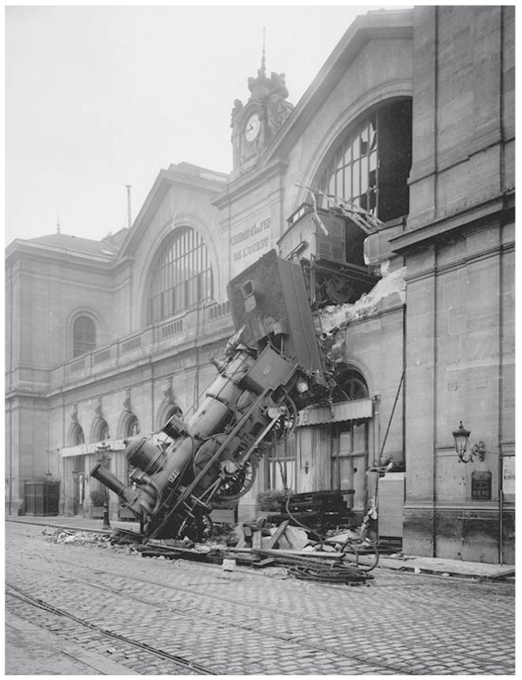
Uncertainty and Significant Figures
The uncertainty of a measured quantity is indicated by its number of significant figures.
For multiplication and division, the answer can have no more significant figures than the smallest number of significant figures in the factors.
For addition and subtraction, the number of significant figures is determined by the term having the fewest digits to the right of the decimal point.
As this train mishap illustrates, even a small percent error can have spectacular results!
Video Tutor Solution: Example 1.3

Slide 10
Vectors and Scalars
A scalar quantity can be described by a single number.
A vector quantity has both a magnitude and a direction in space.
In this book, a vector quantity is represented in boldface italic type with an arrow over it:
The magnitude of
is written as A or

Slide 11
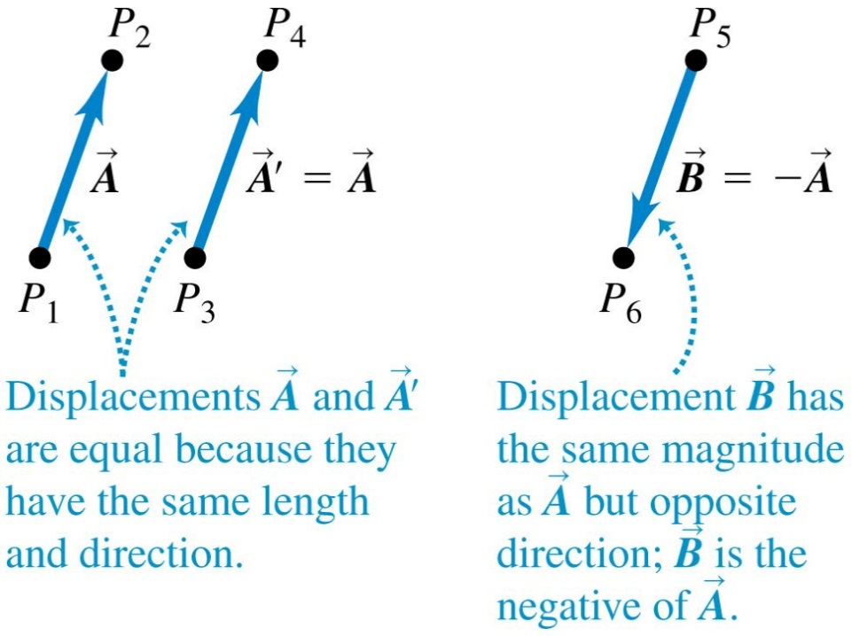
Drawing Vectors
Draw a vector as a line with an arrowhead at its tip.
The length of the line shows the vector’s magnitude.
The direction of the line shows the vector’s direction.

Slide 12
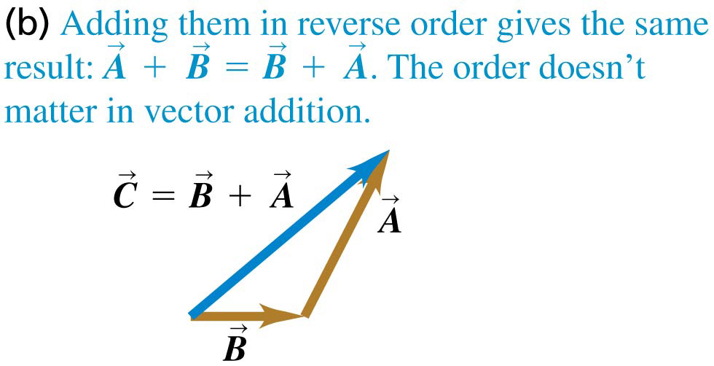
Adding Two Vectors Graphically (1 of 3)

Slide 13
Adding Two Vectors Graphically (2 of 3)

Slide 14
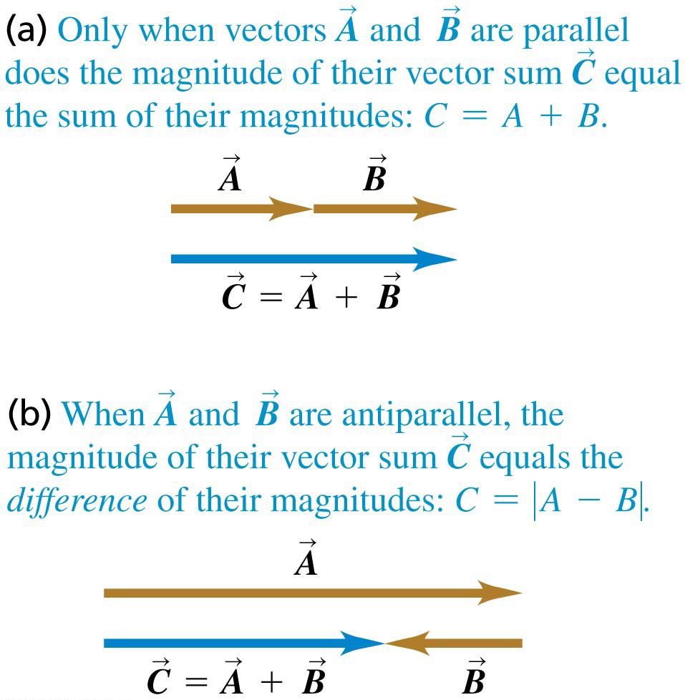
Adding Two Vectors Graphically (3 of 3)

Slide 15
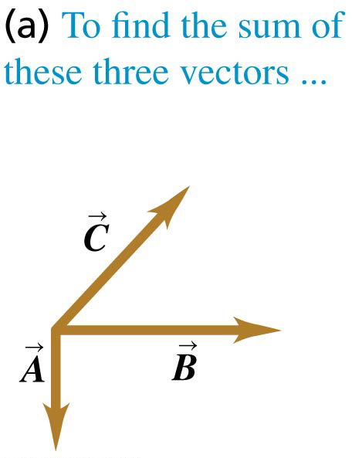
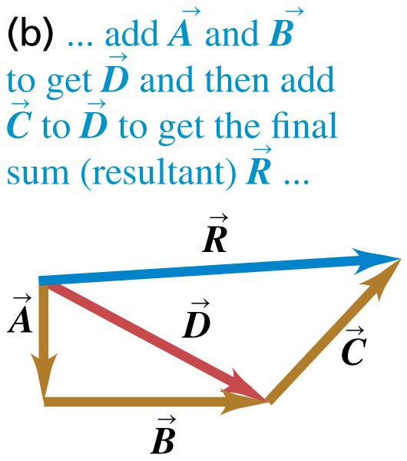
Adding More Than Two Vectors Graphically (1 of 3)
To add several vectors, use the head-to-tail method.
The vectors can be added in any order.

Slide 16
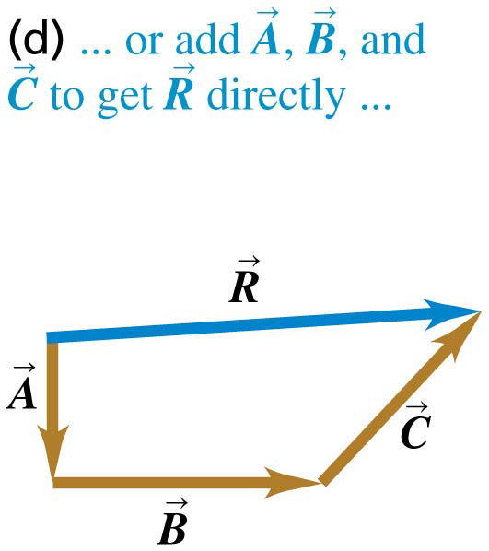
Adding More Than Two Vectors Graphically (2 of 3)
To add several vectors, use the head-to-tail method.
The vectors can be added in any order.

Slide 17
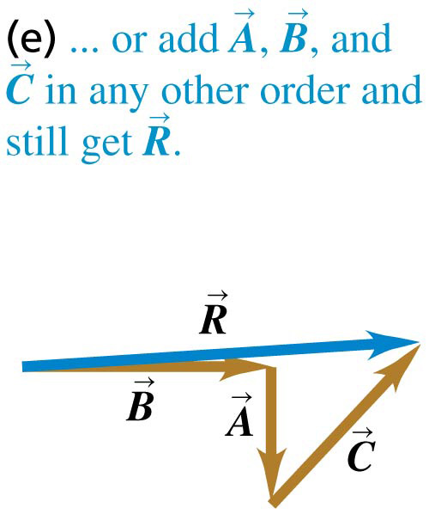
Adding More Than Two Vectors Graphically (3 of 3)
To add several vectors, use the head-to-tail method.
The vectors can be added in any order.

Slide 18
Subtracting Vectors

Slide 19
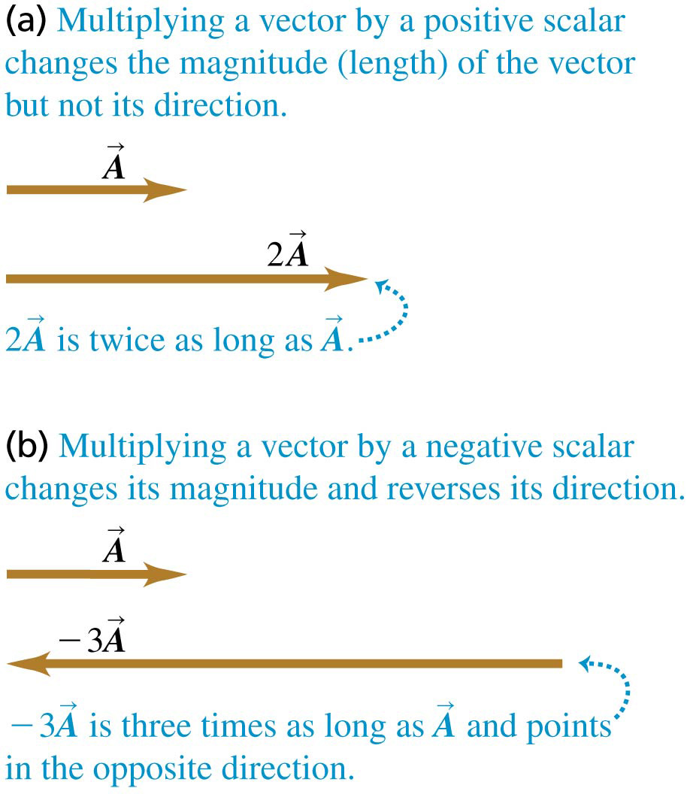
Multiplying a Vector by a Scalar
If c is a scalar, the product
has magnitude
The figure illustrates multiplication of a vector by
a positive scalar and
a negative scalar.

Slide 20
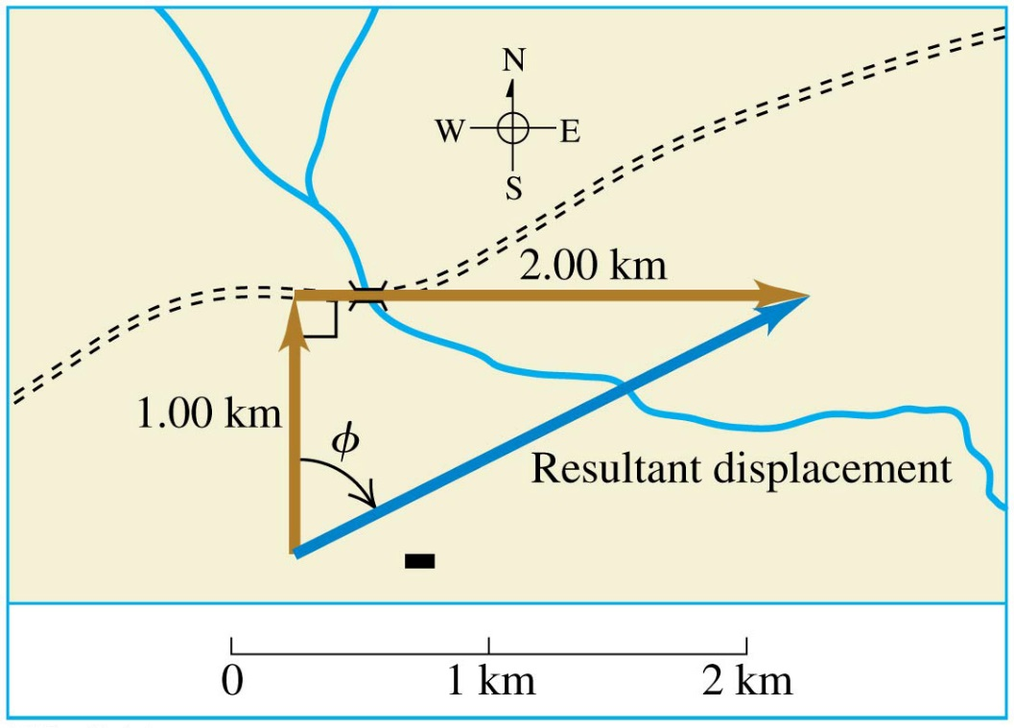
Addition of Two Vectors at Right Angles
To add two vectors that are at right angles, first add the vectors graphically.
Then use trigonometry to find the magnitude and direction of the sum.
In the figure, a cross-country skier ends up 2.24 km from her starting point, in a direction of 63.4 degrees east of north.

Slide 21
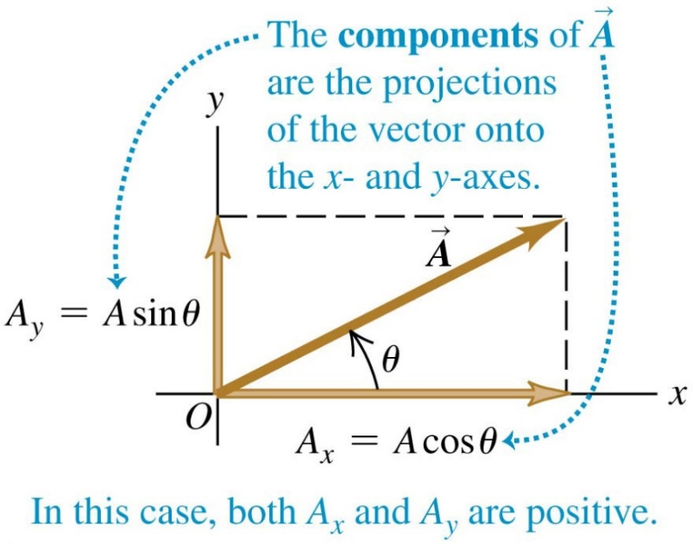
Components of a Vector
Adding vectors graphically provides limited accuracy. Vector components provide a general method for adding vectors.
Any vector can be represented by an x-component A_{x} and a y-component A_{y}.

Slide 22
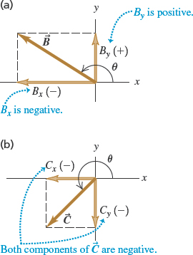
Positive and Negative Components
The components of a vector may be positive or negative numbers, as shown in the figures.

Slide 23
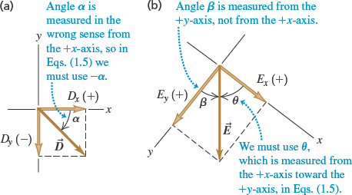
Finding Components
We can calculate the components of a vector from its magnitude and direction.
Video Tutor Solution: Example 1.6

Slide 24
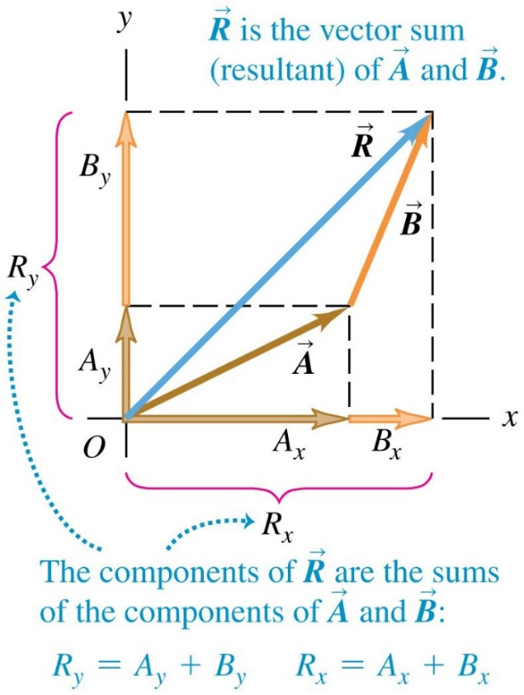
Calculations Using Components
We can use the components of a vector to find its magnitude and direction:
We can use the components of a set of vectors to find the components of their sum:
Refer to Problem-Solving Strategy 1.3.

Slide 25
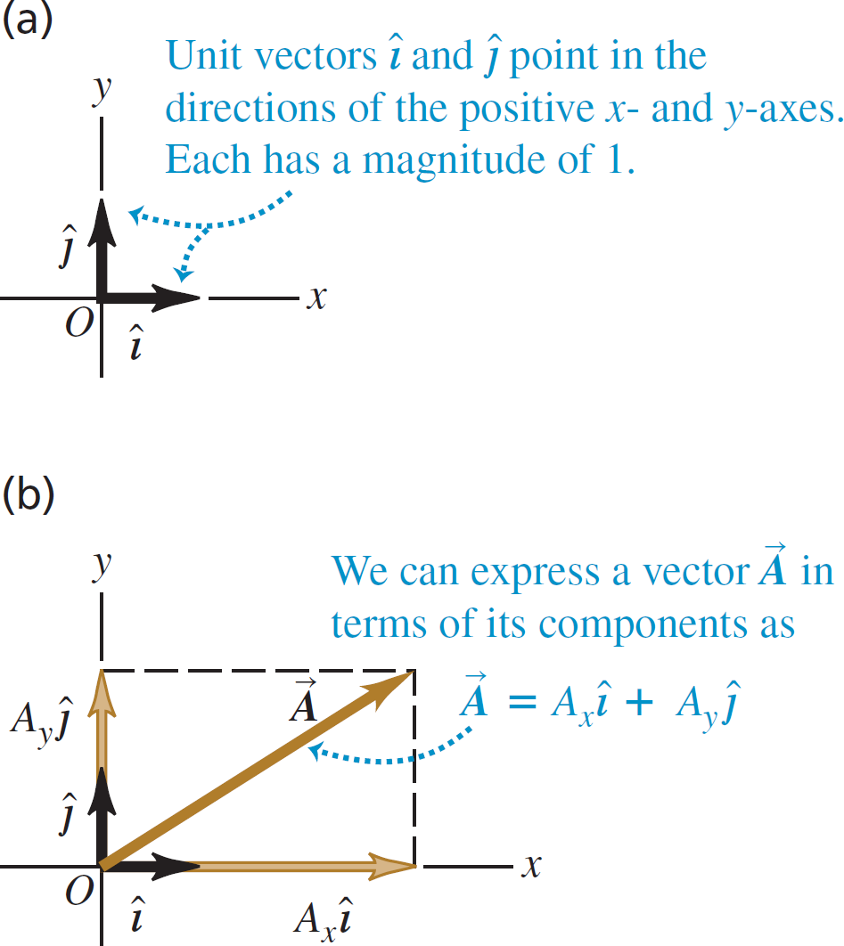
Unit Vectors
A unit vector has a magnitude of 1 with no units.
The unit vector
points in the +x-direction,
points in the +y-direction, and
points in the +z-direction.
Any vector can be expressed in terms of its components as

Slide 26
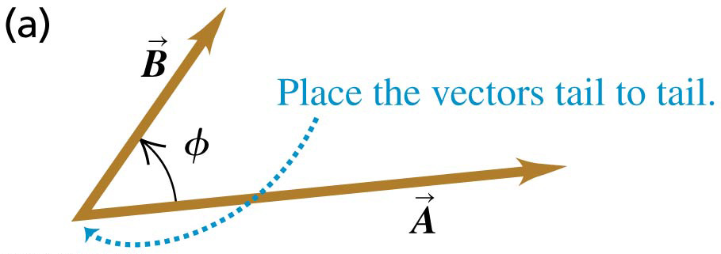
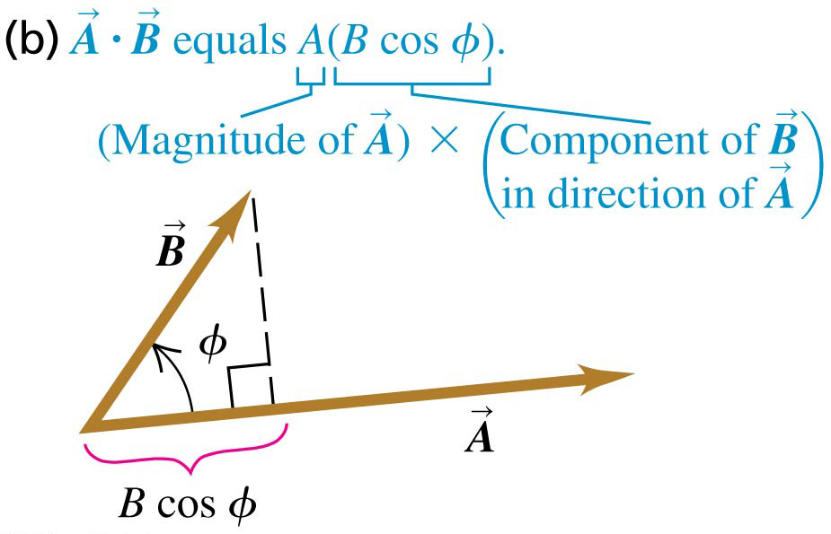
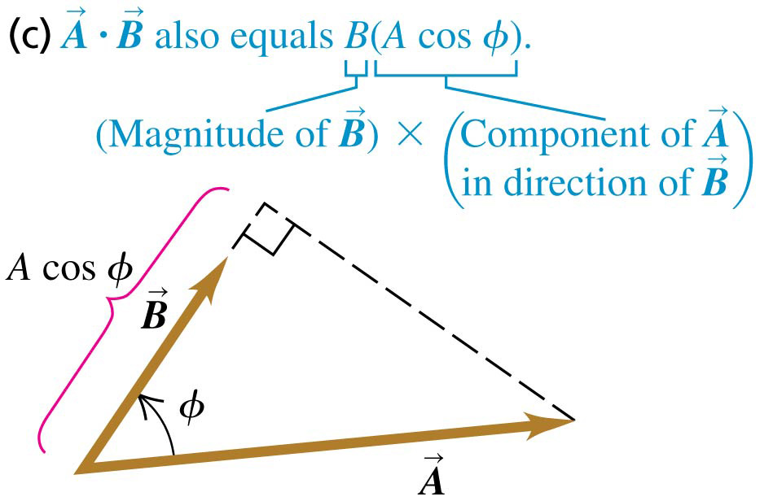
The Scalar Product (1 of 2)

Slide 27
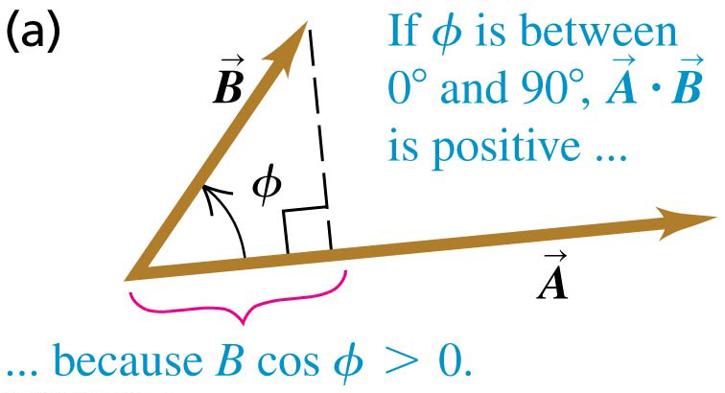
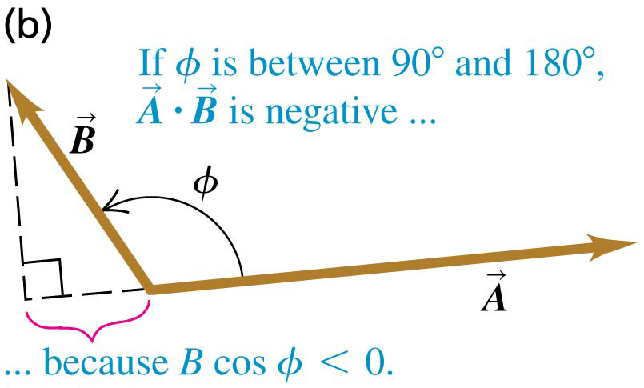
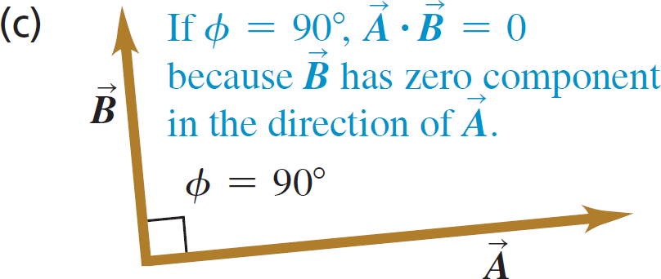
The Scalar Product (2 of 2)
The scalar product can be positive, negative, or zero, depending on the angle between

Slide 28
Calculating a Scalar Product Using Components
In terms of components:
The scalar product of two vectors is the sum of the products of their respective components.

Slide 29
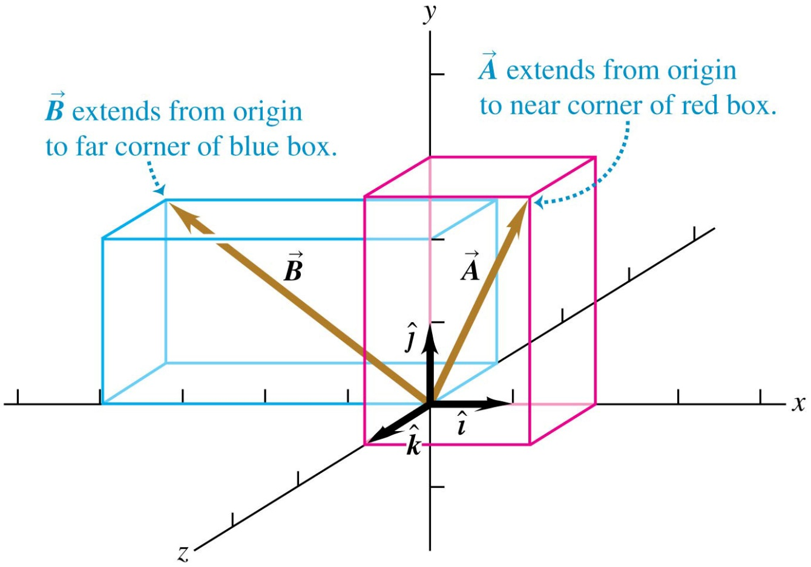
Finding an Angle Using the Scalar Product
Example 1.10 shows how to use components to find the angle between two vectors.

Slide 30
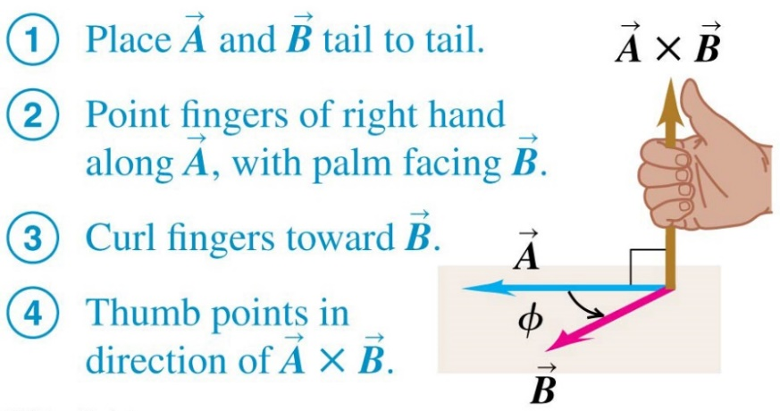
The Vector Product
If the vector product (“cross product”) of two vectors is
The direction of the vector product can be found using the right-hand rule:

Slide 31
The Vector Product is Anticommutative

Slide 32
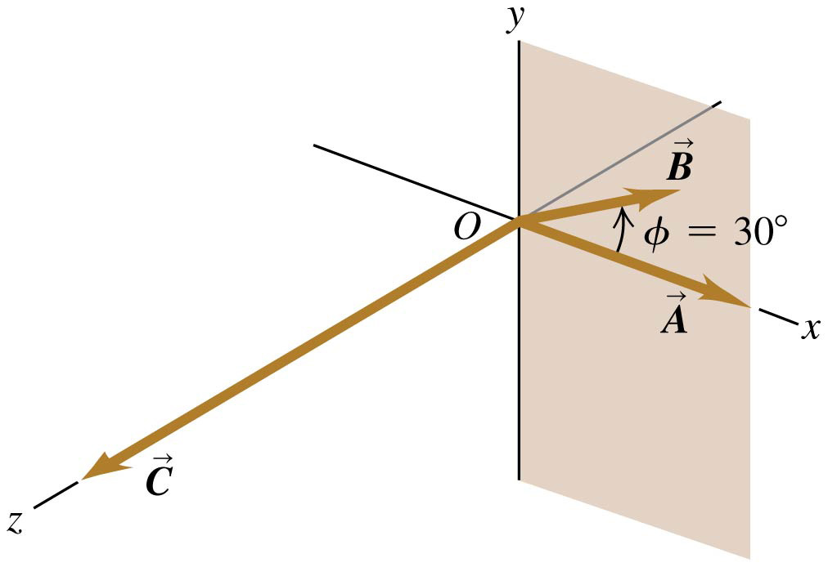
Calculating the Vector Product
Use
to find the magnitude and the right-hand
rule to find the direction.
Refer to Example 1.11.
Video Tutor Solution: Example 1.11

