Slide 1
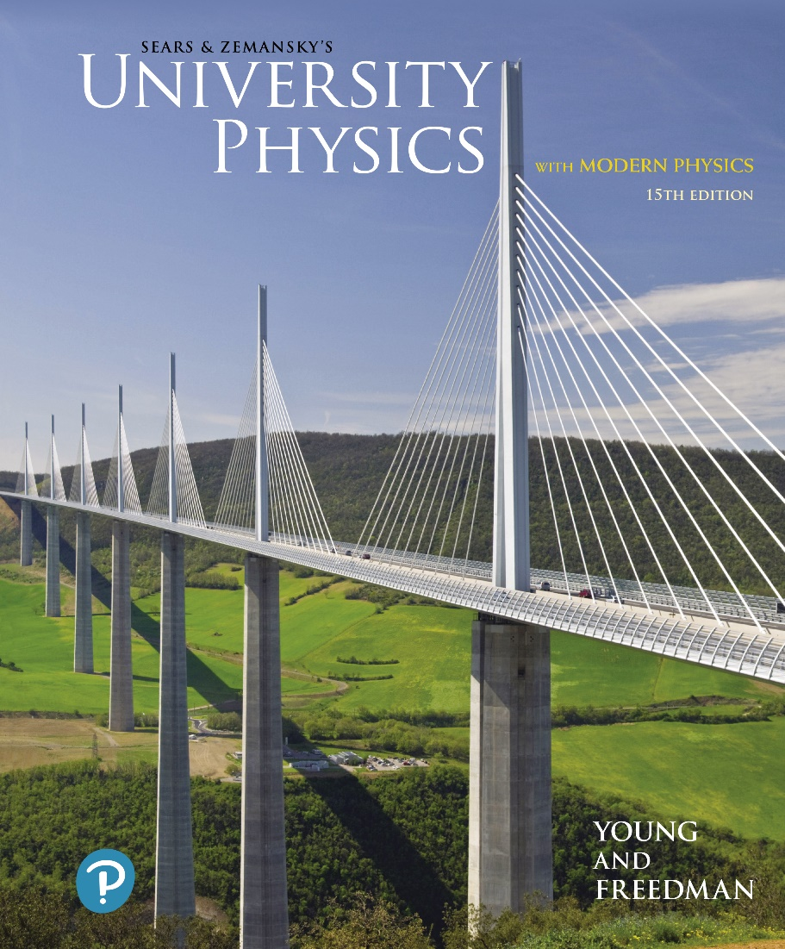
University Physics with Modern Physics
Fifteenth Edition
Chapter 13
Gravitation
Copyright © 2020 Pearson Education, Inc. All Rights Reserved

Slide 2
Learning Outcomes
In this chapter, you’ll learn…
how to calculate the gravitational forces that any two objects exert on each other.
how to relate the weight of an object to the general expression for gravitational force.
how to calculate the speed, orbital period, and mechanical energy of a satellite in a circular orbit.
how to apply and interpret Kepler’s three laws that describe the motion of planets.
what black holes are, how to calculate their properties, and how astronomers discover them.

Slide 3
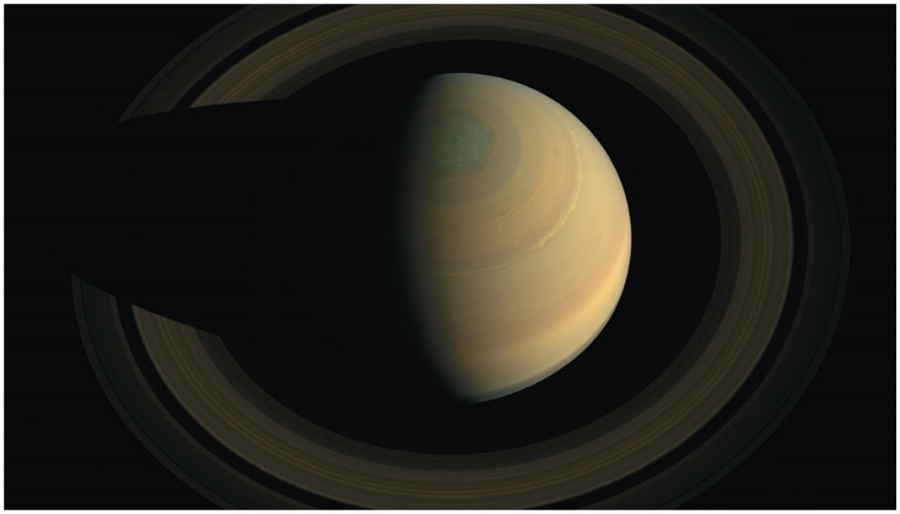
Introduction
What can we say about the motion of the particles that make up Saturn’s rings?
Why doesn’t the moon fall to earth, or the earth into the sun?
By studying gravitation and celestial mechanics, we will be able to answer these and other questions.

Slide 4
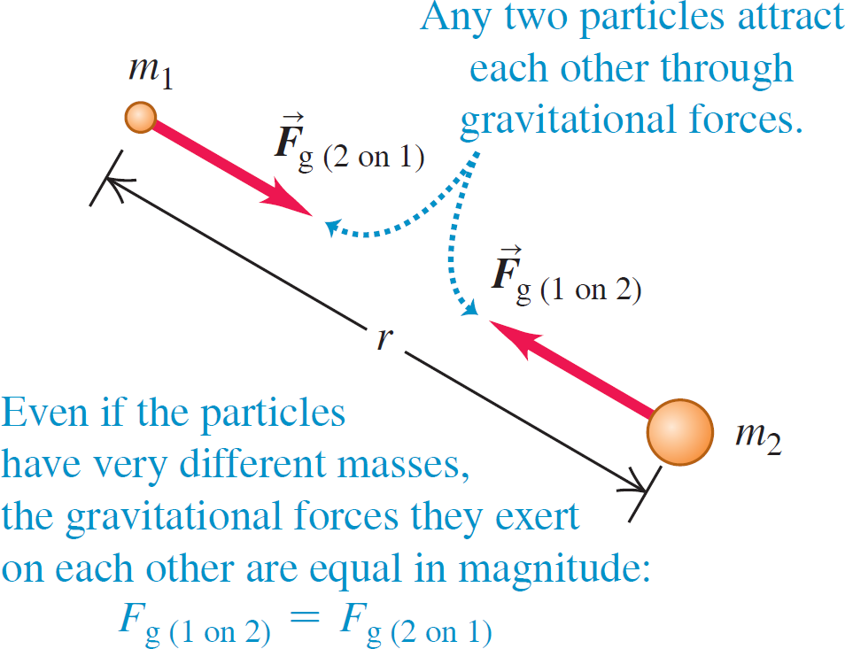
Newton's Law of Gravitation (1 of 2)

Slide 5
Newton's Law of Gravitation (2 of 2)
Law of gravitation: Every particle of matter attracts every other particle with a force that is directly proportional to the product of their masses and inversely proportional to the square of the distance between them:
The gravitational constant G is a fundamental physical constant that has the same value for any two particles.
Video Tutor Solution: Example 13.1

Slide 6
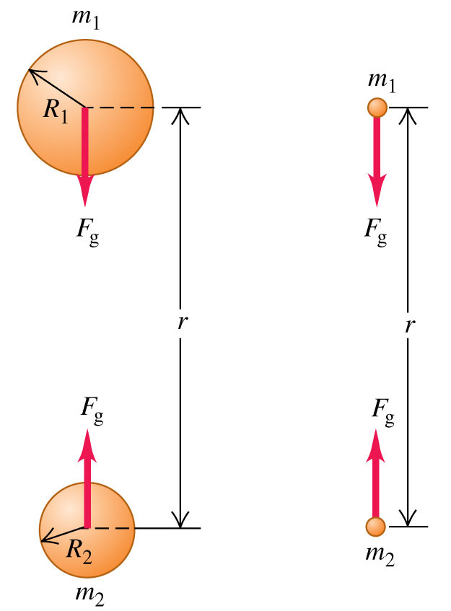
Gravitation and Spherically Symmetric Objects
The gravitational effect outside any spherically symmetric mass distribution is the same as though all of the mass were concentrated at its center.
The force F_{g} attracting m₁ and m₂ on the left is equal to the force F_{g} attracting the two point particles m₁ and m₂ on the right, which have the same masses and whose centers are separated by the same distance.

Slide 7
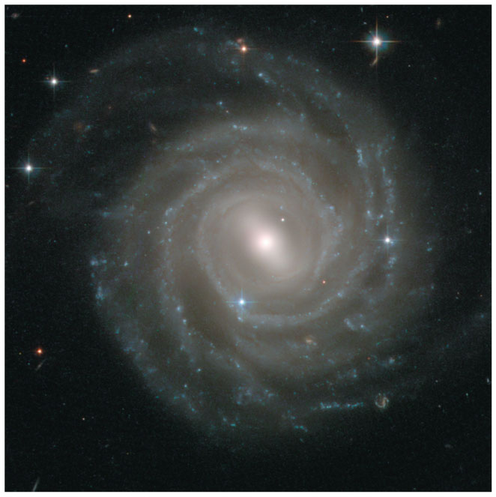
Gravitational Attraction
Our solar system is part of a spiral galaxy like this one, which contains roughly
stars as well as gas, dust, and other matter.
The entire assemblage is held together by the mutual gravitational attraction of all the matter in the galaxy.

Slide 8
Weight
The weight of an object is the total gravitational force exerted on it by all other objects in the universe.
At the surface of the earth, we can neglect all other gravitational forces, so an object’s weight is:
The acceleration due to gravity at the earth’s surface is:

Slide 9
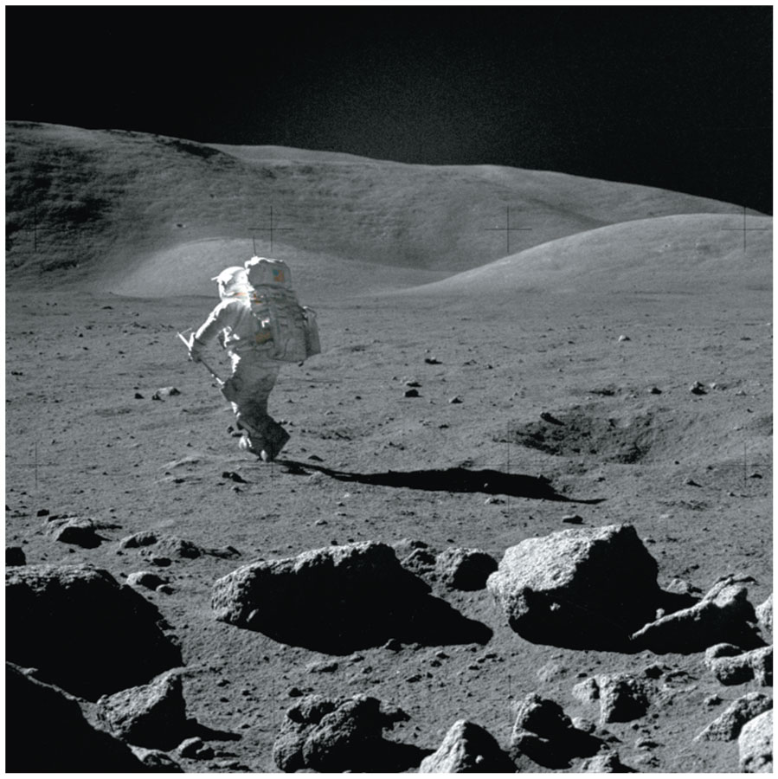
Walking and Running on the Moon
You automatically transition from a walk to a run when the vertical force the ground exerts on you exceeds your weight.
This transition from walking to running happens at much lower speeds on the moon, where objects weigh only 17% as much as on earth.
Hence, the Apollo astronauts found themselves running even when moving relatively slowly during their moon “walks.”

Slide 10
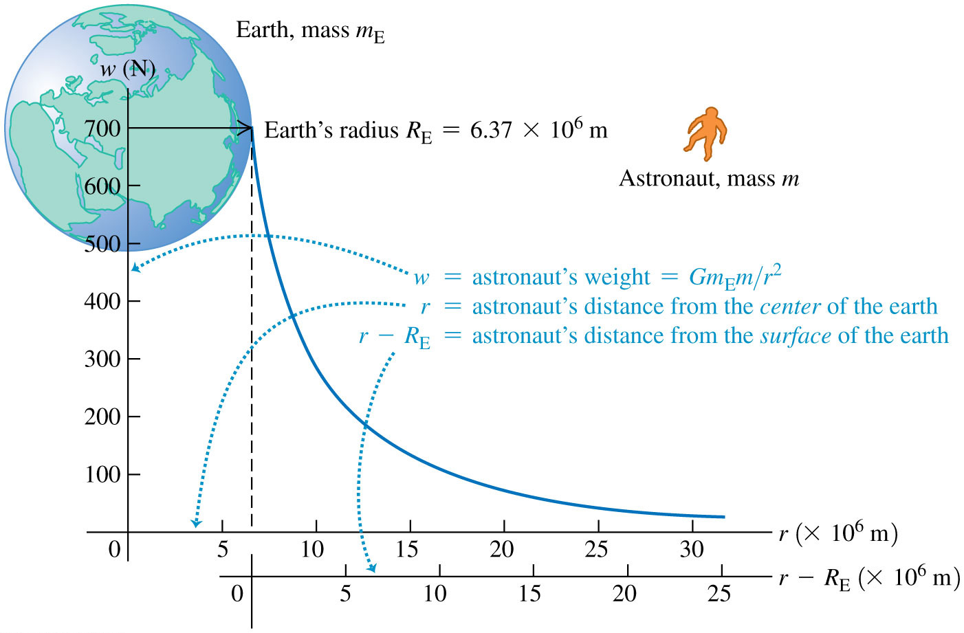
Weight Decreases with Altitude

Slide 11
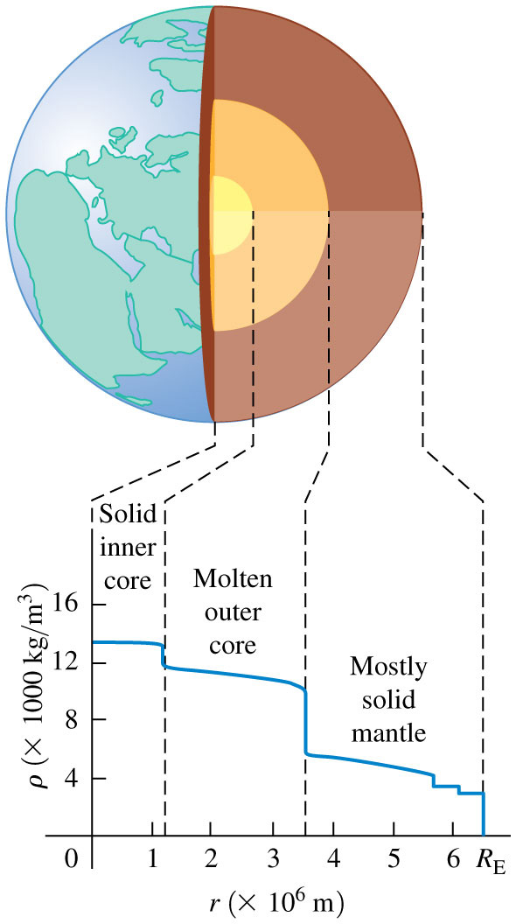
Interior of the Earth
The earth is approximately spherically symmetric, but it is not uniform throughout its volume.
The density ρ decreases with increasing distance r from the center.

Slide 12
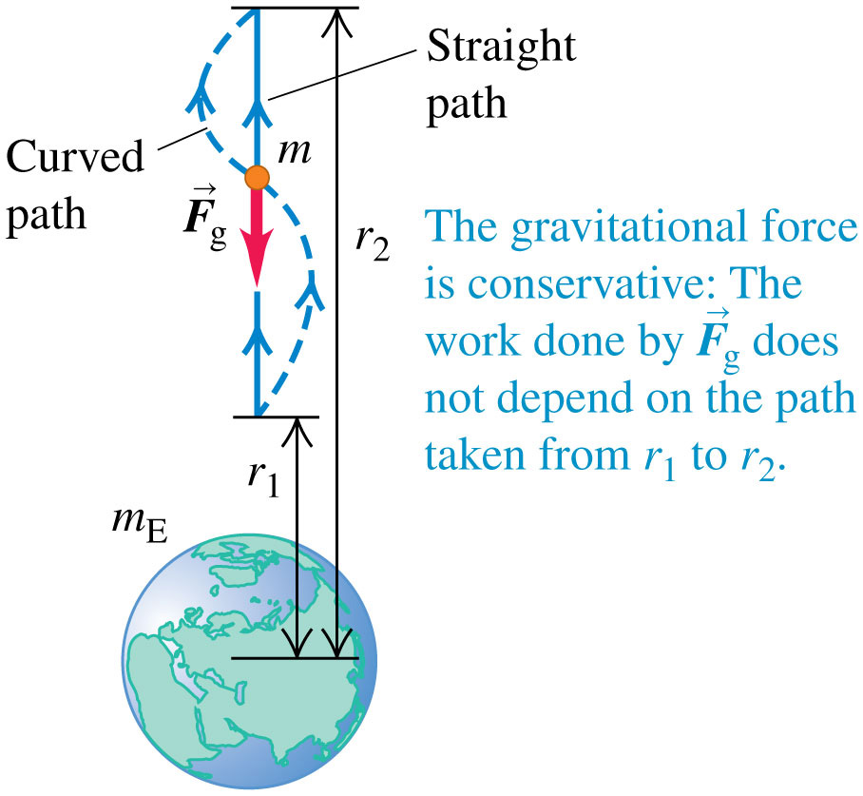
Gravitational Potential Energy (1 of 2)
The change in gravitational potential energy is defined as −1 times the work done by the gravitational force as the object moves from r₁ to r₂.

Slide 13
Gravitational Potential Energy (2 of 2)
We define the gravitational potential energy U so that W_{grav} = U₁ − U₂:
If the earth’s gravitational force on an object is the only force that does work, then the total mechanical energy of the system of the earth and object is constant, or conserved.

Slide 14
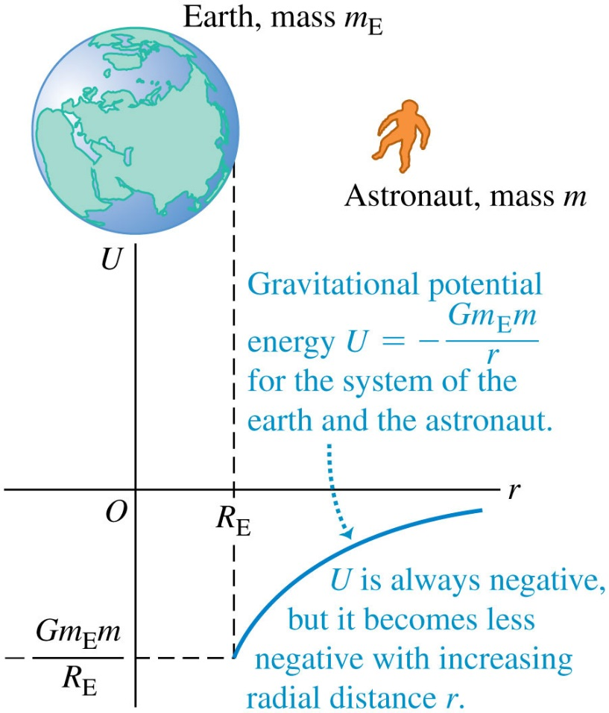
Gravitational Potential Energy Depends on Distance
The gravitational potential energy of the earth–astronaut system increases (becomes less negative) as the astronaut moves away from the earth.

Slide 15
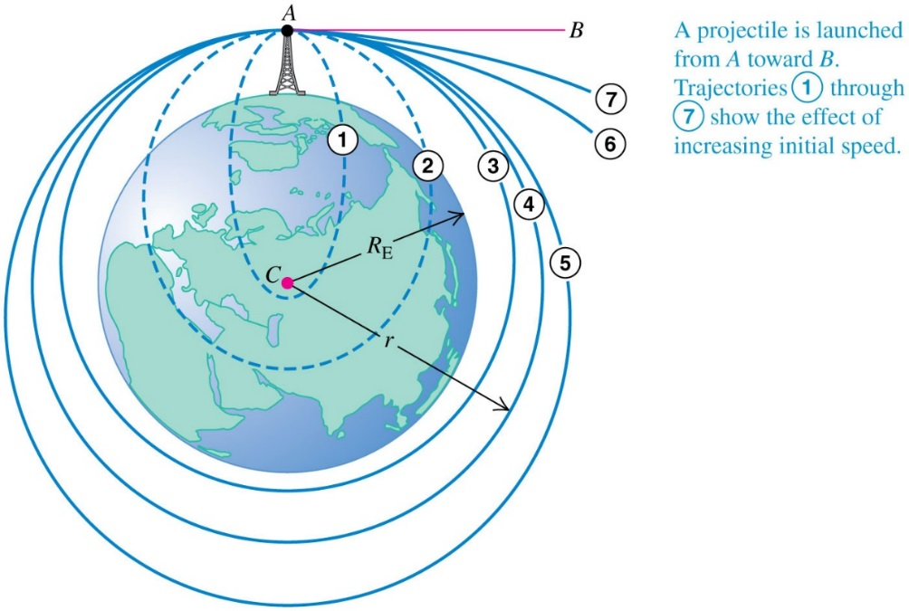
The Motion of Satellites
The trajectory of a projectile fired from a great height (ignoring air resistance) depends on its initial speed.

Slide 16
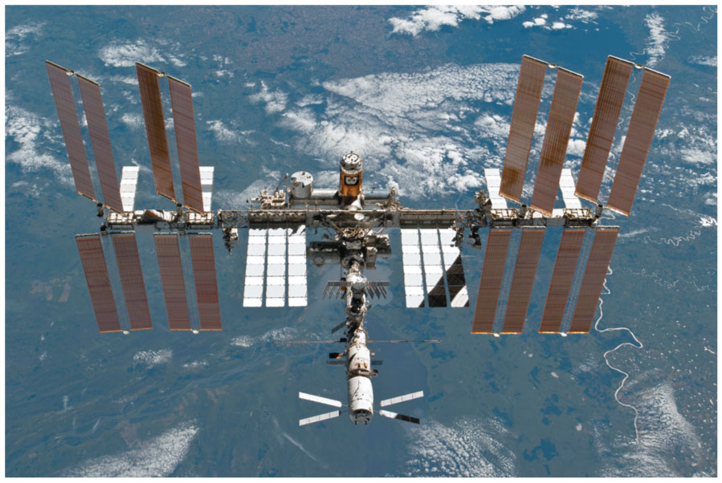
Circular Satellite Orbits (1 of 3)
With a mass of approximately
and a width of over 108 m, the International Space Station is the largest satellite ever placed in orbit.

Slide 17
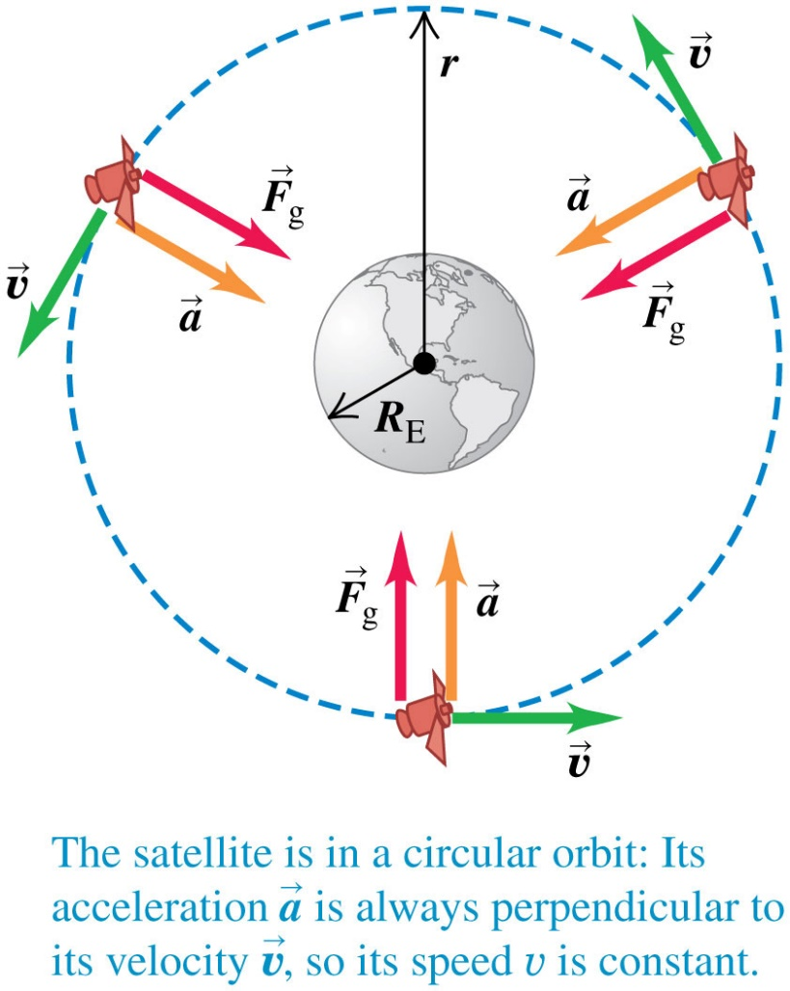
Circular Satellite Orbits (2 of 3)
For a circular orbit, the speed of a satellite is just right to keep its distance from the center of the earth constant.
The force
due to the earth’s gravitational attraction provides the centripetal acceleration that keeps a satellite in orbit.
Video Tutor Solution: Example 13.6

Slide 18
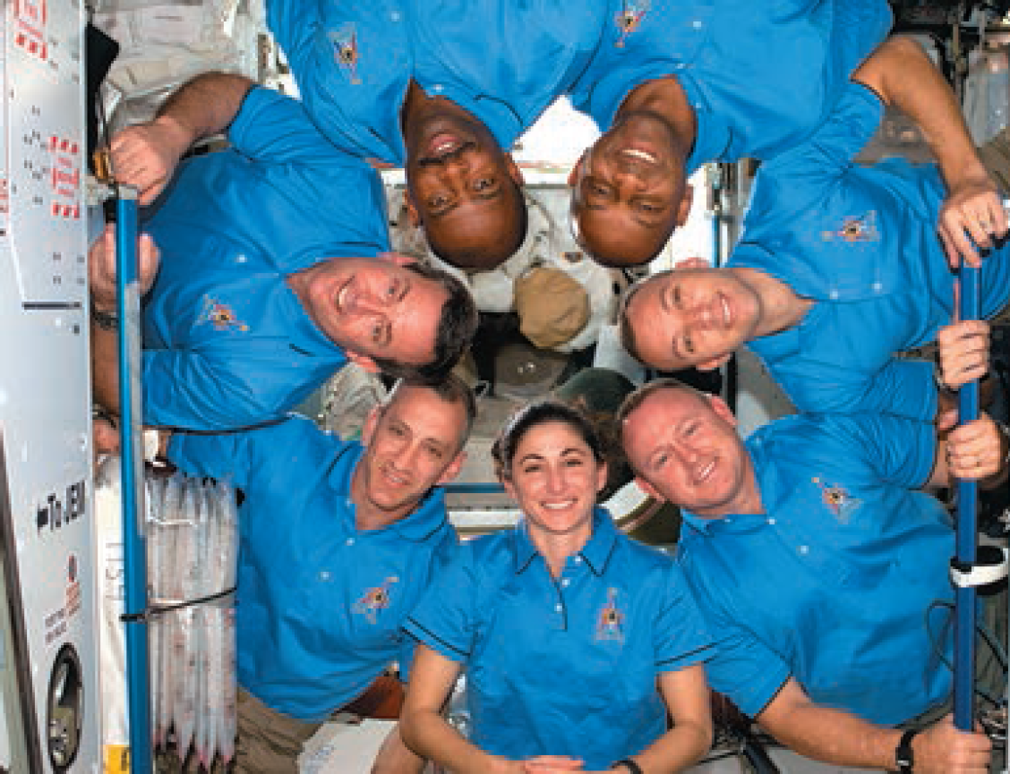
Circular Satellite Orbits (3 of 3)
A satellite is constantly falling around the earth.
Astronauts inside the satellite in orbit are in a state of apparent weightlessness because they are falling with the satellite.

Slide 19
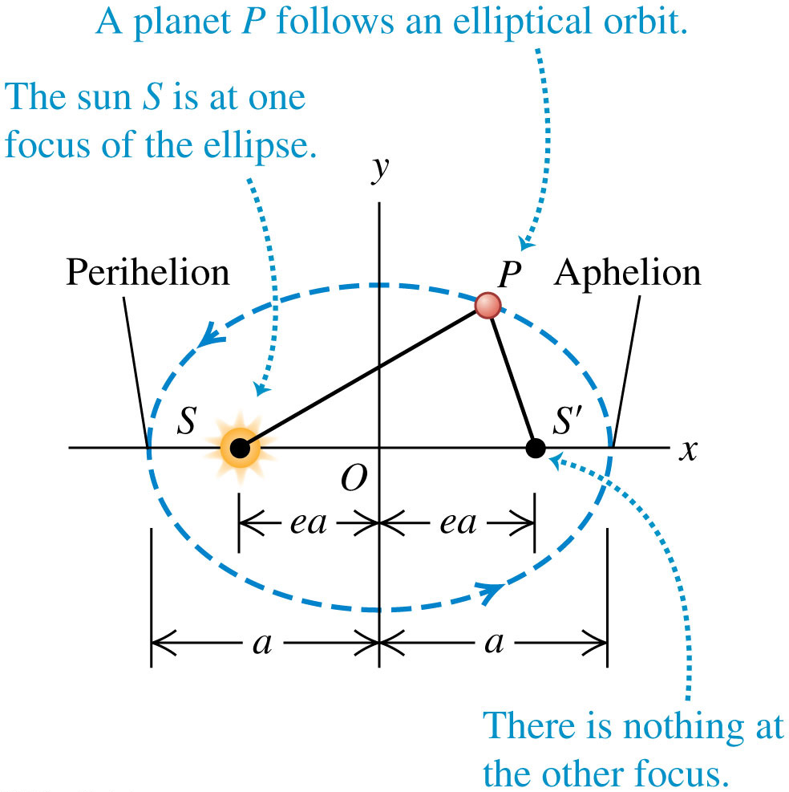
Kepler's First Law
Each planet moves in an elliptical orbit with the sun at one focus of the ellipse.

Slide 20
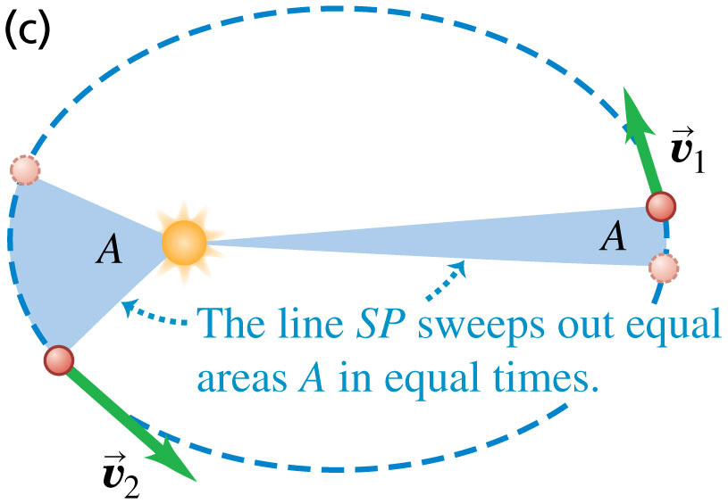
Kepler's Second Law (1 of 2)
A line from the sun to a given planet sweeps out equal areas in equal times.
Video Tutor Solution: Example 13.7

Slide 21
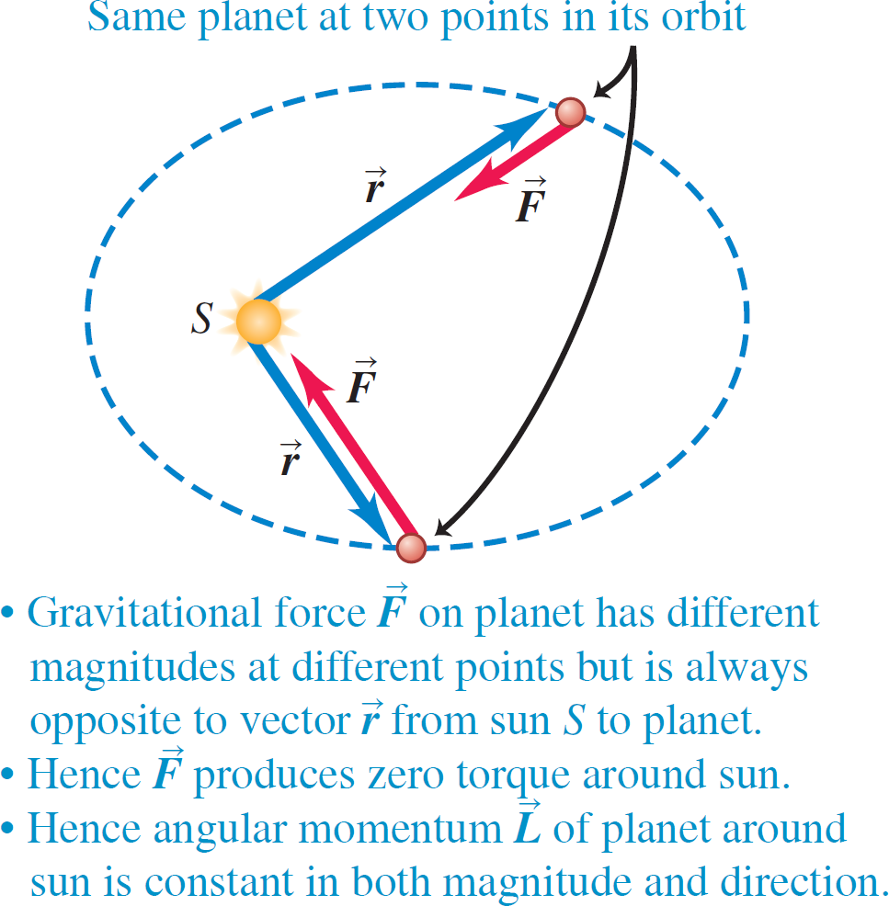
Kepler's Second Law (2 of 2)
Because the gravitational force that the sun exerts on a planet produces zero torque around the sun, the planet’s angular momentum around the sun remains constant.

Slide 22
Kepler's Third Law
The periods of the planets are proportional to the three-halves powers of the major axis lengths of their orbits.
(elliptical orbit around the sun)
Note that the period does not depend on the eccentricity e.
An asteroid in an elongated elliptical orbit with semi-major axis a will have the same orbital period as a planet in a circular orbit of radius a.
Video Tutor Solution: Example 13.8

Slide 23
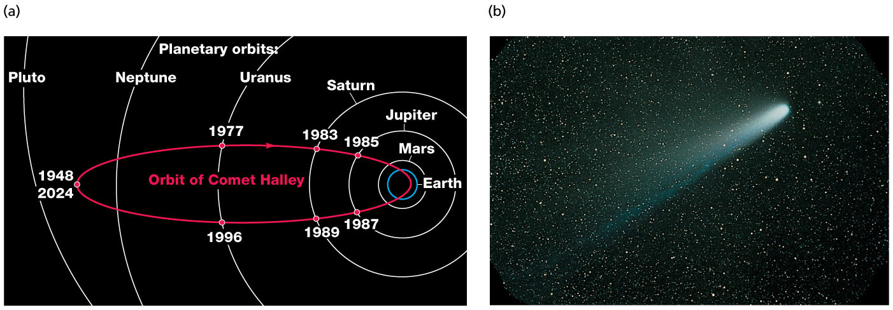
Comet Halley
At the heart of Comet Halley is an icy object, called the nucleus, that is about 10 km across.
When the comet’s orbit carries it close to the sun, the heat of sunlight causes the nucleus to partially evaporate.
The evaporated material forms the tail, which can be tens of millions of kilometers long.

Slide 24
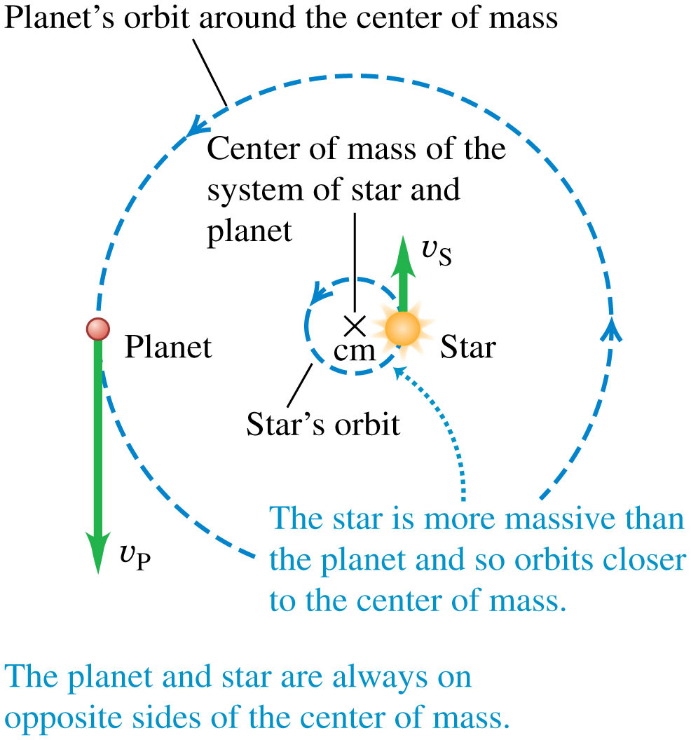
Planetary Motions and the Center of Mass
We have assumed that as a planet or comet orbits the sun, the sun remains absolutely stationary.
In fact, both the sun and the planet orbit around their common center of mass.

Slide 25
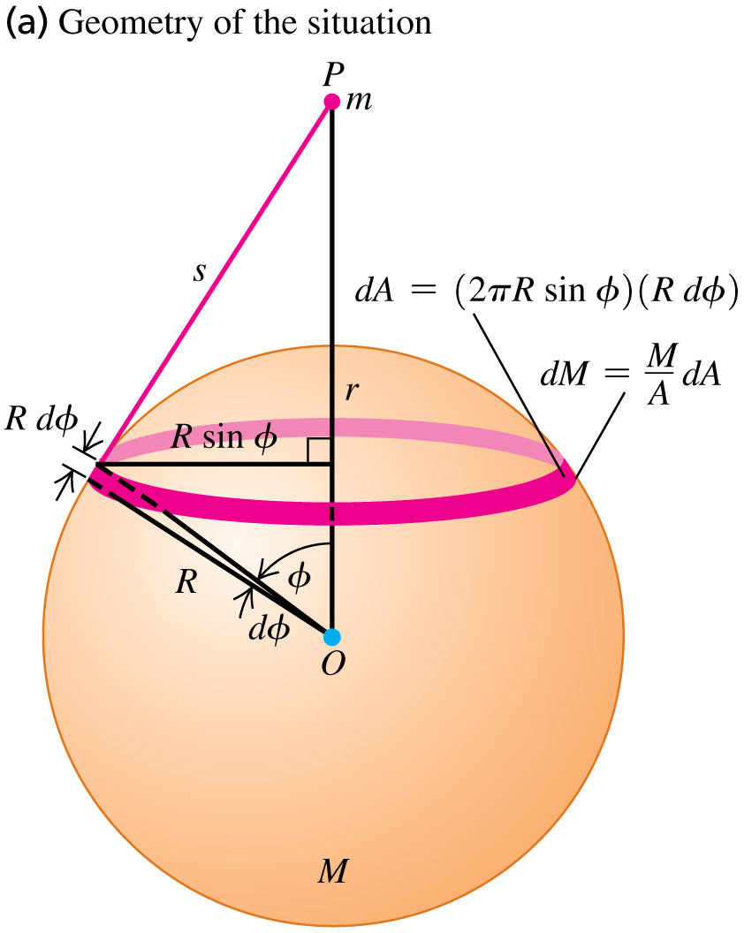
Spherical Mass Distributions
Follow the proof that the gravitational interaction between two spherically symmetric mass distributions is the same as if each one were concentrated at its center.
To begin, we consider the gravitational force on a point mass m outside a spherical shell.

Slide 26
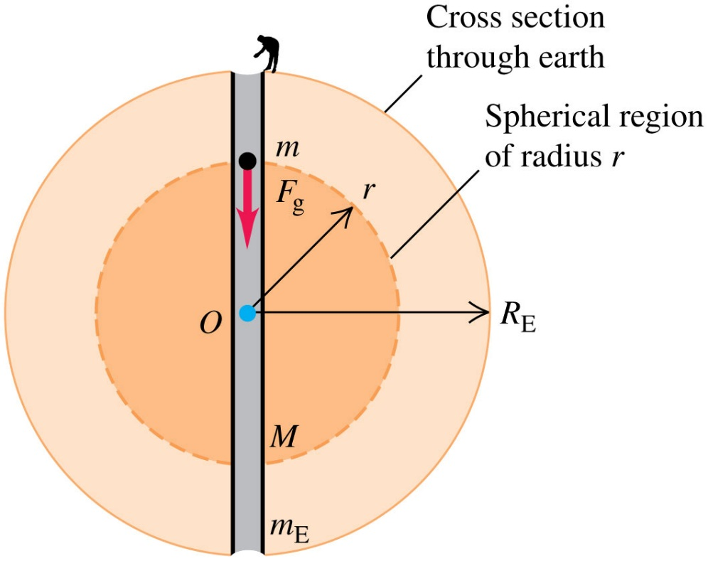
A Point Mass Inside a Spherical Shell
If a point mass is inside a spherically symmetric shell, the potential energy of the system is constant.
This means that the shell exerts no force on a point mass inside of it.
Only the mass inside a sphere of radius r exerts a net gravitational force on it.

Slide 27
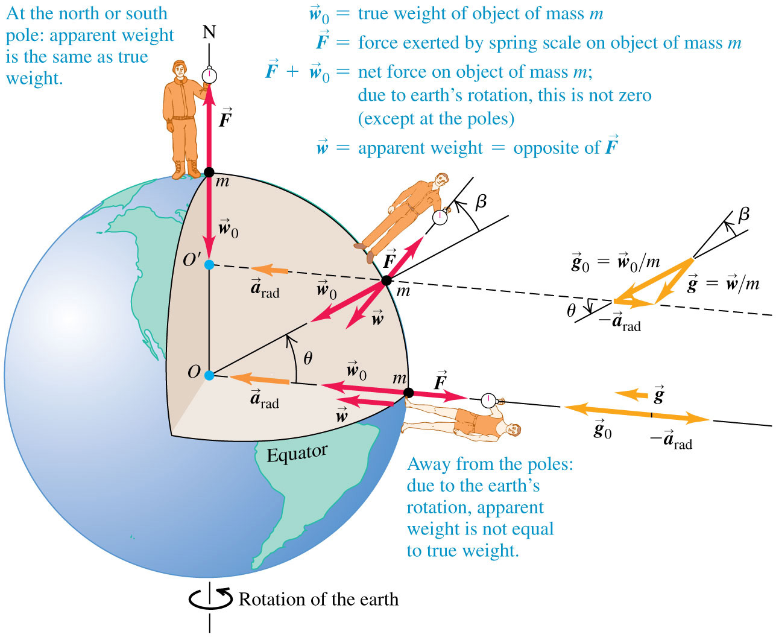
Apparent Weight and the Earth's Rotation

Slide 28
Variations of G with Latitude and Elevation
Station | North Latitude | Elevation (m) | g (m/s²)
Canal Zone | 09° | 0 | 9.78243
Jamaica | 18° | 0 | 9.78591
Bermuda | 32° | 0 | 9.79806
Denver, CO | 40° | 1638 | 9.79609
Pittsburgh, PA | 40.5° | 235 | 9.80118
Cambridge, MA | 42° | 0 | 9.80398
Greenland | 70° | 0 | 9.82534

Slide 29
Black Holes (1 of 2)
If a spherical nonrotating object has radius less than the Schwarzschild radius, nothing can escape from it.
Such an object is a black hole.
The surface of the sphere with radius R_{S} surrounding a black hole is called the event horizon.
Since light can’t escape from within that sphere, we can’t see events occurring inside.

Slide 30
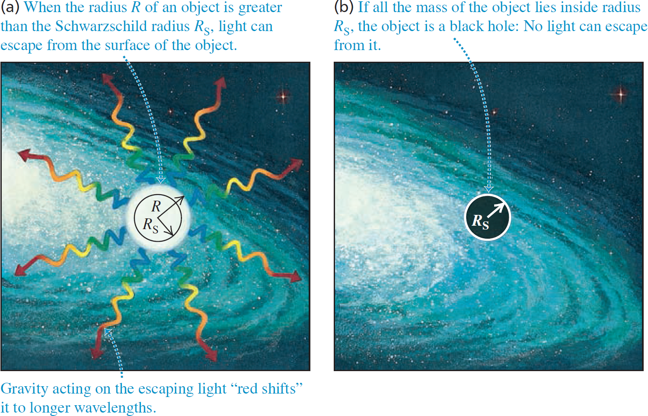
Black Holes (2 of 2)

Slide 31
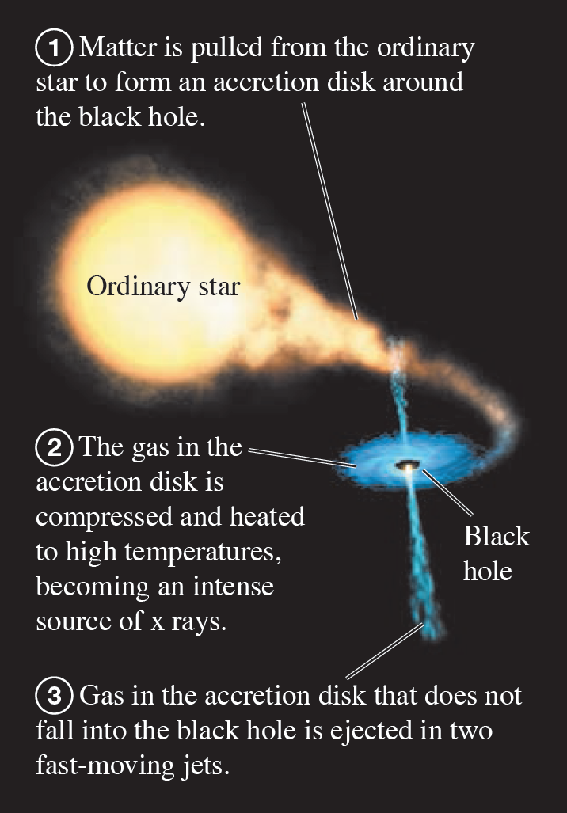
Detecting Black Holes
We can detect black holes by looking for x rays emitted from their accretion disks.

