Slide 1
University Physics with Modern Physics
Fifteenth Edition
Chapter 2
Motion Along a Straight Line
Copyright © 2020 Pearson Education, Inc. All Rights Reserved

Slide 2
Learning Outcomes
In this chapter, you’ll learn…
how the ideas of displacement and average velocity help us describe straight-line motion.
the meaning of instantaneous velocity; the difference between velocity and speed.
how to use average acceleration and instantaneous acceleration to describe changes in velocity.
how to solve problems in which an object is falling freely under the influence of gravity alone.
how to analyze straight-line motion when the acceleration is not constant.

Slide 3
Introduction
Kinematics is the study of motion.
Velocity and acceleration are important physical quantities.
A typical runner gains speed gradually during the course of a sprinting foot race and then slows down after crossing the finish line.

Slide 4
Displacement, Time, and Average Velocity
A particle moving along the x-axis has a coordinate x.
The change in the particle’s coordinate is
The average x-velocity of the particle is

Slide 5
Rules for the Sign of X-Velocity
If x-coordinate is: | . . . x-velocity is:
Positive and increasing (getting more positive) | Positive: Particle is moving in +x-direction
Positive and decreasing (getting less positive) | Negative: Particle is moving in −x-direction
Negative and increasing (getting less negative) | Positive: Particle is moving in +x-direction
Negative and decreasing (getting more negative) | Negative: Particle is moving in −x-direction

Slide 6
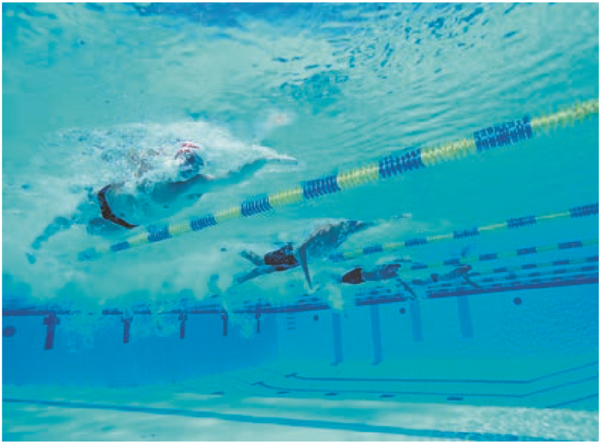
Average Velocity
The winner of a 50-m swimming race is the swimmer whose average velocity has the greatest magnitude.
That is, the swimmer who traverses a displacement
of 50 m in the shortest elapsed time

Slide 7
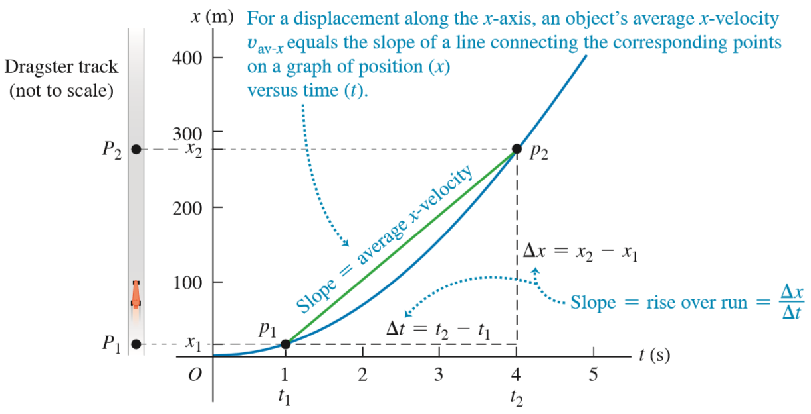
A Position-Time Graph (1 of 2)

Slide 8
Instantaneous Velocity
The instantaneous velocity is the velocity at a specific instant of time or specific point along the path and is given by
The average speed is not the magnitude of the average velocity!

Slide 9
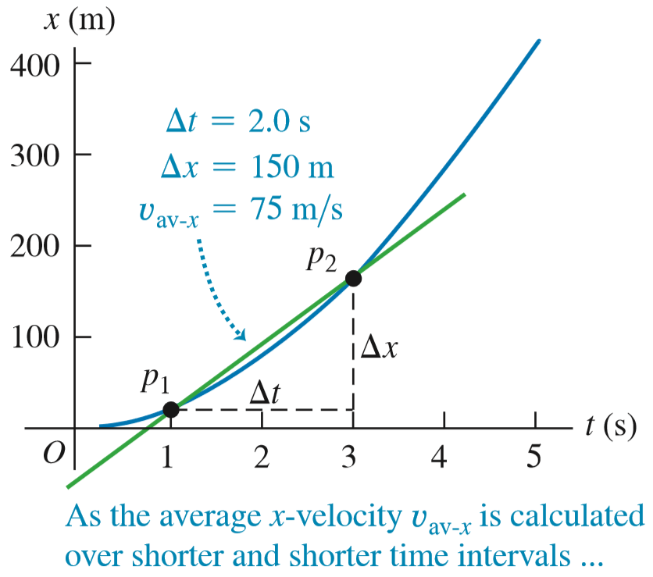
Finding Velocity on an X-T Graph (1 of 3)

Slide 10
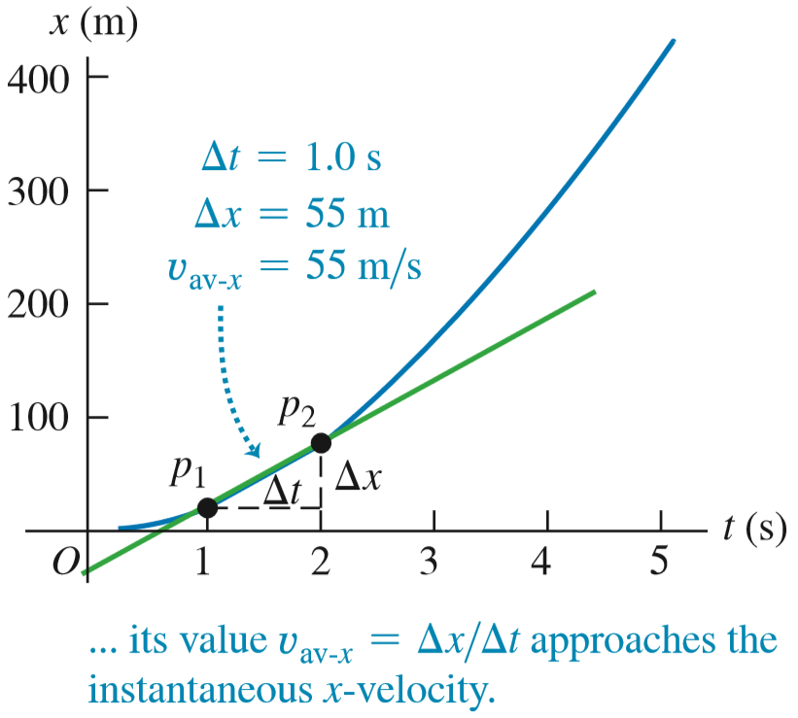
Finding Velocity on an X-T Graph (2 of 3)

Slide 11
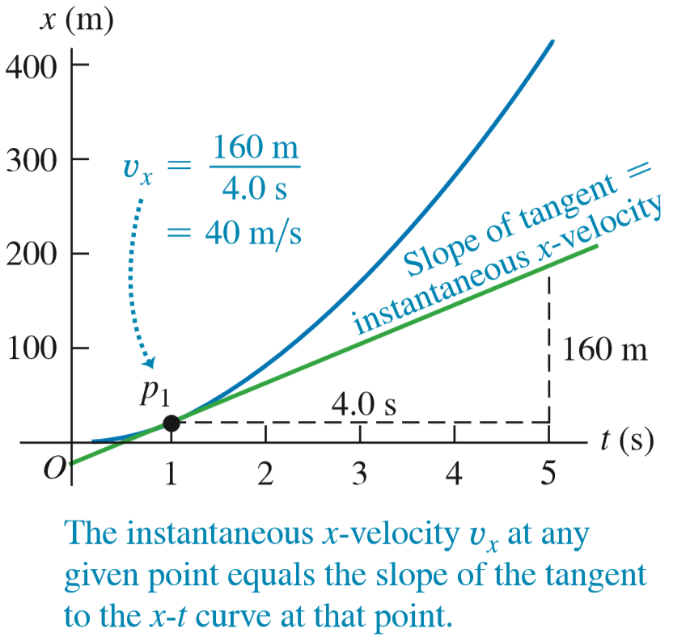
Finding Velocity on an X-T Graph (3 of 3)

Slide 12
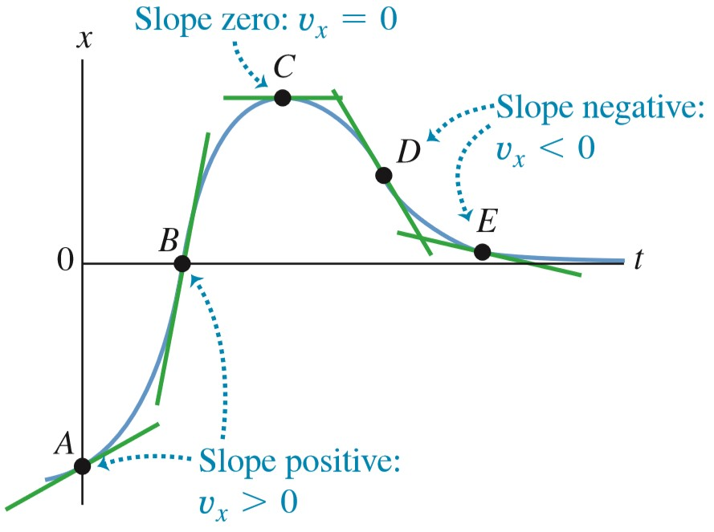
X-T Graphs

Slide 13
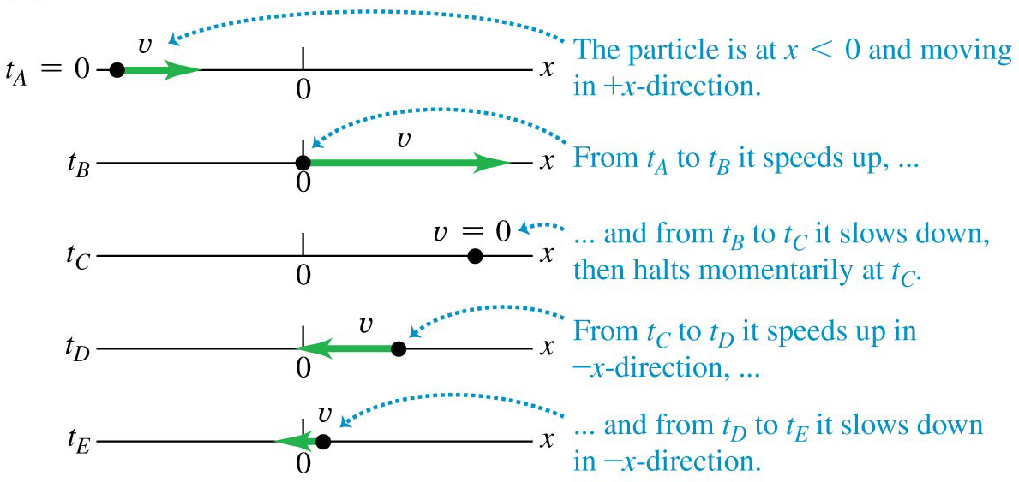
Motion Diagrams (1 of 3)
Here is a motion diagram of the particle in the previous x-t graph.

Slide 14
Average Acceleration
Acceleration describes the rate of change of velocity with time.
The average x-acceleration is
Video Tutor Solution: Example 2.2

Slide 15
Instantaneous Acceleration
The instantaneous acceleration is

Slide 16
Rules for the Sign of X-Acceleration
If x-velocity is: | . . . x-acceleration is:
Positive and increasing (getting more positive) | Positive: Particle is moving in +x-direction and speeding up
Positive and decreasing (getting less positive) | Negative: Particle is moving in +x-direction and slowing down
Negative and increasing (getting less negative) | Positive: Particle is moving in −x-direction and slowing down
Negative and decreasing (getting more negative) | Negative: Particle is moving in −x-direction and speeding up

Slide 17
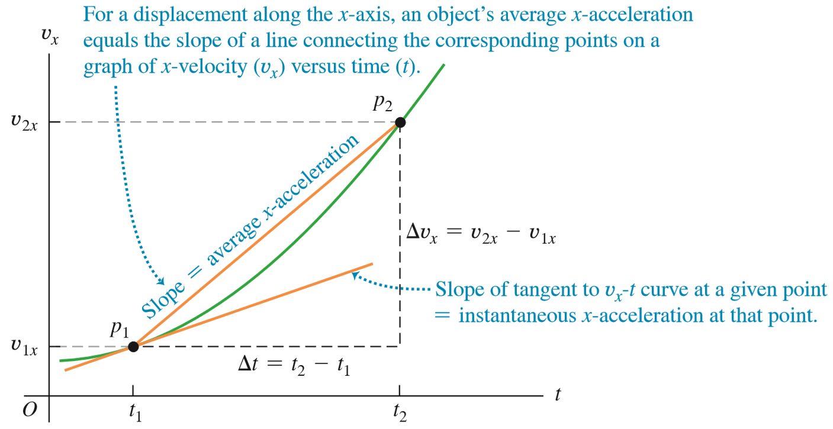
Finding Acceleration on a V_{x}-T Graph

Slide 18
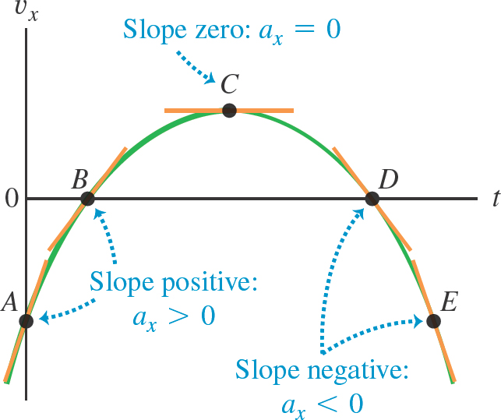
A V_{x}-T Graph (1 of 2)

Slide 19
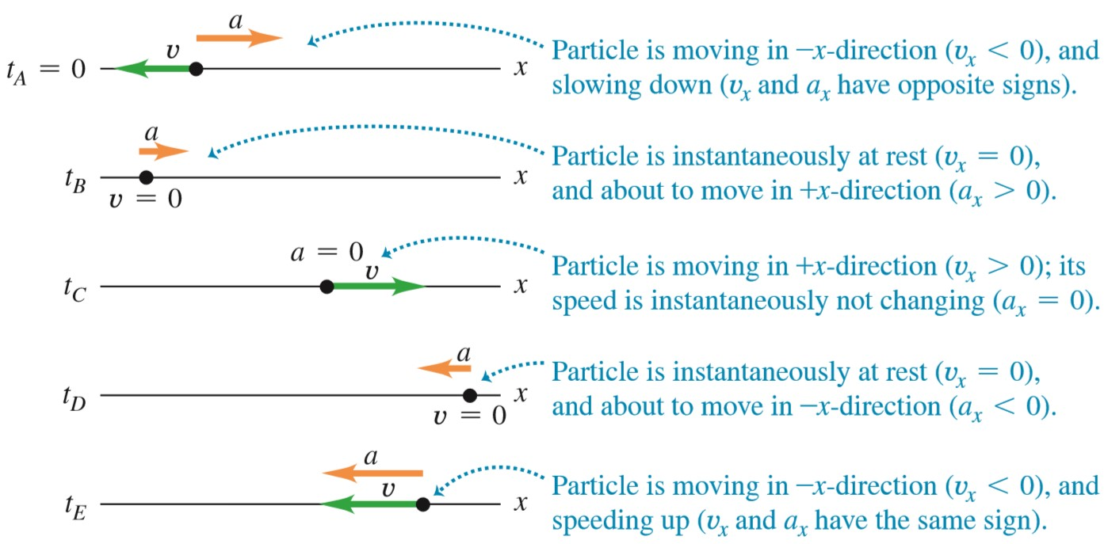
Motion Diagrams (2 of 3)
Here is the motion diagram for the particle in the previous v_{x}-t graph.

Slide 20
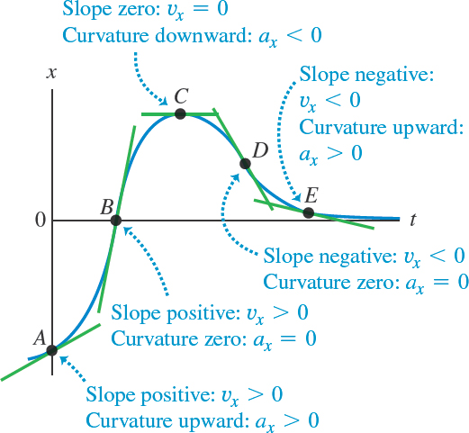
A V_{x}-T Graph (2 of 2)

Slide 21
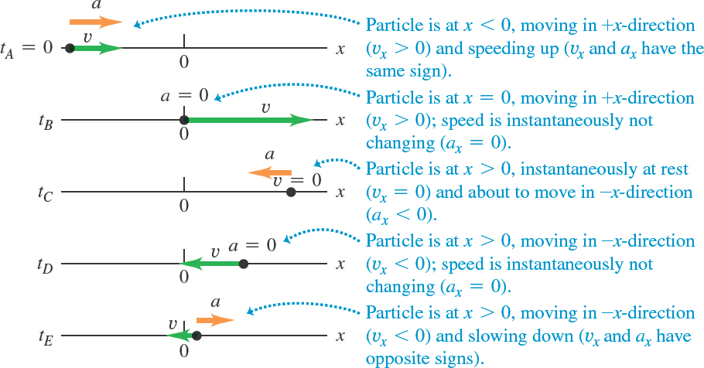
Motion Diagrams (3 of 3)
Here is the motion diagram for the particle in the previous v_{x}-t graph.

Slide 22
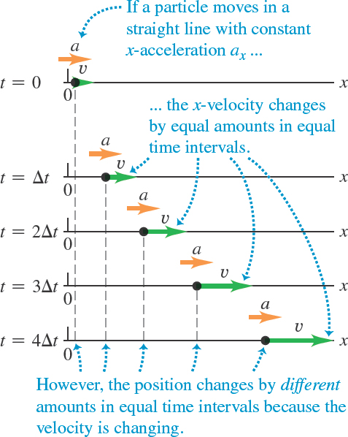
Motion with Constant Acceleration (1 of 2)

Slide 23
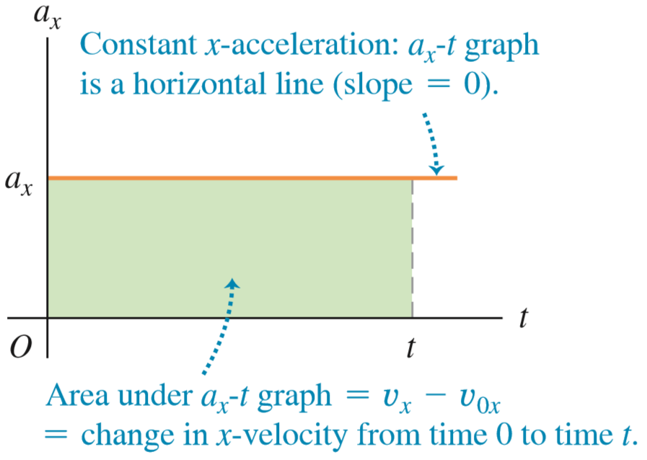
Motion with Constant Acceleration (2 of 2)

Slide 24
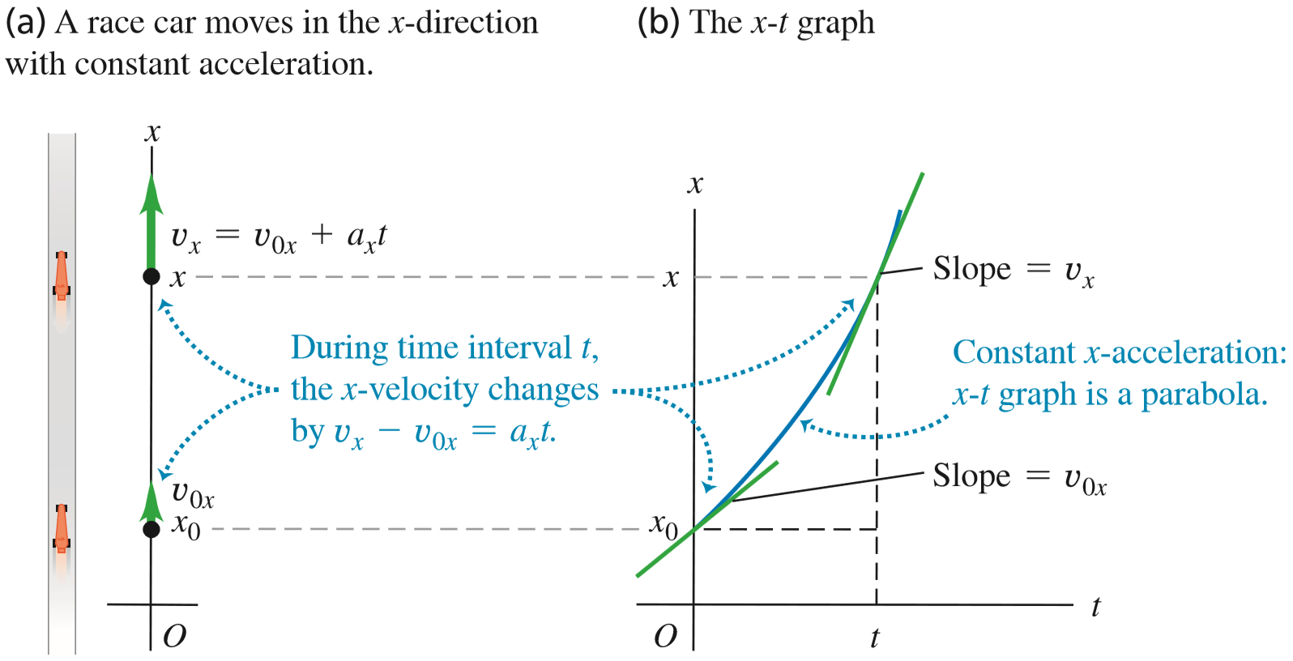
A Position-Time Graph (2 of 2)

Slide 25
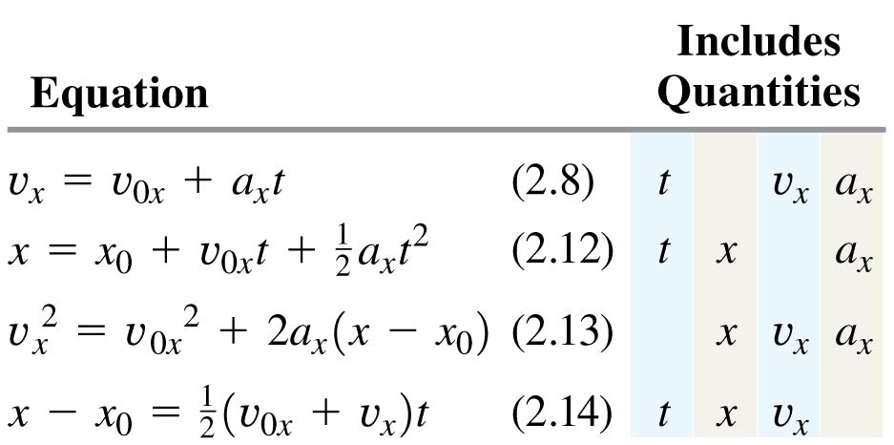
The Equations of Motion with Constant Acceleration
The four equations below apply to any straight-line motion with constant acceleration a_{x}.

Slide 26
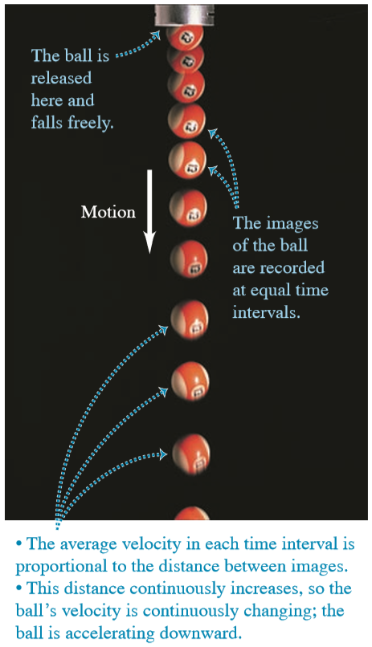
Freely Falling Objects
Free fall is the motion of an object under the influence of only gravity.
In the figure, a strobe light flashes with equal time intervals between flashes.
The velocity change is the same in each time interval, so the acceleration is constant.

Slide 27
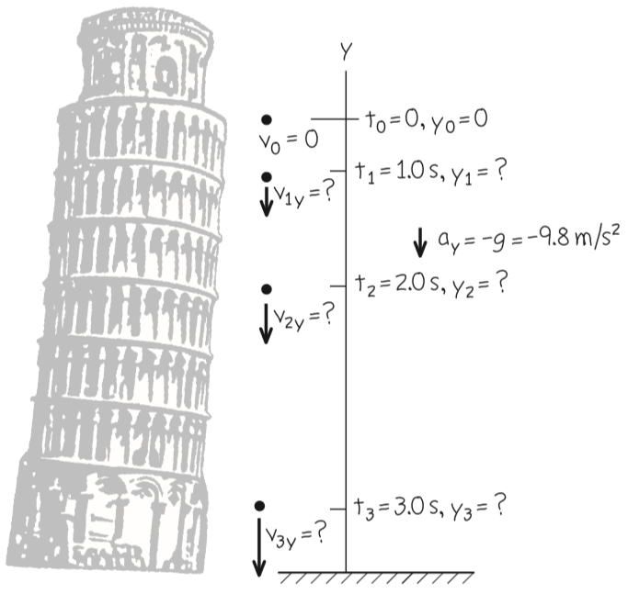
A Freely Falling Coin
If there is no air resistance, the downward acceleration of any freely falling object is
Video Tutor Solution: Example 2.6

Slide 28
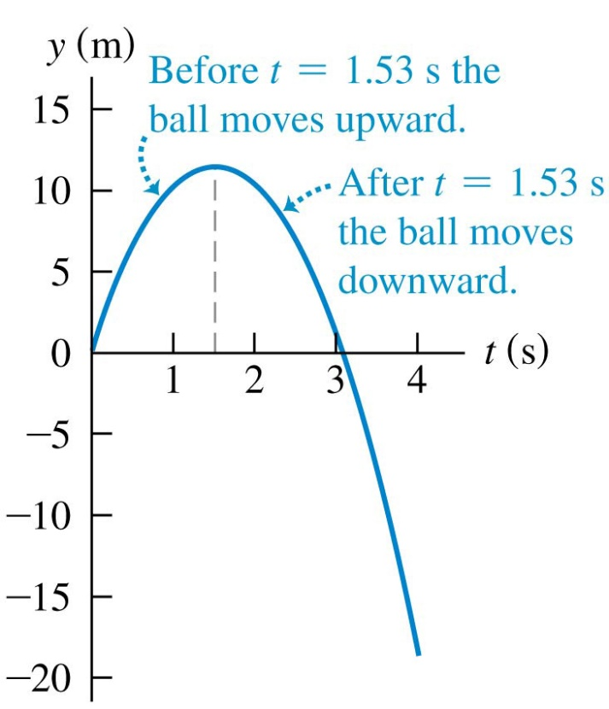
Up-And-Down Motion in Free Fall (1 of 2)
Position as a function of time for a ball thrown upward with an initial speed of 15.0 m/s.
Video Tutor Solution: Example 2.7

Slide 29
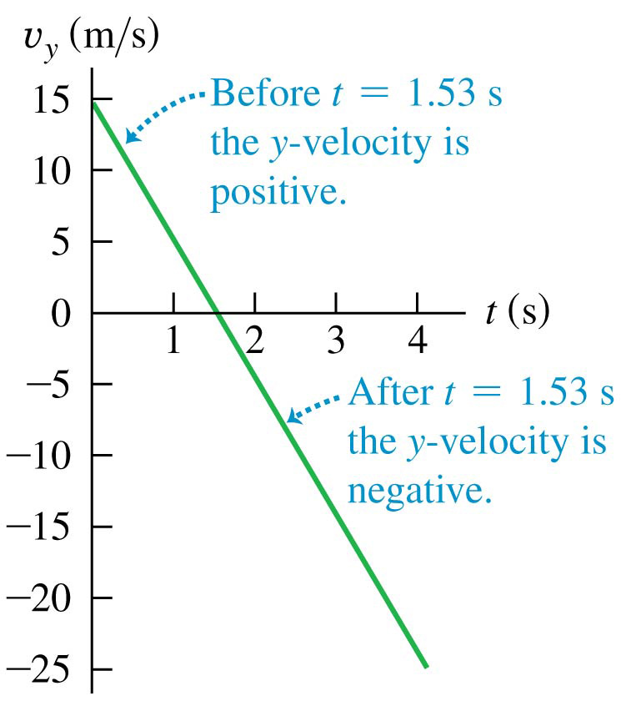
Up-And-Down Motion in Free Fall (2 of 2)
Velocity as a function of time for a ball thrown upward with an initial speed of 15.0 m/s.
The vertical velocity, but not the acceleration, is zero at the highest point.

Slide 30
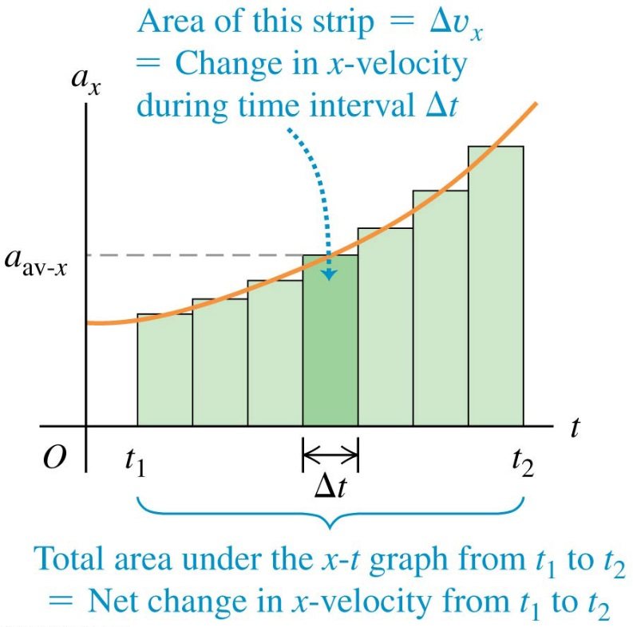
Velocity and Position by Integration
The acceleration of a car is not always constant.
The motion may be integrated over many small time intervals to

