Slide 1
University Physics with Modern Physics
Fifteenth Edition
Chapter 3
Motion in Two or Three Dimensions
Copyright © 2020 Pearson Education, Inc. All Rights Reserved

Slide 2
Learning Outcomes
In this chapter, you’ll learn…
how to use vectors to represent the position and velocity of a particle in two or three dimensions.
how to find the vector acceleration of a particle, and how to interpret the components of acceleration parallel to and perpendicular to a particle’s path.
how to solve problems that involve the curved path followed by a projectile.
how to analyze motion in a circular path, with either constant speed or varying speed.
how to relate the velocities of a moving object as seen from two different frames of reference.

Slide 3
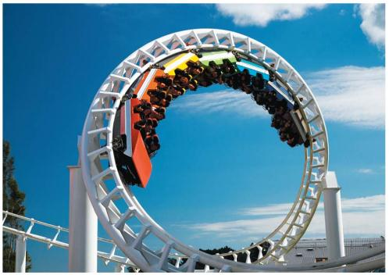
Introduction
What determines where a batted baseball lands?
How do you describe the motion of a roller coaster car along a curved track or the flight of a circling hawk?
Which hits the ground first, a baseball that you simply drop or one that you throw horizontally?
We need to extend our description of motion to two and three dimensions.

Slide 4
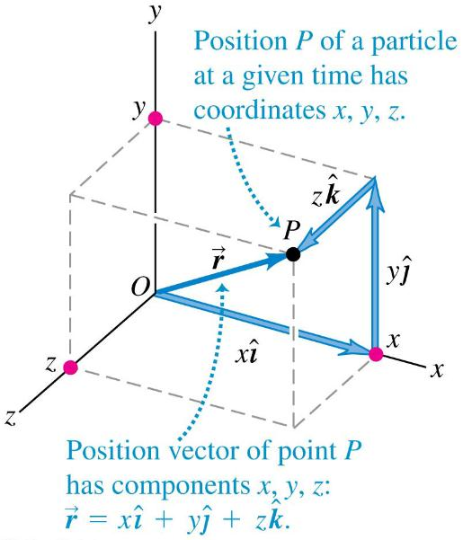
Position Vector
The position vector from the origin to point P has components x, y, and z.

Slide 5
Velocity
We define the average velocity as the displacement divided by the time interval:
Instantaneous velocity (a.k.a. “velocity”) is the instantaneous rate of change of position with time:

Slide 6
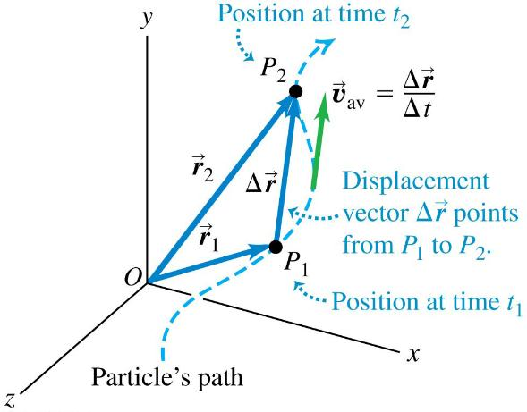
Average Velocity
The average velocity between two points is the displacement divided by the time interval between the two points, and it has the same direction as the displacement.

Slide 7
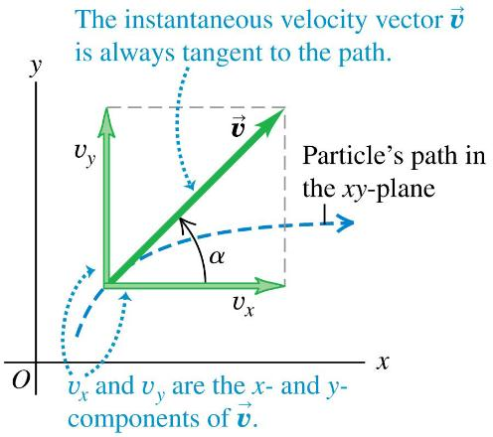
Instantaneous Velocity
The instantaneous velocity is the instantaneous rate of change of position vector with respect to time.
The components of the instantaneous velocity are
The instantaneous velocity of a particle is always tangent to its path.
Video Tutor Solution: Example 3.1

Slide 8
Acceleration (1 of 2)
Acceleration describes how the velocity changes.

Slide 9
Acceleration (2 of 2)
We define the average acceleration as the change in velocity divided by the time interval:
Instantaneous acceleration (a.k.a. “acceleration”) is the instantaneous rate of change of velocity with time:

Slide 10
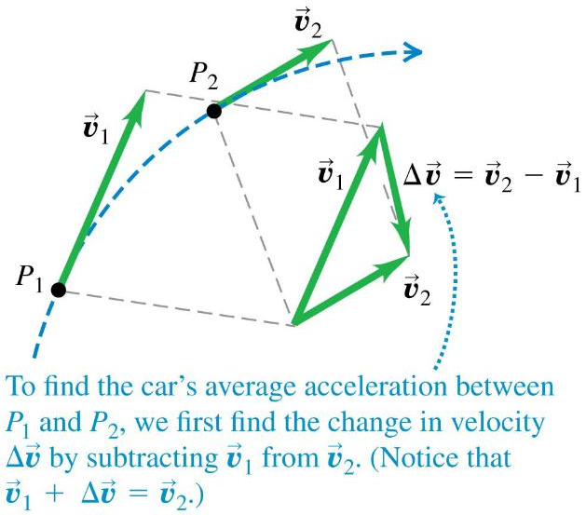
Average Acceleration (1 of 2)
The change in velocity between two points is determined by vector subtraction.

Slide 11
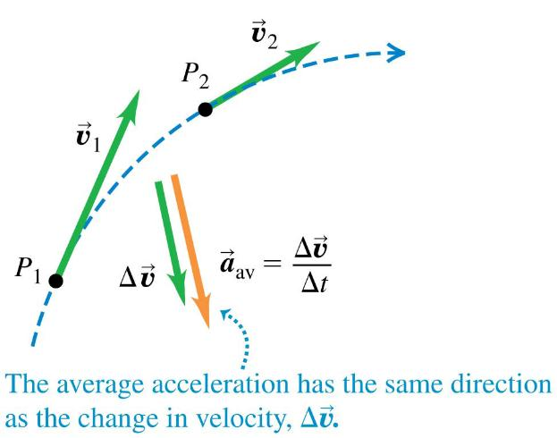
Average Acceleration (2 of 2)

Slide 12
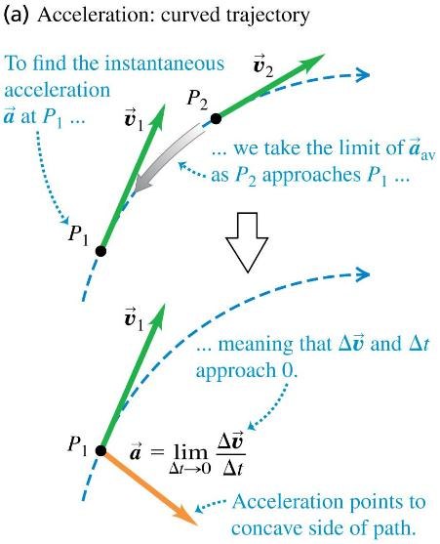
Instantaneous Acceleration (1 of 2)
The velocity vector is always tangent to the particle’s path, but the instantaneous acceleration vector does not have to be tangent to the path.
If the path is curved, the acceleration points toward the concave side of the path.

Slide 13
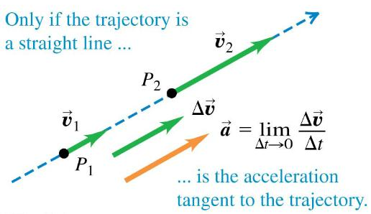
Instantaneous Acceleration (2 of 2)

Slide 14
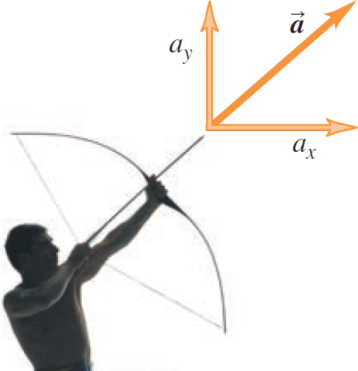
Components of Acceleration
Shooting an arrow is an example of an acceleration vector that has both x- and y-components.

Slide 15
Parallel and Perpendicular Components of Acceleration (1 of 3)
Velocity and acceleration vectors for a particle moving through a point P on a curved path with constant speed

Slide 16
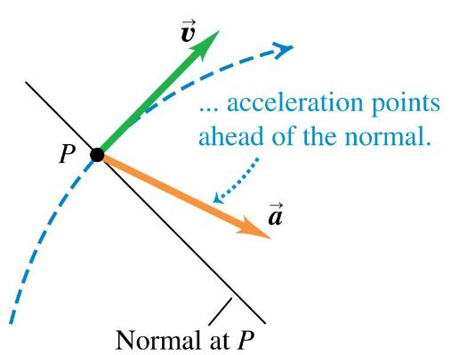
Parallel and Perpendicular Components of Acceleration (2 of 3)
Velocity and acceleration vectors for a particle moving through a point P on a curved path with increasing speed

Slide 17
Parallel and Perpendicular Components of Acceleration (3 of 3)
Velocity and acceleration vectors for a particle moving through a point P on a curved path with decreasing speed

Slide 18
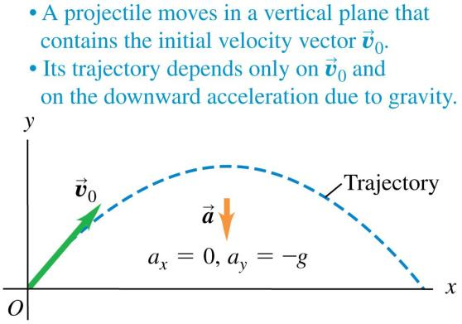
Projectile Motion (1 of 3)
A projectile is any object given an initial velocity that then follows a path determined by the effects of gravity and air resistance.
Begin by neglecting resistance and the curvature and rotation of the earth.

Slide 19
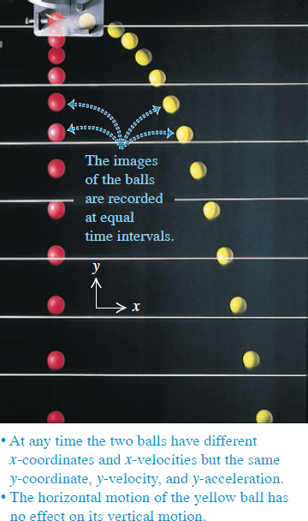
The X- and Y-Motion Are Separable
The red ball is dropped at the same time that the yellow ball is fired horizontally.
The strobe marks equal time intervals.
We can analyze projectile motion as horizontal motion with constant velocity and vertical motion with constant acceleration:
Video Tutor Demonstration: Dropped and Thrown Balls

Slide 20
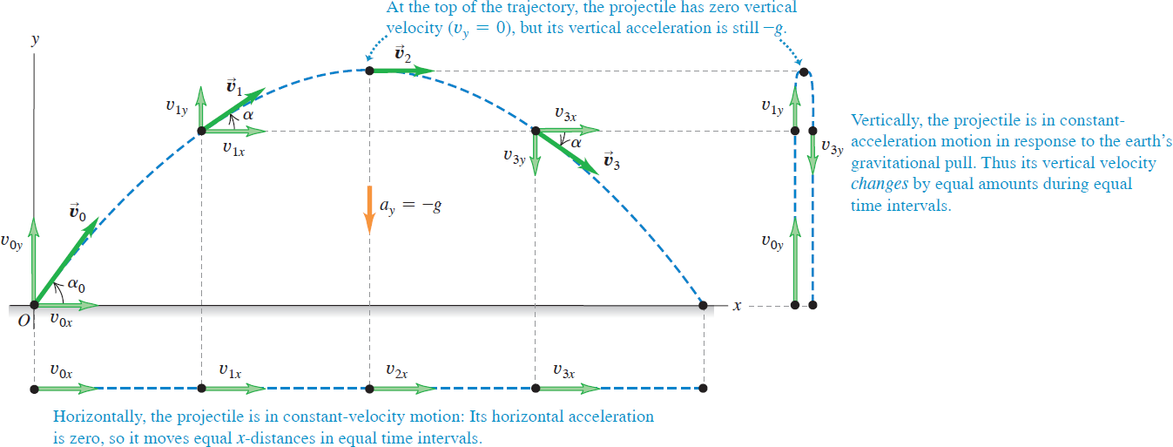
Projectile Motion (2 of 3)
If air resistance is negligible, the trajectory of a projectile is a combination of horizontal motion with constant velocity and vertical motion with constant acceleration.
Video Tutor Demonstration: Ball Fired Upward from Moving Cart

Slide 21
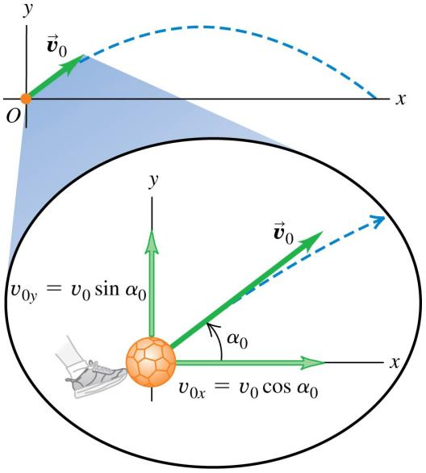
Projectile Motion – Initial Velocity
The initial velocity components of a projectile (such as a kicked soccer ball) are related to the initial speed and initial angle.

Slide 22
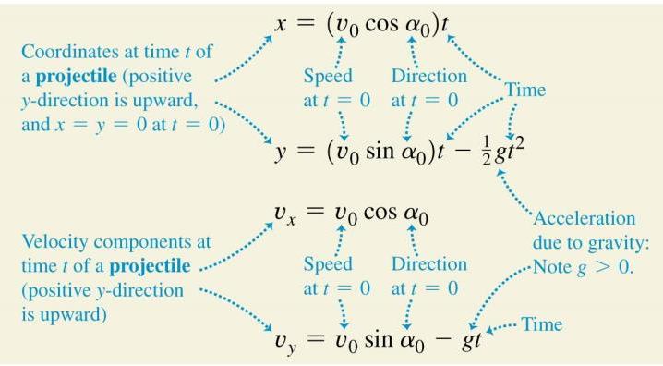
The Equations for Projectile Motion
If we set x₀ = y₀ = 0, the equations describing projectile motion are shown below:

Slide 23
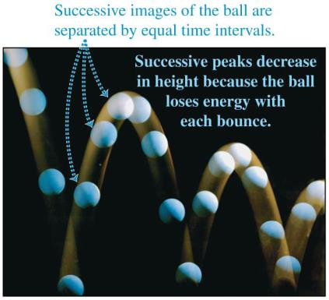
Parabolic Trajectories of a Bouncing Ball

Slide 24
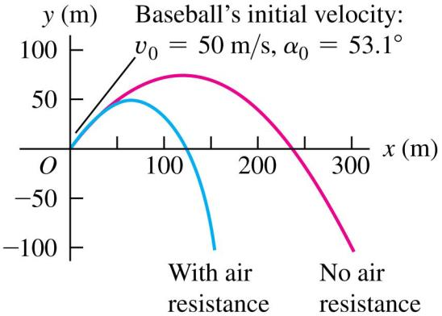
The Effects of Air Resistance
Calculations become more complicated.
Acceleration is not constant.
Effects can be very large.
Maximum height and range decrease.
Trajectory is no longer a parabola.

Slide 25
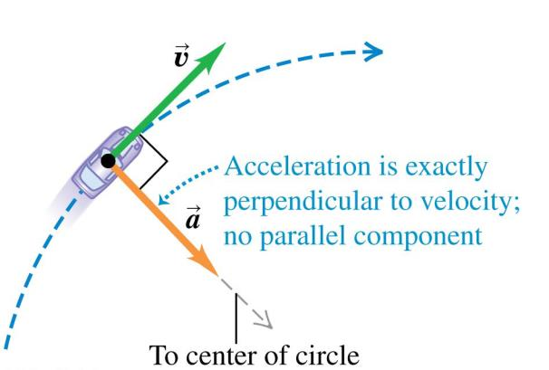
Motion in a Circle (1 of 3)
Uniform circular motion is constant speed along a circular path.

Slide 26
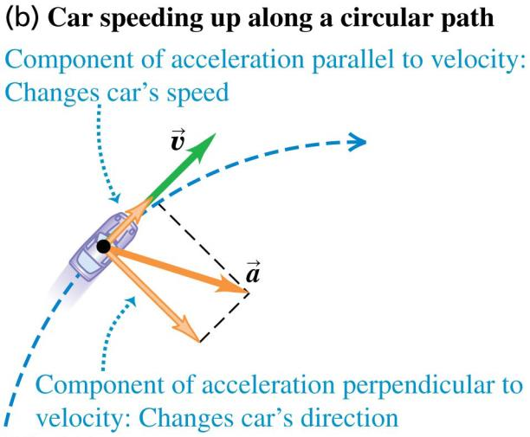
Motion in a Circle (2 of 3)
Car speeding up along a circular path

Slide 27
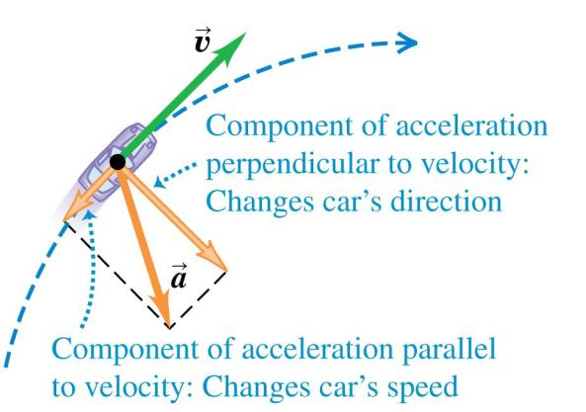
Motion in a Circle (3 of 3)
Car slowing down along a circular path

Slide 28
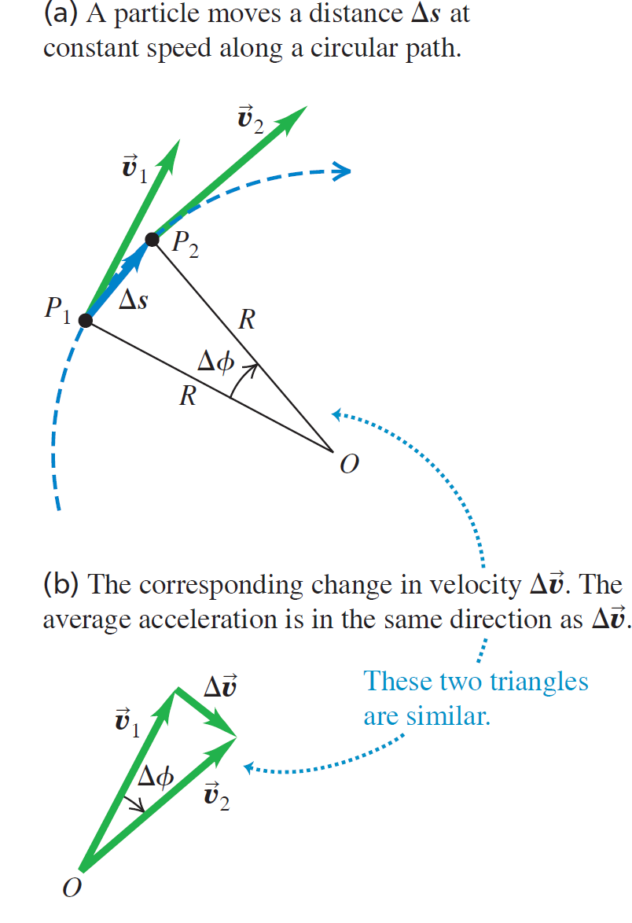
Acceleration for Uniform Circular Motion (1 of 2)

Slide 29
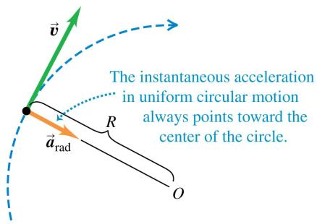
Acceleration for Uniform Circular Motion (2 of 2)
For uniform circular motion, the instantaneous acceleration always points toward the center of the circle and is called the centripetal acceleration.
The magnitude of the acceleration is
The period T is the time for one revolution, and

Slide 30
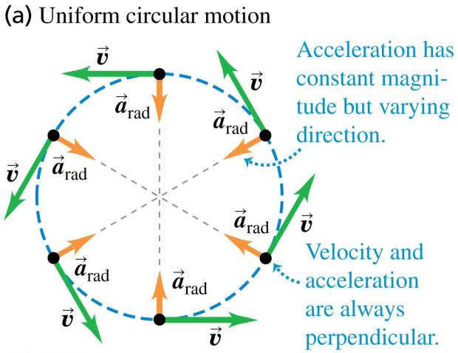
Uniform Circular Motion

Slide 31
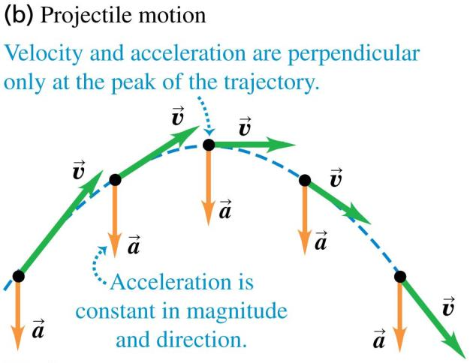
Projectile Motion (3 of 3)

Slide 32
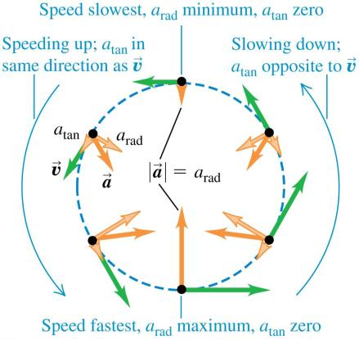
Nonuniform Circular Motion
If the speed varies, the motion is nonuniform circular motion.
The radial acceleration component is still
but there is also a tangential acceleration component a_{tan} that is parallel to the instantaneous velocity.

Slide 33
Relative Velocity
The velocity of a moving object seen by a particular observer is called the velocity relative to that observer, or simply the relative velocity.
A frame of reference is a coordinate system plus a time scale.
In many situations relative velocity is extremely important.

Slide 34
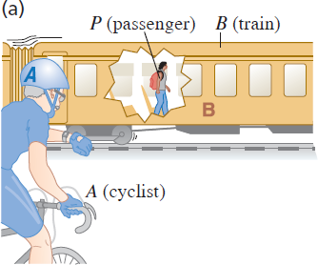
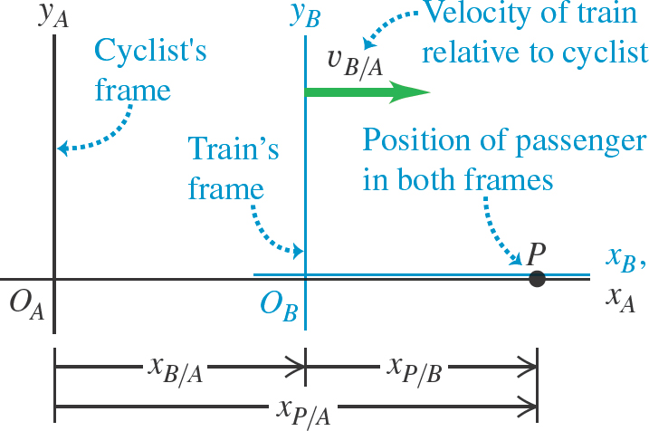
Relative Velocity in One Dimension
If point P is moving relative to reference frame A, we denote the velocity of P relative to frame A as v_{P/A}.
If P is moving relative to frame B and frame B is moving relative to frame A, then the x-velocity of P relative to frame A is

Slide 35
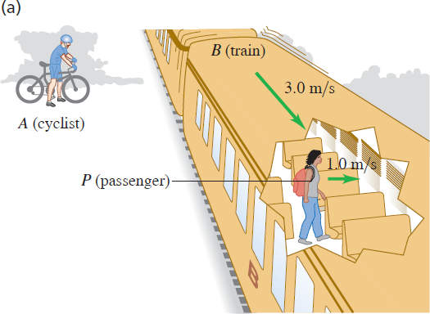
Relative Velocity in Two or Three Dimensions (1 of 2)
We extend relative velocity to two or three dimensions by using vector addition to combine velocities.

Slide 36
Relative Velocity in Two or Three Dimensions (2 of 2)
Video Tutor Solution: Example 3.15

