Slide 1
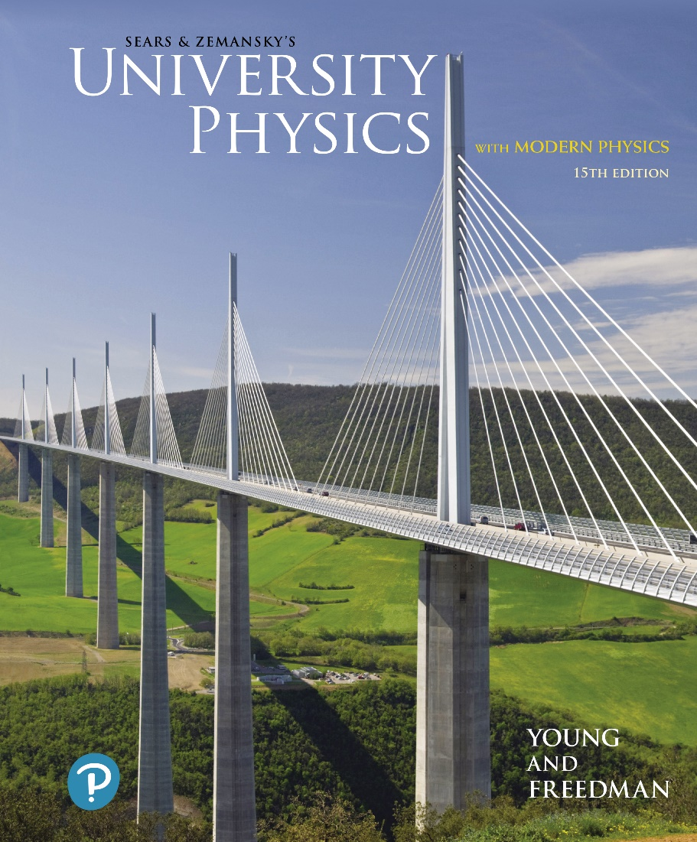
University Physics with Modern Physics
Fifteenth Edition
Chapter 8
Momentum, Impulse, and Collisions
Copyright © 2020 Pearson Education, Inc. All Rights Reserved

Slide 2
Learning Outcomes
In this chapter, you’ll learn…
the momentum of a particle, and how the net force acting on a particle causes its momentum to change.
the circumstances under which the total momentum of a system of particles is constant (conserved).
elastic, inelastic, and completely inelastic collisions.
what’s meant by the center of mass of a system, and what determines how the center of mass moves.
how to analyze situations such as rocket propulsion in which the mass of an object changes as it moves.

Slide 3
Introduction
In many situations, such as hailstones shattering a roof, we cannot use Newton’s second law to solve problems because we know very little about the complicated forces involved.
In this chapter, we shall introduce momentum and impulse, and the conservation of momentum, to solve such problems.

Slide 4
Momentum and Newton's Second Law
The momentum of a particle is the product of its mass and its velocity:
Newton’s second law can be written in terms of momentum:

Slide 5
Impulse (1 of 3)
The impulse of a force is the product of the force and the time interval during which it acts:
versus time, the impulse is equal to the area under the curve:
On a graph of

Slide 6
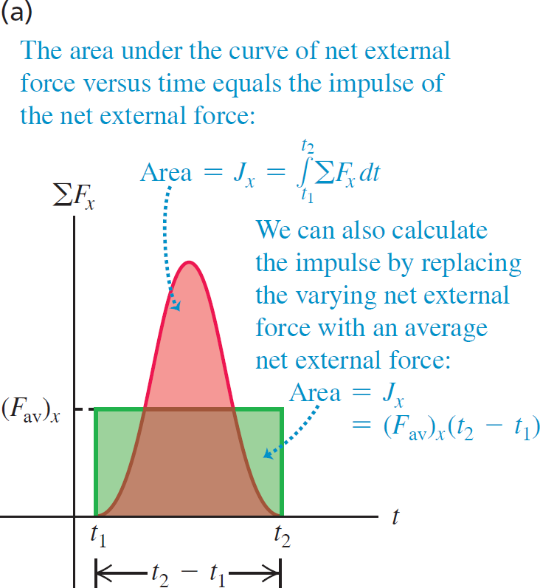
Impulse (2 of 3)

Slide 7
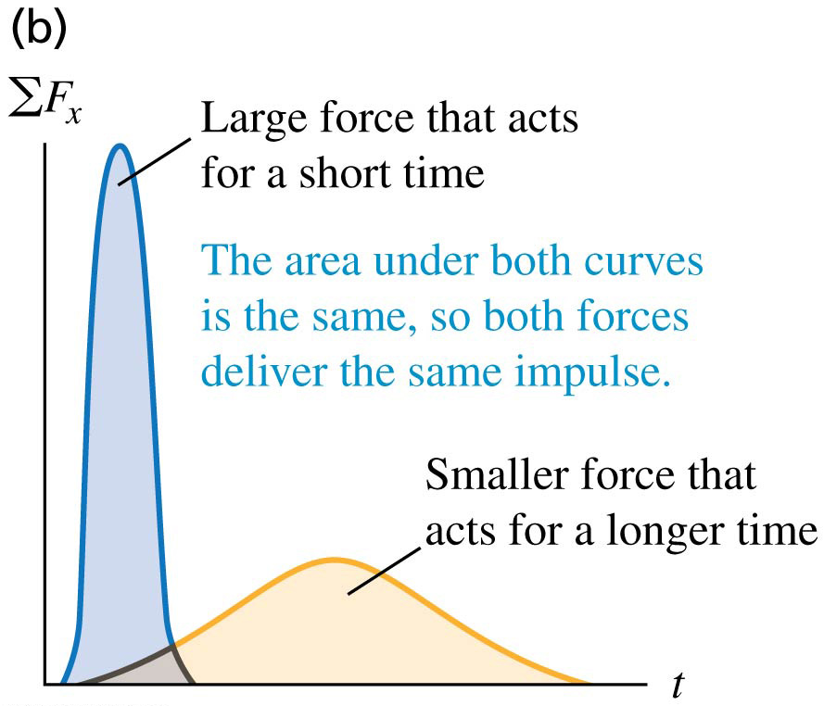
Impulse (3 of 3)

Slide 8
Impulse and Momentum (1 of 2)
Impulse–momentum theorem: The change in momentum of a particle during a time interval is equal to the impulse of the net force acting on the particle during that interval:
Video Tutor Solution: Example 8.2

Slide 9
Impulse and Momentum (2 of 2)
When you land after jumping upward, your momentum changes from a downward value to zero.
It’s best to land with your knees bent so that your legs can flex.
You then take a relatively long time to stop, and the force that the ground exerts on your legs is small.
If you land with your legs extended, you stop in a short time, the force on your legs is larger, and the possibility of injury is greater.

Slide 10
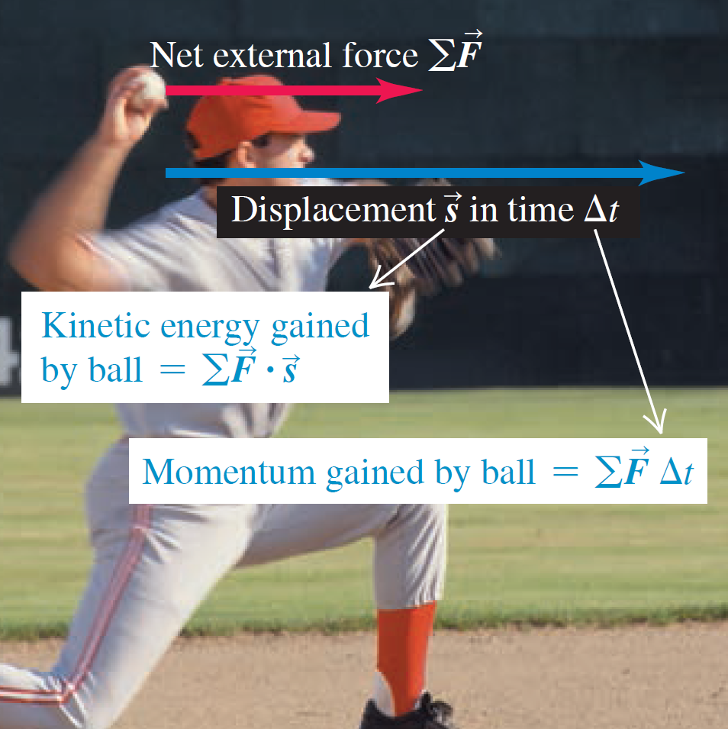
Compare Momentum and Kinetic Energy
The kinetic energy of a pitched baseball is equal to the work the pitcher does on it (force multiplied by the distance the ball moves during the throw).
The momentum of the ball is equal to the impulse the pitcher imparts to it (force multiplied by the time it took to bring the ball up to speed).

Slide 11
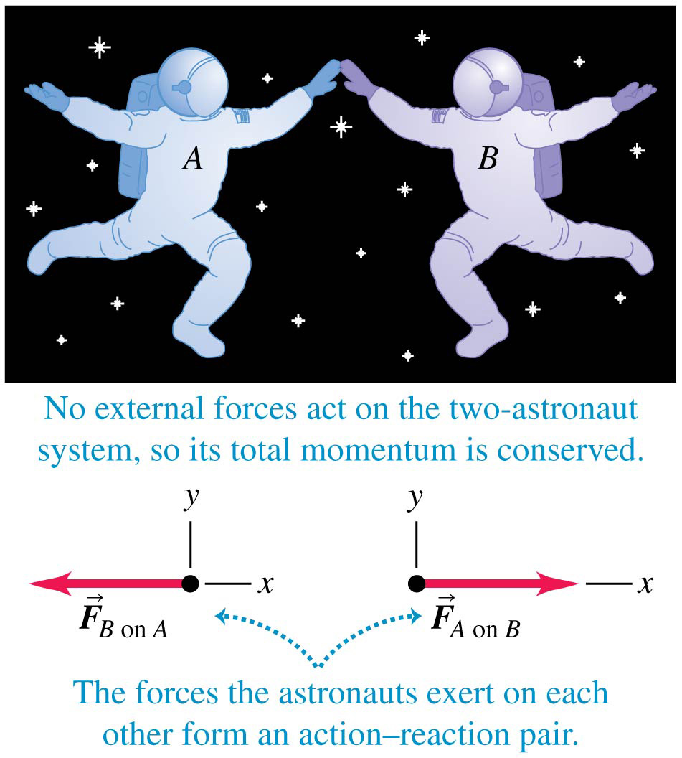
An Isolated System
Two astronauts push each other as they float freely in the zero-gravity environment of space.
There are no external forces; when this is the case, we have an isolated system.

Slide 12
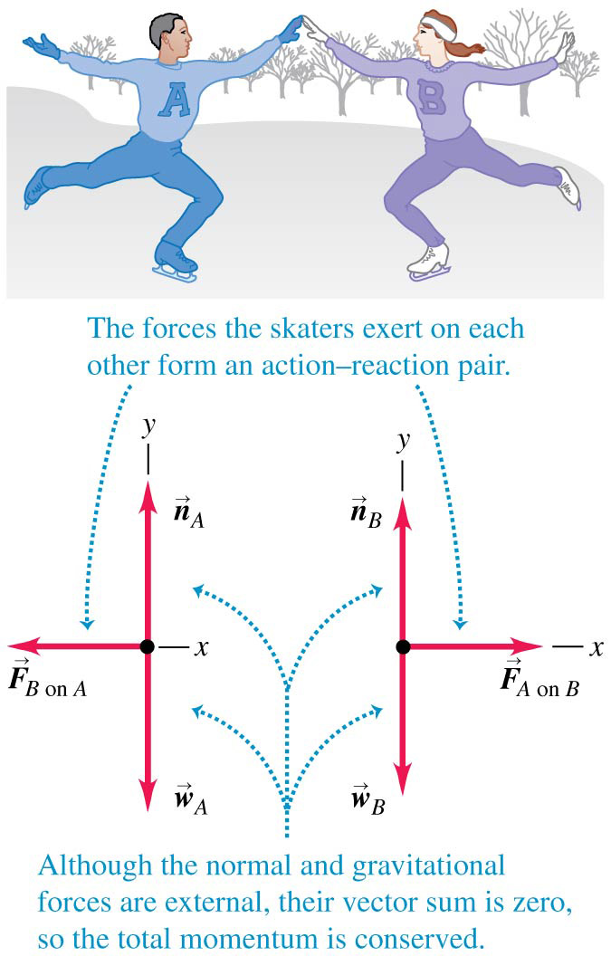
Conservation of Momentum
External forces (the normal force and gravity) act on the skaters shown, but their vector sum is zero.
Therefore the total momentum of the skaters is conserved.
Conservation of momentum: If the vector sum of the external forces on a system is zero, the total momentum of the system is constant.

Slide 13
Remember that Momentum Is a Vector!
When applying conservation of momentum, remember that momentum is a vector quantity!
Use vector addition to add momenta, as shown at the right.
Video Tutor Solution: Example 8.3

Slide 14
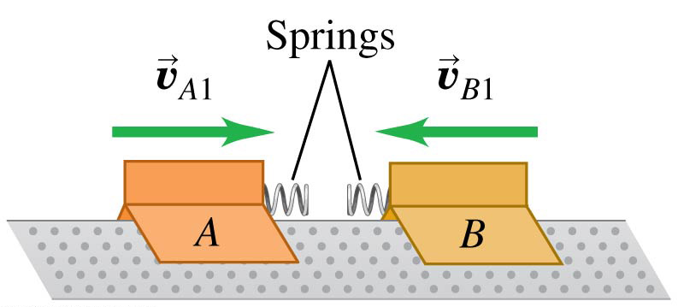
Elastic Collisions: Before
In an elastic collision, the total kinetic energy of the system is the same after the collision as before.

Slide 15
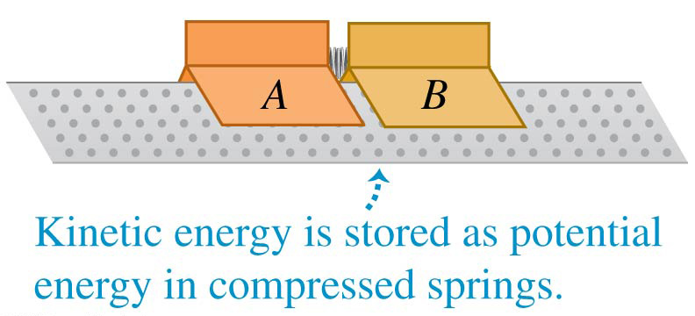
Elastic Collisions: During
In an elastic collision, the total kinetic energy of the system is the same after the collision as before.

Slide 16
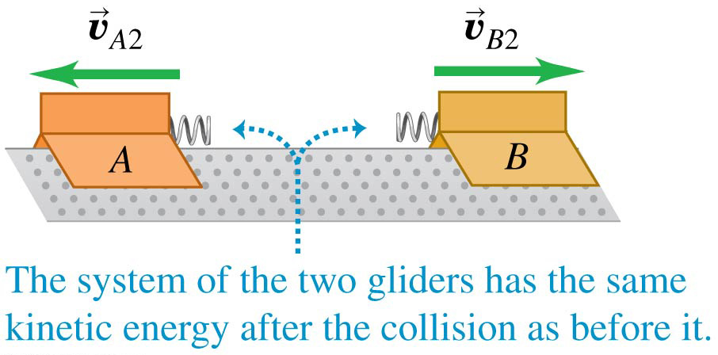
Elastic Collisions: After
In an elastic collision, the total kinetic energy of the system is the same after the collision as before.

Slide 17
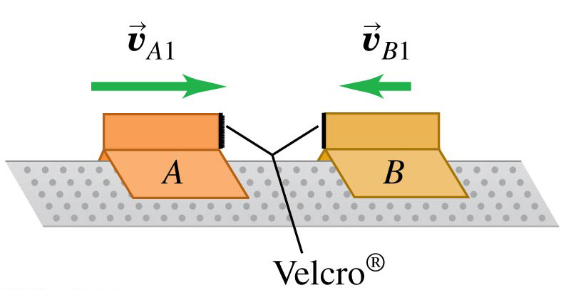
Completely Inelastic Collisions: Before
In an inelastic collision, the total kinetic energy after the collision is less than before the collision.

Slide 18
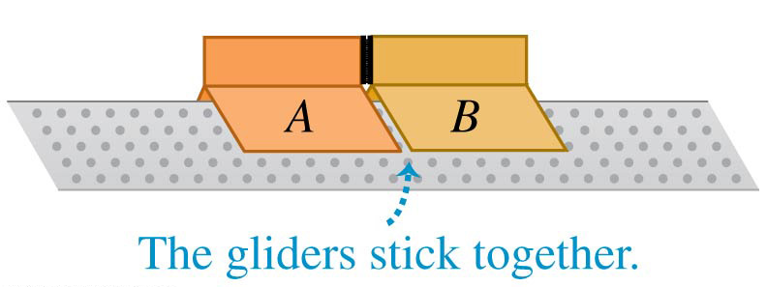
Completely Inelastic Collisions: During
In an inelastic collision, the total kinetic energy after the collision is less than before the collision.

Slide 19
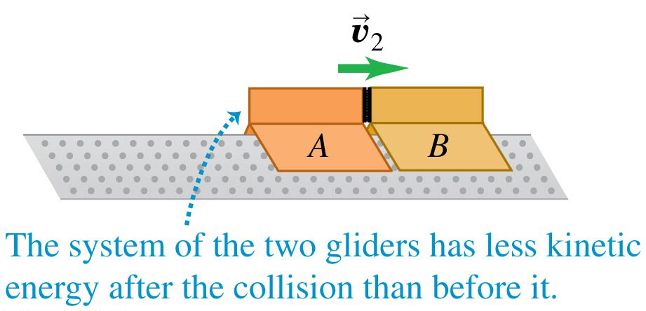
Completely Inelastic Collisions: After
In an inelastic collision, the total kinetic energy after the collision is less than before the collision.

Slide 20
Collisions
In an inelastic collision, the total kinetic energy after the collision is less than before the collision.
A collision in which the objects stick together is called a completely inelastic collision.
In any collision in which the external forces can be neglected, the total momentum is conserved.
In elastic collisions only, the total kinetic energy before equals the total kinetic energy after.

Slide 21
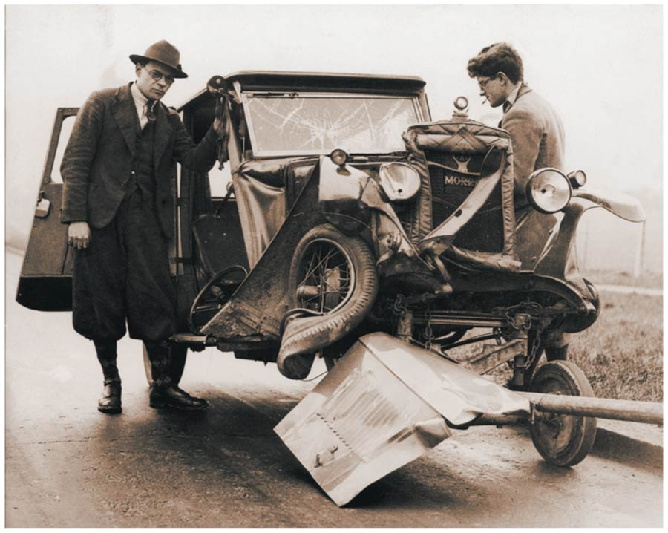
Inelastic Collision Example
Cars are designed so that collisions are inelastic—the structure of the car absorbs as much of the energy of the collision as possible.
This absorbed energy cannot be recovered, since it goes into a permanent deformation of the car.

Slide 22
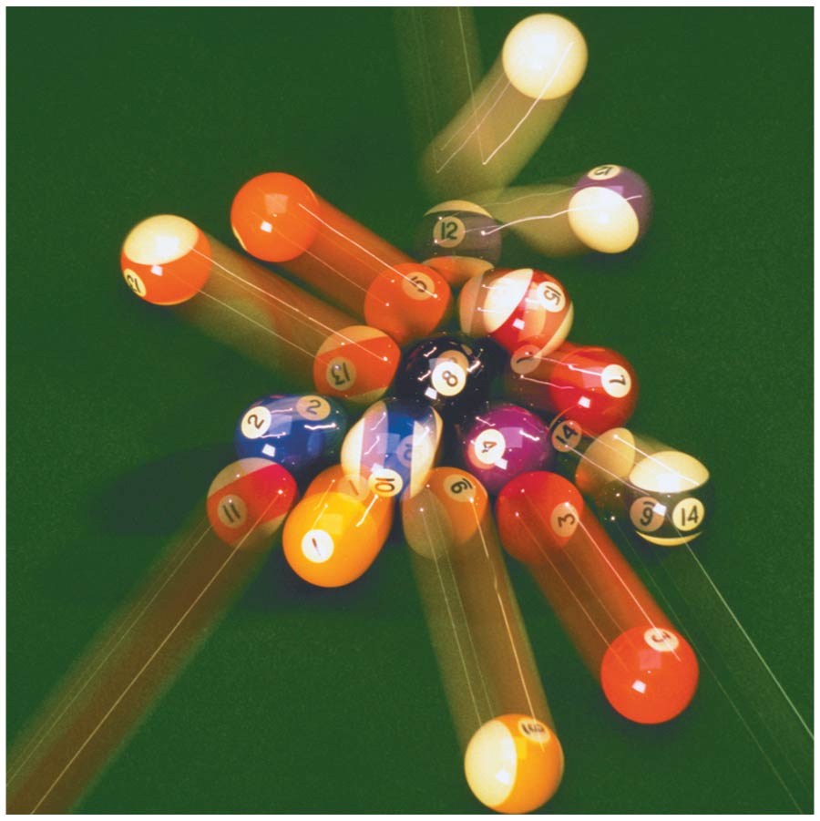
Elastic Collision Example
Billiard balls deform very little when they collide, and they quickly spring back from any deformation they do undergo.
Hence the force of interaction between the balls is almost perfectly conservative, and the collision is almost perfectly elastic.
Video Tutor Demonstration: Happy/Sad Pendulums

Slide 23
Elastic Collisions in One Dimension (1 of 4)
Let’s look at a one-dimensional elastic collision between two objects A and B, in which all the velocities lie along the same line.
We will concentrate on the particular case in which object B is at rest before the collision.
Conservation of kinetic energy and momentum give the result for the final velocities of A and B:
Video Tutor Solution: Example 8.11

Slide 24
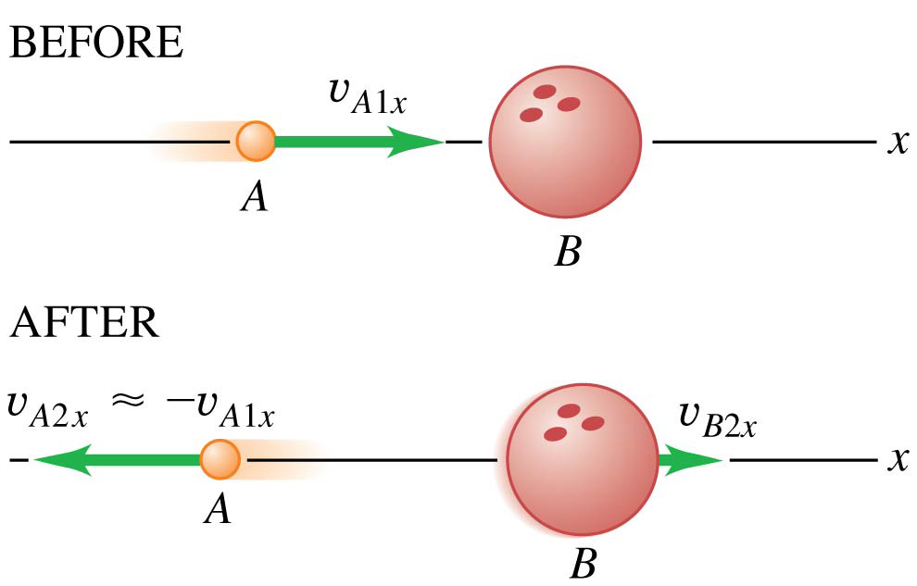
Elastic Collisions in One Dimension (2 of 4)
When B is much more massive than A, then A reverses its velocity direction, and B hardly moves.

Slide 25
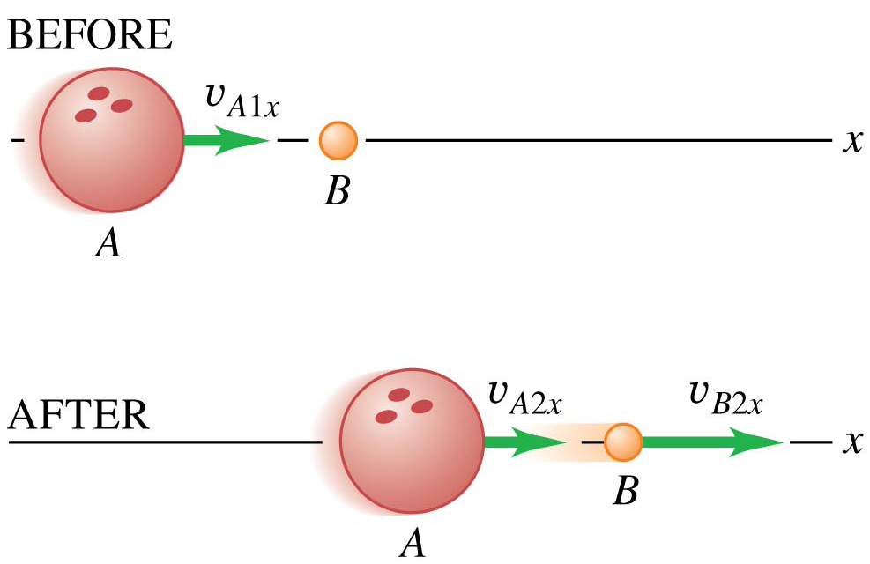
Elastic Collisions in One Dimension (3 of 4)
When B is much less massive than A, then A slows a little bit, while B picks up a velocity of about twice the original velocity of A.

Slide 26
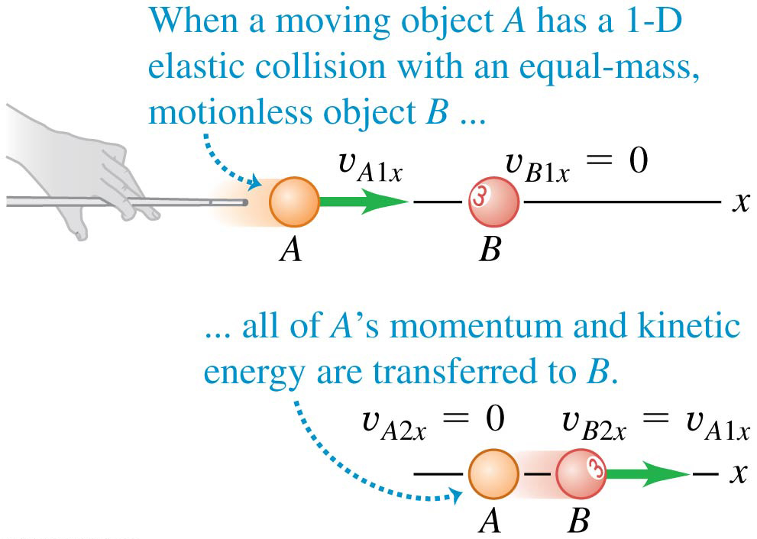
Elastic Collisions in One Dimension (4 of 4)
When A and B have similar masses, then A stops after the collision and B moves with the original speed of A.

Slide 27
Center of Mass
We can restate the principle of conservation of momentum in a useful way by using the concept of center of mass.
Suppose we have several particles with masses m₁, m₂, and so on.
We define the center of mass of the system as the point at the position given by:

Slide 28
Center of Mass of Symmetrical Objects (1 of 2)

Slide 29
Center of Mass of Symmetrical Objects (2 of 2)

Slide 30
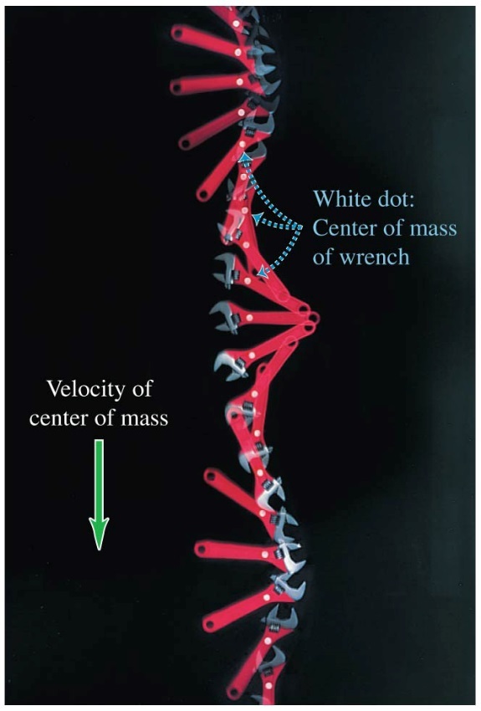
Motion of the Center of Mass
The total momentum of a system is equal to the total mass times the velocity of the center of mass.
The center of mass of the wrench at the right moves as though all the mass were concentrated there.

Slide 31
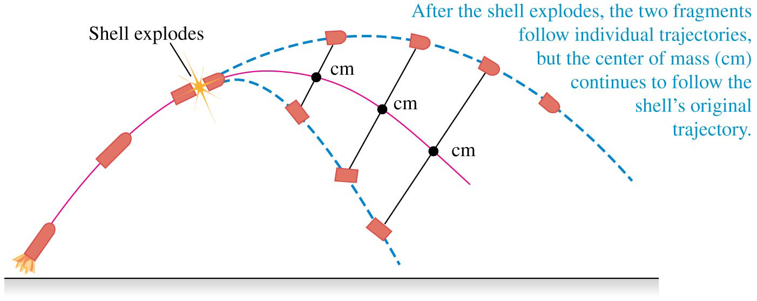
External Forces and Center-Of-Mass Motion
When an object or a collection of particles is acted on by external forces, the center of mass moves as though all the mass were concentrated at that point and it were acted on by a net force equal to the sum of the external forces on the system.

Slide 32
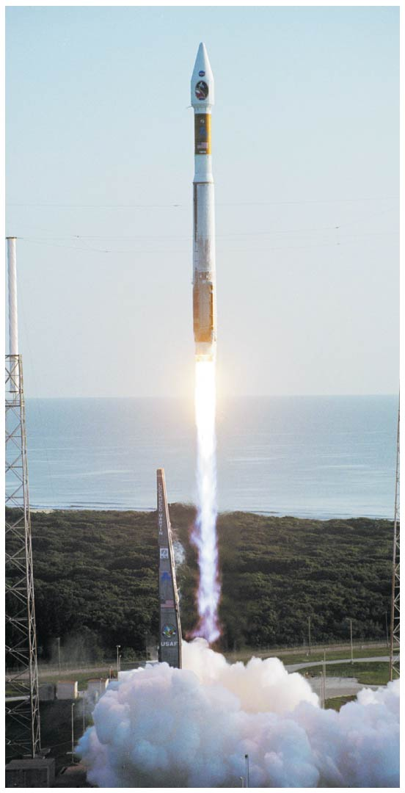
Rocket Propulsion
As a rocket burns fuel, its mass decreases.
To provide enough thrust to lift its payload into space, this Atlas V launch vehicle ejects more than 1000 kg of burned fuel per second at speeds of nearly 4000 m/s.
Video Tutor Demonstration: Water Rocket

