Slide 1
Physics 320: Newtonian Mechanics (Lecture 4)
Dale Gary
NJIT Physics Department

Slide 2
Isaac Newton
Isaac Newton was one of the great scientific minds of history, perhaps even the greatest of all time. He was born in the year Galileo died, 1642, and at age 18 he entered Cambridge University in England.
During two years when he interrupted his studies to escape the plague, he alone laid the foundation for great discoveries in the physics of motion, astronomy, optics, and mathematics.
He developed new mathematical techniques that led to calculus (what he called fluxions), which made it possible to solve other problems such as his universal law of gravitation.
Like Kepler’s three laws, Newton developed three laws of motion, not just applied to planets, but to all bodies anywhere.
You have all learned Newton’s three laws in your freshman physics class, but we will briefly go through them again. Then we will spend a little more time on the law of gravitation.

Slide 3
Newton’s Three Laws of Motion
Law of Inertia is basically a statement of conservation of linear momentum
Force Law defines the force on a body in terms of its effect in accelerating the body
Law of Action and Reaction is basically the conservation of total linear momentum for a system of particles:
The velocity of a body remains constant unless the body is acted on by an outside force; A body at rest tends to remain at rest, a body in motion tends to remain in motion, unless acted on by an outside force; $F=\frac{dp}{dt}=0⇒\frac{mdv}{dt}=0⇒ma=0$
The acceleration imparted to a body is proportional to and in the direction of the force applied, and inversely proportional to the mass of the body; $F=ma$
For every force acting on a body, there is an equal and opposite force exerted by the body; $F_{1}=−F_{2};$or $P=\sum{p_{i}}$ = constant

Slide 4
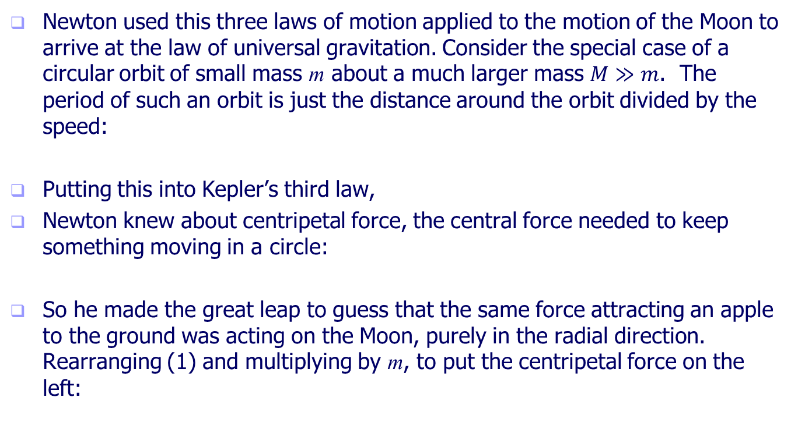
Newton’s Law of Universal Gravitation
Newton used this three laws of motion applied to the motion of the Moon to arrive at the law of universal gravitation. Consider the special case of a circular orbit of small mass m about a much larger mass $M≫m$. The period of such an orbit is just the distance around the orbit divided by the speed:
Putting this into Kepler’s third law,
Newton knew about centripetal force, the central force needed to keep something moving in a circle:
So he made the great leap to guess that the same force attracting an apple to the ground was acting on the Moon, purely in the radial direction. Rearranging (1) and multiplying by m, to put the centripetal force on the left:
$$P=\frac{2πr}{v}$$
$$P^{2}=\frac{4π^{2}r^{2}}{v^{2}}= kr^{3} (1)$$
$$F_{r}=\frac{mv^{2}}{r}$$
$$F=\frac{mv^{2}}{r}=\frac{4π^{2}m}{kr^{2}} (2)$$

Slide 5
Newton’s Law of Universal Gravitation
From Newton’s third law, he knew that this force on the Moon would have to be balanced by an equal and opposite force of the Moon on the Earth. But in that case, the mass in the force equation would be the Earth’s mass (and the constant k would be different).
Thus, there is a third constant, which he called G, with the value
So that both (2) and (2’) become the same equation:
If this same force is the one that attracts an apple, then the value G can be determined from
$$F=\frac{4π^{2}M}{k′r^{2}} (2′)$$
$$G=\frac{4π^{2}}{kM}=\frac{4π^{2}}{k^{′}m}$$
$$F=G\frac{Mm}{r^{2}} (3)$$
Acceleration of gravity, g
$$F=G\frac{Mm}{r^{2}}=mg⇒G=g\frac{R_{⨁}^{2}}{M_{⨁}}=6.673×{10}^{−11} \text{N} {\text{m}}^{\text{2}} {\text{kg}}^{\text{−2}}$$

Slide 6
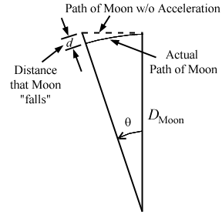
The Falling Moon
This was a great result, but Newton was not done yet. Like all good scientists, he had to check his work!
How? By comparing the orbit of the Moon with the distance it would fall if his theory were correct.
First, he needed the acceleration of gravity at the distance of the Moon:
The value of g' is 2.71 x 10⁻³ m s⁻². Thus, in 1 s, the Moon will fall a distance:$x=\frac{1}{2}at^{2}=\frac{1}{2}g^{′}t^{2}=1.36×{10}^{−3} \text{m}\text{.}$
Let’s see if this matches the orbit of the Moon.
$$F=G\frac{M_{⊕}M_{⦅}}{D_{⦅}^{2}}=gM_{⦅}\frac{R_{⊕}^{2}}{D_{⦅}^{2}}=g′M_{⦅}$$
Same answer!
The sidereal period of the Moon is P = 27.32 days = 2.36×10⁶ s, so the angular velocity is 2π/P = 2.66×10⁻⁶ s⁻¹. Thus, in 1 s, the Moon moves through an angle of 2.66×10⁻⁶ radians. The distance that the Moon falls is shown in the figure above, and is related to the distance to the Moon by
$$d=\frac{D_{⦅}}{\cos{θ}} −D_{⦅}=D_{⦅}\left(1−\frac{1}{\cos{θ}}\right)≈\frac{D_{⦅}θ^{2}}{2}=\frac{1}{2}\left(384,000 \text{km}\right){\left(2.66×{10}^{−6}\right)}^{2}=1.36×{10}^{−3} \text{m}$$

Slide 7
Series Expansions
$$D_{⦅}\left(1−\frac{1}{\cos{θ}}\right)≈\frac{D_{⦅}θ^{2}}{2}$$
The approximation required the use of two expansions:
These are often necessary for working with very small numbers, or numbers very close to 1 (as in this case). Most calculators will evaluate cos(2.66×10⁻⁶) as 1, which would give a result of 0 in the above case.
You should be able to recognize situations where an expansion is called for, and be able to perform the expansion using the appropriate formula.
$$\cos{θ}=1−\frac{θ^{2}}{2}+\frac{θ^{4}}{24}−…$$
$${\left(1−x\right)}^{n}=1+nx+\frac{1}{2}n\left(n−1\right)x^{2}+…$$

Slide 8
Update to Kepler’s Third Law
Earlier, we noted that Newton defined the gravitational constant as
But recall that the k in the first relation came from Kepler’s third law. Thus, Newton determined the value of k,
and as a result we can rewrite Kepler’s third law as
It turns out that this is only valid for an orbiting object of mass $m≪M.$
In a couple of weeks, we will make a further improvement to get the final form:
$$G=\frac{4π^{2}}{kM}=\frac{4π^{2}}{k^{′}m}$$
$$k=\frac{4π^{2}}{GM}$$
$$P^{2}=\frac{4π^{2}}{GM}a^{3}$$
$$P^{2}=\frac{4π^{2}}{G\left(m_{1}+m_{2}\right)}a^{3}$$

Slide 9
Gravity Due to a Spherical Mass
In astronomy, we are very often dealing with spherical masses with densities that depend only on radius (that is, the mass is evenly distributed azimuthally, but is concentrated in the center). This is the case for stars and planets, and is a good approximation even for relatively small but more-or-less round asteroids.
There is an important result for the gravity force due to a spherical shell, that the force of the spherical shell acts as if it is a point mass located at the center of the shell, with the mass of the total mass of the shell.
Since a sphere with densities depending only on radius can be built up of a nested series of such shells, this shows that the gravity force of such a spherical body acts as a point mass at its center, with mass equal to the total mass of the body.
There are some surprising results of this for points inside the shell! cf. Dyson spheres and Ring World.

Slide 10
What We’ve Learned
Know the contributions of Isaac Newton, especially his law of universal gravitation, which gave physical meaning to the constant k in Kepler’s third law.
Be able to name and describe Newton’s three laws of motion.
Understand the behavior of the gravity of a spherical shell, both inside and outside.
Be able to calculate the acceleration of gravity at any point in space due to the gravity of a sphere. Remember that the distance to use in this calculation is not the height h above the surface, but R + h, where R is the radius of the sphere.
Know the new form for Kepler’s third law, and how k changes with mass of the object being orbited (the primary).
When the primary is the Sun, the period is expressed in years, and the semi-major axis (orbital radius) is expressed in AU, the value of k = 1. In all other cases, you’ll need to calculate k.

