Slide 1
Physics 320: Interstellar Medium (Lecture 8)
Dale Gary
NJIT Physics Department

Slide 2
Birth of the Solar System
We are going to spend a couple of weeks looking into how the solar system (and other planetary systems we have discovered) came to be. That starts with the raw materials that the solar system is made of.
That material is gas and dust that permeates all of space, but of course is denser in some places than others. This forms the gas and dust clouds called nebulae, which are fun to look at in small telescopes, and make such beautiful and colorful images when photographed with “deep” exposures.
In the early universe, there was no dust, only gas in the form of mostly hydrogen, with about 25% helium (by mass), and traces of lithium. This gas eventually became dense and cold enough to collapse under its own gravity and form very large stars, which, because they were so large, lived their lives very quickly (perhaps 100 million years or less). The stars shine by fusing their hydrogen into heavier and heavier elements, until iron (element 26) is reached. They then undergo supernova explosions, creating even heavier elements and spewing them into space.
Many such generations of stars have lived and died, creating the gas and dust that we now see as the interstellar medium.

Slide 3
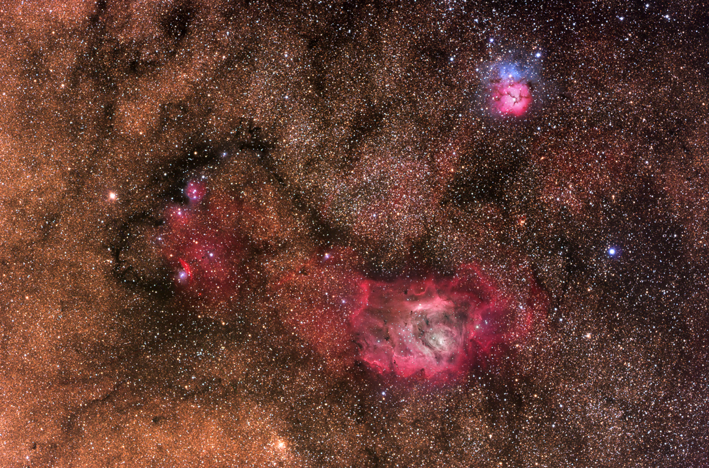
Gas and Dust in the Milky Way
Photo by Steve Mazlin and Jim Misti

Slide 4
Interstellar Medium
You can see from the previous image that the interstellar medium, or ISM, has a lot of structure, and appears in different forms that can have distinctive colors. In this lecture, we will investigate what phenomena are causing these differences.
Note that the term ISM also includes the magnetic fields that may be present, in addition to the particles of gas and dust.
Aside from those regions that seem to glow in red and blue colors, most of the ISM is dark and hard to detect. The dark clouds of the Milky Way are only visible due to their absorption of light from the background stars of the Milky Way, but such dust is in every direction we look, even if it cannot be directly seen.
We already mentioned last week that one effect of the dust was to absorb some starlight, so that we have to modify the distance modulus equation to account for it:
We use the subscript λ just to emphasize that the absorption is wavelength (or color) dependent. As we said last week, this absorption reddens starlight, and affects the “color excess” CE = CI_{observed} – CI_{intrinsic}.
$$m_{λ}−M_{λ}=5\log{d}−5+A_{λ}$$

Slide 5
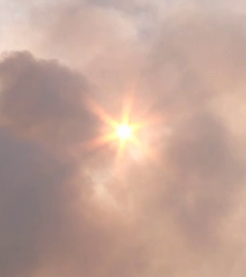
Black and Blue Dust
There is an aspect of the effect of dust that often gives students difficulty, so let’s discuss it in some detail.
First, there are a couple of direct experiences you yourself have had. One is the blue appearance of thin smoke seen by reflected light.
Sufficiently tiny dust particles tend to reflect blue light, because blue light has a shorter wavelength that red light, and so it scatters more easily on particles of similar size. This is Mie scattering, so is somewhat different than the Rayleigh scattering that explains why the sky is blue.
© Mitch Martinez
Sun through smoke
However, when you look at an object through such smoke, the object is reddened? Why? Because the blue light is scattered and not transmitted.

Slide 6
Black and Blue Dust, continued
The amount of scattering depends on how far the light travels through the dust, with some fraction of the remaining light being scattered, so one can write down a simple differential equation: $dI=−Iκ_{λ}dl$, where $κ_{λ}$ is a constant absorption per unit length. This has the solution
Here $τ_{λ}$ is a dimensionless number called the optical depth, and $e^{−τ_{λ}}$ represents the fraction of incident intensity $I_{λ,0}$ that escapes from the cloud. If the cloud is so thin as to be ignorable, then $τ_{λ}=0$ and we say the cloud is optically thin. As $τ_{λ}\overset{→}{}∞$, the emergent intensity goes to zero, and we say the cloud is optically thick. In the case of starlight, this is called extinction.
We can relate the magnitude $A_{λ}$ in the equation , by noting that the flux ratio and intensity ratio will be the same ($\frac{ℱ_{λ}}{ℱ_{λ,0}}=\frac{I_{λ}}{I_{λ,0}})$, so we can form a magnitude difference:
This says that the observed magnitude $m_{λ}$ is larger (the star is fainter) than the original magnitude $m_{λ,0}$ by the amount $A_{λ}=1.086τ_{λ}$. So $A_{λ}≈τ_{λ}$.
$$\frac{I_{λ}}{I_{λ,0}}=e^{−\int{κ_{λ}dl}}=e^{−τ_{λ}}$$
$$m_{λ}−M_{λ}=5\log{d}−5+A_{λ}$$
$$m_{λ,0}−m_{λ}=2.5\log{\frac{I_{λ}}{I_{λ,0}}}=−2.5τ_{λ}\log{e}=−1.086τ_{λ}$$

Slide 7
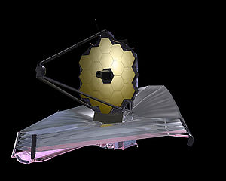
Mie Scattering
Let’s assume for simplicity that a dust grain is spherical, with an area (called a cross-section) $σ_{g}=πa^{2}$, where a is the grain radius. This area will interact with light differently depending on the wavelength of the light.
A long wavelength (compared to the grain size) will hardly be affected, while a sufficiently short wavelength will be blocked, or scattered off the spherical surface, just as we experience in everyday life. In other words, the cross-section will be wavelength-dependent, approaching $σ_{λ}→σ_{g}$ as the wavelength $λ→0$.
Gustav Mie was able to show that the dimensionless extinction coefficient $Q_{λ}≡\frac{σ_{λ}}{σ_{g}}\sim \frac{a}{λ}$ for $λ≥a$, which goes to zero at long wavelengths, and is around unity when $λ≈a$. Note $σ_{λ}∝{a^{3}}/λ$ in that case.
This is a very important property for astronomy! It says that we can reduce the extinction due to dust by going to longer wavelengths, so we will find that astronomers can peer into dust clouds by using long infrared (IR) wavelengths. Such long wavelengths are blocked by the atmosphere, though, so such telescopes have to be launched into space. The upcoming James Webb Space Telescope (JWST) will work almost entirely in the IR.

Slide 8
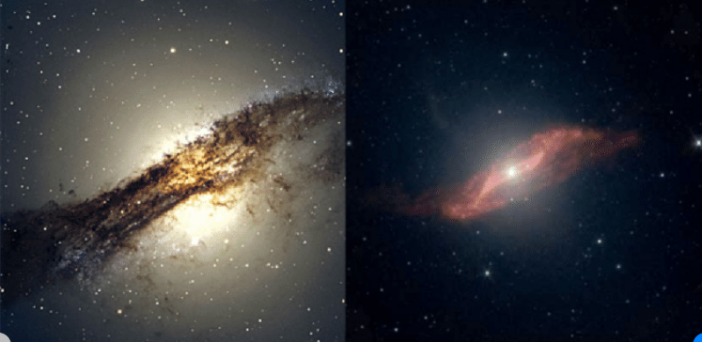
Reddening and Extinction—Cen A

Slide 9
Gas and Dust in the Milky Way
Dust (reflection nebula)
Dust (absorption nebula)
?
Gas (emission nebula)
Photo by Steve Mazlin and Jim Misti

Slide 10
Gas vs. Dust
Gas (atomic nuclei, neutral atoms, molecules)
obeys gas dynamics (e.g. ideal gas law), emission processes.
Factor of 10¹² larger number of gas particles than dust particles.
Seen by emission or absorption (mostly of spectral lines), so mainly RED due to the strongest optical line of hydrogen (Hα).
Dust (grains, aggregates of molecules)
only small in number (avg. 1 particle in 10⁶ m³),
but BIG -- of order 1 micron in size.
Make up about 1% of ISM by mass.
Dominates opacity (interstellar absorption and other effects).
Seen by reflection or absorption (continuum), so BLUE (if thin) or BLACK (if thick)

Slide 11
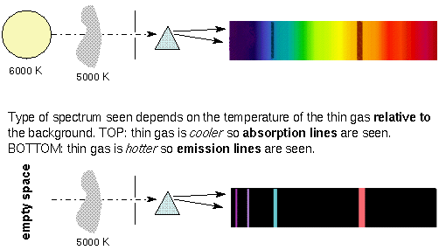
Interaction of Light with Gas
In the ISM, gas comes in many forms, depending on temperature and density. These are, in order of increasing energy:
Molecular gas, e.g H₂, but others like CO, OH, CH₄
Neutral atomic gas, e.g. H or H I, but also He
Ionized gas (called a plasma), e.g. H II, but others like C IV, Si IV, even up to Fe XXIV
Elementary particles (when the energies are so high that electrons are all stripped from the atoms).
These different forms react with light (both for absorption, and its inverse, emission) in different ways.
Molecular gas around a hot star is first dissociated (broken into its constituent atoms) and becomes neutral atomic gas. Photons from the star will excite the atom into higher atomic states, which spontaneously emit photons, e.g. Hα. Higher energy photons ionize the gas.
Absorbs photon
Emits photon

Slide 12
Emission from Gas
Just as it takes more and more energy to create these different species of gas, from molecular, through atomic, to ionized, so too these different species of gas emit photons from lower to higher energy generally in the same sequence.
That is because for every process of absorption, there is an equivalent, but opposite, process of emission.
Molecules tend to emit at very long wavelengths, such as millimeter-wavelength radio emission. So if you want to make images of the distribution of molecular clouds, the main technique is to use radio telescopes.
Atoms can emit a very wide range of energies, from extreme ultraviolet on the high-energy end to long-wavelength radio emission at the low-energy end. Of course, the Hα line, in the visible part of the spectrum, is one of the most prominent optical lines, which is why gas nebulae are red.
Ionized atoms emit mainly at the high-energy end of this range, i.e. ultraviolet. That wavelength is absorbed by the Earth’s atmosphere, so to observe ultraviolet, one must again use spacecraft.

Slide 13
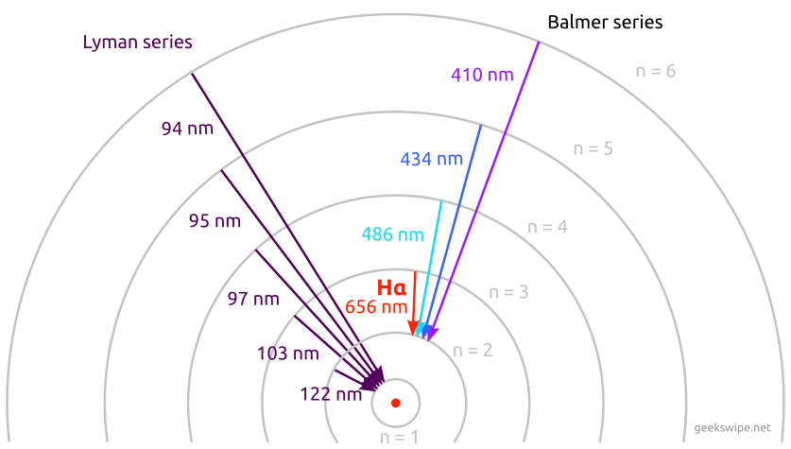
Hydrogen Emission
(Transitions to n=2)
(Transitions to n=1)
Ultraviolet
Extreme Ultraviolet
Optical (red)

Slide 14
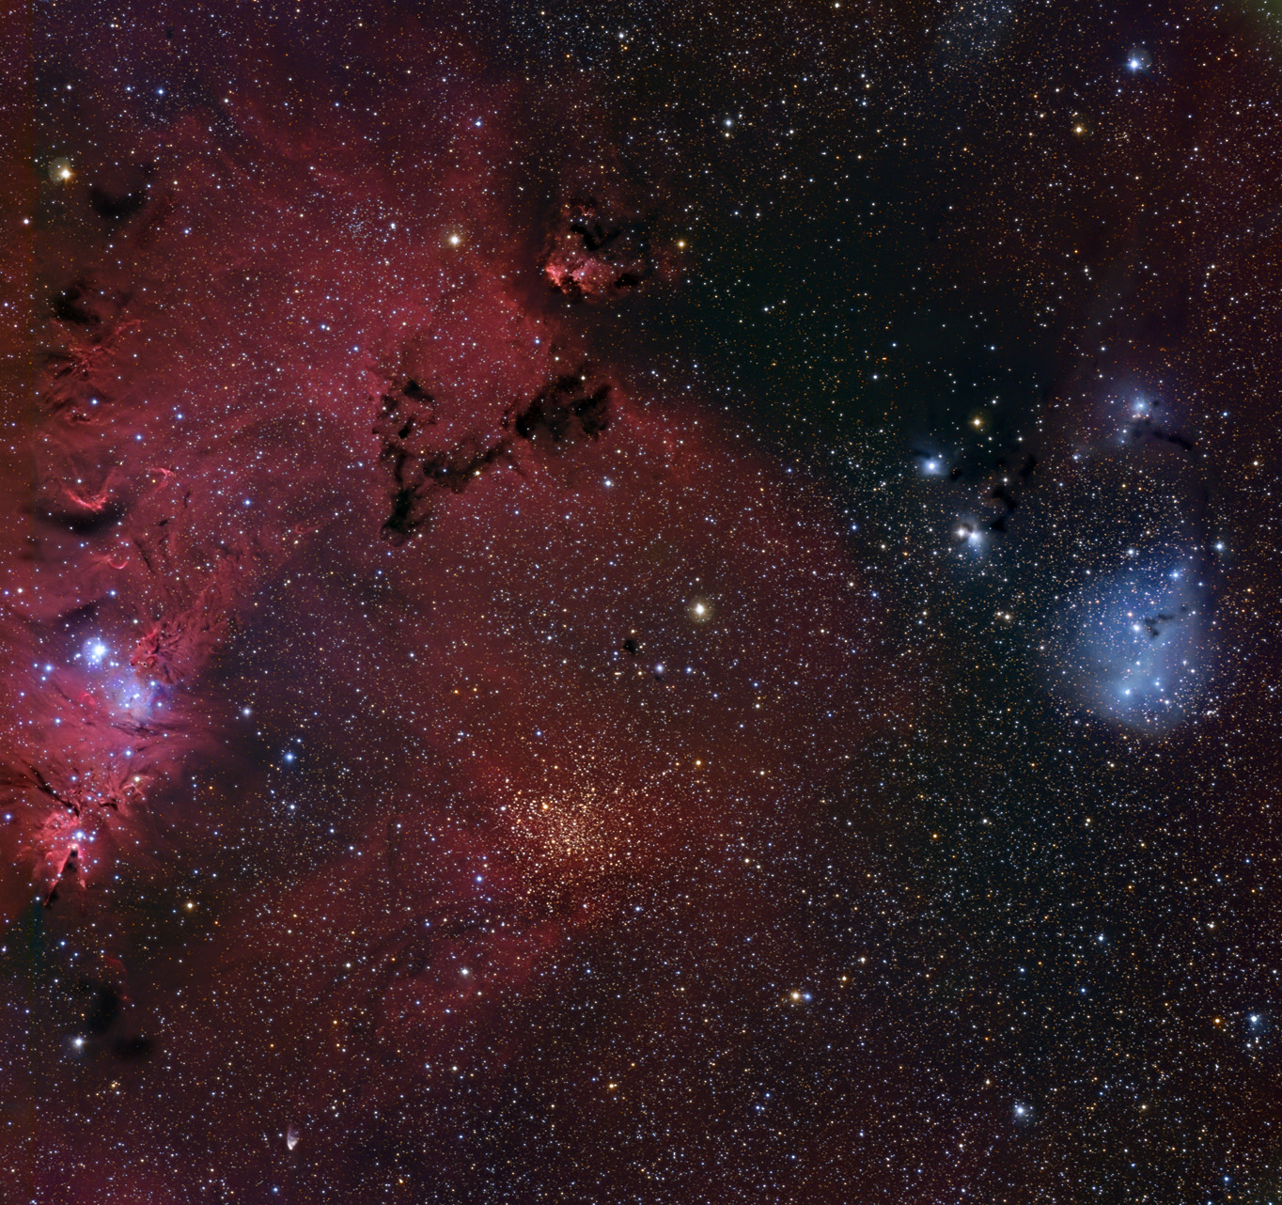
Try It
In this photo, identify:
Dust
Reflection nebula
Absorption nebula
Emission nebula
Star cluster
Which types require nearby hot stars?
Photo by Adam Block and Tim Puckett

Slide 15
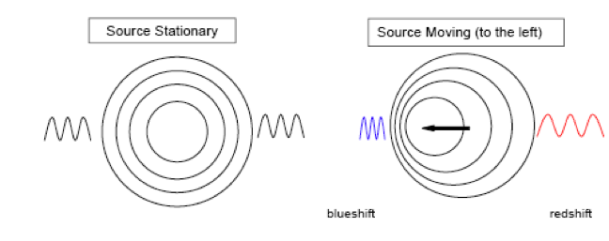
How Do We Study Nebulae?
Doppler Effect
As for sound (when you hear an approaching siren and it sounds higher pitched), light also shifts its wavelength depending on its motion. Atoms moving toward the observer emit blue-shifted light, while atoms moving away emit red-shifted light. That means spectral lines emitted by those atoms are shifted from their rest wavelength.
Hot objects have atoms in disordered motion (moving in all directions), so their spectral lines are “Doppler broadened.” Cool objects have narrow lines.
$$ν_{obs}=ν_{src}\left(\sqrt{\frac{1+{v\cos{θ}}/c}{1−{v\cos{θ}}/c}}\right)$$
v
θ
$$v\cos{θ}$$
Interstellar Absorption Lines
Unlike dust, gas is largely transparent--except in narrow spectral lines.
Look at stars, and see absorption lines in the star-light that are not due to star -- Ca I, Ca II, Ti I, Ti II, Na I, and molecules link CN and CH
What should such lines look like?
sharp and narrow (because cool and low thermal doppler broadening)
can be shifted due to bulk doppler shifts--multiple clouds.

Slide 16
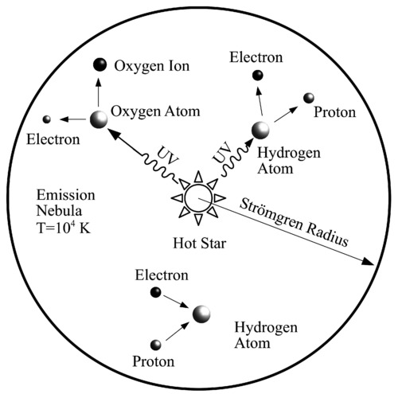
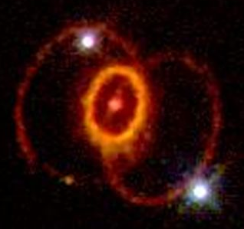
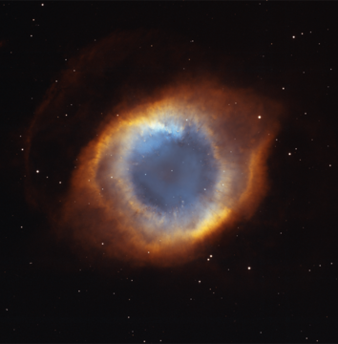
How Do We Study Nebulae?
Emission Nebulae--H II Regions
Hydrogen lines are due to recombination of ionized hydrogen (H II).
Ionization occurs due to UV photons ( > 91.2 nm, Lyman continuum) from hot (T = 20,000 K) O and B stars.
Gas fluoresces by converting UV photons to visible (electrons cascade down to lower energy levels)
If gas is uniform, an O or B star has a roughly spherical volume of H II (Strömgren Sphere).
Radio continuum comes from the free electrons
Supernove Remnants and Planetary Nebulae
These are other types of nebulae that form by other processes.
They shine by the same processes, but with a different source of energy.
Strömgren Sphere
SN 1987 A Helix Nebula

Slide 17
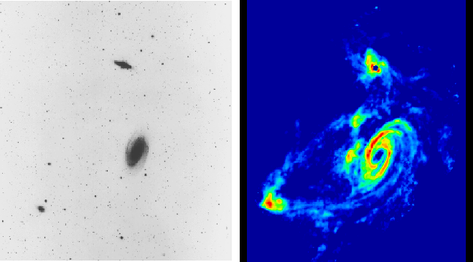
Interstellar Radio Lines
21-cm line
Lowest energy state of hydrogen
Electron in one of two spin states "up" or "down"
Define "up" to be parallel with proton spin--then this is higher energy state--would rather be antiparallel
Energy difference between "up" and "down" corresponds to radio photon of 21 cm wavelength
Spontaneous flip occurs only once every few million years!
Collisions in ISM occur once every 400 years, so most flips are due to collisions (no radiation)
Rare photon emission, but there are enormous numbers of H atoms along each line of sight, so line is strong!
The optical depth is:
Here, N_{H} is the column density
$$τ_{H}=5.2×{10}^{−23}\frac{N_{H}}{T∆υ}$$

Slide 18
Interstellar Radio Lines
Recombination Lines
Electrons recombining with hydrogen in H II regions can attach in very high excitation levels, then transition to slightly lower ones, i.e. n = 105 to n = 104. These low-energy transitions give off low-energy photons in the radio region of the spectrum, giving another way to study H II regions.
Molecular Lines
CO rotational line, with J = 0 to 1 transition at 115 GHz, and the 1 to 2 transition at 230 GHz. These correspond to mm wavelengths--radio again.
Molecules that have been detected: CO, CN, OH, H2CO, CH3OH, H2O, NH3, HCN, HC3N, HNCO, and many more
Most molecules, however, are good old H2 (molecular hydrogen).
Chance of these forming in ISM seem very small (one collision every 400 years) but dust helps
provides place to collect and hold atoms while molecules form over millions (perhaps billions) of years
shadows fragile molecules from dissociating radiation
Widespread existence of molecules has implications for extraterrestrial life.

Slide 19
What We’ve Learned
We learned that the interstellar medium is composed of gas, dust, particles, and magnetic fields.
We learned that dust is made a large grains, and causes extinction and reddening of star light due to Mie scattering. Grain cross sections are just the geometrical one for short wavelengths, but $σ_{λ}∝{a^{3}}/λ$ for longer wavelengths.
Extinction requires a correction to obs. magnitudes where the extinction magnitude is $A_{λ}=1.086τ_{λ}$, i.e. is almost a direct measure of optical depth.
We learned that gas far outnumbers dust grains in terms of numbers, but are very much lighter. Unlike dust, gas is transparent, but it can absorb specific wavelengths depending on temperature, density, and composition.
Gas comes in a hierarchy of species, molecular, neutral, ionized, and particles, with increasing energy.
We briefly covered the processes of emission and absorption, and discussed the extremely important Doppler effect, which let’s us learn about motions and even temperatures of clouds of gas.
We surveyed many of the types of emission that can be measured in the radio, visible, and ultraviolet.
$$m_{λ}−M_{λ}=5\log{d}−5+A_{λ}$$

