Slide 1
Physics 320: Extrasolar Planets (Lecture 10)
Dale Gary
NJIT Physics Department

Slide 2
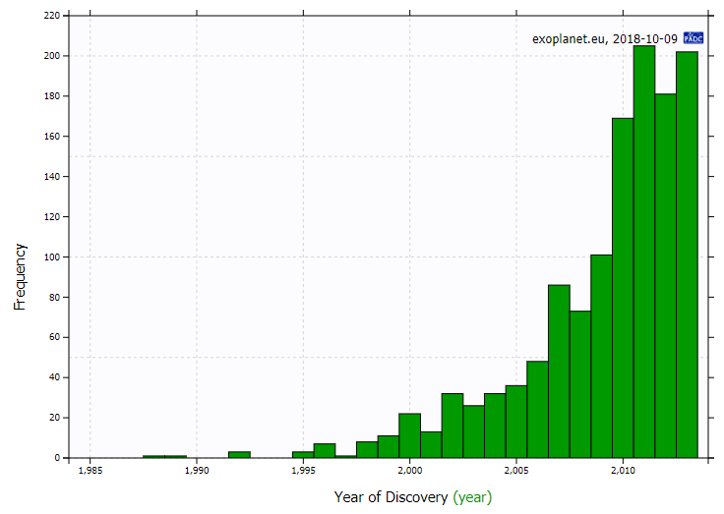
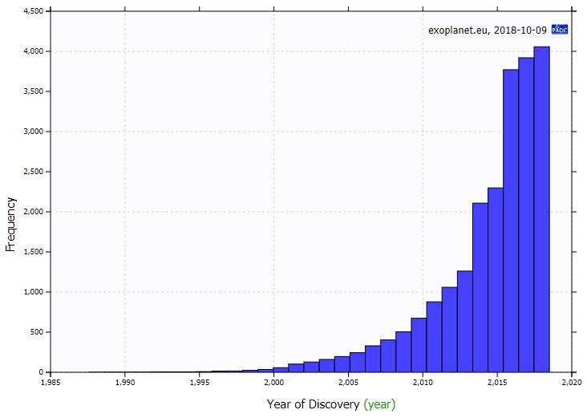
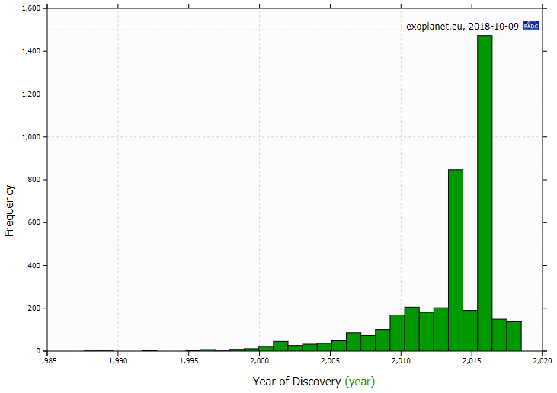
Lots of Exoplanets
The plot at right shows a histogram of the number of exoplanets discovered in each year, up to 2013. The number has grown each year, up to >200 per year.
In the five years since 2013, though there were two huge spikes. That is because of the data releases of the Kepler mission, which I will describe in a moment.
The cumulative histogram shows that we now know of > 4000 exoplanets, and have lots of information about each of them, such as planetary radius, estimate of mass (or $m\sin{i}$), orbital parameters link semi-major axis and period, parent-star parameters, and so on.
Some reasons for the explosion of discoveries are:
the development of new instruments/detectors,
refinement of techniques for detection,
the development of new methods of detection, and
the increase in number of groups now actively working on discoveries and follow-up observations.

Slide 3
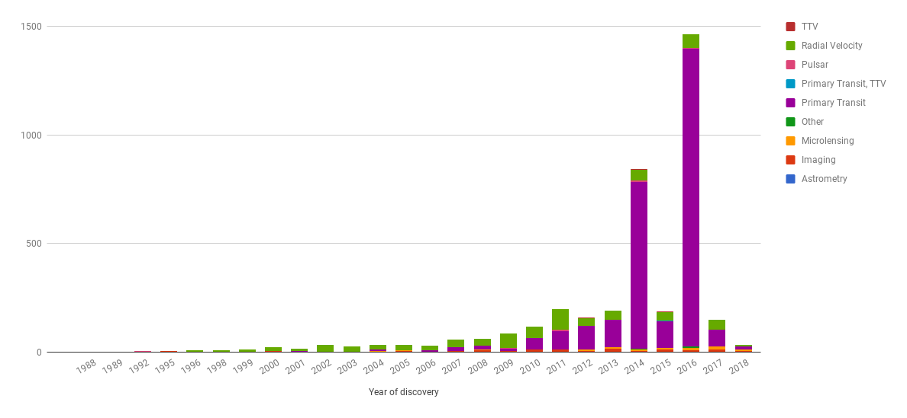
Histogram by Detection Type
Most important methods

Slide 4
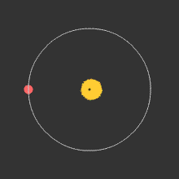
Methods of Detection
Radial Velocity Method
This used to be the most prolific method of detection: measuring the radial velocity of the star that the planet is orbiting around.
We discussed earlier that two bodies can be thought of as orbiting their common center of mass (barycenter). The planet is undetectable, but the star is easily seen, and should show a wobble about a point not quite at its center.
The period of the wobble is exactly the same as the period of orbit of the planet. To measure the period, and the extent of the wobble, we can use measurements of doppler shift of spectral lines to measure the "radial velocity" (the speed with which it is either moving towards us, causing a blue shift in spectral lines, or away from us, causing a red shift).
The figure below shows the physical situation, and here is an animation that shows the corresponding shift in spectral lines.

Slide 5
Radial Velocity Method, continued
Radial velocities as small as 3 m s⁻¹ can be measured, about the speed of a slow jogger.
Astronomers pass the starlight through an iodine vapor, so that they record both the "rest wavelength" of the iodine lines and the wavelength of the corresponding iodine lines in the star spectrum.
Of course, we must keep track of many other, even larger motions, including the Earth's spin and wobble, motion of the Earth around the Sun (30 km s⁻¹), and the motion of the Sun relative to the star.
Other motions on the star itself also have to be considered, such as its own rotation, possible oscillations or pulsations (in and out motions) of the star's surface. For reference, would the planets in our solar system be detectable by this method, if the limit is 3 m s⁻¹?
Note that the masses of planets determined by the radial velocity method are actually lower limits ($m\sin{i}$, where i is the angle of inclination of the orbit from the plane of the sky). The reason is not hard to see. Imagine that the animation on the previous page is seen from "above" as shown. The motion of the star is entirely in the plane of the page, so there is no radial velocity. The inclination in this case is i = 0 (the orbit is in the plane of the sky), so $\sin{i=0}$. When viewed from the side, i = 90 degrees, so $\sin{i}=1$.
The mass estimate is $m_{\text{est}}=m\sin{i}$, which is a lower limit to the true mass, m.

Slide 6
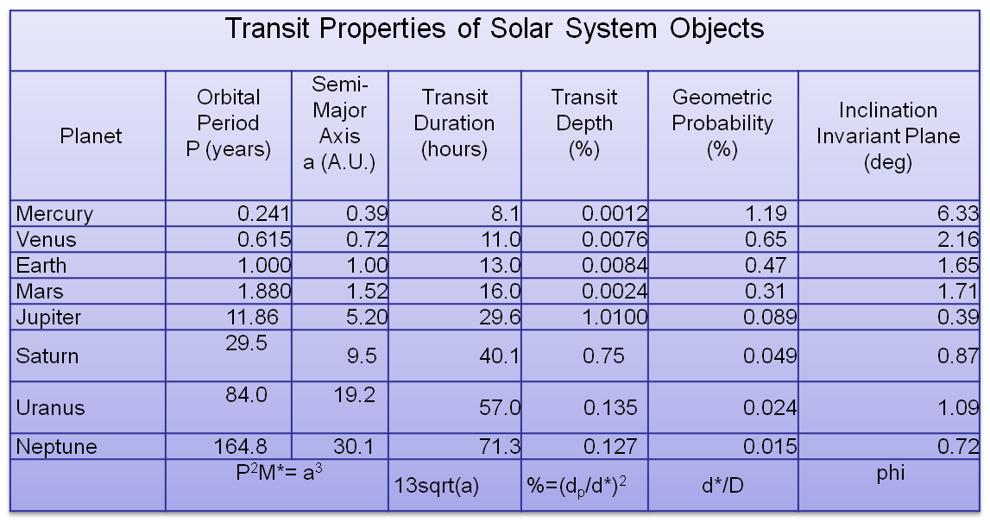
Transit Method
Currently, the most prolific method is detection by measuring a decrease in brightness of a star due to the passage of a planet in front of the star (transit).
The basic method is shown in the figure at right, but note that the planet is often very small compared to the star, so the decrease in brightness is often extremely small, perhaps 3-4 milli-magnitudes for a large planet, grading down to undetectable for small planets.
To get a feeling for the detectability of planets by the transit method, the table shows the transit properties of the solar system.
If you were observing our Sun from another star, and happened to be aligned such that the inclination angle was close to 90 degrees, you would detect transits of the planets as shown.

Slide 7
Detectability of Our Planets by Transit
For the Earth, once per year you would see a dip of 0.0084% of the brightness of the Sun (or a factor of 0.000084).
If the flux of the Sun is considered to be 1 without the transit, then during the transit the flux would be 0.999916, so the magnitude change ($m_{1}−m_{2}=2.5\log{\frac{f_{2}}{f_{1}}=2.5\log{0.999916}=0.01}$milli-magnitudes).
We can conclude that detecting Earth from another star would be very hard! How about Jupiter? The change in magnitude during a transit would be much larger, about 11 milli-magnitudes, which is easily detectable, but the dip would only occur once every 11.86 years, and we would have to be much better aligned (inclination angle within 0.39 degrees of 90).
You can see that distant planets are much less likely to be detected.
90-i
90-i'

Slide 8
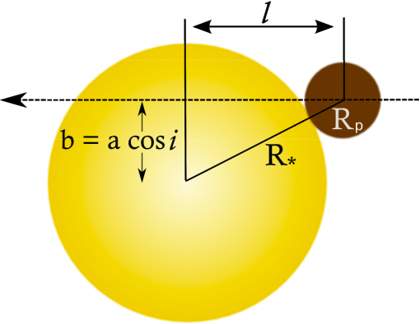
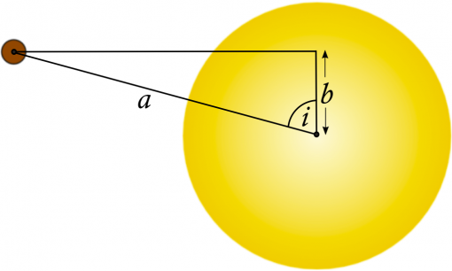
Information from Transit Lightcurves
One can use the timing of the transit lightcurve to measure a number of things about the planet and the star.
The duration of the linear part of the decrease is related to the diameter of the planet, d_{p}=2R_{p}.
We get the orbital velocity by $v_{orb}=\frac{2πa}{P}$, where a and P are related by Kepler’s third law.
The duration of the entire transit is related to the diameter of the star. The distance l is:
So the duration of the transit gives
$$t_{2}−t_{1}=t_{4}−t_{3}=d_{p}/v_{orb}$$
t₁
t₂
t₃
t₄
$$l=\sqrt{{\left(R_{∗}+R_{p}\right)}^{2}−b^{2}}$$
$$b=a\cos{i}$$
$$t_{4}−t_{1}=\frac{2l}{v_{orb}}=2l\frac{P}{2πa}$$
From: https://www.paulanthonywilson.com/the-transit-light-curve/

Slide 9
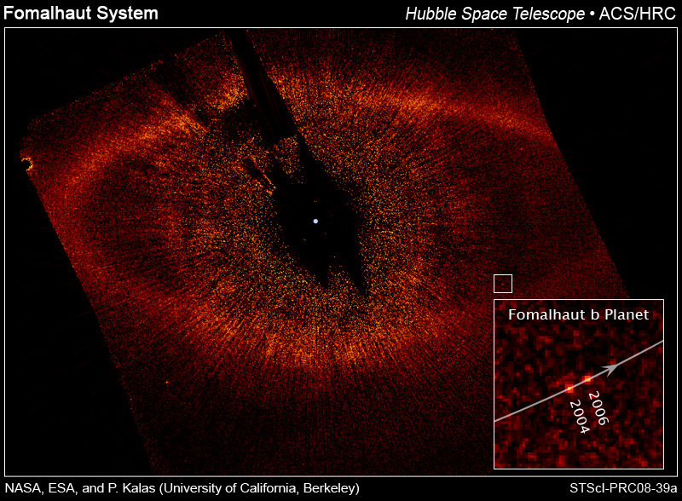
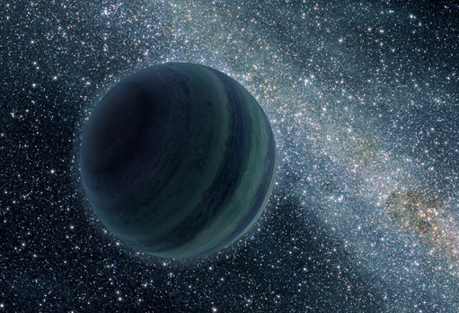
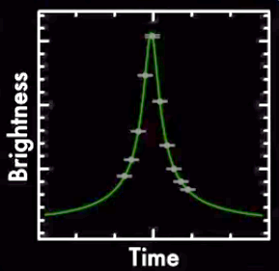
Other Methods
Astrometry
Directly measure the wobble as a star moves through space – works for large inclinations
Direct Imaging
We saw an example of this with Fomalhaut.
Pulsar Timing
Pulsars are neutron stars that spin very rapidly and are so regular that they make fantastically precise clocks. Slight differences in their pulse timings can be linked to the presence of a planet.
Gravitational Microlensing
We saw this earlier, too, when discussing free-floating planets. Light bending around them will intensify a background star in a characteristic way, and one can even measure the mass.

Slide 10
Space Missions
One reason that transits have become the most prolific method of detecting new objects, at least for awhile, is the highly successful, but now defunct Kepler space mission. Kepler is in orbit about the Sun, and was staring at a single region of the sky in the constellation Cygnus for its entire base mission. Example of Kepler data.
Recently (earlier in 2018), a new mission called TESS (Transiting Exoplanet Survey Satellite) was launched, with a much different strategy. It will cover the entire sky, looking at star fields for 27 days before going on to the next position. When it sees a possible transit, it will not follow up itself, but will announce it for ground-based observatories to follow up. At least two candidates have already been announced.

Slide 11
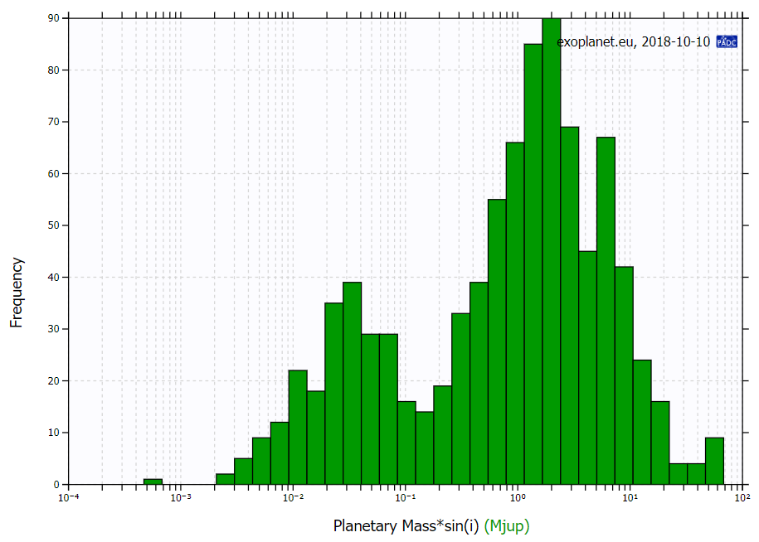
Exoplanet Masses
You can make plots of lots of information at exoplanet.eu.
Here are plots of the mass ($m\sin{i}$) for all of the planets where it has so far been measured. These are lower limits in the case of the radial velocity method, but actual masses for the transit method.
Note that by far most of the planets so far discovered are very large—Jupiter sized or bigger. Recall that Earth is about 1/100th of Jupiter’s mass.
This is due to the selection effects—larger planets are easier to detect. Probably the actual distribution is quite different, but it is hard to know.

Slide 12
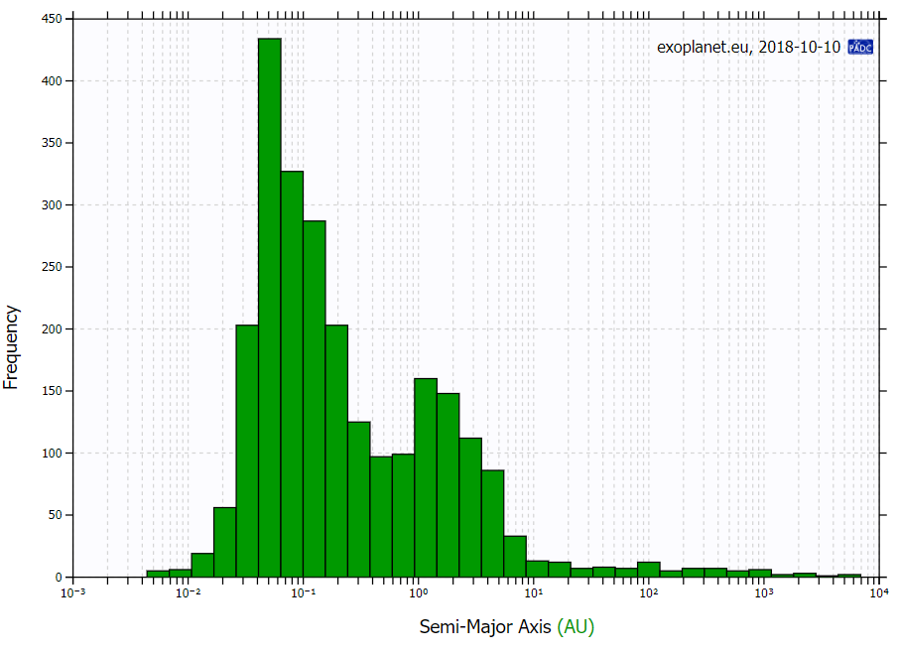
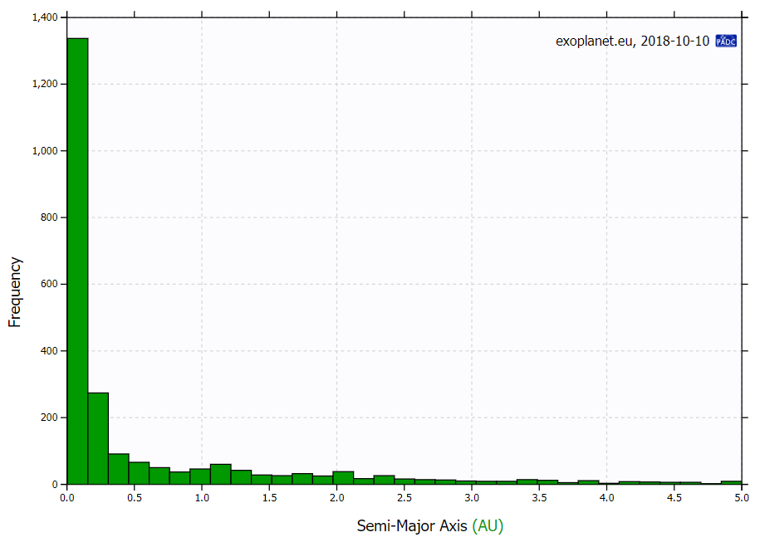
Exoplanet Orbits
Here are plots of the semi-major axes of the planet orbits, in AU.
Note that by far most of the planets so far discovered are very close to their parent star. This is also a selection effect. Distant planets are harder to detect, at least in the transit method.
A few, though, are really far out.
Pluto

Slide 13
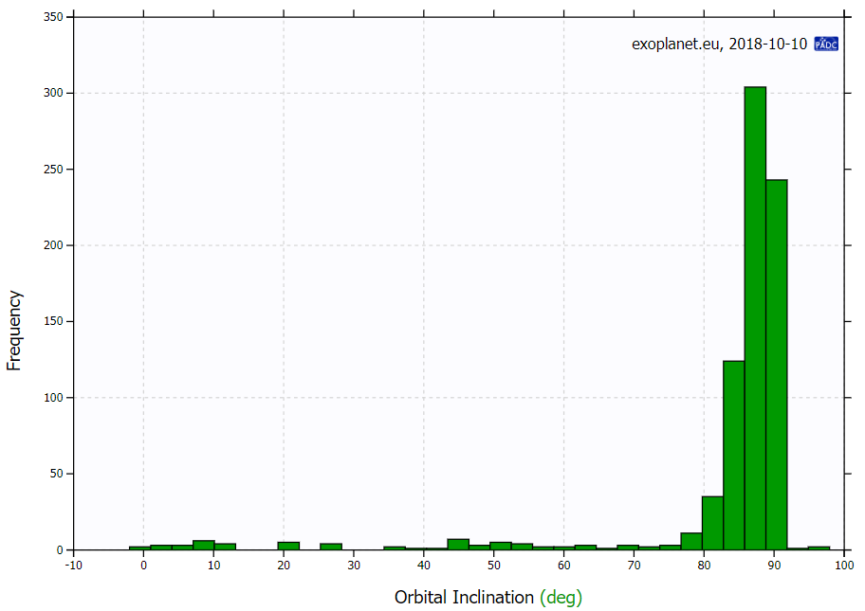
Exoplanet Orbital Inclination
Here are plots of the inclination of the planet orbits, in AU.
Note that by far most of the planets so far discovered are very close to 90 degrees inclination. That is because the transit method requires it, and the radial velocity method prefers it.

Slide 14
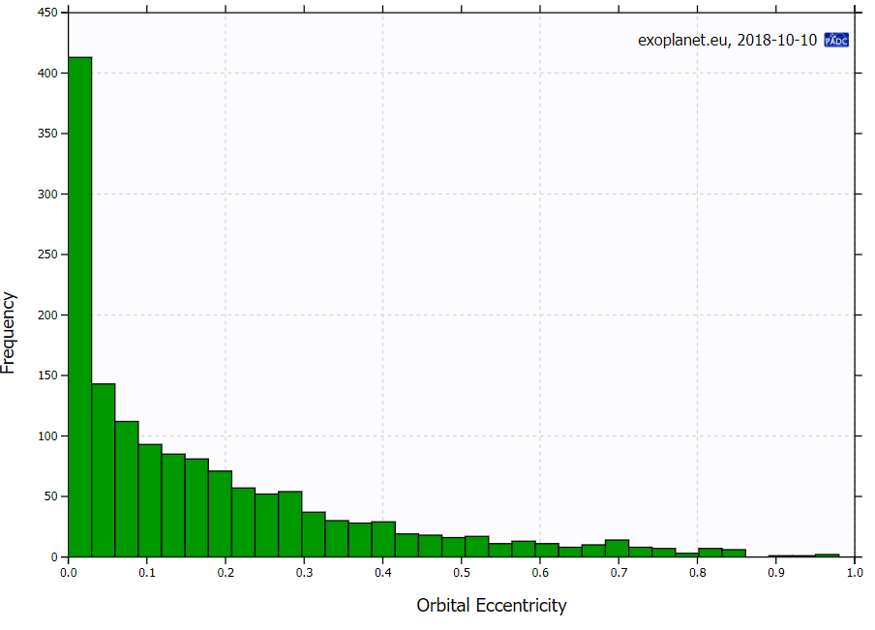
Exoplanet Orbital Eccentricity
For the most part, eccentricities are quite large compared to planets of our solar system, and sometimes really large. Even Pluto has an eccentricity only 0.24 or so.

Slide 15
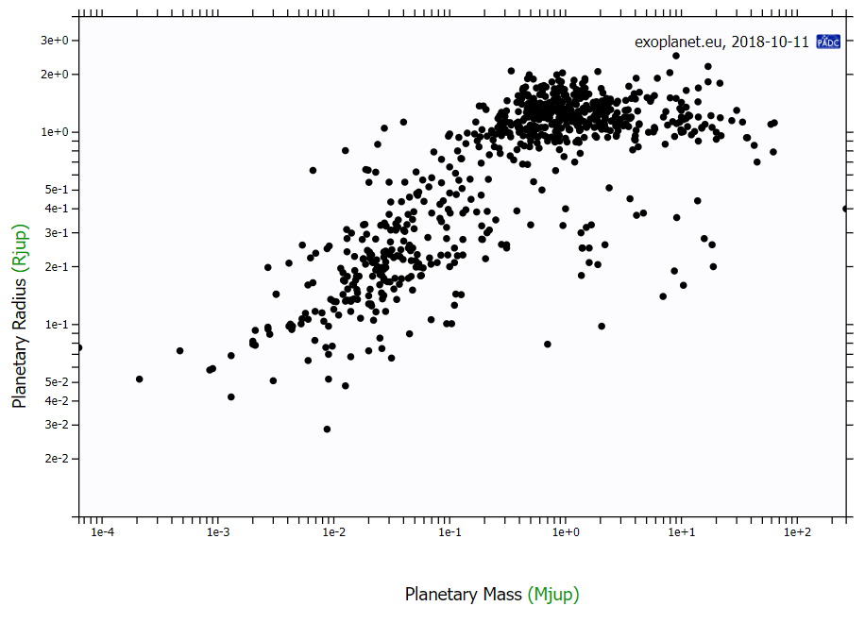
Exoplanet Radius vs. Mass
Here is an interesting plot. One would expect the mass and radius to grow together, but this plot indicates that only happens up to around 1 M_{Jup}, and then the masses continue to go up while the radius does not change much. That means the objects are getting denser.

Slide 16
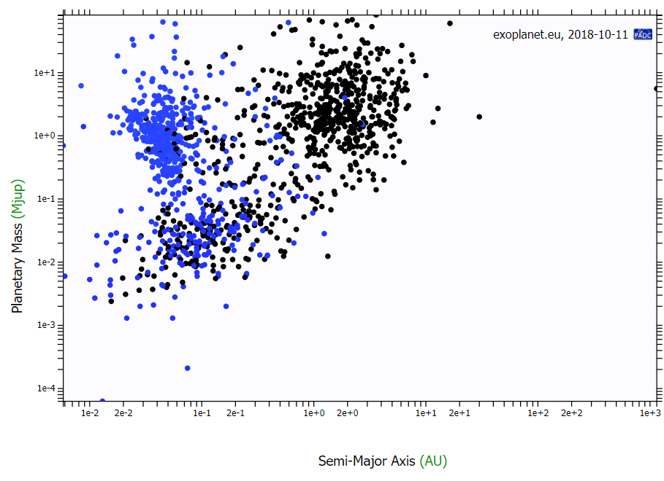
Exoplanet Mass/Semi-Major Axis vs. Method of Detection
The blue points were measured by the transit method, and the black ones by the radial velocity method. You can see the strong selection effect of the transit method, for close-in planets.
That is because Kepler only ran for a few years, and needed to see several transits in order to confirm the detection.

Slide 17
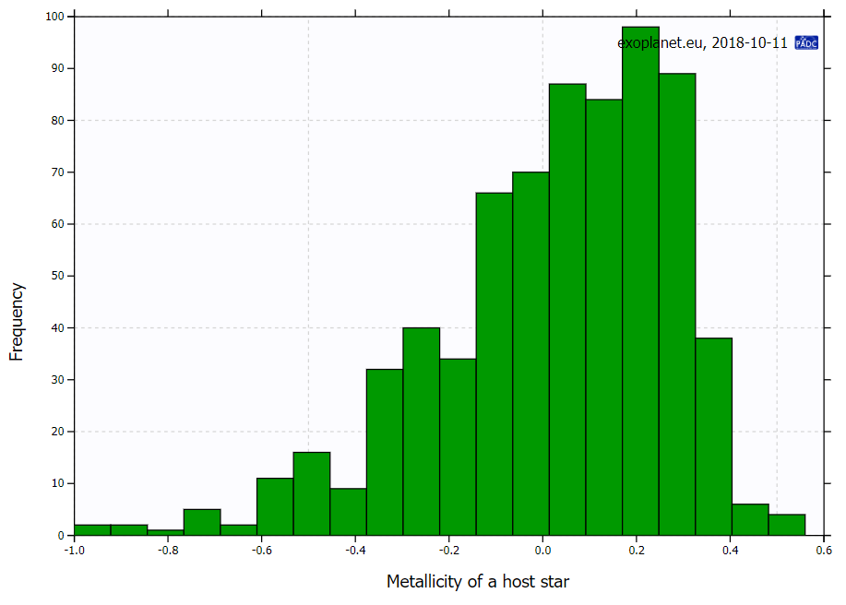
Number of Exoplanets vs. Metallicity of Host Star
This plot, for the planets discovered with the radial velocity method, shows that planets are strongly favored for stars with greater “metallicity” than the Sun, which implies that the cloud they were formed from was more enriched in heavier elements.
That makes sense, because then there is more stuff to make planets from!
If we include also planets detected by Kepler, it messes up the distribution, because Kepler was looking only in the plane of the galaxy, where most stars are like the Sun (metallicity of 0.0)

Slide 18
Summary of Exoplanet Characteristics
We should always be aware of the selection effects of our detection methods, and be careful not to make an incorrect generalization based on incomplete data. But we can say that the known systems have the following properties:
Planets are quite common around stars with high metallicity.
Perhaps as much as 25% of stars have planets of Jupiter mass.
The planets do not follow any clear progression of planetary size and location, as the planets seem to do in our solar system.
Many of the known systems have hot Jupiters, which are a surprise and a challenge for theories of solar system formation. Did they form there, or did they move there after forming elsewhere?
A sizeable number of stars have more than one planet known (and it is expected that most do).
It is of interest to ask whether any of the known exoplanets could harbor life, and especially whether they could support humans. Some clearly are too large and too hot to be habitable to humans, but of course life can come in many varieties, so the question of life is a more complicated question. We should keep in mind that even those that are too large for humans could have moons that might be perfect for us if they are not too hot or too cold. We can find the comfort zone (habitable zone) by considering where liquid water could exist.

Slide 19
Planets in Habitable Zone

Slide 20
What We’ve Learned
You should understand and appreciate the revolution in our understanding of other solar systems due to the explosion of discoveries of exoplanets since 1995.
You should know that there are several ways that exoplanets can be detected, and be knowledgeable about the two main ones, the radial velocity method and the transit method.
You should be able to state how the radial velocity method is done using the Doppler Effect, and how it is due to the very slight “wobble” of a star around the barycenter, which can be measured with as little as 3 m/s of radial motion. You should know the selection effects of the method, preferring large planets in close orbits, and that it measures only a lower limit of the mass, m sin i.
You should be able to state how the transit method works, and be familiar with how the shape of the light curve can tell us details about the planet and star. You should know the selection effects of this method, again preferring large planets, close in to the star. The inclination is known in this case, and must be near 90-degrees in order for the transit to happen.
You should know the role of the Kepler mission in finding many planets by the transit method. Additional space missions are underway or planned that will continue transit measurements.
You should be familiar with the summary of exoplanet characteristics, and the concept of habitable zone and why it is important to the potential for life elsewhere in the galaxy.

