Slide 1
Physics 320: Venus, Earth, and Moon (Lecture 15)
Dale Gary
NJIT Physics Department

Slide 2
Venus
Venus is unusual in having a retrograde rotation, although the rotation is very slow (sidereal period 243.01 days). It has only a 3 degree inclination (tilt of its axis relative to its orbital plane), although due to the retrograde motion it should be considered 177 degrees.
The bulk density is 5200 kg/m³, which matches Earth well considering Venus' slightly smaller mass (82% of Earth). This implies that Venus may have an interior very like Earth's.
To learn a little more about Venus’ interior, we can use the concept of hydrostatic equilibrium that we applied to atmospheres, which applies equally well to the fluid (plastic) interior of planets.
The equation of hydrostatic equilibrium was $\frac{dP}{dr}=−ρg$, but recall that the acceleration of gravity, $g(r)$, will go down as we descend into the planet, since the central mass is only the mass of the sphere interior to the position $r$. Writing it in terms of the mass $M(r)$ interior to $r,$ we have
In general, we do not know how the density $ρ(r)$ varies with depth, but as an approximation we can again assume that the density is a constant value, the bulk density $\left\langle ρ\right\rangle =\frac{M}{\left(\frac{4}{3}πR^{3}\right)}=5200 kg/m3$, where $M$ and $R$ are the mass and radius of Venus. Then $M\left(r\right)=\frac{4}{3}πr^{3}\left\langle ρ\right\rangle$, and the differential pressure is
$$\frac{dP}{dr}=−ρ\frac{GM(r)}{r^{2}}$$
$$dP=−{\left\langle ρ\right\rangle }^{2}\frac{4}{3}πGr dr.$$

Slide 3
Central Pressure for Venus
$$dP=−{\left\langle ρ\right\rangle }^{2}\frac{4}{3}πGr dr$$
We can easily integrate from $r=0→R$ (pressure from the center to the surface, ${P=P}_{c}→0$)
to get the central pressure:
This expression is valid for any planet. Using Venus’ bulk density, $5200 kg/m3$, and radius of $6052 km$, we get a central pressure of $P_{c}=1.38×{10}^{11} Pa=1.38×{10}^{6} atm.$
The SI unit for pressure is in pascals, where $105 Pa = 1 atm$(1 atmosphere).
The actual pressure at the center of the Venus is about $3×106 atm$, due to the fact that density is not actually constant with radius. By the same approach as above, we find that Earth's central pressure is about 23% higher ($3.7×106 atm$), due to its higher average density ($5500 kg/m3$) and slightly larger radius.
$\int_{P_{c}}^{0}{dP}=−{\left\langle ρ\right\rangle }^{2}\frac{4}{3}πG\int_{0}^{R}{r dr}$,
$P_{c}=\frac{2}{3}πG{\left\langle ρ\right\rangle }^{2}R^{2}≈1.4×{10}^{−10}{\left\langle ρ\right\rangle }^{2}R^{2}$.

Slide 4
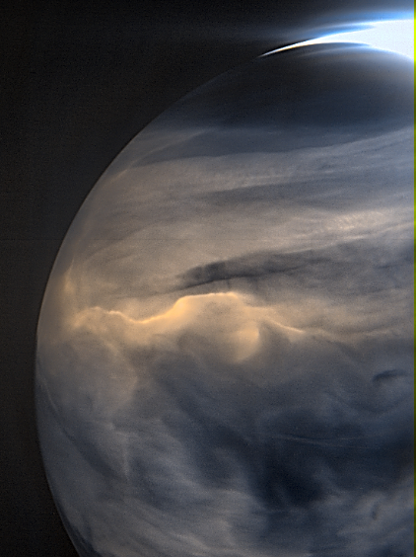
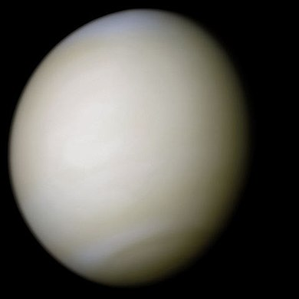
Venus’ Visual Appearance
Venus appears completely cloud covered, with a high albedo (0.67). In normal, unprocessed light, it appears a nearly featureless white:
True-color image taken
by Mariner 10 (flyby)
https://en.wikipedia.org/wiki/Venus
In ultraviolet or infrared light, swirling wind patterns can be seen in the clouds, as shown in these photos from Galileo and Akatsuki.
Images from Japanese spacecraft Akatsuki, of the night-side clouds of Venus in the infrared.
From the web site:
This view of Venus was acquired by the Japanese Akatsuki spacecraft's IR2 camera, which observes—among other things—the "warmth" of the planet's atmosphere on its nocturnal side.
Images from Galileo (a Jupiter probe that used Venus as a gravity assist) 1 day apart, except the bottom two images were taken 2 hours apart. Note that the clouds are lagging behind at the equator, and the patterns move right to left in the figure. The temperate zones have the equivalent of jet streams, like we see on Earth.

Slide 5
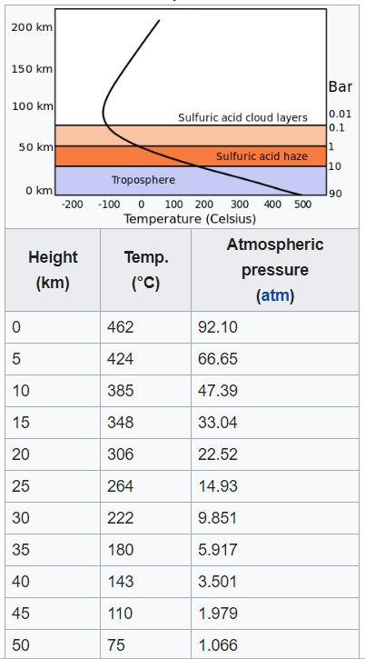
Venus’ Atmosphere
Because Venus’ atmosphere is so thick (surface pressure around 90 atm), it extends much higher above the planet. Any temperature inversions such as in Earth’s atmosphere (caused by absorption of X-rays and UV) would occur at greater heights than in the plot at right, so the temperature falls with height all the way to 70 km.
The composition is mostly CO₂ (carbon dioxide), which is a major greenhouse gas. The greenhouse effect causes the temperature at the surface to be >450 C, hot enough to melt lead, tin, and zinc. There are only trace amounts of water.
The following reactions create sulfuric acid in the upper layers of the atmosphere:
The heat, pressure, and acidic environment make Venus a very forbidding place!
90 atm is the pressure about 900 m below the Earth’s ocean surface!
CO₂ → CO + O
SO₂ + O → SO₃
2SO₃ + 4H₂O → 2H₂SO₄·H₂O

Slide 6
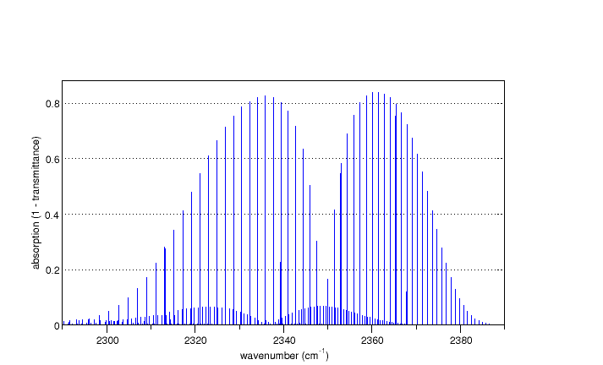
IR Absorption by Greenhouse Gases
The demonstration below shows how glass can block infrared light, even though it is transparent to visible light. This is also a feature of certain gasses, called greenhouse gases. These include methane, carbon dioxide, and water.
It is not hard to see how such gasses do this. Recall that molecules can vibrate and rotate, and that these energies are quantized. The various frequencies at which they tend to vibrate or rotate create energy bands (called vibrational or rotational bands) that spread over a wide range of the spectrum (see plot below). These bands occur in the infrared, and absorb infrared light so that it cannot escape.

Slide 7
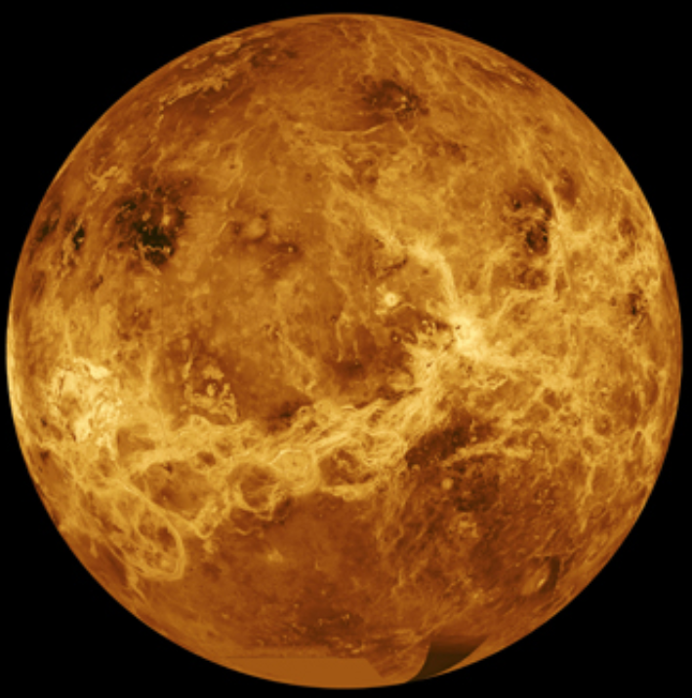
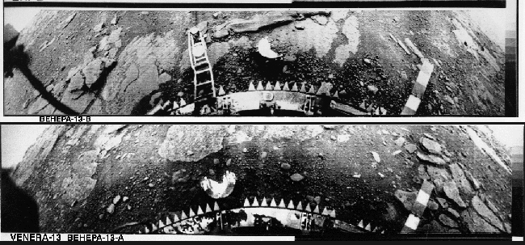
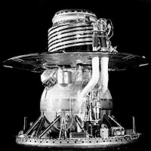
Venus’ Surface Features
Despite the clouds, we actually have detailed knowledge of the surface features of Venus.
This was obtained from the NASA Venus orbiter Magellan, which was equipped with a radar mapper that could peer through the clouds and use the radar echoes to determine surface roughness and measure the height of features at high spatial scale.
The entire globe (98%) was mapped over the 4-year lifetime of the Magellan probe, providing the map at right.
To explore some of these features, click this link to explore further.
Even more interesting, in the 1960s-70s the Soviet Union landed Venera probes on Venus.

Slide 8
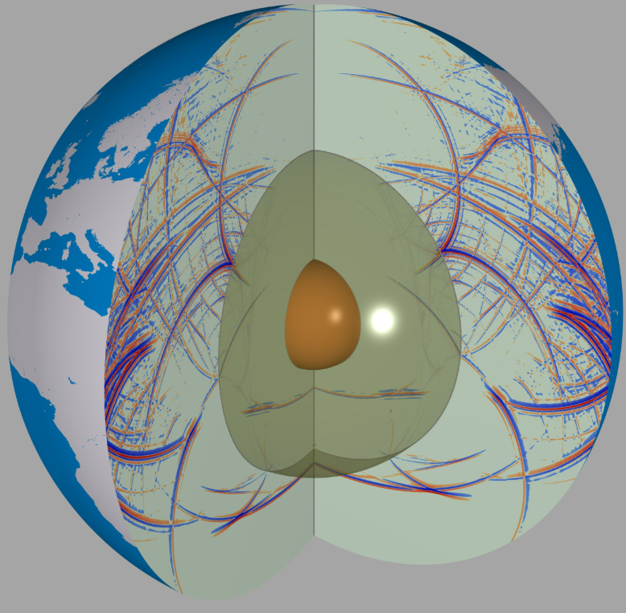
Earth and Moon
The Earth is a planet, but one that we can study in great detail. We know a lot about the structure of the interior of the Earth, but we must remember that other planets may be different in fundamental ways. We must take what we learn about Earth and compare and contrast it with the other planets.
The mean or bulk density of a planet is an easily measured quantity that can tell us a great deal about what the planet is made of. Earth's bulk density is
(compare with the density of water, $1000 kg/m3$). But the density of the Earth's surface (density of silicate rocks) is only $2800 kg/m3$, so the interior must be much more dense than the surface, a result of the pressure of overlying rocks due to hydrostatic equilibrium, as we discussed above. The structure of the interior of the Earth has been pieced together from a number of clues, such as what the surface is made of, what we see coming to the surface in volcanoes, and most of all what we learn from earthquakes.
$$\left\langle ρ\right\rangle =\frac{3M_{⨁}}{4πR_{⨁}^{3}}=5520 kg/m3$$
Global Wave Propagation Model
https://www.geophysik.uni-muenchen.de/research/seismology

Slide 9
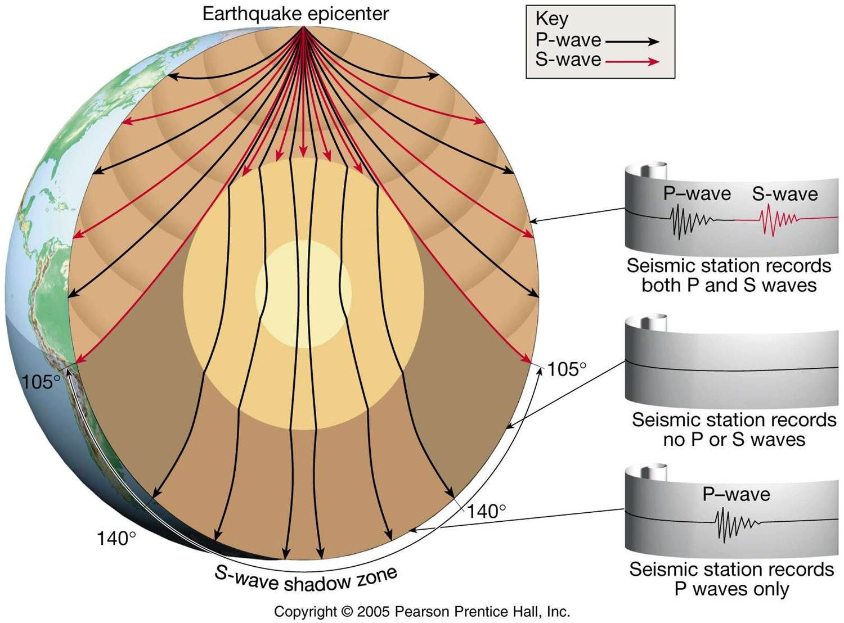
Earth Seismology and Plate Techtonics
The earthquakes, adjustments of the Earth's crust due to internal stresses, launch two types of seismic waves, longitudinal compression (P) waves (sound waves), and transverse distortion (S) waves. The P waves travel faster, and so the letter P could stand for Pressure or Prompt waves. The slower S waves arrive later, and so the letter S could stand for Secondary, or Slow waves.
An important difference between longitudinal and transverse waves is that longitudinal waves can travel through liquid, but transverse waves cannot. Both kinds of waves refract due to density gradients in the Earth's interior.
Due to the refraction of both kinds of waves, and the lack of propagation of S waves, we learn that the interior has a liquid layer, and also can measure such quantities as temperature and density as a function of depth. The size of the liquid core can be determined by measuring "earthquake shadow zones." (see movie on next slide)
Plate Tectonics
Subduction Zones
Magnetic Striping
Earthquake Zones
Hotspots

Slide 10
Seismic Wave Movie
http://web.utah.edu/thorne/movies/Movie_S_Sdiff_1080p.wmv

Slide 11
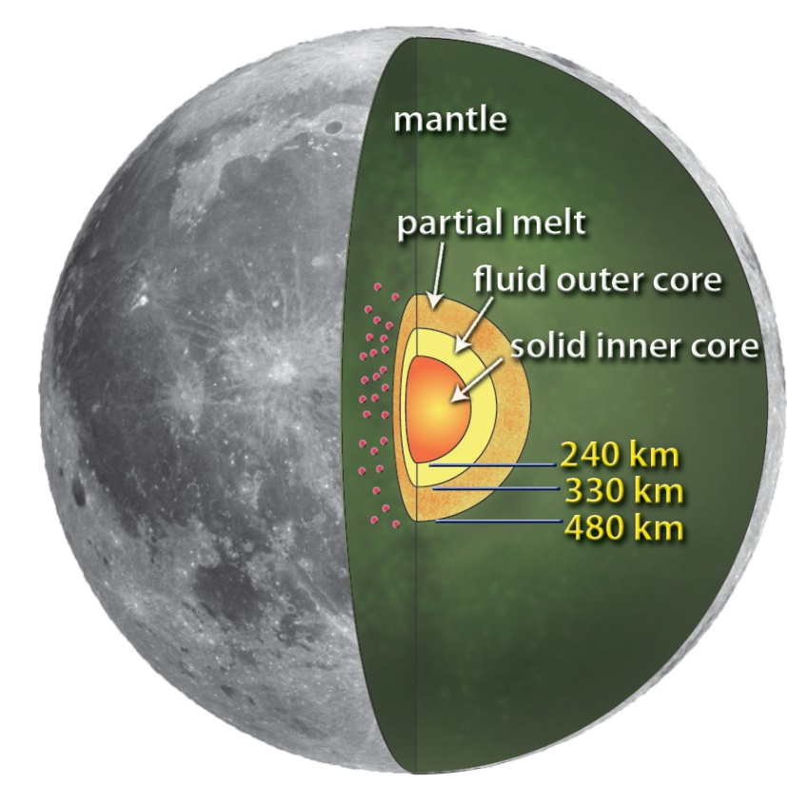
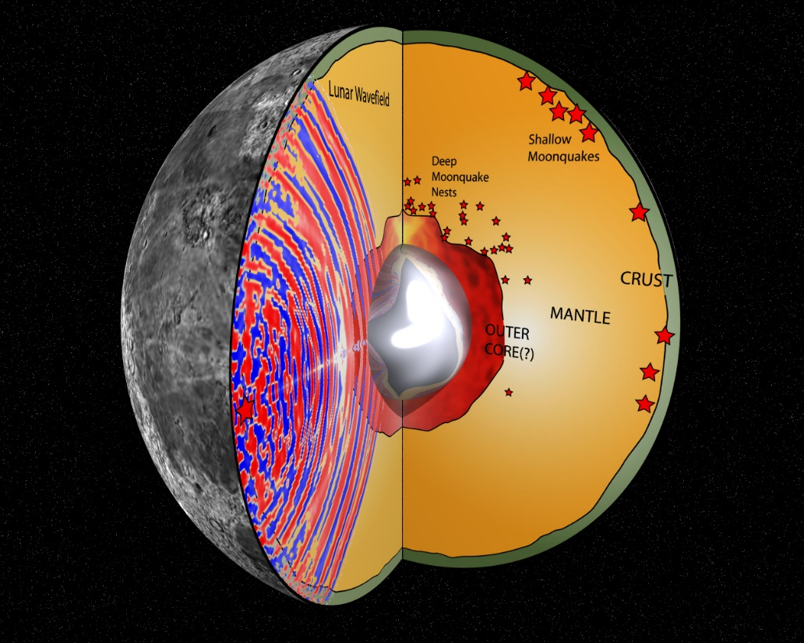
Interior of the Moon
The interior of the Moon is completely different from the interior of the Earth, as can be determined from the Moon's bulk density of 3370 kg/m3, similar in density to the Earth's crust. So the density of the Moon cannot rise much in the center, as Earth's does. From seismic experiments from stations left on the Moon by the Apollo astronauts, the current model for the Moon's interior includes an off-center solid core, a fluid outer core, a mantle, and outer crust.
Michael Thorne, U. Utah
Cartoon of Moon's interior, from NASA JPL web site.

Slide 12
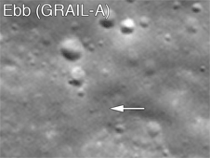
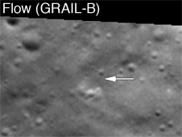
Recent Lunar Missions
A recent mission to the Moon (GRAIL), launched on Sept. 10, 2011 as a pair of orbiters that flew in formation and precisely measured the gravity of the Moon as a way of mapping the interior.
Another mission has been returning high-resolution images of the surface: Lunar Reconnaissance Orbiter.
GRAIL impact sites as seen by LRO

Slide 13
What We’ve Learned
You should be familiar with the expression we derived for the central pressure of a planet, based on hydrostatic equilibrium and using the bulk density $\left\langle ρ\right\rangle$ (which is just the mass of the planet divided by its volume).
You should know that Venus’ atmosphere is thick, with a high pressure (90 atm) at its surface, and its main constituent is CO₂, with sulfur dioxide (SiO₂) and even sulfuric acid in its upper layers.
You should have an appreciation of the very high surface temperatures on Venus, due to the greenhouse gases. You should know how the greenhouse effect occurs, due to the molecular rotation and vibration modes that block IR from escaping.
You should know how we were able to map the surface features of Venus (radar mapping from Magellan), and how those features differ from similar features on other bodies, primarily due to the high atmospheric pressure and the high temperatures.
You should understand how P and S seismic waves work, and how we can learn about the interior of the Earth from seismic studies.
You should know the various pieces of evidence for plate tectonics, and how that has significantly changed the surface of the Earth.
You should know the basics of the interior of the Moon and how it differs from Earth.
$$P_{c}=\frac{2}{3}πG{\left\langle ρ\right\rangle }^{2}R^{2}$$

