Slide 1
Physics 320: Moons and Rings of Giant Planets (Lecture 19)
Dale Gary
NJIT Physics Department

Slide 2
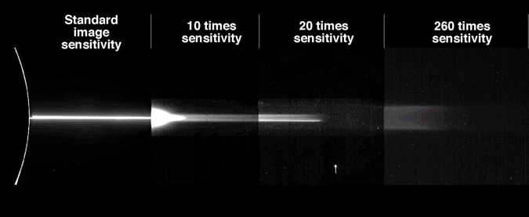
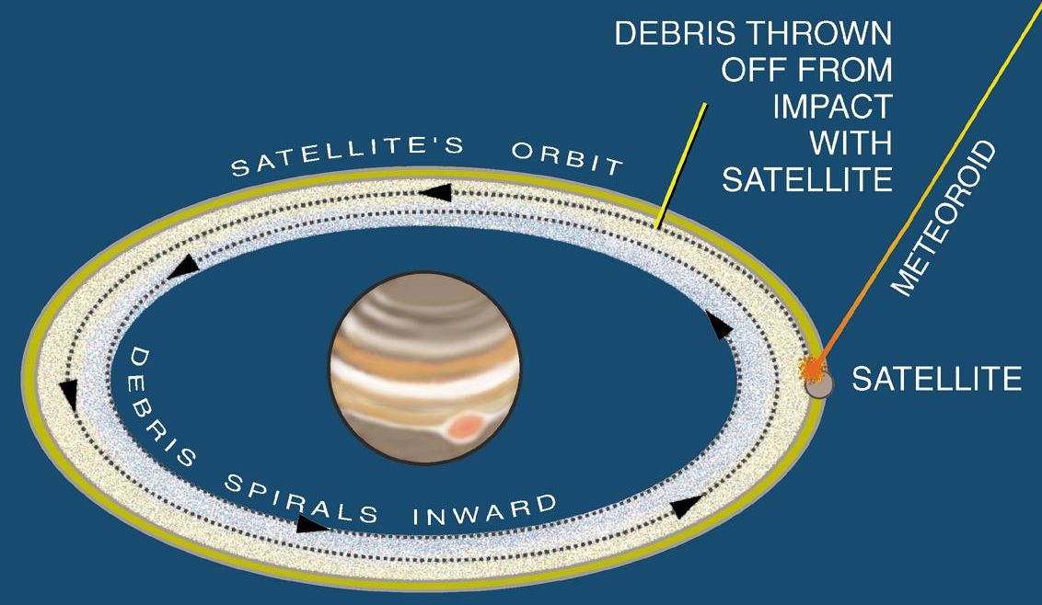
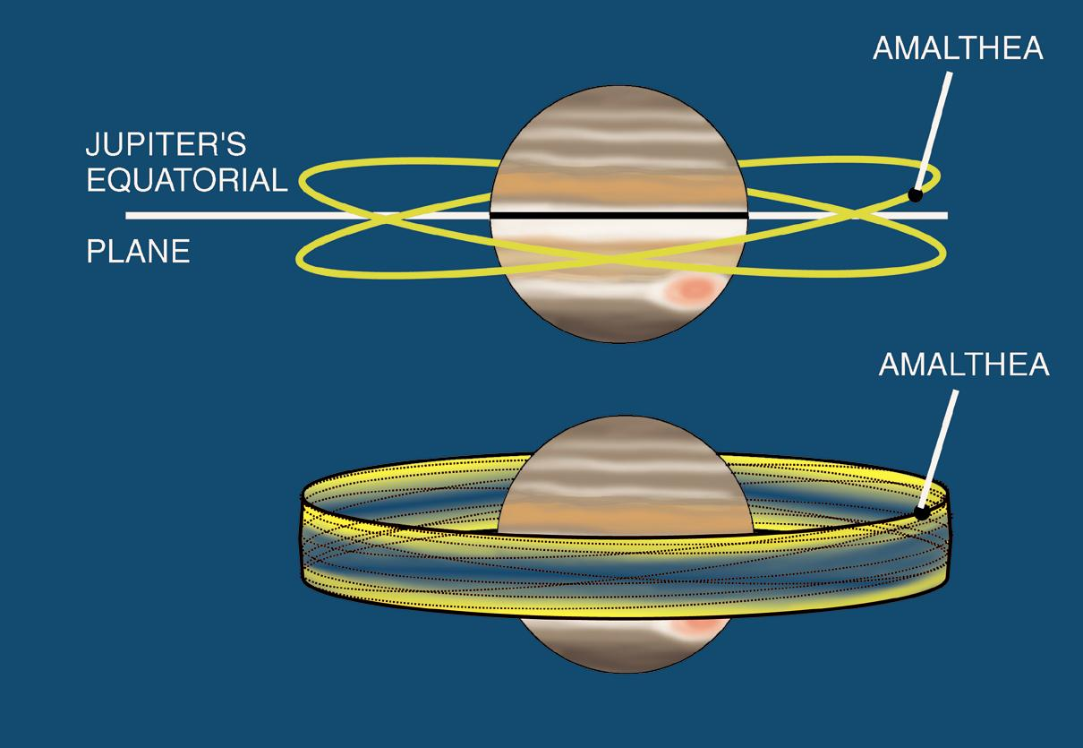
Jupiter’s Rings
Jupiter has extremely tenuous rings that can only be seen with back-lighted conditions, and long time exposures.
The animation at right shows how the rings are associated with Jupiter’s small moons, Metis and Adrastea (shepherd moods, exactly in the ring plane), Almathea (slightly inclined), and Thebe (inclined to greater degree).
The origin of the ring particles is the moons themselves, due to meteoroid impacts:
The rings were discovered by the Voyager 1 space probe in 1979. The optical depths are ~ 10⁻⁶, 10⁻⁷, and 3x10⁻⁸, hence they are very dim, and cannot be seen by occultations.

Slide 3
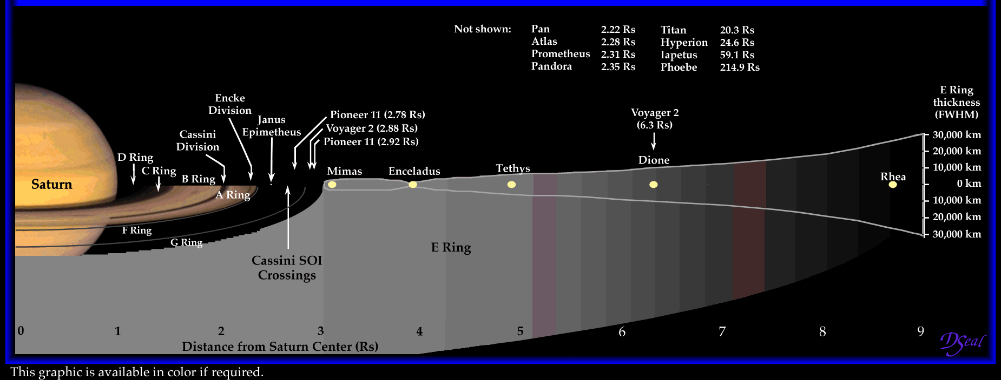
Saturn’s Rings
We already saw a lot images of Saturn’s rings last time, but today we will examine the structure and nomenclature of the rings. Note the main rings, A and B, separated by Cassini Division, then inner rings C and D. The broad E ring is due to the volcanic plumes from Enceladus’s “tiger stripes”.

Slide 4
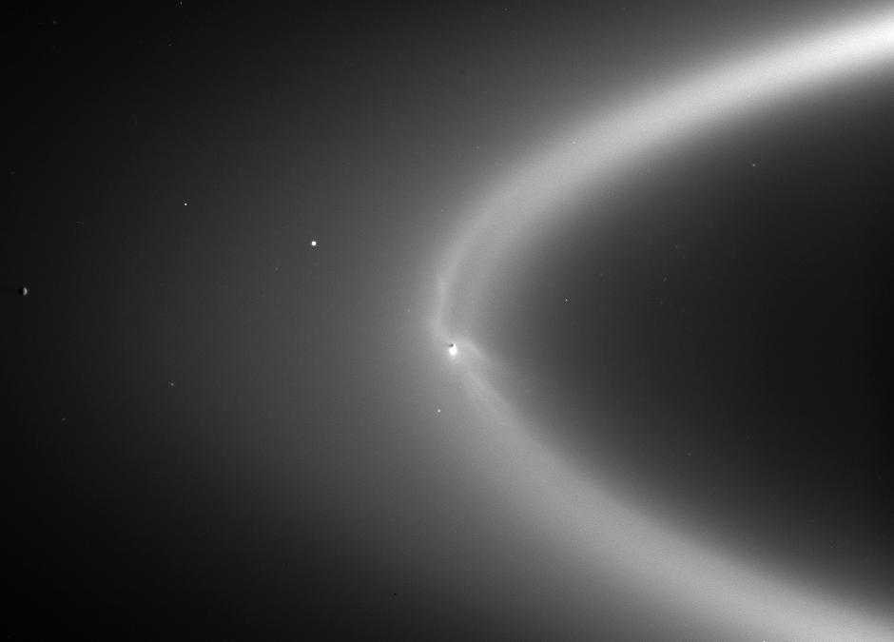
Saturn’s Rings
Here is a full map (made from images) of the A-D and F rings of Saturn, with a number of named gaps shown.
There are debates about the origin of the “main” rings A-D. These rings are very bright, and made of nearly pure water ice.
At right is the E ring, with Enceladus shown as the source of the ring. This is also water ice, but of microscopic particles.

Slide 5
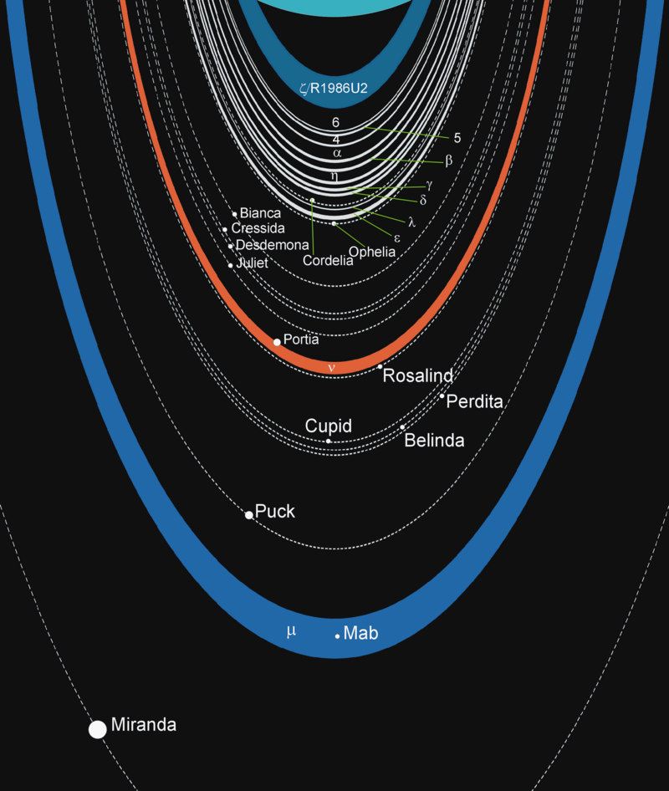
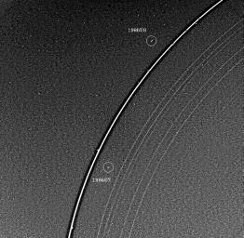
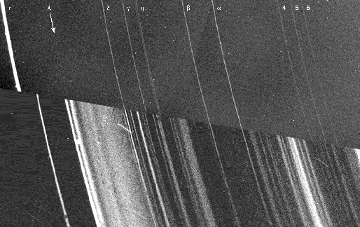
Uranus’ Rings
The inner rings (α – ε) were discovered serendipitously in 1977, from the occultation of a star. Now we know of 13 rings, 9 that are very narrow, two that are dusty (from moons), and two outer rings. The composition is not known, but they are very dark (albedo ~ 0.05)
Uranus' outer epsilon ring showing the two shepard moons, 1986U7 and 1986U8, which act in concert to keep the ring narrow.
Uranus' Rings as seen in forward (top) and backward (bottom) scattered light. Note that the outer (epsilon) ring doesn't match up in the two figures because it is rather eccentric (elliptical).

Slide 6
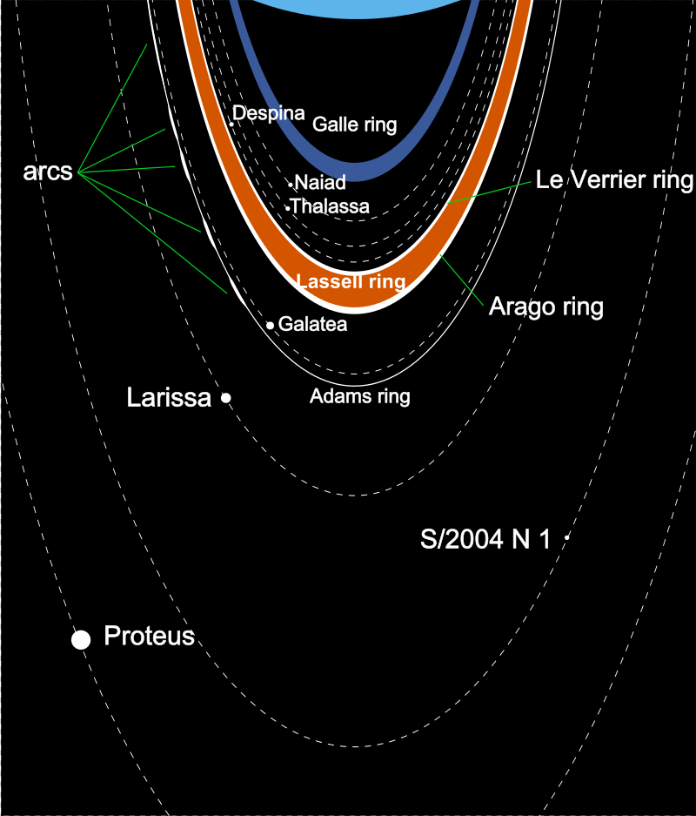
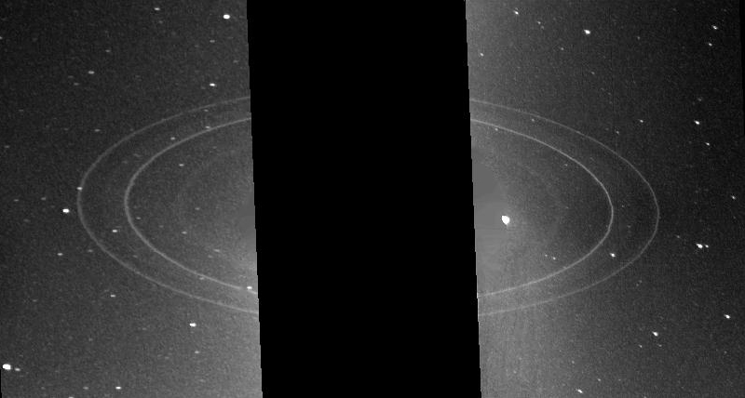
Neptune’s Rings
The rings were suggested in 1981 and later occultations of a star, but the results were confusing and not conclusive. They were definitively imaged by Voyage 2, the only spacecraft to have visited Neptune, in 1989. There are 5 distinct rings. The Adams ring has several partial arcs, which are still being puzzled over.

Slide 7
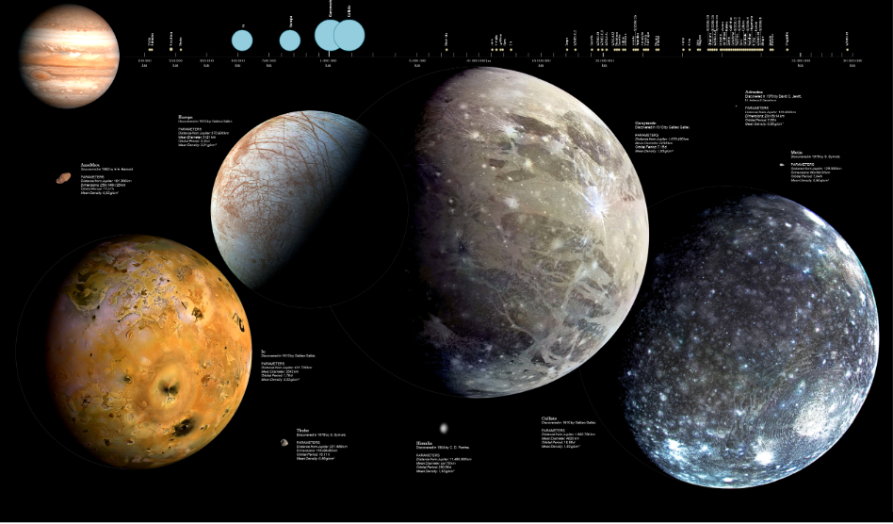
Jupiter’s Moons

Slide 8
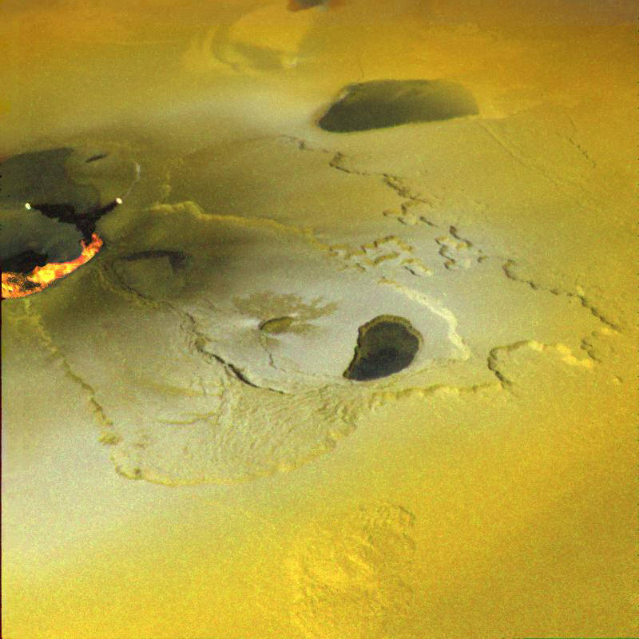
Galilean Moons of Jupiter
Io

Slide 9
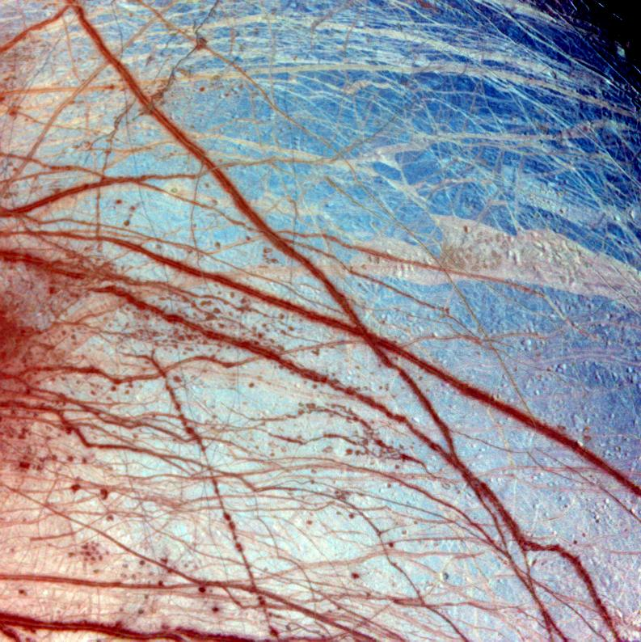
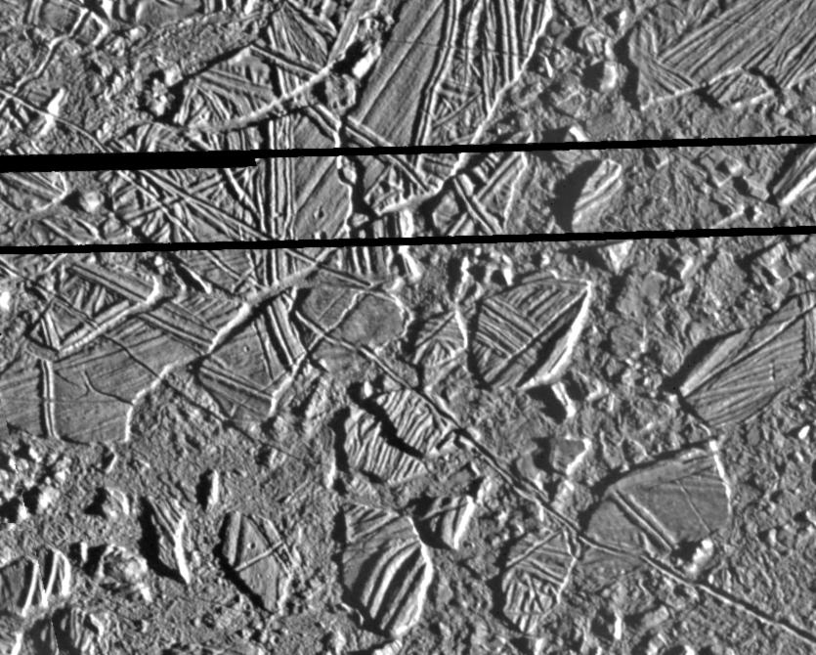
Galilean Moons of Jupiter
Europa

Slide 10
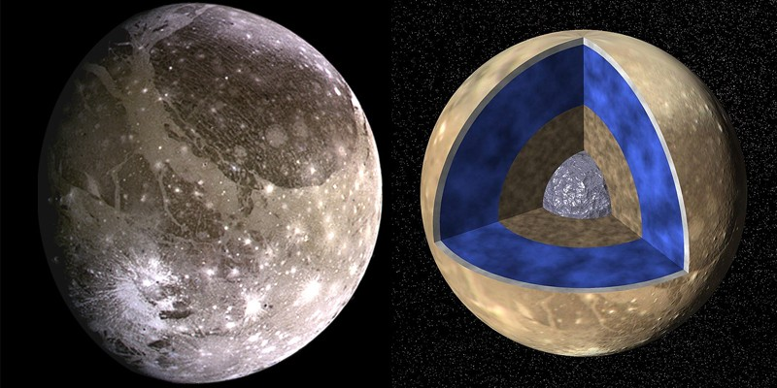
Galilean Moons of Jupiter
Ganymede
Europa

Slide 11
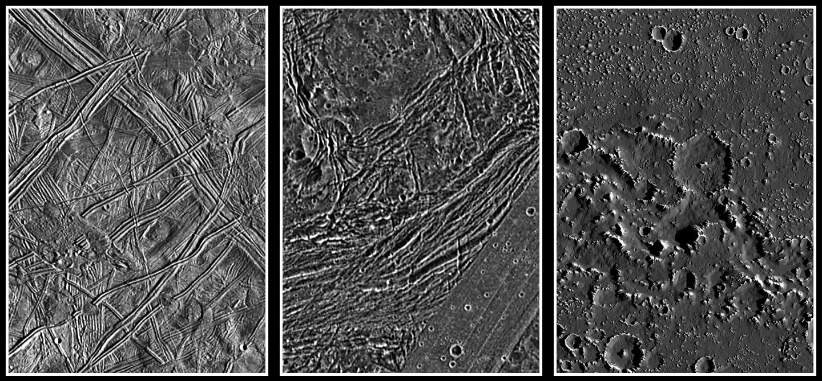
Galilean Moons of Jupiter
Landforms
Callisto
Europa

Slide 12
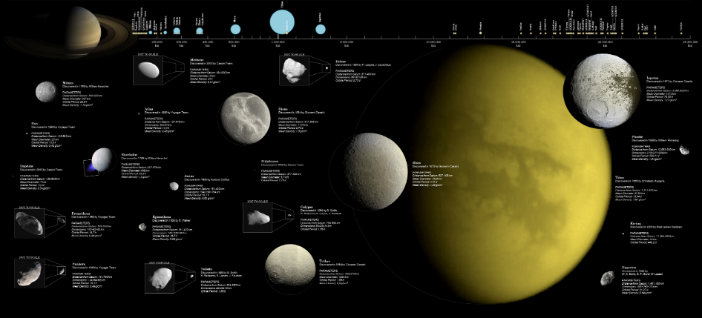
Saturn’s Moons

Slide 13
Uranus’ Moons

Slide 14
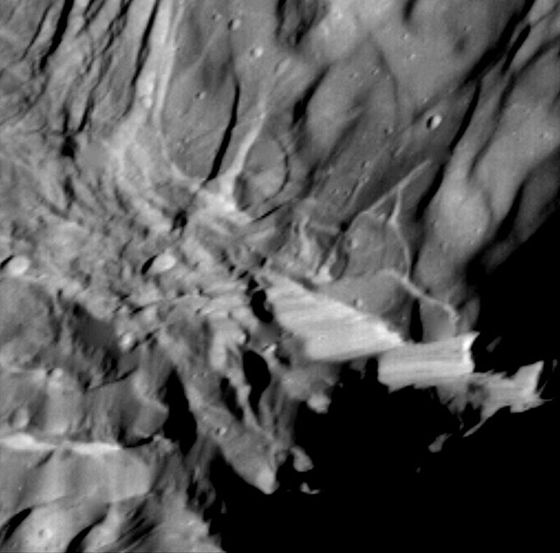
Uranus’ Moons
Miranda is a particularly interesting moon.
Notice that it appears to have been torn apart and then reassembled in rather amateurish fashion.
Notice this cliff on
Miranda—the tallest
in the solar system.
Verona Rupes

Slide 15
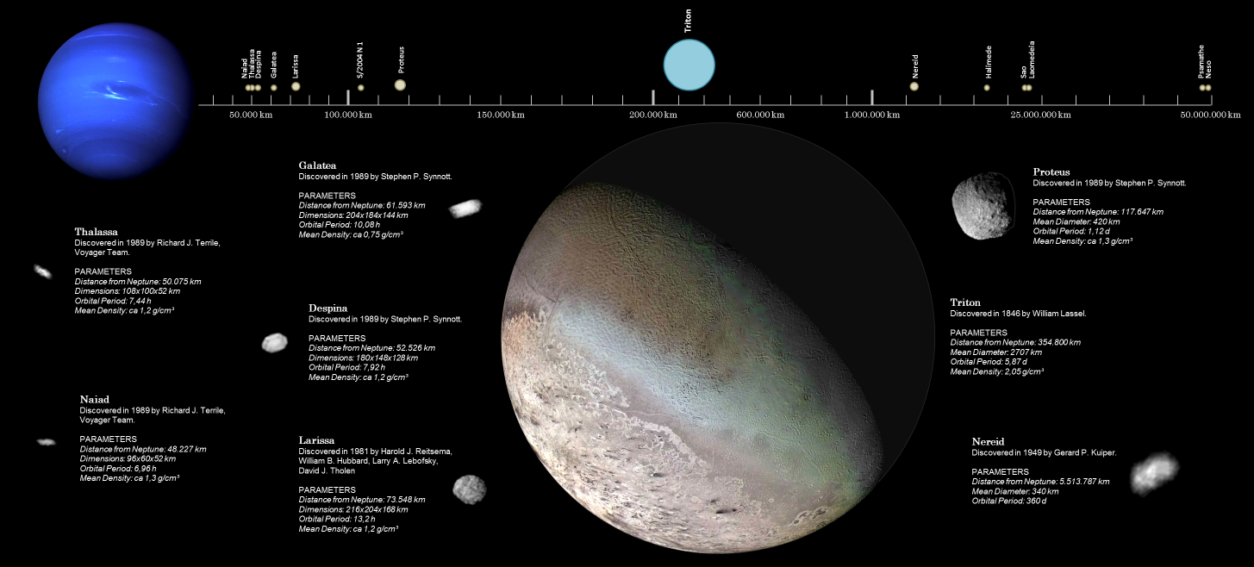
Neptune’s Moons
Triton is the only large moon with a retrograde orbit. It is geologically active, with a plume being seen by Voyager 2

Slide 16
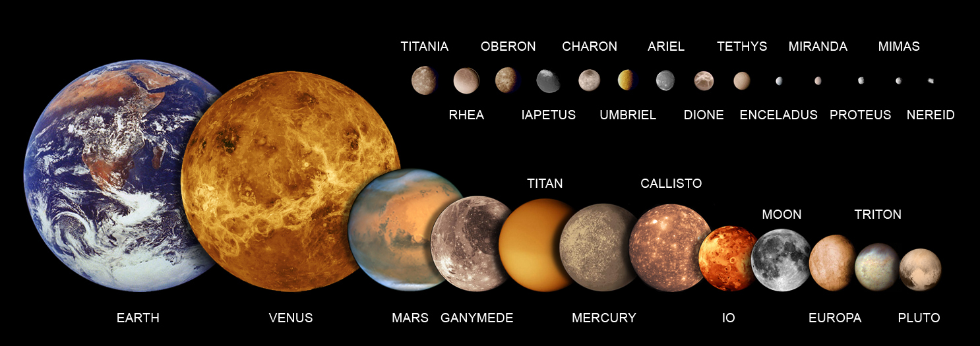
Moons Compared

Slide 17
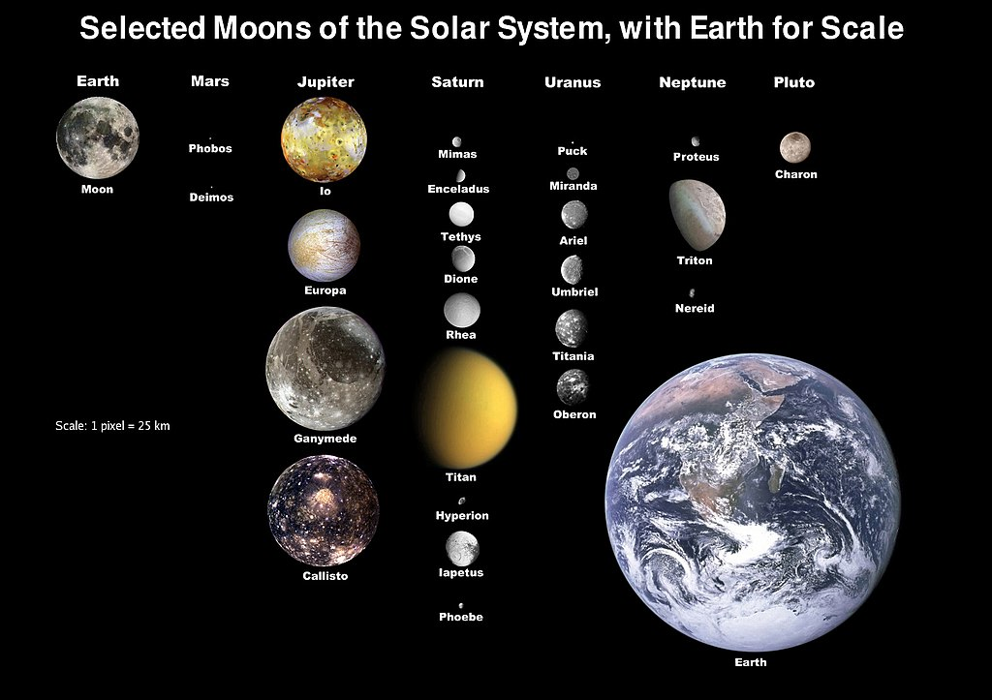
Moons Compared

Slide 18
What We’ve Learned
All four of the giant planets have ring systems.
Rings have two (or possibly three) basic origins:
Particles from a moon is the most common, either from spallation by meteoroids, or outgassing (Io and Enceladus)
Breakup due to a moon getting too close (within the Roche limit) of the parent planet
(A third possibility is left-over debris from the formation of the planet, but this is speculative)
All planets from Earth outward have moons. The Earth’s moon is very large relative to the planet—only the dwarf planet Pluto has a larger relative size for its moon (Charon).
Moons also have two basic origins:
Capture by the planet of an asteroid (most of the minor moons of Jupiter and Saturn) or larger body (Triton, around Neptune)
Formation of the moon from a nebular disk during the formation of the planets (the four Galilean satellites of Jupiter, and probably the larger moons of Saturn and Uranus).
Earth’s moon may have been formed in a third mechanism—a late-phase collision of two planetary-sized bodies.
Four moons have evidence for being geologically active: Io, Europa, Enceladus, and Triton. All of these objects have young surfaces (almost no craters).
Triton is unique in having a retrograde orbit, which implies that it is moving closer to Neptune over time. It is predicted that 3.6 billion years from now, Triton will cross the Roche limit.

