Slide 1
Physics 320: Asteroids, Comets, and Meteors (Lecture 21)
Dale Gary
NJIT Physics Department

Slide 2
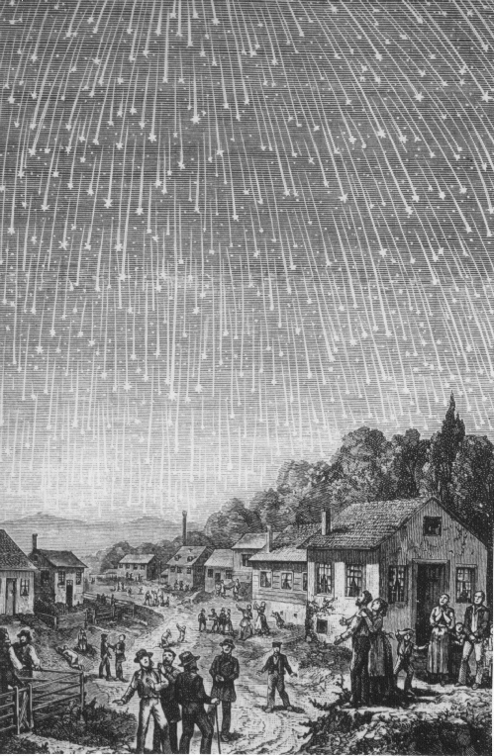
Meteor Showers
Meteors, or “shooting stars” are a phenomenon occurring within Earth’s atmosphere (compare the study of weather, which is called meteorology). Typically, an object as small as a grain of sand, on entering the atmosphere from space, creates a vapor trail (trail of ionized gas) that glows as it burns up.
Objects of larger size, such as a baseball, create a much larger streak of light across the sky, called a fireball. Sometimes objects of that size can survive to reach the ground, as in this report. Then the meteor becomes a meteorite.
In addition to sporadic meteors you may see on any given night, meteors also come in regular, yearly meteor showers. These are orbiting debris from comets, which the Earth passes through every year. Here are some major showers:
Leonids (source Tempel-Tuttle) → this causes huge outbursts every 33 years
Orionids (source Halley)
Perseids (source, Swift-Tuttle)
Geminids (source Phaethon --asteroid?)

Slide 3
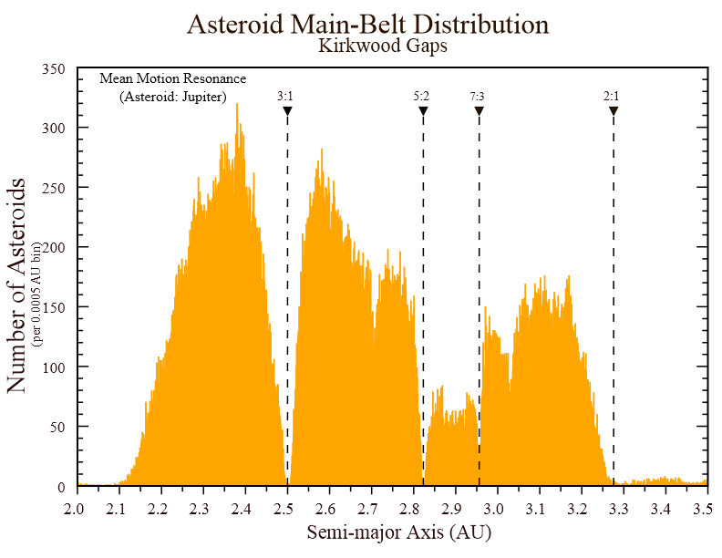
Main Belt Asteroids
If one plots the number of main-belt asteroids vs. their semi-major axis, one finds some initially puzzling patterns--gaps in the distribution where there are missing asteroids.
However, these gaps are exactly at resonances with Jupiter (3:1, 5:2, 7:3).
Notice that there are very few asteroids with orbits closer to Jupiter than the 2:1 resonance at 3.27 AU, or farther away from Jupiter than the 4:1 resonance at 2.06 AU.
Notice the dips at 2.71 AU and at 3.07 AU. These are the 8:3 and 11:5 resonances, respectively.
These are called Kirkwood gaps, and show that Jupiter's gravitational influence is dominating these special zones of the asteroid belt, slowly perturbing them over millions of years and forcing them into different orbits.
There are no spatial gaps in the asteroid belt itself! These gaps are only seen in the semi-major axes.

Slide 4
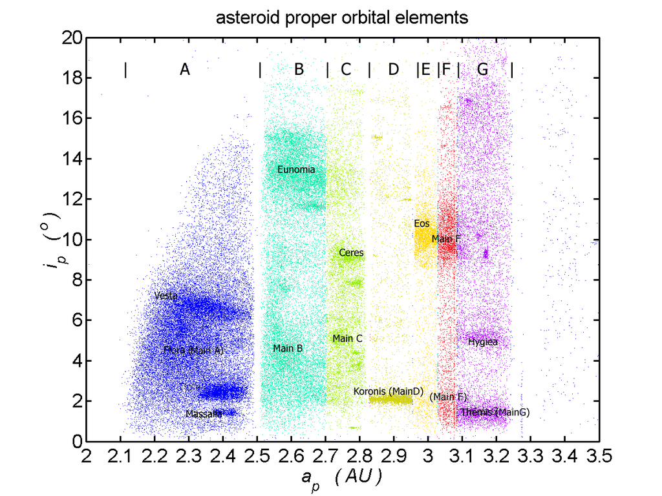
Asteroid Families
Other interesting patterns show up for plots of orbital parameters such as inclination vs. semi-major axis and inclination vs. eccentricity. Now several asteroid families begin to show up.
Look carefully at the Koronis family, which is thought to be the result of a catastropic collision at least 2 billion years ago between two larger bodies.
You can see evidence for perturbations having spread the semi-major axes between the 5:2 and 7:3 resonance gaps, but if they try to extend further they get wildly disrupted due to the resonance. This creates a sharp edge to the distribution. You can see similar edges in other families.

Slide 5
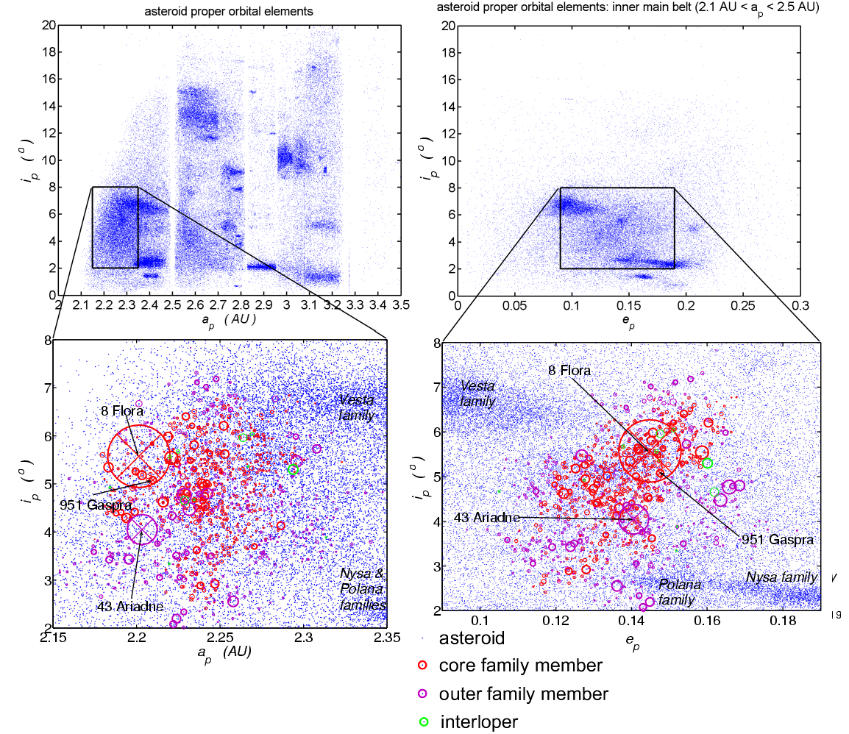
The Flora Family
Let's take a closer look at the Flora family. This family of S-type (stony) asteroids lies close to the unstable zone of the asteroid belt due to a so-called secular resonance with Saturn.
As a result, the Flora family is considered a good candidate for the L chondrite meteorites, which constitute 38% of all meteorites that are found on Earth. By studying these meteorites, radioisotope dating shows that the parent body was catastrophically disrupted around 470 million years ago.
Meteorites come in the same types as asteroids! L condrites may come from the Flora family of asteroids. What about the iron meteorites? Chemical and isotope analysis indicates that perhaps 50 different parent bodies were involved. See Psyche NASA mission.

Slide 6
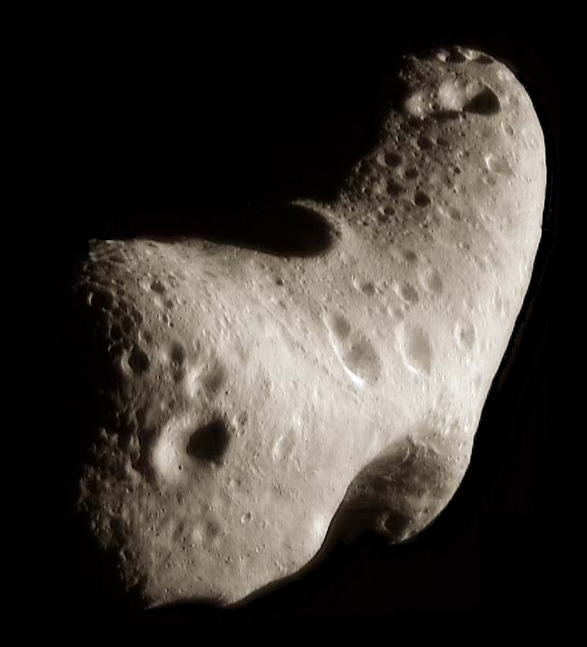
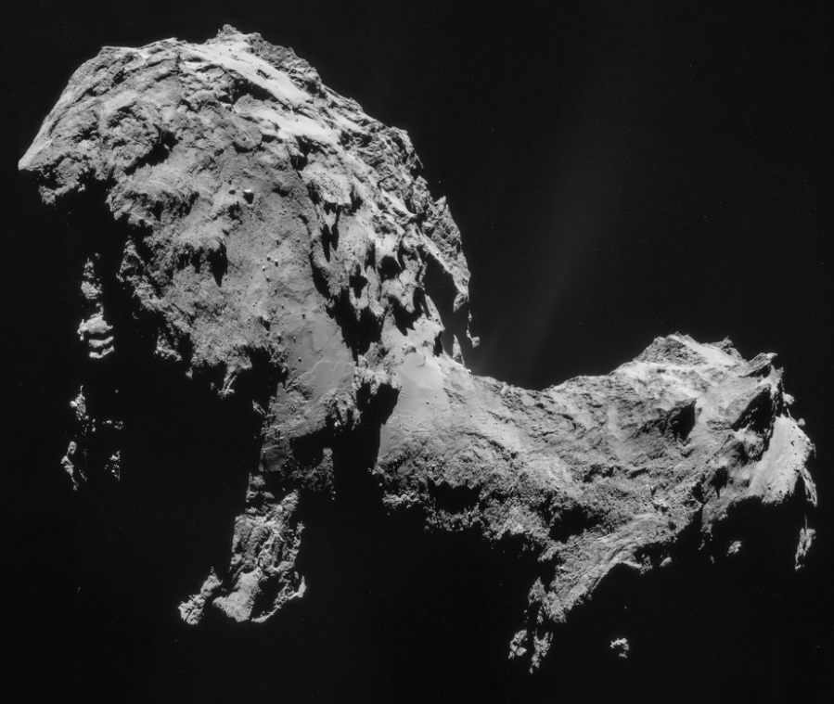
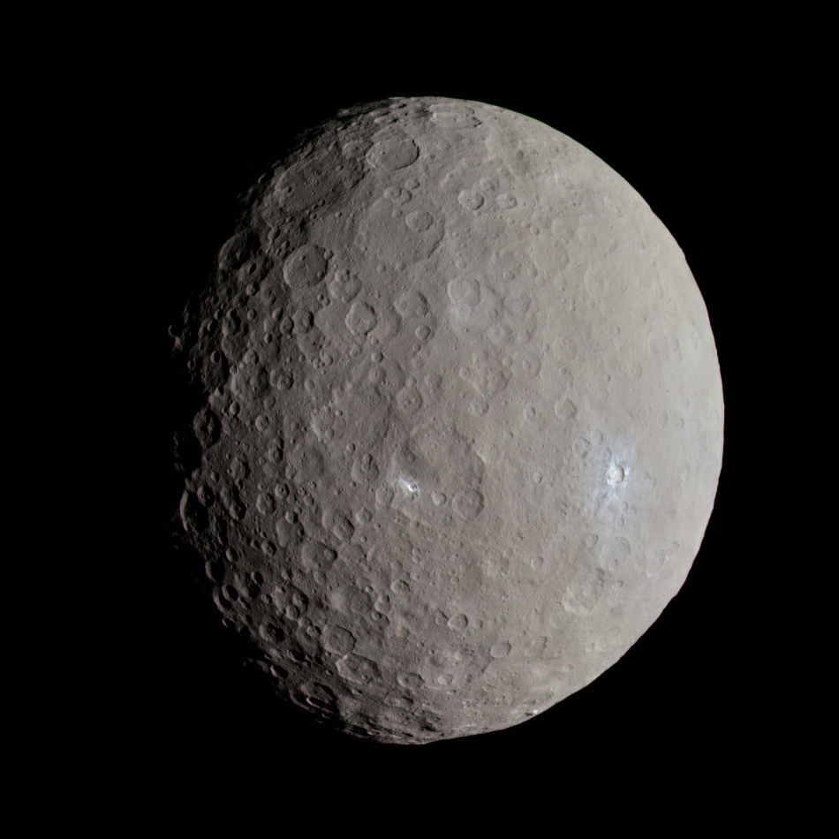
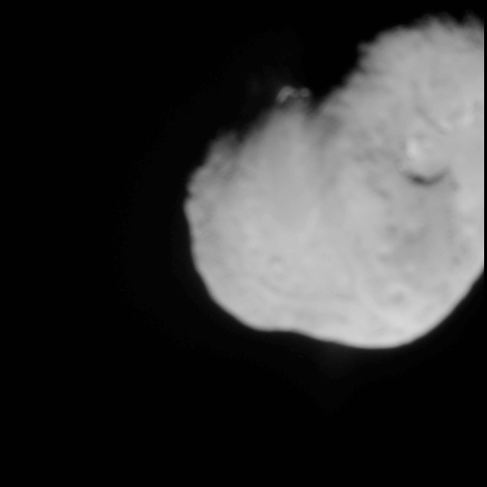
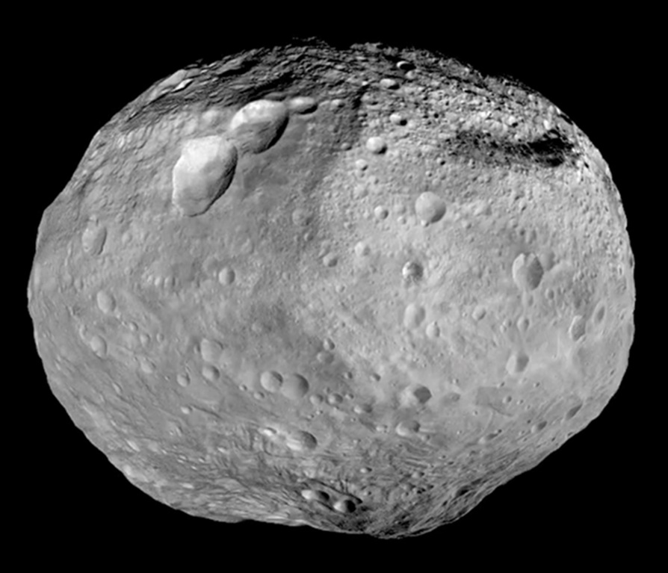
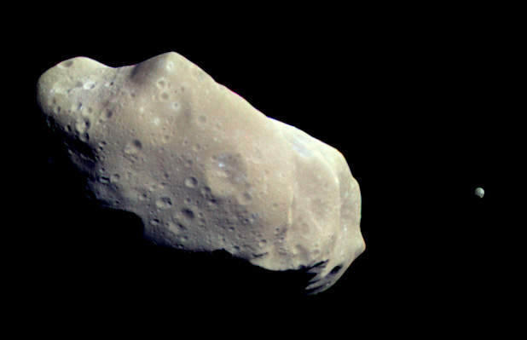
Spacecraft Visits to Asteroids and Comets
It is quite surprising to see how many asteroids and comets have now been visited by spacecraft.
These include:
Asteroid (Dwarf Planet) Ceres
Asteroid Vesta
Asteroid Ida (and Dactyl)
Asteroid Eros
Comet Hartley 2
Comet Tempel 1
Comet Churyumov-Gerasimenko
Most of the comets that have been visited are approached only very far from the Sun, where they are quiescent and in a “deep freeze.”
They come to life only on nearing the Sun, where their volatile elements are vaporized to create the coma and tail.
Ida (and Dactyl)
Hartley 2
Vesta
Churyumov–Gerasimenko
Tempel 1
Ceres
Eros

Slide 7
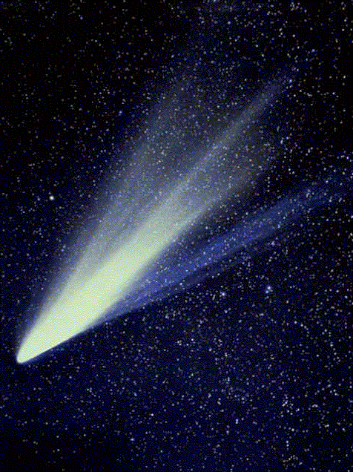
Behavior of Comet Tails
The tail of a comet appears to be streaming behind the comet as it races across the sky. In fact, there are two tails, and the reason for their streaming away from the comet are different in the two cases. However, both tails point away from the Sun, even when the comet is itself moving away from the Sun--in that case the tails point ahead of the comet motion. What is happening?
The two tails are:
Ionized gas tail
color is bluish
main force is the solar wind
solar wind speed is 400-800 km/s, comet's speed is about 30-50 km/s.
tail is straight
dust tail
color is white (reflected sunlight)
main force is photon (radiation) pressure
particles are large and not much affected by the solar wind
tail is often curved

Slide 8
Radiation Pressure
Photons have energy $E=hν$, where $h=6.62×{10}^{−34} J s$ is Planck's constant. They also have a corresponding momentum $p=E/c$. Just like particles, they can "bounce off" an object and impart twice their momentum, or be absorbed by the object and impart their momentum to the object. The energy flux from the Sun, as we have seen before, is $F = L_{⨀}/4πd2$, where $L_{⨀}$ is the solar luminosity (watts, or J/s) and $d$ is the distance from the Sun. Thus, there is also an associated momentum flux $P=\frac{F}{c}=L_{⨀}/4πcd2$, which has units of force/area, or pressure. This is called radiation pressure. Consider a dust particle of radius $r$, which intercepts this momentum flux over its cross-sectional area $πr2$. It will experience a force
$$F_{R}=πr2L_{⨀}/4πcd2=(L_{⨀}/4c)(r2/d2).$$
At the same time, the dust particle feels a gravitational force
$$F_{G}=GMm/d2=GM_{⨀}(4πr3ρ/3)/d2.$$
where $ρ$ is the density of the dust grain. It is interesting that these both depend in the same way on distance from the Sun, so that the ratio is independent of distance:
$$F_{R}/F_{G}=(πr2L_{⨀}/4πcd2) / (GM_{⨀}(4πr3ρ/3)/d2)=3L_{⨀}/(16πcGM_{⨀}ρr)=5.8×{10}^{−4} / ρr.$$
where $ρ$ must be expressed in $kg/m3$, and $r$ must be expressed in $m$. Note that for reasonable densities ($ρ≈ 1000 to 6000 kg/m3$) the ratio is greater than one only for particles of size $< r \sim 0.1 μm$, so only particles smaller than this size can be blown away from the Sun by radiation pressure. This tells us that comet tails are made of very fine material.

Slide 9
Poynting-Robertson Effect
For much larger particles, a new effect of the momentum of light becomes important. As they orbit the Sun the photons come from slightly ahead of the object (they "run into" the photons), with the angle between the incoming photons and the radial direction being $θ=v/c$. This causes an ever-so-slight slowing down of the particles, so that they actually spiral into the Sun. The component of the radiation force that opposes the orbital motion is $θF_{R}=v/c F_{R}$. The time that it takes for a particle at size $r$, originally at a distance $d$ (in AU), and density $ρ$ ($kg/m3$) to spiral into the Sun is only
$$t = 7×{10}^{5}ρrd2 years.$$
This is only about 3000 years for a $1 μm$ particle of density $ρ = 4300 kg/m3$. Of course, particles of size $1 m$ take 1 million times longer, or $3 billion years$.
Yet another effect
There is another effect that has recently been considered, and that is the effect of differential emission of IR radiation from a body that is not at uniform temperature. Recall that the sunlit and dark sides of a slowly rotating body can have considerably different temperatures, and will therefore emit different amounts of IR radiation. If a body is rotating in the direct (CCW) sense, its "hot" side will be continually turning to face in the opposite direction to its motion, so the body will get a little boost and spiral away from the Sun. If instead the body rotates in the retrograde (CW) sense, it will be slowed down and spiral toward the Sun. This is a favored way for asteroids and smaller meteoroids to migrate into the Kirchwood gaps and get ejected from those orbits into the inner or outer solar system.

Slide 10
What We’ve Learned
You should know the difference of terms meteoroid (object still in space), meteor (the brief period with the object is burning up in the atmosphere), and meteorite (after the object reaches the ground).
You should know the origin of the meteors that occur in meteor showers, which is debris from comets that continue in orbit around the Sun, intersecting the Earth’s orbit at the same time each year.
You should know that the main belt asteroids have gaps (Kirkwood gaps) in their orbit semi-major axes, which are the result of period resonances with Jupiter and Saturn.
You should know about the evidence that asteroid families, whose orbits have similar semi-major axes and inclinations, are actually pieces of a larger parent body. In addition clustering due to the orbital similarities, they also have similar colors and spectroscopic signatures.
You should be aware of the large and growing number of asteroids and comets that have been visited by spacecraft, including hitting one with an impactor, landing on their surface, and collecting and returning samples to Earth.
You should know the characteristics of the two types of comet tail, how they are formed, and how to recognize them in a photo.
You should know about several effects that operate on particles and dust in the solar system: radiation pressure, which compares to gravity as $F_{R}/F_{G}=3L_{⨀}/(16πcGM_{⨀}ρr)=5.8×{10}^{−4} / ρr$, the Poynting-Robertson effect that slows objects and spirals them into the Sun on a timescale $t = 7×{10}^{5}ρrd2 years$ ($d in AU$) due to running into photons, and the unequal heating of spinning objects.

