Slide 1
Physics 320: The Sun (Lecture 22)
Dale Gary
NJIT Physics Department

Slide 2
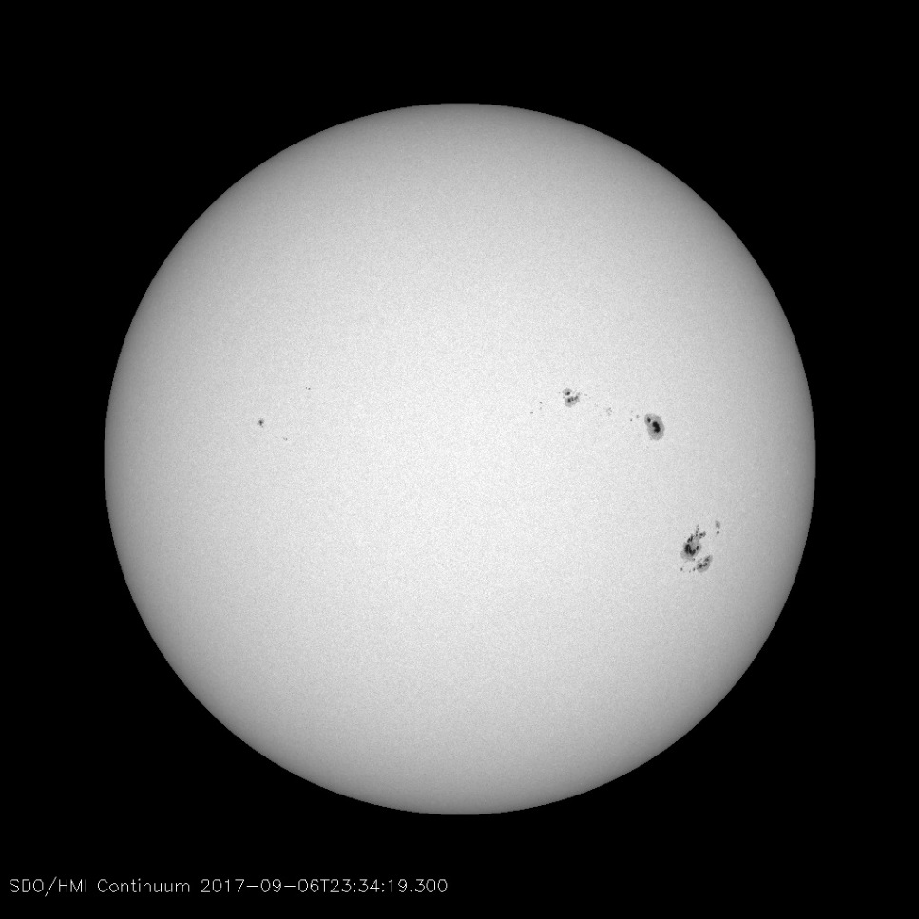
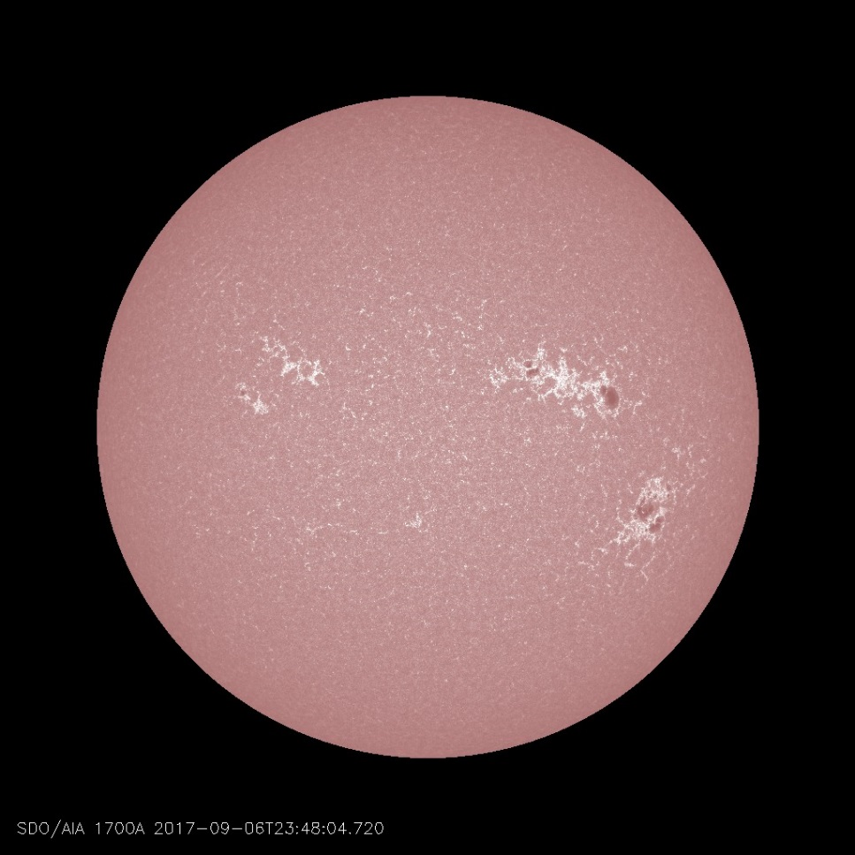
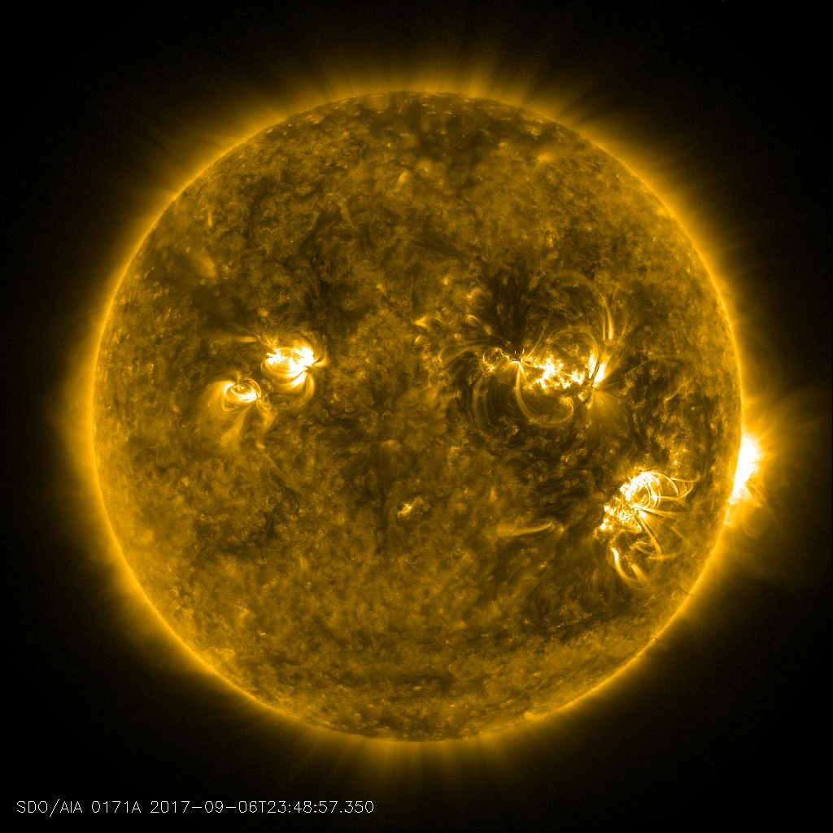
The Sun
Up to now, we have been focusing our attention on the solar nebula and its formation into a disk, then forming planets and the other debris of the solar system.
Finally, we will turn our attention to the “star” of the show, the object forming in the center of the cloud.
We talked a bit about protostars, and how they shine by release of gravitational potential energy for the early stage of their existence. They attain the designation of a true star only when they begin to burn hydrogen into helium through nuclear fusion.
We will talk about that today, but first let’s discuss the physics and conditions of the interior of the Sun.
It may seem strange, but we know far more about the interior of the Sun than we do the interior of any planet, with the possible exception of the Earth. For many decades, this knowledge came from studies of stars, of which the Sun is but one example, and numerical (computer) models that incorporate our knowledge of physics.
Some images from the Solar Dynamics Observatory (SDO) space mission.
Starting in the mid-1970s, however, the discovery of solar oscillations revolutionized our study of the Sun's interior, and in the process also firmed up our knowledge of the interiors of other stars.

Slide 3
The Solar Interior
We will start with some simple scaling arguments like we did earlier for planets. First, the bulk density of the Sun is just $\left\langle ρ\right\rangle =\frac{M_{⨀}}{\frac{4}{3}πR_{⨀}^{3}}=1410 kg m^{−3}$.
Its composition is given in terms of three ratios:
$X = mHnH/\left\langle ρ\right\rangle$(ratio of density of hydrogen to bulk density)
$Y = mHenHe/\left\langle ρ\right\rangle$ (ratio of density of helium to bulk density)
$Z = mZnZ/\left\langle ρ\right\rangle$ (ratio of density of everything else to bulk density)
At the surface of the Sun (and throughout most of its interior), we have the values $X=0.73, Y=0.26,$ and $Z=0.01$. This means that the Sun is mostly ($>90\%$by number) hydrogen, the rest ($\sim 10\%$) is helium, with a tiny fraction being something else (e.g. carbon, oxygen, iron, etc.).
These composition numbers come from spectral measurements of the light from the surface of the Sun, where we see many spectral lines from which the composition can be determined.
However, the composition can change with depth in the Sun, mostly because the core of the Sun is a nuclear furnace that is converting hydrogen to helium through the process of nuclear fusion. To determine that, we have to rely on numerical models, and know the rate of this conversion, plus the overall age of the Sun.
But the rate of the conversion depends also on the interior conditions such as temperature, density, and pressure. Higher temperatures cause the rate of nuclear fusion to increase, and vice versa.
A star must maintain equilibrium, gravity balanced by the outward pressure from the nuclear fusion rate.

Slide 4
Conditions in the Solar Interior
As before, we can estimate the central pressure in the Sun from the equation of hydrostatic equilibrium, $\frac{dP}{dr}=−\frac{GM\left(r\right)ρ\left(r\right)}{r^{2}}$ . The central pressure is found by assuming a constant density equal to the bulk density, which leads to:
Plugging in the numbers, we get $P_{c}=2.7×{10}^{14} Pa=2.7×{10}^{9} atm$.
To estimate the central temperature, we can use the Ideal Gas Law to develop the equation of state for the solar interior:
$P=nkT$.
Note that the number density refers to individual particles, whether hydrogen atoms, helium atoms, or whatever. How do we count atoms? The way that composition plays a role in stellar structure is mainly through the mean molecular weight, defined in terms of its inverse as:
$\frac{1}{μ}=mHn / ρ$ (1)
where $n$ is the number density ($particles m^{−3}$) of particles of all types, i.e. $n=ne+nH+nHe+nZ$.
Because the gas (actually plasma) of the solar interior is very hot, we can assume that it is completely ionized, so all of the electrons that would normally be bound to each atom are free particles (and have to be added to the count). How many electrons will there be?
$$P_{c}=−GM_{⨀}\left\langle ρ\right\rangle /R_{⨀}$$

Slide 5
Conditions in the Solar Interior
Each hydrogen atom will contribute 1 electron. Each helium atom will contribute 2 electrons. Each higher-number element $Z$ will contribute $Z$ electrons. In this case, the mean molecular weight is given by:
$\frac{1}{μ}=2X+\frac{3}{4}Y+\frac{1}{2}Z$, where $X$, $Y$, and $Z$ were given earlier as $X=0.73, Y=0.26,$ and $Z=0.01$.
Solving for $μ$, we get $μ \sim 0.6$. So equation (1) gives for the density $n=ρ/{μm}_{H}$. Finally, the equation of state is:
$P=ρkT/μm_{H}$ (2)
Solving for T, and using our earlier estimate of central pressure and bulk density, we have:
$$T_{c}=\frac{P_{c}μm_{H}}{\left\langle ρ\right\rangle k}=1.44×{10}^{7}K.$$
This gives for the central temperature more than $14 million K$, which is enough to permit nuclear fusion. Note that this high temperature is a consequence of the huge mass of the Sun pressing down on the center, and results from the behavior of gas particles under such a huge pressure through the ideal gas law.
There are many important physical effects we have ignored, such as the increasing density with depth, and the changing composition, but our estimates for $P_{c}$ and $T_{c}$ are actually pretty good. The actual values are obtained from the "standard model," which properly accounts for all that is known about the interior, about other stars, and properly accounts for the full physics, including partial ionization.

Slide 6
Conditions in the Solar Interior
Through our simple use of scaling arguments, we have seen that the average density, core pressure and core temperature are as given in the table below. These are contrasted with the more exact values determined from computer models of the Sun's interior (the so-called standard model). We also show the mass fraction of hydrogen (X) and of helium (Y) at the surface and at the core.
The Sun is about 4.52 billion years old, and has been converting hydrogen to helium in its core all that time. More than half of the hydrogen has been used up already, in the core, so the Sun is about middle-aged. The solar model can be traced in time from an initial composition through to its present age. As the composition changes due to using up its hydrogen, the other parameters of the Sun such as its radius, temperature, and luminosity must change as well.
From Scaling Arguments |  | From Standard Model
Core Temperature | 1.4$×$10⁷ K | Central Temperature | 1.58$×$10⁷ K
Core Pressure | 2.7$×$10¹⁴ N m⁻² | Central Pressure | 2.50$×$10¹⁶ N m⁻²
Average Density | 1410 kg m⁻³ | Central Density | 1.62$×$10⁵ kg m⁻³
X at surface | 0.73 | X at core | 0.336
Y at surface | 0.26 | Y at core | 0.643

Slide 7
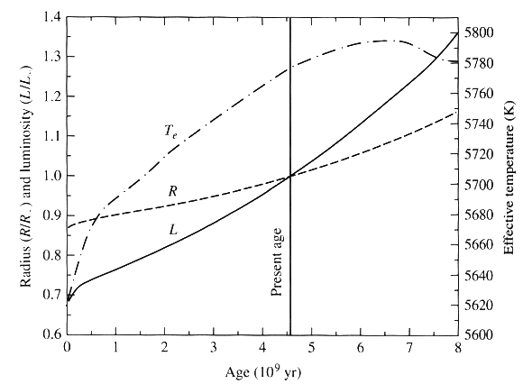
Evolution of the Sun Over Time
According to the figure below, the solar radius has increased by about $12\%$ over its lifetime, the surface temperature has increased by about $20\%$, and the luminosity ($4πR2σT4$) has increased by $30\%$. However, this implies about a $5\%$ increase in the last $500 million years$, and it is not clear that such an increase is compatible with known Earth climate history.
Theoretical understanding of how the radius, temperature, and luminosity of the Sun has changed over the lifetime of the Sun. The changes may be more extreme than actually occurred, given what we know of Earth's climate history. Figure from Carroll and Ostlie, Introduction to Modern Astrophysics, 2nd Edition, Addison-Wesley, New York, 2007.

Slide 8
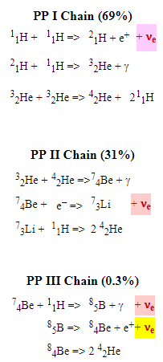
Seeing into the Solar Interior
Computer models such as the standard model must fit the observable constraints that we have, e.g. the mass, radius, surface temperature, luminosity, and composition. We have some other constraints such as the age of the solar system (4.5 billion years), but we would like to have other information to be sure that the model is correct. Currently, we have two additional methods, both pioneered in the 1970's, that actually let us "see" inside the Sun. These are
solar neutrino detections
helioseismology
One of these, helioseismology, agrees spectacularly with the standard model and can give us information about the interior rotation of the Sun. For a time in the late 1990s, the other, solar neutrino measurements, disagreed rather spectacularly!
The nuclear reactions that occur in the solar interior (the proton-proton chain) are shown in the right column.
The electron neutrinos in each reaction are highlighted. Neutrinos are rather mysterious particles, nearly massless and very unreactive. They pass through the Sun as if it were not there, so while photons reach us from the core only after 1 million years of torturous meandering, neutrinos come directly to us. However, if traveling 700,000 km through a star cannot stop them, how can we detect them?

Slide 9
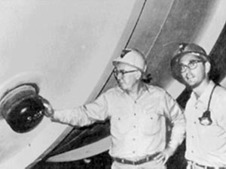
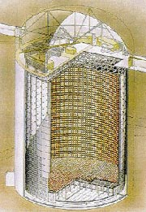
Seeing into the Solar Interior (neutrinos)
The neutrino in the yellow cell on the previous page can be captured by a Chlorine-37 nucleus in the following reaction.
In the Homestake Gold Mine in South Dakota, a tank of 100,000 gallons of cleaning fluid ($C2Cl4$) acts as a neutrino detector, in a pioneering experiment by Raymond Davis. Every several months the tank was purged to detect the $Ar$ atoms produced in the reaction. From the standard solar model, it is expected that only slightly more than $1 atom per day$will be produced among the $1030$ Chlorine atoms in the tank! In fact, Davis only found less than 1 every two or three days. This became known as the solar neutrino problem. Other experiments were then set up to detect neutrinos, including the far more numerous neutrinos produced in the PP-I chain (purple cell on previous page).
In 2001, the solar neutrino problem was solved:
neutrinos come in three flavors, electron, muon, and tau.
The Sun produces only electron neutrinos
Before 2001, only electron neutrinos could be counted, and they indicated too few neutrinos--something was wrong.
However, if the neutrinos have mass, they may "oscillate" among the three forms, only one of which had been previously counted.
Ray Davis & John Bahcall
Super-Kamiokonde

Slide 10
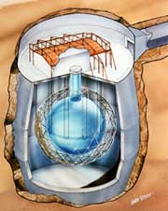
Seeing into the Solar Interior (neutrinos)
In 2001, the solar neutrino problem was solved—continued:
A new detector at the Sudbury Mine in Canada can detect both "neutral current" and "charged current" reactions
Neutral current is when the reaction with deuterium produces a proton and a neutron (a simple split of the deuterium atom). All three flavors of neutrino cause this kind of reaction.
Charged current is when the reaction with deuterium produces two protons and an electron. Only electron neutrinos cause this kind of reaction.
The neutral current reactions allow all neutrinos to be counted, while the charged current reactions allow the proportion of electron neutrinos to be counted.
The new results show that the total number of non-electron neutrinos (actually determined from Super Kamiokande in Japan) increased in the same proportion that the electron neutrinos decreased, indicating that the electron neutrinos are indeed changed to one of the other flavors.
The measurement allows the electron neutrino mass to be estimated to be between 0.05 to 0.18 eV
Artist’s drawing showing cutaway of the Sudbury Solar Neutrino Observatory, encased in its housing and submerged in a mine. Drawing: Copyright © Garth Tietien 1991

Slide 11
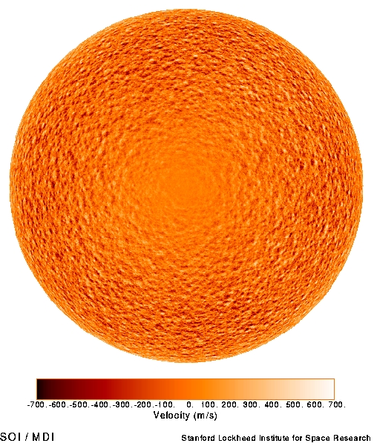
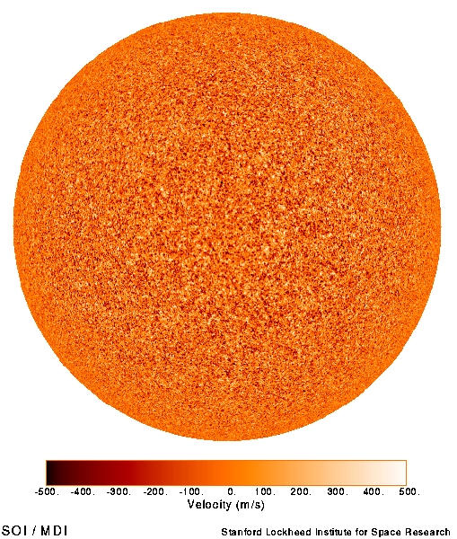
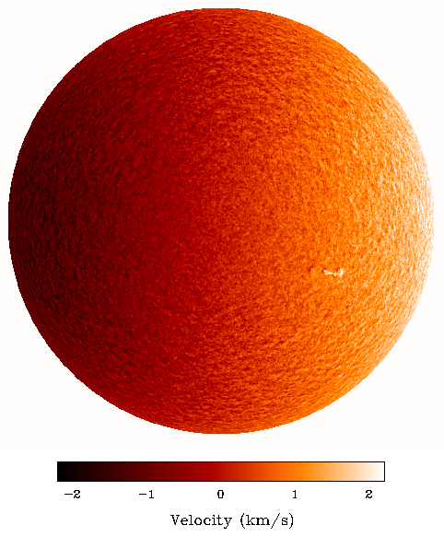
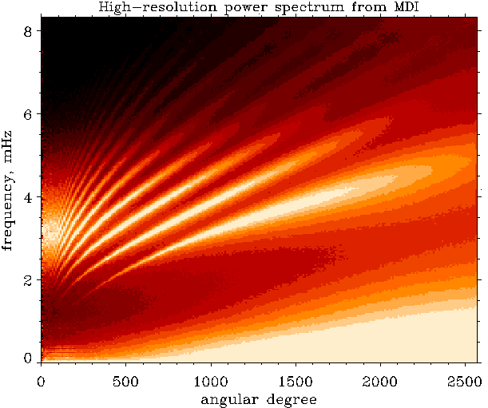
Seeing into the Solar Interior (helioseismology)
Helioseismology is the study of "seismic" pressure and gravity waves inside the Sun. Just as we can study earthquakes to learn about the Earth's interior, we can also study "sunquakes" to learn about the Sun's interior. Sound waves are generated randomly from small-scale convective turbulence at the surface of the Sun. They rattle around inside the Sun, but those modes that are at special wavelengths to match spherical harmonics of the Sun can live a long time and resonate.
The images at right are velocity maps (dopplergrams) of the Sun, showing the rotation signature, the surface convection (supergranule) signature, and when these have been subtracted, the remaining signature is due to the global oscillations.
The normal modes of oscillation of the solar interior are revealed in $k\text{−}ω$ diagrams like the one at right.
The exact frequencies of the ridges are sensitive to the internal temperature, rotation rate, and other parameters.

Slide 12
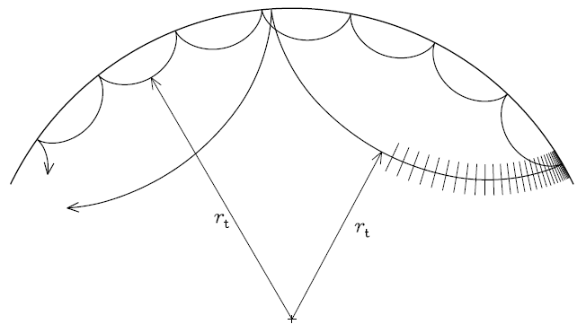
Seeing into the Solar Interior (helioseismology)
From helioseismology, we learn that the radiative core, out to about 0.7 R, rotates like a solid body while the outer convective envelope rotates more like a cylinder, with the equatorial band (0-30º) rotating faster and the poles (60-90º) rotating much more slowly.
Diagram of two waves of different wavelengths being "launched" from the same point near the surface of the Sun at the right.
The longer wavelength wave propagates to a greater depth before refraction causes it to turn upward, so this mode samples
deeper into the interior. Each wave also reflects from the surface. Waves that bounce exactly an integral number of times and
come back to the same point form the "normal modes" and have long lifetimes, causing the Sun to reverberate like a bell.
From "Lecture Notes on Stellar Oscillations" by Joergen Christensen-Dalsgaard (http://users-phys.au.dk/jcd/oscilnotes/)

Slide 13
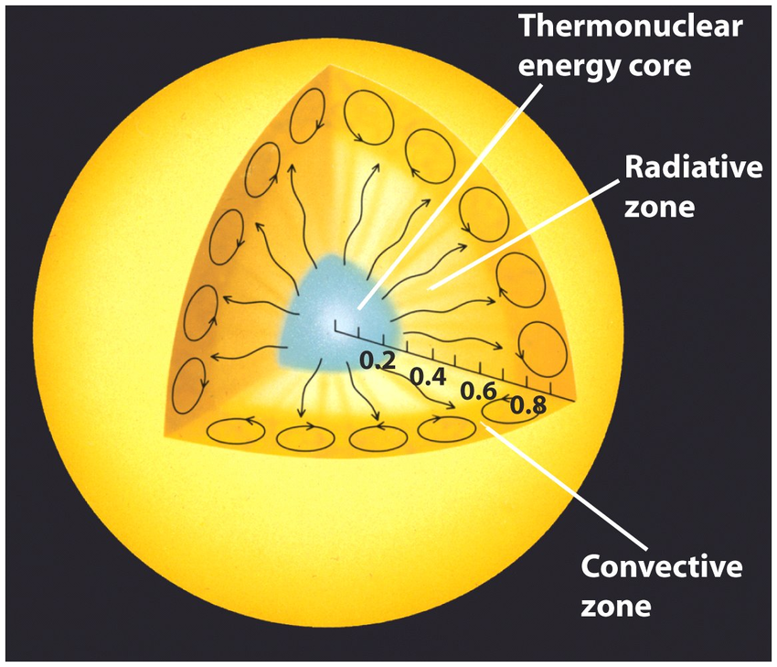
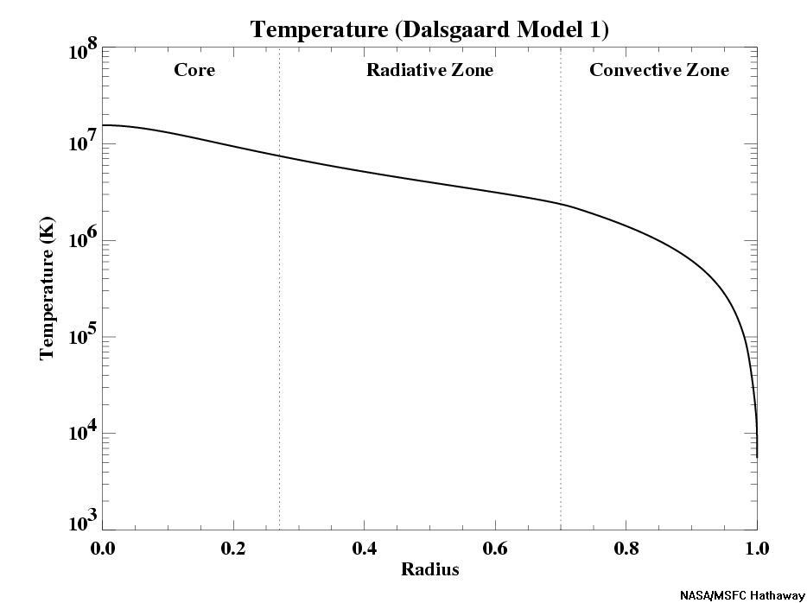
Radial Structure of the Solar Interior
At right is a cut-away view of the radial structure of the solar interior. The inner $0.3 R⨀$ is the source of energy, where nuclear fusion is taking place.
Beyond that, the Sun is not producing energy, only transporting it outward. From $0.3$-$0.7 R⨀$is the radiative zone, where energy is carried by radiation only.
Photons generated in the core do a random walk, and diffuse slowly outward, taking about 1 million years to reach $0.7 R⨀$.
From $0.7$-$1 R⨀$, the atmosphere is unstable to convection, and the energy is then carried by large-scale convection cells. The energy takes only about 1 month to make this journey.
Why does the energy transport mode change? It is due to the temperature gradient, and the same physics as we discussed for the weather patterns in the Earth’s atmosphere.
If a hot parcel of gas moves upward, it cools, but if the atmosphere cools more slowly, then the gas will be cooler than its surroundings and fall back, hence is stable. A steep temperature gradient causes instability.

Slide 14
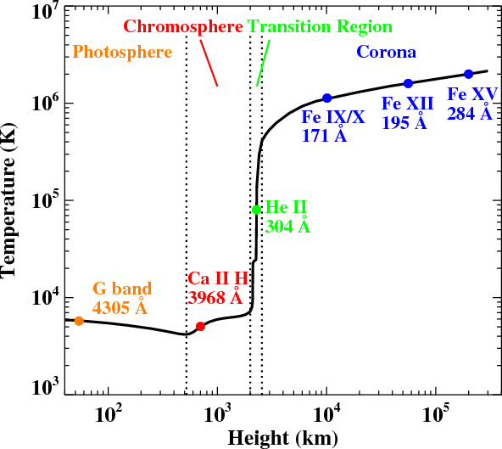
The Solar Atmosphere
The Sun does not end at its surface (the photosphere). The matter of the Sun extends far out into interplanetary space, and these regions are referred to as the Sun's atmosphere. Different regions of the atmosphere have different characteristics:
Photosphere Where the continuum (H⁻) is formed)
Chromosphere Where spectral lines are formed
Transition Region Region of rapid drop in density, rapid rise in temperature
Corona Extended, thin, million degree plasma
Solar Wind 400-800 km/s flow of gas and field into IP space
These different layers of the atmosphere are structured by the magnetic field, which provides energy to heat the atmosphere, and also guides the hot plasma along the field lines.
The temperature profile of the solar atmosphere governs how it appears in different wavelengths. The photosphere is around 5800 K, then the temperature falls to about 4000 K at the temperature minimum, but at around 2000 km height, it suddenly skyrockets to around 1 million K.

Slide 15
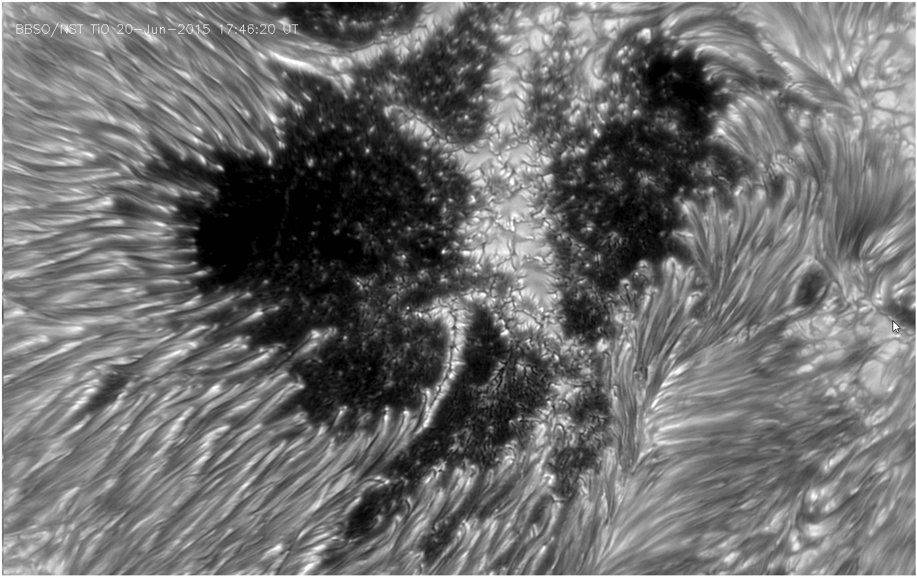
Photosphere
This is a movie from NJIT’s Big Bear Solar Observatory, showing some of the highest resolution solar images ever taken.
This is the visible surface of the Sun, where sunspots are regions of very strong magnetic field, so strong that the field inhibits the flow of heat, and so the surface is cooler (hence dark).
The striations in this image are due to horizontal field lines, which make the hot plasma flow along them.
In a few places, one can see the “normal” surface of the Sun—the granulation.

Slide 16
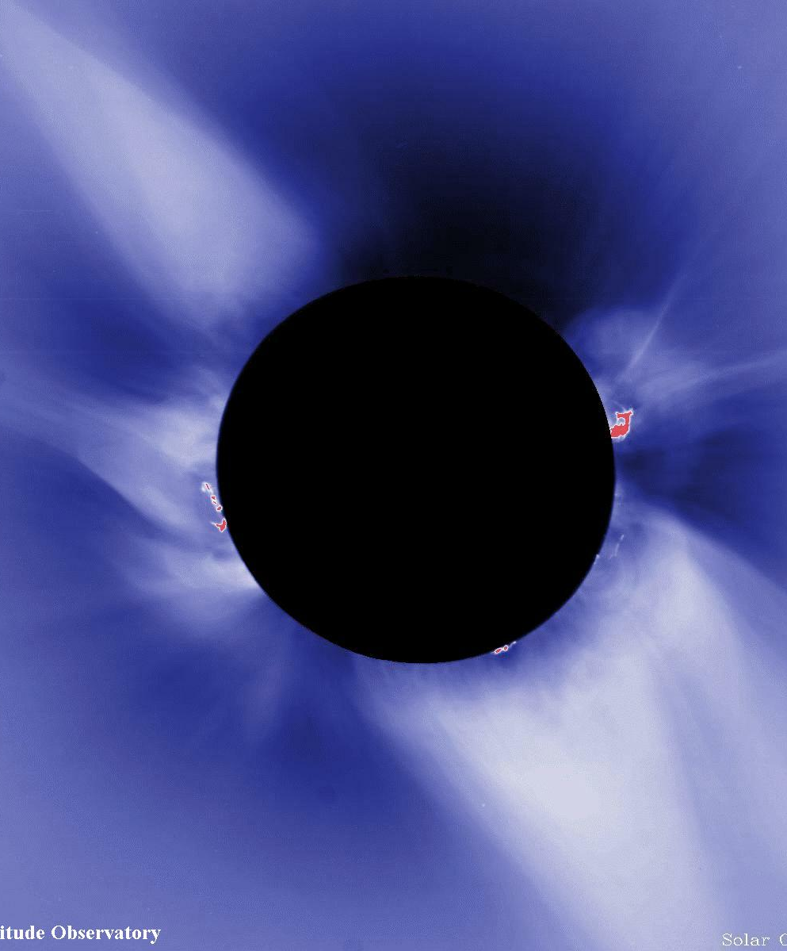
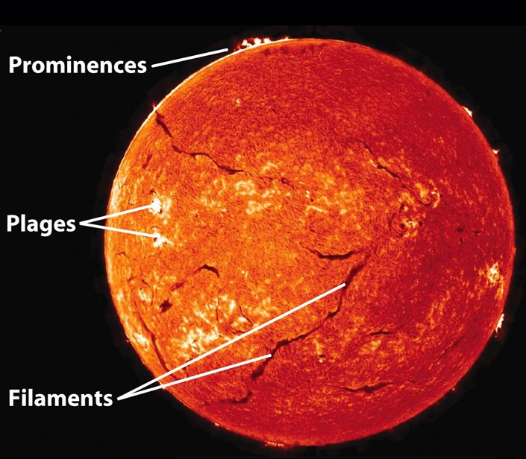
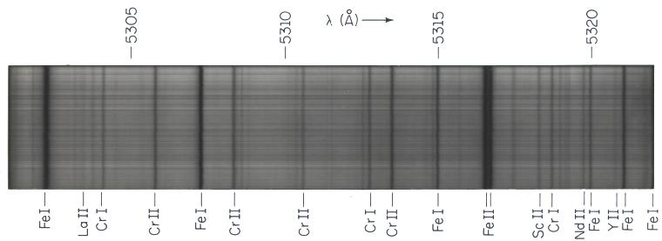
Chromosphere
Chromo means color, and this layer is so named because it appears red at times of solar eclipses.
It appears red for exactly the same reason that star-forming clouds (nebulae) in the interstellar medium appear red. They both are glowing strongly in the red line of hydrogen alpha (Hα).
The chromosphere is the region where a wide range of spectral lines are formed, and they are absorption lines because the chromosphere includes the temperature minimum region. The cooler gas there absorbs the light from the photosphere below it.
That is also why making images in certain spectral lines makes features show up that are not ordinarily visible.
This Hα image shows features like filaments, prominences, and plage that are not normally seen, but stand out clearly when viewed in the narrow line of Hα.

Slide 17
Corona
The corona is extremely hot, > 1 million K. It shines in the visible part of the spectrum, as in this photo from a solar eclipse, due to scattered light from the photosphere.
It is so faint that it cannot be seen from the ground except when a solar eclipse blocks the bright light of the photosphere.
However, the hot plasma of the corona is also shining in various spectral lines. It is much too hot to shine in Hα, because as you recall that line is due to electrons dropping from the $n=3$ to $n=2$ energy level. In the corona, there are no electrons in any energy level—the hydrogen is all completely ionized!
But other, more highly ionized species like Fe XII, or Fe XIV have transitions in the extreme ultraviolet (EUV), so the corona is bright at those wavelengths.
But those do not reach the ground, so we have to go to space to photograph them.

Slide 18
The EUV Corona
Movie showing the different appearance of solar features in different wavelengths, covering the photosphere, chromosphere, and corona.
SDO Year 3 movie showing dynamics.
In addition to EUV, the corona also shines in soft X-rays.
We have not yet mentioned the solar wind, but we talked about that in earlier lectures, especially when discussing magnetospheres. We will also look at it more closely in the final lecture on the heliosphere.
Next time, we will look at the various phenomena of solar activity, and learn something about where sunspots come from, and how the Sun influences the Earth.

Slide 19
What We’ve Learned
You should understand the basic interior structure of the Sun, including a core $0\text{-}0.3 R⨀$ where fusion energy is created, the radiative zone $0.3\text{-}0.7 R⨀$, where energy is carried very slowly by radiation, and $0.7\text{-}1R⨀$, where energy is carried much more quickly to convective overturning.
You should know that the reactions mainly follow the proton-proton chain, although there are additional, minor reaction chains also at work.
You should know that there are two ways in which we can directly “observe” the interior, from the neutrinos produced in nuclear reactions, and from sound waves (helioseismology).
You should have a basic knowledge about the neutrino problem—an undercounting of neutrinos—which was finally solved by measuring all types of neutrinos and verifying that they can oscillate among different flavors (electron, tauon, and muon neutrinos).
You should know the names and characteristics of the several layers or regions of the solar atmosphere (photosphere, chromosphere, transition region, corona, and solar wind).
You should have an appreciation for the general temperature differences, which govern their visibility in different wavelengths. Photosphere—visible light. Chromosphere—spectral lines. Corona—white light (during eclipses) or EUV.
You should understand the role the magnetic field plays, both as a source of energy for the atmosphere and as the force that guides the structure of the atmosphere.

