Slide 1
Physics 320: Interplanetary Space and the Heliosphere (Lecture 24)
Dale Gary
NJIT Physics Department

Slide 2
Interplanetary Space
We already mentioned the solar wind as one aspect of interplanetary space, the "empty" space between the Sun and the planets. In addition to the solar wind of particles (electrons, protons, helium atoms, and dust), interplanetary space is also filled with very weak magnetic fields. At about 1 solar radius above the photosphere, the magnetic field is almost radial, but as we go farther out the rotation of the Sun causes the field lines to lag behind and become a spiral. The spiral form is called an Archimedes' Spiral, which has the simple polar coordinate equation:
$r=aθ$. (1)
We can get an equation for the field lines by taking the derivative with respect to time
$$dr/dt=a dθ/dt$$
where $dr/dt=v$is the velocity that the field lines are being carried away from the Sun (the solar wind velocity) and $dθ/dt =ω$is the solar rotation rate. Thus, we can identify the value for the constant $a$, which controls the tightness of the spiral (large $a$ means a loose spiral, small $a$ means a tight spiral),
$a=v/ω$.
Starting at $r=ro$at an angular position $θ=θo$, (1) becomes
$(r−ro)=(v/ω)(θ−θo)$,
but this spirals the wrong way, so we need a minus sign. The final form of the equation is:
$(r−ro)=(v/ω)(θ−θo)$ (2)

Slide 3
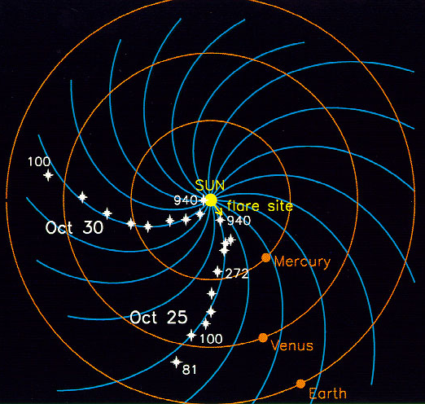
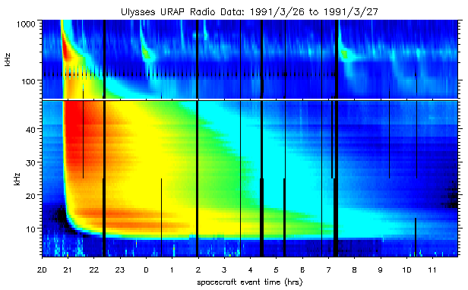
Interplanetary Space
This spiral structure can be seen in the path of charged particles accelerated during solar flares. These particles generate radio emission (an example is shown below), so tracking the position of the radio emission allows the tracing of their path. Scientists try to predict the future conditions in the IP space using the ENLIL model.

Slide 4
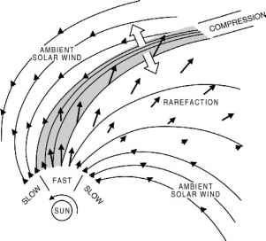
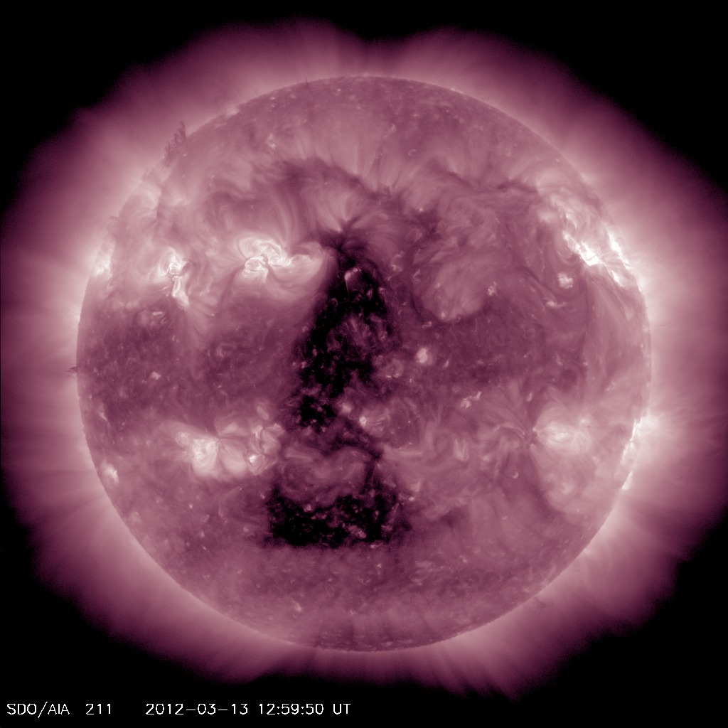
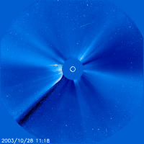
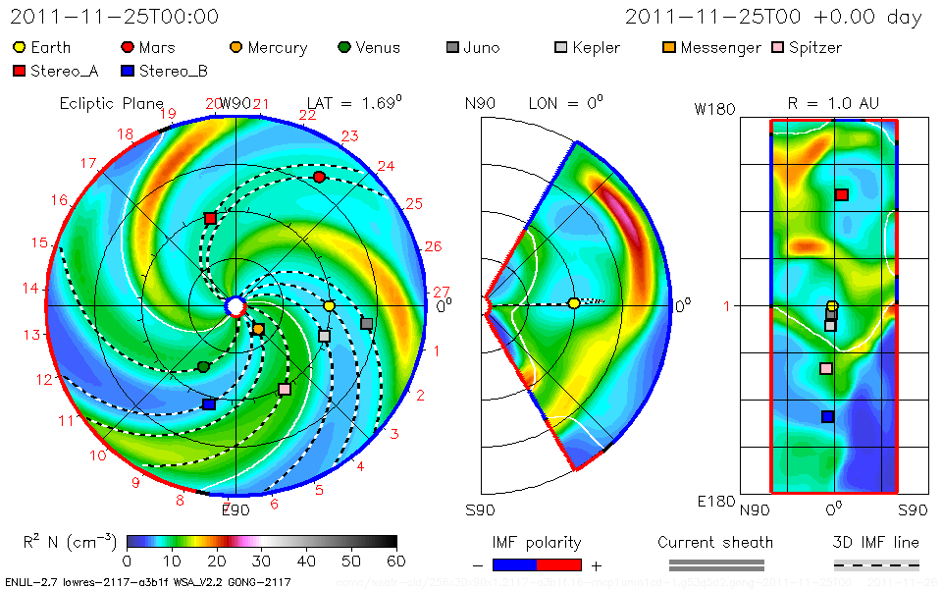
Effects on Earth
There are several features of the solar wind that can affect Earth.
For example, there are regions on the Sun called coronal holes, where the solar wind speed suddenly changes. The fast wind (loose spiral) catches up with the slow wind (tight spiral), to form a corotating interaction region. When that sweeps by the Earth, it compresses the Earth’s magnetosphere, which we discussed earlier, and can cause a magnetic storm.
Also, coronal mass ejections (CMEs), which we discussed last time, can be directed at Earth and also can cause a magnetic storm.
Finally, the CMEs can drive a shock wave, which can accelerate particles to high energies, to create the particle radiation we discussed last time. One of the purposes of the ENLIL model is to predict the arrival time of shock waves, not only at Earth, but at other planets and spacecraft.
Slow Fast Slow
(Coronal
Hole)

Slide 5
The Solar Wind, Magnetosphere Interaction
We already discussed the structure of planetary magnetospheres, but it is interesting to discuss what happens when a magnetic cloud from the Sun interacts with the Earth’s magnetosphere.
The direction of the Earth’s field at the interaction point is northward (magnetic field lines come out of the south magnetic pole and go in at the north magnetic pole).
The Sun’s field can point in any direction, but if it happens to point southward, as shown in the drawing, the two oppositely directed field lines can “reconnect.” That releases energy.
That reconnection drives the magnetic fields in the tail toward each other, and they are also oppositely directed, so another reconnection happens there, which drives a current that is closed in the upper atmosphere in the arctic regions of the Earth.
That results in the magnetic storm just mentioned, which causes the aurora. Here is a rather poorly done animation.
Direction of Earth field is northward.

Slide 6
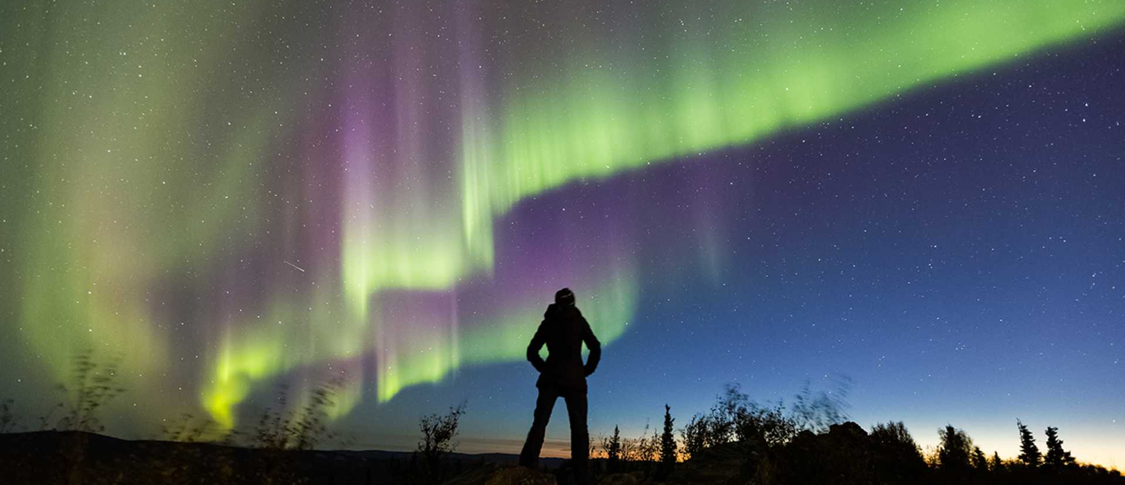
Aurora Borealis, or Northern Lights
https://www.explorefairbanks.com/explore-the-area/aurora-season/

Slide 7
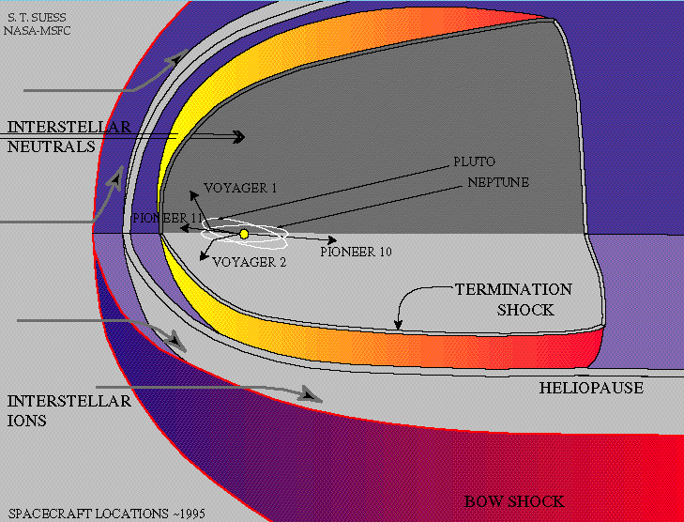
The Heliosphere
The solar wind exerts a pressure radiating outward from the Sun, due to both the gas pressure, $Pgas$, and the magnetic pressure $Pmag$. Since the gas is expanding outward into a roughly spherical volume as it leaves the Sun, the gas density drops approximately at $1/R2$. An approximate representation for the number density is
$ne = 5×{10}^{6} {\left(R/R⨀\right)}^{−2} {cm}^{−3}$.
Eventually the gas and magnetic pressure from the Sun is overcome by the pressure exerted by the interstellar medium (ISM). This is made up of the gas and magnetic pressure of material from other stars, or left over from the formation of the galaxy. We can think of the Sun's influence as forming a "bubble" in the ISM, and this bubble is called the heliosphere.
Back in 2001, my lecture stated: We still do not know the exact extent of the heliosphere. Several spacecraft are slowly making their way outward from the Sun, and looking for the termination shock associated with it.
Since then, we do know! The Voyager spacecraft passed the termination shock in 2005 and 2007, and Voyager 1 passed the heliopause in 2012.
Spacecraft locations in 1995, long before the reached the termination shock. The Voyager spacecraft finally arrived in 2012.

Slide 8
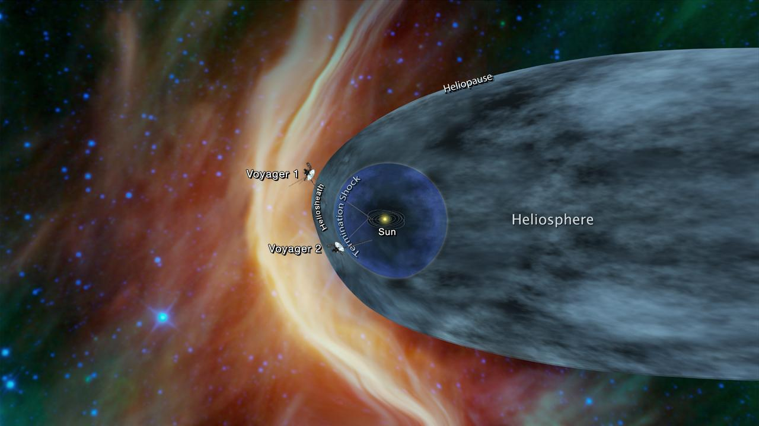
The Heliosphere
Now the mission of the project has changed. The Voyagers were sent to study Jupiter and Saturn, and then Voyager 2 was adjusted to go on to Uranus and Neptune. Now that Voyager 1 is in true interstellar space, the new mission is the Voyager Interstellar Mission. Check out this timeline. Voyager 1 crossed the termination shock at 94 AU in December 2004 and Voyager 2 crossed at 84 AU in August 2007. You can see where they are now, at the mission status page. As of December 2018, Voyager 1 is in interstellar space, at a distance of 144.1 AU from the Sun and Voyager 2 is still in the heliosheath, at a distance of 119.3 AU.
It is no accident that the heliosphere looks a lot like a magnetosphere. The Sun is moving through the galaxy, and there is a bow shock in the direction it is moving, while in the opposite direction the heliosphere is stretched out into a long tail.
This artists conception does not try to draw it, because we do not know anything about it. The Voyagers are exploring the closer side.

Slide 9
What We’ve Learned
You should understand the due to solar rotation the magnetic field lines from the Sun are wrapped into an Archimedean spiral shape.
We can map out the shape by measuring the location of radio bursts, which map out the spiral as particles stream outward along it.
Disturbances in the solar wind that can affect Earth are corotating interaction regions (CIRs), coronal mass ejections (CMEs), and shock waves.
We looked briefly at how the solar wind disturbances can trigger geomagnetic storms, which are the cause of auroras. The important feature that determines whether a CME will trigger a storm is the direction of its magnetic cloud. If the field lines point southward, it can trigger a storm.
We looked at the characteristics of the heliosphere, and the fact that the Voyager spacecraft have now ventured through the termination shock, and Voyager 2 has passed the heliopause, so it is now truly in interstellar space.

