Slide 2
Chapter 11 Oscillations and Waves

Slide 3
Contents of Chapter 11
Simple Harmonic Motion—Spring Oscillations
Energy in Simple Harmonic Motion
The Period and Sinusoidal Nature of SHM
The Simple Pendulum
Damped Harmonic Motion
Forced Oscillations; Resonance
Wave Motion
Types of Waves and Their Speeds: Transverse and Longitudinal

Slide 4
Contents of Chapter 11
Energy Transported by Waves
Reflection and Transmission of Waves
Interference; Principle of Superposition
Standing Waves; Resonance
Refraction
Diffraction
Mathematical Representation of a Traveling Wave

Slide 5
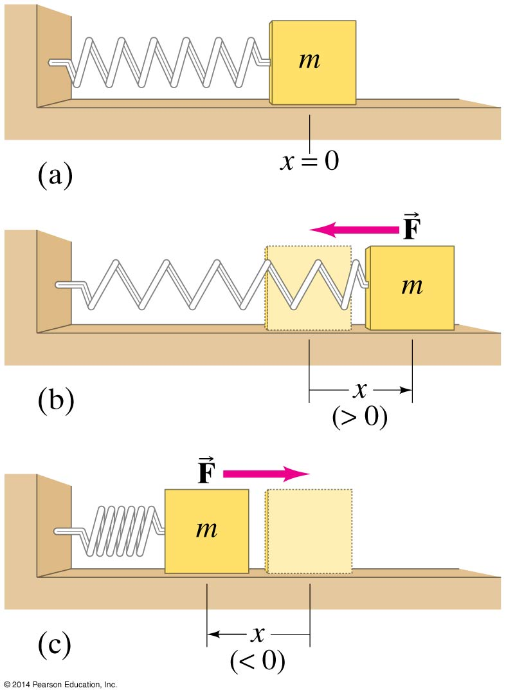
11-1 Simple Harmonic Motion—Spring Oscillations
If an object vibrates or oscillates back and forth over the same path, each cycle taking the same amount of time, the motion is called periodic. The mass and spring system is a useful model for a periodic system.

Slide 6
11-1 Simple Harmonic Motion—Spring Oscillations
We assume that the surface is frictionless. There is a point where the spring is neither stretched nor compressed; this is the equilibrium position. We measure displacement from that point (x = 0 on the previous figure).
The force exerted by the spring depends on the displacement:
(11-1)

Slide 7
11-1 Simple Harmonic Motion—Spring Oscillations
The minus sign on the force indicates that it is a restoring force—it is directed to restore the mass to its equilibrium position.
k is the spring constant
The force is not constant, so the acceleration is not constant either

Slide 8
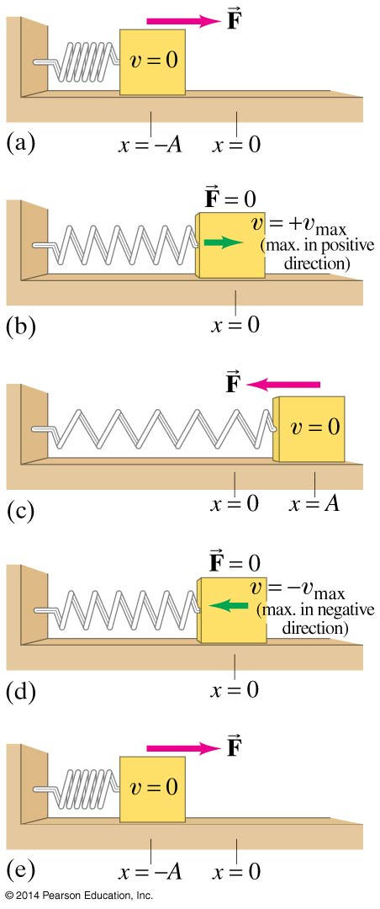
11-1 Simple Harmonic Motion—Spring Oscillations
Displacement is measured from the equilibrium point
Amplitude is the maximum displacement
A cycle is a full to-and-fro motion; this figure shows half a cycle
Period is the time required to complete one cycle
Frequency is the number of cycles completed per second

Slide 9
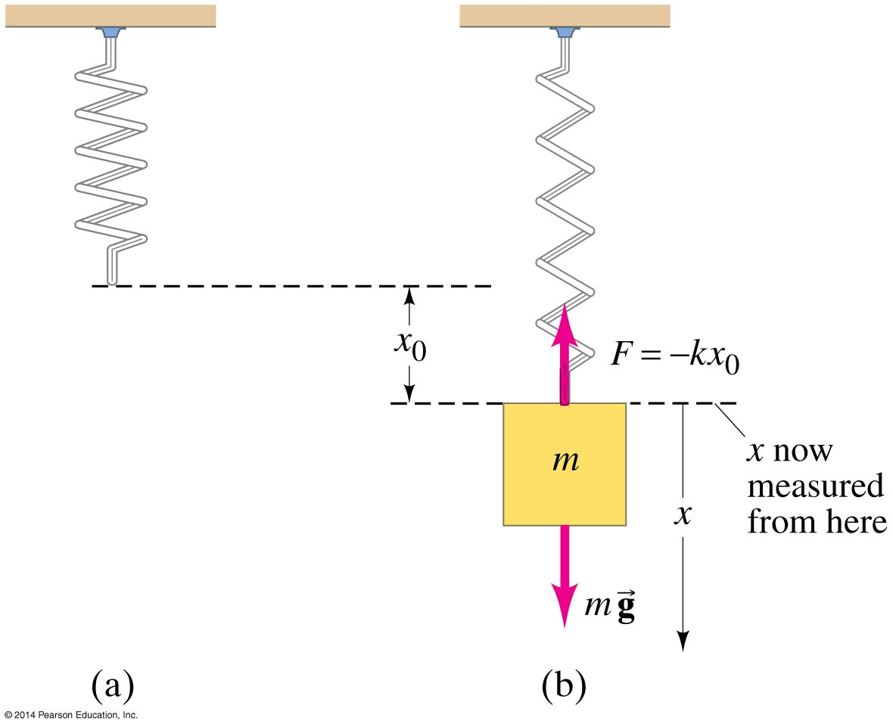
11-1 Simple Harmonic Motion—Spring Oscillations
If the spring is hung vertically, the only change is in the equilibrium position, which is at the point where the spring force equals the gravitational force.

Slide 10
11-1 Simple Harmonic Motion—Spring Oscillations
Any vibrating system where the restoring force is proportional to the negative of the displacement is in simple harmonic motion (SHM), and is often called a simple harmonic oscillator.

Slide 11
11-2 Energy in Simple Harmonic Motion
We already know that the potential energy of a spring is given by:
PE = ½ kx²
The total mechanical energy is then:
The total mechanical energy will be conserved, as we are assuming the system is frictionless.
(11-3)

Slide 12
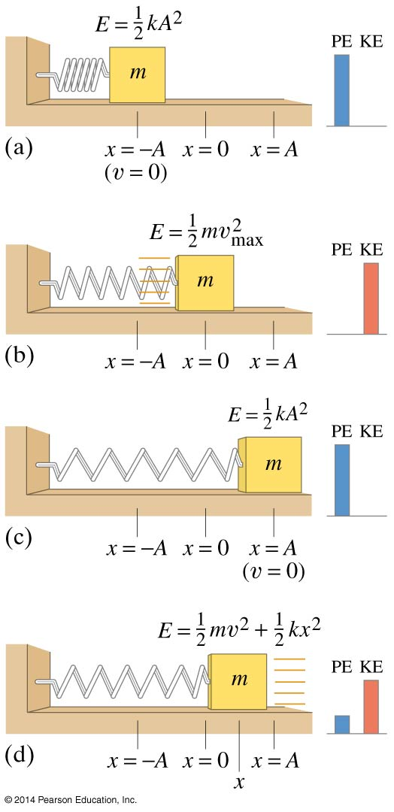
11-2 Energy in Simple Harmonic Motion
If the mass is at the limits of its motion, the energy is all potential.
If the mass is at the equilibrium point, the energy is all kinetic.
We know what the potential energy is at the turning points:
(11-4a)

Slide 13
11-2 Energy in Simple Harmonic Motion
The total energy is, therefore ½ kA²
And we can write:
This can be solved for the velocity as a function of position:
where
(11-4c)
(11-5b)
(11-5a)

Slide 14
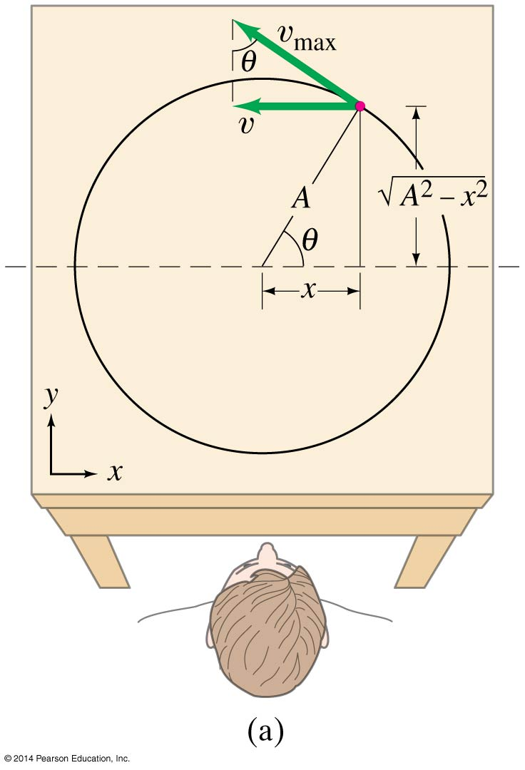
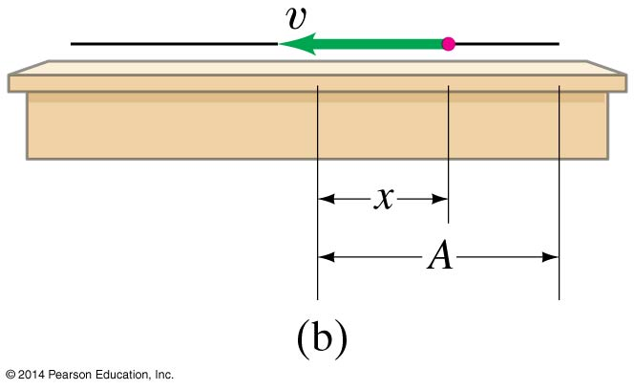
11-3 The Period and Sinusoidal Nature of SHM
If we look at the projection onto the x axis of an object moving in a circle of radius A at a constant speed v_{max}, we find that the x component of its velocity varies as:
This is identical to SHM.
(11-5b)

Slide 15
11-3 The Period and Sinusoidal Nature of SHM
Therefore, we can use the period and frequency of a particle moving in a circle to find the period and frequency:
(11-6a)
(11-6b)

Slide 16
11-3 The Period and Sinusoidal Nature of SHM
We can similarly find the position as a function of time:
(11-8a)
(11-8b)
(11-8c)

Slide 17
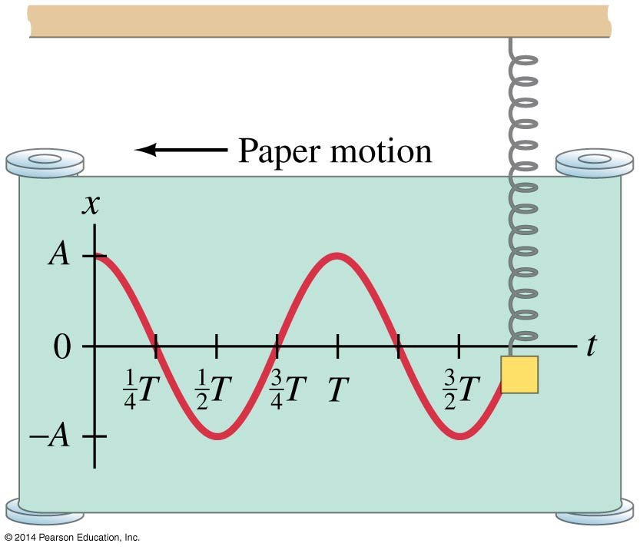
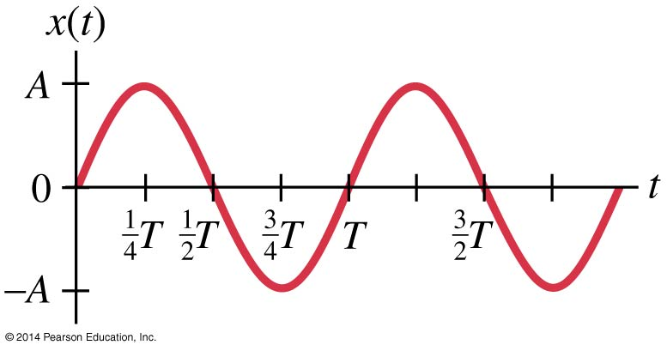
11-3 The Period and Sinusoidal Nature of SHM
The top curve is a graph of the previous equation.
The bottom curve is the same, but shifted ¼ period so that it is a sine function rather than a cosine.

Slide 18
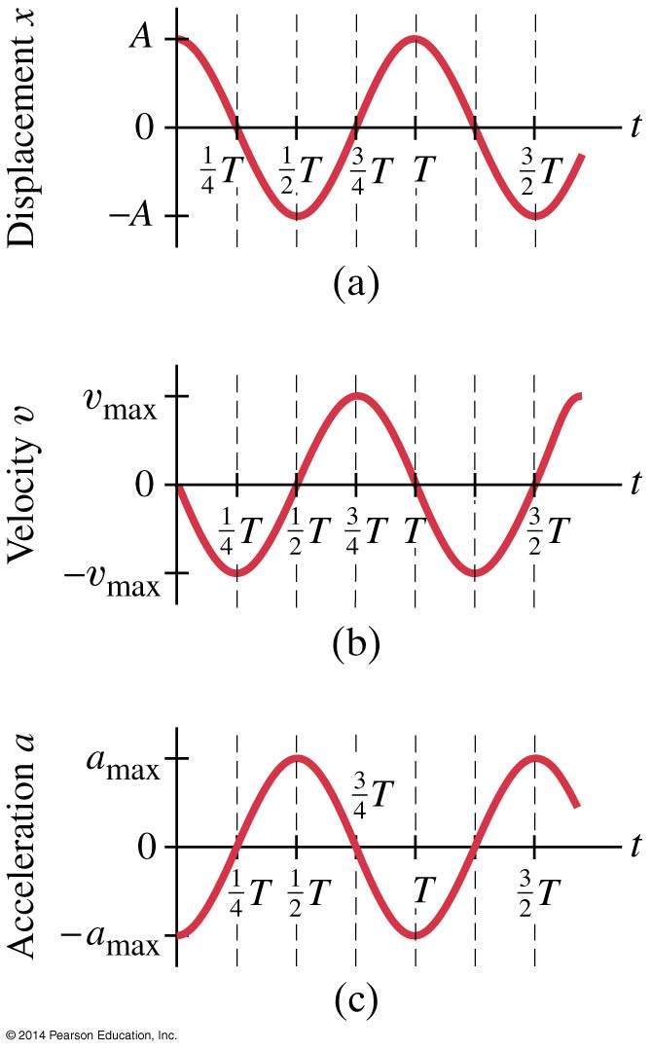
11-3 The Period and Sinusoidal Nature of SHM
The velocity and acceleration can be calculated as functions of time; the results are below, and are plotted at left.
(11-9)
(11-10)

Slide 19
11-4 The Simple Pendulum
A simple pendulum consists of a mass at the end of a lightweight cord. We assume that the cord does not stretch, and that its mass is negligible.

Slide 20
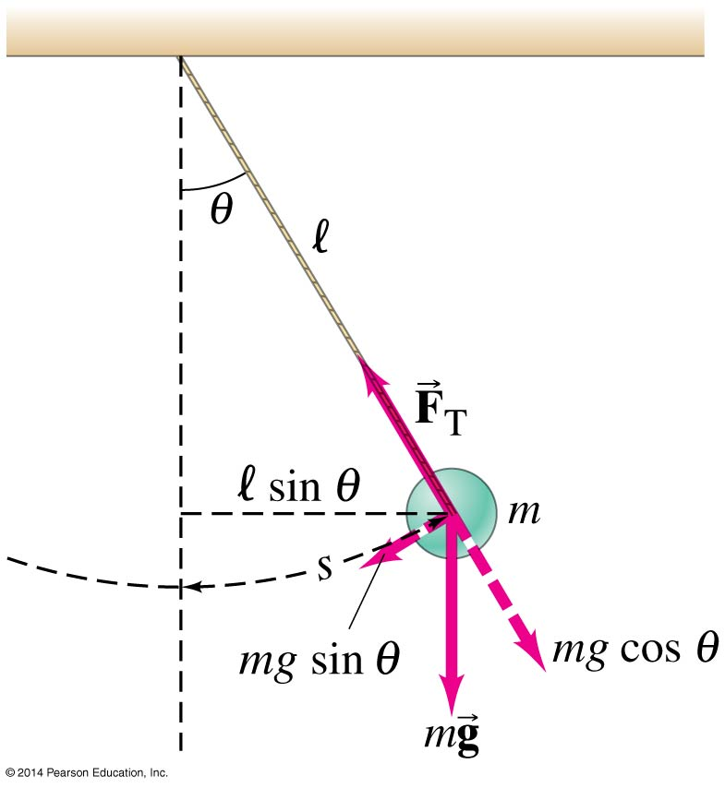
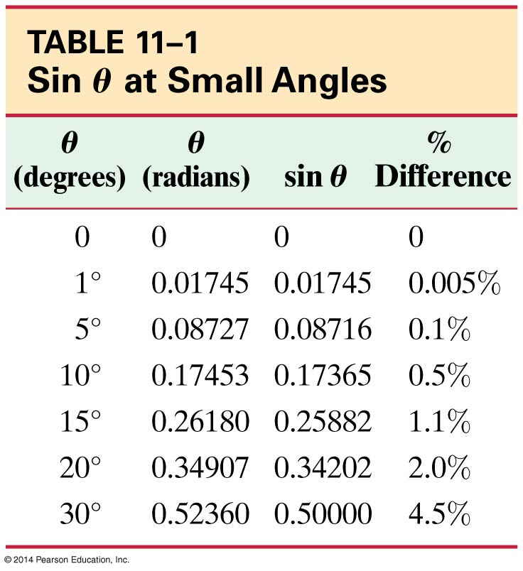
11-4 The Simple Pendulum
In order to be in SHM, the restoring force must be proportional to the negative of the displacement. Here we have F = ‑mg sin θ which is proportional to sin θ and not to θ itself.
However, if the angle is small, sin θ ≈ θ.

Slide 21
11-4 The Simple Pendulum
Therefore, for small angles, the force is approximately proportional to the angular displacement.
The period and frequency are:
(11-11a)
(11-11b)

Slide 22
11-4 The Simple Pendulum
So, as long as the cord can be considered massless and the amplitude is small, the period does not depend on the mass.

Slide 23
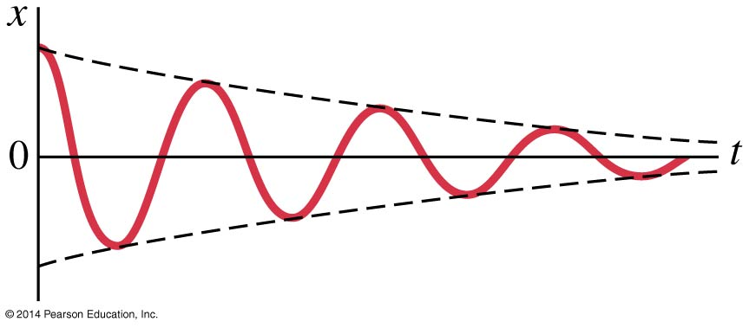
11-5 Damped Harmonic Motion
Damped harmonic motion is harmonic motion with a frictional or drag force. If the damping is small, we can treat it as an “envelope” that modifies the undamped oscillation.

Slide 24
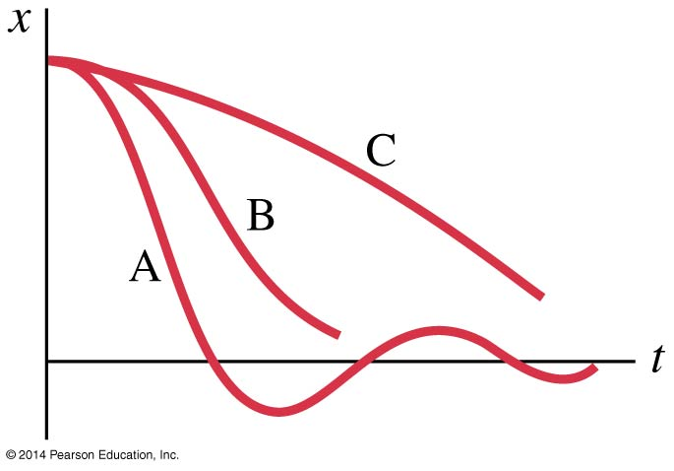
11-5 Damped Harmonic Motion
However, if the damping is large, it no longer resembles SHM at all.
A: underdamping: there are a few small oscillations before the oscillator comes to rest.
B: critical damping: this is the fastest way to get to equilibrium.
C: overdamping: the system is slowed so much that it takes a long time to get to equilibrium.

Slide 25
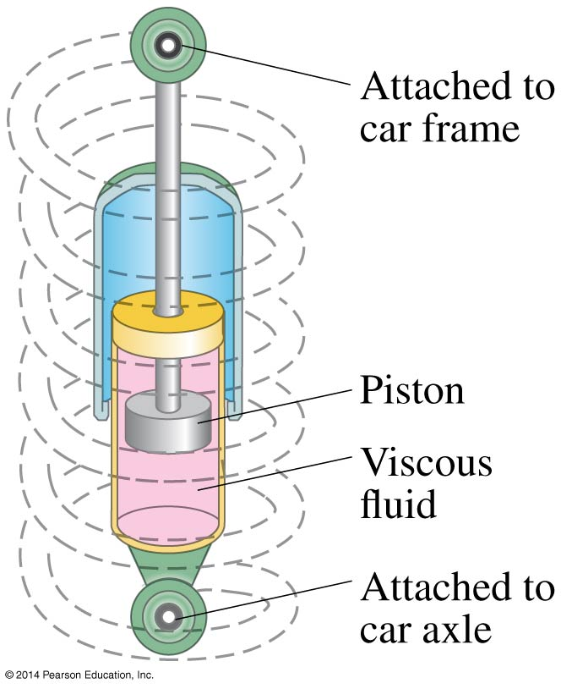
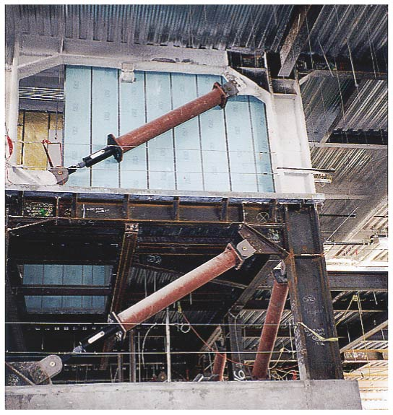
11-5 Damped Harmonic Motion
There are systems where damping is unwanted, such as clocks and watches.
Then there are systems in which it is wanted, and often needs to be as close to critical damping as possible, such as automobile shock absorbers and earthquake protection for buildings.

Slide 26
11-6 Forced Oscillations; Resonance
Forced vibrations occur when there is a periodic driving force. This force may or may not have the same period as the natural frequency of the system.
If the frequency is the same as the natural frequency, the amplitude becomes quite large. This is called resonance.

Slide 27
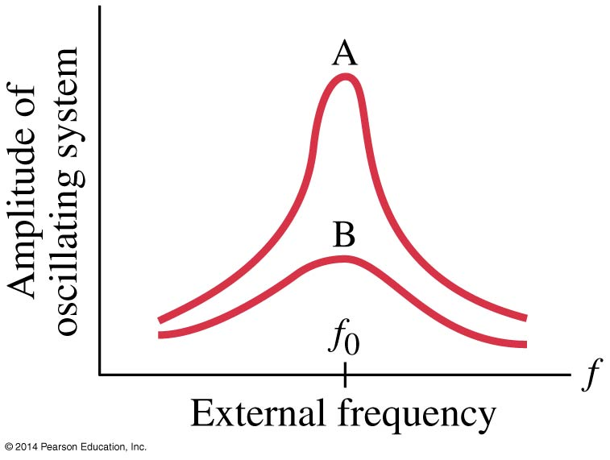
11-6 Forced Oscillations; Resonance
The sharpness of the resonant peak depends on the damping. If the damping is small (A), it can be quite sharp; if the damping is larger (B), it is less sharp.
Like damping, resonance can be wanted or unwanted. Musical instruments and TV/radio receivers depend on it.

Slide 28
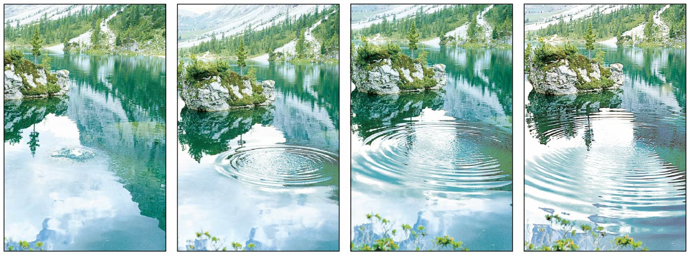
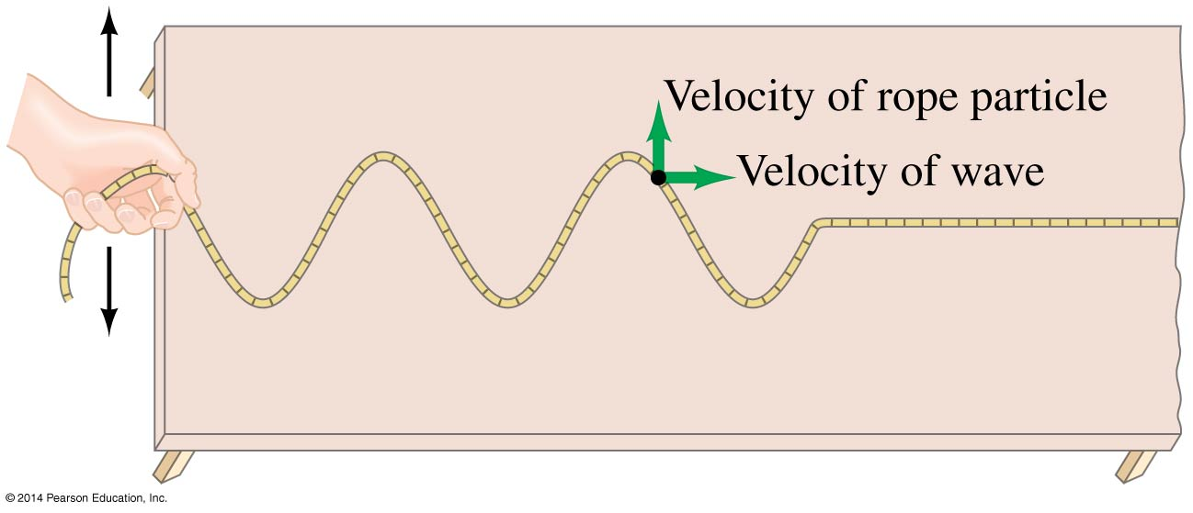
11-7 Wave Motion
A wave travels along its medium, but the individual particles just move up and down.

Slide 29
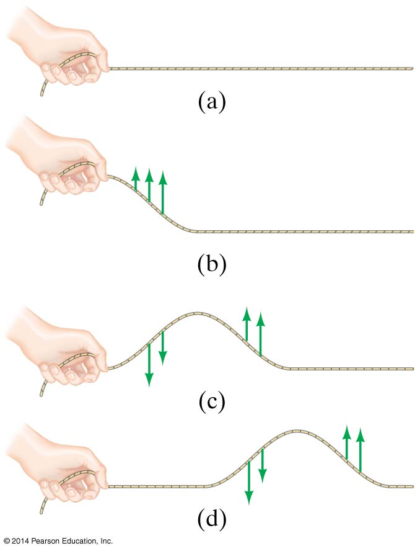
11-7 Wave Motion
All types of traveling waves transport energy.
Study of a single wave pulse shows that it is begun with a vibration and transmitted through internal forces in the medium.
Continuous waves start with vibrations too. If the vibration is SHM, then the wave will be sinusoidal.

Slide 30
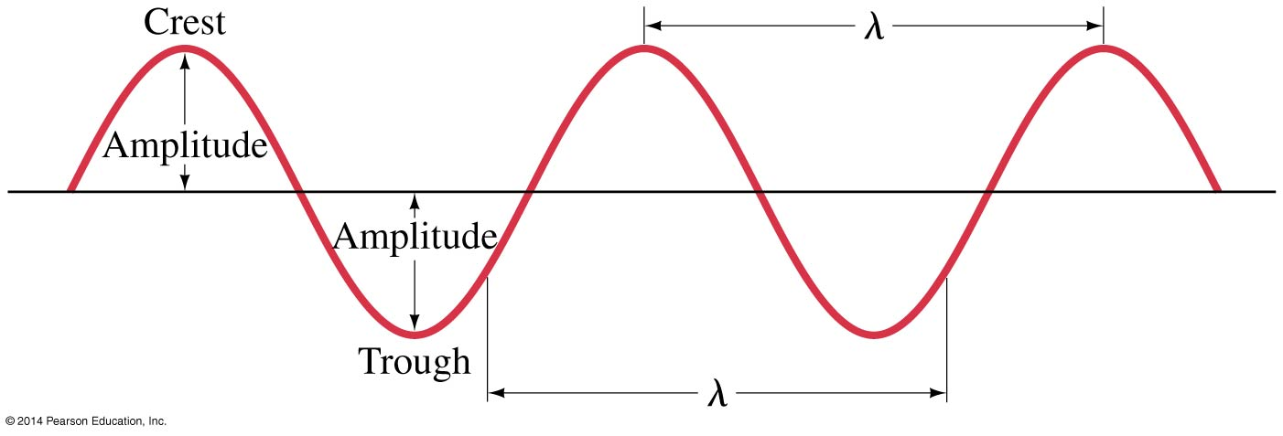
11-7 Wave Motion
Wave characteristics:
Amplitude, A
Wavelength, λ
Frequency f and period T
Wave velocity
(11-12)

Slide 31
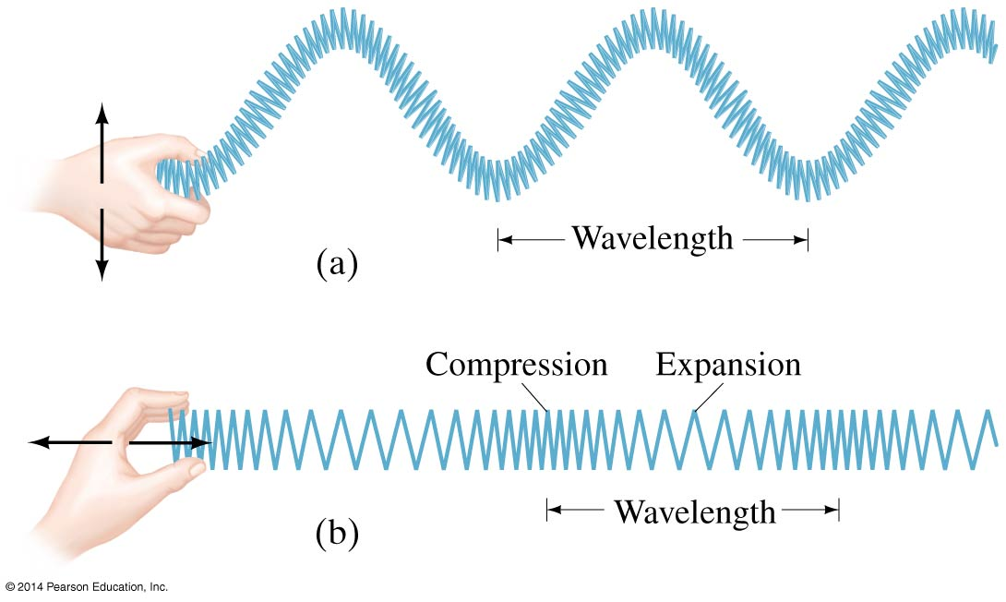
11-8 Types of Waves and Their Speeds: Transverse and Longitudinal
The motion of particles in a wave can either be perpendicular to the wave direction (transverse) or parallel to it (longitudinal).

Slide 32
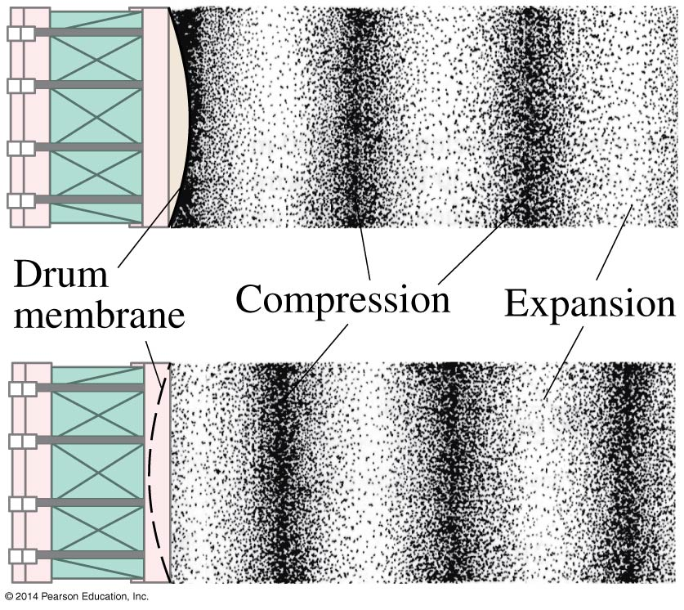
11-8 Types of Waves and Their Speeds: Transverse and Longitudinal
Sound waves are longitudinal waves:

Slide 33
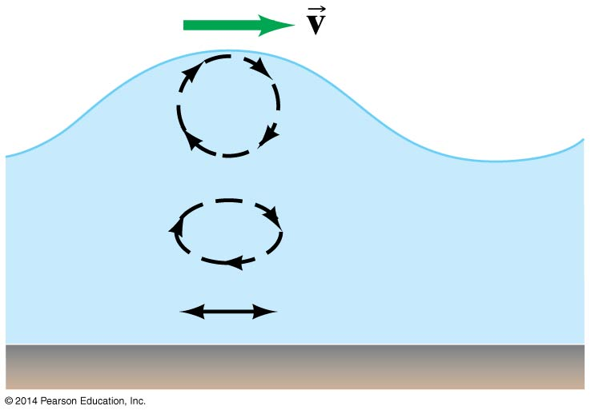
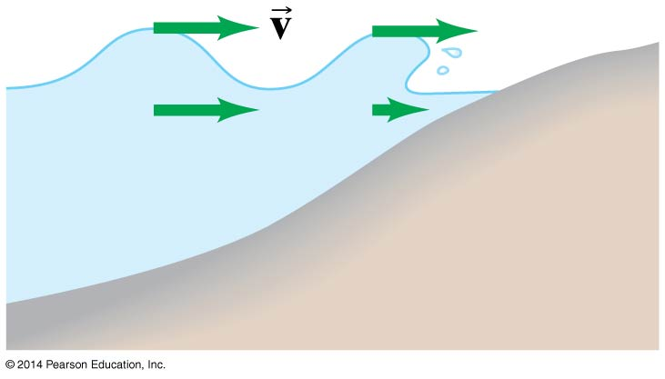
11-8 Types of Waves and Their Speeds : Transverse and Longitudinal
Earthquakes produce both longitudinal and transverse waves. Both types can travel through solid material, but only longitudinal waves can propagate through a fluid—in the transverse direction, a fluid has no restoring force.
Surface waves are waves that travel along the boundary between two media.

Slide 34
11-9 Energy Transported by Waves
Just as with the oscillation that starts it, the energy transported by a wave is proportional to the square of the amplitude.
Definition of intensity:
The intensity is also proportional to the square of the amplitude:
(11-15)

Slide 35
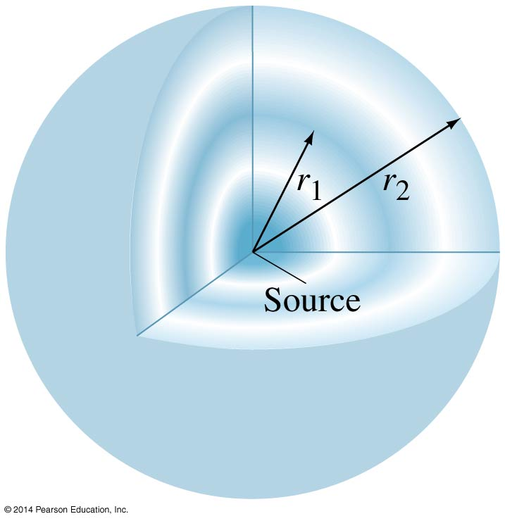
11-9 Energy Transported by Waves
If a wave is able to spread out three-dimensionally from its source, and the medium is uniform, the wave is spherical.
Just from geometrical considerations, as long as the power output is constant, we see:
(11-16b)

Slide 36
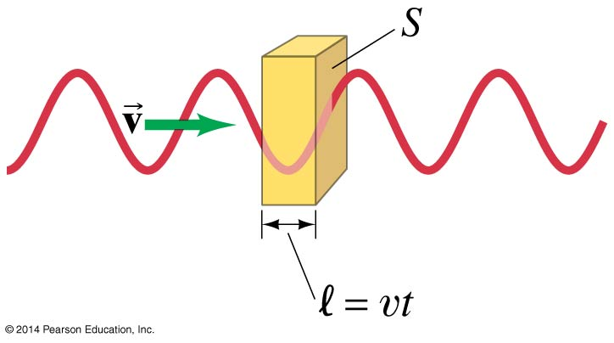
11-9 Energy Transported by Waves
By looking at the energy of a particle of matter in the medium of the wave, we find:
Then, assuming the entire medium has the same density, we find:
Therefore, the intensity is proportional to the square of the frequency and to the square of the amplitude.
(11-17a)
(11-18)

Slide 37
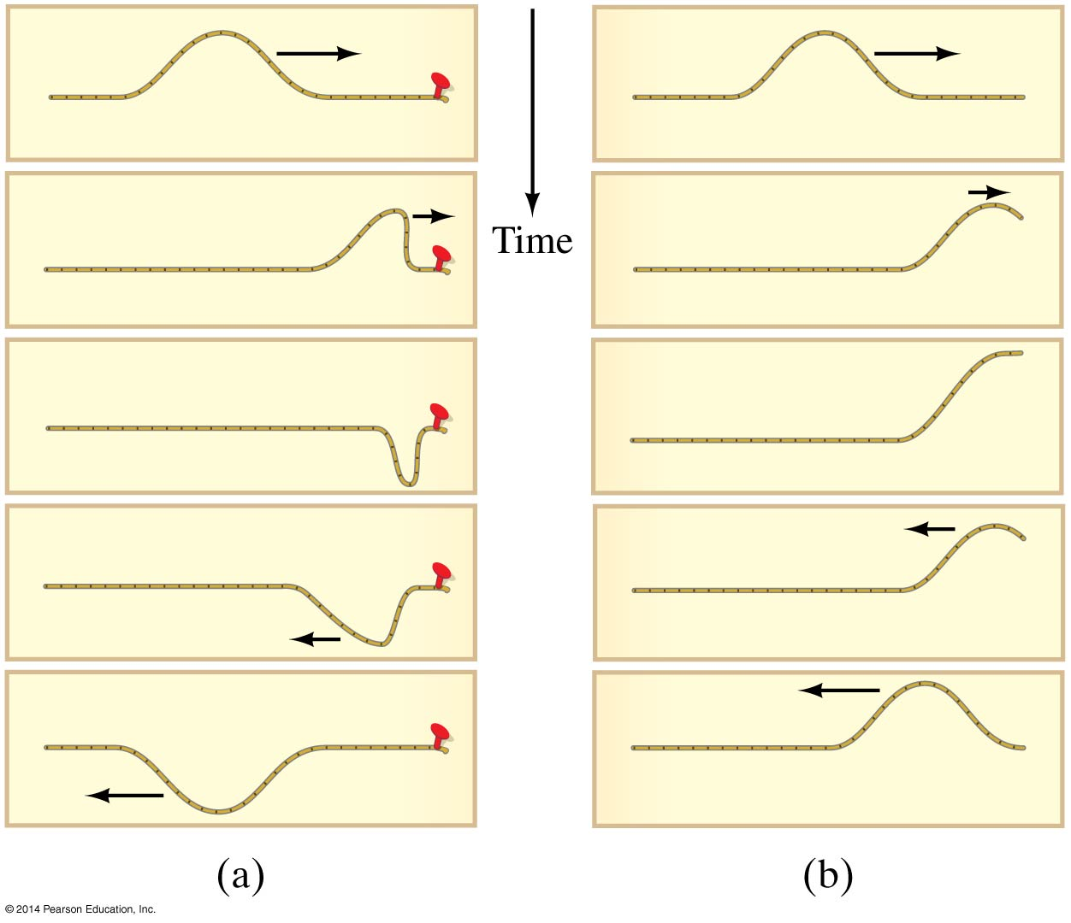
11-10 Reflection and Transmission of Waves
A wave reaching the end of its medium, but where the medium is still free to move, will be reflected (b), and its reflection will be upright.
A wave hitting an obstacle will be reflected (a), and its reflection will be inverted.

Slide 38
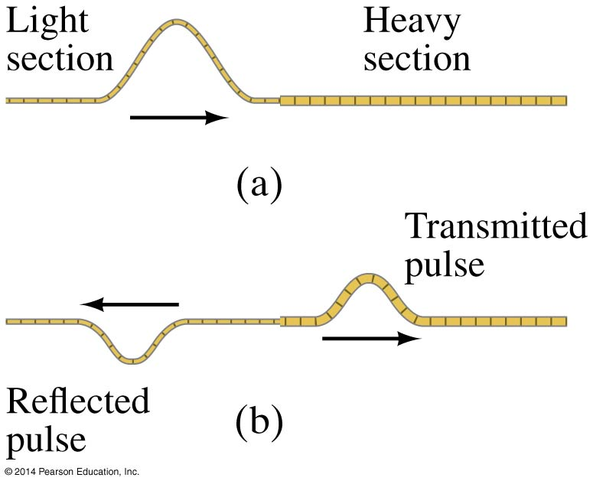
11-10 Reflection and Transmission of Waves
A wave encountering a denser medium will be partly reflected and partly transmitted; if the wave speed is less in the denser medium, the wavelength will be shorter.

Slide 39
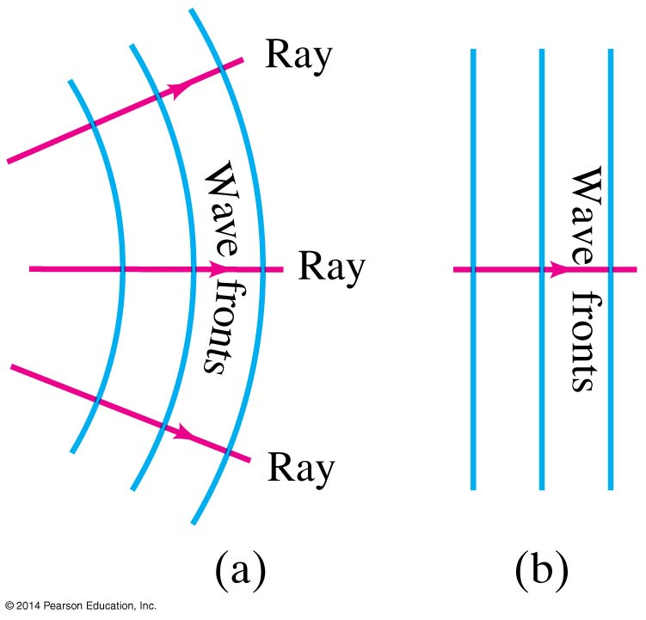
11-10 Reflection and Transmission of Waves
Two- or three-dimensional waves can be represented by wave fronts, which are curves of surfaces where all the waves have the same phase.
Lines perpendicular to the wave fronts are called rays; they point in the direction of propagation of the wave.

Slide 40
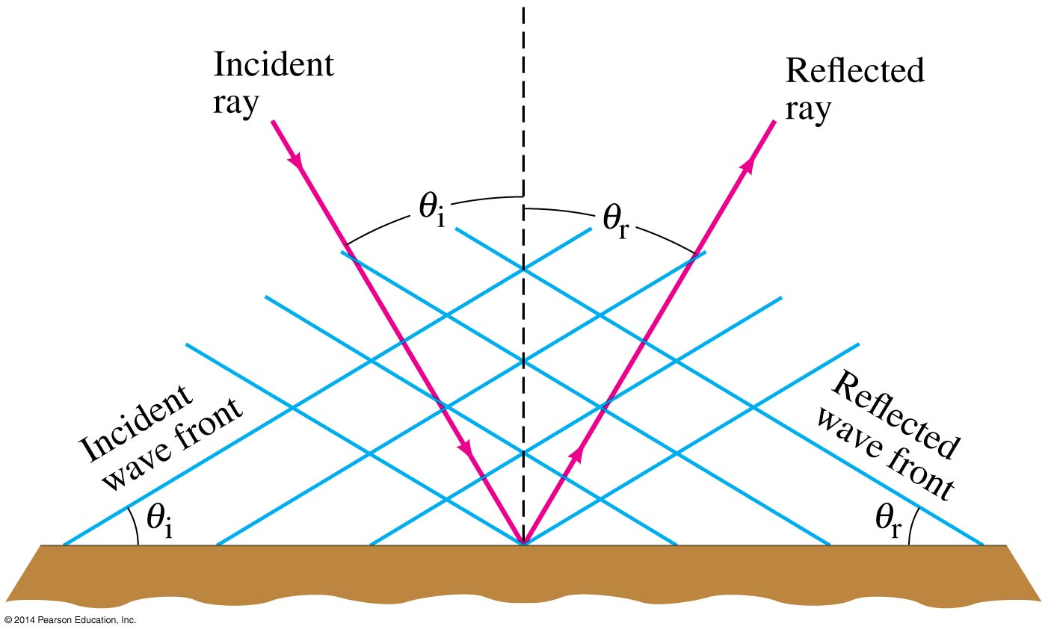
11-10 Reflection and Transmission of Waves
The law of reflection: the angle of incidence equals the angle of reflection.

Slide 41
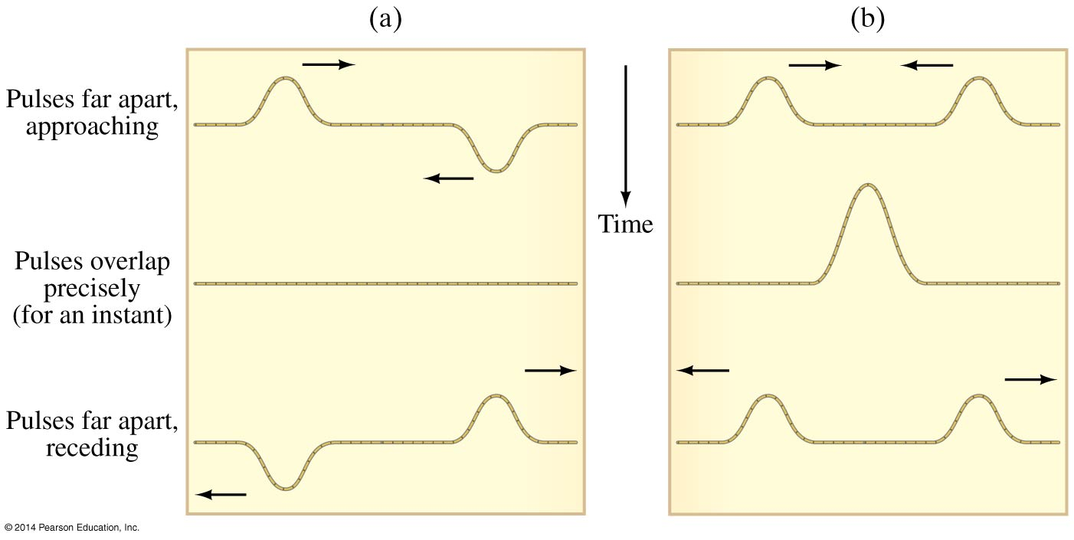
11-11 Interference; Principle of Superposition
The superposition principle says that when two waves pass through the same point, the displacement is the arithmetic sum of the individual displacements.
In the figure below, (a) exhibits destructive interference and (b) exhibits constructive interference.

Slide 42
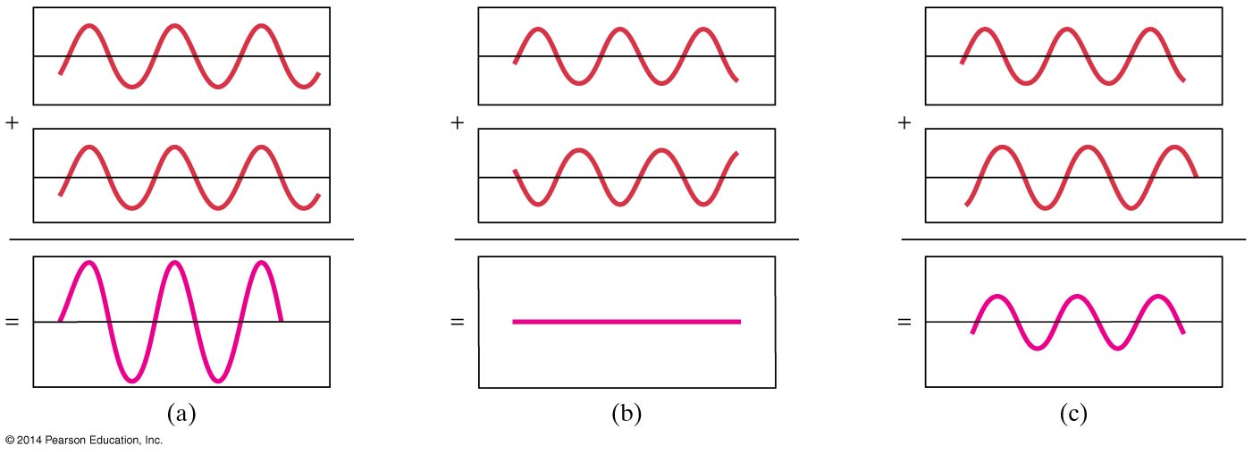
11-11 Interference; Principle of Superposition
These figures show the sum of two waves. In (a) they add constructively; in (b) they add destructively; and in (c) they add partially destructively.

Slide 43
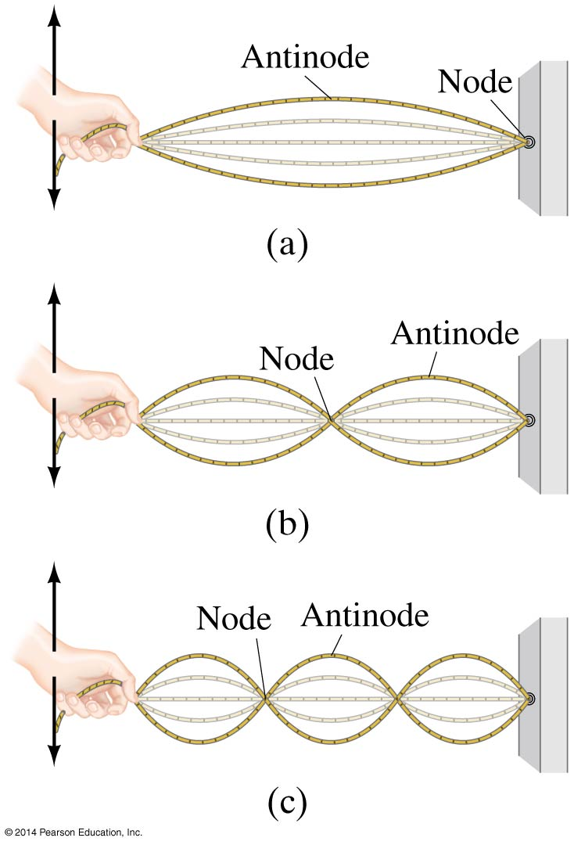
11-12 Standing Waves; Resonance
Standing waves occur when both ends of a string are fixed. In that case, only waves which are motionless at the ends of the string can persist. There are nodes, where the amplitude is always zero, and antinodes, where the amplitude varies from zero to the maximum value.

Slide 44
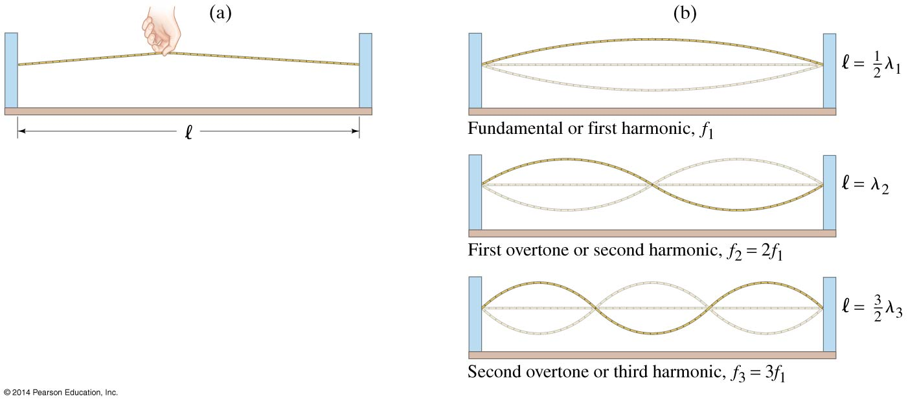
11-12 Standing Waves; Resonance
The frequencies of the standing waves on a particular string are called resonant frequencies.
They are also referred to as the fundamental and harmonics.

Slide 45
11-12 Standing Waves; Resonance
The wavelengths and frequencies of standing waves are:
(11-19a)
(11-19b)

Slide 46
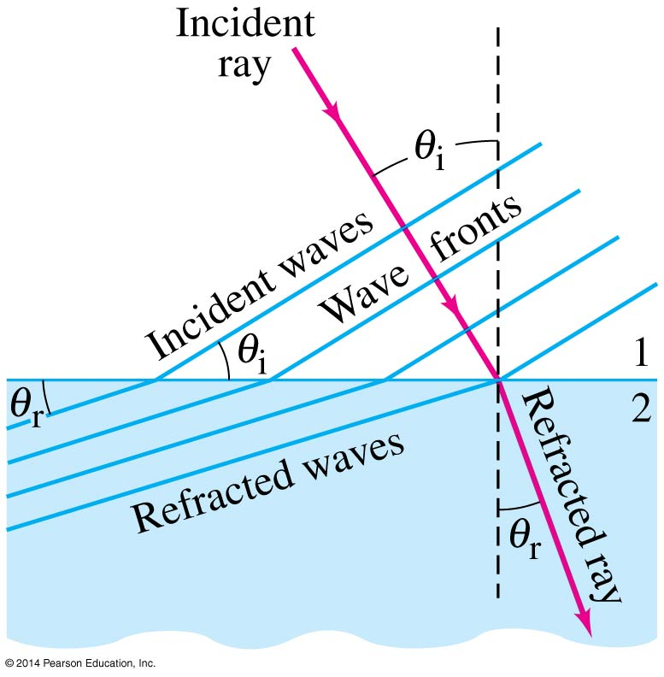
11-13 Refraction
If the wave enters a medium where the wave speed is different, it will be refracted—its wave fronts and rays will change direction.
We can calculate the angle of refraction, which depends on both wave speeds:
(11-20)

Slide 47
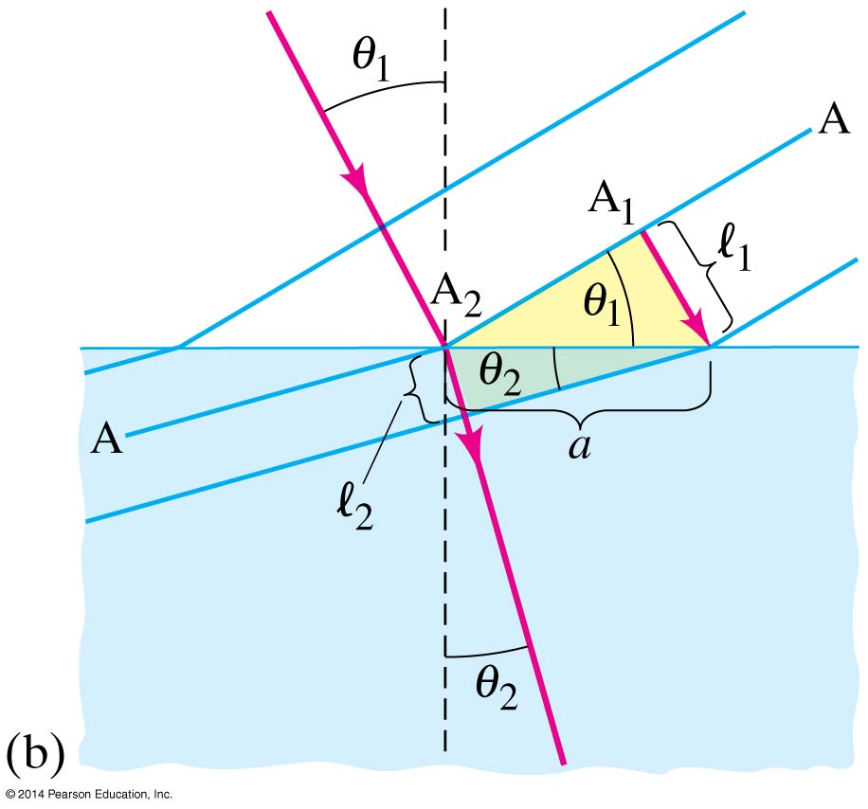
11-13 Refraction
The law of refraction works both ways—a wave going from a slower medium to a faster one would follow the red line in the other direction.

Slide 48
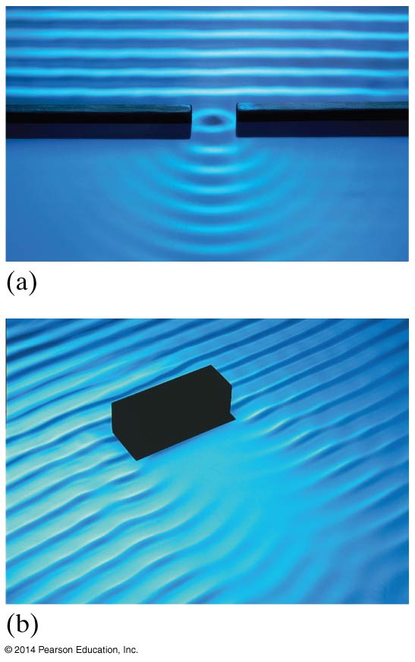
11-14 Diffraction
When waves encounter an obstacle, they bend around it, leaving a “shadow region.” This is called diffraction.

Slide 49
11-14 Diffraction
The amount of diffraction depends on the size of the obstacle compared to the wavelength. If the obstacle is much smaller than the wavelength, the wave is barely affected (a). If the object is comparable to, or larger than, the wavelength, diffraction is much more significant (b, c, d).

Slide 50
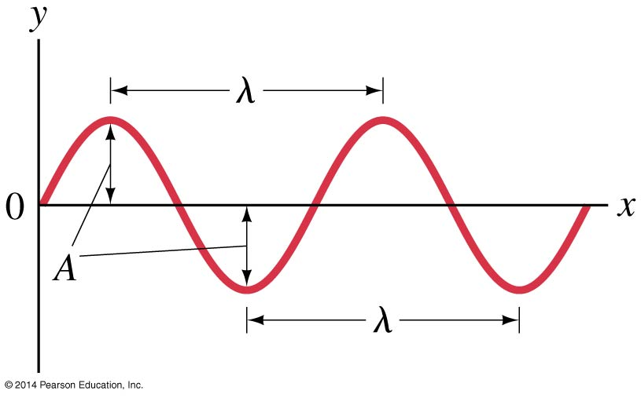
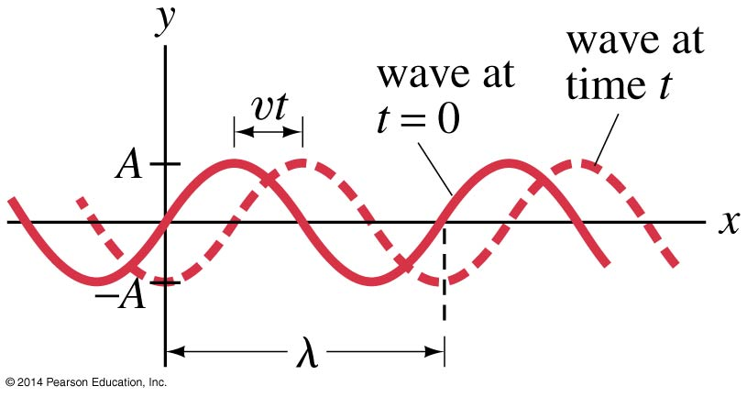
11-15 Mathematical Representation of a Traveling Wave
To the left, we have a snapshot of a traveling wave at a single point in time. Below left, the same wave is shown traveling.

Slide 51
11-15 Mathematical Representation of a Traveling Wave
A full mathematical description of the wave describes the displacement of any point as a function of both distance and time:
(11-22)

Slide 52
Summary of Chapter 11
For SHM, the restoring force is proportional to the displacement.
The period is the time required for one cycle, and the frequency is the number of cycles per second.
Period for a mass on a spring:
SHM is sinusoidal.
During SHM, the total energy is continually changing from kinetic to potential and back.
(11-6a)

Slide 53
Summary of Chapter 11
A simple pendulum approximates SHM if its amplitude is not large. Its period in that case is:
When friction is present, the motion is damped.
If an oscillating force is applied to a SHO, its amplitude depends on how close to the natural frequency the driving frequency is. If it is close, the amplitude becomes quite large. This is called resonance.
(11-11a)

Slide 54
Summary of Chapter 11
Vibrating objects are sources of waves, which may be either a pulse or continuous.
Wavelength: distance between successive crests.
Frequency: number of crests that pass a given point per unit time.
Amplitude: maximum height of crest.
Wave velocity: v = λf

Slide 55
Summary of Chapter 11
Transverse wave: oscillations perpendicular to direction of wave motion.
Longitudinal wave: oscillations parallel to direction of wave motion.
Intensity: energy per unit time crossing unit area (W/m²):
Angle of reflection is equal to angle of incidence.
(11-16b)

Slide 56
Summary of Chapter 11
When two waves pass through the same region of space, they interfere. Interference may be either constructive or destructive.
Standing waves can be produced on a string with both ends fixed. The waves that persist are at the resonant frequencies.
Nodes occur where there is no motion; antinodes where the amplitude is maximum.
Waves refract when entering a medium of different wave speed, and diffract around obstacles.

