Slide 2
Chapter 12 Sound

Slide 3
Contents of Chapter 12
Characteristics of Sound
Intensity of Sound: Decibels
The Ear and Its Response; Loudness
Sources of Sound: Vibrating Strings and Air Columns
Quality of Sound, and Noise; Superposition
Interference of Sound Waves; Beats
Doppler Effect

Slide 4
Units of Chapter 12
Shock Waves and the Sonic Boom
Applications: Sonar, Ultrasound, and Medical Imaging

Slide 5
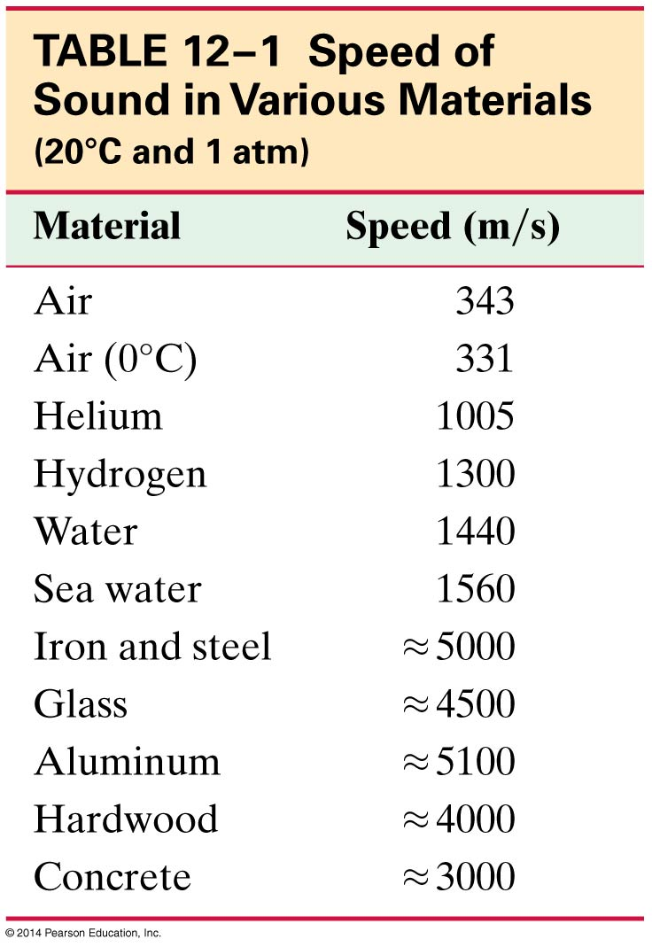
12-1 Characteristics of Sound
Sound can travel through any kind of matter, but not through a vacuum.
The speed of sound is different in different materials; in general, it is slowest in gases, faster in liquids, and fastest in solids.
The speed depends somewhat on temperature, especially for gases.

Slide 6
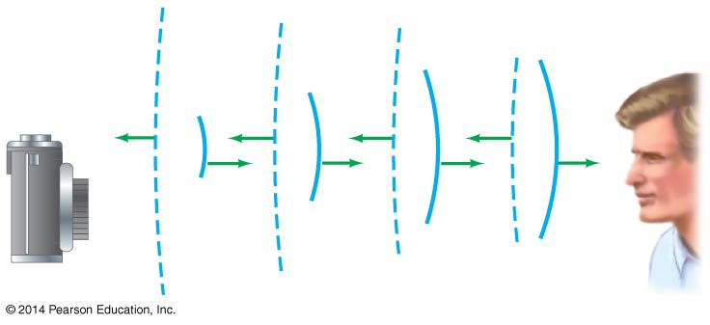
12-1 Characteristics of Sound
Loudness: related to intensity of the sound wave
Pitch: related to frequency.
Audible range: about 20 Hz to 20,000 Hz; upper limit decreases with age
Ultrasound: above 20,000 Hz; see ultrasonic camera focusing below
Infrasound: below 20 Hz

Slide 7
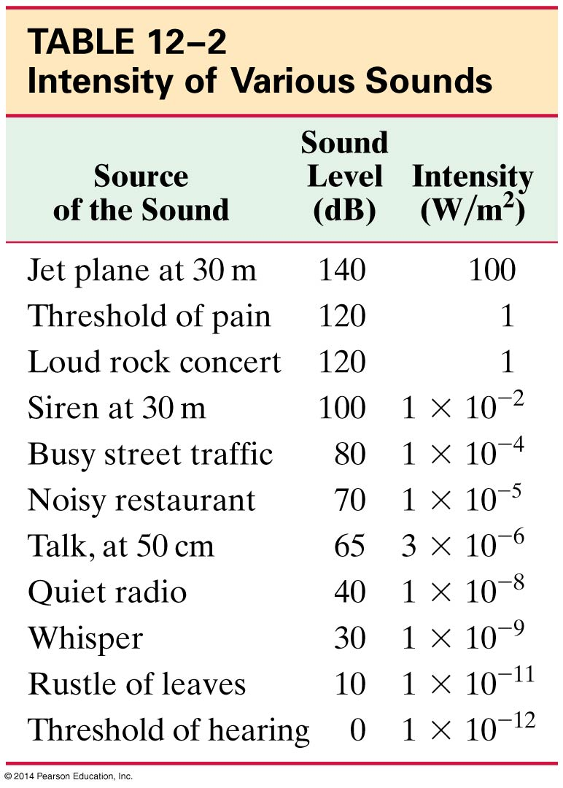
12-2 Intensity of Sound: Decibels
The intensity of a wave is the energy transported per unit time across a unit area.
The human ear can detect sounds with an intensity as low as 10⁻¹² W/m² and as high as 1 W/m².
Perceived loudness, however, is not proportional to the intensity.

Slide 8
12-2 Intensity of Sound: Decibels
The loudness of a sound is much more closely related to the logarithm of the intensity.
Sound level is measured in decibels (dB) and is defined:
I₀ is taken to be the threshold of hearing:
I₀ = 1.0 × 10⁻¹² W/m²
(12-1)

Slide 9
12-2 Intensity of Sound: Decibels
An increase in sound level of 3 dB, which is a doubling in intensity, is a very small change in loudness.
In open areas, the intensity of sound diminishes with distance:
I ∝ 1/r²
However, in enclosed spaces this is complicated by reflections, and if sound travels through air the higher frequencies get preferentially absorbed.

Slide 10
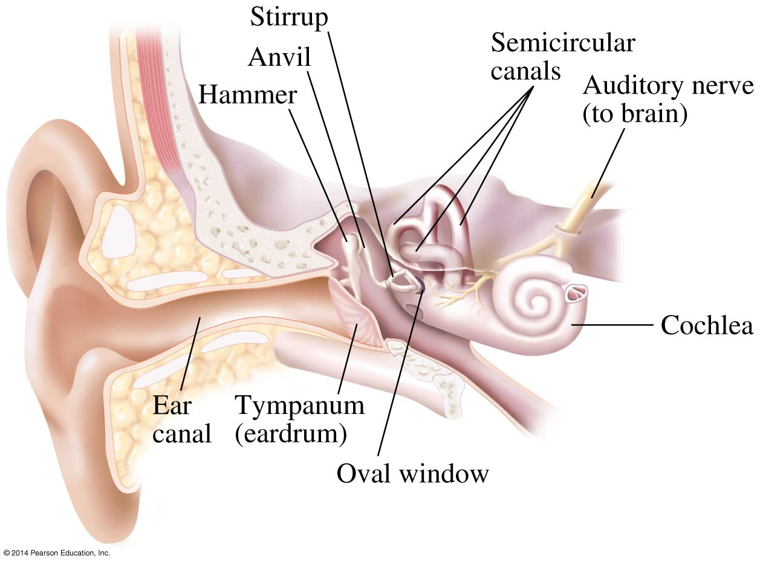
12-3 The Ear and Its Response; Loudness

Slide 11
12-3 The Ear and Its Response; Loudness
Outer ear: sound waves travel down the ear canal to the eardrum, which vibrates in response
Middle ear: hammer, anvil, and stirrup transfer vibrations to inner ear
Inner ear: cochlea transforms vibrational energy to electrical energy and sends signals to the brain

Slide 12
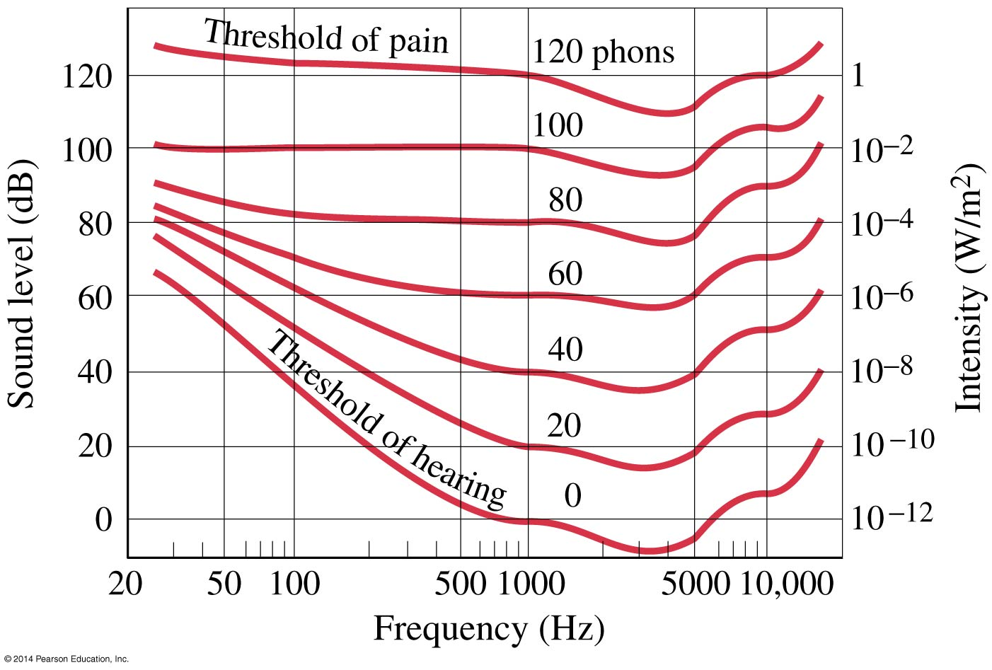
12-3 The Ear and Its Response; Loudness
The ear’s sensitivity varies with frequency. These curves translate the intensity into sound level at different frequencies.

Slide 13
12-4 Sources of Sound: Vibrating Strings and Air Columns
Musical instruments produce sounds in various ways— vibrating strings, vibrating membranes, vibrating metal or wood shapes, vibrating air columns.
The vibration may be started by plucking, striking, bowing, or blowing. The vibrations are transmitted to the air and then to our ears.

Slide 14
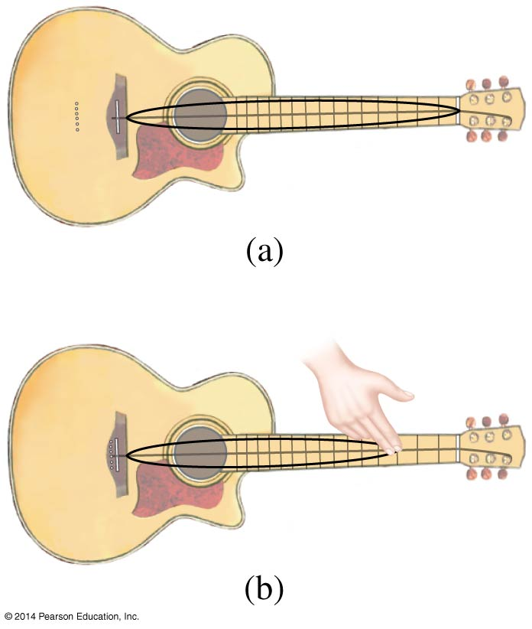
12-4 Sources of Sound: Vibrating Strings and Air Columns
The strings on a guitar can be effectively shortened by fingering, raising the fundamental pitch.
The pitch of a string of a given length can also be altered by using a string of different density.

Slide 15
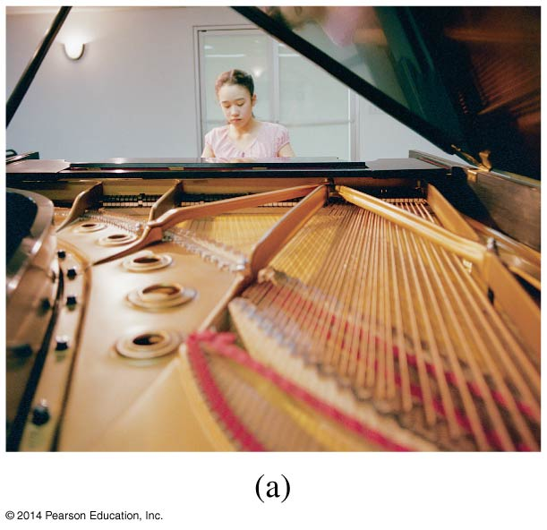
12-4 Sources of Sound: Vibrating Strings and Air Columns
A piano uses both methods to cover its more than seven-octave range—the lower strings (at left) are both much longer and much thicker than the higher ones.

Slide 16
12-4 Sources of Sound: Vibrating Strings and Air Columns
Wind instruments create sound through standing waves in a column of air.

Slide 17
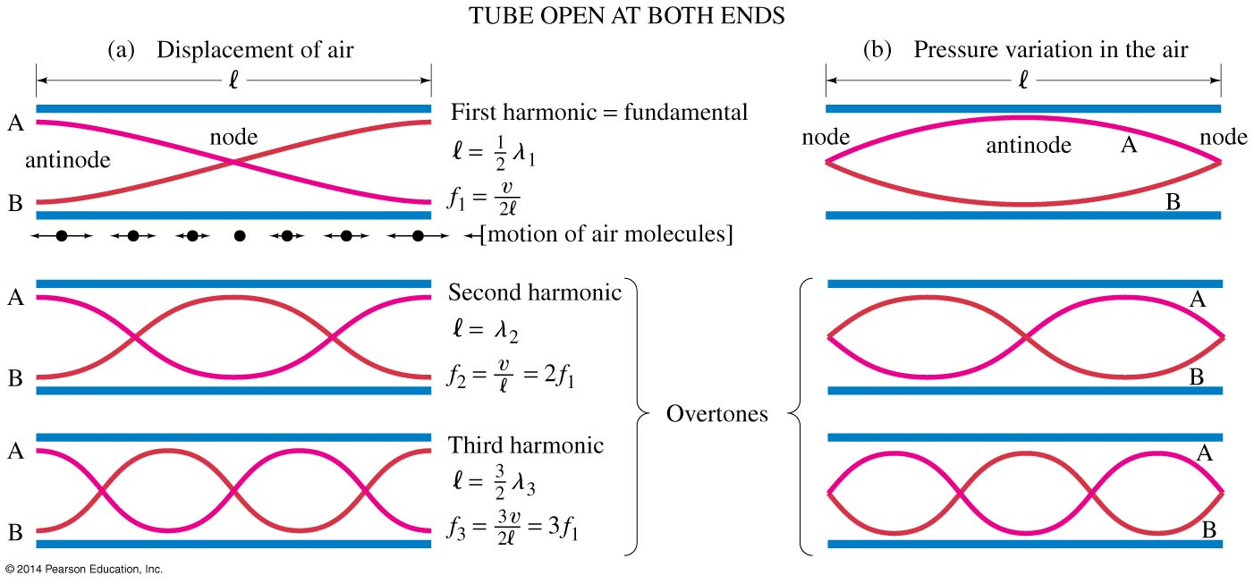
12-4 Sources of Sound: Vibrating Strings and Air Columns
A tube open at both ends (most wind instruments) has pressure nodes, and therefore displacement antinodes, at the ends.

Slide 18
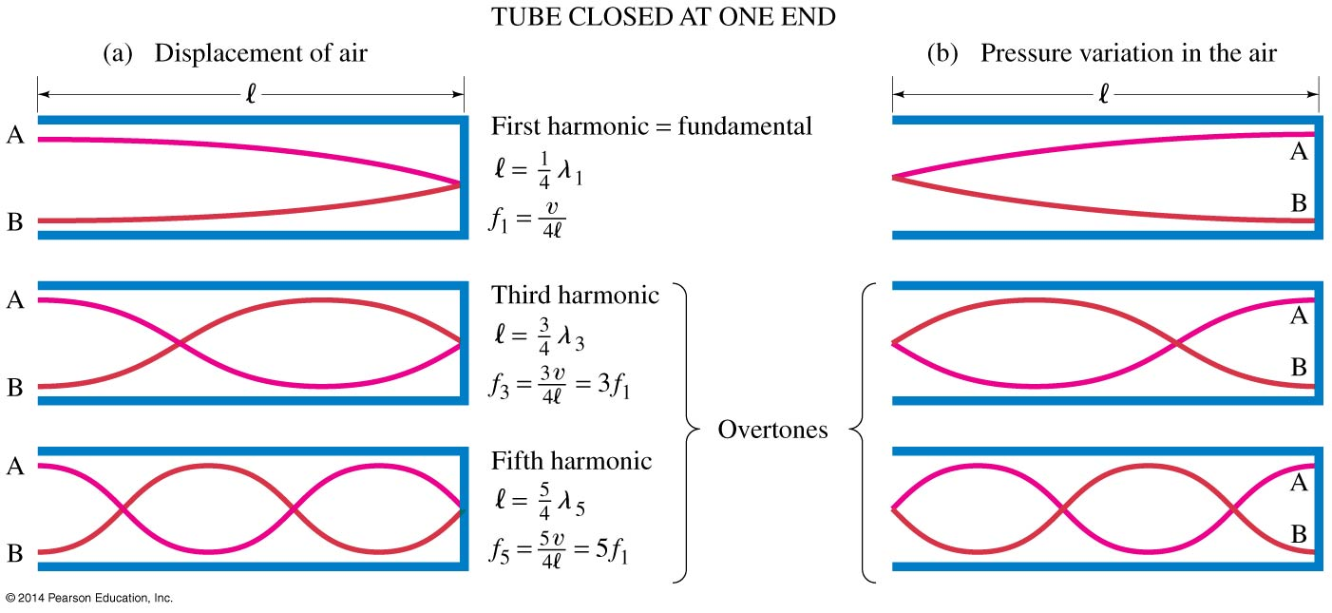
12-4 Sources of Sound: Vibrating Strings and Air Columns
A tube closed at one end (some organ pipes) has a displacement node (and pressure antinode) at the closed end.

Slide 19
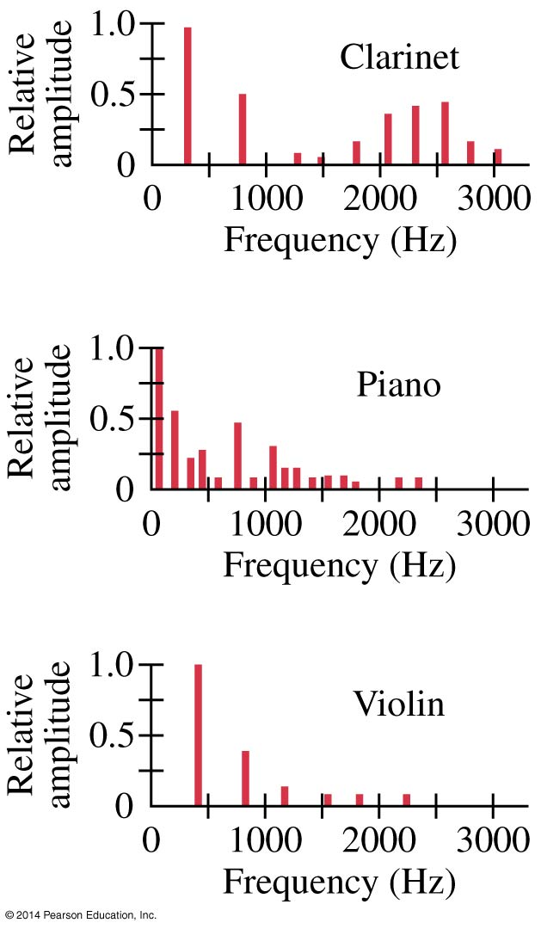
12-5 Quality of Sound, and Noise; Superposition
So why does a trumpet sound different from a flute? The answer lies in overtones—which ones are present, and how strong they are, makes a big difference.
The plot below shows frequency spectra for a clarinet, a piano, and a violin. The differences in overtone strength are apparent.

Slide 20
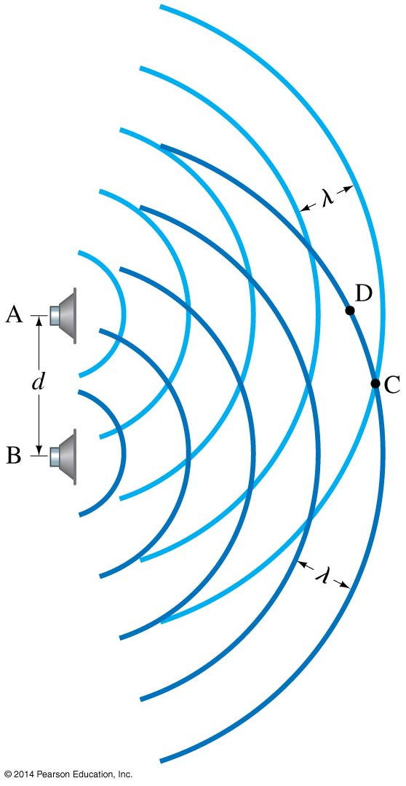
12-6 Interference of Sound Waves; Beats
Sound waves interfere in the same way that other waves do in space.

Slide 21
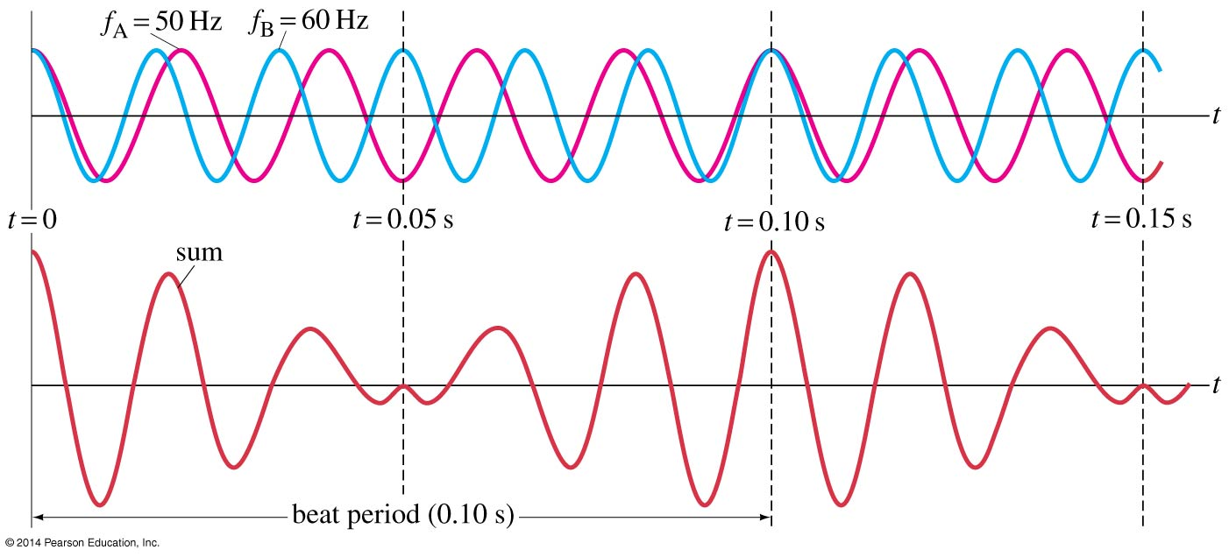
12-6 Interference of Sound Waves; Beats
Waves can also interfere in time, causing a phenomenon called beats. Beats are the slow “envelope” around two waves that are relatively close in frequency.

Slide 22
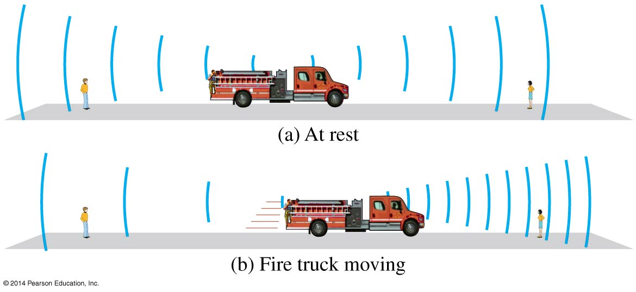
12-7 Doppler Effect
The Doppler effect occurs when a source of sound is moving with respect to an observer.

Slide 23
12-7 Doppler Effect
As can be seen in the previous image, a source moving toward an observer has a higher frequency and shorter wavelength; the opposite is true when a source is moving away from an observer.

Slide 24
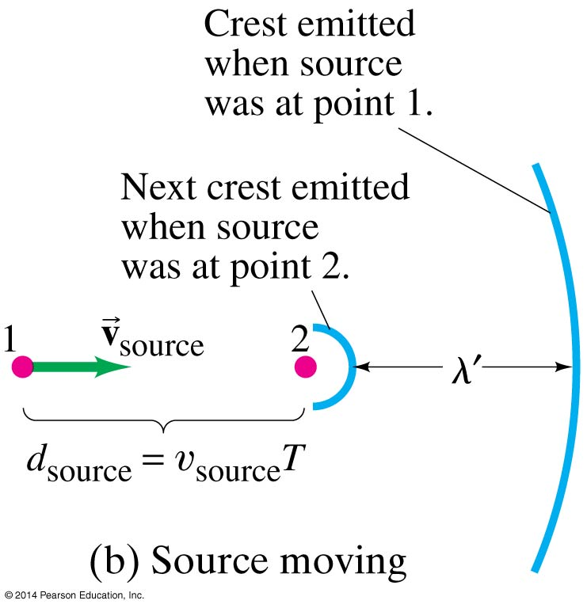
12-7 Doppler Effect
If we can figure out what the change in the wavelength is, we also know the change in the frequency.

Slide 25
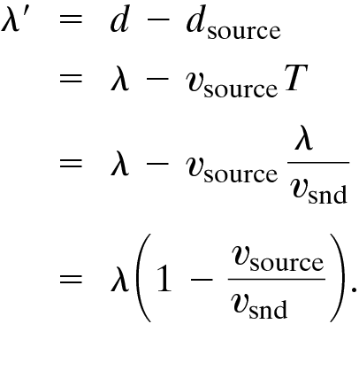
12-7 Doppler Effect
The change in the wavelength is given by:

Slide 26
12-7 Doppler Effect
And the change in the frequency:
If the source is moving away from the observer:
(12-2a)
(12-2b)

Slide 27
12-7 Doppler Effect
If the observer is moving with respect to the source, things are a bit different. The wavelength remains the same, but the wave speed is different for the observer.

Slide 28
12-7 Doppler Effect
We find, for an observer moving towards a stationary source:
And if it is moving away:
(12-3a)
(12-3b)

Slide 29
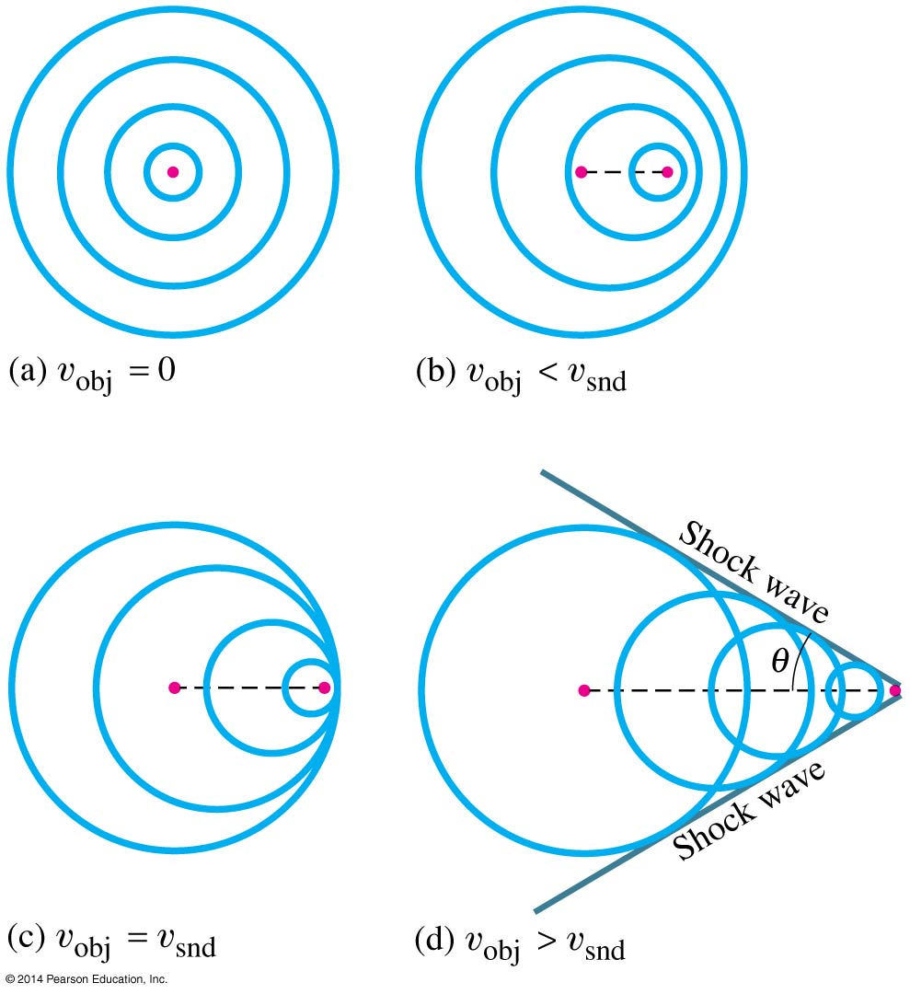
12-8 Shock Waves and the Sonic Boom
If a source is moving faster than the wave speed in a medium, waves cannot keep up and a shock wave is formed.
The angle of the cone is:
(12-5)

Slide 30
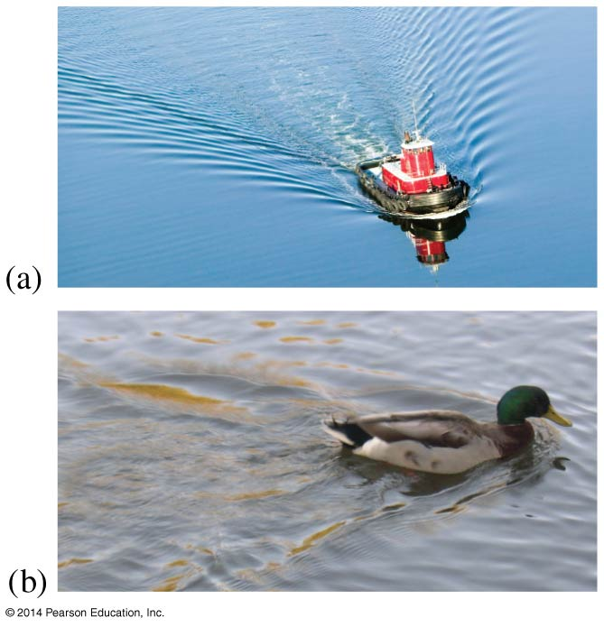
12-8 Shock Waves and the Sonic Boom
Shock waves are analogous to the bow waves produced by a boat going faster than the wave speed in water.

Slide 31
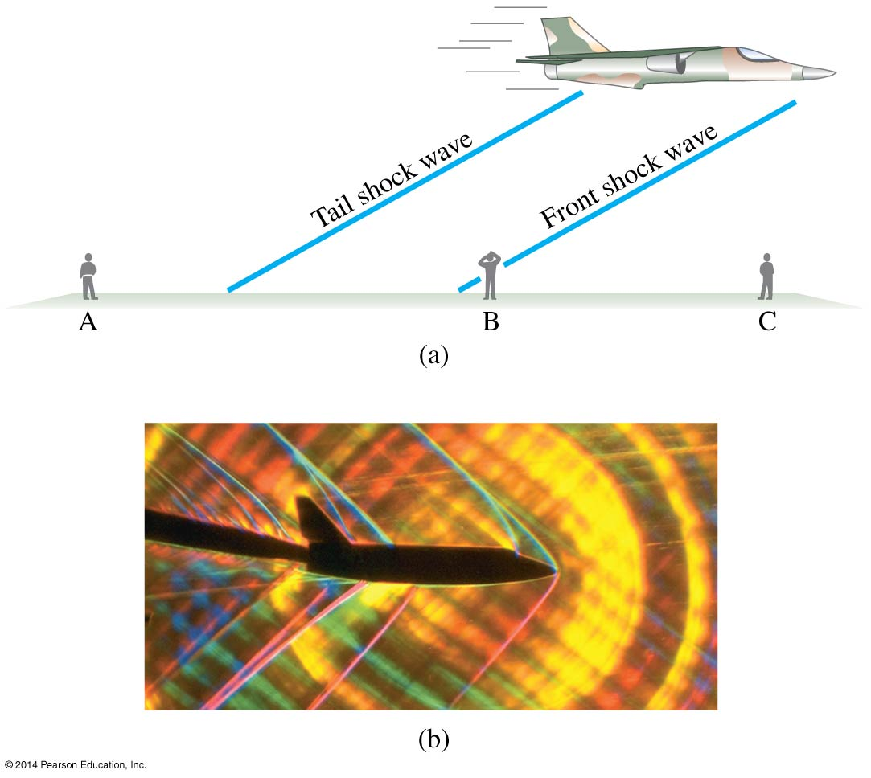
12-8 Shock Waves and the Sonic Boom
Aircraft exceeding the speed of sound in air will produce two sonic booms, one from the front and one from the tail.

Slide 32
12-9 Applications: Sonar, Ultrasound, and Medical Imaging
Sonar is used to locate objects underwater by measuring the time it takes a sound pulse to reflect back to the receiver.
Similar techniques can be used to learn about the internal structure of the Earth.
Sonar usually uses ultrasound waves, as the shorter wavelengths are less likely to be diffracted by obstacles.

Slide 33
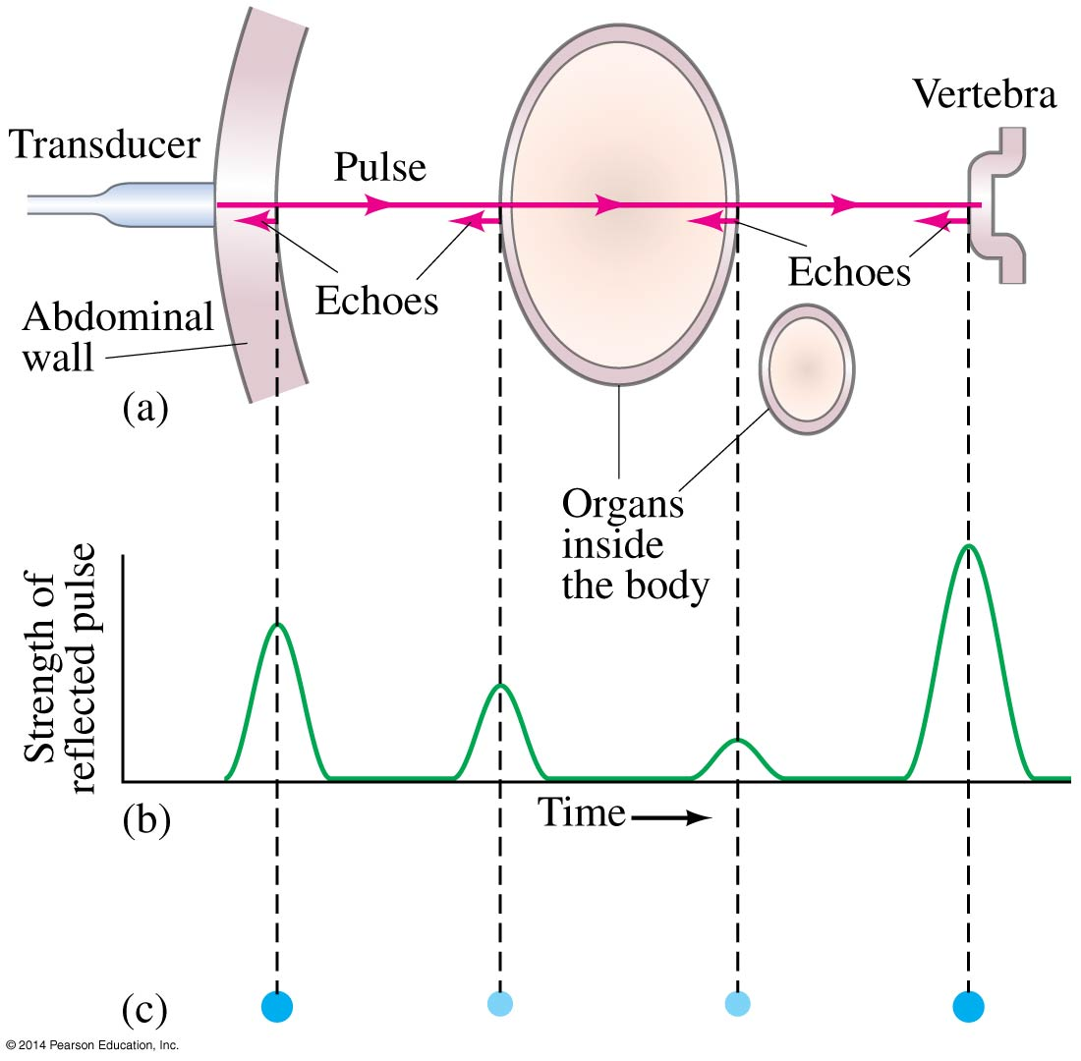
12-9 Applications: Sonar, Ultrasound, and Medical Imaging
Ultrasound is also used for medical imaging. Repeated traces are made as the transducer is moved, and a complete picture is built.

Slide 34
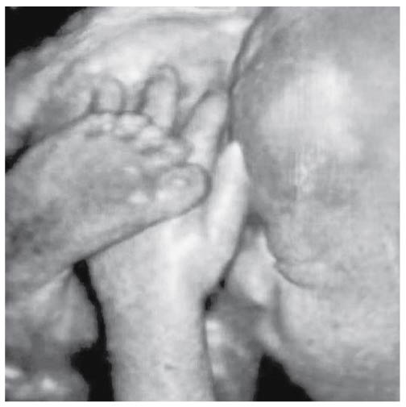
12-9 Applications: Sonar, Ultrasound, and Medical Imaging
Modern high-resolution ultrasound can produce very detailed images.

Slide 35
Summary of Chapter 12
Sound is a longitudinal wave in a medium.
The pitch of the sound depends on the frequency.
The loudness of the sound depends on the intensity and also on the sensitivity of the ear.
The strings on stringed instruments produce a fundamental tone whose wavelength is twice the length of the string; there are also various harmonics present.

Slide 36
Summary of Chapter 12
Wind instruments have a vibrating column of air when played. If the tube is open, the fundamental is twice its length; if it is closed the fundamental is four times the tube length.
Sound waves exhibit interference; if two sounds are at slightly different frequencies they produce beats.
The Doppler effect is the shift in frequency of a sound due to motion of the source or the observer.

