Slide 2
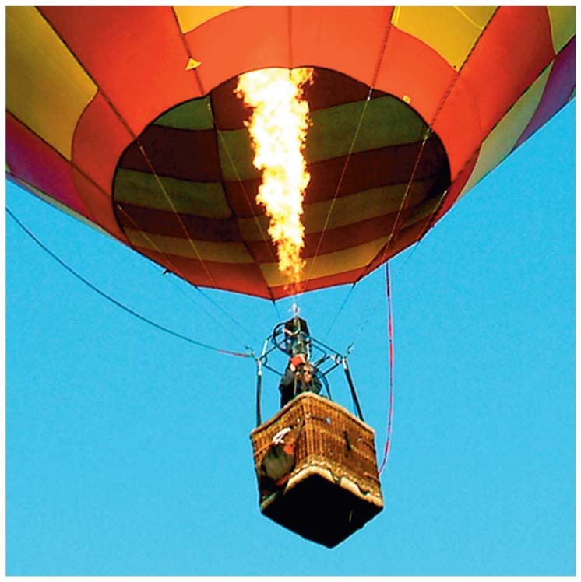
Chapter 13 Temperature and Kinetic Theory

Slide 3
Contents of Chapter 13
Atomic Theory of Matter
Temperature and Thermometers
Thermal Equilibrium and the Zeroth Law of Thermodynamics
Thermal Expansion
The Gas Laws and Absolute Temperature
The Ideal Gas Law
Problem Solving with the Ideal Gas Law

Slide 4
Contents of Chapter 13
Ideal Gas Law in Terms of Molecules: Avogadro’s Number
Kinetic Theory and the Molecular Interpretation of Temperature
Distribution of Molecular Speeds
Real Gases and Changes of Phase
Vapor Pressure and Humidity
Diffusion

Slide 5
13-1 Atomic Theory of Matter
Atomic and molecular masses are measured in unified atomic mass units (u). This unit is defined so that the carbon-12 atom has a mass of exactly 12.0000 u. Expressed in kilograms:
1 u = 1.6605 × 10⁻²⁷ kg
Brownian motion is the jittery motion of tiny flecks in water; these are the result of collisions with individual water molecules.

Slide 6
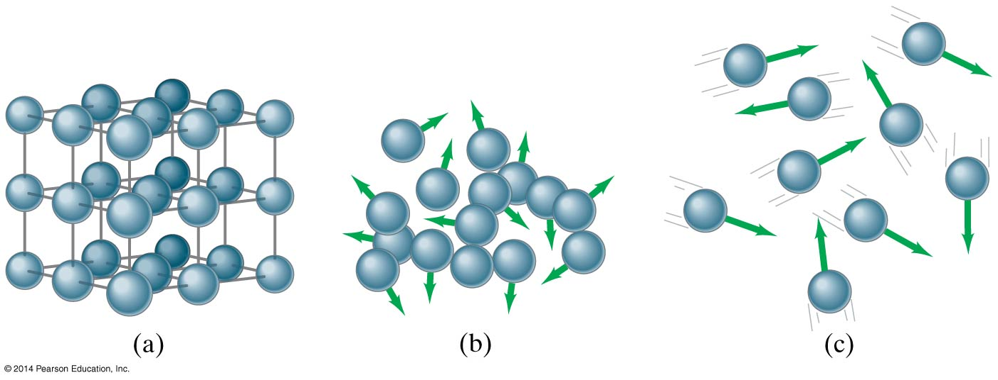
13-1 Atomic Theory of Matter
On a microscopic scale, the arrangements of molecules in solids (a), liquids (b), and gases (c) are quite different.

Slide 7
13-2 Temperature and Thermometers
Temperature is a measure of how hot or cold something is.
Most materials expand when heated.

Slide 8
13-2 Temperature and Thermometers
Thermometers are instruments designed to measure temperature. In order to do this, they take advantage of some property of matter that changes with temperature.
Early thermometers:

Slide 9
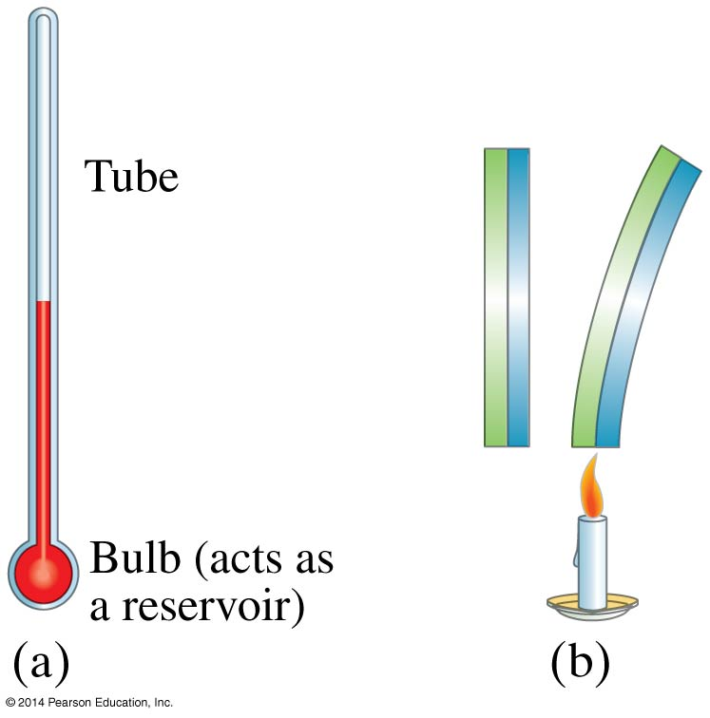
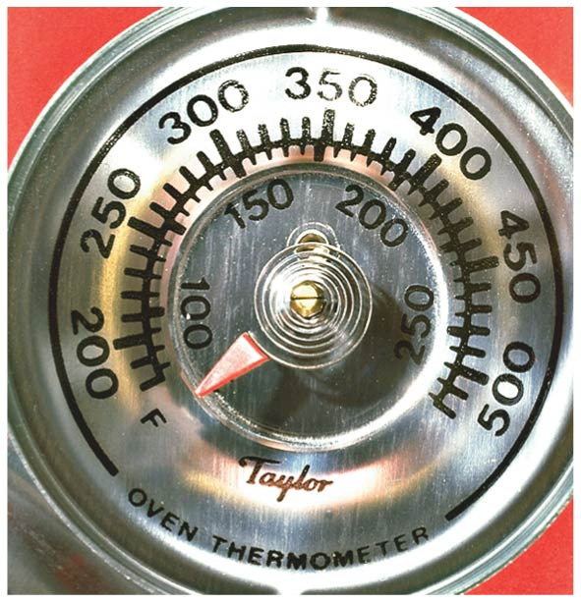
13-2 Temperature and Thermometers
Common thermometers used today include the liquid-in-glass type and the bimetallic strip.

Slide 10
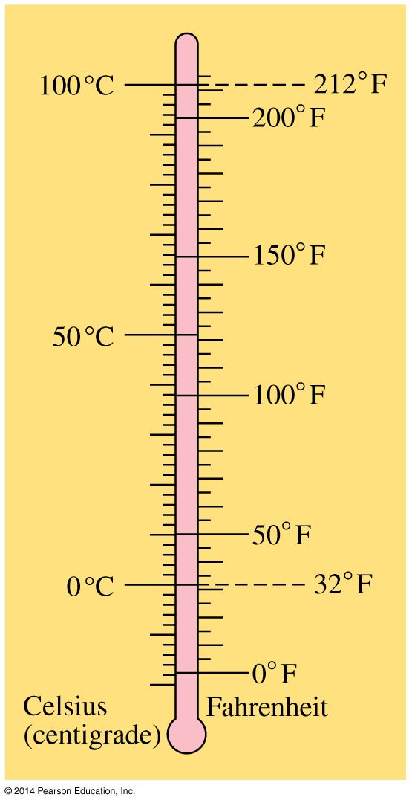
13-2 Temperature and Thermometers
Temperature is generally measured using either the Fahrenheit or the Celsius scale.
The freezing point of water is 0°C, or 32°F; the boiling point of water is 100°C, or 212°F.

Slide 11
13-3 Thermal Equilibrium and the Zeroth Law of Thermodynamics
Two objects placed in thermal contact will eventually come to the same temperature. When they do, we say they are in thermal equilibrium.
The zeroth law of thermodynamics says that if two objects are each in equilibrium with a third object, they are also in thermal equilibrium with each other.

Slide 12
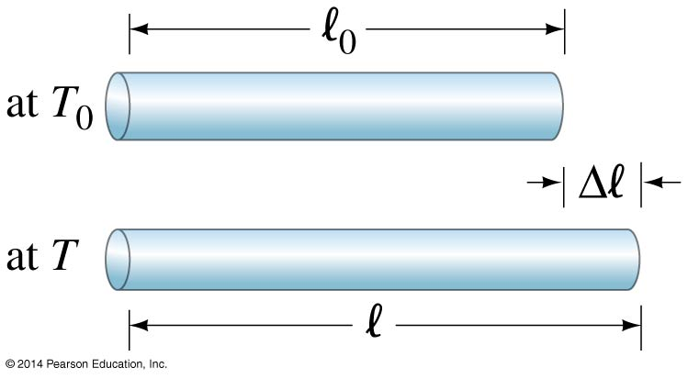
13-4 Thermal Expansion
Linear expansion occurs when an object is heated.
Here, α is the coefficient of linear expansion.
(13-1b)

Slide 13
13-4 Thermal Expansion
Volume expansion is similar, except that it is relevant for liquids and gases as well as solids:
Here, β is the coefficient of volume expansion.
For uniform solids, β ≈ 3^{α}.
(13-2)

Slide 14
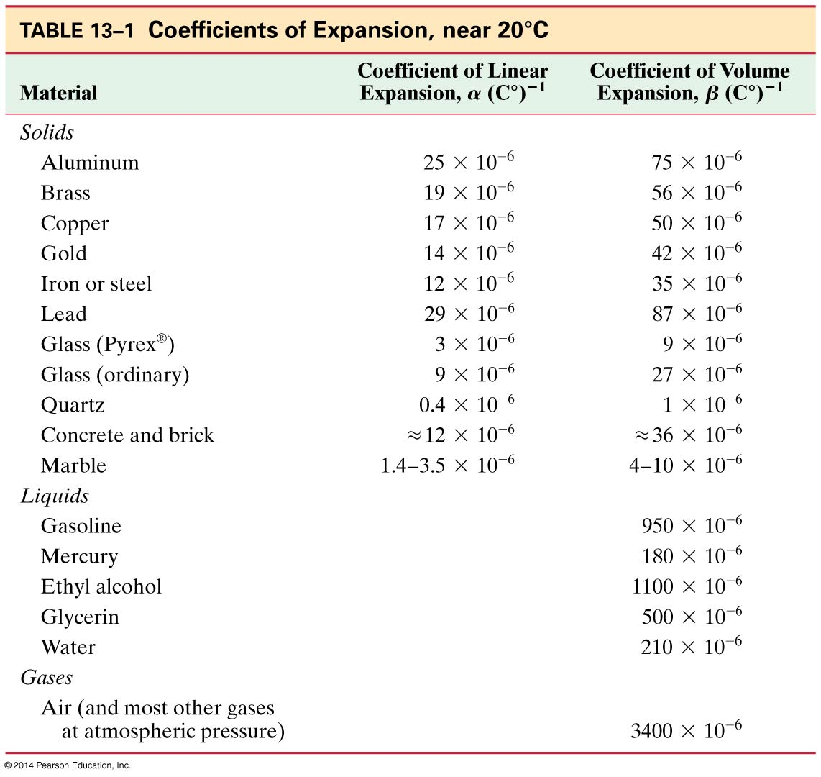
13-4 Thermal Expansion

Slide 15
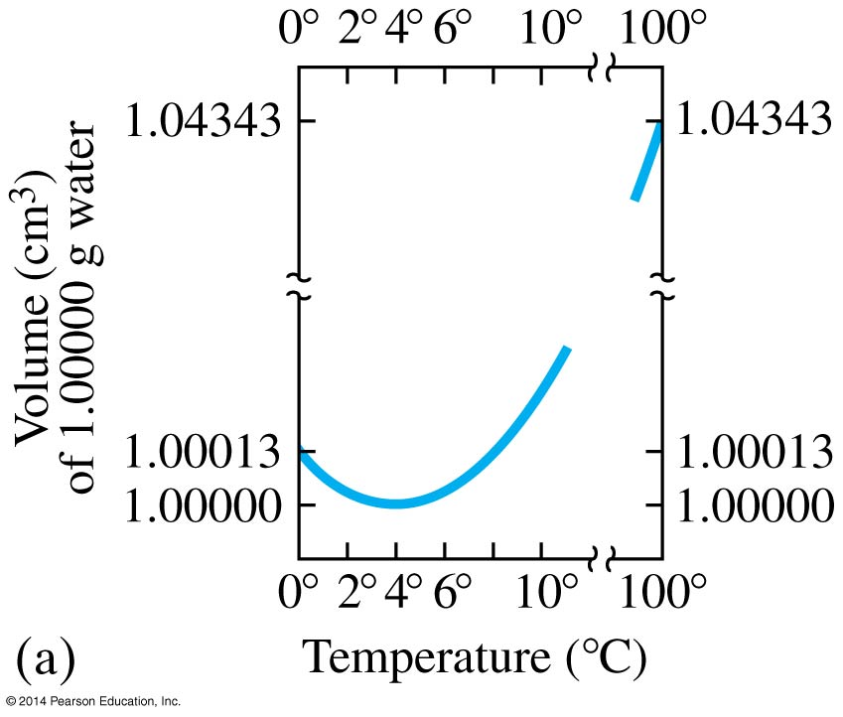
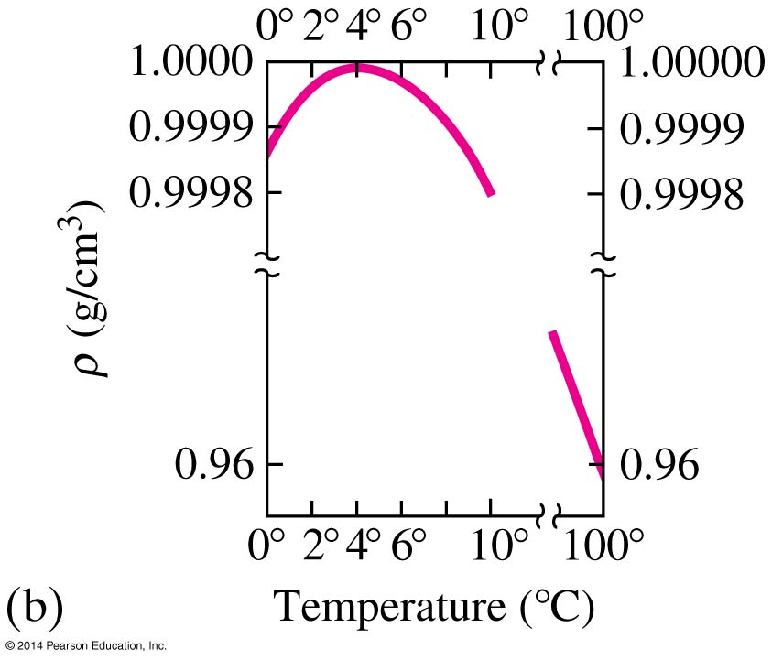
13-4 Thermal Expansion
Water behaves differently from most other solids—its minimum volume occurs when its temperature is 4°C. As it cools further, it expands, as anyone who has left a bottle in the freezer to cool and then forgets about it can testify.

Slide 16
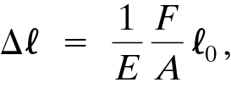
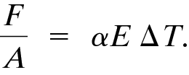
13-4 Thermal Expansion
A material may be fixed at its ends and therefore be unable to expand when the temperature changes. It will then experience large compressive or tensile stress—thermal stress—when its temperature changes.
The force required to keep the material from expanding is given by:
where E is the Young’s modulus of the material. Therefore, the stress is:

Slide 17
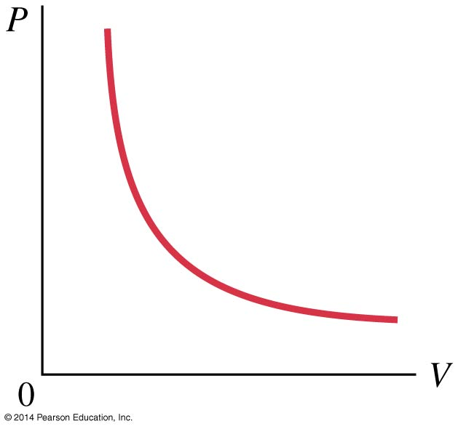
13-5 The Gas Laws and Absolute Temperature
The relationship between the volume, pressure, temperature, and mass of a gas is called an equation of state.
We will deal here with gases that are not too dense.
Boyle’s Law: the volume of a given amount of gas is inversely proportional to the pressure as long as the temperature is constant.
V ∝ 1/P

Slide 18
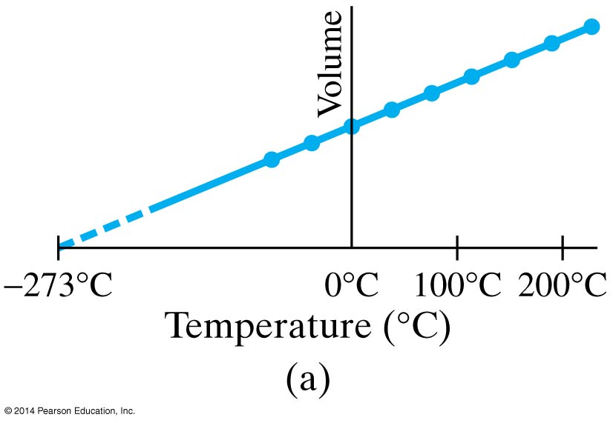
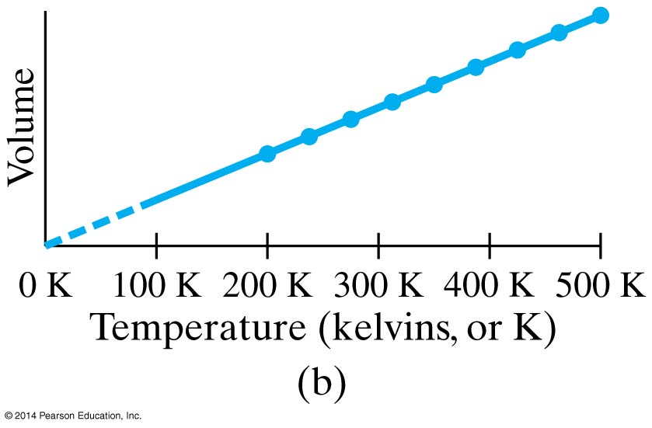
13-5 The Gas Laws and Absolute Temperature
The volume is linearly proportional to the temperature, as long as the temperature is somewhat above the condensation point and the pressure is constant: V ∝ T.
Extrapolating, the volume becomes zero at −273.15°C; this temperature is called absolute zero.

Slide 19
13-5 The Gas Laws and Absolute Temperature
The concept of absolute zero allows us to define a third temperature scale—the absolute, or Kelvin, scale.
This scale starts with 0 K at absolute zero, but otherwise is the same as the Celsius scale.
Therefore, the freezing point of water is 273.15 K, and the boiling point is 373.15 K.
Finally, when the volume is constant, the pressure is directly proportional to the temperature: P ∝T.

Slide 20
13-6 The Ideal Gas Law
We can combine the three relations just derived into a single relation:
PV ∝ T
What about the amount of gas present? If the temperature and pressure are constant, the volume is proportional to the amount of gas:
PV ∝ mT

Slide 21
13-6 The Ideal Gas Law
A mole (mol) is defined as the number of grams of a substance that is numerically equal to the molecular mass of the substance:
1 mol H₂ has a mass of 2 g
1 mol Ne has a mass of 20 g
1 mol CO₂ has a mass of 44 g
The number of moles in a certain mass of material:

Slide 22
13-6 The Ideal Gas Law
We can now write the ideal gas law:
where n is the number of moles and R is the universal gas constant.
(13-3)

Slide 23
13-7 Problem Solving with the Ideal Gas Law
Useful facts and definitions:
Standard temperature and pressure (STP)
T = 273 K (0°C)
P = 1.00 atm = 1.013 × 10⁵ N/m² = 101.3 kPa
Volume of 1 mol of an ideal gas is 22.4 L
If the amount of gas does not change:
Always measure T in kelvins
P must be the absolute pressure

Slide 24
13-8 Ideal Gas Law in Terms of Molecules: Avogadro’s Number
Since the gas constant is universal, the number of molecules in one mole is the same for all gases. That number is called Avogadro’s number:
N_{A} = 6.02 × 10²³
The number of molecules in a gas is the number of moles times Avogadro’s number:
N = nN_{A}

Slide 25
13-8 Ideal Gas Law in Terms of Molecules: Avogadro’s Number
Therefore we can write:
where k is called Boltzmann’s constant.
(13-4)

Slide 26
13-9 Kinetic Theory and the Molecular Interpretation of Temperature
Assumptions of kinetic theory:
large number of molecules, moving in random directions with a variety of speeds
molecules are far apart, on average
molecules obey laws of classical mechanics and interact only when colliding
collisions are perfectly elastic

Slide 27
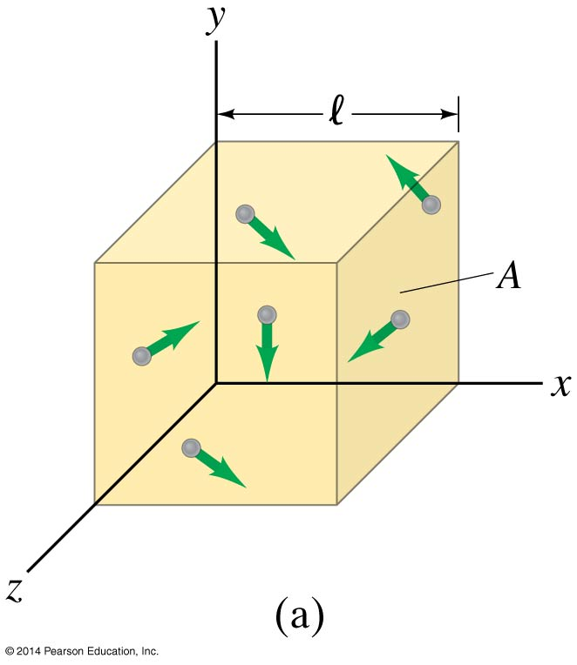
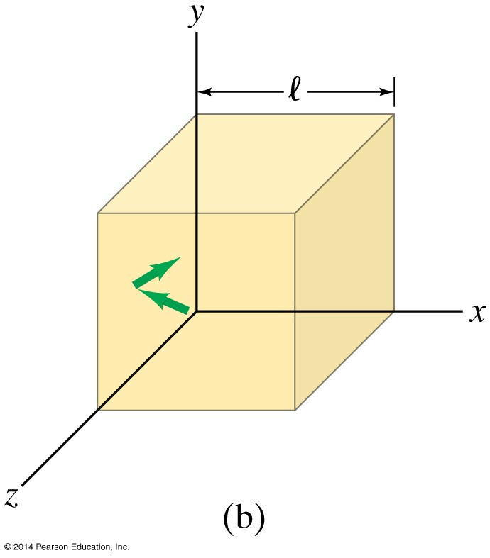
13-9 Kinetic Theory and the Molecular Interpretation of Temperature
The force exerted on the wall by the collision of one molecule is
Then the force due to all molecules colliding with that wall is

Slide 28
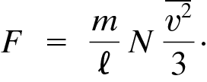
13-9 Kinetic Theory and the Molecular Interpretation of Temperature
The averages of the squares of the speeds in all three directions are equal:
So the pressure is:
(13-6)

Slide 29
13-9 Kinetic Theory and the Molecular Interpretation of Temperature
Rewriting,
so
The average translational kinetic energy of the molecules in an ideal gas is directly proportional to the temperature of the gas.
(13-7)
(13-8)

Slide 30
13-9 Kinetic Theory and the Molecular Interpretation of Temperature
We can invert this to find the average speed of molecules in a gas as a function of temperature:
(13-9)

Slide 31
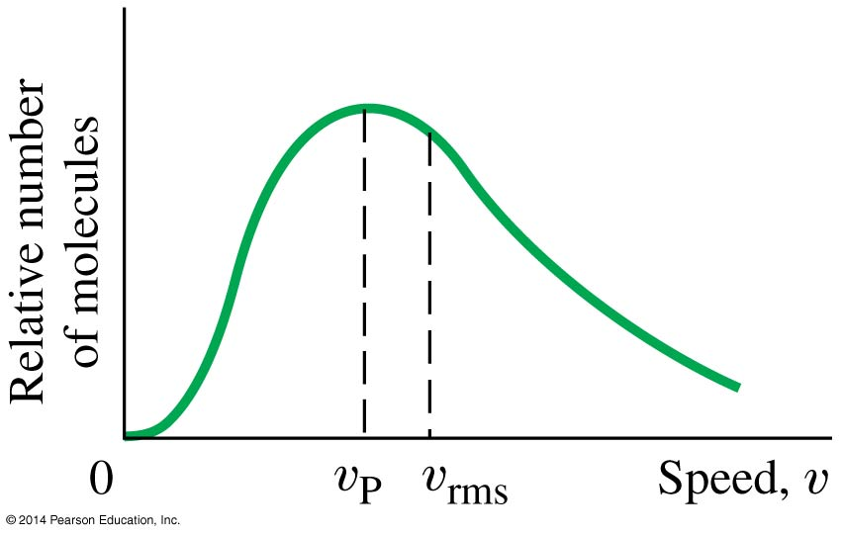
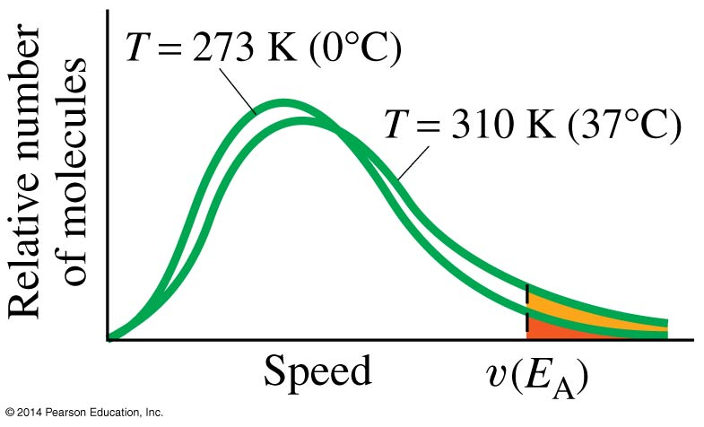
13-10 Distribution of Molecular Speeds
These two graphs show the distribution of speeds of molecules in a gas, as derived by Maxwell. The most probable speed, v_{P}, is not quite the same as the rms speed.
As expected, the curves shift to the right with temperature.

Slide 32
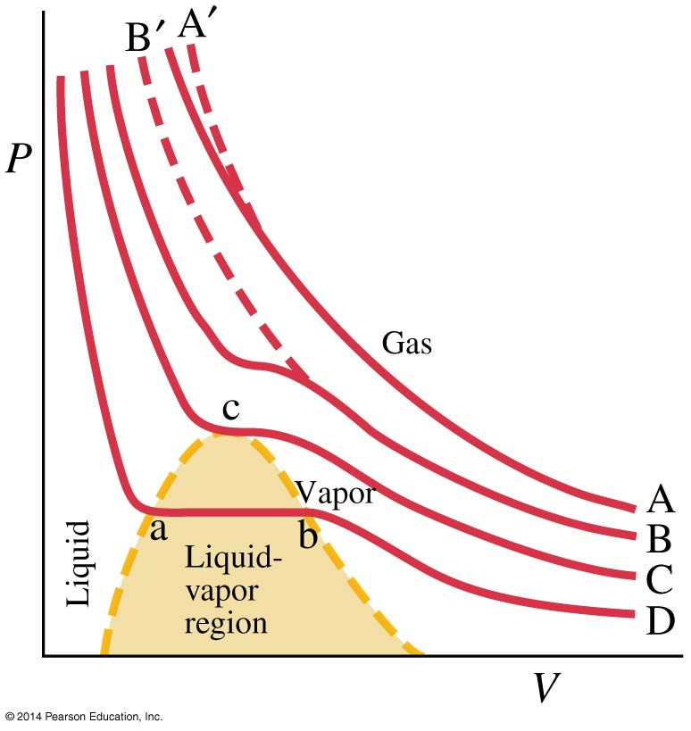
13-11 Real Gases and Changes of Phase
The curves here represent the behavior of the gas at different temperatures. The cooler it gets, the farther the gas is from ideal.
In curve D, the gas becomes liquid; it begins condensing at (b) and is entirely liquid at (a).
The point (c) is called the critical point.

Slide 33
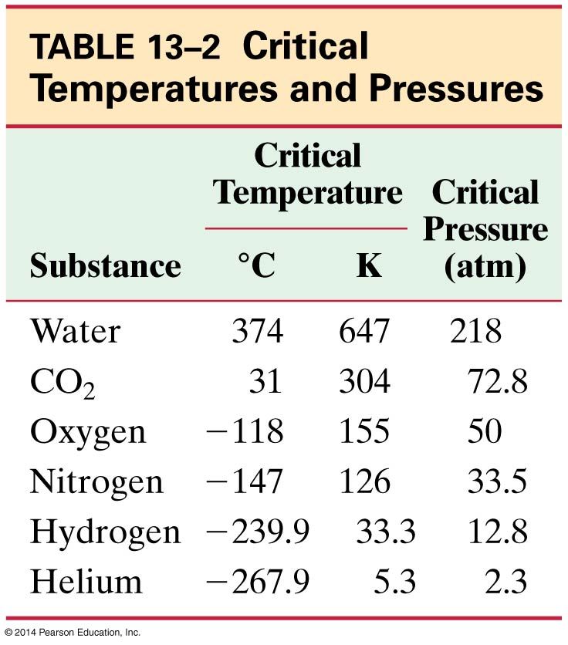
13-11 Real Gases and Changes of Phase
Below the critical temperature, the gas can liquefy if the pressure is sufficient; above it, no amount of pressure will suffice.

Slide 34
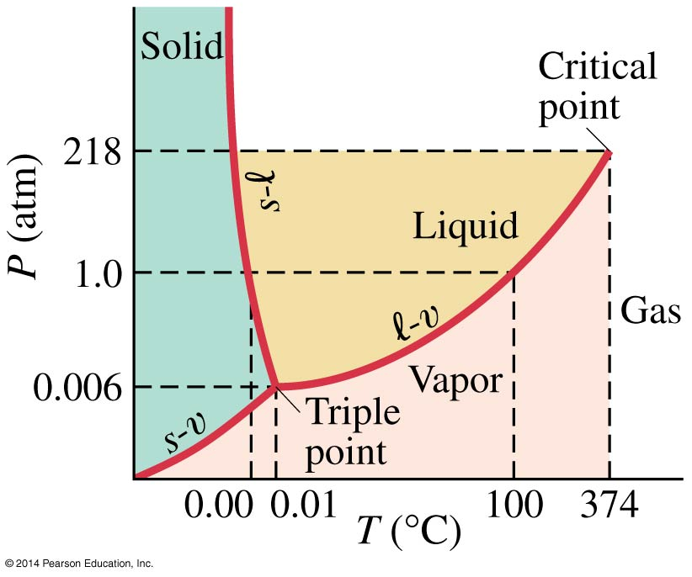
13-11 Real Gases and Changes of Phase
A PT diagram is called a phase diagram; it shows all three phases of matter. The solid-liquid transition is melting or freezing; the liquid-vapor one is boiling or condensing; and the solid-vapor one is sublimation.
Phase diagram of water

Slide 35
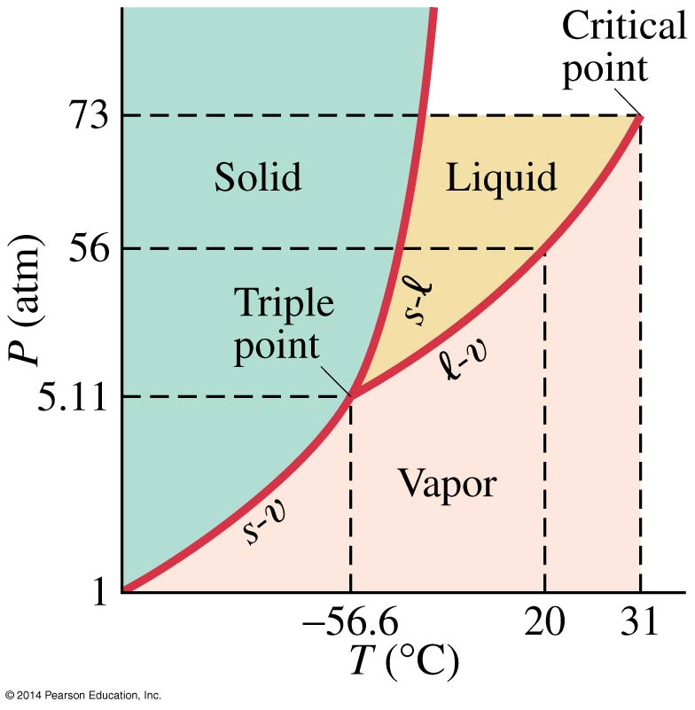
13-11 Real Gases and Changes of Phase
The triple point is the only point where all three phases can coexist in equilibrium.
Phase diagram of carbon dioxide

Slide 36
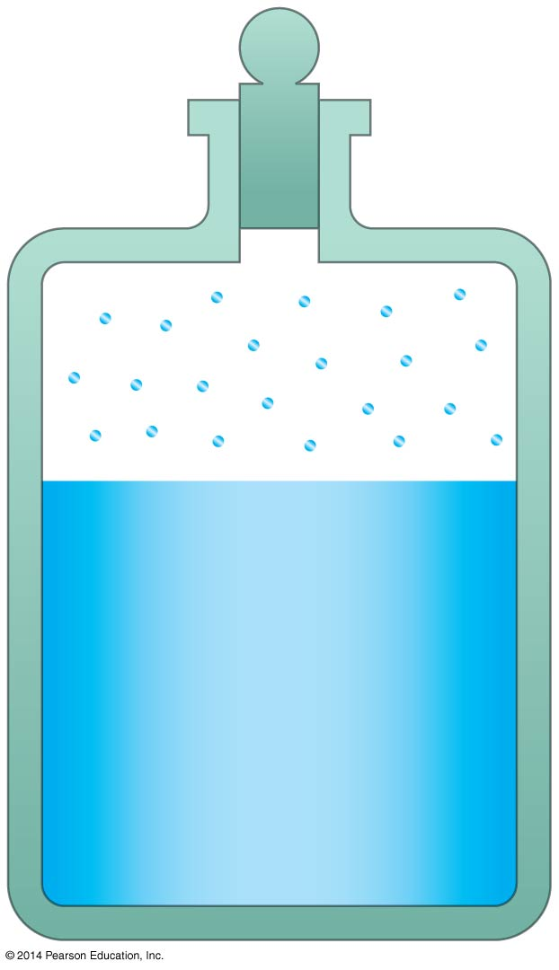
13-12 Vapor Pressure and Humidity
An open container of water can evaporate, rather than boil, away. The fastest molecules are escaping from the water’s surface, so evaporation is a cooling process as well.
The inverse process is called condensation.
When the evaporation and condensation processes are in equilibrium, the vapor just above the liquid is said to be saturated, and its pressure is the saturated vapor pressure.

Slide 37
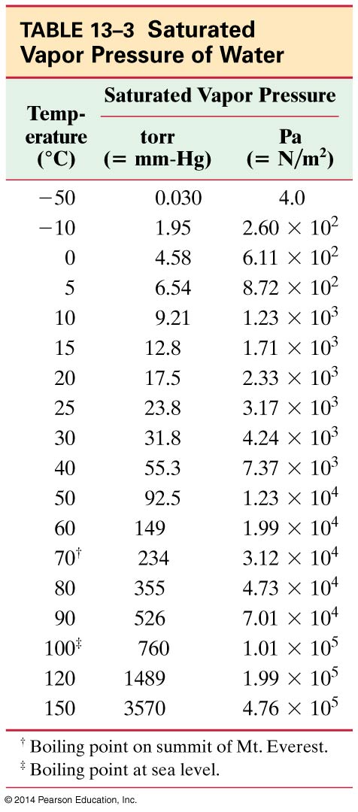
13-12 Vapor Pressure and Humidity
The saturated vapor pressure increases with temperature.

Slide 38
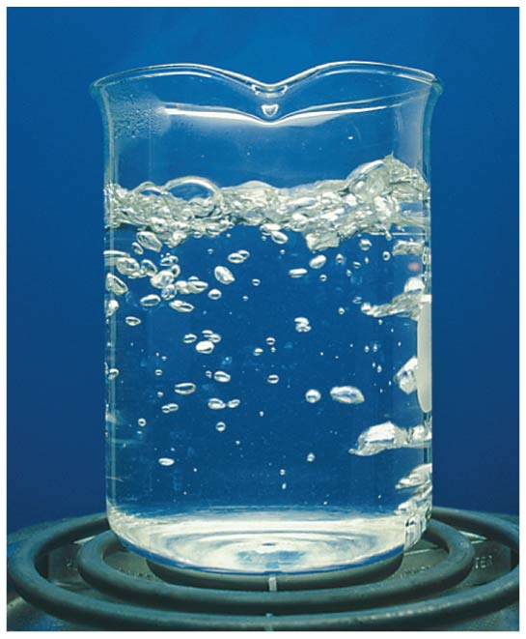
13-12 Vapor Pressure and Humidity
A liquid boils when its saturated vapor pressure equals the external pressure.

Slide 39
13-12 Vapor Pressure and Humidity
Partial pressure is the pressure each component of a mixture of gases would exert if it were the only gas present. The partial pressure of water in the air can be as low as zero, and as high as the saturated vapor pressure at that temperature.
Relative humidity is a measure of the saturation of the air.

Slide 40
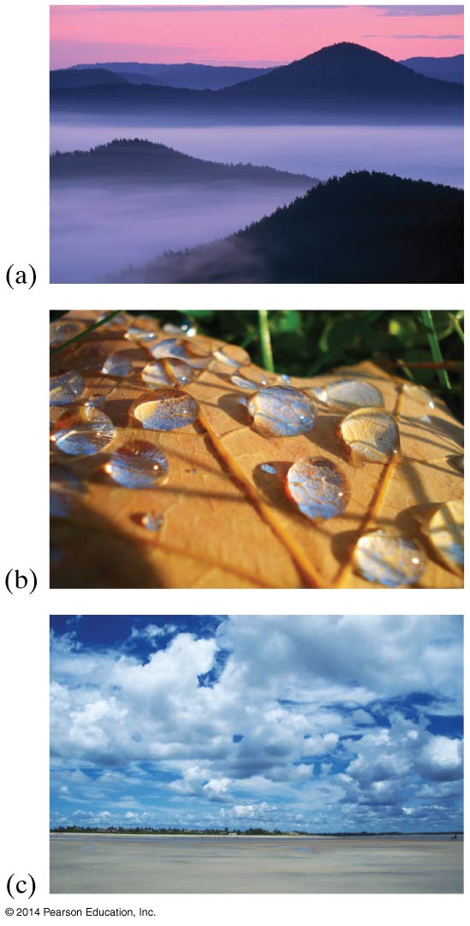
13-12 Vapor Pressure and Humidity
When the humidity is high, it feels muggy; it is hard for any more water to evaporate.
The dew point is the temperature at which the air would be saturated with water.
If the temperature goes below the dew point, dew, fog, or even rain may occur.

Slide 41
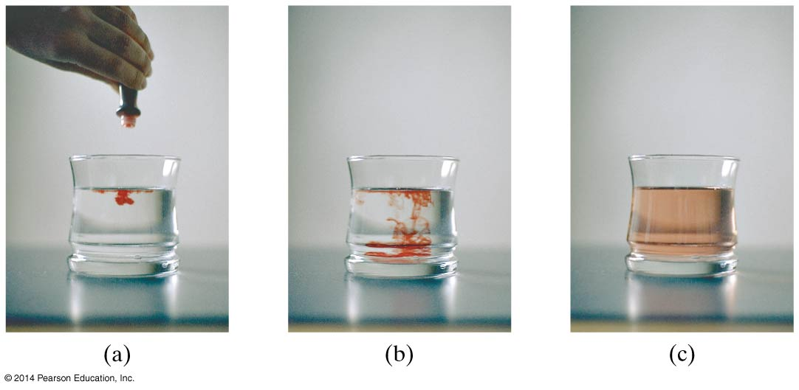
13-13 Diffusion
Even without stirring, a few drops of dye in water will gradually spread throughout. This process is called diffusion.

Slide 42
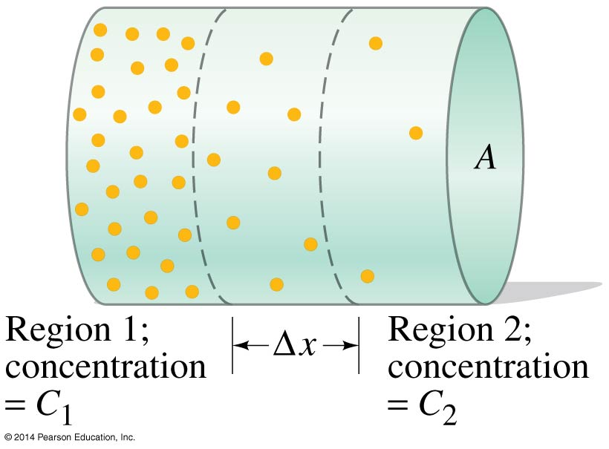
13-13 Diffusion
Diffusion occurs from a region of high concentration towards a region of lower concentration.

Slide 43
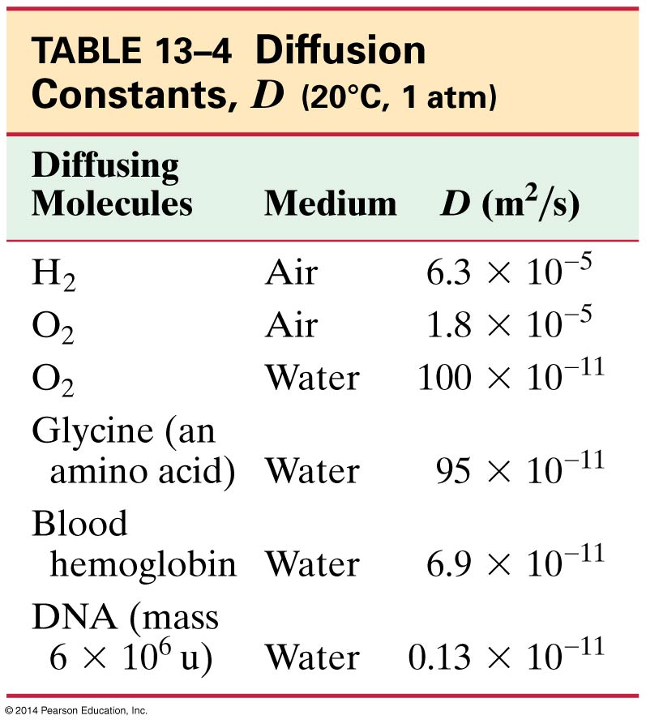
13-13 Diffusion
The rate of diffusion is given by:
In this equation, D is the diffusion constant.
(13-10)

Slide 44
Summary of Chapter 13
All matter is made of atoms.
Atomic and molecular masses are measured in atomic mass units, u.
Temperature is a measure of how hot or cold something is, and is measured by thermometers.
There are three temperature scales in use: Celsius, Fahrenheit, and Kelvin.
When heated, a solid will get longer by a fraction given by the coefficient of linear expansion.

Slide 45
Summary of Chapter 13
The fractional change in volume of gases, liquids, and solids is given by the coefficient of volume expansion.
Ideal gas law: PV = nRT
One mole of a substance is the number of grams equal to the atomic or molecular mass.
Each mole contains Avogadro’s number of atoms or molecules.

Slide 46
Summary of Chapter 13
The average kinetic energy of molecules in a gas is proportional to the temperature:
Below the critical temperature, a gas can liquefy if the pressure is high enough.
At the triple point, all three phases are in equilibrium.
Evaporation occurs when the fastest moving molecules escape from the surface of a liquid.
(13-8)

Slide 47
Summary of Chapter 13
Saturated vapor pressure occurs when the two phases are in equilibrium.
Relative humidity is the ratio of the actual vapor pressure to the saturated vapor pressure.
Diffusion is the process whereby the concentration of a substance becomes uniform.

