Slide 2
Chapter 19 DC Circuits

Slide 3
Contents of Chapter 19
EMF and Terminal Voltage
Resistors in Series and in Parallel
Kirchhoff’s Rules
EMFs in Series and in Parallel; Charging a Battery
Circuits Containing Capacitors in Series and in Parallel

Slide 4
Contents of Chapter 19
RC Circuits—Resistor and Capacitor in Series
Electric Hazards
Ammeters and Voltmeters—Measurement Affects the Quantity Being Measured

Slide 5
19-1 EMF and Terminal Voltage
Electric circuit needs battery or generator to produce current—these are called sources of emf.
Battery is a nearly constant voltage source, but does have a small internal resistance, which reduces the actual voltage from the ideal emf:
(19-1)

Slide 6
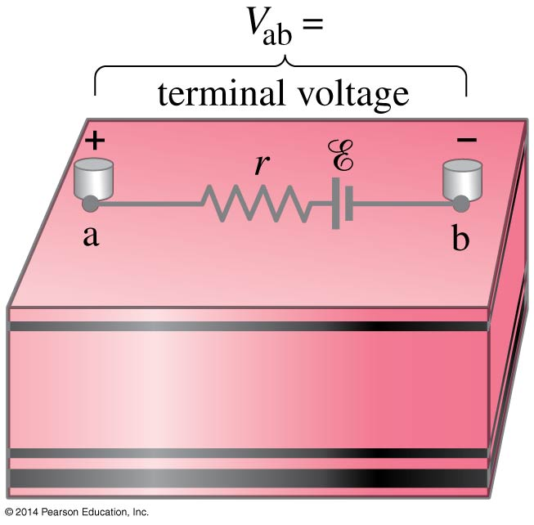
19-1 EMF and Terminal Voltage
This resistance behaves as though it were in series with the emf.

Slide 7
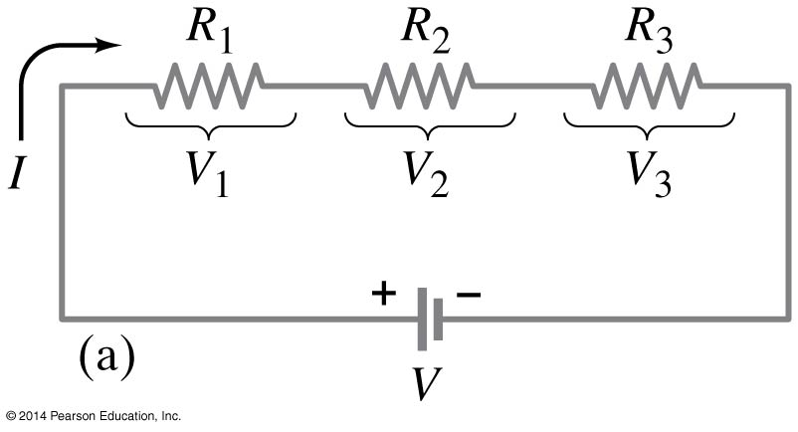
19-2 Resistors in Series and in Parallel
A series connection has a single path from the battery, through each circuit element in turn, then back to the battery.

Slide 8
19-2 Resistors in Series and in Parallel
The current through each resistor is the same; the voltage depends on the resistance. The sum of the voltage drops across the resistors equals the battery voltage.
(19-2)

Slide 9
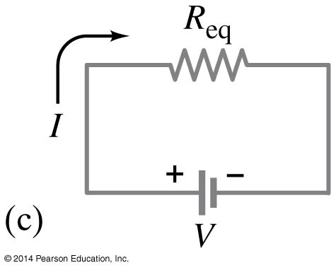
19-2 Resistors in Series and in Parallel
From this we get the equivalent resistance (that single resistance that gives the same current in the circuit).
(19-3)

Slide 10
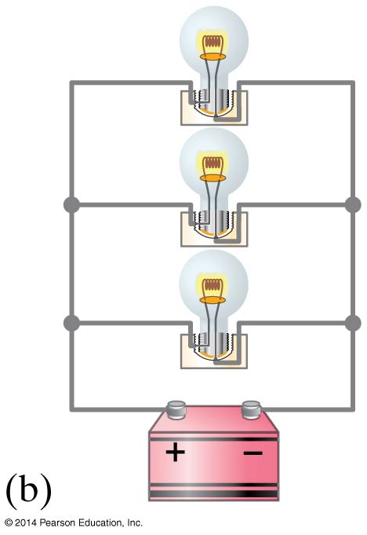
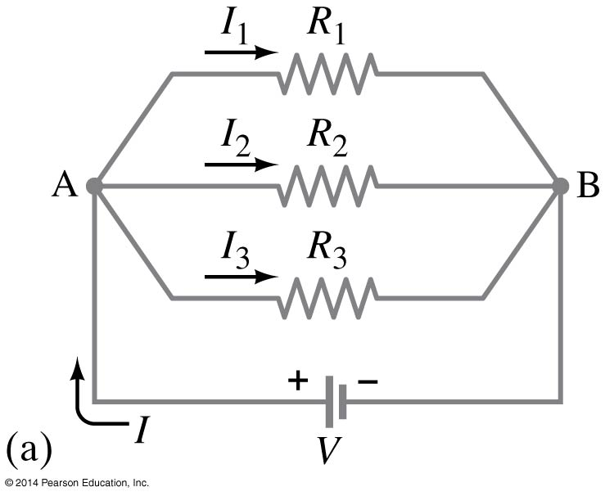
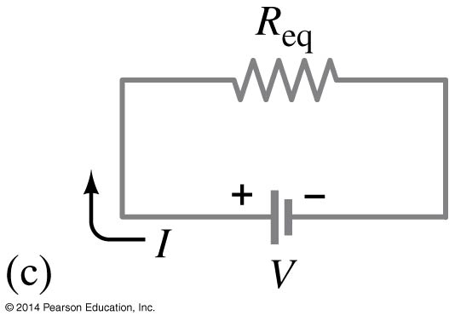
19-2 Resistors in Series and in Parallel
A parallel connection splits the current; the voltage across each resistor is the same:

Slide 11
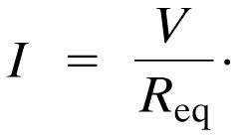
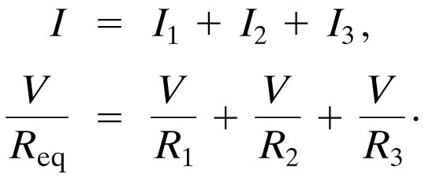
19-2 Resistors in Series and in Parallel
The total current is the sum of the currents across each resistor:

Slide 12
19-2 Resistors in Series and in Parallel
This gives the reciprocal of the equivalent resistance:
(19-4)

Slide 13
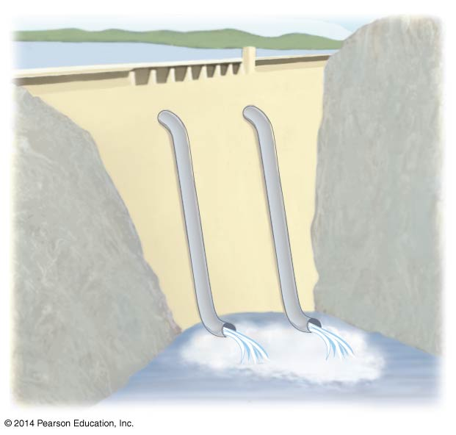
19-2 Resistors in Series and in Parallel
An analogy using water may be helpful in visualizing parallel circuits:

Slide 14
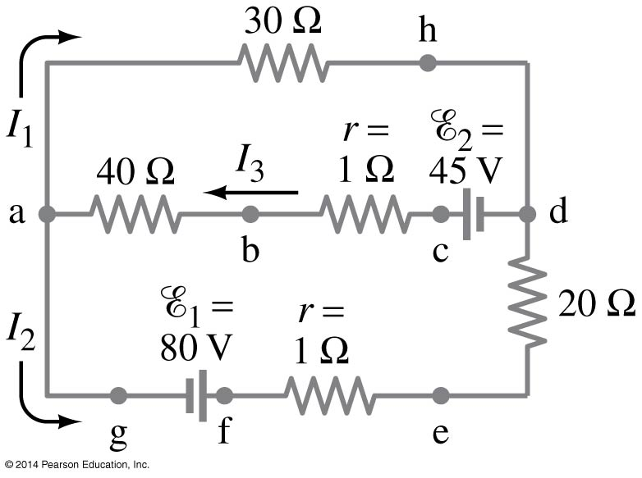
19-3 Kirchhoff’s Rules
Some circuits cannot be broken down into series and parallel connections.

Slide 15
19-3 Kirchhoff’s Rules
For these circuits we use Kirchhoff’s rules.
Junction rule: The sum of currents entering a junction equals the sum of the currents leaving it.

Slide 16
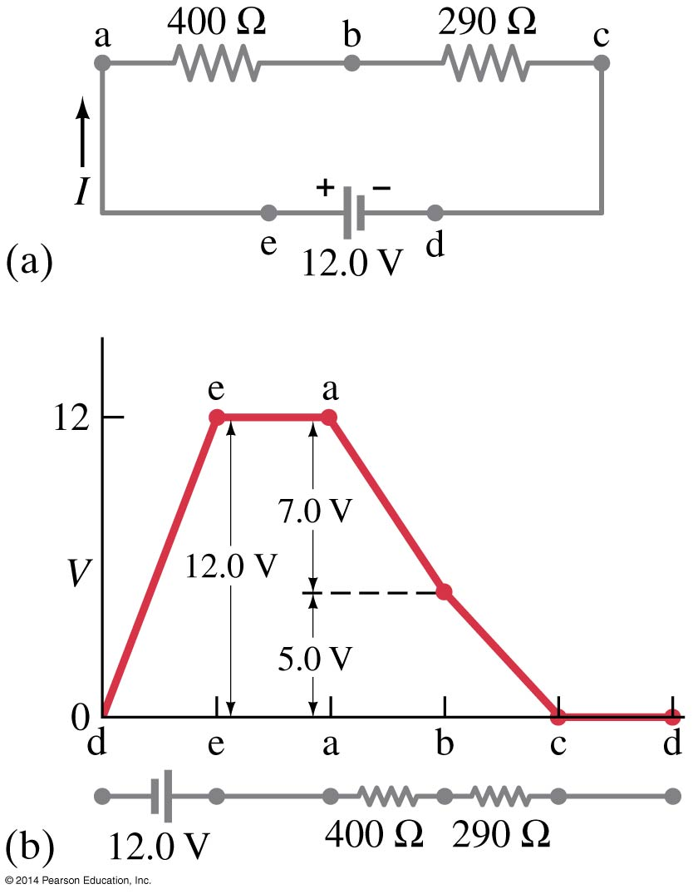
19-3 Kirchhoff’s Rules
Loop rule: The sum of the changes in potential around a closed loop is zero.

Slide 17
19-3 Kirchhoff’s Rules
Problem Solving: Kirchhoff’s Rules
Label each current.
Identify unknowns.
Apply junction and loop rules; you will need as many independent equations as there are unknowns.
Solve the equations, being careful with signs.

Slide 18
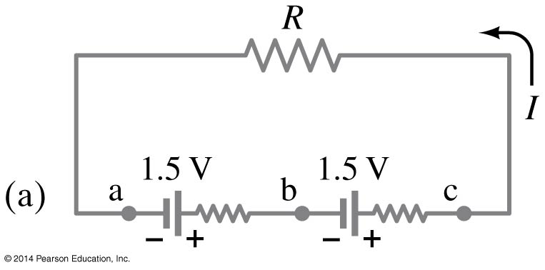
19-4 EMFs in Series and in Parallel; Charging a Battery
EMFs in series in the same direction: total voltage is the sum of the separate voltages

Slide 19
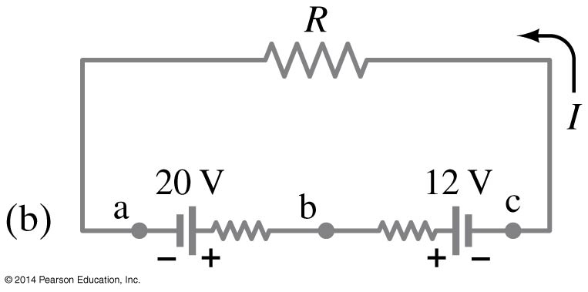
19-4 EMFs in Series and in Parallel; Charging a Battery
EMFs in series, opposite direction: total voltage is the difference, but the lower-voltage battery is charged.

Slide 20
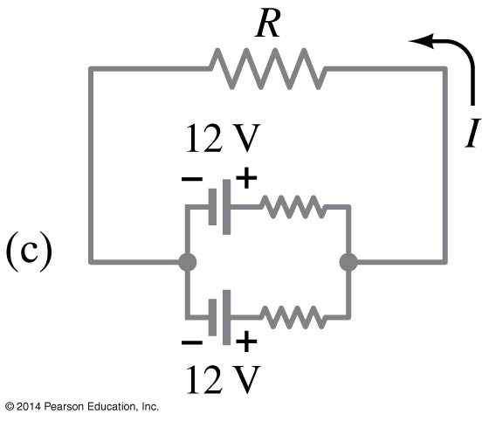
19-4 EMFs in Series and in Parallel; Charging a Battery
EMFs in parallel only make sense if the voltages are the same; this arrangement can produce more current than a single emf.

Slide 21
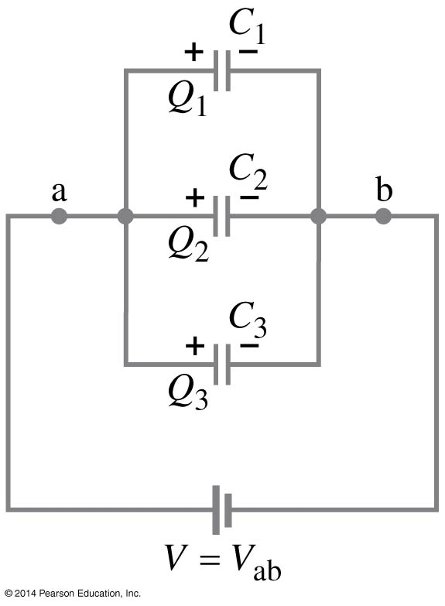
19-5 Circuits Containing Capacitors in Series and in Parallel
Capacitors in parallel have the same voltage across each one:

Slide 22
19-5 Circuits Containing Capacitors in Series and in Parallel
In this case, the total capacitance is the sum:
(19-5)

Slide 23
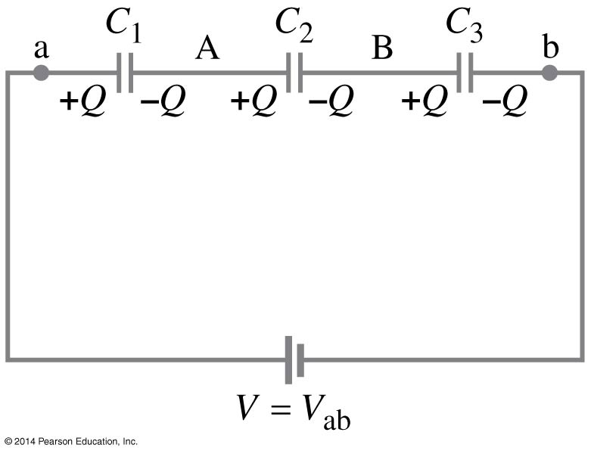
19-5 Circuits Containing Capacitors in Series and in Parallel
Capacitors in series have the same charge:

Slide 24
19-5 Circuits Containing Capacitors in Series and in Parallel
In this case, the reciprocals of the capacitances add to give the reciprocal of the equivalent capacitance:
(19-6)

Slide 25
19-6 RC Circuits—Resistor and Capacitor in Series
When the switch is closed, the capacitor will begin to charge.

Slide 26
19-6 RC Circuits—Resistor and Capacitor in Series
The voltage across the capacitor increases with time:
This is a type of exponential.
(19-7a)

Slide 27
19-6 RC Circuits—Resistor and Capacitor in Series
The charge follows a similar curve:
This curve has a characteristic time constant:
(19-7b)
(19-7c)

Slide 28
19-6 RC Circuits—Resistor and Capacitor in Series
If an isolated charged capacitor is connected across a resistor, it discharges:
Q = Q₀e^{-t/RC}

Slide 29
19-7 Electric Hazards
Even very small currents—10 to 100 mA can be dangerous, disrupting the nervous system. Larger currents may also cause burns.
Household voltage can be lethal if you are wet and in good contact with the ground. Be careful!

Slide 30
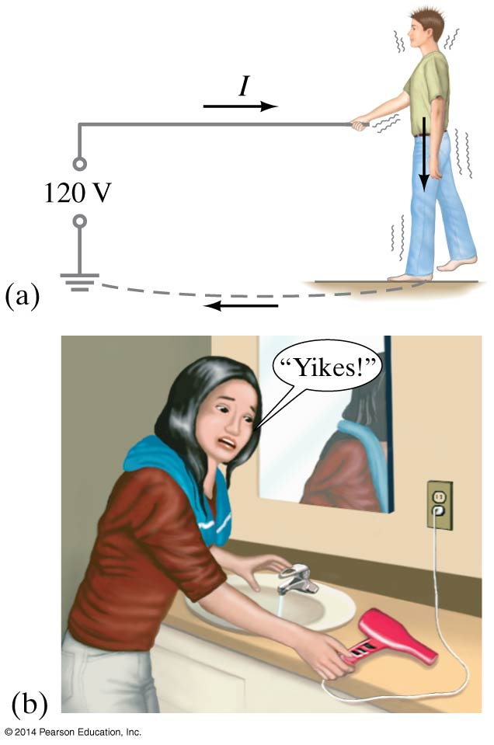
19-7 Electric Hazards
A person receiving a shock has become part of a complete circuit.

Slide 31
19-7 Electric Hazards
Faulty wiring and improper grounding can be hazardous. Make sure electrical work is done by a professional.

Slide 32
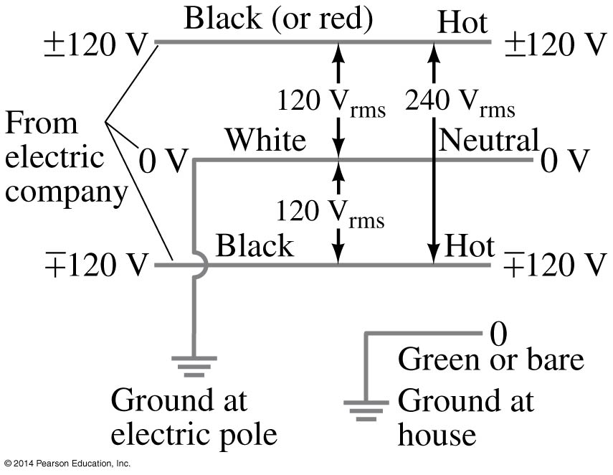
19-7 Electric Hazards
The safest plugs are those with three prongs; they have a separate ground line.
Here is an example of household wiring—colors can vary, though! Be sure you know which is the hot wire before you do anything.

Slide 33
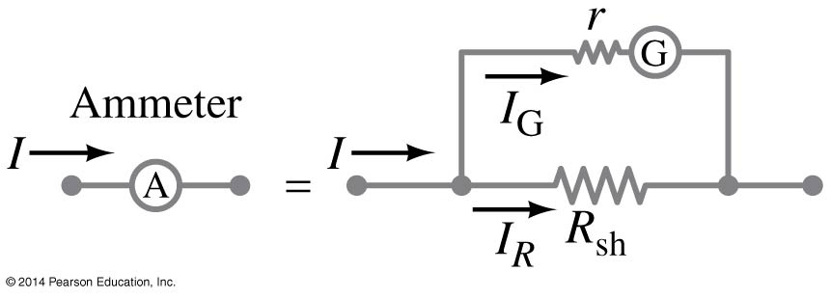
19-8 Ammeters and Voltmeters—Measurement Affects the Quantity Being Measured
An ammeter measures current; a voltmeter measures voltage. Both are based on galvanometers, unless they are digital.
The current in a circuit passes through the ammeter; the ammeter should have low resistance so as not to affect the current.

Slide 34
19-8 Ammeters and Voltmeters—Measurement Affects the Quantity Being Measured
A voltmeter should not affect the voltage across the circuit element it is measuring; therefore its resistance should be very large.

Slide 35
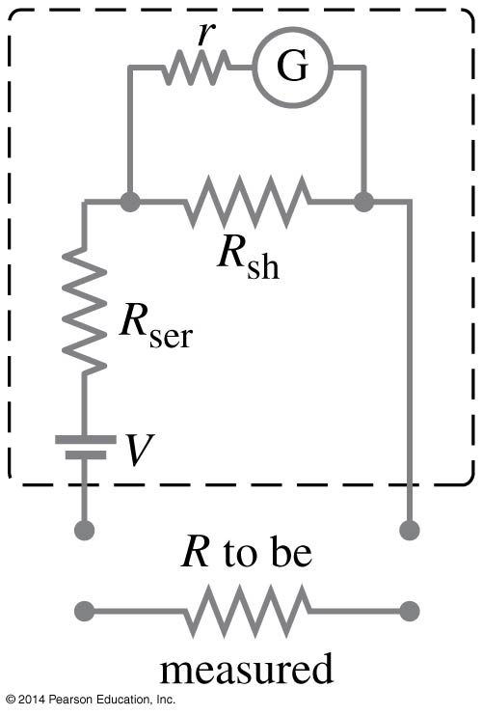
19-8 Ammeters and Voltmeters—Measurement Affects the Quantity Being Measured
An ohmmeter measures resistance; it requires a battery to provide a current

Slide 36
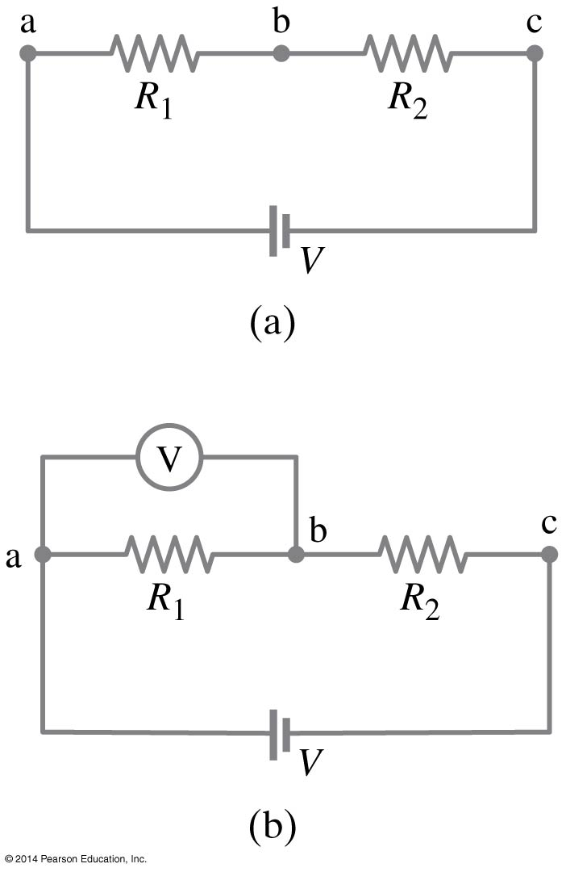
19-8 Ammeters and Voltmeters—Measurement Affects the Quantity Being Measured
If the meter has too much or (in this case) too little resistance, it can affect the measurement.

Slide 37
Summary of Chapter 19
A source of emf transforms energy from some other form to electrical energy
A battery is a source of emf in parallel with an internal resistance
Resistors in series:
Resistors in parallel:

Slide 38
Summary of Chapter 19
Kirchhoff’s rules:
sum of currents entering a junction equals sum of currents leaving it
total potential difference around closed loop is zero

Slide 39
Summary of Chapter 19
Capacitors in parallel:
Capacitors in series:

Slide 40
Summary of Chapter 19
RC circuit has a characteristic time constant:
To avoid shocks, don’t allow your body to become part of a complete circuit
Ammeter: measures current
Voltmeter: measures voltage

