Slide 2
Chapter 23 Light: Geometric Optics

Slide 3
Contents of Chapter 23
The Ray Model of Light
Reflection; Image Formed by a Plane Mirror
Formation of Images by Spherical Mirrors
Index of Refraction
Refraction: Snell’s Law

Slide 4
Contents of Chapter 23
Total Internal Reflection; Fiber Optics
Thin Lenses; Ray Tracing
The Thin Lens Equation
Combinations of Lenses
Lensmaker’s Equation

Slide 5
23-1 The Ray Model of Light
Light very often travels in straight lines. We represent light using rays, which are straight lines emanating from an object. This is an idealization, but is very useful for geometric optics.

Slide 6
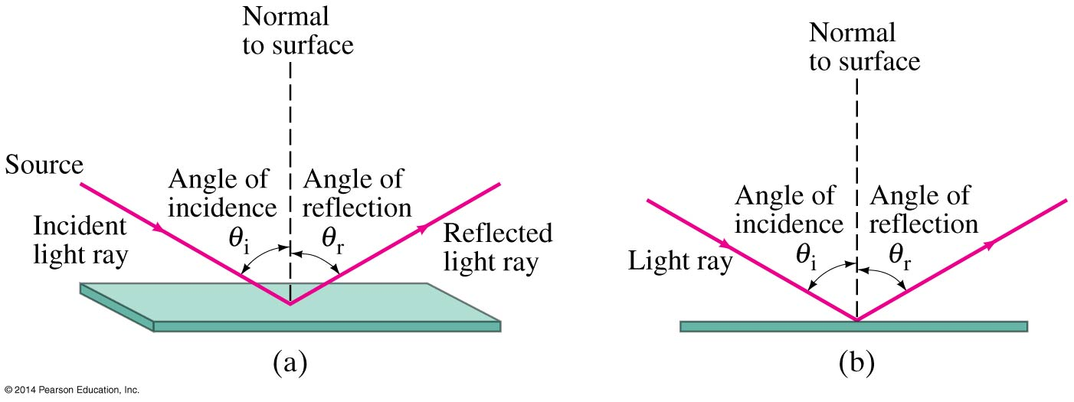
23-2 Reflection; Image Formation by a Plane Mirror
Law of reflection: the angle of reflection (that the ray makes with the normal to a surface) equals the angle of incidence.

Slide 7
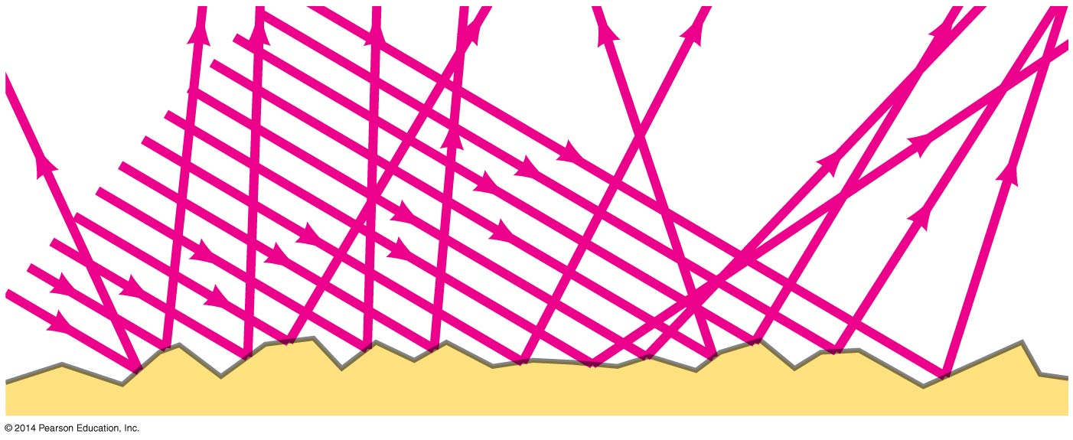
23-2 Reflection; Image Formation by a Plane Mirror
When light reflects from a rough surface, the law of reflection still holds, but the angle of incidence varies. This is called diffuse reflection.

Slide 8
23-2 Reflection; Image Formation by a Plane Mirror
With diffuse reflection, your eye sees reflected light at all angles. With specular reflection (from a mirror), your eye must be in the correct position.

Slide 9
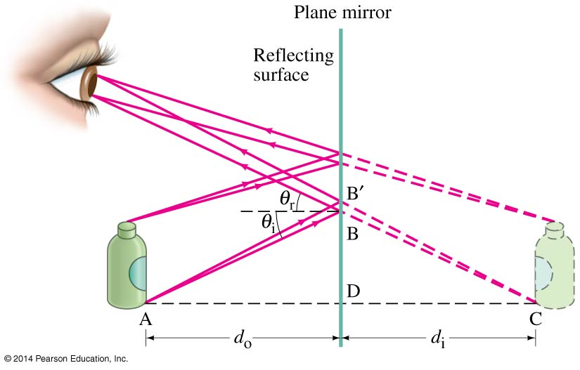
23-2 Reflection; Image Formation by a Plane Mirror
What you see when you look into a plane (flat) mirror is an image, which appears to be behind the mirror.

Slide 10
23-2 Reflection; Image Formation by a Plane Mirror
This is called a virtual image, as the light does not go through it. The distance of the image from the mirror is equal to the distance of the object from the mirror.

Slide 11
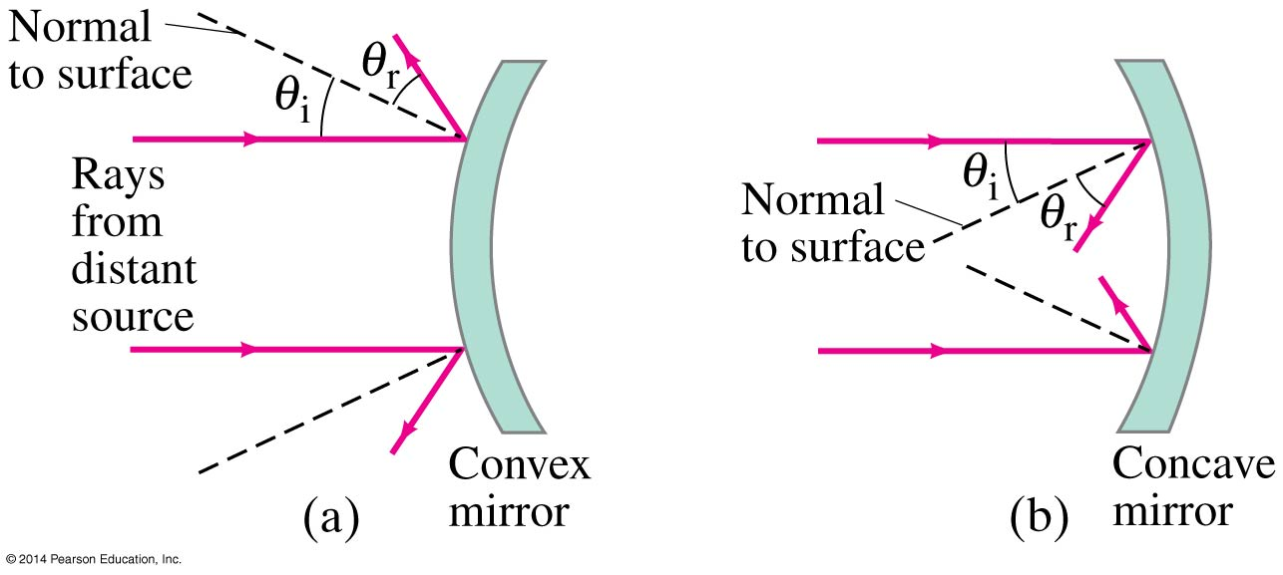
23-3 Formation of Images by Spherical Mirrors
Spherical mirrors are shaped like sections of a sphere, and may be reflective on either the inside (concave) or outside (convex)

Slide 12
23-3 Formation of Images by Spherical Mirrors
Rays coming from a faraway object are effectively parallel.

Slide 13
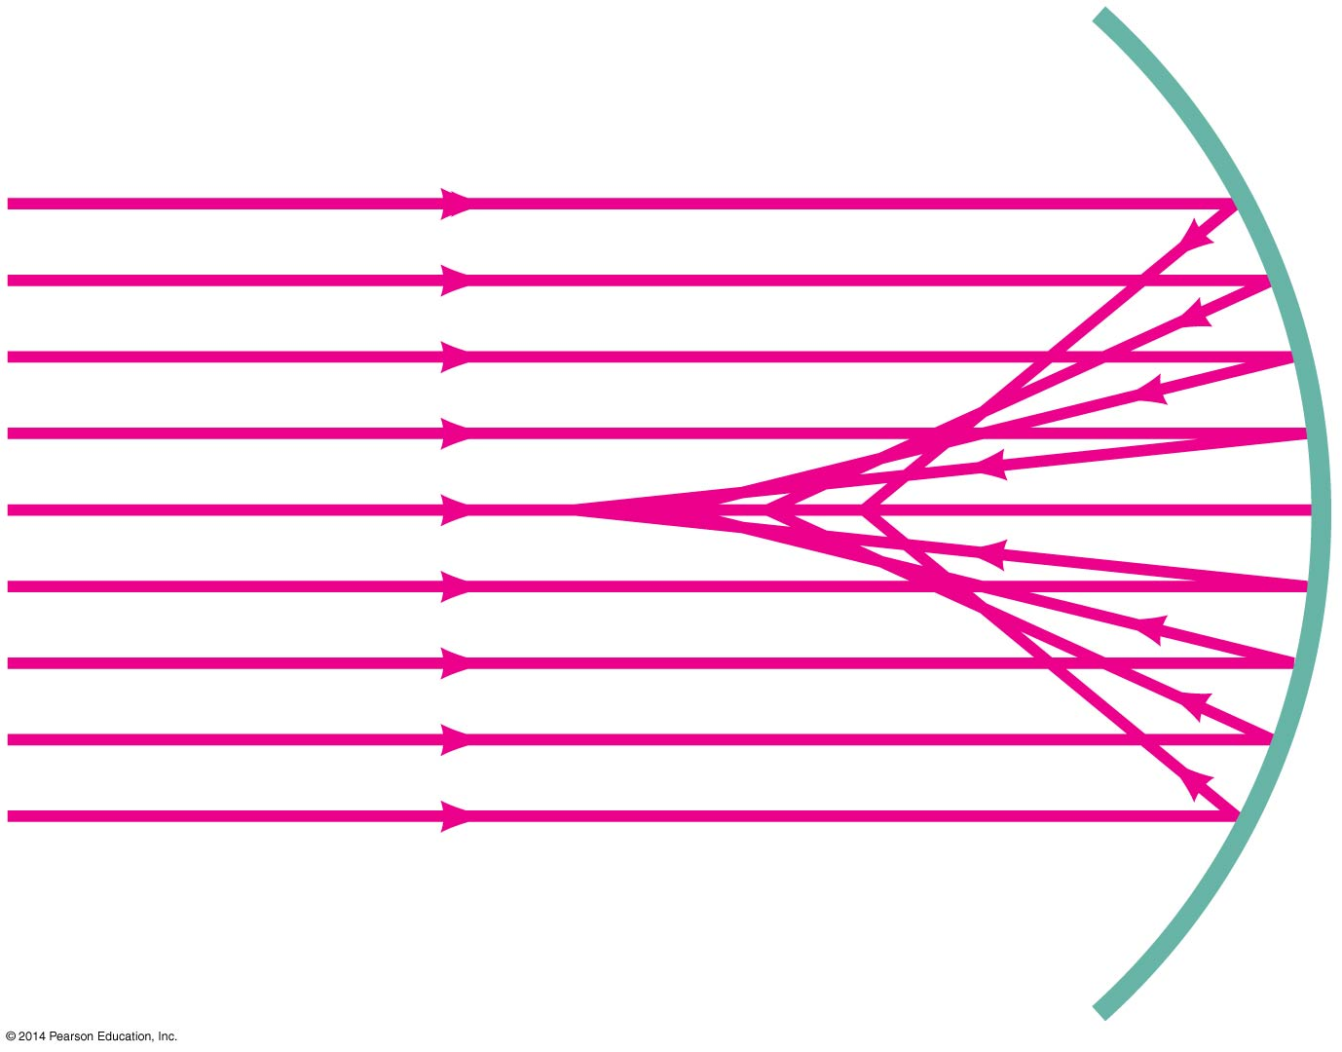
23-3 Formation of Images by Spherical Mirrors
Parallel rays striking a spherical mirror do not all converge at exactly the same place if the curvature of the mirror is large; this is called spherical aberration.

Slide 14
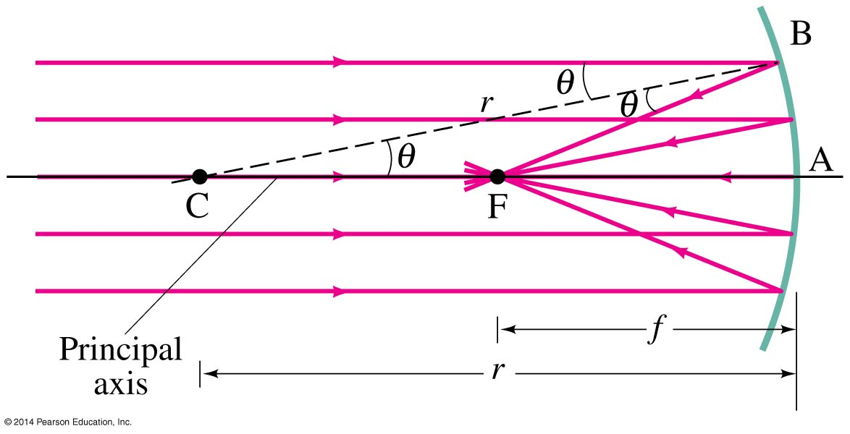
23-3 Formation of Images by Spherical Mirrors
If the curvature is small, the focus is much more precise; the focal point is where the rays converge.

Slide 15
23-3 Formation of Images by Spherical Mirrors
Using geometry, we find that the focal length is half the radius of curvature:
Spherical aberration can be avoided by using a parabolic reflector; these are more difficult and expensive to make, and so are used only when necessary, such as in research telescopes.
(23-1)

Slide 16
23-3 Formation of Images by Spherical Mirrors
We use ray diagrams to determine where an image will be. For mirrors, we use three key rays, all of which begin on the object:
A ray parallel to the axis; after reflection it passes through the focal point
A ray through the focal point; after reflection it is parallel to the axis
A ray perpendicular to the mirror; it reflects back on itself

Slide 17
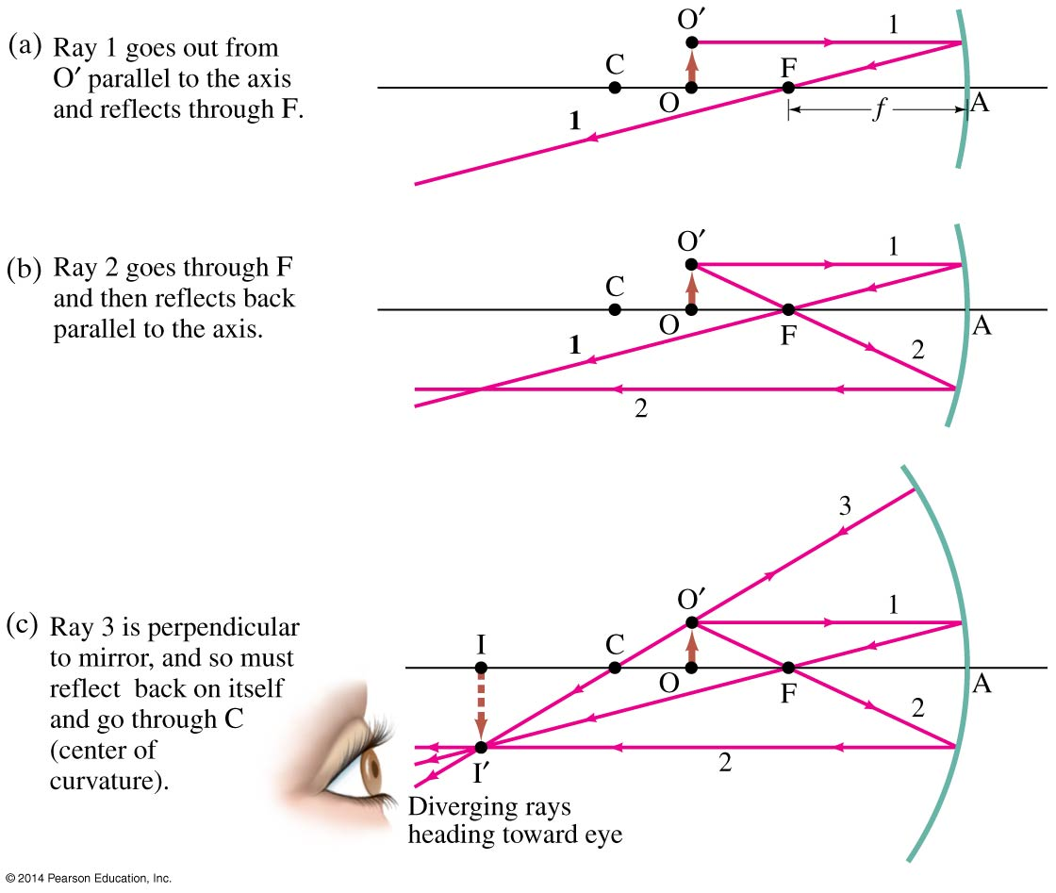
23-3 Formation of Images by Spherical Mirrors

Slide 18
23-3 Formation of Images by Spherical Mirrors
The intersection of these three rays gives the position of the image of that point on the object. To get a full image, we can do the same with other points (two points suffice for many purposes).

Slide 19
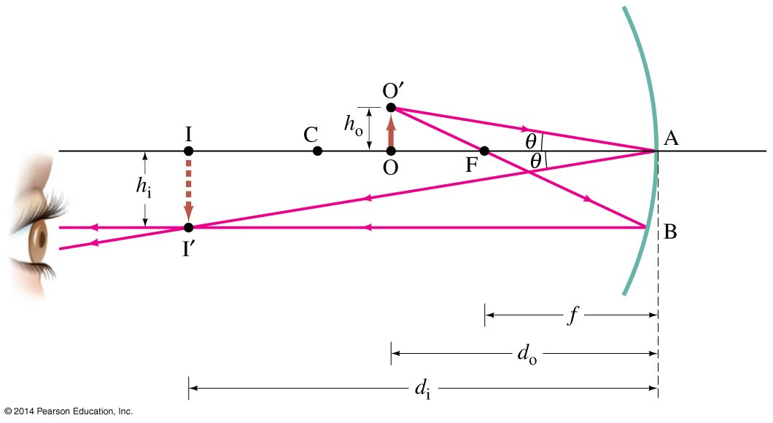
23-3 Formation of Images by Spherical Mirrors
Geometrically, we can derive an equation that relates the object distance, image distance, and focal length of the mirror:
(23-2)

Slide 20
23-3 Formation of Images by Spherical Mirrors
We can also find the magnification (ratio of image height to object height).
The negative sign indicates that the image is inverted. This object is between the center of curvature and the focal point, and its image is larger, inverted, and real.
(23-3)

Slide 21
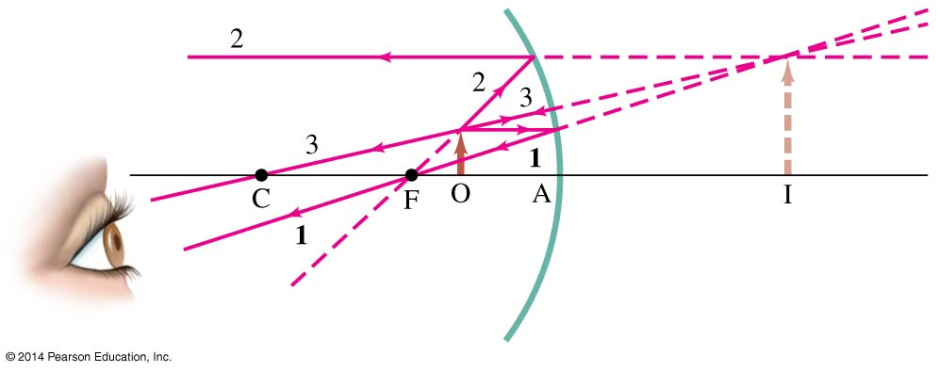
23-3 Formation of Images by Spherical Mirrors
If an object is inside the focal point, its image will be upright, larger, and virtual.

Slide 22
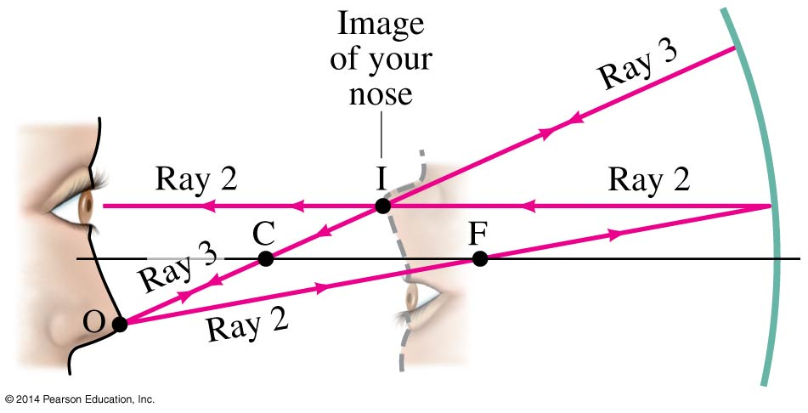
23-3 Formation of Images by Spherical Mirrors
If an object is outside the center of curvature of a concave mirror, its image will be inverted, smaller, and real.

Slide 23
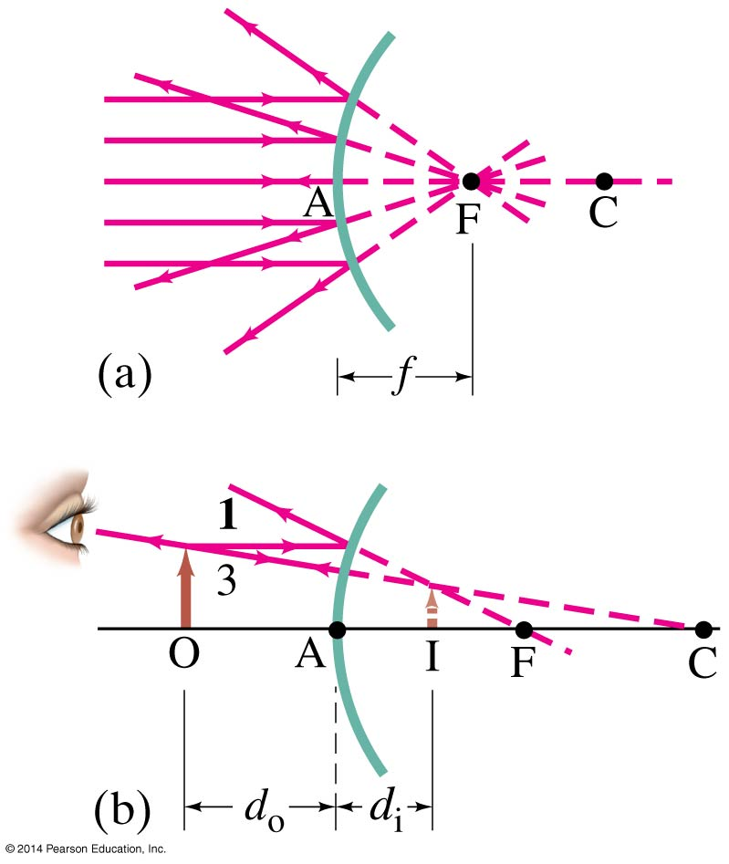
23-3 Formation of Images by Spherical Mirrors
For a convex mirror, the image is always virtual, upright, and smaller.

Slide 24
23-3 Formation of Images by Spherical Mirrors
Problem Solving: Spherical Mirrors
Draw a ray diagram; the image is where the rays intersect.
Apply the mirror and magnification equations.
Sign conventions: if the object, image, or focal point is on the reflective side of the mirror, its distance is positive, and negative otherwise. Magnification is positive if image is upright, negative otherwise.
Check that your solution agrees with the ray diagram.

Slide 25
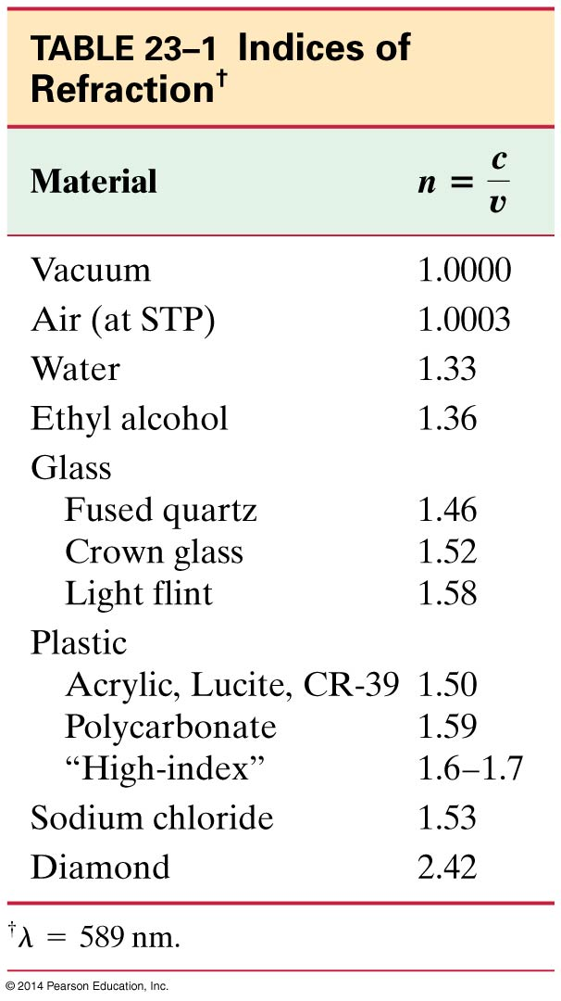
23-4 Index of Refraction
In general, light slows somewhat when traveling through a medium. The index of refraction of the medium is the ratio of the speed of light in vacuum to the speed of light in the medium:
(23-4)

Slide 26
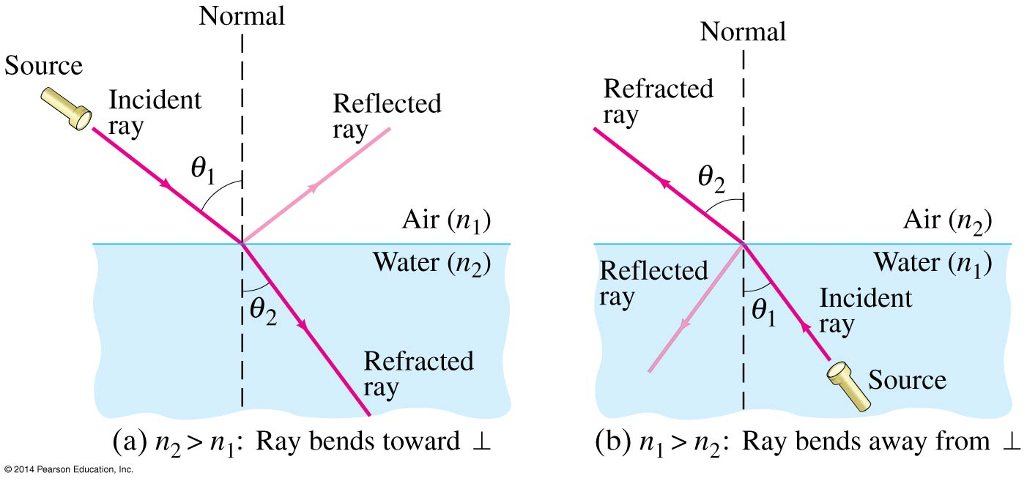
23-5 Refraction: Snell’s Law
Light changes direction when crossing a boundary from one medium to another. This is called refraction, and the angle the outgoing ray makes with the normal is called the angle of refraction.

Slide 27
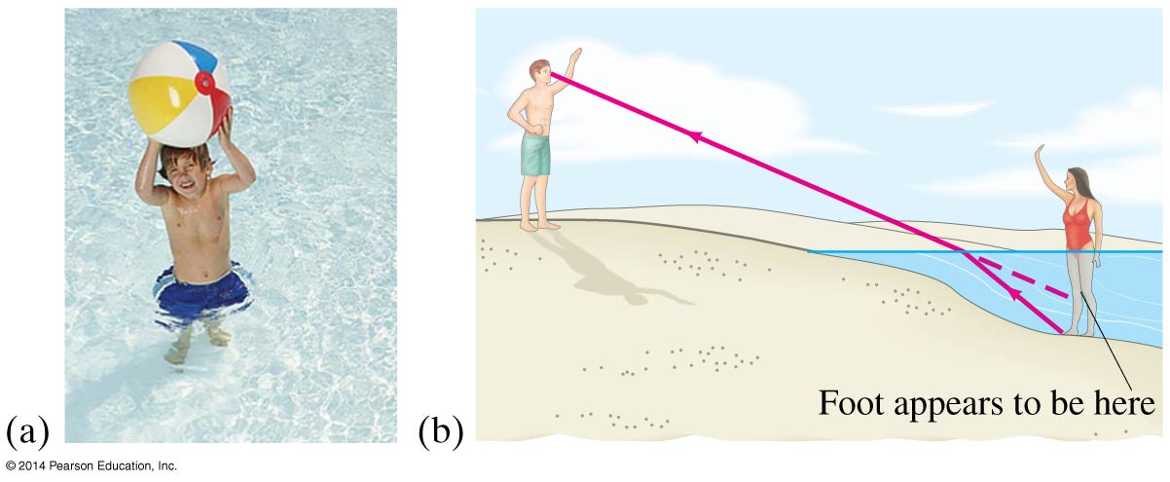
23-5 Refraction: Snell’s Law
Refraction is what makes objects half-submerged in water look odd.

Slide 28
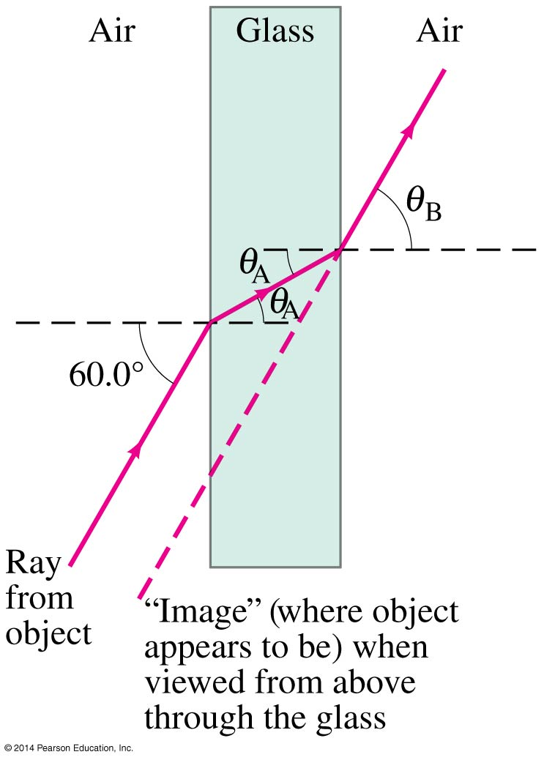
23-5 Refraction: Snell’s Law
The angle of refraction depends on the indices of refraction, and is given by Snell’s law:
(23-5)

Slide 29
23-6 Total Internal Reflection; Fiber Optics
If light passes into a medium with a smaller index of refraction, the angle of refraction is larger. There is an angle of incidence for which the angle of refraction will be 90°; this is called the critical angle:
(23-6)

Slide 30
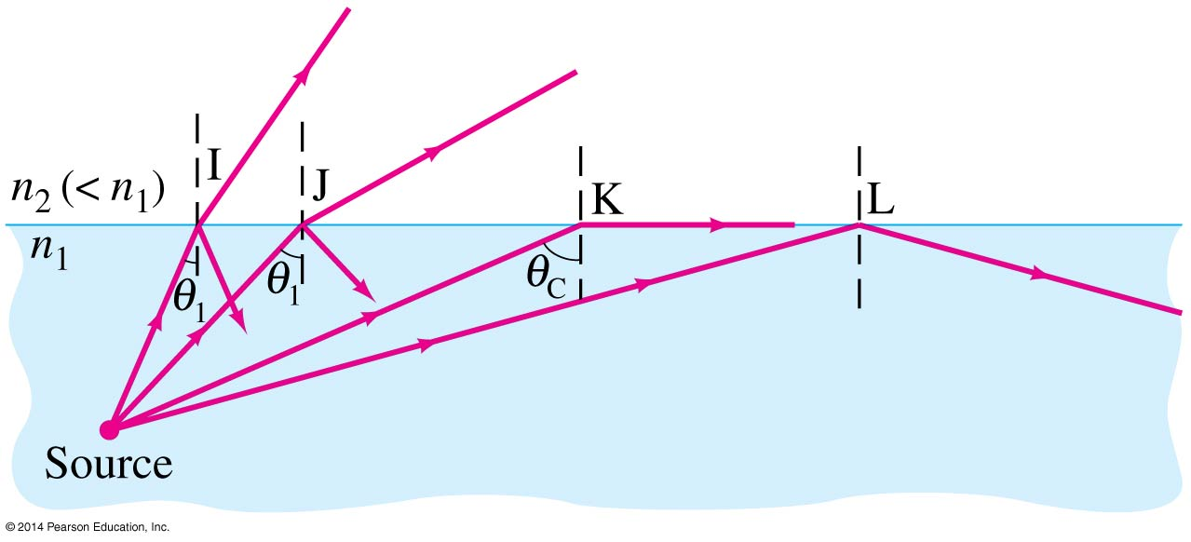
23-6 Total Internal Reflection; Fiber Optics
If the angle of incidence is larger than this, no transmission occurs. This is called total internal reflection.

Slide 31
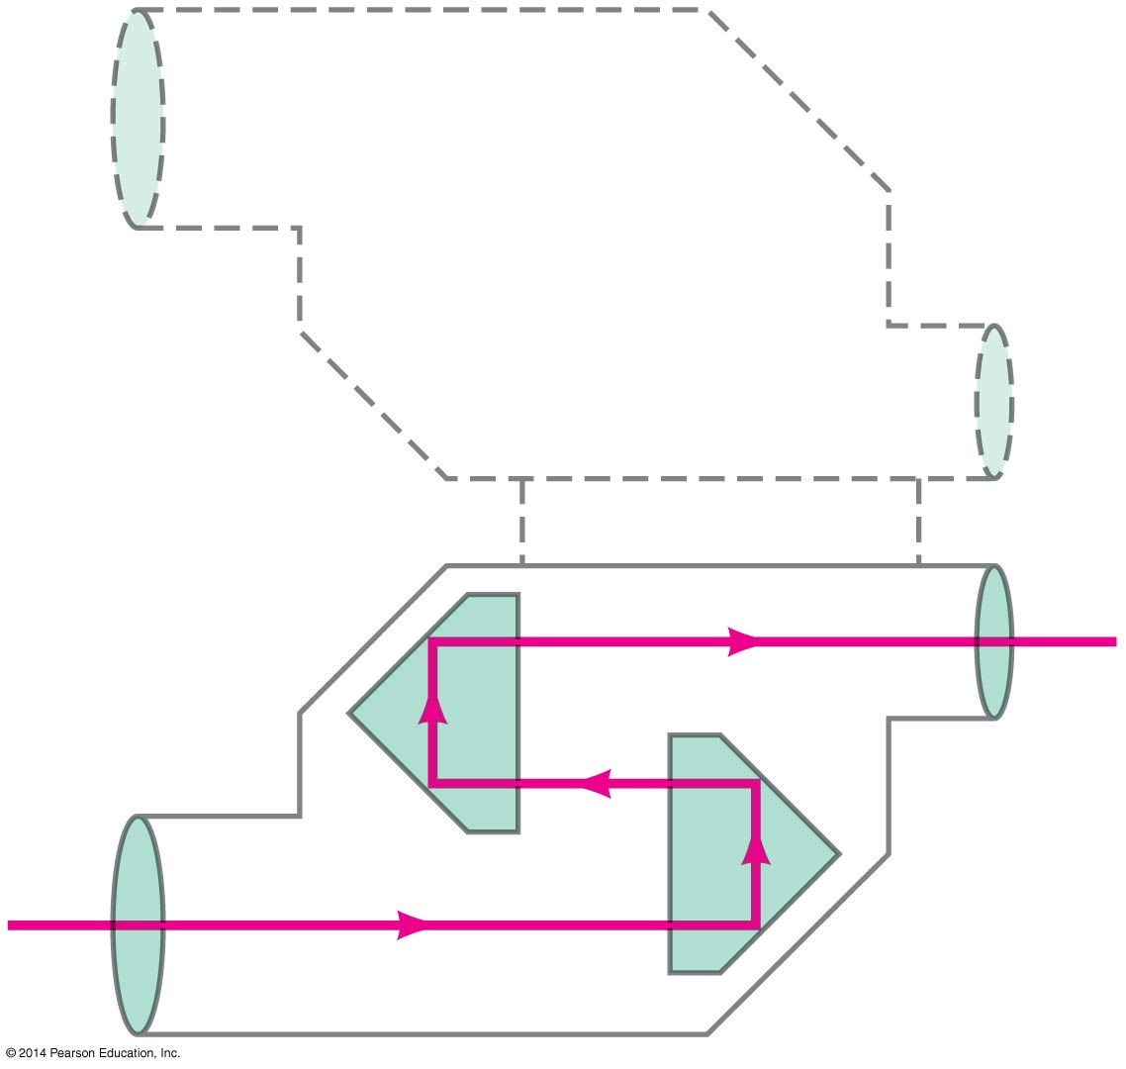
23-6 Total Internal Reflection; Fiber Optics
Binoculars often use total internal reflection; this gives true 100% reflection, which even the best mirror cannot do.

Slide 32
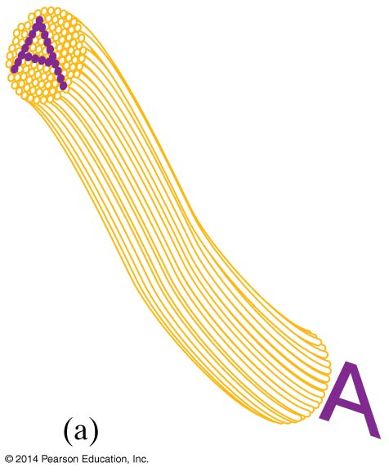
23-6 Total Internal Reflection; Fiber Optics
Total internal reflection is also the principle behind fiber optics. Light will be transmitted along the fiber even if it is not straight. An image can be formed using multiple small fibers.

Slide 33
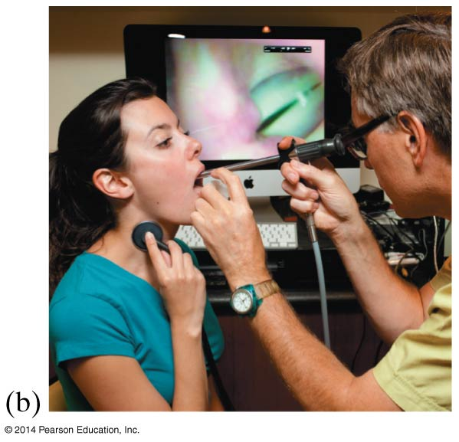
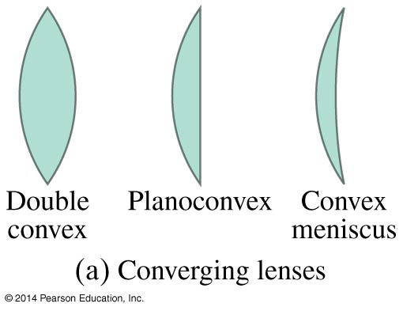
23-7 Thin Lenses; Ray Tracing
Thin lenses are those whose thickness is small compared to their radius of curvature. They may be either converging (a) or diverging (b).

Slide 34
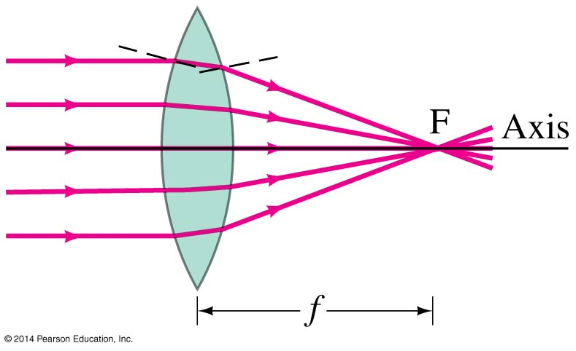
23-7 Thin Lenses; Ray Tracing
Parallel rays are brought to a focus by a converging lens (one that is thicker in the center than it is at the edge).

Slide 35
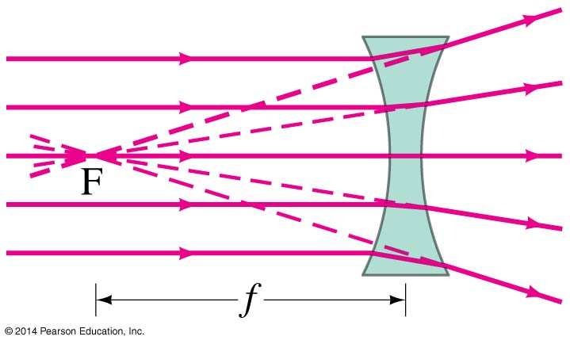
23-7 Thin Lenses; Ray Tracing
A diverging lens (thicker at the edge than in the center) make parallel light diverge; the focal point is that point where the diverging rays would converge if projected back.

Slide 36
23-7 Thin Lenses; Ray Tracing
The power of a lens is the inverse of its focal length.
Lens power is measured in diopters, D.
1 D = 1 m⁻¹
(23-7)

Slide 37
23-7 Thin Lenses; Ray Tracing
Ray tracing for thin lenses is similar to that for mirrors. We have three key rays:
This ray comes in parallel to the axis and exits through the focal point.
This ray comes in through the focal point and exits parallel to the axis.
This ray goes through the center of the lens and is undeflected.

Slide 38
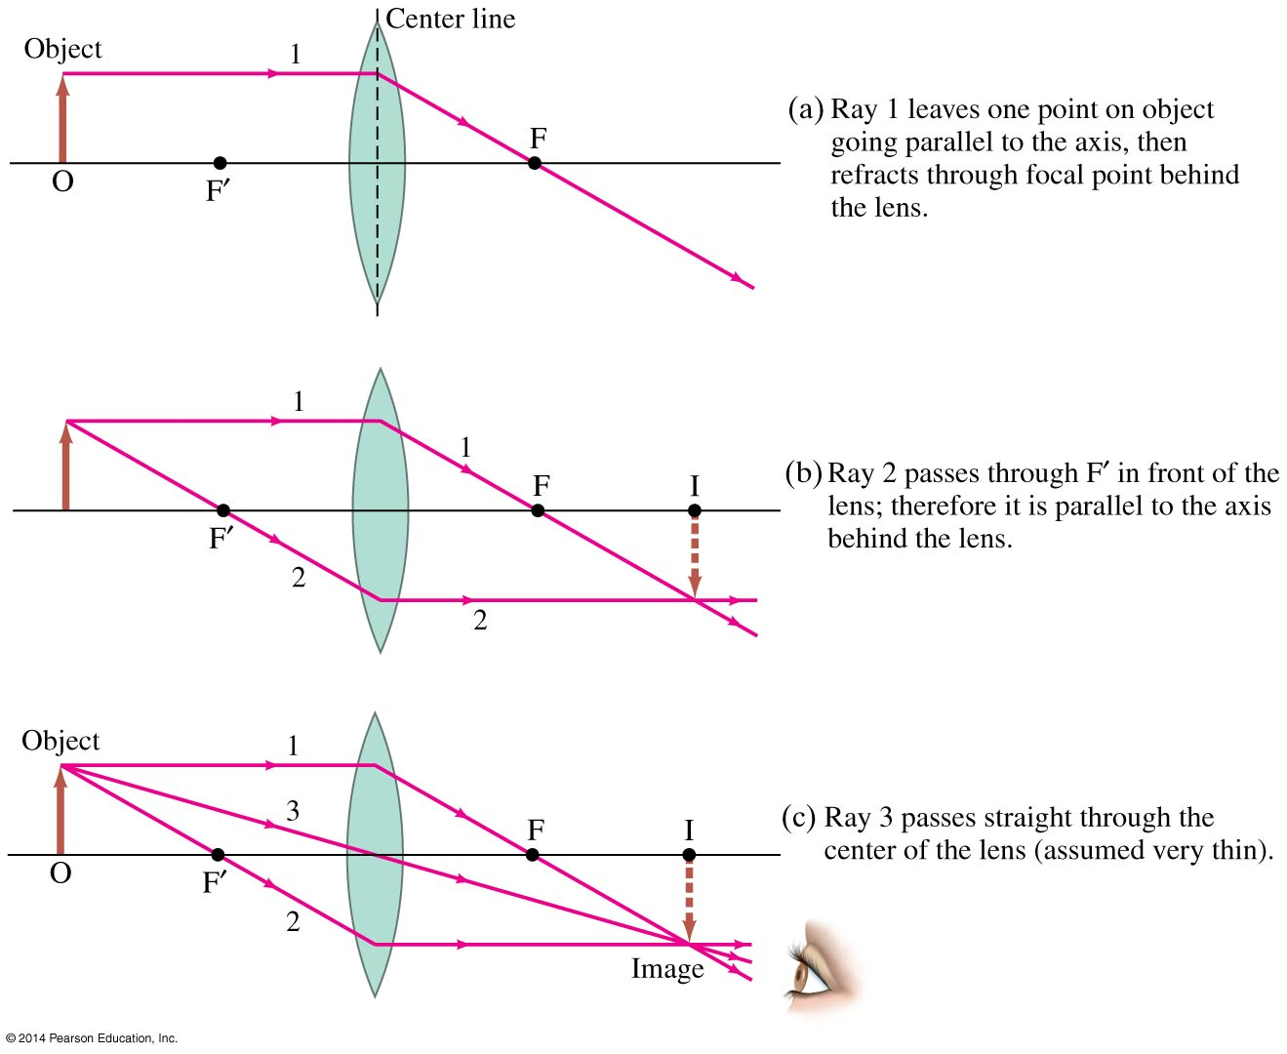
23-7 Thin Lenses; Ray Tracing

Slide 39
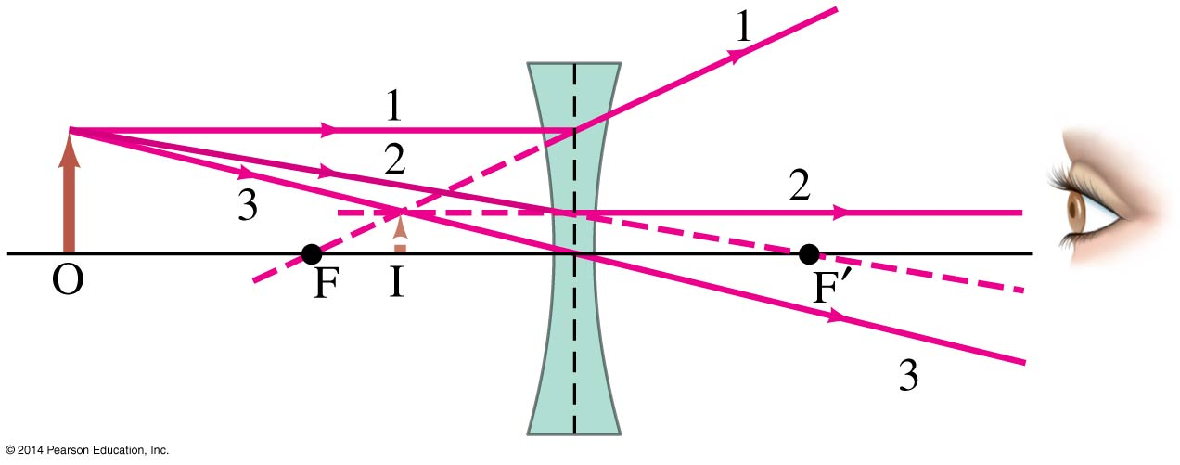
23-7 Thin Lenses; Ray Tracing
For a diverging lens, we can use the same three rays; the image is upright and virtual.

Slide 40
23-8 The Thin Lens Equation
The thin lens equation is the same as the mirror equation:
(23-8)

Slide 41
23-8 The Thin Lens Equation
The sign conventions are slightly different:
The focal length is positive for converging lenses and negative for diverging.
The object distance is positive when the object is on the same side as the light entering the lens (not an issue except in compound systems); otherwise it is negative.
The image distance is positive if the image is on the opposite side from the light entering the lens; otherwise it is negative.
The height of the image is positive if the image is upright and negative otherwise.

Slide 42
23-8 The Thin Lens Equation
The magnification formula is also the same as that for a mirror:
The power of a lens is positive if it is converging and negative if it is diverging.
(23-9)

Slide 43
23-8 The Thin Lens Equation
Problem Solving: Thin Lenses
Draw a ray diagram. The image is located where the key rays intersect.
Solve for unknowns.
Follow the sign conventions.
Check that your answers are consistent with the ray diagram.

Slide 44
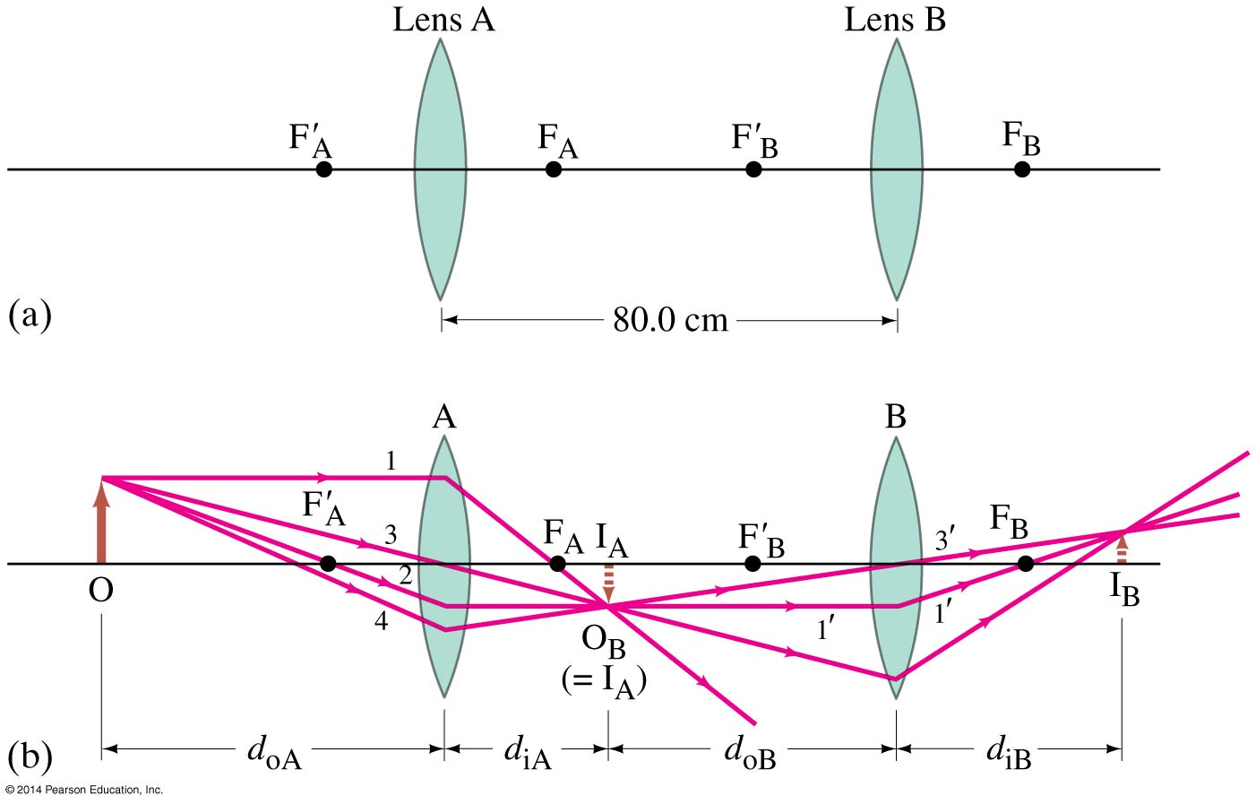
23-9 Combinations of Lenses
In lens combinations, the image formed by the first lens becomes the object for the second lens (this is where object distances may be negative).

Slide 45
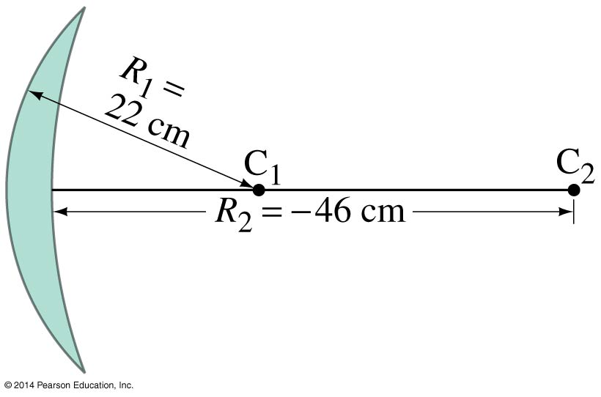
23-10 Lensmaker’s Equation
This useful equation relates the radii of curvature of the two lens surfaces, and the index of refraction, to the focal length. This useful equation relates the radii of curvature of the two lens surfaces, and the index of refraction, to the focal length.
(23-10)

Slide 46
Summary of Chapter 23
Light paths are called rays
Index of refraction:
Angle of reflection equals angle of incidence
Plane mirror: image is virtual, upright, and the same size as the object
Spherical mirror can be concave or convex
Focal length of the mirror:

Slide 47
Summary of Chapter 23
Mirror equation:
Magnification:
Real image: light passes through it
Virtual image: light does not pass through

Slide 48
Summary of Chapter 23
Law of refraction (Snell’s law):
Total internal reflection occurs when angle of incidence is greater than critical angle:
A converging lens focuses incoming parallel rays to a point

Slide 49
Summary of Chapter 23
A diverging lens spreads incoming rays so that they appear to come from a point
Power of a lens:
Thin lens equation:
Magnification:

