Slide 1
University Physics with Modern Physics
Fifteenth Edition
Chapter 5
Applying Newton’s Laws
Copyright © 2020 Pearson Education, Inc. All Rights Reserved

Slide 2
Learning Outcomes
In this chapter, you’ll learn…
how to use Newton’s first law to solve problems involving the forces that act on an object in equilibrium.
how to use Newton’s second law to solve problems involving the forces that act on an accelerating object.
The nature of the different types of friction forces and how to solve problems that involve these forces.
How to solve problems involving the forces that act on an object moving along a circular path.
the key properties of the four fundamental forces of nature.

Slide 3
Introduction
Newton’s three laws of motion can be stated very simply, but applying these laws to real-life situations requires analytical skills and problem-solving techniques.
In this chapter we’ll begin with equilibrium problems, in which we analyze the forces that act on an object that is at rest or moving with constant velocity.
We’ll then consider objects that are not in equilibrium, for which we’ll have to deal with the relationship between forces and motion.

Slide 4
Using Newton's First Law When Forces Are in Equilibrium
An object is in equilibrium when it is at rest or moving with constant velocity in an inertial frame of reference.
The essential physical principle is Newton’s first law:

Slide 5
Problem-Solving Strategy for Equilibrium Situations (1 of 2)
Identify the main concept: You must use Newton’s first law.
Set up the problem by using the following steps:
Draw a sketch of the physical situation.
Draw a free-body diagram for each object that is in equilibrium.
Ask yourself what is interacting with the object by contact or in any other way. If the mass is given, use w = mg to find the weight.
Check that you have only included forces that act on the object.
Choose a set of coordinate axes and include them in your free-body diagram.

Slide 6
Problem-Solving Strategy for Equilibrium Situations (2 of 2)
Execute the solution as follows:
Find the components of each force along each of the object’s coordinate axes.
Set the sum of all x-components of force equal to zero. In a separate equation, set the sum of all y-components equal to zero.
If there are two or more objects, repeat all of the above steps for each object. If the objects interact with each other, use Newton’s third law to relate the forces they exert on each other.
Make sure that you have as many independent equations as the number of unknown quantities. Then solve these equations to obtain the target variables.
Evaluate your answer.
Video Tutor Solution: Example 5.6

Slide 7
Using Newton's Second Law: Dynamics of Particles
In dynamics problems, we apply Newton’s second law to objects on which the net force is not zero.
These objects are not in equilibrium and hence are accelerating:

Slide 8
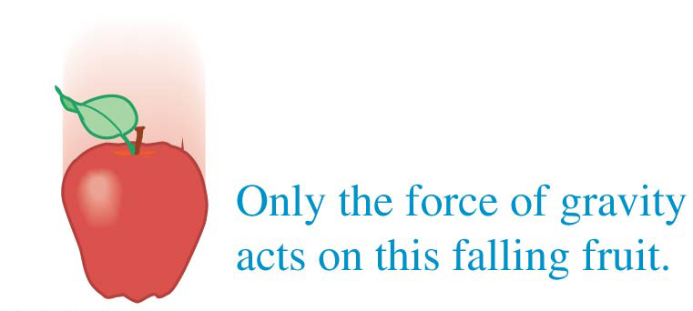
A Note on Free-Body Diagrams (1 of 3)
does not belong in a free-body diagram.

Slide 9
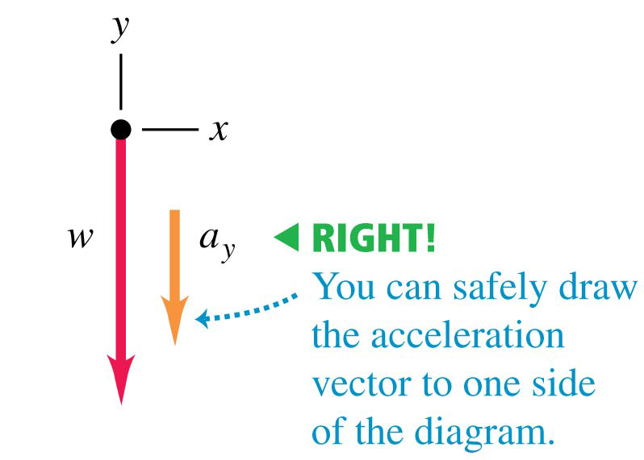
A Note on Free-Body Diagrams (2 of 3)
Correct free-body diagram

Slide 10
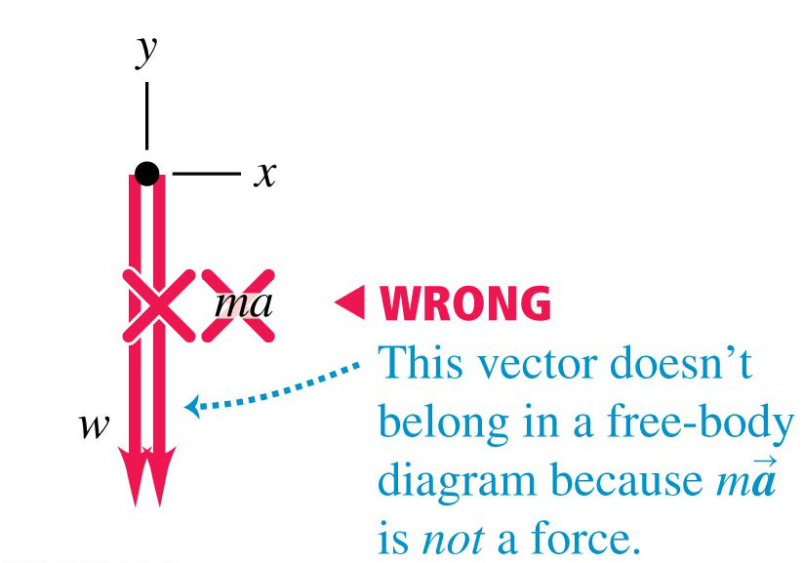
A Note on Free-Body Diagrams (3 of 3)
Incorrect free-body diagram

Slide 11
Problem-Solving Strategy for Dynamics Situations (1 of 2)
Identify the relevant concept: You must use Newton’s second law.
Set up the problem by using the following steps:
Draw a simple sketch of the situation that shows each moving object. For each object, draw a free-body diagram that shows all the forces acting on the object.
Label each force. Usually, one of the forces will be the object’s weight w = mg.
Choose your x- and y-coordinate axes for each object, and show them in your free-body diagram.
Identify any other equations you might need. If more than one object is involved, there may be relationships among their motions; for example, they may be connected by a rope.

Slide 12
Problem-Solving Strategy for Dynamics Situations (2 of 2)
Execute the solution as follows:
For each object, determine the components of the forces along each of the object’s coordinate axes.
List all of the known and unknown quantities. In your list, identify the target variable or variables.
For each object, write a separate equation for each component of Newton’s second law. Write any additional equations that you identified in step 4 of “Set Up.” (You need as many equations as there are target variables.)
Do the easy part—the math! Solve the equations to find the target variable(s).
Evaluate your answer.

Slide 13
Apparent Weight and Apparent Weightlessness
When a passenger with mass m rides in an elevator with y-acceleration a_{y}, a scale shows the passenger’s apparent weight to be: n = m(g + a_{y})
The extreme case occurs when the elevator has a downward acceleration a_{y} = −g — that is, when it is in free fall.
In that case n = 0 and the passenger seems to be weightless.
Similarly, an astronaut orbiting the earth with a spacecraft experiences apparent weightlessness.

Slide 14
Frictional Forces (1 of 3)
There is friction between the feet of this caterpillar (the larval stage of a butterfly of the family Papilionidae) and the surfaces over which it walks.
Without friction, the caterpillar could not move forward or climb over obstacles.

Slide 15
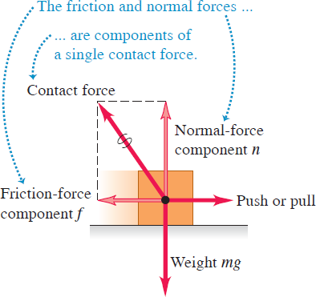
Frictional Forces (2 of 3)
When an object rests or slides on a surface, the friction force is parallel to the surface.

Slide 16
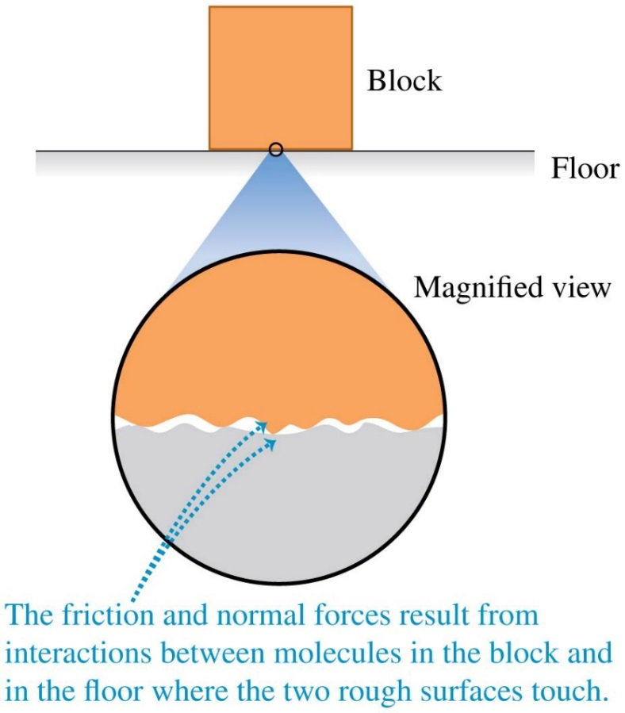
Frictional Forces (3 of 3)
Friction between two surfaces arises from interactions between molecules on the surfaces.

Slide 17
Kinetic and Static Friction
Kinetic friction acts when an object slides over a surface.
The kinetic friction force is
Static friction acts when there is no relative motion between objects.
The static friction force can vary between zero and its maximum value:

Slide 18
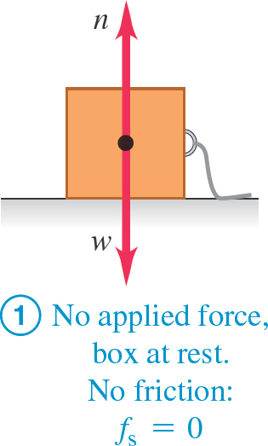
Static Friction Followed by Kinetic Friction (1 of 5)
Before the box slides, static friction acts. But once it starts to slide, kinetic friction acts.

Slide 19
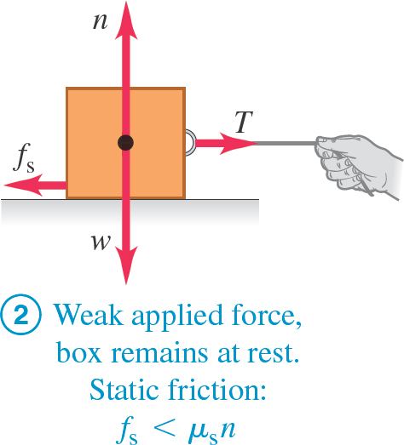
Static Friction Followed by Kinetic Friction (2 of 5)
Before the box slides, static friction acts. But once it starts to slide, kinetic friction acts.

Slide 20
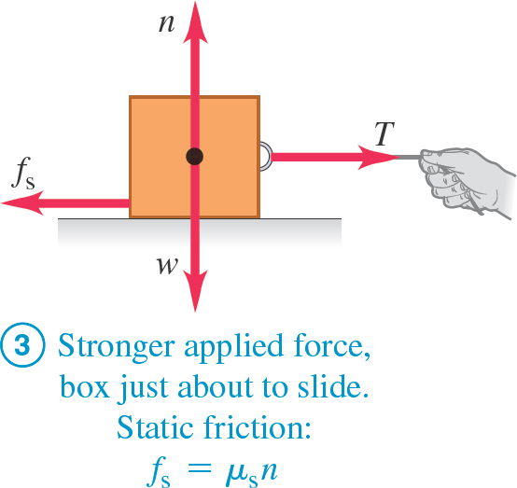
Static Friction Followed by Kinetic Friction (3 of 5)
Before the box slides, static friction acts. But once it starts to slide, kinetic friction acts.

Slide 21
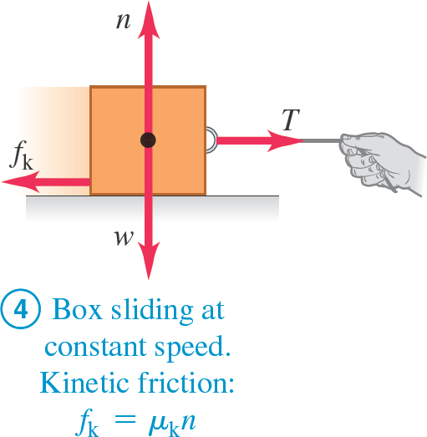
Static Friction Followed by Kinetic Friction (4 of 5)
Before the box slides, static friction acts. But once it starts to slide, kinetic friction acts.
Video Tutor Solution: Example 5.13

Slide 22
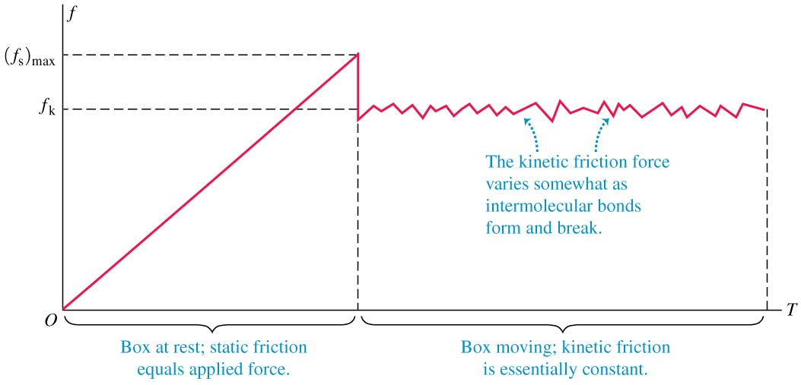
Static Friction Followed by Kinetic Friction (5 of 5)
Before the box slides, static friction acts. But once it starts to slide, kinetic friction acts.

Slide 23
Some Approximate Coefficients of Friction
Materials | Coefficient of Static Friction, mu sub s | Coefficient of Kinetic Friction, mu sub k
Steel on steel | 0.74 | 0.57
Aluminum on steel | 0.61 | 0.47
Copper on steel | 0.53 | 0.36
Brass on steel | 0.51 | 0.44
Zinc on cast iron | 0.85 | 0.21
Copper on cast iron | 1.05 | 0.29
Glass on glass | 0.94 | 0.40
Copper on glass | 0.68 | 0.53
Teflon on Teflon | 0.04 | 0.04
Teflon on steel | 0.04 | 0.04
Rubber on concrete (dry) | 1.0 | 0.8
Rubber on concrete (wet) | 0.30 | 0.25

Slide 24
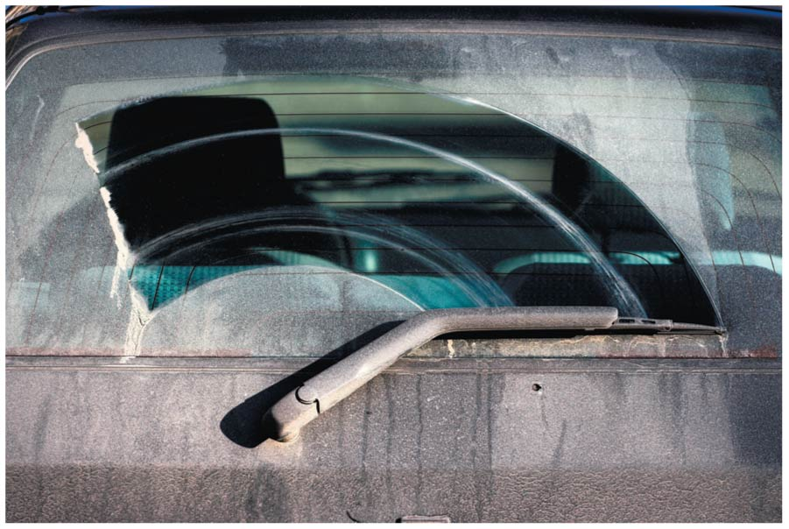
Static Friction and Windshield Wipers
The squeak of windshield wipers on dry glass is a stick-slip phenomenon.
The moving wiper blade sticks to the glass momentarily, then slides when the force applied to the blade by the wiper motor overcomes the maximum force of static friction.
When the glass is wet from rain or windshield cleaning solution, friction is reduced and the wiper blade doesn’t stick.

Slide 25
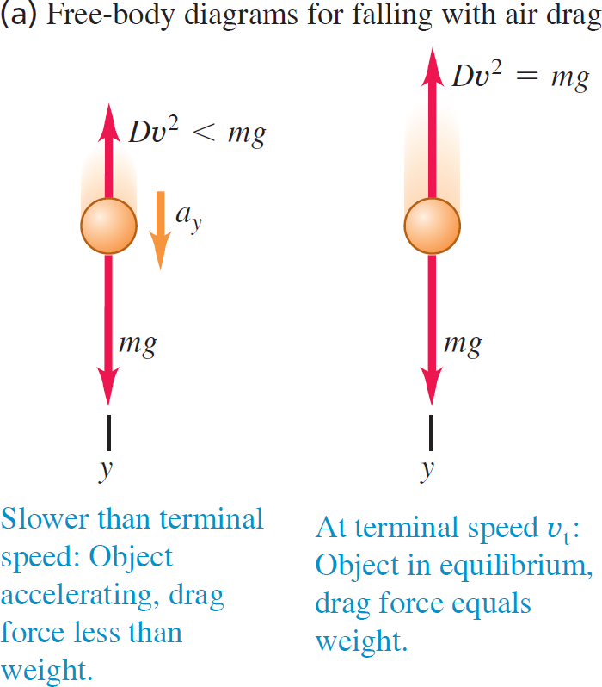
Fluid Resistance and Terminal Speed (1 of 2)
The fluid resistance acting on an object depends on the speed of the object.
A falling object reaches its terminal speed when the resisting force equals the weight of the object.
The figures at the right illustrate the effects of air drag.

Slide 26
Fluid Resistance and Terminal Speed (2 of 2)

Slide 27
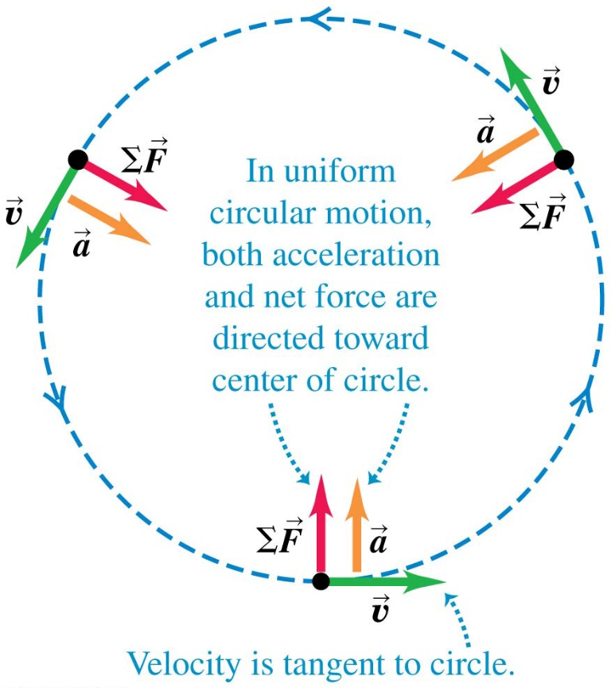
Dynamics of Circular Motion
If a particle is in uniform circular motion, both its acceleration and the net force on it are directed toward the center of the circle.
The net force on the particle is

Slide 28
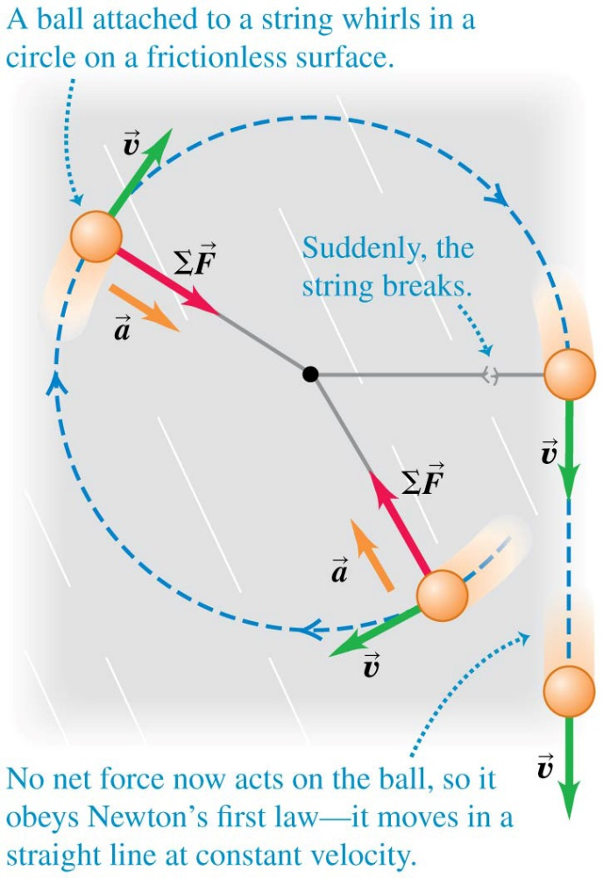
What If the String Breaks?
If the string breaks, no net force acts on the ball, so it obeys Newton’s first law and moves in a straight line.
Video Tutor Demonstration: Ball Leaves Circular Track

Slide 29
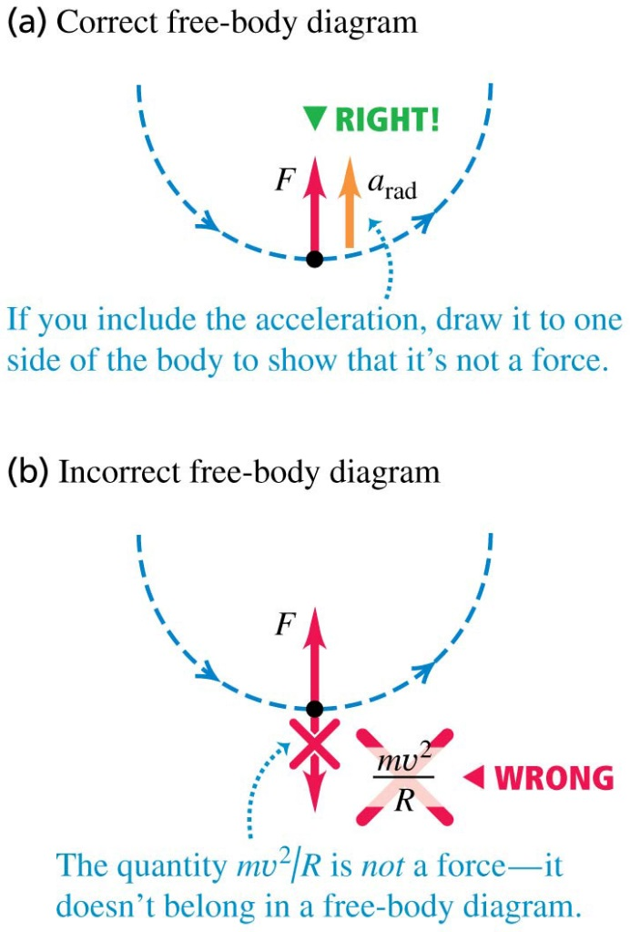
Avoid Using "Centrifugal Force"
Figure (a) shows the correct free-body diagram for an object in uniform circular motion.
Figure (b) shows a common error.
In an inertial frame of reference, there is no such thing as “centrifugal force.”

Slide 30
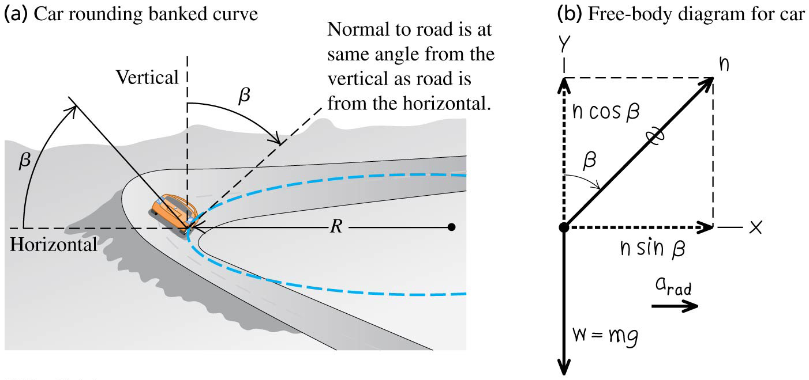
A Car Rounds a Banked Curve
At what angle should a curve be banked so a car can make the turn even with no friction?
Follow Example 5.22.

Slide 31
The Fundamental Forces of Nature
According to current understanding, all forces are expressions of four distinct fundamental forces:
gravitational interactions
electromagnetic interactions
the strong interaction
the weak interaction
Physicists have taken steps to unify all interactions into a theory of everything.

