Slide 1
Evaluation of protein alignments
Usman Roshan
BNFO 236

Slide 2
Gap penalties
How do we pick gap parameters to produce meaningful protein sequence alignments?
We use “true” alignments created manually (with some computational input) and with structure information
Recall that proteins have 3-D structure. We use the structure to manually align the proteins and then select gap penalties that maximize similarity of computed alignment to true ones.
Since Needleman-Wunsch is not convex or even differentiable we will use cross-validation to determine the best gap penalty

Slide 3
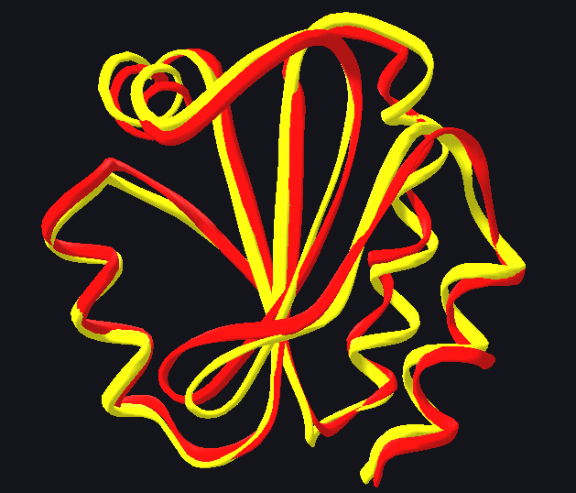
Structural alignment - example 1
Alignment of thioredoxins from
human and fly taken from the
Wikipedia website. This protein
is found in nearly all organisms
and is essential for mammals.
PDB ids are 3TRX and 1XWC.

Slide 4
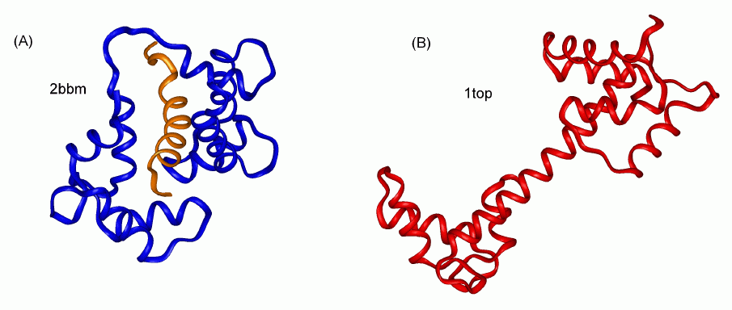
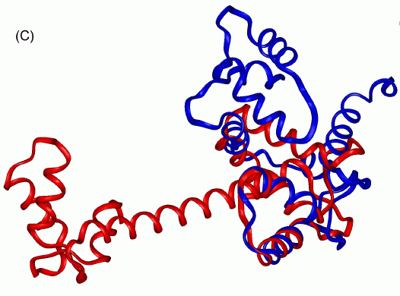
Structural alignment - example 2
Taken from http://bioinfo3d.cs.tau.ac.il/Align/FlexProt/flexprot.html
Unaligned proteins.
2bbm and 1top are
proteins from fly and
chicken respectively.
Computer generated
aligned proteins

Slide 5
Benchmark alignments
Protein alignment benchmarks
BAliBASE, SABMARK, PREFAB, HOMSTRAD are frequently used in studies for protein alignment.
Proteins benchmarks are generally large and have been in the research community for sometime now.
BAliBASE 3.0

Slide 6
Comparison of two alignments
How can we quantify the “correctness” of a test alignment with respect to a reference?
We measure the number of pairs in the test that are also aligned in the reference alignment.
This is also called the sum-of-pairs accuracy.
Instead of writing this ourselves we will use the qscore program from Bob Edgar at drive5.com and also posted on class website

