Slide 1
K-means based feature learning for protein sequence classification
Usman Roshan
Department of Computer Science
New Jersey Institute of Technology

Slide 2
Background
We consider the problem of protein sequence classification
Problem: Given a protein sequence determine its classification
The classification contains information about protein structure and function that is useful in biology and medicine

Slide 3
Background
A straightforward method is to use BLAST or Smith-Waterman and assign proteins based on their similarity scores
Machine learning methods have been explored for this problem since the 1990’s with neural networks and hidden Markov models
Methods based on support vector machines have been highly successful and among the state of the art

Slide 4
Background
The general approach to classify proteins with machine learning:
First convert protein sequences into feature vectors of a fixed dimensional space
Then apply a classifier such as support vector machine
Protein sequence representation in feature space is a key problem here
Depending upon how we represent the protein we can get very different results
Previous methods
Spectrum kernel
Empirical kernel with Pairwise BLAST and Smith-Waterman scores

Slide 5
Previous methods
Spectrum kernel:
We count number of kmers for fixed k.
Gives us a sparse high dimensional representation (upto 23^{k} features)
For example suppose k=3 and we want to convert ACGA into a feature vector
The feature vector will have all coordinates 0 except for positions corresponding to ACG and CGA that will have 1.

Slide 6
Previous methods
Empirical kernel map:
Represent a protein with similarity scores against a reference set
If reference contains m proteins then this is the dimensionality of the new feature space
For example suppose we have three reference proteins: ACYA, ACTT, and GCYT
If we let similarity be the number of matches then the feature vector for ACAT would be (3, 3, 2)
In practice the reference set is large and BLAST or Smith-Waterman similarity scores are used

Slide 7
Our method
Inspired by feature learning for images (Coates et. al. AISTATS 2011)
Overview:
Extract all m by m patches from images with a fixed stride s
Perform k-means clustering on all patches (K-means is fast and accurate clustering method, highly popular in machine learning, requires no labels)
Determine feature vectors for each patch from the clustering
Add vectors for all patches belonging to the same image to obtain a feature vector for the image
Now apply support vector machine

Slide 8
Our method
Extract all substrings of length w and stride s from each protein sequence with sliding window method
Perform k-means clustering on all such fragments for k clusters (String k-means clustering shown later)
Now we construct a feature vector f for each fragment:
Each fragment feature vector is of dimension k (number of clusters)
We set f[j] = 1 if the fragment is in cluster j
To obtain the feature vector for a protein sequence we add feature vectors of all its fragments. Let f₁,…,f_{m} be the m fragments of a protein sequence s. Then the feature vector for s is Σ_{i} f_{i}
The aim is to have proteins that are similar to have similar feature vectors and thus classified into the same category

Slide 9
Suppose we have four protein sequences belonging to two classes
Class 1: ACYGPA, TCYGPG
Class 2: ACYHKA, ACYHPG
We fragment each protein with width
3 and stride 1
ACYGPA → ACY, CYG, YGP, GPA
TCYGPG → TCY, CYG, YGP, GPG
ACYHKA → ACY, CYH, YHK, HKA
ACYHPG → ACY, CYH, YHP, HBG
Add features of fragments to get vectors of original sequences
ACYGPA: (1, 1, 1, 0, 1, 0)
TCYGPG: (1, 1, 1, 0, 1, 0)
ACYHKA: (1, 1, 0, 1, 0, 1)
ACYHPG: (1, 1, 0, 1, 0, 1)
We can see that the two similar proteins in each class have identical feature vectors
ACY: (1, 0, 0, 0, 0, 0)
TCY: (1, 0, 0, 0, 0, 0)
CYG: (0, 1, 0, 0, 0, 0)
CYH: (0, 1, 0, 0, 0, 0)
YGP: (0, 0, 1, 0, 0, 0)
YHP: (0, 0, 0, 1, 0, 0)
HKA: (0, 0, 0, 0, 0, 1)
We create feature vectors for each
fragment (all fragments now shown here)
Perform string k-means clustering on the fragments. The centroid is the mode in each position and distance is negative Hamming. Suppose we have six clusters below:
1
2
ACY
TCY
ACY
ACY
CYG
CYG
CYH
CYH
3
5
YGP
YGP
GPA
GPG
6
4
HKA
HBG
YHK
YHP

Slide 10
String k-means clustering
We wish to cluster protein fragments directly but k-means generally requires numerical feature vectors
Thus we propose a string k-means
We make two modifications to the original k-means:
Centroid: We use the mode at each sequence position. For example if a cluster has ACG, ACC, ATC then the mode is ACC
Distance between fragments: We use the negative Hamming distance.
We find that a few iterations of our string k-means gives a decent clustering (in the context of our problem)

Slide 11
Our method
From the example in the previous slides we see that increasing the number of clusters would give better feature vectors
More clusters will slow down k-means
Instead of the negative Hamming distance we also consider a negative BLOSUM distance (biologically sound)

Slide 12
Experimental performance study
Parallel Python implementation available at http://web.njit.edu/~usman/kmeans_fl_protein/
Experimental platform: Intel Xeon E5-2630-v4 20 core processors
Data: Protein sequences from four large protein databases (Sonego et. al., Nucleic Acids Research 2007)
Each datasets has several classification tasks. Classes are formed based on family, superfamily, phyla kingdom, homology, and architecture

Slide 13
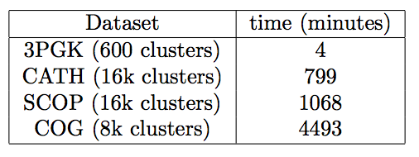
Experimental performance study
We cluster all proteins in each dataset separately. Both train and test sequences are included in the clustering. Remember that k-means is unsupervised and requires no labels.
Runtime is proportional to dataset size
We then learn a support vector machine (with Python scikit-learn) on training and predict on test for each task
We use the ROC area under curve as a measure of accuracy
This is between 0 and 1 and roughly speaking measures the probability of ranking a positive instance higher than a negative instance

Slide 14
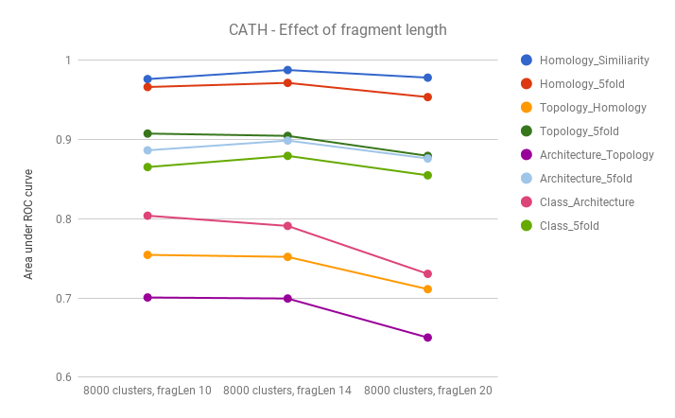
Results: Effect of window length (stride = 1)

Slide 15
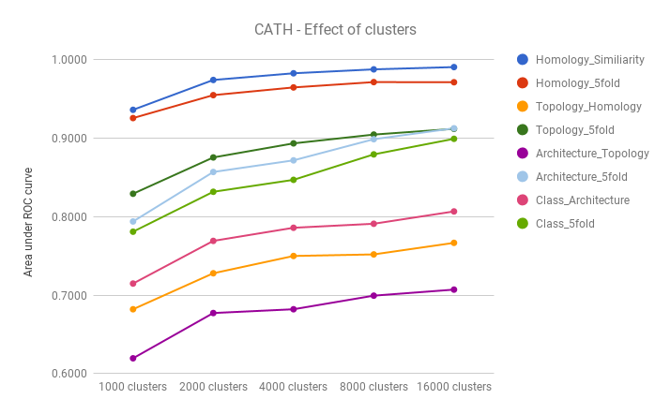
Results: Effect of number of clusters

Slide 16
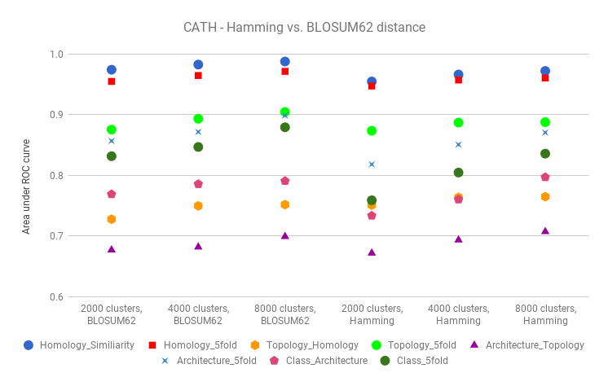
Results: Effect of Hamming vs BLOSUM in string k-means

Slide 17
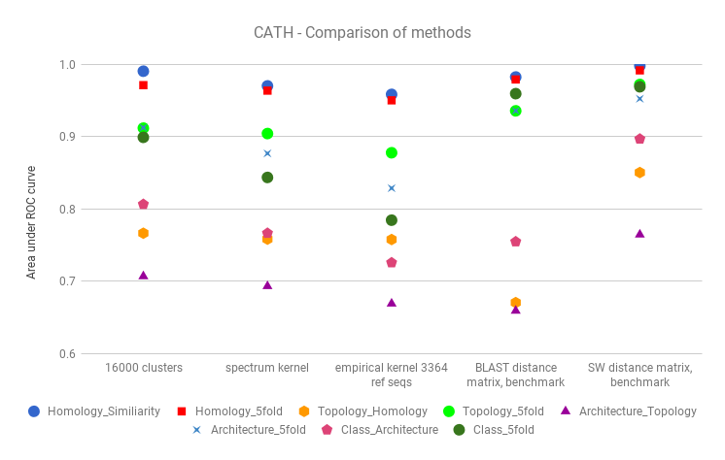
Results: Comparison to other methods on CATH

Slide 18
Results: Comparison to other methods on CATH
Are the differences between our method and spectrum and empirical kernel significant?
We measure p-values given by the Wilcox rank test. If one method obtains better values than the other one across most of the classification tasks (1414 in total) then the p-value is small

Slide 19
Results: Comparison to other methods
On 3PGK and COG we see that our k-means based method obtains highest accuracies
The Smith-Waterman method does best on CATH and SCOP, however its runtime is much greater than our k-means based one

Slide 20
Results: Learning model on COG and predicting on CATH (generalization across datasets)
Suppose we obtain feature vectors for CATH protein sequences with the clustering (centroids) on COG (our largest dataset)
Can we still correctly classify CATH sequences even though the sequences were not used to create their feature vectors?

Slide 21
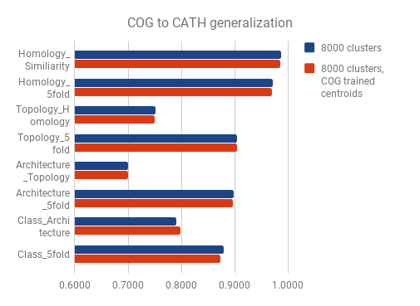
Results: Learning model on COG and predicting on CATH (generalization across datasets)

Slide 22
Discussion
Why does our method perform best on 3PGK and COG datasets but not on CATH and SCOP? Both 3PGK and COG have longer proteins, suggesting our method performs best on long sequences
Our string k-means uses the mode at a given column position for the centroid. Could we perform better if we used a profile of probabilities instead of the majority each time?
Can we extend this to metagenomics?
A major big data problem
Requires clustering millions of fragments of genome sequences

Slide 23
Discussion
Can we do sequence alignment classification with this method?
How does one deal with gaps?
How does one cluster protein alignment fragments?
What would the centroid be?
Major avenues of future work on-going in our lab

Slide 24
Acknowledgements
Paul Melman (MS Bioinformatics) wrote the code and performed all experiments
NJIT Academic and Research Computing (ARCS) support in running experiments

Slide 25
Conclusion
Initial work is promising
Moving forward requires more experimentation and dealing with big data challenges
Thank you
Questions?

