Slide 1
Disease risk prediction
Usman Roshan

Slide 2
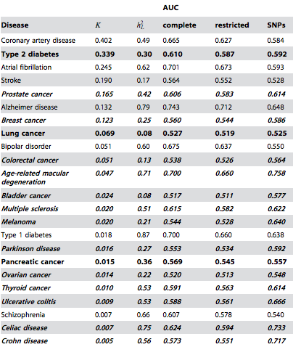
Disease risk prediction
Prediction of disease risk with genome wide association studies has yielded low accuracy for most diseases.
Family history competitive in most cases except for cancer (Do et. al., PLoS Genetics, 2012)

Slide 3
Disease risk prediction
Our own studies have shown limited accuracy with various machine learning methods
Univariate and multivariate feature selection
Multiple kernel learning
What accuracy can we achieve with machine learning methods applied to variants detected from whole exome data?

Slide 4
Chronic lymphocytic leukemia prediction with exome sequences and machine learning
We selected exome sequences of chronic lymphocytic leukemia from dbGaP. Largest at the time of download in August 2013. 186 cases and 169 controls
Case and control prediction accuracy with genetic variants unknown
Same dataset previously studied in Wang et. al., NEJM, 2011 where new associated genes are reported but no risk prediction

Slide 5
What is whole exome data?
Human genome sequence
Introns
Coding regions
Exons
Illumina 76bp short reads (exome data).
In practice flanking regions are also sequenced
and so some intronic regions are included.

Slide 6
Obtain structural variants (1)
Human genome reference sequence
Data of size 3.2 Terrabytes and 140X coverage
Mapped to human genome reference with BWA MEM (popular short read mapper)
Short reads are aligned to human genome

Slide 7
Human genome
reference
Short reads from a
single individual
ATTAA
ACCAG
ACCAG
ATTGA
ATTGA
ACCAG
ACCAG
ATT--A
ATTGA
ACCAG
ACCAG
ATT--A
ATTGA
ACCCG
ACCAG
ATT--A
ATTGA
ACCCG
ACCAG
ATTGA
ATTGA
ACCAG
ATTGA
ATTGA
Here no variant is reported but we detected it in a different individual. Thus we assign it a value of 0 for this individual.
ATTGA
Heterozygous
SNP encoded
as 1
Homozygous SNP
encoded as 2 (0 if
same as reference)
Heterozygous indel
encoded as 1
Encoded into a feature
vector of four dimensions
(2, 1, 0, 1)

Slide 8
Obtain structural variants (2)
ATTGA
ACCAG
ATTGA
ATTGA
ACCAG
Obtained SNPs and indels from the alignments for each individual
ATT--A
ATTGA
ACCAG
ATT--A
ATTGA
ACCAG
Short reads from a
single individual
ATT--A
Human genome
reference
ATTGA
ACCCG
ATTGA
ATTGA
ACCCG
ATTGA
ATTGA
ACCCG
ATTGA
Homozygous SNP
encoded as 1 (0 if
same as reference)
Heterozygous SNP
encoded as 1
Heterozygous indel
encoded as 1

Slide 9
Obtain structural variants (3)
A/C C/G A/C C/G
C0 AA CC C0 0 0
C1 AC CG C1 1 1
C2 AA GG C2 0 2
Co1 AC CG Co1 1 1
Co2 CC CG Co2 2 1
Combine variants from different individuals to form a data matrix
Each row is a case or control and each column is a variant
153 cases and 144 controls after excluding very large files and problematic datasets
122392 SNPs and 2200 indels
Numerically encoded

Slide 10
Perform cross-validation study
0 0 1 2 0 . . .
0 2 2 2 1 . . .
Split rows randomly into training validation sets (90:10 ratio).
Rank all variants on training
Learn support vector machine classifer on training data with top k ranked variants
Predict case and control on validation data.
Compute error and repeat 100 times
.
.
.
Training data
Validation data
Full dataset: each row
is a case or control
individual and each
column is a variant
(SNP or indel)

Slide 11
Variant ranking
F0 F1 F2 F1 F2 F0
C0 1 2 0 C0 2 0 1
C1 1 2 1 C1 2 1 1
C2 1 2 2 C2 2 2 1
Co1 1 0 1 Co1 0 1 1
Co2 2 0 0 Co2 0 0 2
Rank features

Slide 12
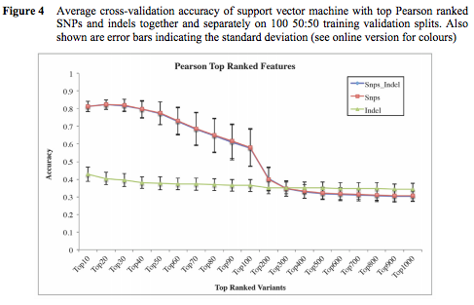
Risk prediction with Pearson ranked SNPs
Notes:
Similar curves with Pearson
Small k better than large k (k = number of variants)
SNPs better than indels
Top 60 SNPs mostly in chromosome 14

Slide 13
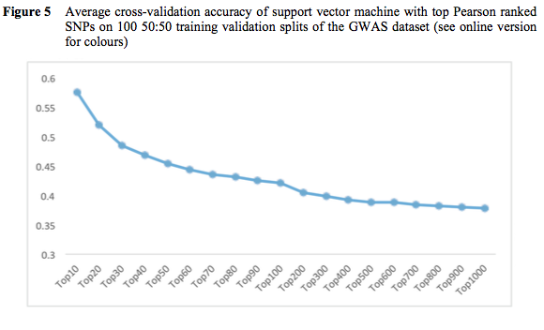
Prediction with GWAS

Slide 14
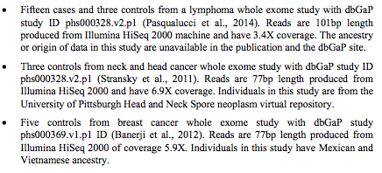
Cross-study validation

Slide 15
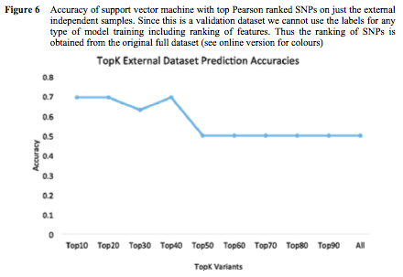
Prediction on external samples

Slide 16
Prediction on external samples

Slide 17
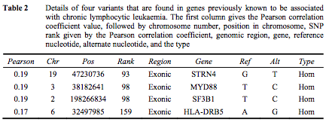
Pearson ranking of genes associated with CLL

Slide 18
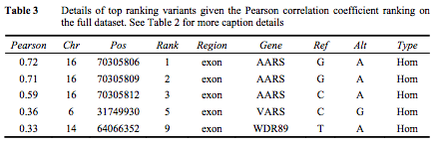
Analysis of top ranked Pearson genes

Slide 19
Conclusion
Encouraging results with exome data
No known risk prediction study with exome data
Limitations:
Small sample size
Ancestry of some data unknown

