Slide 1
Stacking
Usman Roshan

Slide 2
Stacking
A method to combine classifiers
Instead of majority vote or boosting use non-linearized outputs to create new features
Then apply a classifier on the new representation
Closely related to representation learning
“Stacked generalization”
Very little theory is known but works in practice

Slide 3
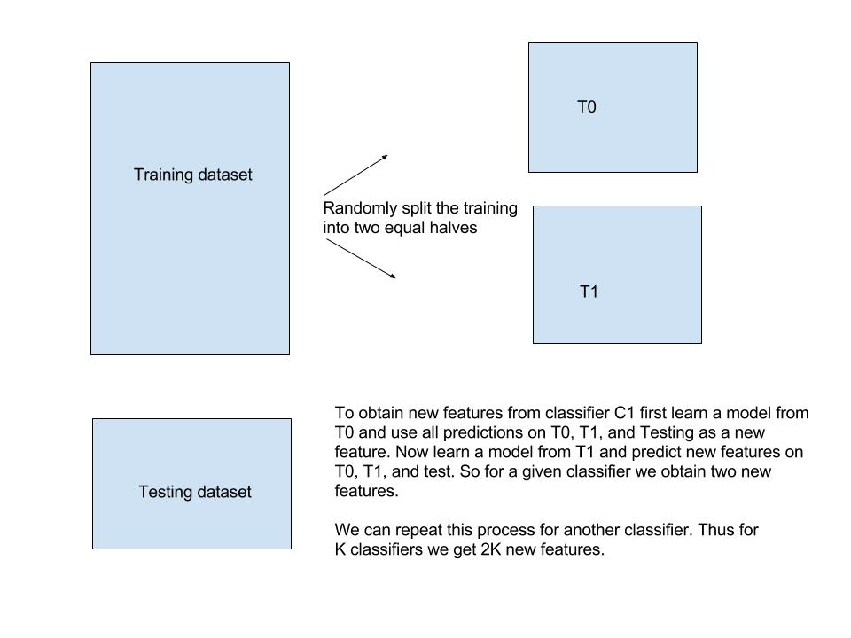
Stacking

Slide 4
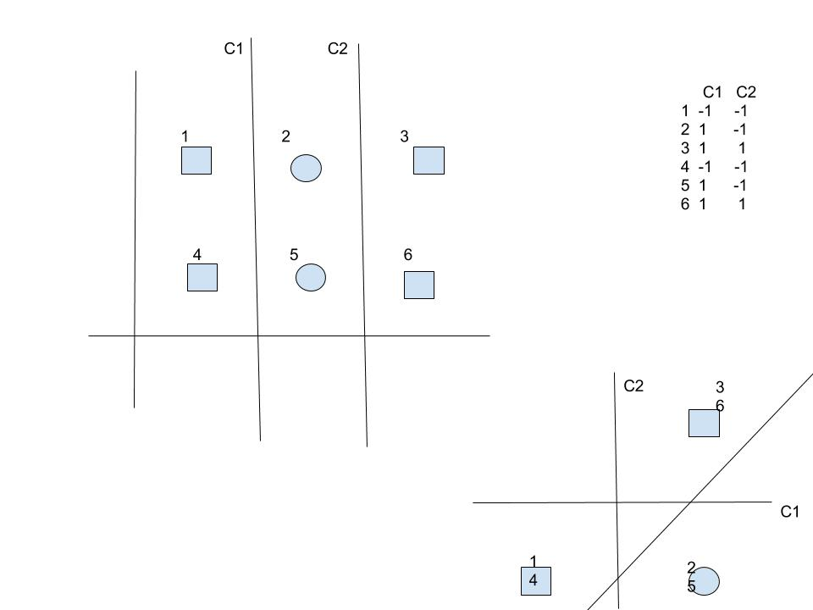
Stacking for non-linear classification

