Slide 1
Combining multiple learners
Usman Roshan

Slide 2
Bagging
Randomly sample training data
Determine classifier C_{i} on sampled data
Goto step 1 and repeat m times
For final classifier output the majority vote
Popular example: random forest
Similar to tree bagging
Compute decision trees on bootstrapped datasets
Return majority vote

Slide 3
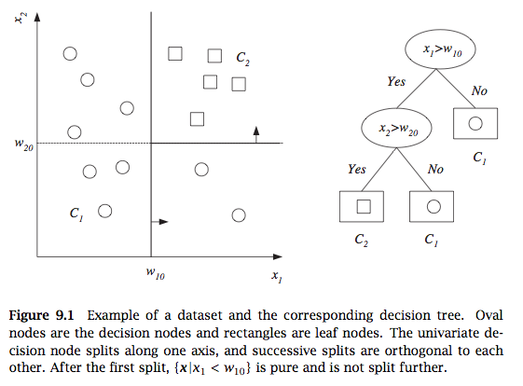
Decision tree
From Alpaydin, 2010

Slide 4
Decision tree construction
For a given dataset there are many trees with no error
Finding the tree with no error and fewest nodes is NP-complete
Greedy heuristic:
First best split.
Goodness of split given by entropy, gini index, or misclassification error
Example
Similar approach for regression – (regression trees)

Slide 5
Random forest
In addition to sampling datapoints (feature vectors) we also sample features
Compute many decision trees and output majority vote
Can also rank features
Comparison against SVM feature selection in genomic data
Alternative to bagging is to select datapoints with different probabilities that change in the algorithm

Slide 6
Boosting
Main idea:
Assign equal probabilities to training data
Randomly sample from training data and classify
Redo probabilities by assigning lower values to correctly classified points and higher to misclassified points
Go to step 2 and repeat
Perform final classification with weighted combination of classifiers

Slide 7
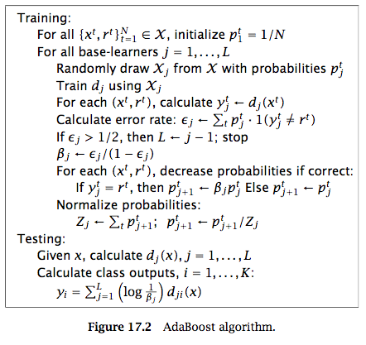
Ada-boost
From Alpaydin, 2010

Slide 8
AdaBoost

Slide 9
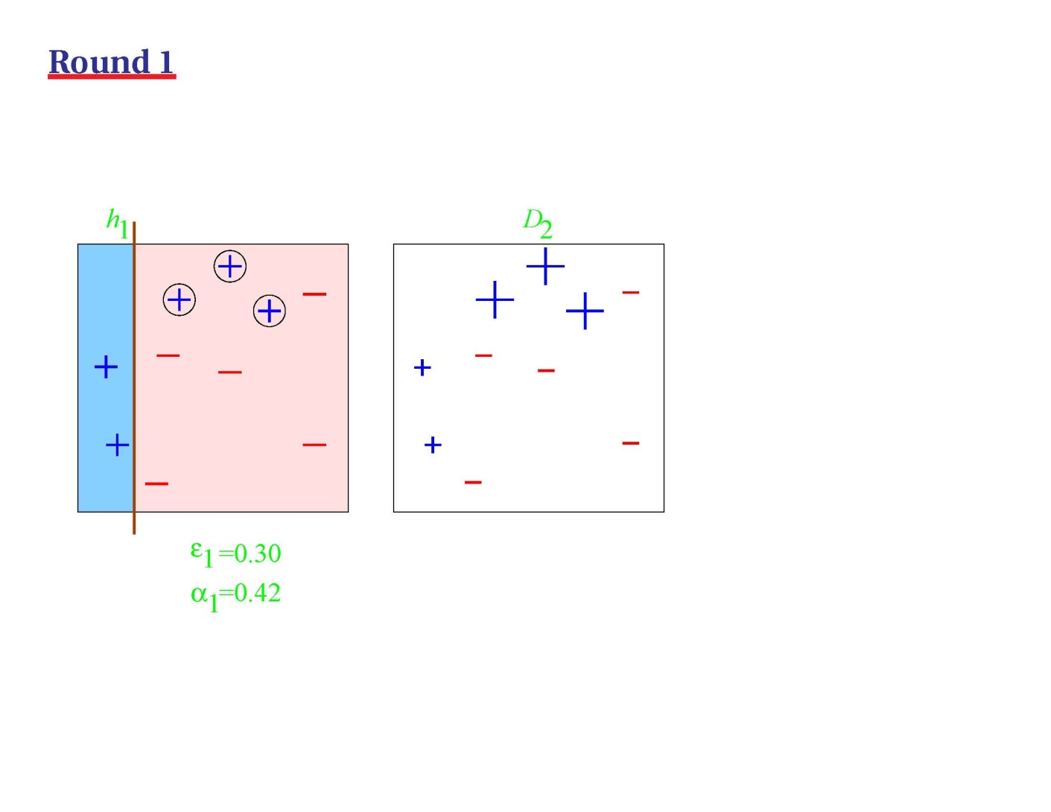
AdaBoost

Slide 10
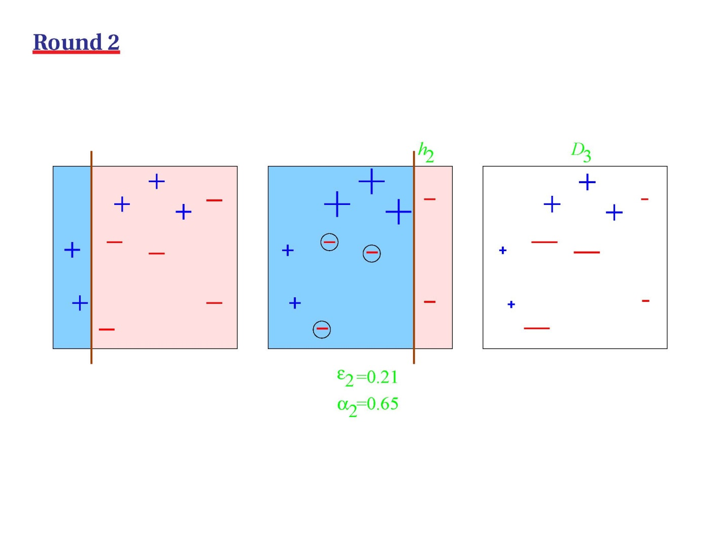
AdaBoost

Slide 11
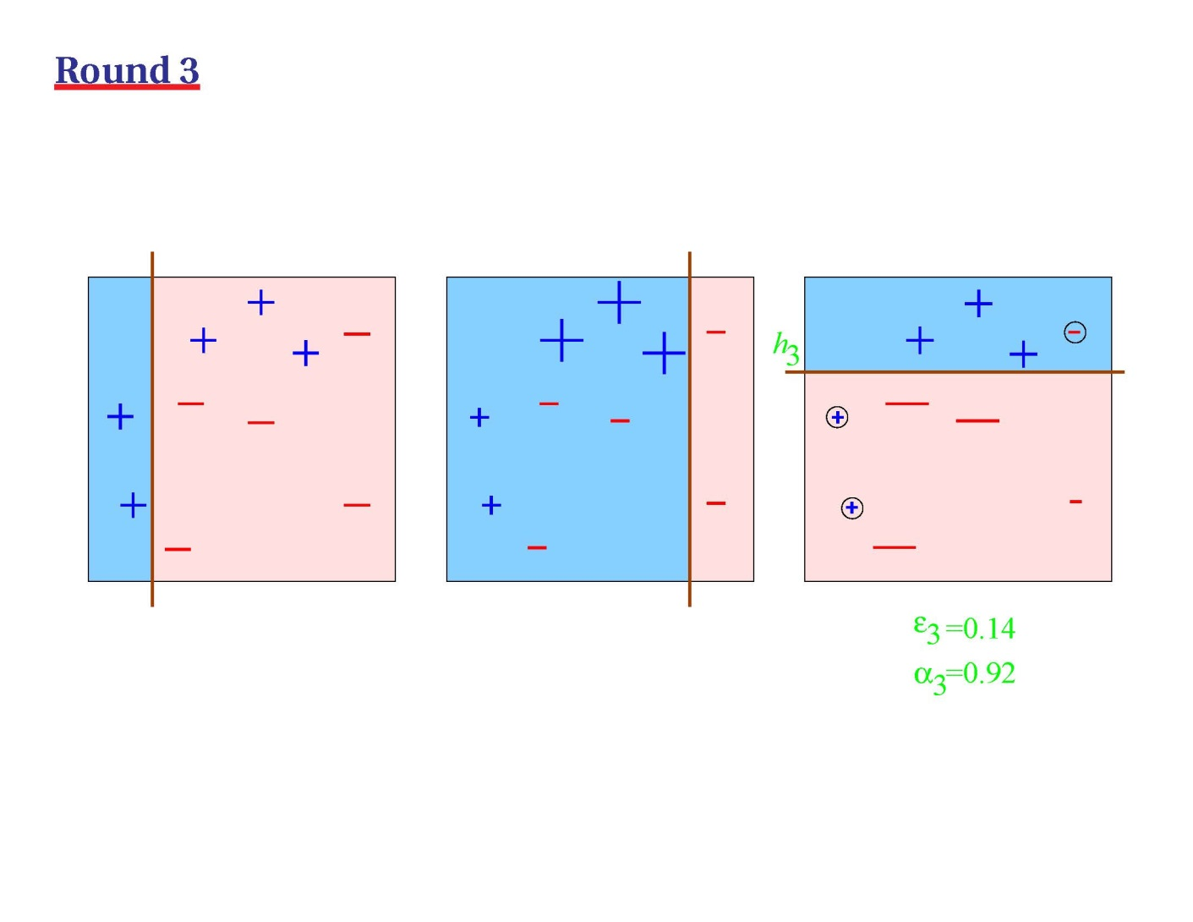
AdaBoost

Slide 12
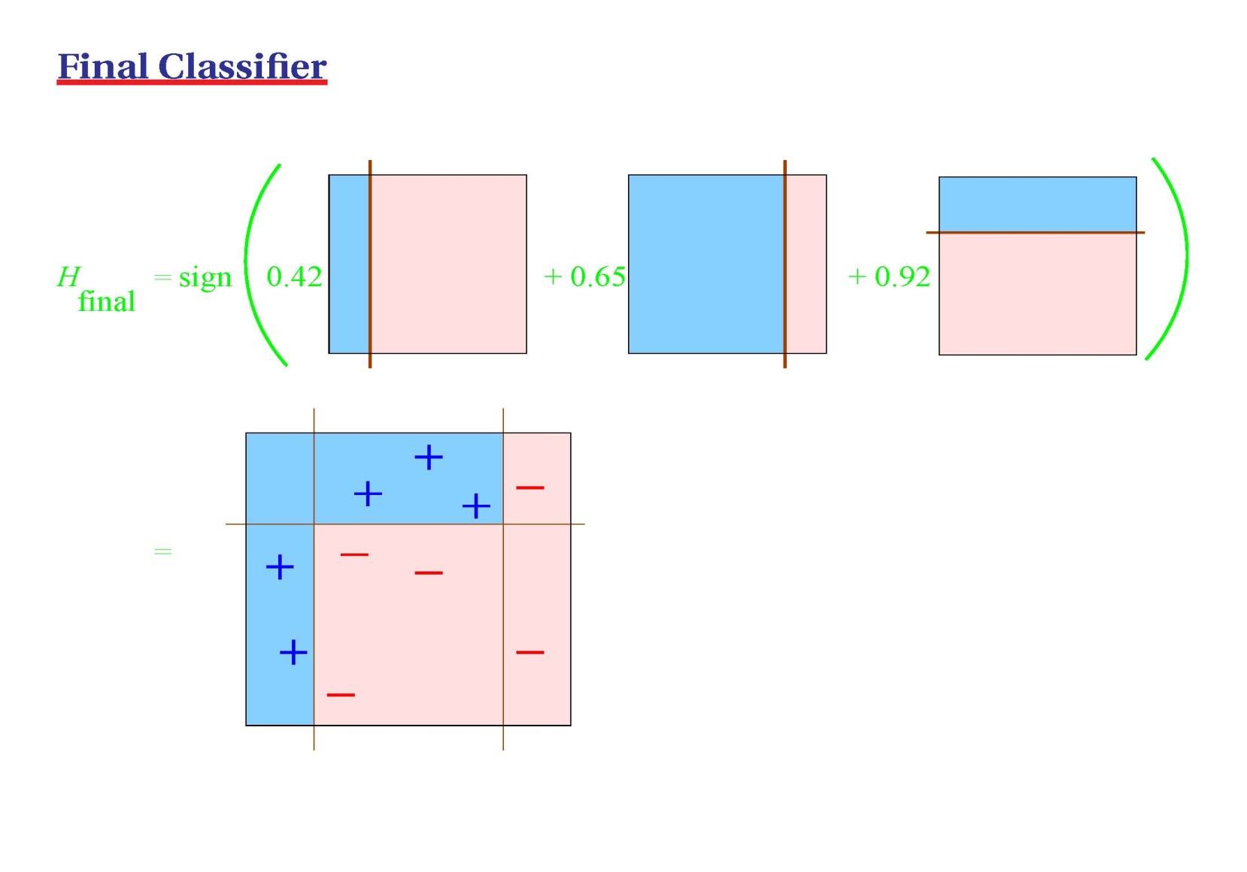
AdaBoost
Example thanks to Turki Turki

Slide 13
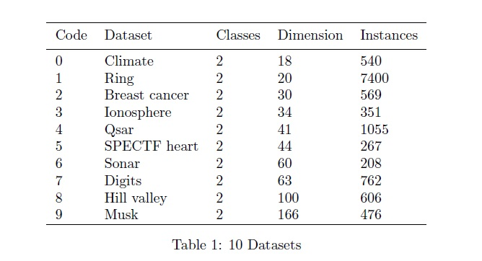
Datasets

Slide 14
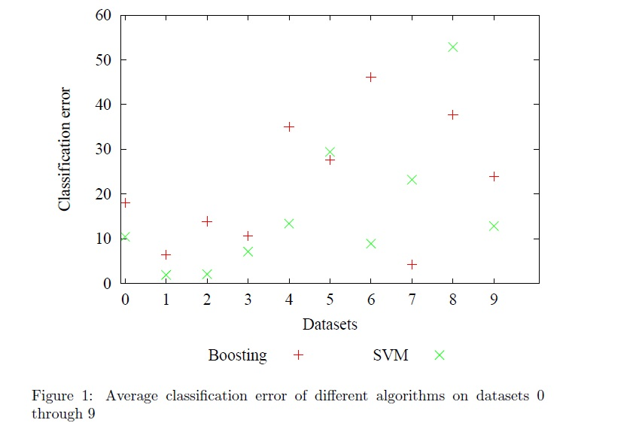
Results Classification Error plots

Slide 15
Conclusion
Average of All Average Errors
- SVM
10 Datasets=16.1961041%
- Boosting
10 Datasets=22.3489047%

