Slide 1
Dimensionality reduction
Usman Roshan
CS 675

Slide 2
Supervised dim reduction: Linear discriminant analysis
Fisher linear discriminant:
Maximize ratio of difference means to sum of variance

Slide 3
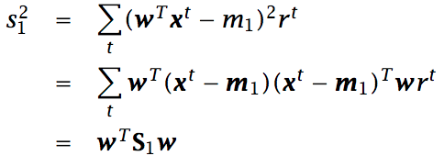
Linear discriminant analysis
Fisher linear discriminant:
Difference in means of projected data gives us the between-class scatter matrix
Variance gives us within-class scatter matrix

Slide 4
Linear discriminant analysis
Fisher linear discriminant solution:
Take derivative w.r.t. w and set to 0
This gives us w = cS_{w}⁻¹(m₁-m₂)

Slide 5
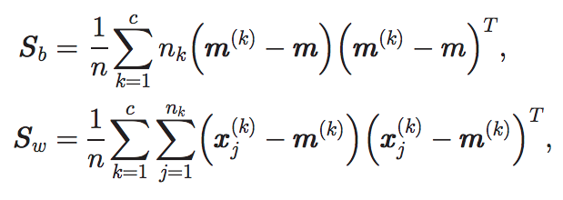
Scatter matrices
S_{b} is between class scatter matrix
S_{w} is within-class scatter matrix
S_{t} = S_{b} + S_{w} is total scatter matrix

Slide 6
Fisher linear discriminant
General solution is given by eigenvectors of S_{w}⁻¹S_{b}

Slide 7
Fisher linear discriminant
Problems can happen with calculating the inverse
A different approach is the maximum margin criterion

Slide 8
Maximum margin criterion (MMC)
Define the separation between two classes as
S(C) represents the variance of the class. In MMC we use the trace of the scatter matrix to represent the variance.
The scatter matrix is

Slide 9
Maximum margin criterion (MMC)
The scatter matrix is
The trace (sum of diagonals) is
Consider an example with two vectors x and y

Slide 10
Maximum margin criterion (MMC)
Plug in trace for S(C) and we get
The above can be rewritten as
Where S_{w} is the within-class scatter matrix
And S_{b} is the between-class scatter matrix

Slide 11
Weighted maximum margin criterion (WMMC)
Adding a weight parameter gives us
In WMMC dimensionality reduction we want to find w that maximizes the above quantity in the projected space.
The solution w is given by the largest eigenvector of the above

Slide 12
How to use WMMC for classification?
Reduce dimensionality to fewer features
Run any classification algorithm like nearest means or nearest neighbor.
Experimental results to follow.

Slide 13
K-nearest neighbor
Classify a given datapoint to be the majority label of the k closest points
The parameter k is cross-validated
Simple yet can obtain high classification accuracy

Slide 14
Weighted maximum variance (WMV)
Find w that maximizes the weighted variance

Slide 15
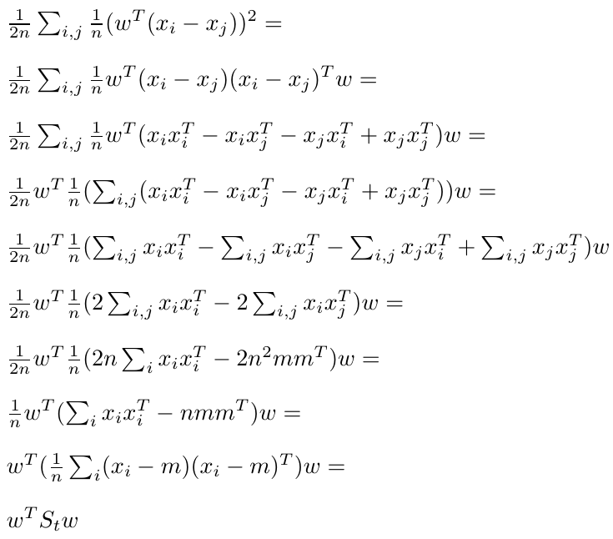
PCA via WMV
Reduces to PCA if C_{ij} = 1/n

Slide 16
MMC via WMV
Let y_{i} be class labels and let nk be the size of class k.
Let G_{ij} be 1/n for all i and j and L_{ij} be 1/n_{k} if i and j are in same class.
Then MMC is given by

Slide 17
MMC via WMV (proof sketch)

Slide 18
Graph Laplacians
We can rewrite WMV with Laplacian matrices.
Recall WMV is
Let L = D – C where D_{ii} = Σ_{j}C_{ij}
Then WMV is given by where X = [x₁, x₂, …, x_{n}] contains each x_{i} as a column.
w is given by largest eigenvector of XLX^{T}

Slide 19
Graph Laplacians
Widely used in spectral clustering (see tutorial on course website)
Weights C_{ij} may be obtained via
Epsilon neighborhood graph
K-nearest neighbor graph
Fully connected graph
Allows semi-supervised analysis (where test data is available but not labels)

Slide 20
Graph Laplacians
We can perform clustering with the Laplacian
Basic algorithm for k clusters:
Compute first k eigenvectors v_{i} of Laplacian matrix
Let V = [v₁, v₂, …, v_{k}]
Cluster rows of V (using k-means)
Why does this work?

Slide 21
Graph Laplacians
We can cluster data using the mincut problem
Balanced version is NP-hard
We can rewrite balanced mincut problem with graph Laplacians. Still NP-hard because solution is allowed only discrete values
By relaxing to allow real values we obtain spectral clustering.

Slide 22
Back to WMV – a two parameter approach
Recall that WMV is given by
Collapse C_{ij} into two parameters
C_{ij} = α < 0 if i and j are in same class
C_{ij} = β > 0 if i and j are in different classes
We call this 2-parameter WMV

Slide 23
Experimental results
To evaluate dimensionality reduction for classification we first extract features and then apply 1-nearest neighbor in cross-validation
20 datasets from UCI machine learning archive
Compare 2PWMV+1NN, WMMC+1NN, PCA+1NN, 1NN
Parameters for 2PWMV+1NN and WMMC+1NN obtained by cross-validation

Slide 24
Datasets

Slide 25
Results

Slide 26
Results

Slide 27
Results
Average error:
2PWMV+1NN: 9.5% (winner in 9 out of 20)
WMMC+1NN: 10% (winner in 7 out of 20)
PCA+1NN: 13.6%
1NN: 13.8%
Parametric dimensionality reduction does help

Slide 28
High dimensional data

Slide 29
High dimensional data

Slide 30
Results
Average error on high dimensional data:
2PWMV+1NN: 15.2%
PCA+1NN: 17.8%
1NN: 22%

