Slide 1
Comparison of classifiers
Usman Roshan
CS 675

Slide 2
Comparison of classifiers
Empirical comparison of supervised classifiers – ICML 2006
Do we need hundreds of classifiers – JMLR 2014

Slide 3
Empirical comparison of supervised classifiers – ICML 2006
Classifiers compared
SVM
ANN
Logreg
Naïve Bayes
KNN
Random forest
Decision trees
Bagged trees

Slide 4
Empirical comparison of supervised classifiers – ICML 2006
Performance metrics
Threshold metrics
Accuracy
F-score
Lift
Ordering/rank metrics
Area under curve (AUC)
Average precision
Precision/recall breakpoint
Probability metrics
Root mean square distance (RMSD)
Cross-entropy (MXE)

Slide 5
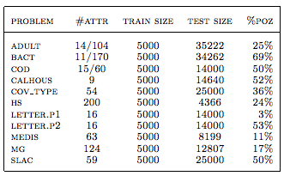
Empirical comparison of supervised classifiers – ICML 2006
Datasets

Slide 6
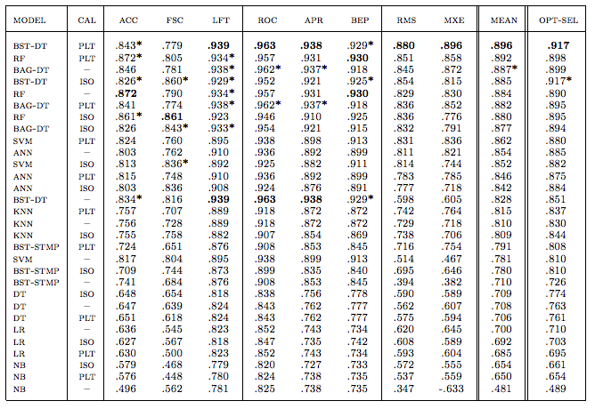
Empirical comparison of supervised classifiers – ICML 2006

Slide 7
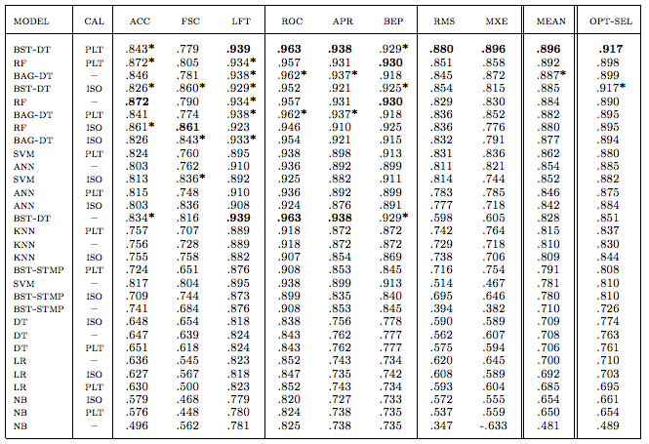
Empirical comparison of supervised classifiers – ICML 2006

Slide 8
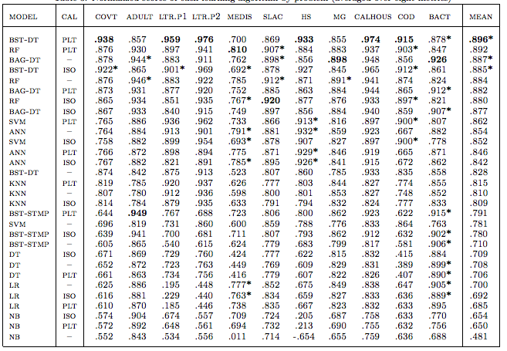
Empirical comparison of supervised classifiers – ICML 2006

Slide 9
Empirical comparison of supervised classifiers – ICML 2006

Slide 10
Do we need hundreds of classifiers – JMLR 2014
Datasets
121 in total from UCI
Classifiers
179 in total
Implemented in C/C++, Matlab, Weka, and R

Slide 11
Do we need hundreds of classifiers – JMLR 2014
Classifiers
Discriminant analysis (20)
Bayesian methods (6)
Neural networks (21)
SVMs (10)
Decision trees (14)
Rule-based (12)
Boosting (20)
Bagging (24)
Stacking (2)
Random forests (8)
Other ensembles (11)
Generalized linear models (5)
Nearest neighbor (5)
Partial least squares and PCA regression (6)
Logistic and multinomial regression (3)
Multivariate adaptive splines (2)
Other methods (10)

Slide 12
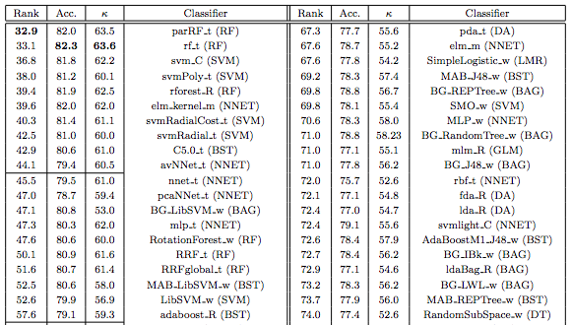
Do we need hundreds of classifiers – JMLR 2014

Slide 13
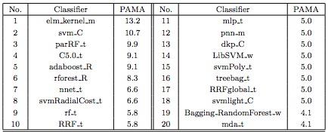
Do we need hundreds of classifiers – JMLR 2014

Slide 14
Do we need hundreds of classifiers – JMLR 2014

Slide 15
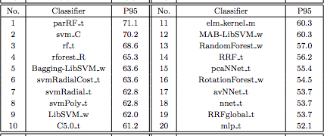
Do we need hundreds of classifiers – JMLR 2014

Slide 16
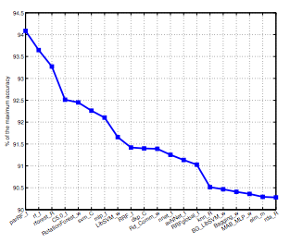
Do we need hundreds of classifiers – JMLR 2014

Slide 17
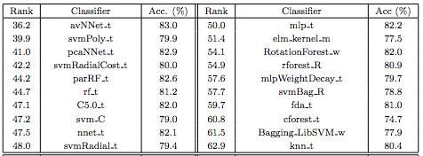
Do we need hundreds of classifiers – JMLR 2014
Binary classification only

Slide 18
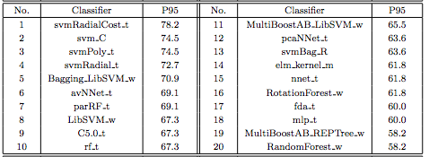
Do we need hundreds of classifiers – JMLR 2014
Binary classification only

Slide 19
Limitations of study
Not all classifiers were tuned by cross-validation
Comparison on big datasets – deep learning
No runtimes provided

