Slide 1
Big data
Usman Roshan
CS 675

Slide 2
Big data
Typically refers to datasets with very large number of instances (rows) as opposed to attributes (columns).
Data with high columns is referred to as high dimensional
Big dataset in many places
Genomics: DNA sequences, millions of species
Image recognition: internet, public cameras
Business: security, advertising, marketing

Slide 3
How to solve big data problems?
Parallel computing
This field has existed before big data came around
Divide and conquer: divide the problem into smaller subsets, solve each component in parallel, merge to form one solution
Distributed computing
Run same problem on multiple instances of the input
Reduce input size
Stochastic gradient descent
Mini-batch

Slide 4
Big data in machine learning
Some machine learning programs take a long time to finish. For example large neural networks and kernel methods.
Dataset sizes are getting larger. While linear classification and regression programs are generally very fast they can be slow on large datasets.

Slide 5
Examples
Dot product evaluation
Gradient descent algorithms
Cross-validation
Evaluating many folds in parallel
Parameter estimation
http://www.nvidia.com/object/data-science-analytics-database.html

Slide 6
Parallel computing
Multi-core programming
OpenMP: ideal for running same program on different inputs
MPI: master slave setup that allows message passing
Graphics Processing Units:
Equipped with hundred to thousand cores
Designed for running in parallel hundreds of short functions called threads

Slide 7
GPU programming
Memory has four types with different sizes and access times
Global: largest, ranges from 3 to 6GB, slow access time
Local: same as global but specific to a thread
Shared: on-chip, fastest, and limited to threads in a block
Constant: cached global memory and accessible by all threads
Coalescent memory access is key to fast GPU programs. Main idea is that consecutive threads access consecutive memory locations.

Slide 8
GPU programming
Designed for running in parallel hundreds of short functions called threads
Threads are organized into blocks which are in turn organized into grids
Ideal for running the same function on millions of different inputs

Slide 9
Languages
CUDA:
C-like language introduced by NVIDIA
CUDA programs run only on NVIDIA GPUs
OpenCL:
OpenCL programs run on all GPUs
Same as C
Requires no special compiler except for opencl header and object files (both easily available)

Slide 10
GPU programs
GPU speedup for eigenvector computation speeds up PCA and other dimensionality reduction algorithms.
Supported by NVIDIA
Problem specific solutions
Our work
MaxSSmap
Chi8

Slide 11
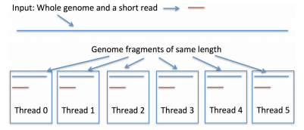
MaxSSmap
Comparing a short DNA sequence to a much large whole
genome sequence.

Slide 12
Chi8
Univariate feature selection is fast even for a million features
But bivariate can be much slower. For example a dataset with m columns requires m choose 2 bivariate tests
In Chi8 we use a GPU to run bivariate tests in parallel
Requires cleverly storing the data in GPU memory

Slide 13
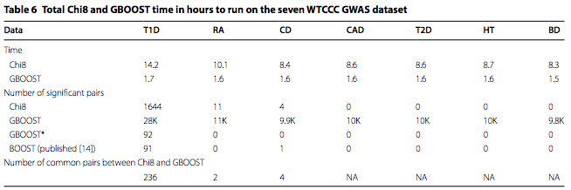
Chi8
Running times on real data

Slide 14
Distributed computing
Systems for distributed computing have existed for many years
Examples:
Sun scheduler for cluster computing
Condor for running programs on idle public computers
Mapreduce from LISP
Recently we have Hadoop that is an open source implementation of Mapreduce
Hadoop is increasing in popularity and is used by industry

Slide 15
Stochastic gradient descent
Instead of using all the datapoints to compute the gradient we take a random subset (or just one point)
For example least squares gradient search
In stochastic gradient descent we would select one point or a subset to compute the gradient.
In practice leads to great speed-ups without much loss in accuracy

Slide 16
Mini-batch methods
Popular in k-means clustering
Main idea:
select a random (small) subset of the input data as opposed to the full dataset
Compute clustering
Assign remaining points to their clusters by the centroids

