Slide 1
Efficient Estimation of Word Representation in Vector Space
Paper presentation by:
Aradhya Chouhan

Slide 2
Authors:
Tomas Mikolov(Google Inc.)
Kai Chen(Google Inc.)
Greg Corrado(Google Inc.)
Jeffrey Dean(Google Inc.)

Slide 3
Introduction:
Many NLP systems and techniques treat words as atomic units - there is no notion of similarity between words, as these are represented as indices in a vocabulary.
Simple models trained on huge amounts of data outperform complex systems trained on less data.
However, simple techniques are at their limits in many tasks.The amount of relevant in-domain data for automatic speech recognition is limited - the performance is usually dominated by the size of high quality transcribed speech data (often just millions of words).

Slide 4
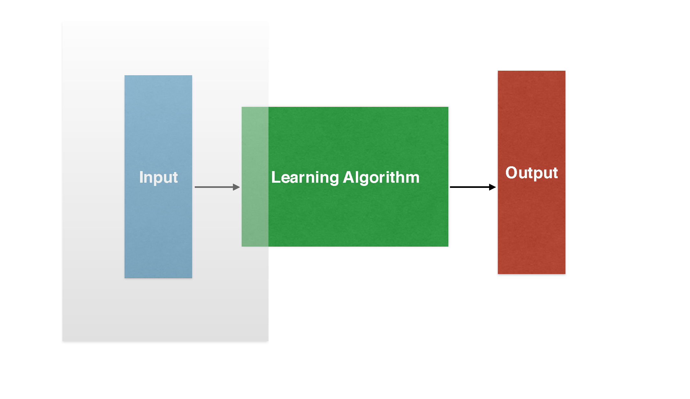
With progress of machine learning techniques in recent years, it has become possible to train more complex models on much larger data set, and they typically outperform the simple models.
Probably the most successful concept is to use distributed representations of words. For example, neural network based language models significantly outperform N-gram models.

Slide 5
Objectives:
The main goal of this paper is to introduce techniques that can be used for learning high-quality word vectors from huge data sets with billions of words, and with millions of words in the vocabulary.
Maximize accuracy of these vector operations by developing new model architectures that preserve the linear regularities among words.

Slide 6
Language Models:
A language model computes a probability for a sequence of words: P(w1,w2…,wT)
Useful for machine translation word ordering
P(the cat is small) > P(small the is cat)
Useful in machine translation word choice
P(walking home after school) > P(walking house after school)

Slide 7
One-hot encoding:

Slide 8
One-hot encoding:

Slide 9
One-hot encoding:

Slide 10
Dimensionality reduction: (Idea-1)
Singular value decomposition: X = UΣVt
Columns of U contain the eigenvectors of XXt
Columns of V contain the eigenvectors of XtX
Σ is a diagonal matrix. Diagonal values are eigenvalues
Of XtX or XXt.
Computational cost in SVD is quadratic for dxn matrix O(dn^2). Impractical for large datasets.

Slide 11
Dimensionality reduction: (Idea-2)
Predict surrounding word of every word(word2vec).
Capture co-occurrence counts directly(GloVe).
Fast and can incorporate a new sentence or add a word to vocabulary.

Slide 12
Distribution Hypothesis:
The distribution hypothesis in linguistics is derived from the semantic theory of language usage.
“Words that are used and occur in the same context tend to purport similar meaning.” → Harris.Z (1954) Distributional Structures
“A word is characterized by the company it keeps.” → J.R. Firth (1957) A Synopsis of linguistics theory

Slide 13
Co-occurrence matrix:
All the models we will see use the idea of co-occurrence implicitly or explicitly. Co- occurrence can be seen as an indicator of semantic proximity of words.
“Silence is the language of Gods, all else is poor translation.” → Rumi(1207-1273)
Vocabulary → silence, is, the, language, of, gods, all, else, poor, translation

Slide 14
 | silence | is | the | language | of | gods | all | else | poor | translation
silence | 0 | 1 | 0 | 0 | 0 | 0 | 0 | 0 | 0 | 0
is | 0 | 0 | 1 | 0 | 0 | 0 | 0 | 0 | 1 | 0
the | 0 | 0 | 0 | 1 | 0 | 0 | 0 | 0 | 0 | 0
language | 0 | 0 | 0 | 0 | 1 | 0 | 0 | 0 | 0 | 0
of | 0 | 0 | 0 | 0 | 0 | 1 | 0 | 0 | 0 | 0
gods | 0 | 0 | 0 | 0 | 0 | 0 | 1 | 0 | 0 | 0
all | 0 | 0 | 0 | 0 | 0 | 0 | 0 | 1 | 0 | 0
else | 0 | 1 | 0 | 0 | 0 | 0 | 0 | 0 | 0 | 0
poor | 0 | 0 | 0 | 0 | 0 | 0 | 0 | 0 | 0 | 1
translation | 0 | 0 | 0 | 0 | 0 | 0 | 0 | 0 | 0 | 0

Slide 15
Neural Network Language Model Architecture:

Slide 16
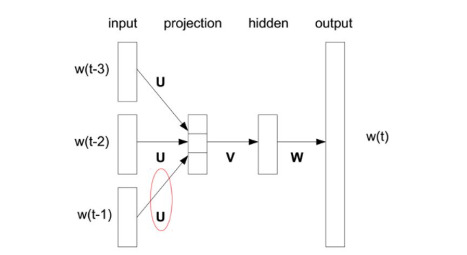
Feedforward NNLM:

Slide 17
NNLM Architectures:
Feedforward Neural Net Language Model (NNLM):
Complexity:Q = N × D + N × D × H + H × V
V is size of the vocabulary
N is previous words are encoded using 1-of-V coding
H is hidden layer size
D is dimensionality of projection layer.
Notes:
Many different types of models were proposed for estimating continuous representations of words, including the well-known Latent Semantic Analysis (LSA) and Latent Dirichlet Allocation (LDA). In this paper, we focus on distributed representations of words learned by neural networks, as it was previously shown that they perform significantly better than LSA for preserving linear regularities among words ; LDA moreover becomes computationally very expensive on large data sets. The NNLM architecture becomes complex for computation between the projection and the hidden layer, as values in the projection layer are dense.

Slide 18
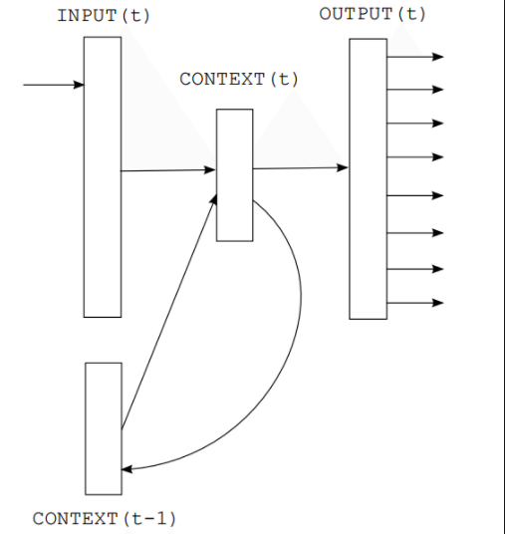
Recurrent NNLM:

Slide 19
NNLM Architectures:
Recurrent Neural Net Language Model (RNNLM):
Complexity: Q = H × H + H × V
H is dimensionality of the hidden layer
V is the size of vocabulary

Slide 20
New Log-linear Models:
Continuous bag-of-words
The first proposed architecture is similar to the feedforward NNLM, where the non-linear hidden layer is removed and the projection layer is shared for all words (not just the projection matrix); thus, all words get projected into the same position (their vectors are averaged).

Slide 21
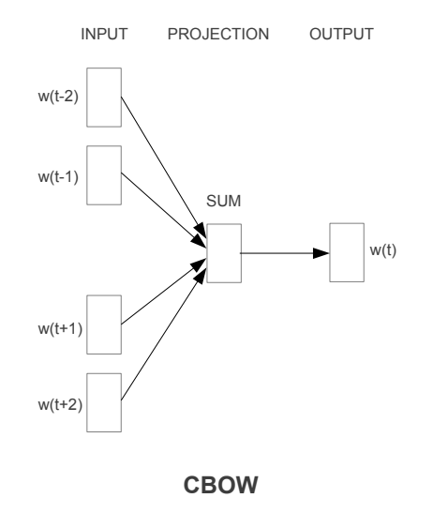
New Log-linear Models:
Continuous bag-of-words:
Training complexity
Q = N × D + D × log(V)

Slide 22
New Log-linear Models:
Continuous skip-gram
The second architecture is similar to CBOW, but instead of predicting the current word based on the context, it tries to maximize classification of a word based on another word in the same sentence. More precisely, we use each current word as an input to a log-linear classifier with continuous projection layer, and predict words within a certain range before and after the current word.

Slide 23
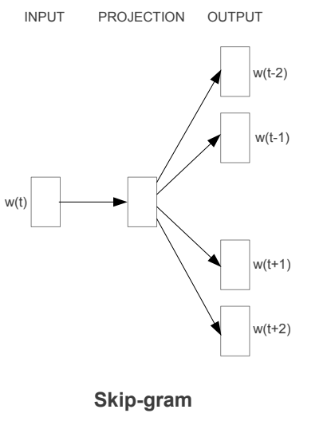
New Log-linear Models:
Continuous Skip-gram Model:
Training complexity
Q = C × (D + D × log(V))

Slide 24
Task Description:
Defined a comprehensive test set that contains five types of semantic questions, and nine types of syntactic questions.
Overall, there are 8869 semantic and 10675 syntactic questions
Question is assumed to be correctly answered only if the closest word to the vector computed using the above method is exactly the same as the correct word in the question; synonyms are thus counted as mistakes.

Slide 25
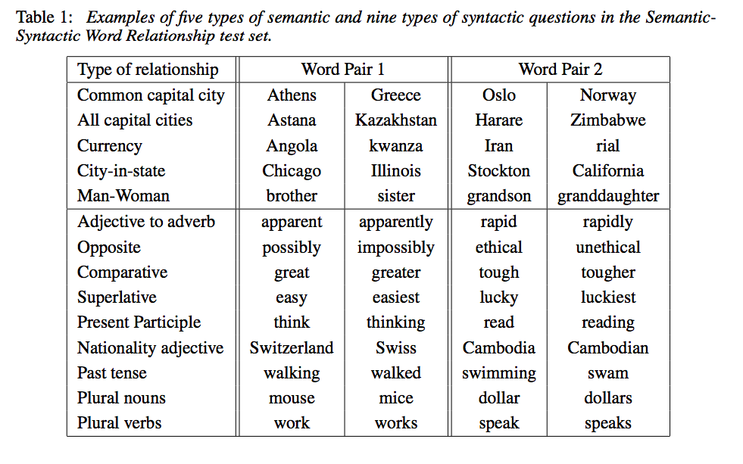
Task Description:

Slide 26
Results:

Slide 27
Results:

Slide 28
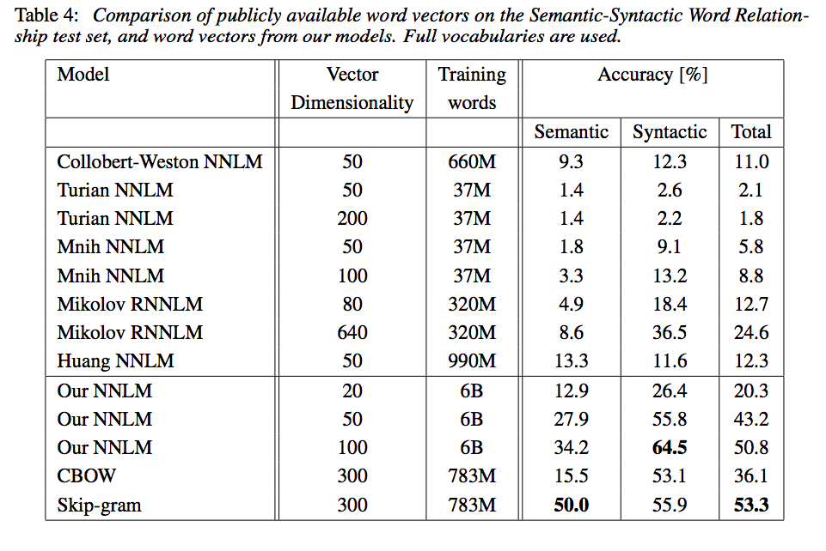
Results:

Slide 29
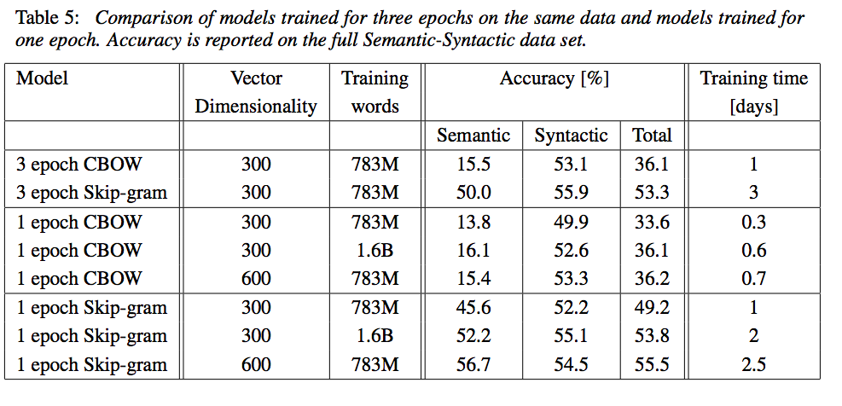
Results:

Slide 30
Conclusion:
In this paper we studied the quality of vector representations of words derived by various models on a collection of syntactic and semantic language tasks. We observed that it is possible to train high quality word vectors using very simple model architectures, compared to the popular neural network models (both feedforward and recurrent). Because of the much lower computational complexity, it is possible to compute very accurate high dimensional word vectors from a much larger data set.

