Slide 1
Brain2Image: Converting Brain Signals into Images
Recovering Observed Stimulus Using Visually-Evoked EEG Signals.

Slide 2
Introduction
The recent rediscovery of deep learning combined to the large interest of scientific community on generative methods has enabled the generation of realistic images by learning a data distribution from noise.
Goal : Generating images using visually-evoked brain signals recorded through an electroencephalograph (EEG).
Why? Brain signals have been employed to drive the learning of intelligent systems for emotion classification [14], medical tasks [1] (ex: epilepsy), etc.
Notes:
[14] Yuan-Pin Lin, Chi-Hong Wang, Tzyy-Ping Jung, Tien-Lin Wu, Shyh-Kang Jeng, Jeng-Ren Duann, and Jyh-Horng Chen. 2010. EEG-based emotion recognition in music listening. IEEE Transactions on Biomedical Engineering 57, 7 (2010), 1798–1806.
[1] U Rajendra Acharya, S Vinitha Sree, G Swapna, Roshan Joy Martis, and Jasjit S Suri. 2013. Automated EEG analysis of epilepsy: a review. KnowledgeBased Systems 45 (2013), 147–165.

Slide 3
Hypotheses
Brain activity contains detectable patterns related to visual stimuli categories.
Latent features are only employed for automated classification and no means to “see” what humans are seeing is considered.
Brain2Image framework consisting of a discriminative model to learn latent features from brain signals and a generative model, which, starting from the learned manifold, is able to generate visual samples from it. As discriminative model we employed an LSTM and as generative model we used and compared generative adversarial networks (GAN) and variational encoders (VAE).

Slide 4
Literature Review
Visual stimuli elicit detectable changes in EEG brain responses [4, 17].
Through recurrent neural networks able to extract such information [26] for being used by machines.
Variational Autoencoders (VAE) [11]: encoder/ decoder scheme + noise vector ---> generator ---> an image that contains a visual feature corresponding to that distribution.
Generative Adversarial Networks (GAN) [6]: a generator network creates an image starting from noise and a discriminator tries to identify whether an input image is fake or real ---> minmax game

Slide 5
Method
The objective of this work is to create an approach able to “translate” visually-evoked EEG signals into meaningful images.
Brain2Image approach consists of an encoder, which aims at identifying a latent feature space for brain signal classification, and a decoder, which turns the learned feature into images using a deconvolution approach.
50 images from 40 different ImageNet classes

Slide 6
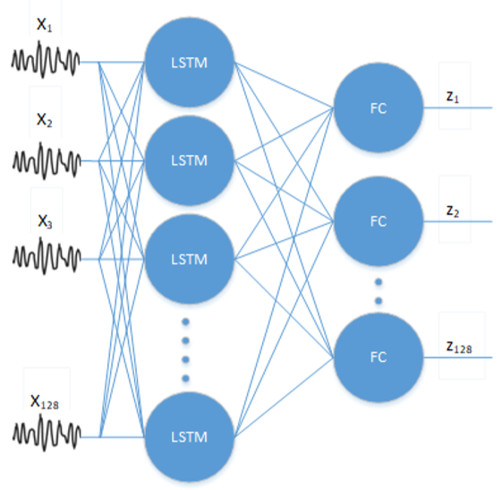
Data Presentation
EEG feature extraction: the acquired signals are processed by an encoder, which is trained to output a feature vector (EEG features), containing class-discriminative information.
EEG-conditioned image generation: generative models (decoder in VAE or a generator–discriminator pair in GAN) are trained to produce images from the EEG feature vectors.
Input EEG sequence is fed into the LSTM layer, whose output at the final time step goes into a fully-connected layer with a ReLU activation function.

Slide 7
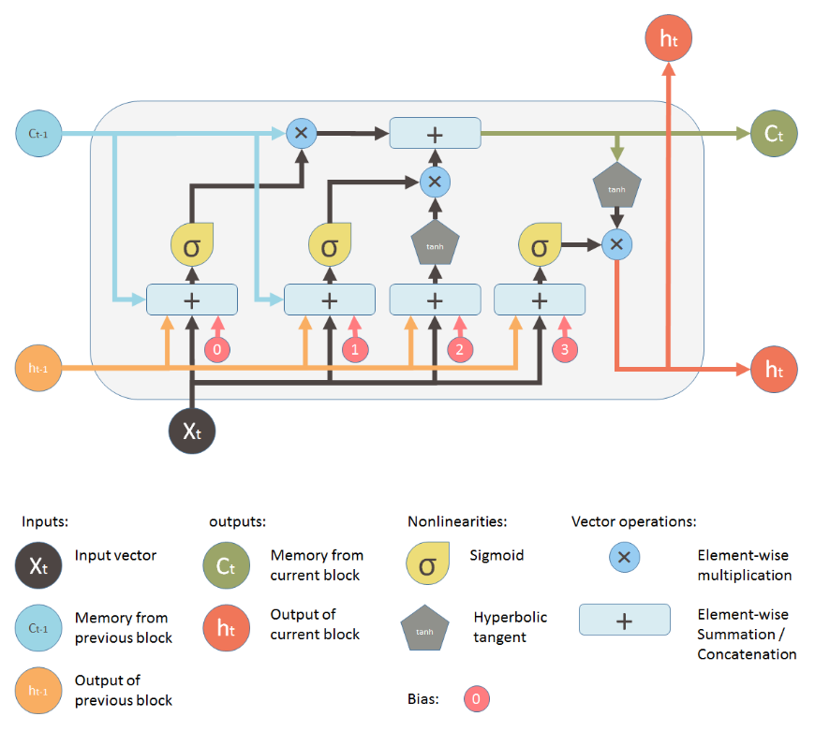
LSTM

Slide 8
Data Presentation
Overview of the VAE-based architecture design of the proposed Brain2Image module driving the EEG-based image generation approach, showing the constituting parts (encoder and decoder).
Overview of the GAN-based architecture design of the proposed Brain2Image module driving the EEG-based image generation approach, showing the constituting parts (encoder, generator and discriminator).

Slide 9
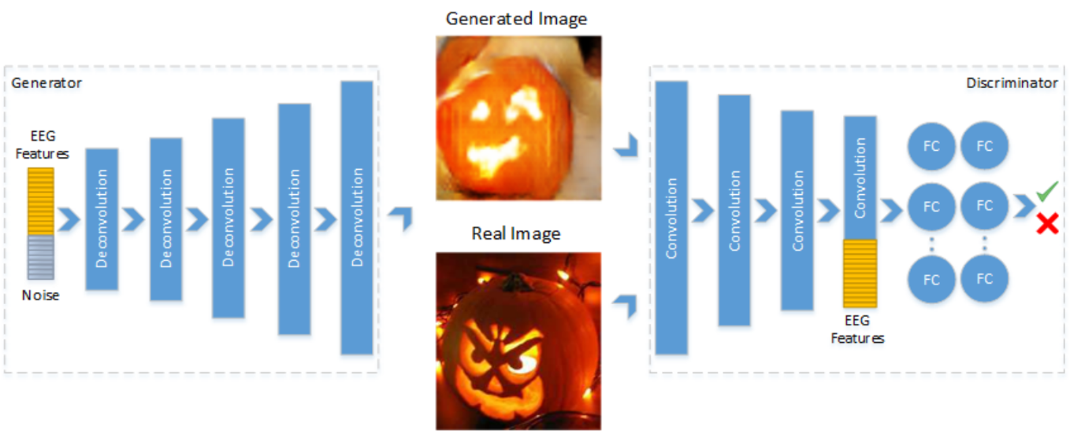
Data Presentation
Random noise and a condition vector coming out from the encoder network. D(x |y)
Generator
Target image distribution P(x)
Discriminator
D(x |y)

Slide 10
Data Presentation
True Sample St = (Xt,Yt) : Real data with correct condition.
Fake Sample Sf = (Xf,Yf) : Fake data with arbitrary condition.
conditioning vector y we use the features learned by our encoder.
Adam gradient descent- learning rate initialized to 0.001.
Mini-batches of size 16.
The encoder’s LSTM layer size is set to 128, as is the number of the fully connected non-linear output layer.
The generator’s input layer has 228 (100-dimensional random noise and 128- dimensional EEGfeatures) nodes.
Gen loss:
Disc loss:

Slide 11
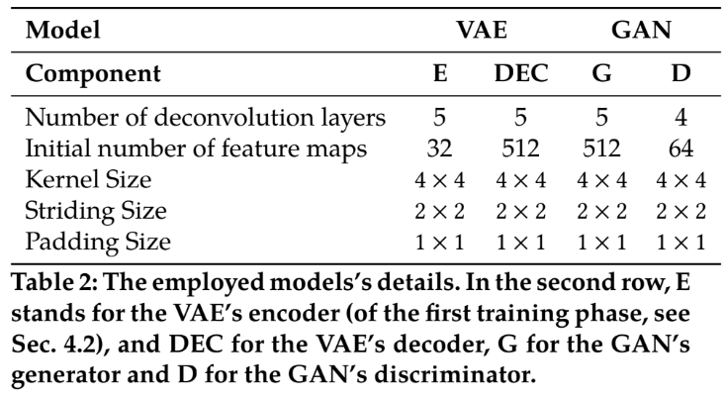
Data Presentation
5 deconvolutional layers: 1st upsamples the vector by four time.
Each of the others: Doubles the size at every step Output is 64*64.
4*4
Each convolution step reduces size to half.
Discriminator

Slide 12
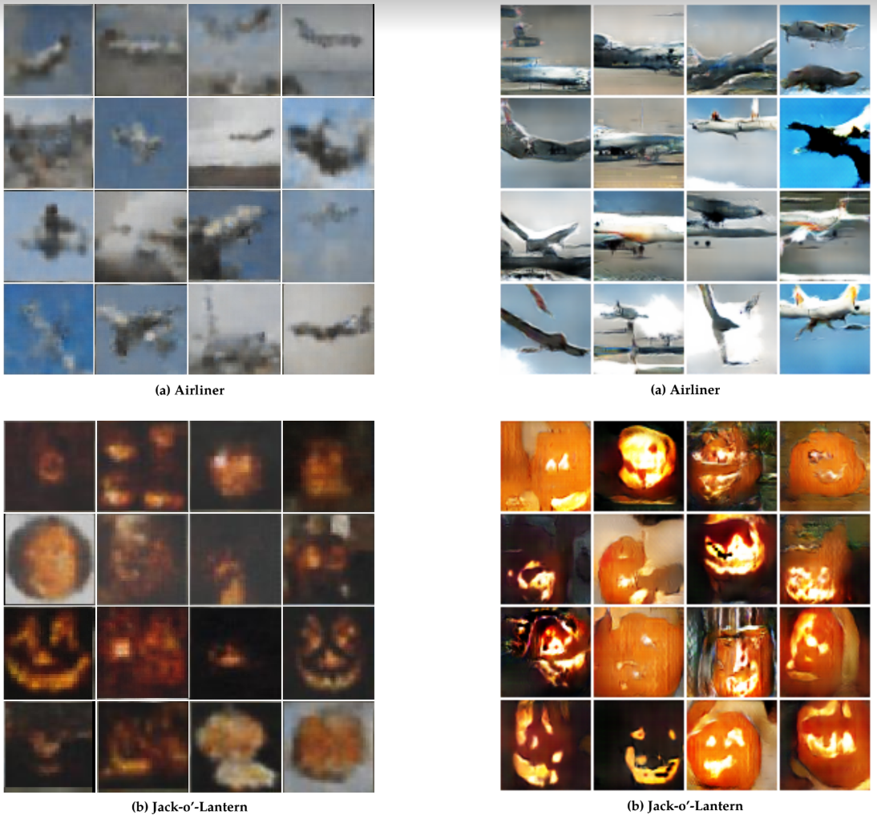
Conclusion

