Slide 1
Dual Path Network for improved Mammogram Image Processing
SUJOY DEB BARMA

Slide 2
WHAT IS MAMMOGRAM ?
A mammogram is an X-ray picture of the breast.
Mammograms are the best tests doctors have , to find breast cancer early, sometimes up to three years before it can be felt.
According to the International Agency for Research on Cancer, breast cancer is the most frequently diagnosed cancer and the second most fatal disease among women around the world.
However, the manual inspection of screening mammograms by radiologists is tedious, subjective, and prone to errors, which may cause high false positive rates and over diagnosis.

Slide 3
Role of Computer vision
Traditional mammographic computer-aided diagnosis (CAD) systems rely heavily on elaborate hand-crafted features . The objective is to mass detection, mass segmentation and classification.
Mass Detection : Mass detection aims to find the regions of interest (ROIs) where abnormalities may be located.
Mass segmentation : Mass segmentation provides detailed features with precise outlines within ROIs.
Mass Classification : Mass classification categorizes mammogram patches or full mammograms into benign or malignant.
Instead of CAD, Deep learning can be used as a better tool to find all of the above.

Slide 4
Earlier Work Done till DUAL PATH APPROACH
First Approach – Deep Learning for global classification of mammograms.
W. Zhu, Q. Lou, Y. S. Vang, and X. Xie, “Deep multi-instance networks with sparse label assignment for whole mammogram classification,” in International Conference on Medical Image Computing and Computer-Assisted Intervention. Springer, 2017, pp. 603–611.
G. Carneiro, J. Nascimento, and A. P. Bradley, “Automated analysis of unregistered multi-view mammograms with deep learning,” IEEE transactions on medical imaging, vol. 36, no. 11, pp. 2355–2365, 2017.
S. Shams, R. Platania, J. Zhang, J. Kim, and S.-J. Park, “Deep generative breast cancer screening and diagnosis,” in International Conference on Medical Image Computing and Computer-Assisted Intervention. Springer, 2018, pp. 859–867.
Later Approach – Classification based on local Region of Interest (ROI)
CNN- low accuracy.
U-NET- Labelling inconsistency- (less precision, less F1 score)

Slide 5
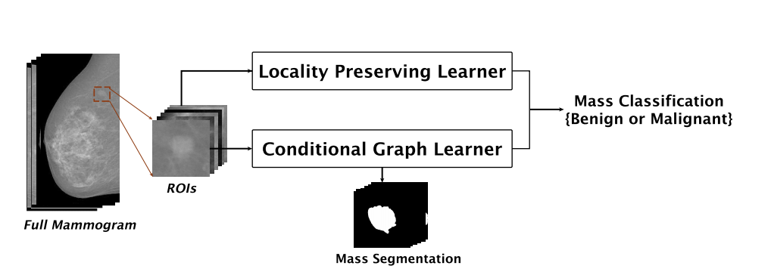
DualcoreNET (new approach)
Dual-path Conditional Residual Network (DUALCORENET) is the new way this paper proposes which is also the state-of-the-art approach to carry out mass segmentation , mass classification on publicly available mammogram dataset.
The two paths are :
Locality preserving Learner (for classification)
Conditional Graph Learner ( for segmentation)

Slide 6
Detailed architecture
Path1- For classification- Resnet2
Path2- For segmentation- U-Net Resnet

Slide 7
Locality preserving learner(LPL)
Binary cross entropy loss:
Negative of, log the points in the positive region + log of the points in negative region.
The larger the cross entropy value, larger the error, and less accurate our model is.
To avoid vanishing gradient problems, residual learning is used.
Ycls : 0 -> Benign, 1-> malignant

Slide 8
Conditional graph learner
CGL first employs the revised U-Net, mapping ROIs to geometry and spatial features, then a graphical inference layer to preserve pixel consistency with conditional restrictions and finally the separable convolution stacks to efficiently learn hierarchical features and class labels mapping.
The loss function for the segmentation is defined with weighted categorical cross-entropy of the residual learning U-Net.
Then The loss of the CGL path is again defined by the classification binary cross-entropy.

Slide 9
Overall cross entropy loss

Slide 10
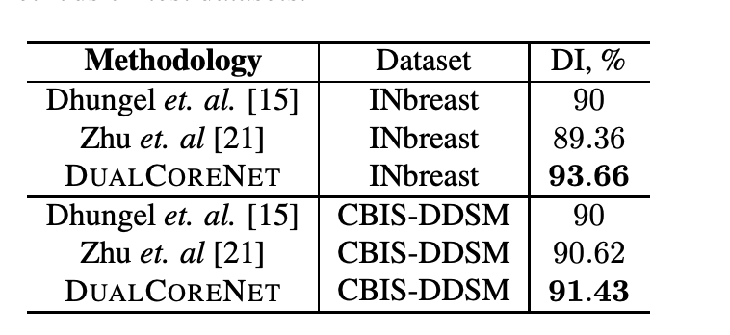
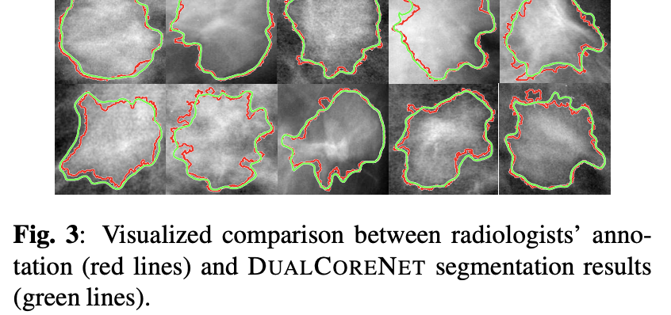
Comparing Results for Inbreast & CBIS-DDSM
For Mass segmentation :

Slide 11
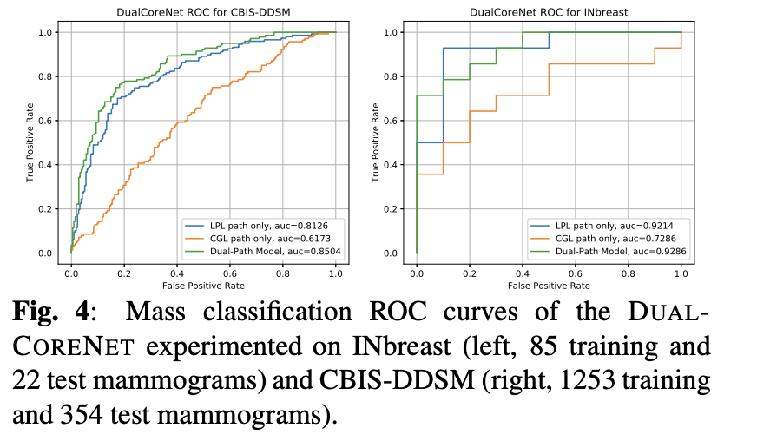
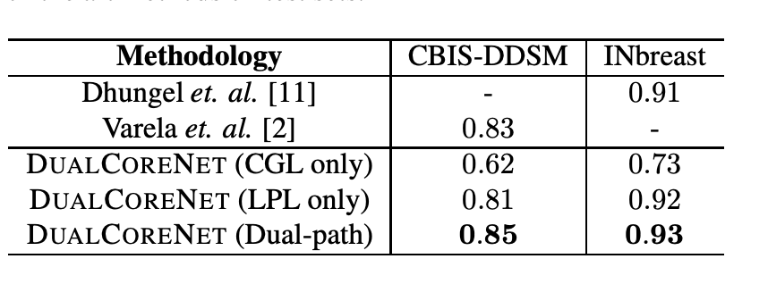
Comparing Results for Inbreast & CBIS-DDSM
For Mass classification:

Slide 12
conclusion
In this paper, it proposed a novel DUALCORENET for improved mammogram image analysis.
By integrating the conditional graph learner path and the locality preserving learner path, our DUALCORENET works in a simple but effective way to jointly learn segmentation and classification.

