Slide 1
Medical Image Synthesis for Data Augmentation and Anonymization using Generative Adversarial Networks
Stephen Iezzi

Slide 2
Motivation
Some of the biggest problems in medical AI are the heavily imbalanced datasets and the constraints around the use of patient data
This paper proposes a technique that would address both these problems by using GANs to generate synthetic images from publicly available brain MRI datasets
Time required to manually annotate data has led to smaller datasets
Traditional data augmentation techniques produce highly correlated image training data

Slide 3
Approach
Utilize GANs as a form of data augmentation on the MRI images by altering tumor size, changing tumor location, or placing a tumor on an otherwise healthy brain
Use 3D data as input/output a step up from related works which utilized 2D slices

Slide 4
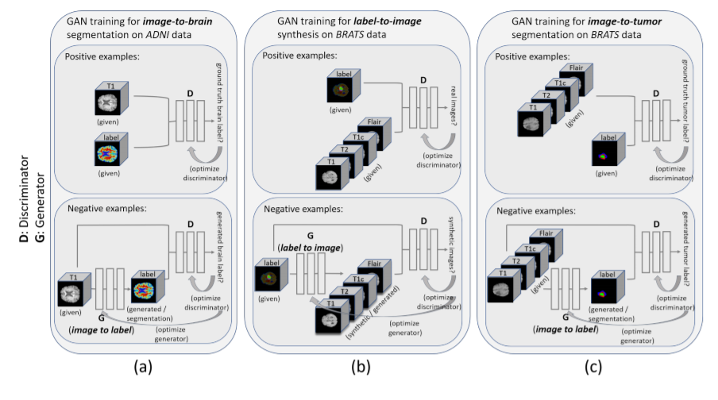
Methods
GAN trained to perform various tasks
Image to Brain Segmentation (True brain label or generated brain label)
Label to MRI Synthesis (Real Image or Synthetic Image)
Image to Tumor Segmentation (True tumor label or generated tumor label

Slide 5
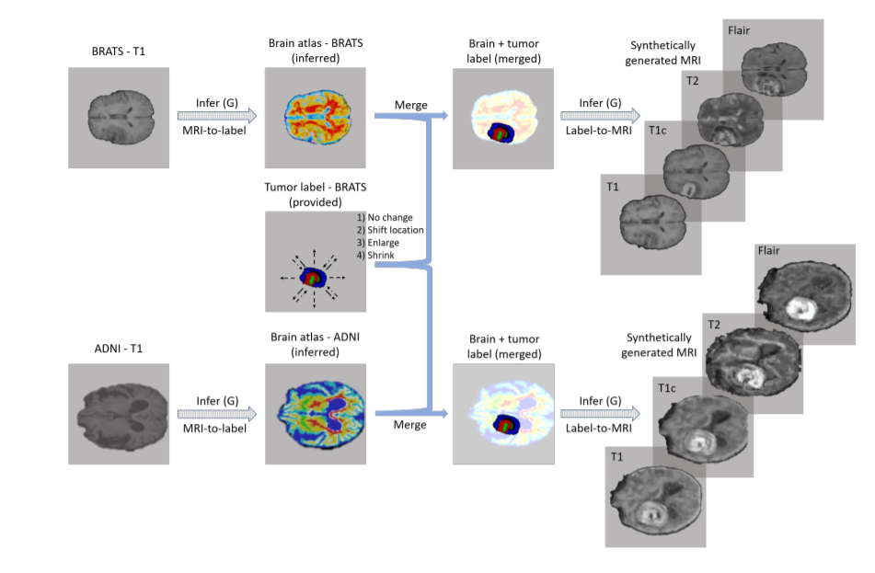
Data Augmentation with Synthetic Images
MRI-to-label GAN applied to T1-weighted images.
Merged with tumor label that is provided with dataset (possibly with alterations: change location, shrink, enlarge)
The merged labels are then fed into label-to-MRI GAN to produce synthetic multi-parametric MRI with brain tumor

Slide 6
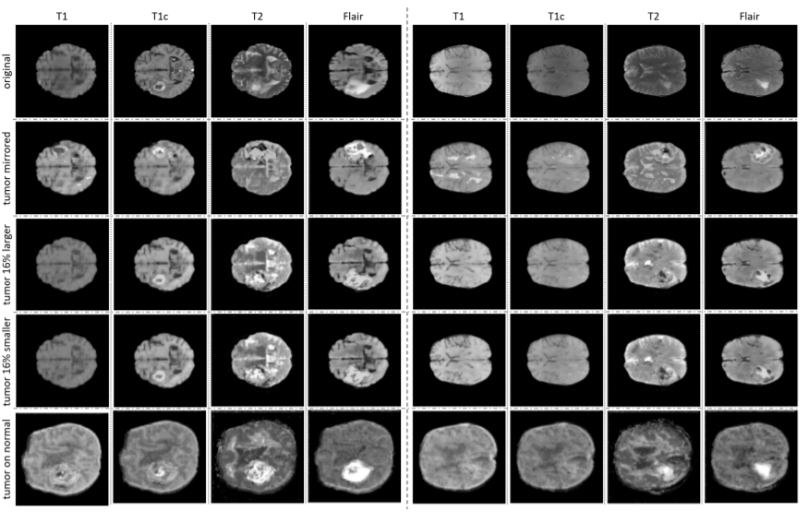
Examples of Synthetic Images

Slide 7
Data Anonymization
These synthetic images provide proof that training data can be created that is based on original patient data, however, it cannot be linked to the original patient
The synthetic images that are altered in various ways have no direct link to a specific patient but rather has a link to the specific dataset it was sampled from

Slide 8
Results
Notes:
No aug refers to no usual data aug techniques, with aug refers to with usual data aug techniques.
Why worse than Wang? GPU memory limits so had to reduce size of images

