Slide 1
Domain Adaptation
Kabilan Senapathy
Triman Kaur
Usman Roshan

Slide 2
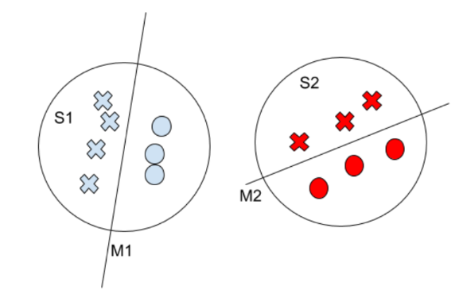
Problem Description
Consider scanners S1 and S2, whose images are trained in models M1 and M2
The decision boundaries may look like this:

Slide 3
Problem Description
Our goal is to perform feature transformation of images from $S2$ to make it look like it was generated by $S1$
Let the transformed feature space be ${S2}_{T}$
The feature space transformation is achieved by passing $S2$ images through an adapter $A$
We can imagine $A$ as just a network that learns a kernel function

Slide 4
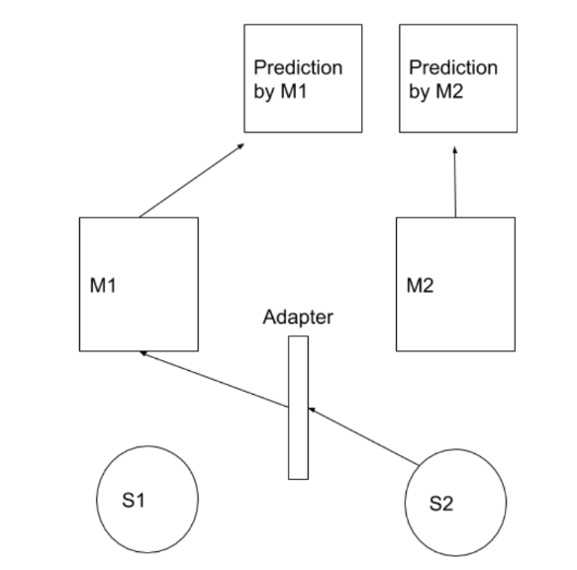
Problem Description

Slide 5
Setup : Pre-Processing
Pre-Processing
We developed a pre-processing script to convert the nibabel files into numpy vectors for each scanner.
We saved the leision files and anatomy files into two separate npy files.
The dimensions of each image is 196, 229, 196
The image pixel data contains only boolean data (0 or 1), hence we did not proceed to normalize the data.

Slide 6
Method
Our first step was to design and train a single U-net.
We found that a typical(also complete) U-net, required major modifications to be able to handle the unequal dimensions of the cuboid like image (196, 229, 196)
We dropped the idea of using a 2D U-net with the 3rd dimension as channel, because we sacrifice the number of learnable parameters ie. Weights in the network
We designed a simple 3D U-net that can handle the cuboid like image as well as have tunable channel parameters.

Slide 7
Method
We used the same architecture of the 3D U-net for both M1 and M2, by using PyTorch OOP features.
Adapter:
The adapter is a single 3D convolution that can be applied to the image
Can be made more complex, has to be experimented
How does a single layer network compare to a convolution adapter?

Slide 8
Method
We now have three networks M1, M2 and A
The loss functions for M1, M2 and A
M1:
M2:
A:

Slide 9
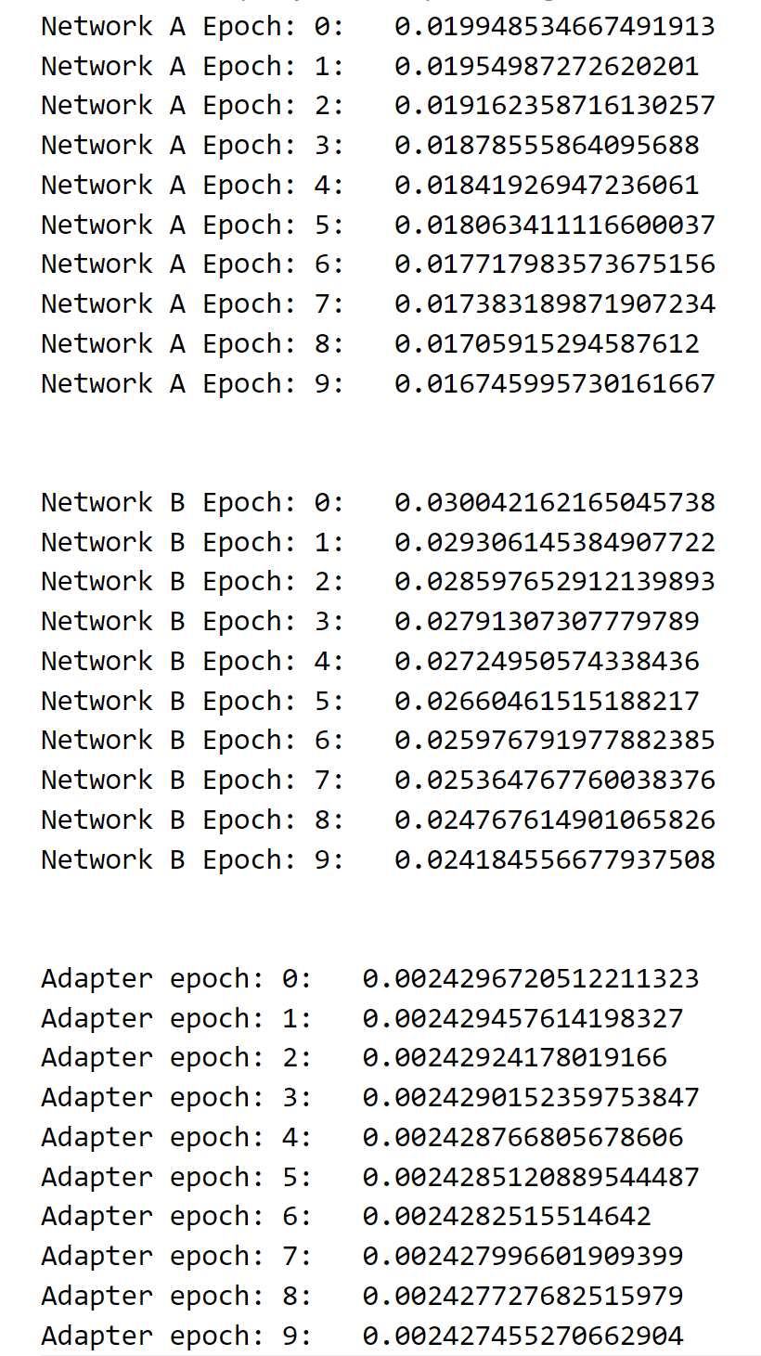
Results
We trained all three networks in a single run
We can see the loss consistently decreases on all three networks
We can verify that feature space transformation using adapter network works

Slide 10
Improvements
We improved the 3D U-net by adding a padding layer, which adds padding to just one(the second) dimension of the image(196,229,196)
This enables us to develop more complex structure for the 3D-Unet (especially adding more layers)

Slide 11
Questions

Slide 12
Thank You

