Slide 1
Query-Efficient Hard-label Black-box Attack: An Optimization-based Approach
ROHIT BISHT

Slide 2
INTRODUCTION
Addresses hard label black box attack problem based on optimization framework.
Explains white box and black box attacks.
Proposed approach addresses discontinuous step function by introducing algorithms:
Boundary Based Re-formulation
Zeroth order optimization

Slide 3
PROBLEM SETTING
Idea Behind attack:

Slide 4
WHITE BOX ATTACKS:
Classifier is exposed to the attacker.
Weights and network structure is known to the attacker.

Slide 5
BLACK BOX ATTACKS
Attackers have no information regarding model or classifier.
Reclines on queries to evaluate model parameters.
Previous approaches relies on :
Transfer Attack
Score based black box attack

Slide 6
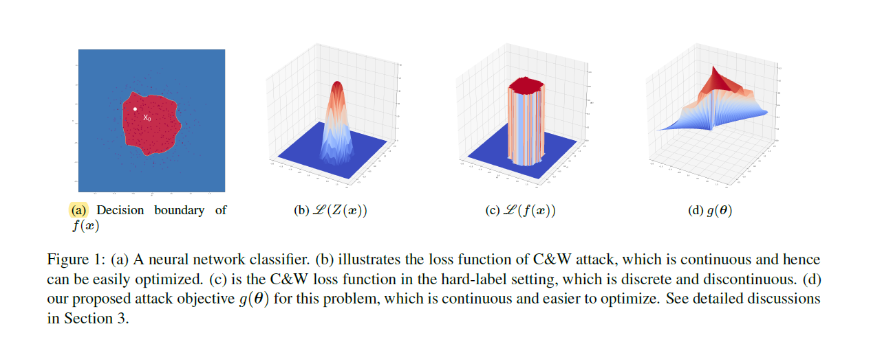
CHALLENGES IN HARD LABEL BLACK BOX ATTACKS

Slide 7
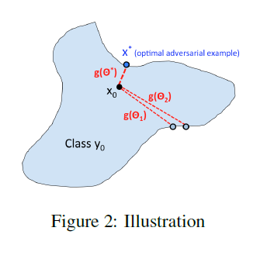
ALGORITHMS:

Slide 8
ALGORITHMS

Slide 9
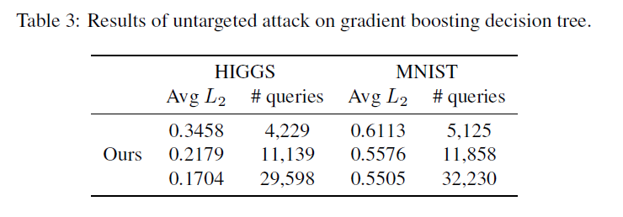
EXPERIMENTS AND RESULTS
Attack Gradient Boosting Decision Tree (GBDT)

Slide 10
CONCLUSION
Proposed generic and optimization-based hard-label black-box attack algorithm
Proposed algorithms addresses discrete and non-continuous models other than neural networks, such as the gradient boosting decision tree.

