Slide 1
Linear hyperplanes as classifiers
Usman Roshan

Slide 2
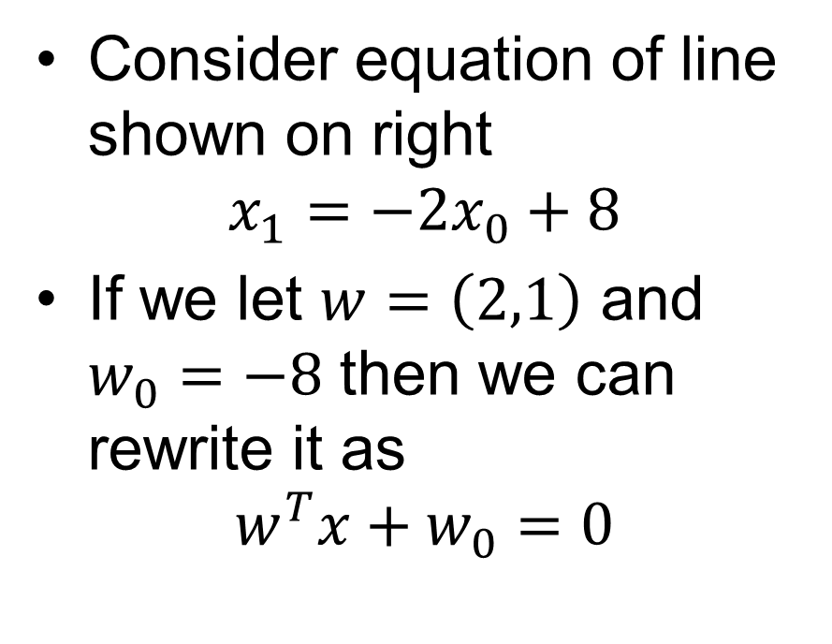
Hyperplane separators
Consider equation of line shown on right
$$x_{1}=−2x_{0}+8$$
If we let $w=\left(2,1\right)$ and $w_{0}=−8$ then we can rewrite it as
$$w^{T}x+w_{0}=0$$

Slide 3
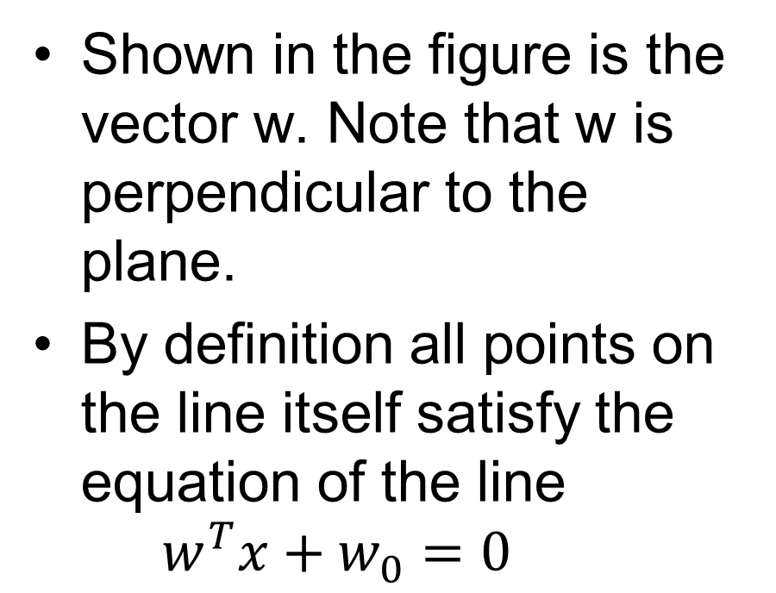
Hyperplane separators
Shown in the figure is the vector w. Note that w is perpendicular to the plane.
By definition all points on the line itself satisfy the equation of the line $w^{T}x+w_{0}=0$
w

Slide 4
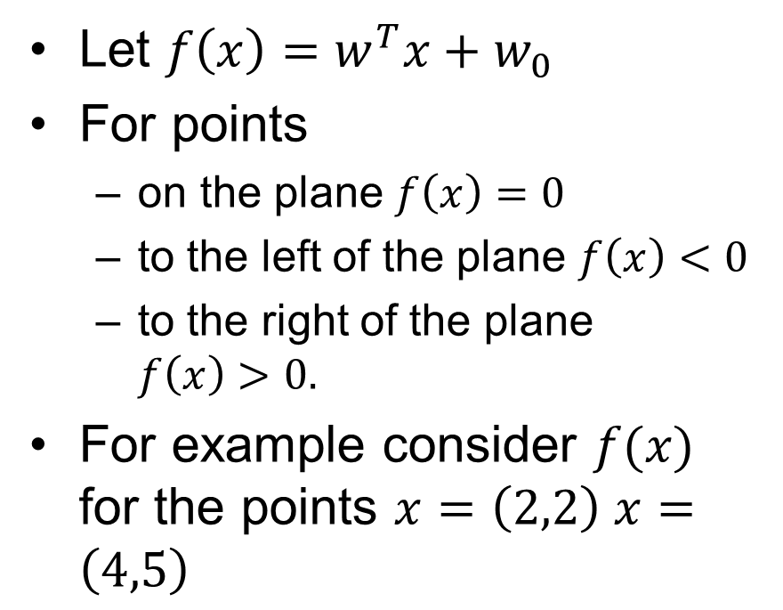
Hyperplane separators
Let ${f\left(x\right)=w}^{T}x+w_{0}$
For points
  on the plane $f\left(x\right)=0$
  to the left of the plane $f\left(x\right)<0$
  to the right of the plane $f\left(x\right)>0.$
For example consider $f(x)$ for the points $x=\left(2,2\right) x=\left(4,5\right)$
w

Slide 5
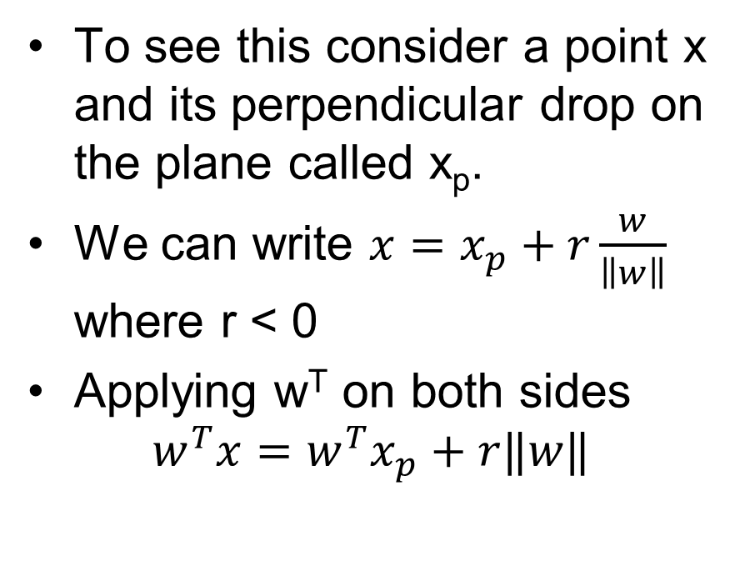
Hyperplane separators
To see this consider a point x and its perpendicular drop on the plane called x_{p}.
We can write $x=x_{p}+r\frac{w}{\left\|w\right\|}$ where r < 0
Applying w^{T} on both sides $w^{T}x=w^{T}x_{p}+r‖w‖$
r
x
x_{p}
w

Slide 6
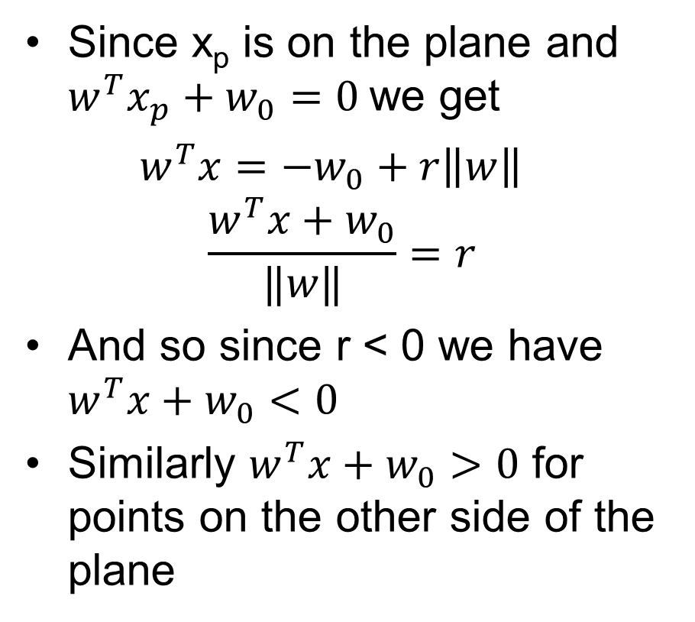
Hyperplane separators
Since x_{p} is on the plane and $w^{T}x_{p}+w_{0}=0$we get
$w^{T}x=−w_{0}+r\left\|w\right\|$
$$\frac{w^{T}x+w_{0}}{‖w‖}=r$$
And so since r < 0 we have $w^{T}x+w_{0}<0$
Similarly $w^{T}x+w_{0}>0$ for points on the other side of the plane
r
x
x_{p}
w

Slide 7
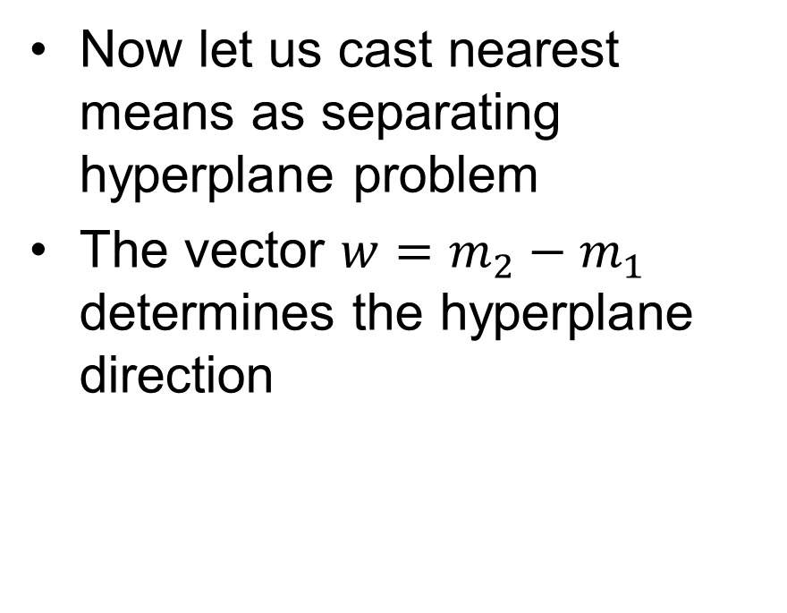
Nearest mean as hyperplane separator
Now let us cast nearest means as separating hyperplane problem
The vector $w=m_{2}−m_{1}$ determines the hyperplane direction
m₂
m₁

Slide 8
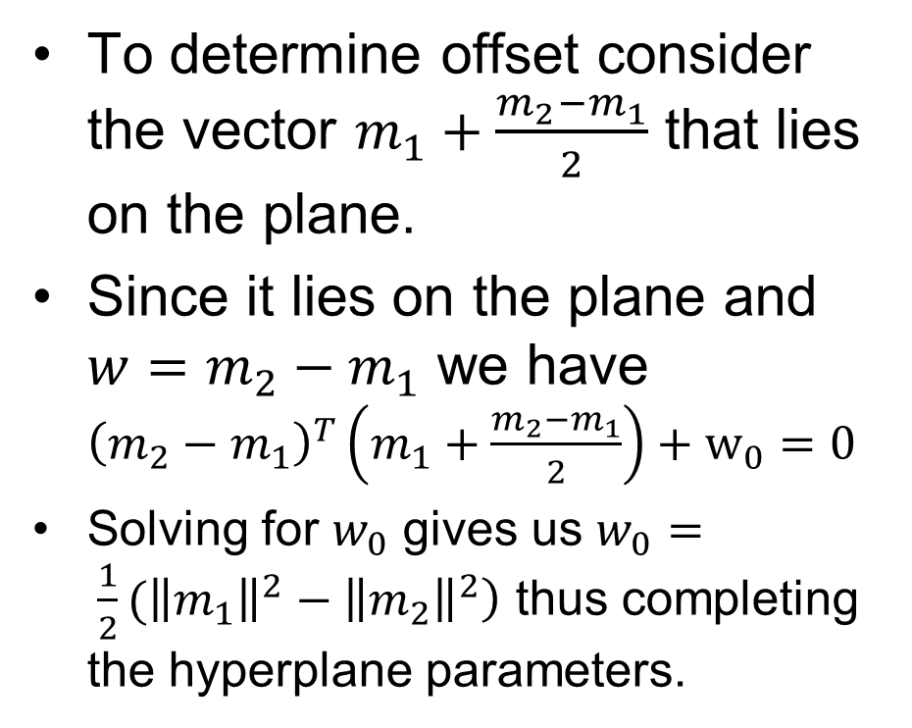
Nearest mean as hyperplane separator
To determine offset consider the vector $m_{1}+\frac{m_{2}−m_{1}}{2}$ that lies on the plane.
Since it lies on the plane and $w=m_{2}−m_{1}$ we have ${\left(m_{2}−m_{1}\right)}^{T}\left(m_{1}+\frac{m_{2}−m_{1}}{2}\right)+w_{0}=0$
Solving for $w_{0}$ gives us $w_{0}= \frac{1}{2}({\left\|m_{1}\right\|}^{2}−\left\|m_{2}{\left.​\right\|}^{2}\right)$ thus completing the hyperplane parameters.
m₂
m₁
m₁ + (m₂-m₁)/2

Slide 9
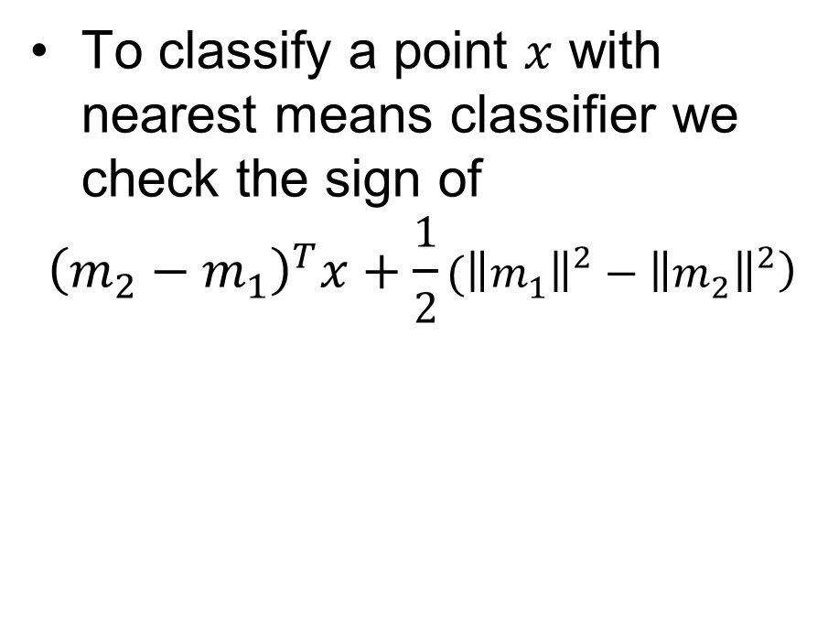
Nearest mean as hyperplane separator
To classify a point $x$ with nearest means classifier we check the sign of
$${\left(m_{2}−m_{1}\right)}^{T}x+\frac{1}{2}({\left\|m_{1}\right\|}^{2}−\left\|m_{2}{\left.​\right\|}^{2}\right)$$
m₂
m₁

Slide 10
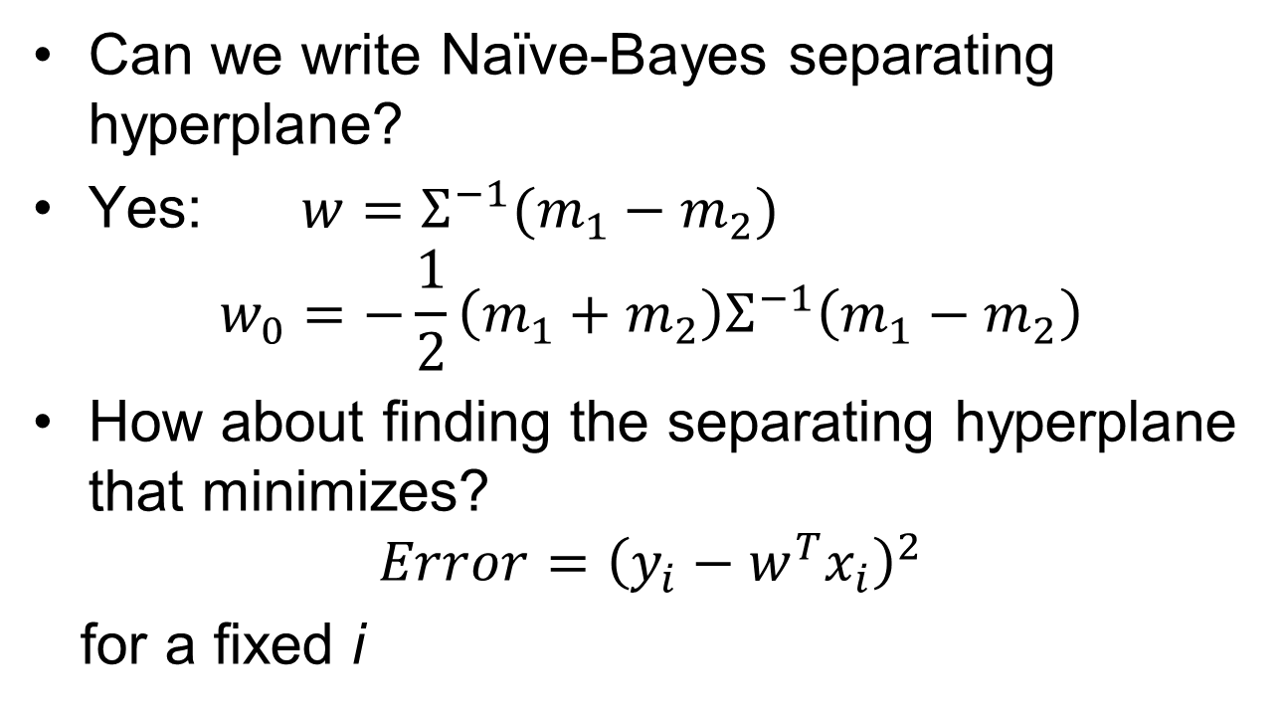
Separating hyperplanes
Can we write Naïve-Bayes separating hyperplane?
Yes: $w={Σ^{−1}(m}_{1}−m_{2})$
$$w_{0}=−\frac{1}{2}\left(m_{1}+m_{2}\right)Σ^{−1}\left(m_{1}−m_{2}\right)$$
How about finding the separating hyperplane that minimizes?
$$Error={\left(y_{i}−w^{T}x_{i}\right)}^{2}$$
for a fixed i

Slide 11
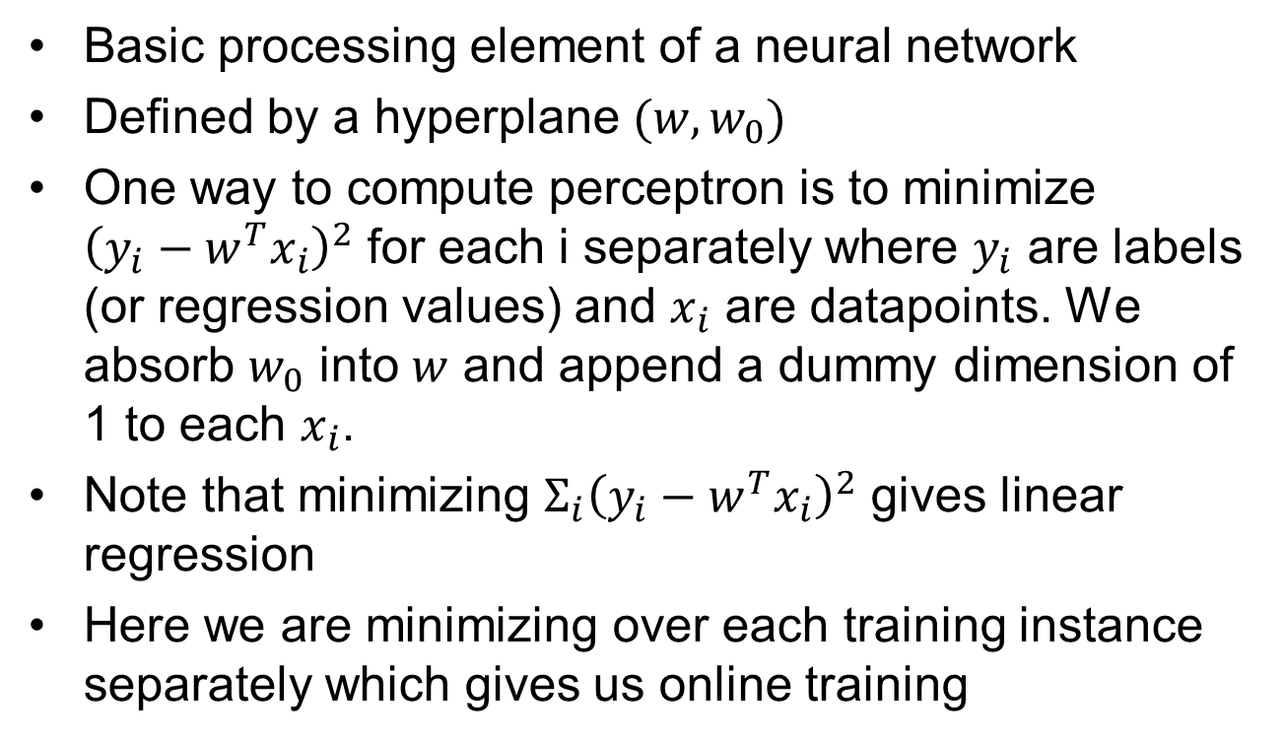
Perceptron
Basic processing element of a neural network
Defined by a hyperplane $(w,w_{0})$
One way to compute perceptron is to minimize ${\left(y_{i}−w^{T}x_{i}\right)}^{2}$ for each i separately where $y_{i}$ are labels (or regression values) and $x_{i}$ are datapoints. We absorb $w_{0}$ into $w$ and append a dummy dimension of 1 to each $x_{i}$.
Note that minimizing $Σ_{i}{\left(y_{i}−w^{T}x_{i}\right)}^{2}$ gives linear regression
Here we are minimizing over each training instance separately which gives us online training

Slide 12
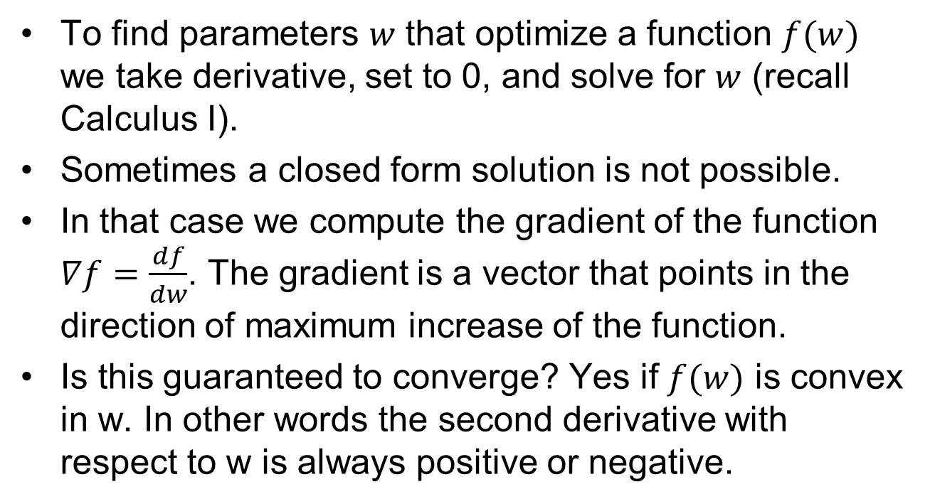
Gradient descent
To find parameters $w$ that optimize a function $f(w)$ we take derivative, set to 0, and solve for $w$ (recall Calculus I).
Sometimes a closed form solution is not possible.
In that case we compute the gradient of the function $∇f=\frac{df}{dw}$. The gradient is a vector that points in the direction of maximum increase of the function.
Is this guaranteed to converge? Yes if $f(w)$ is convex in w. In other words the second derivative with respect to w is always positive or negative.

Slide 13
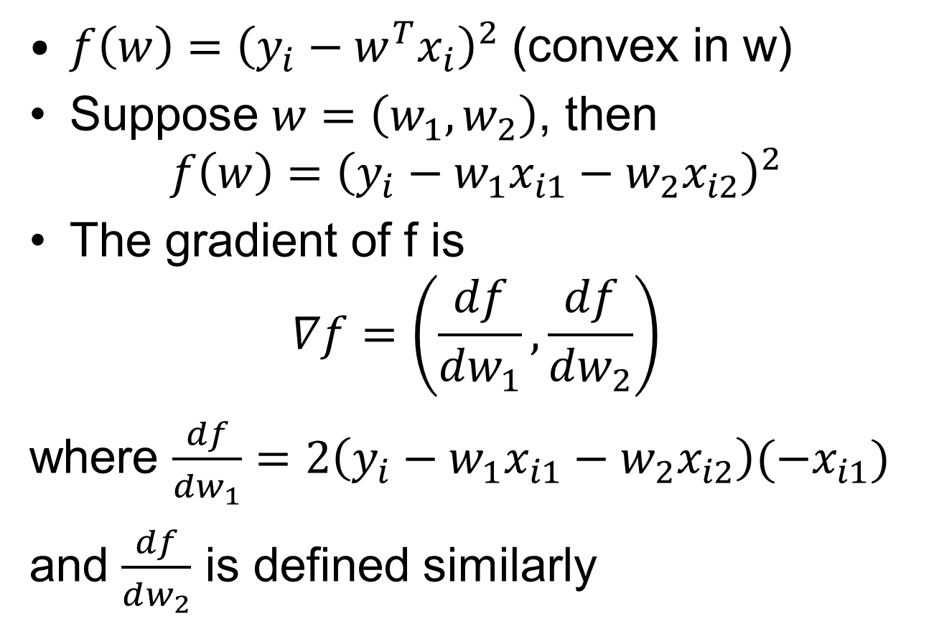
Perceptron training
$f\left(w\right)={\left(y_{i}−w^{T}x_{i}\right)}^{2}$ (convex in w)
Suppose $w=\left(w_{1},w_{2}\right)$, then
$$f\left(w\right)={\left(y_{i}−w_{1}x_{i1}−w_{2}x_{i2}\right)}^{2}$$
The gradient of f is
$$∇f=\left(\frac{df}{dw_{1}},\frac{df}{dw_{2}}\right)$$
where $\frac{df}{dw_{1}}=2\left(y_{i}−w_{1}x_{i1}−w_{2}x_{i2}\right)(−x_{i1})$
and $\frac{df}{dw_{2}}$ is defined similarly

Slide 14
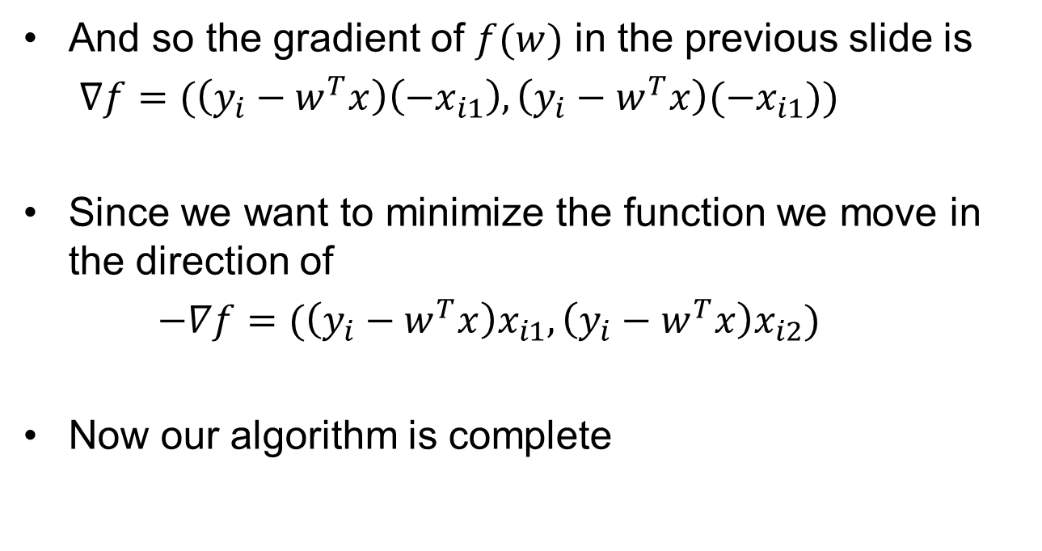
Perceptron training
And so the gradient of $f(w)$ in the previous slide is
$∇f=(\left(y_{i}−w^{T}x\right)\left(−x_{i1}\right),\left(y_{i}−w^{T}x\right)(−x_{i1})\text{)}$
Since we want to minimize the function we move in the direction of
$−∇f=(\left(y_{i}−w^{T}x\right)x_{i1},\left(y_{i}−w^{T}x\right)x_{i2}\text{)}$
Now our algorithm is complete

Slide 15
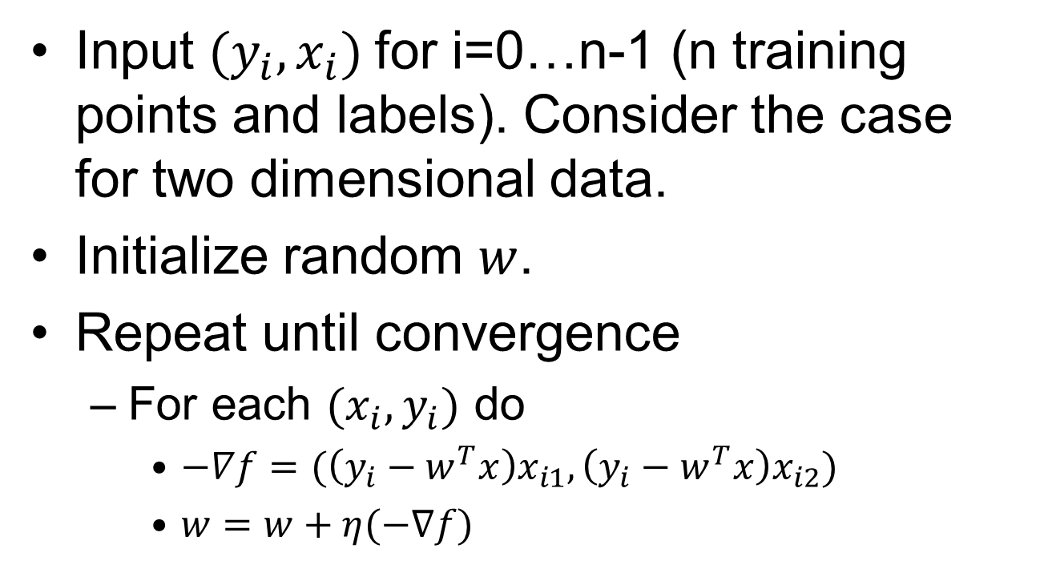
Perceptron training by gradient descent
Input $(y_{i}, x_{i})$for i=0…n-1 (n training points and labels). Consider the case for two dimensional data.
Initialize random $w$.
Repeat until convergence
  For each $(x_{i},y_{i})$ do
    $−∇f=(\left(y_{i}−w^{T}x\right)x_{i1},\left(y_{i}−w^{T}x\right)x_{i2}\text{)}$
    $w=w+η(−∇f)$

Slide 16
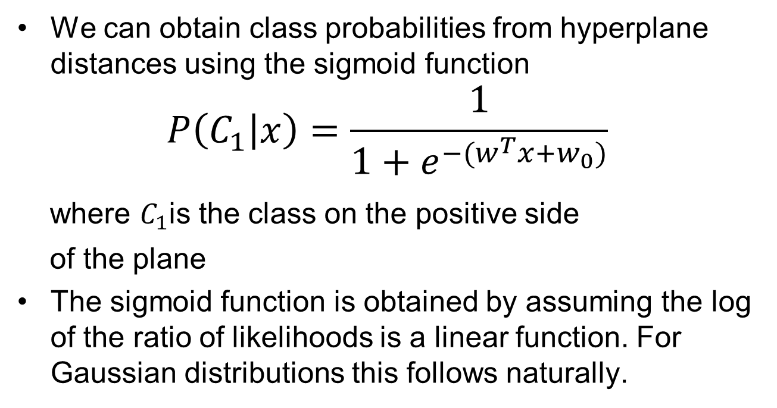
Obtaining probability from hyperplane distances
We can obtain class probabilities from hyperplane distances using the sigmoid function
$$P\left(C_{1} | x\right)=\frac{1}{1+e^{−(w^{T}x+w_{0})}}$$
where $C_{1}$is the class on the positive side
of the plane
The sigmoid function is obtained by assuming the log of the ratio of likelihoods is a linear function. For Gaussian distributions this follows naturally.

Slide 17
Separating hyperplanes
For two sets of points there are many hyperplane separators
Which one should we choose for classification?
In other words which one is most likely to produce least error?
y
x

Slide 18
Separating hyperplanes
Best hyperplane is the one that maximizes the minimum distance of all training points to the plane (Learning with kernels, Scholkopf and Smola, 2002)
Its expected error is at most the fraction of misclassified points plus a complexity term (Learning with kernels, Scholkopf and Smola, 2002)

Slide 19
Margin of a plane
We define the margin as the minimum distance to training points (distance to closest point)
The optimally separating plane is the one with the maximum margin
y
x

Slide 20

Optimally separating hyperplane
y
$$\frac{2}{{\left\|w\right\|}^{2}}$$
w
x

Slide 21
Optimally separating hyperplane
How do we find the optimally separating hyperplane?
Recall distance of a point to the plane defined earlier

Slide 22

Hyperplane separators
Distance of x to plane
$$\frac{w^{T}x+w_{0}}{‖w‖}=r$$
r
x
x_{p}
w

Slide 23
Distance of a point to the separating plane
And so the distance to the plane r is
given by
or
where y is -1 if the point is on the left side of
the plane and +1 otherwise.

Slide 24
Support vector machine: optimally separating hyperplane
Distance of point x (with label y) to the hyperplane is given by
We want this to be at least some value
By scaling w we can obtain infinite solutions. Therefore we require that
So we minimize ||w|| to maximize the distance which gives us the SVM optimization
problem.

Slide 25
Support vector machine: optimally separating hyperplane
SVM optimization criterion
We can solve this with Lagrange multipliers.
That tells us that
The x_{i} for which α_{i} is non-zero are called support vectors.

Slide 26
Support vector machine: optimally separating hyperplane

Slide 27
Inseparable case
What is there is no separating hyperplane? For example XOR function.
One solution: consider all hyperplanes and select the one with the minimal number of misclassified points
Unfortunately NP-complete (see paper by Ben-David, Eiron, Long on course website)
Even NP-complete to polynomially approximate (Learning with kernels, Scholkopf and Smola, and paper on website)

Slide 28
Inseparable case
But if we measure error as the sum of the distance of misclassified points to the plane then we can solve for a support vector machine in polynomial time
Roughly speaking margin error bound theorem applies (Theorem 7.3, Scholkopf and Smola)
Note that total distance error can be considerably larger than number of misclassified points

Slide 29


Optimally separating hyperplane with errors
y
$$\frac{2}{{\left\|w\right\|}^{2}}$$
$$ξ_{1}$$
$$ξ_{2}$$
w
x

Slide 30
Support vector machine: optimally separating hyperplane
In practice we allow for error terms in case there is no
hyperplane.

Slide 31
SVM software
Plenty of SVM software out there. Two popular packages:
  SVM-light
  LIBSVM

Slide 32
Kernels
What if no separating hyperplane exists?
Consider the XOR function.
In a higher dimensional space we can find a separating hyperplane
Example with SVM-light

Slide 33
Kernels
The solution to the SVM is obtained by applying KKT rules (a generalization of Lagrange multipliers). The problem to solve becomes

Slide 34
Kernels
The previous problem can be solved in turn again with KKT rules.
The dot product can be replaced by a matrix K(i,j)=x_{i}^{T}x_{j} or a positive definite matrix K.

Slide 35
Kernels
With the kernel approach we can avoid explicit calculation of features in high dimensions
How do we find the best kernel?
Multiple Kernel Learning (MKL) solves it for K as a linear combination of base kernels.

