Slide 1
SUPPORT VECTOR MACHINES
PRESENTED BY
MUTHAPPA

Slide 2
Introduction
Support Vector Machines(SVMs) are supervised learning models with associated learning algorithms that analyze data and recognize patterns, used for classification and regression analysis.
A SVM model is a representation of the examples as points in space , mapped so that the examples of the separate categories are divided by a clear gap that is as wide as possible. New examples are then mapped into that same space and predicted to belong to a category based on which side of the gap they fall on.

Slide 3
Why SVM?
Easy to use
Often has good generalization performance
Same algorithm solves a variety of problems with little tuning.

Slide 4
Applications of SVM
Hand written characters can be recognized using SVM.
Used in medical science to classify proteins with up to 90% of the compounds classified correctly.
Classification of images.

Slide 5
Data Classification using SVM
This paper walks us through the overview of SVM, kernel and model selections of SVM and rough sets.
SVM is used on different data (Diabetes data, Heart data, Satellite data and Shuttle data) which have two or multi class.
Comparative results using different kernel functions are shown for all data samples.

Slide 6
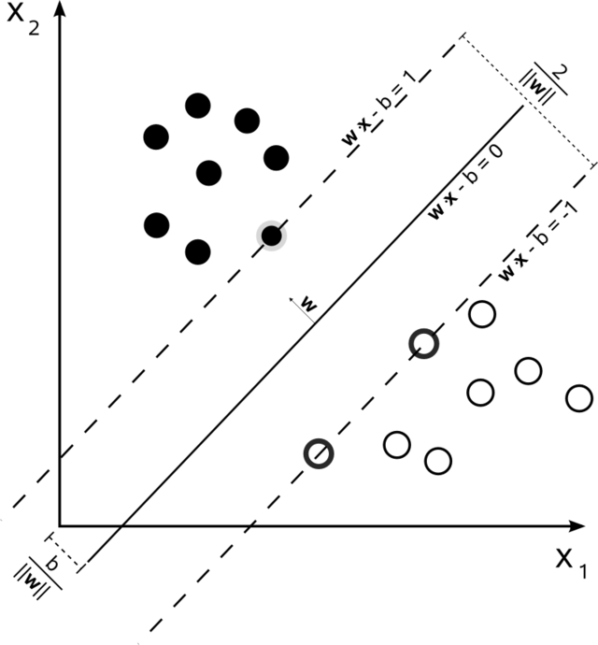
Maximum margin hyper plane and margins for an SVM trained with samples from two classes.

Slide 7
Kernel Selection of SVM
There are many kernel functions in SVM and selecting a good kernel function is a research issue.
Popular kernel functions are:
Linear kernel : K(x_{i}, x_{j}) = x_{i}^{T}x_{j}
Polynomial kernel : K(x_{i}, x_{j}) = (yx_{i}^{T}x_{j} + r)^{d} , y>0
RBF kernel : K(x_{i}, x_{j}) = exp(-y||x_{i} – x_{j}||²), y>0
Sigmoid kernel : K(x_{i}, x_{j}) = tanh(yx_{i}^{T}x_{j} + r)

Slide 8
Why RBF kernel?
RBF is the main kernel function because of the following reasons
The RBF kernel nonlinearly maps samples into a higher dimensional space unlike to linear kernel.
The RBF kernel has less hyper parameters than the polynomial kernel.
The RBF kernel has less numerical difficulties.

Slide 9
Model selection of SVM
Model selection is also an important issue in SVM. Its success depends on the tuning of several parameters which affect the generalization error.
If we use the linear SVM, we only need to tune the cost parameter C.
As many problems are non-linearly separable, we need to select the cost parameter C and kernel parameters y, d.

Slide 10
Rough Set
It is a mathematical tool to deal with un-integrality and uncertain knowledge.
It can effectively analyze and deal with all kinds of fuzzy, conflicting and incomplete information, and finds out the connotative knowledge from it, and reveals its underlying rules.
It finds the lower and upper approximation of the original set (given a pair of sets)
Its applications are in the field of data mining and artificial intelligence.

Slide 11
Results

Slide 12
Imbalance data classification algorithm
This paper combines the merits of FCM cluster algorithm and SVM algorithm to create a new algorithm – FCM-SVM algorithm.
Effectiveness of FCM-SVM algorithm was verified by repeated experiences on dataset from UCI database, the result shows that the algorithm improved the classification performance for imbalance problem compared to existing SVM algorithms.

Slide 13
Imbalance dataset
If the amount of positive class samples differs greatly from the negative class in a dataset, then the feature of majority class will be much more and significant, but the feature of minority class will be very blur.
Classifiers based on this kind of highly imbalance dataset will easily misclassify a new unknown minority sample to the majority class.
To avoid this, the imbalanced dataset should be transferred into balanced dataset.

Slide 14
Addressing imbalance dataset
Addressing imbalance dataset classification problem can be divided into two main directions:
Sampling approaches – include methods that over-sample the minority class to match the size of the majority class and methods that under-sample the majority class to match the size of the minority class.
Algorithmic-based – designed to improve a classifier’s performance based on their inherent characteristics.

Slide 15
SVM algorithms for imbalance datasets
Non-clustering normal SVM – Adopted balance dataset processing method from SVM algorithm to process imbalance dataset. It directly adopted SVM train function to establish model on training dataset of the above processed dataset. Only one classifier was developed.
Smote-Oversampling classification – Transferred imbalance dataset into balance dataset at first, and then use traditional SVM. The algorithm multiplies the minority class samples until there is not much difference between the minority and majority class samples.

Slide 16
SVM algorithms for imbalance datasets
Under sampling classification – It is similar to oversampling classification. It transfers imbalance dataset into balance dataset first and then use traditional SVM method. It randomly selects majority class samples to match minority class samples.
Random classification – It uses cross-validation function to obtain training and testing datasets first and then adopt SVM train function on training dataset to build a classifier model.

Slide 17
FCM-SVM process
Training and Testing dataset
Extract the number of majority and minority class from training dataset.
Calculate the amount radio N=majority/minority, distribute majority class into N classes by FCM.
Adopt SVM train function to develop N – classifiers.
Predicting on testing dataset by the function of SVM predict and N – classifiers.

Slide 18
FCM-SVM process(contd.)
Obtain final predicting results by one-to-veto rule.
Evaluate algorithm performance.

Slide 19
Algorithm Evaluation measures
 | Predicted Positive | Predicted Negative
Actual Positive Actual Negative | TP (True Positive) FP (False Positive) | FN (False Negative) TN (True Negative)
Precision = TP/(TP+FP)
Recall = TP/(TP+FN)
F-measure = 2*Precision*Recall/(Precision + Recall)

Slide 20
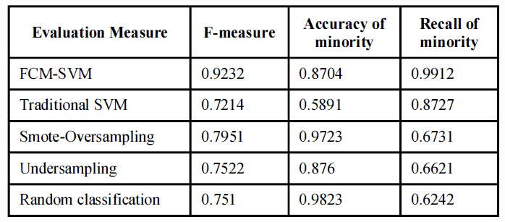
Results of shuttle dataset

Slide 21
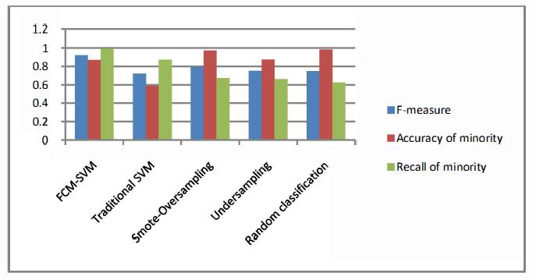
Results of shuttle dataset

Slide 22
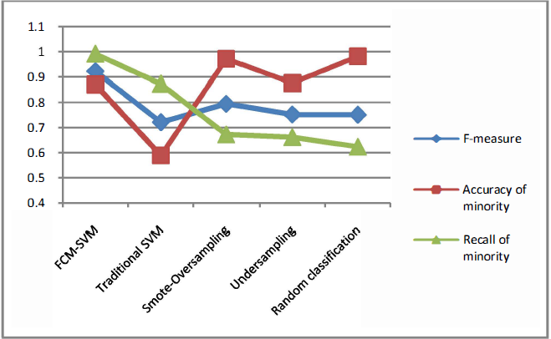
Results of shuttle dataset

Slide 23
References
http://www.cs.columbia.edu/~kathy/cs4701/documents/jason_svm_tutorial.pdf
http://en.wikipedia.org/wiki/Support_vector_machine
Imbalance Data Classification based on SVM and Clustering Function, Kai-Biao Lin, Wei Weng, Robert K. Lai, Ping Lu, 2014.
Data Classification Using Support Vector Machines, Durgesh K. Srivastava , Leekha Bhambu,2005-2009.

Slide 24
Thank You

