Slide 1
PCA on Parallel GPU and CPU
Result and

Slide 2
*NVIDIA CUBLAS SAMPLE

Slide 3
Functions
1.creating and destroying matrix and vector objects in GPU memory;
2.transferring data from CPU mainmemory to GPU memory;
3.executing BLAS on the GPU;
4.transferring data from GPU memory back to the CPU mainmemory.

Slide 4
Class
main(int argc, char *argv[])
Void correl(data, n, m) //Correlation matrix
Void eigen(data, n, m) //Eigenvalue reduction
Void free_matrix(), free_vector() //Deallocate storage
Void hh(a, n, d, e) //Kernel of eigen matrix: Householder reduction

Slide 5
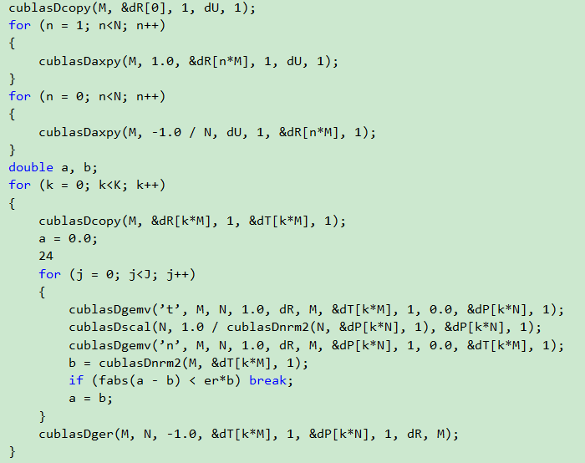
Cublas

Slide 6
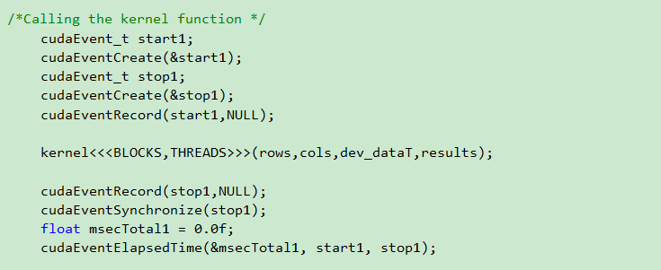
CUDATime

Slide 7
CPUTime

Slide 8
Print time

Slide 9
System And data：
CPU:Intel Core i7-4790K Quad-Core 4.0GHz
GPU:The GeForce® GTX™ 970
DATA:
DOCWORD 400*100
VOCAB 2400*100
PIC1 1024*4096
PIC2 2304*16000
SNP 8000*29623

Slide 10
REsult

