Slide 1
K-means Based Unsupervised Feature Learning for Image Recognition
Ling Zheng

Slide 2
Unsupervised Feature Learning
Much focus on learning good feature from unlabeled data for higher-level tasks such as classification
A typical approach is to use an unsupervised learning algorithm to train a model of the unlabeled data and then use the results to extract interesting features from the data
Andrew Y. Ng found using K-means clustering in feature learning pipelines can get excellent performance
Notes:
Much recent work in machine learning has focused on learning good feature representations from unlabeled input data for higher-level tasks such as classification
A typical approach taken in the literature is to use an unsupervised learning algorithm to train a model of the unlabeled data and then use the results to extract interesting features from the data

Slide 3
Unsupervised feature learning framework
Extract random patches from unlabeled training images
Apply a pre-processing stage to the patches
Learn a feature-mapping using an unsupervised learning algorithm

Slide 4
Feature Extraction and Classification
Given the learned feature mapping and a set of labeled training images :
Extract features from equally spaced sub-patches covering the input image
Pool features together over regions of the input image to reduce the number of feature values
Train a linear classifier to predict the labels given the feature vectors

Slide 5
Extract random patches
Each patch has dimension w-by-w and has d channels (d=3 for color images)
Each w-by-w patch can be represented as a vector in R^{N} of pixel values, N = w · w · d
Construct a dataset of m randomly sampled patches, X = {x⁽¹⁾, ..., x^{(m)}}, where x^{(i)} ∈ R^{N}

Slide 6
pre-processing
Normalization:
For each patch, subtract out the mean of the intensities and divide by the standard deviation
Whitening (important decorrelation step):
commonly used in deep learning

Slide 7
K-means clustering for feature mapping
apply K-means clustering to learn K centroids
two choices for the feature mapping
hard coding
“triangle” encoding (better)
Feature mapping: a function f that transforms an input patch x ∈ R^{N} to a new representation y = f(x) ∈ R^{K}

Slide 8
Feature Extraction
For a training image of n-by-n pixels, get a (n − w + 1)-by-(n − w + 1) patches (patch step=1)
Using the mapping function f, get the feature representation of patches
Before classification, reduce the dimensionality of the image representation by pooling

Slide 9
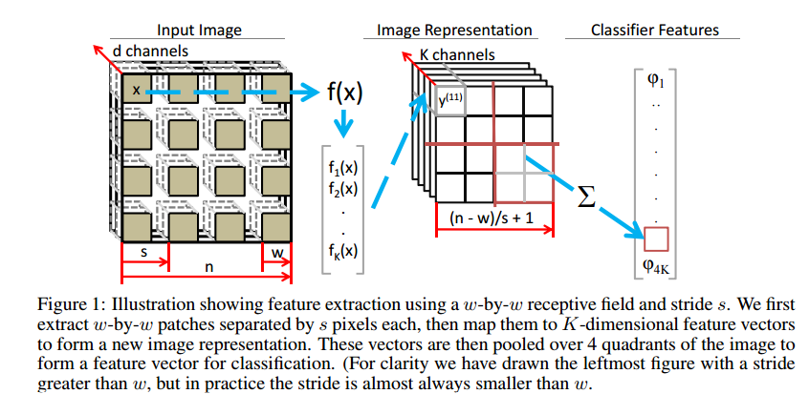

Slide 10
KNN (K-nearest neighbors)
K=3

Slide 11
Random forest
N training records, M attributes
Randomly pick records N times with replacement
randomly pick sqrt(M) attributes and find the best split

Slide 12
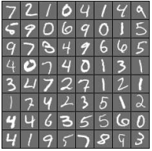
MNIST Dataset
one of the most popular datasets in pattern recognition
It consists of grey images of handwritten digits 0 ~9
60,000 training examples and 10,000 test examples
all have a fixed-size image with 28 × 28 in pixel

Slide 13
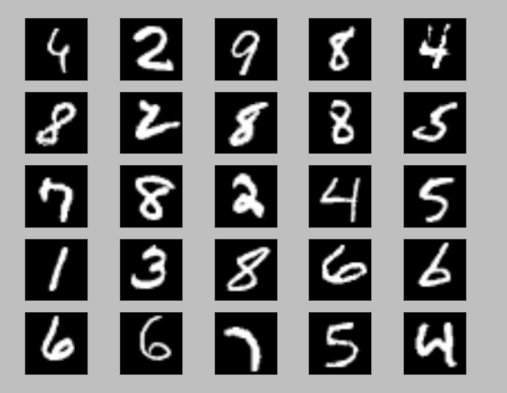
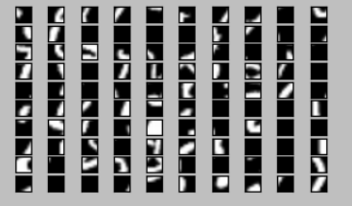
Example of Patches
Input images (28*28)
Samples of 6*6 patches

Slide 14
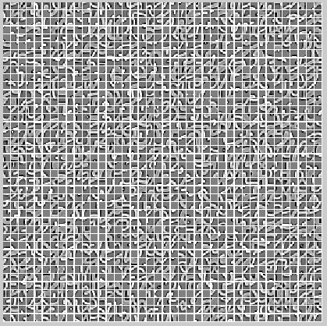
K-Means Result (1600 centroids)
MNIST Dataset

Slide 15
Accuracy for MNIST Dataset
Algorithm | Test accuracy (and error)
KNN (k=3) | 97.05%(2.95%)
KNN (k=3) + PCA (40 components) | 97.45% (2.55%)
Random Forest (Trees=1000) | 97.25% (2.75%)
SVM (Polynomial kernel degree=4, c=0.01 ) | 97.34% (2.66%)
K-Means Feature Learning (k=1600) | 98.97% (1.03%)
K-Means Feature Learning (k=2000) | 99.05% (0.95%)

Slide 16
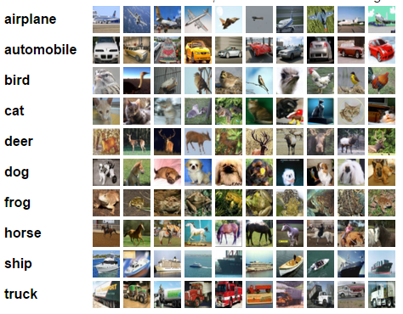
CIFAR-10 Dataset
consist of 60,000 32 × 32 color images in 10 classes, with 6,000 images per class
50,000 training images and 10,000 testing images
images vary in object positions and object scales within each class, also in colors and textures

Slide 17
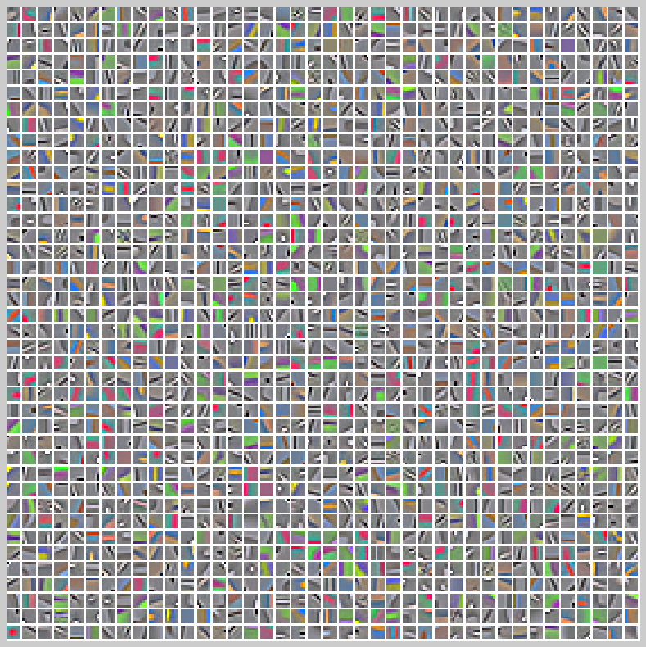
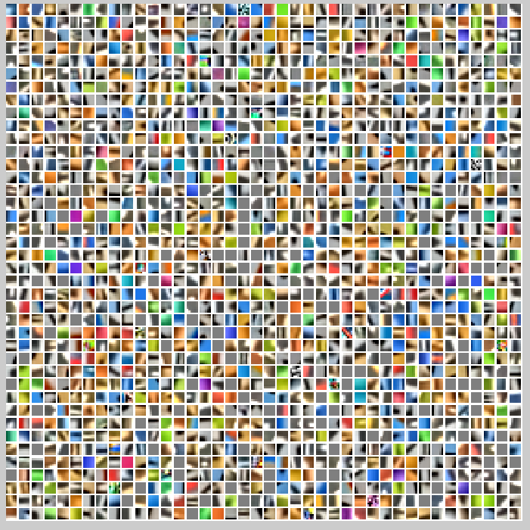
K-Means Result (1600 centroids)
CIFAR10 Dataset with whitening
CIFAR10 Dataset without whitening

Slide 18
Accuracy for CIFAR-10 Dataset
Algorithm | Test accuracy
KNN (k=5) | 33.98%
KNN (k=5) + PCA (40 components) | 40.35%
Random Forest (Trees=1000) | 49.28%
SVM (Polynomial kernel degree=4, c=0.01 ) | 47.32%
K-Means Feature Learning (k=1600) | 77.3%
K-Means Feature Learning (k=2000) | 77.96%
(77.96-49.28)/49.28*100%=58.20%

Slide 19
Effect of whitening

Slide 20
Effect of the number of clusters

Slide 21
Effect of receptive field size

Slide 22
K=1200 76.58%
k=800 75.32%
k=400 72.66%
k=200 69.25%
k=100 65.26%
Size=4 k=1600 76.45%
Size=8 k=1600 77.89%
Size=10 k=1600 76.93%
Size=12 k=1600 75.82%
Size=16 k=1600 73.79%
K=1600 size=6 no whitening 68.73
K=2000 size=6 no whitening 69.52
K=800 size =6 no whitening 65.27

Slide 23
References
[1] Wang, D and Tan, X.: C-SVDDNet: An Effective Single-Layer Network for Unsupervised Feature Learning (2015)
[2] Coates, A., Ng, A.Y.: Learning Feature Representations with K-means, G. Montavon, G. B. Orr, K.-R. M uller (Eds.), Neural Networks: Tricks of the Trade, 2nd edn, Springer LNCS 7700, 2012
[3] Coates, A., Lee, H., Ng, A.Y.: An analysis of single-layer networks in unsupervised feature learning. In: 14th International Conference on AI and Statistics. pp. 215– 223 (2011)
[4] The MNIST database of handwritten digits: Yann LeCun, Courant Institute, NYU; Corinna Cortes, Google Labs, New York; Christopher J.C. Burges, Microsoft Research, Redmond http://yann.lecun.com/exdb/mnist/
[5] The CIFAR-10 dataset: Learning Multiple Layers of Features from Tiny Images, Alex Krizhevsky, 2009. http://www.cs.toronto.edu/~kriz/cifar.html

Slide 24
Thank you!

Slide 25
Deep learning for MNIST: Accuracy=98.97%
KNN for MNIST:
K=20 96.25% k=15 96.33% k=10 96.65% k=5 96.88% k=3 97.05%
K=2 96.27%
Random Forest for MNIST:
Trees=500 97.17% Trees=1000 97.25% 300 97.12%
200 97.08% 100 96.89% 50 96.76% 30 96.47%
SVM for MNIST:
poly degree=4 c=0.01 97.34%
Deep learning for CIFAR: Accuracy=77.3%
KNN for CIFAR:
K=20 33.75% k=10 33.86% k=5 33.98%
Random Forest for CIFAR: 49.28% trees=1000 49.10% 500
SVM for CIFAR: 47.32% (poly degree=4 c=0.01)

