Slide 1
C-SVDDNet: An Effective Single-Layer Network for Unsupervised Feature Learning
Dong Wang and Xiaoyang Tan

Slide 2
I. INTRODUCTION
Learning good feature representation from unlabeled data is the key to make progress in recognition and classification tasks
A representative method is the deep learning (DL)
goal to learn multiple layers of abstract representations from data
one typical DL method is convolutional neural network (ConvNet)
consists of multiple trainable stages stacked on top of each other, followed by a supervised classifier
Many variations of ConvNet network have been proposed for different vision tasks with great success

Slide 3
neural network Vs. single-layer
feature learning | neural network | single-layer (K-means)
principle | one layer at a time on the lower level using unsupervised learning | map the input data into a feature representation by associating each data point to its nearest cluster center
performance | performance of single-layer learning has a big effect on the final representation | only one parameter (# of clusters) very easy to use in practice Coates et al. shows that it is capable to achieve superior performance compared to Neural network method
drawback | Neural network based single layer methods widely used have many parameters time consuming | too terse no consider the non-uniform distribution of cluster size clusters containing more data likely with higher influential power not robust against the noise/outliers

Slide 4
Support Vector Data Description
SVDD to measure the density of each cluster resulted from K-means clustering
a widely used tool to find a minimal closed spherical boundary to describe the data belonging to the target class
for a cluster of data, SVDD generate a ball containing the normal data except outliers
use the distance from the data to each ball’s surface instead of the center as the feature

Slide 5
local detail of the object representation
parameters define the feature extraction pipeline have more impact on the performance
K-means network with 4000 features achieve good performance on several benchmark datasets (better)
But a very crude pooling size has to be adopted to condense the resulting feature maps
large single-layer network highlighting global information of an object using large number of centroids
explore alternative architecture with much smaller number of nodes and with much finer pooling size
emphasize local details of object

Slide 6
II. PRELIMINARIES
Unsupervised Feature Learning
automatically discover useful hidden patterns/features in large datasets without labels
learnt patterns can be utilized to create representations
facilitate subsequent supervised learning

Slide 7
A typical pipeline for unsupervised feature learning
train a set of local filters from the unlabeled training data
given an input image, construct a set of feature maps for it using the learnt filters
apply a pooling operation
feature maps combined into a vector as the feature representation for the input image
local filters contain important prior knowledge about the distribution of the data, plays a critical role in the feature encoding

Slide 8
K-means for Feature Mapping
K-means divides data into a set of K clusters with Euclidean distance as similarity measure
aims to minimize the sum of distance between all data to their corresponding centers
K clusters used to produce a feature mapping
if we have K clusters, the dimension of the resulting feature representation will be K

Slide 9
way for feature mapping
hard coding
“triangle” encoding (better)
output 0 for the feature that has an above average distance to the centroid

Slide 10
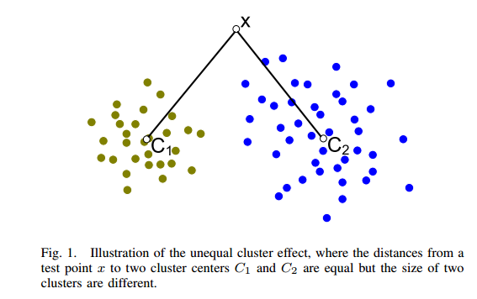
Factors affect feature representation
number of data point in each cluster
distribution of data points in each cluster
Notes:
As shown in Fig. 1, although the data point x has the same distance to the centers C1 and C2 of two clusters, it should be assigned a different score on C1 than on C2 since the former cluster C1 is much bigger than the latter. In practice such unequal clusters are not uncommon and the K-means method by itself can not reliably grasp the size of its clusters due to the existence of outliers

Slide 11
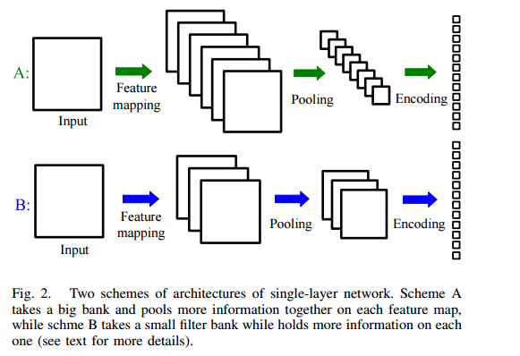
The architecture of the Single-layer Network
Notes:
an input image is first mapped into a set of feature maps using filter banks (or dictionary), which are then subjected to a pooling/subsampling operation to condense the information contained in the feature maps. Finally, the pooled feature maps are concatenated to a feature vector, which serves as the representation for the subsequent classification/cluster tasks
bigger filter banks help each sample find its nearby representative points more accurately but at the cost of yielding a high-dimensional representation, hence a crude pooling/subsampling is needed to reduce the dimensionality. Overall this type of architecture emphasizes more on the global aspects of the samples than on the local ones (e.g., local texture, local shape, etc.). Actually, Coates et al. show that this kind of network is able to yield state of the art results on several challenging datasets [11]. On the other hand, other works use smaller filter banks but highlight the importance of detailed local information in constructing the representation

Slide 12
THE PROPOSED METHOD

Slide 13
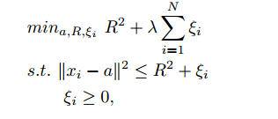
Using SVDD Ball to Cover Unequal Clusters
a ball is described by center a and the radius R
goal of SVDD is to find a closed spherical boundary around the given data points
KKT:

Slide 14
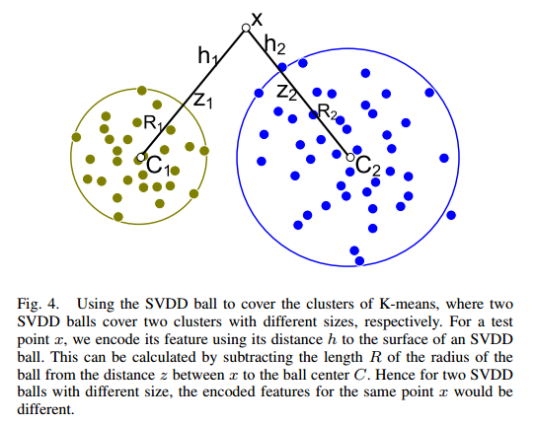
SVDD
compute distance hk to the surface of each SVDD ball Ck

Slide 15
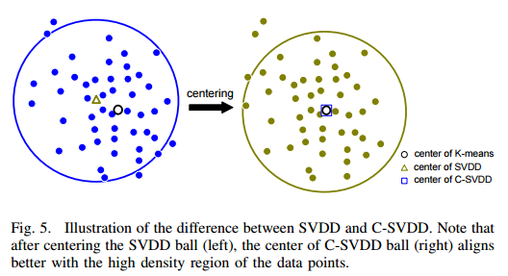
centered-SVDD Model
ball may not align well with the distribution of data points in that cluster

Slide 16
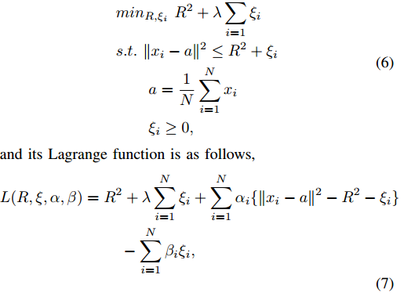
KKT
This objective function is linear to α,
and thus can be solved efficiently with
a linear programming algorithm.

Slide 17
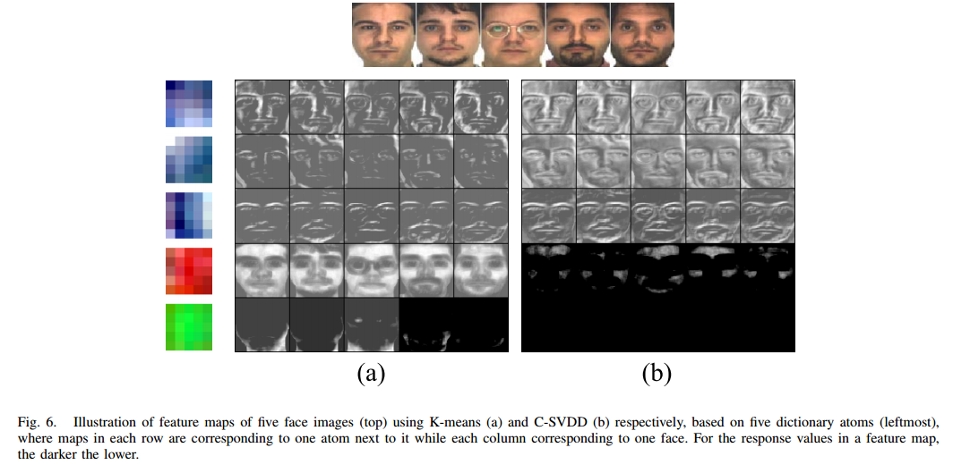
K-means Encoding vs. C-SVDD Encoding
Notes:
we learn a very small dictionary containing only five atoms using five face images, by clustering ZCA-whitened patches randomly sampled from the faces, and then take these for feature encoding.
By comparing the feature maps shown in Fig.6 (a) and Fig.6 (b), one can see that the C-SVDD-based ones contain more detailed information than the K-means feature maps for the first three atoms, while the responses of the last two atoms are largely suppressed by our method (c.f., last two rows of Fig.6 (b)).

Slide 18
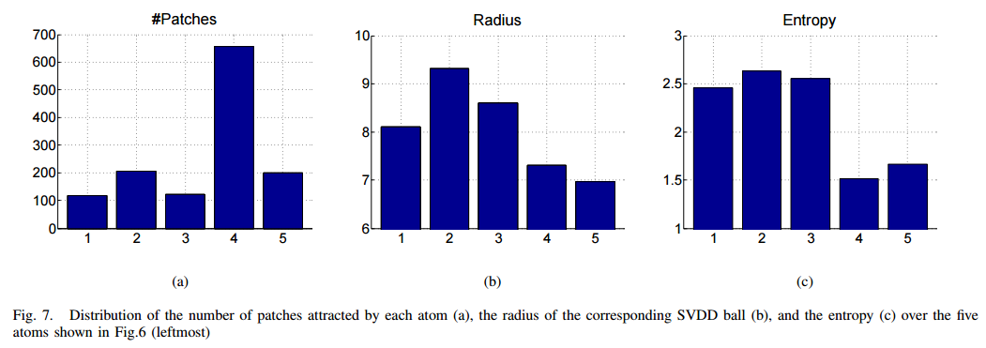
Notes:
The figure shows that the entropy of the last two atoms is much smaller than that of the first three ones, which indicates that the local appearance patterns captured by these last two atoms are much simpler than those by the first three. Hence these two atoms will tend to be widely used by many faces, resulting in reduced discriminative capability in distinguishing different subjects. In this sense, it will be useful to suppress their responses (c.f., the last two rows of Fig.6 (b)).

Slide 19
Encoding Feature Maps with SIFT Representation
SIFT is a widely used descriptor in computer vision and is helpful to suppress the noise and improve the invariant properties of the final feature representation
one problem of SIFT-based representation is its high dimensionality
For example, if we extract 128 dimensional SIFT-descriptors densely in 250 feature maps with the size of 23 × 23 in pixel, the dimension of the obtained representation vector will be as high as over 16M (250 × 23 × 23 × 128 = 16, 928, 000)
Notes:
Scale-invariant feature transform

Slide 20
divide each feature map into m × m blocks
extract an 8-bit gradient histogram from each block in the same way as SIFT does
This results in a feature representation with dimension of m × m × 8 for each map
significantly reducing the dimensionality while preserving rich information for the subsequent task of pattern classification

Slide 21
Multi-scale Receptive Field Voting
exploit multi-scale information for better feature learning
A multi-scale method is a way to describe the objects of interest in different sizes of context
patches of a fixed size can seldom characterize an object well - actually they can only capture local appearance information limited in that size
information at different levels is valuable in that they are not only discriminative by itself but complementary to each other as well

Slide 22
naive way to obtain multi-scale information by using receptive fields of different sizes
fetch patches with Si × Si , i = 1, 2, 3 squares in size from training images and use these to train dictionary atoms with corresponding size through K-means

Slide 23
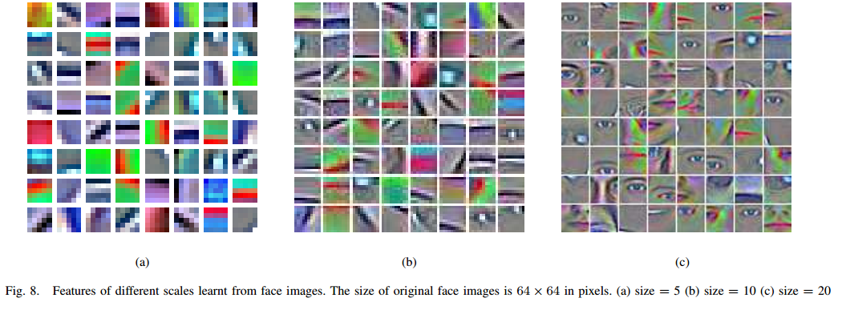
feature extractors similar to those using a typical ConvNet
At each scale train several networks with different pooling size

Slide 24
Classification
train a separate classifier on the output layer of the corresponding network (view) according to different receptive sizes and different pooling sizes
then combine them under a boosting framework

Slide 25
assume the total number of categories is C, and we have M scales (with K different number of pooling sizes for each scale), then we have to learn M × K × C output nodes
These nodes are corresponding to M × K multi-class classifiers.
Let us denote the parameter of the t− th classifier θ_{t} ∈ R^{D×C} (D is the dimension of feature representation) as θ_{t} = [w_{t1}, w_{t2}, ..., w_{tC} ], where w_{tk} is the weight vector for the k-th category. We first train these parameters using a series of one-versus-rest L2-SVM classifiers, and then normalize the outputs of each classifier using a soft max function

Slide 26
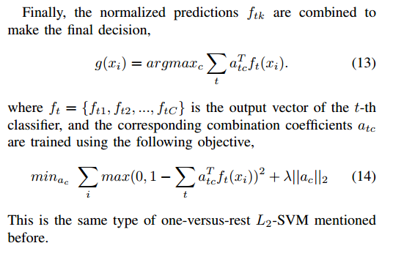

Slide 27
Experiments and Analysis

Slide 28
Datasets
4 object datasets
MINST, NORB, CIFAR-10, STL-10
MINST: popularly used in pattern recognition
NORB: used to evaluate the scalability of many learning algorithms
CIFAR-10: much noisy background
STL-10: popularly used to evaluate the algorithms of unsupervised learning

Slide 29
Experiment Settings
Whiten Preprocess
decorrelation transformation
Common Parameters:
#clusters: <=500
receptive field size: 5 x 5(default), 7 x 7, 9 x 9
average pooling size: 4 x 4, 1 x 1, 3 x 3
λ of C-SVDD: 1(default), 0.005

Slide 30
Experiment Settings continued
K-means:
"triangle" encoding method as baseline with K-means encoding
C-SVDD:
"triangle" encoding method as baseline with C-SVDD encoding
C-SVDDNet:
C-SVDD + SIFT representation encoding
MSRV + C-SVDDNet:
multi-scale Receptive Field voting + C-SVDDNet
K-meansNet:
K-means + SIFT representation

Slide 31
Experiment Results

Slide 32
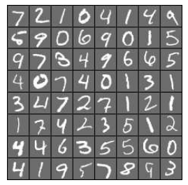
1st Dataset
MINST
consists of grey valued images of handwritten digits between 0 and 9

Slide 33
MINST
Process stage:
Size-normalized, centered into 28 x 28 pixel
400 atoms for feature mapping
Pooling
Extract SIFT features: break each feature map into 9 blocks
Multi-scale receptive voting:
Receptive fields: 5 x 5, 7 x7, 9 x 9
Pooling size: i.e. 1 x 1, 2 x 2
I combine with II to botain 6 different representations
λ value : 1
K-fold cross validation or specific evaluation protocol:
training sample size: 60,000; test sample size : 10,000

Slide 34
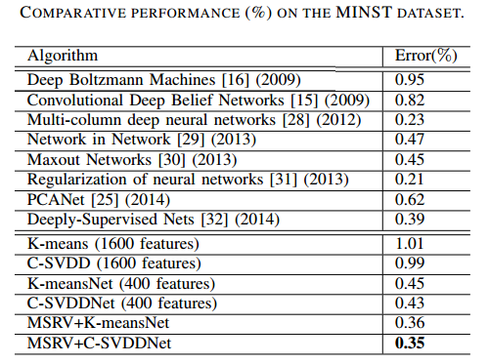
Experimental Results(MINST)

Slide 35
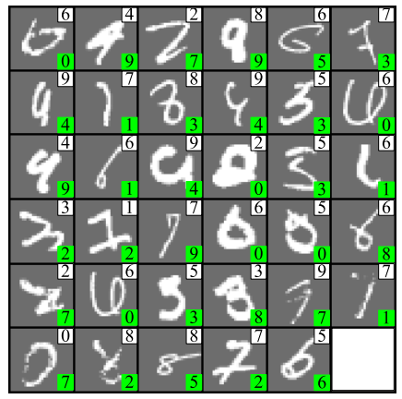
Experimental Results(MINST)
Result 1:
MSRV + C-SVDDNet achieves a low error, 0.35%, highly competitive to other methods.
35 misclasification among 10, 1000 test examples. Confused even for human beings.

Slide 36
Experimental Results(MINST)
Result 2 :
C-SVDDNet with smaller number of filters, reduces error rate by 65%, compared with K-means network.
Result 3:
At least on this dataset, representation is worth to be emphasized more than global aspects using large number of filters and large pooling size.

Slide 37
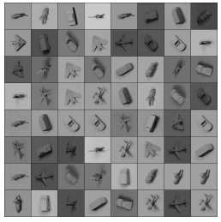
2nd Dataset
NORB
Mnay feature learning algorithms use this database as a benchmark to evaluate their scalability
Before the proposed method, fine-tuned K-means single-layer network was previously shown yield better performance
consists of large amounts of object images
5 classes: animals, humans, planes, trucks, and cars

Slide 38
NORB
Process step:
Normalized-uniform and centered: 96 x 96pixel
Resize all images to 64 x 64 pixel
400 atoms
Average Pooling
Extract SIFT features: break each feature map into 4 x 4 block size
Multi-scale receptive voting:
Receptive fields: 5 x 5, 7 x7
Pooling size: i.e. 2 x 2, 3 x 3, and 4 x 4
I combine with II to botain 6 different representations for each input image
λ value : 1
Specific evaluation protocol
training sample size: 29,160 images; test sample size : 29,160 images

Slide 39
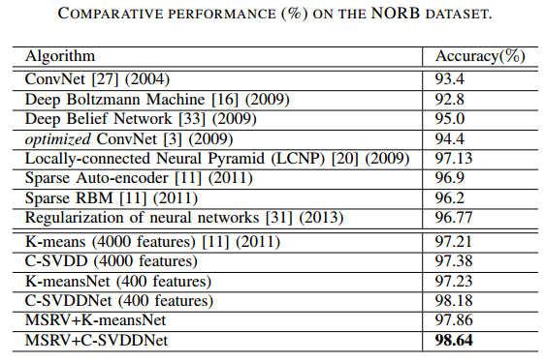
Experimental Results(NORB)

Slide 40
Experimental Results(NORB)
MSRV + C-SVDDnet achieves the highest accuracy: 98.64% on a huge dataset nearly 60 thousands data
compared with previously shown that K-means(4000 features) has a better performance than aforementioned methods, MSRV + C-SVDDnet achieve the state of the art performance(only 400 atoms).

Slide 41
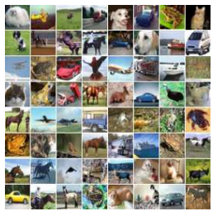
3rd Dataset
CIFAR-10
consists of 60,000 32 x 32 colour images
contains 10 classes, with 6,000 images per class.
within each class, images vary in object positions, objection scales, colors, and textures
Images background cluttered, low resolution

Slide 42
CIFAR-10
Process step:
Larger dictionary: 1,200 atoms
Average Pooling
Extract 32-bit SIFT features: break each feature map into 4 blocks
Multi-scale receptive voting:
Receptive fields: 5 x 5, 7 x7, 9 x 9
Pooling size: i.e. 1 x 1, 2 x 2
I combine with II to botain 6 different representations for each input image
λ value : 0.05, remove noise, larger SVDD balls
Specific evaluation protocol
training sample size: 50,000 images; test sample size : 10,000 images

Slide 43
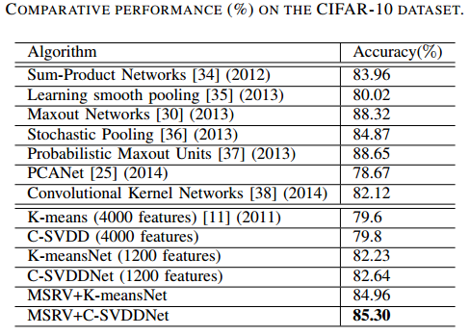
Experimental Results(CIFAR-10)

Slide 44
Experimental Results(CIFAR-10)
MSRV + C-SVDDnet achieves the high accuracy: 85.30% close to the state of the art performance.

Slide 45
Experimental Results(CIFAR-10)
Another result from table:
C-SVDDNet, achieve an accuracy 82.64%, outperforms other multi-layer architecture systems, such as PCANet, Convolutional Kernel Networks.
Possible explanation from table:
SIFT encoding leads to more robust representation.

Slide 46
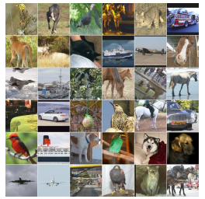
4th Dataset
STL-10
100,000 unlabeled images, 13,000 labeled images(10 object classes), where 5,000 images for training, 8,000 for training
images size : 96 x 96 pixel
Images background cluttered, vary in scales, poses.

Slide 47
STL-10
Process step:
Specific evaluation protocol
Original 5,000 training images are partitioned into 10 overlapped folds, with 1,000 images in each fold
Each fold: training sample size: 1,000, testing: 8,000
Evaluation across 10 folds
Dictionary: 500 atoms
For unsupervised feature learning, randomly select 20, 000 unlabled data
Spatial pooling: 4 x 4
Extract SIFT representation
Multi-scale receptive voting:
Receptive fields: 5 x 5, 7 x7
Pooling size: i.e. 2 x 2, 3 x 3, 4 x 4, 5 x 5, 6 x 6
I combine with II to botain 10 different representations for each input image
λ value : 1

Slide 48
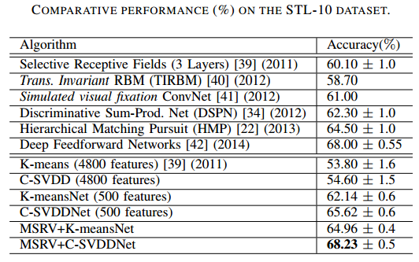
Experimental Results(STL-10)

Slide 49
Experimental Results(STL-10)
MSRV + C-SVDDnet achieves the highest accuracy: 68.23% around, outperforms the current best performer (Deep Feedforward Networks) on the challenging dataset, with 2.6% improvement in accuracy

Slide 50
Experimental Results(STL-10)
Another result from table:
C-SVDDNet, achieve an accuracy 65.62%, outperforms in RBM, Selective Receptive Fields, and Discriminative Sum-Product Networks.
C-SVDDNet, better than K-meansNet with higher 3.0% improvement in accuracy.

Slide 51
The influence of Parameters and Discussions

Slide 52
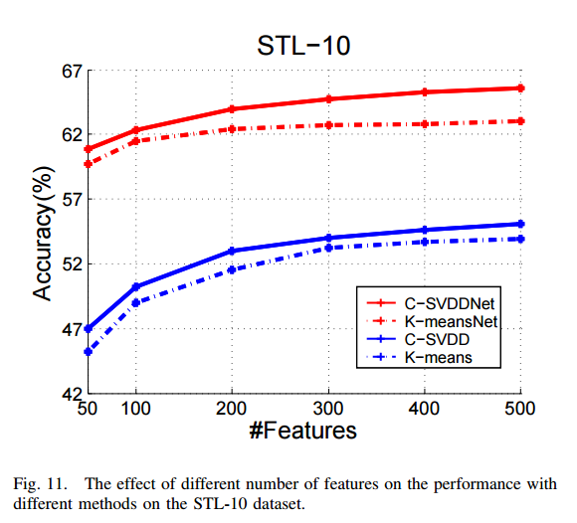
Parameter 1: feature number

Slide 53
Parameter 1: feature number
Result 1 from figure
K-means and C-SVDD: performance rises, with feature number increases.
Explanation: more dicitonary atoms help disentangle variation factors.
Drawback: large dictionary increases redundancy, decreases the efficiency/
Result 2 from figure:
C-SVDD consistently works better than K-means, with different feature number
C-SVDDNet reduces atoms without sacrifying the performance
The previous table for STL-10 dataset show C-SVDDNet with 500 atoms has a over 12% performace increasement than C-SVDD with 4,800 atoms.

Slide 54
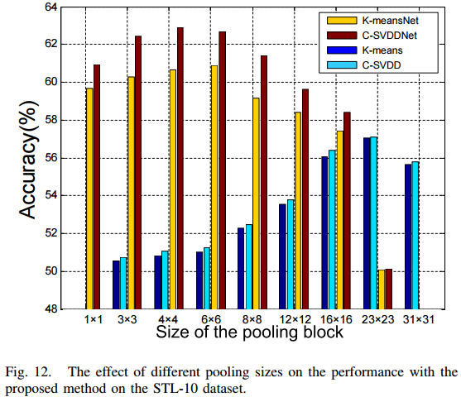
Parameter 2: pooling size

Slide 55
Parameter 2: Pooling Size
Parameter settings:
original image: 96 x 96 pixel
receptive field: 5 x 5
feature maps: 92 x 92
pooling blocks: m x m, where m x m from 1 x 1 to 31 x 31

Slide 56
Parameter 2: pooling size
Result from figure about Pooling size
signle-layer K-means-based network and C-SVDD need bigger block size for improved translation invariance.
K-meansNet and C-SVDDNet can reduces pooling size and achieve better performance
Possible explanation:
SIFT encoding could characterize more detailed information of the objects to be represented

Slide 57
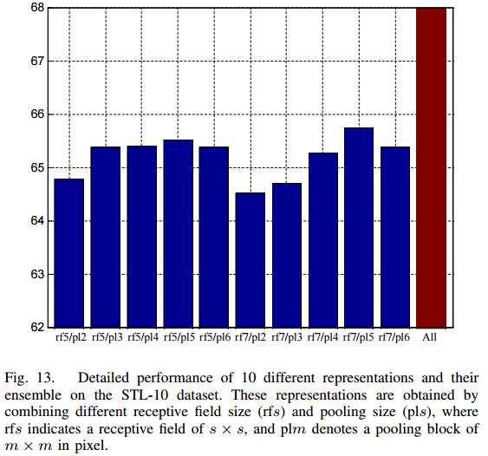
Parameter 3: multi-scale receptive field voting

Slide 58
Parameter 3: multi-scale receptive field voting
Parameter Settings:
receptive field types: 5 x 5, 7 x 7
pooling size: 2 x 2, 3 x 3, 4 x 4, 5 x 5, 6 x 6

Slide 59
Parameter 3: multi-scale receptive field voting
Results from the figure:
Different representation have different prediction accuracy
The combination of different representation results in better performance
Indication
Representation within different receptive fields and pooling size are complementary to each other.

Slide 60
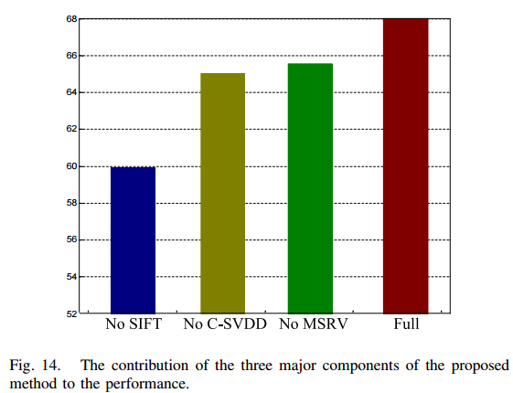
Discussion: Contribution of components

Slide 61
Discussion: Contribution of components
Discussion with individual stages of C-SVDD-based encoding, SIFT-representation, and multi-scale voting, respectively.
comparison strategy: one versus the full method
Result from the figure:
Each stage is beneficial for the performance
SIFT stage contribute the most.

