Slide 1
Metagenomics Binning and Machine Learning
By: Abdulrhman Aljouie

Slide 2
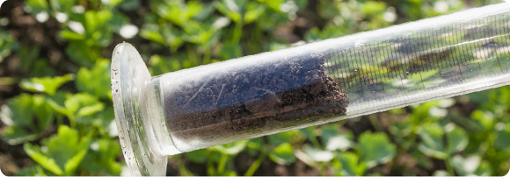
Introduction
Image source: http://www.mgrc.com.my/
Metagenomics defined by National Human Genome Research Institute as “the study of a collection of genetic material (genomes) from a mixed community of organisms”. Usually refers to the study of microbial communities.
Facts: Single gram of soil contains between 5,000 and 40,000 species (conservatively defined) of microbes. This community is one of the most difficult to study because the vast majority of members — probably more than 99.9 percent — cannot be cultured by existing methods (Handelsman LAB, retrieved 4/2015)
Bacteria responsible for 25% deaths. (Handelsman, 2005).
Antibacterial Discovery Void: no major classes of antibiotics were introduced between 1962 and 2000 and refers to the interim as an innovation gap (Lynn L., 2011).

Slide 3
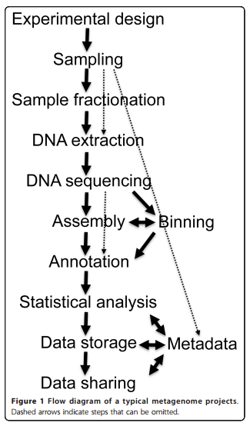
Steps of Seq-based metagenomics project
DNA extraction: process of purification of DNA from sample using a combination of physical and chemical methods. (e.g. removing membrane lipids, protein, RNA).
DNA Sequencing: determining the order of nucleotides within DNA molecule (i.e. A G C T). DNA sequencers example (Illumina HiSeq 2000).
Fig source: Thomas et al. Microbial Informatics and Experimentation 2012, 2:3

Slide 4
Cont. Steps of Seq-based metagenomics project
DNA Assembly: merging DNA fragments to reconstruct original sequence. There are two methods:
De novo: short-reads transcriptome assembly e.g. Trans-ABySS.
Mapping: assembly against reference genome e.g. BWA.
Annotation: identify genes location e.g. RAST.
Fig source: Thomas et al. Microbial Informatics and Experimentation 2012, 2:3

Slide 5
Binning
Metagenomics binning is a classification of the sequence data according to the contributing species.
Algorithms developed utilizing two types of information within the DNA sequence:
similarity-based binning.
Compositional binning algorithms.

Slide 6
Similarity-based binning
The unknown DNA fragment might encode for a gene and the similarity of this gene with known genes in a reference database can be used to classify and hence bin the sequence (Metagenomics - a guide from sampling to data analysis, 2012).

Slide 7
Example of Similarity-based binning
MEGAN: a new computer program that allows laptop analysis of large metagenomic data sets. In a preprocessing step, the set of DNA sequences is compared against databases of known sequences using BLAST or another comparison tool. MEGAN is then used to compute and explore the taxonomical content of the data set, employing the NCBI taxonomy to summarize and order the results (Daniel et al. , 2007).

Slide 8
MEGAN loads the complete NCBI taxonomy, currently containing >280,000 taxa, which can then be interactively explored using customized tree-navigation features. However, the main application of MEGAN is to process the results of a comparison of reads against a database of known sequences. The program parses files generated by BLASTX, BLASTN, or BLASTZ, and saves the results as a series of read–taxon matches in a program-specific metafile. (Additional parsers may be added to process the results generated by other sequence comparison methods.)
The program assigns reads to taxa using the LCA (Lowest common ancestor) algorithm and then displays the induced taxonomy. Nodes in the taxonomy can be collapsed or expanded to produce summaries at different levels of the taxonomy.

Slide 9
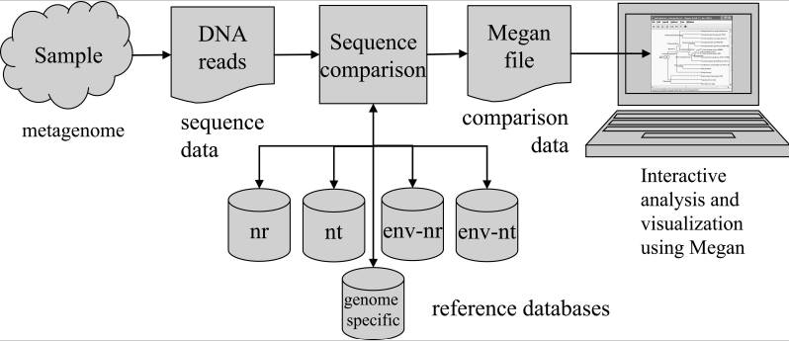

Slide 10
Compositional binning algorithms
compositional binning makes use of the fact that genomes have conserved nucleotide composition (e.g. a certain GC or the particular abundance distribution of k-mers) and this will be also reflected in sequence fragments of the genomes (Metagenomics - a guide from sampling to data analysis, 2012).

Slide 11
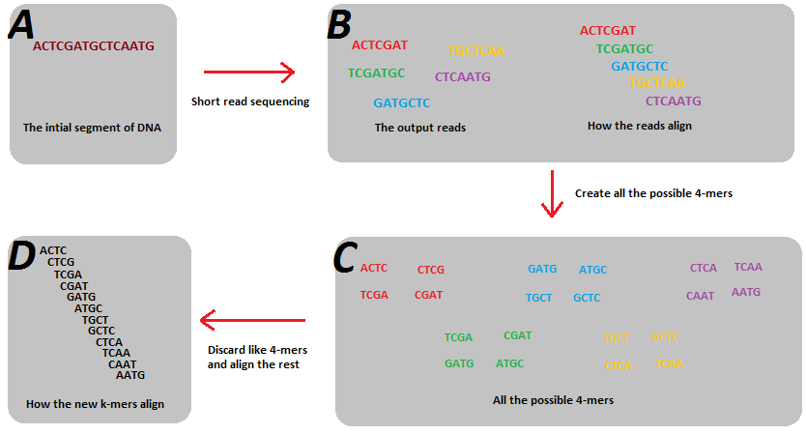
K-mer

Slide 12
GC content
GC content expressed as a percentage value:

Slide 13
Example of compositional binning algorithms
TACOA: A multi-class taxonomic classifier was developed for environmental genomic fragments. It applies the intuitive idea of the k-nearest neighbor (k-NN) approach
a genomic fragment is defined as a DNA sequence of a given length. The total number of oligonucleotides of length l, from the alphabet ∑ = {a, t, c, g} is given by 4^{l}. Each genomic fragment is represented as a vector (i.e. GFV). For each of the possible four oligonucleotides in a sequence, the vector stores the ratio between the observed frequency of that oligonucleotide to the expected frequency given the GC-content of that genomic fragment.

Slide 14
Cont. Example of compositional binning algorithms
It use a smoother kernel function with Gaussian density to profit from its implicit weighting scheme, thus allowing more flexibility on setting the neighborhood width and in handling high-dimensional input data. The weights given by a smoother kernel function decrease as the Euclidean distance between the classified GFV and the reference vector increases. The rate at which the weights decreases is controlled by the neighborhood width λ

Slide 15
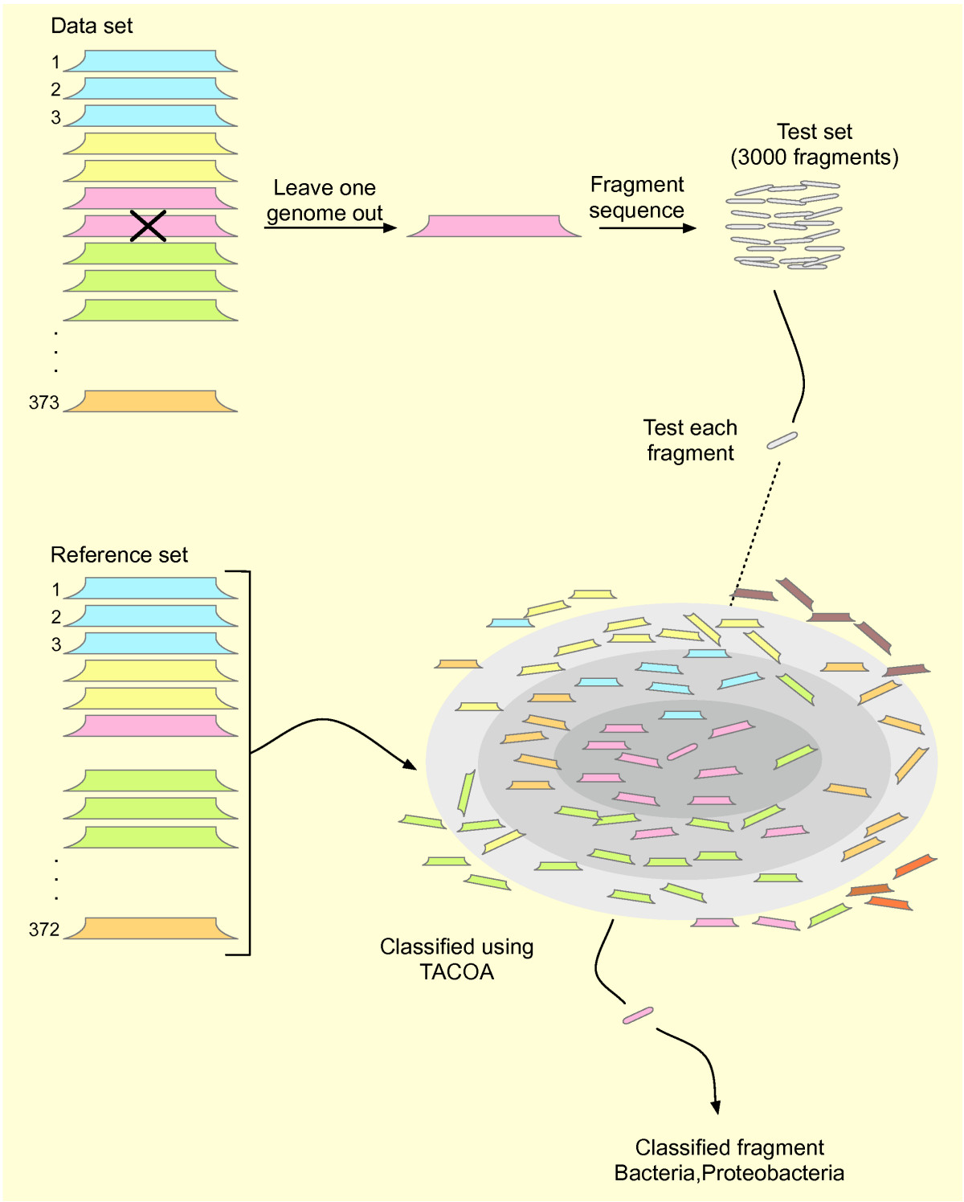
Genome is selected from the data set comprising 373 genomes and fragmented subsequently. The collection of genomic fragments is regarded as the test set from which each fragment is drawn and subsequently classified. Classification of each test fragment is carried out using the remaining 372 organisms as a reference.

Slide 16
Accuracy

Slide 17
Hybrid, a combination of both methods
PhymmBL : Phymm, a classification approach for metagenomics data which uses interpolated Markov models (IMMs) to taxonomically classify DNA sequences, can accurately classify reads as short as 100 bp. Its accuracy for short reads represents a significant leap forward over previous composition-based classification methods. PhymmBL (rhymes with "thimble"), the hybrid classifier included in this distribution which combines analysis from both Phymm and BLAST, produces even higher accuracy.

Slide 18
Metagenomics Binning Technique Via Using Random Forest
It use Oligonucleotide frequencies from 2-mers to 4-mers as features to differentiate between the sequences. By using forward sequential feature selection. Then, based on the reduced feature set compared the classification accuracy between Random Forest classifier and Naïve Bayes classifier. Also, analyze and compare the forward sequential feature selection to the popular t test feature selection method, and analyze the effect of these two feature reduction and selection methods on the classification accuracy of the DNA sequences. It found, as sequence feature representation, that using the existence or non-existence of K-mers rather than using the actual frequency of K-mers in a particular reads, result in better and more accurate classification (Helal S. & Dalila M., 2013)

Slide 19
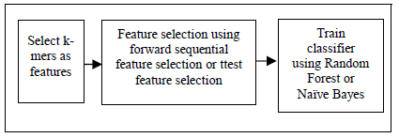
Pipeline for Binning Technique Via Using Random Forest

Slide 20
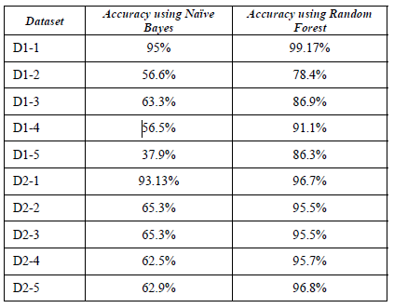
Results Using Forward Sequential Feature Seletion using Naïve Bayes And Random Forest

