Slide 1
Iterative MapReduce Approach to Frequent Subgraph Mining in Biological Datasets
MapReduce on Multi-core
Presented by: Wadood Chaudhary

Slide 2
Outline of the Presentation
Introduction
MapReduce Overview
MapReduce on Muti-Core
Term Project
Frequent subgraph Mining Algorithm for MapReduce
Conclusion
CS 732: Machine Learning
3
Notes:
Experimental results.

Slide 3
Part I MapReduce Overview
14

Slide 4
MapReduce Model
MapReduce
Programming model from LISP
Closer to functional languages.
Solves many problems
Load balancing
Easy to distribute across nodes
Built-in retry/failure semantics
Apache and Google have used it successfully.
CS 732: Machine Learning
15

Slide 5
MapReduce History
MapReduce
http://www.cnet.com/news/google-spotlights-data-center-inner-workings/
The MapReduce software is increasing use within Google. It ran 29,000 jobs in August 2004 and 2.2 million in September 2007. Over that period, the average time to complete a job has dropped from 634 seconds to 395 seconds, while the output of MapReduce tasks has risen from 193 terabytes to 14,018 terabytes, Dean said. On any given day, Google runs about 100,000 MapReduce jobs; each occupies about 400 servers and takes about 5 to 10 minutes to finish, Dean said.
The Global Hadoop Market is expected to reach US$8.74 billion by 2016, growing at a CAGR of 55.63 percent during the period 2012–2016.Easy to distribute across nodes
CS 732: Machine Learning
15

Slide 6
MapReduce Model
User
Program
fork
fork
fork
assign
map
Master
assign
reduce
CS 732: Machine Learning
Input Data
Worker
Output
File 0
write
local
write
Worker
Split 0
read
Split 1
Worker
Split 2
Output
File 1
Worker
Worker
remote
read,
sort
16

Slide 7
MapReduce Components
Input, final output are stored on a distributed file system
Scheduler tries to schedule map tasks “close” to physical storage location of input data
Intermediate results are stored on local FS of map and reduce workers
Output is often input to another map reduce task
CS 732: Machine Learning
17

Slide 8
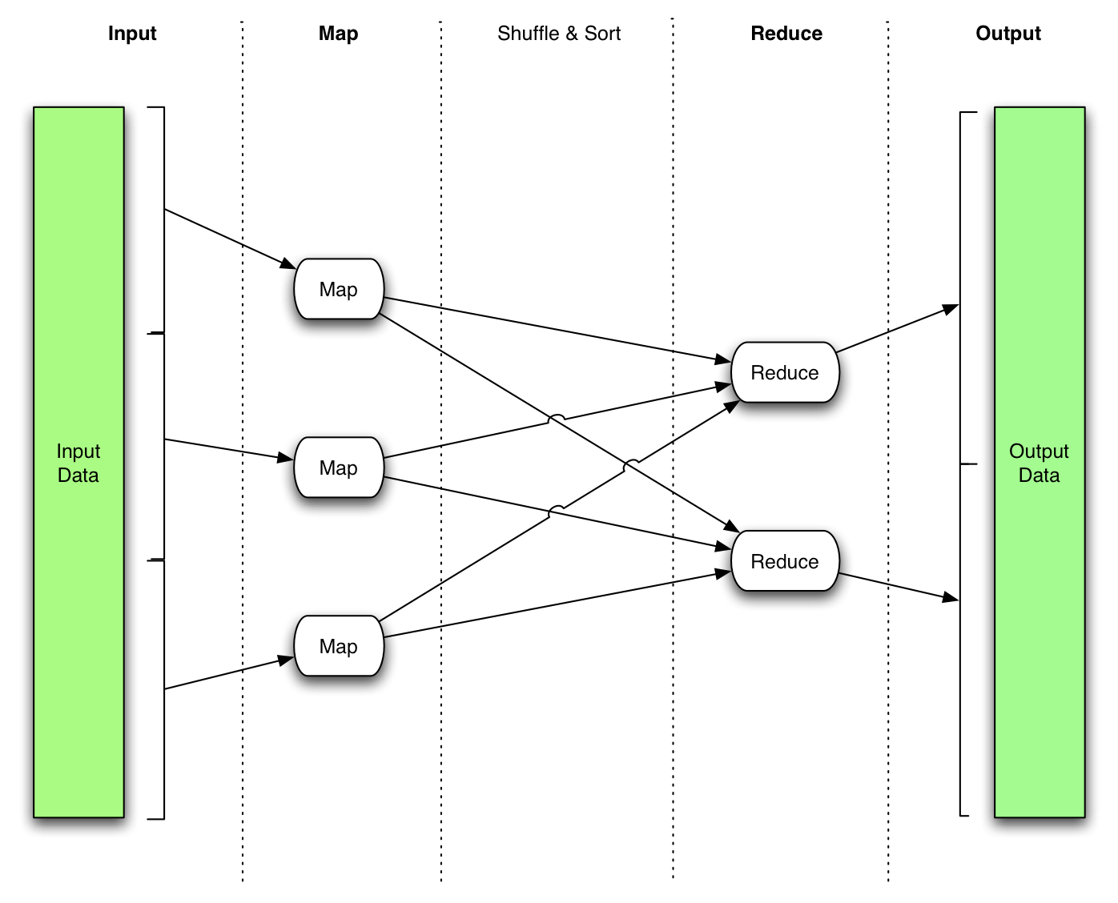
MapReduce Dataflow
CS 732: Machine Learning
(Image source: MapReduce FAQ)
18

Slide 9
MapReduce Benefits
Computation is paralleled across cluster.
Fault Tolerant.
Scheduled Efficiency.
Proven to be useful abstraction
Simplifies large-scale computations
CS 732: Machine Learning
19

Slide 10
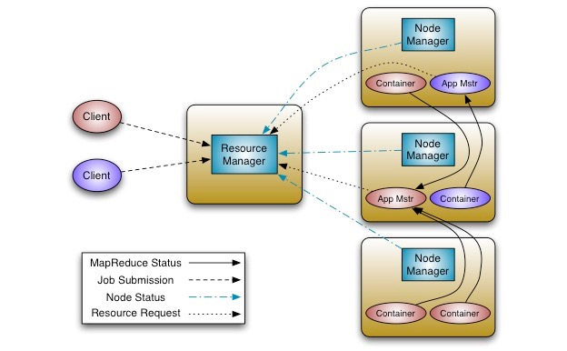
Hadoop
An open-source implementation of Map Reduce in Java
Uses HDFS for stable storage
CS 732: Machine Learning
(Image Source: Hadoop FAQ.)
20

Slide 11
Map-Reduce for Machine Learning on Multicore
Cheng-Tao Chu Yi-An Lin ∗ chengtao@stanford.edu
Kunle Olukotun ∗ kunle@cs.stanford.edu
Sang Kyun Kim
skkim38@stanford.edu
YuanYuan Yu
yuanyuan@stanford.edu
Andrew Y. Ng
ang@cs.stanford.edu
Presented by: Wadood Chaudhary

Slide 12
Goal on Multicore
Multicore
A general means of programming machine learning on multicore.
Developing a general and exact technique for parallel programming of a large class of machine learning algorithms for multicore processors.
The central idea of this approach is to allow a future programmer or user to speed up machine learning applications by ”throwing more cores” at the problem rather than search for specialized optimizations.
CS 732: Machine Learning
11

Slide 13
Main Contributions
Develop a pragmatic and general framework
We show that any algorithm fitting the Statistical Query Model may be written in a certain “summation form.
This form does not change the underlying algorithm and so is not an approximation, but is instead an exact implementation.
The summation form does not depend on, but can be easily expressed in a map-reduce framework which is easy to program in.
This technique achieves basically linear speed-up with the number of cores.
CS 732: Machine Learning
11

Slide 14
Sum Values from a Large Data Set
Data set D divided into d1, d2, ... dn.
Mappers running on CPU 1, CPU 2, ... CPU n
Each mapper forms a sum over its piece of the dat and emits the sum s1, s2, ... sn.
CPU 1 – mapper Sum Elements of d1
CPU 1 – mapper Sum Elements of d1
CPU 1 – mapper Sum Elements of d1
CS 732: Machine Learning
Reducer Sum Mapper Outputs
11

Slide 15
Main Contributions
Locally Weighted Linear Regression, Naïve Bayes,
Gaussian Discriminative Analysis, k-Means,
Neural Networks,
Principal Component Analysis, Independent Component Analysis, Expectation Maximization, Support Vector Machines
In some cases, iteration is required. Each iterative step involves a map-reduce sequence
Other machine learning algorithms can be arranged for map reduce – but not in Statistical Query Model form (e.g. canopy clustering or binary decision trees)
CS 732: Machine Learning
11

Slide 16
Statistical Query Model
Mappers compute partial sums of the form ∑(􏰀􏰁􏰀􏰁xixiT) and ∑xiyi
Reducer aggregates the partial sums into totals and completes the calculation Θ* = A-1 b􏰀􏰁 􏰃􏰁
CPU 1 – mapper
Sum xix,T & xiyi for xi ε d1
CPU 2 - mapper
Sum xix,T & xiyi for xi ε d2
CPU - mapper
Sum xix,T & xiyi for xi ε dn
CS 732: Machine Learning
Sumxx,, Sumxy
Sumxx,, Sumxy
Sumxx,Sumxy
Reducer
Aggregate mapper outputs
A = ∑Sumxx, b = ∑Sumxy Calculate: Θ* = A-1 b
11

Slide 17
Statistical Query and Summation Form
Isolated Cores.
There is little communication between cores.
multicore mostly benefits concurrent applications
the data is subdivided and stays local to the cores
Kearns’ Statistical Query Model
Given a function f (x, y) over instances, the statistical query oracle returns an estimate of the expectation of f (x, y) (averaged over the training/test distribution).
Algorithms that calculate sufficient statistics or gradients fit this model, and since these calculations may be batched, they are expressible as a sum over data points.
CS 732: Machine Learning
11

Slide 18
Linear Regression
Isolated Cores.
y = θ^{T} x by solving: θ∗ = min_{θ} ^{m}_{i=1}(θ^{T} x_{i} − y_{i})² The parameter θ is typically solved for by
Defining the design matrix X ∈ R^{m×n} to be a matrix whose rows contain the training instances x₁, . . . , x_{m}, letting ⃗y = [y₁, . . . , y_{m}]^{m} be the vector of target labels, and solving the normal equations to obtain θ∗ = (X^{T} X)⁻¹X^{T} ⃗y.
To put this computation into summation form, we reformulate it into a two phase algorithm where we first compute sufficient statistics by summing over the data, and then aggregate those statistics and solve to get θ∗ = A⁻¹b. Concretely, we compute A = X^{T} X and b = X^{T} ⃗y as follows: A = ^{􏰃m}_{i=1} (x_{i} x^{T}_{i} ) and b = ^{􏰃m}_{i=1} (x_{i} y_{i} ). The computation of A and b can now be divided into equal size pieces and distributed among the cores. We next discuss an architecture that lends itself to the summation form: Map-reduce.
CS 732: Machine Learning
11

Slide 19
More Map Reduce Detail
Mappers emit a key-value pair <key, value>
controller sorts key-value pairs <key, value> by key Reducer gets pairs grouped by key
Mapper can be a two-step process
Mapper emit each xixiT and xiyi, instead of emitting sums of
these quantities
Post processing the mapper output (e.g. forming ∑ ) is a mapper function called "combiner" Reduces network traffic
CS 732: Machine Learning
11
Notes:
We assume that the dimension of the inputs is n (i.e., x ∈ Rn), that we have m training examples, and that there are P cores. The complexity of iterative algorithms is analyzed foroneiteration,andsotheiractualrunningtimemaybeslower.1 Afewalgorithmsrequirematrix inversion or an eigen-decomposition of an n-by-n matrix; we did not parallelize these steps in our experiments, because for us m >> n, and so their cost is small. However, there is extensive research in numerical linear algebra on parallelizing these numerical operations [4], and in the complexity analysis shown in the table, we have assumed that matrix inversion and eigen-decompositions can be sped up by a factor of P ′ on P cores. (In practice, we expect P ′ ≈ P .) In our own software imple- mentation, we had P ′ = 1. Further, the reduce phase can minimize communication by combining data as it’s passed back; this accounts for the log(P ) factor.

Slide 20
Architecture
CS 732: Machine Learning
11
Notes:
Many programming frameworks are possible for the summation form, but inspired by Google’s success in adapting a functional programming construct, map-reduce [7], for wide spread parallel programming use inside their company, we adapted this same construct for multicore use. Google’s map-reduce is specialized for use over clusters that have unreliable communication and where indi- vidual computers may go down. These are issues that multicores do not have; thus, we were able to developed a much lighter weight architecture for multicores, shown in Figure 1.
Figure 1 shows a high level view of our architecture and how it processes the data. In step 0, the map-reduce engine is responsible for splitting the data by training examples (rows). The engine then caches the split data for the subsequent map-reduce invocations. Every algorithm has its own engine instance, and every map-reduce task will be delegated to its engine (step 1). Similar to the original map-reduce architecture, the engine will run a master (step 1.1) which coordinates the mappers and the reducers. The master is responsible for assigning the split data to different mappers, and then collects the processed intermediate data from the mappers (step 1.1.1 and 1.1.2). After the intermediate data is collected, the master will in turn invoke the reducer to process it (step 1.1.3) and return final results (step 1.1.4). Note that some mapper and reducer operations require additional scalar information from the algorithms. In order to support these operations, the mapper/reducer can obtain this information through the query info interface, which can be customized for each different algorithm (step 1.1.1.1 and 1.1.3.2).

Slide 21
Canopy Clustering
Algorithm:
Given set of points P and distance measure d(,) Pick two distance thresholds T1 > T2 > 0
Step 1: Find cluster center
Initialize set of centers C=null
Iterate over points pi ε P
If there isn't c ε C s.t. d(c,pi) < T2 Add pi to C
get next pi
Step 2: Assign point to clusters
For pi ε P assign
pi to {c ε C: d(pi ,c)<T1}
(Notice that points generally get assigned to more than one cluster)
CS 732: Machine Learning
11
Notes:
Usually used as rough clustering to reduce computation (e.g. search zip code for the closest pizza versus search the world)
Find well distributed initial conditions for other clustering also (K-Means)

Slide 22
Canopy Clustering
CS 732: Machine Learning
11

Slide 23
Canopy Clustering with MapReduce
1st Pass – Find centers
Mappers – Run canopy clustering on subset, pass centers to reducer Reducer – Run canopy clustering on centers from mappers.
2nd Pass – Make cluster assignments (if necessary)
Mappers– compare points pi to centers to form
set ci ={cεC|d(pi ,c)<T1}
Emit<key,value>=<c,pi >for each c ε ci
Reducer – Since the reducer input is sorted on key value, the reducer input will be a list of all the points assigned to a given center.
CS 732: Machine Learning
11
Notes:
(here, that's cluster center)
-One small problem is that the centers picked by the reducer may not cover all the points of the combined original set. Pick T1 > 2*T2 or use larger T2 in reducer in order to insure that all points are covered.

Slide 24
K-means Clustering
-K-means algorithm seeks to partition a data set into K disjoint sets, such that the sum of the within set variances is minimized.
-Using Euclidean distance, within set variance is the sum of squared distances from the set's centroid
-Lloyd's algorithm for K-means goes as follows:
Initialize:
Pick K starting guesses for centroids (at random)
Iterate:
Assign points to cluster whose centroid is closest Calculate cluster centroids
CS 732: Machine Learning
11

Slide 25
K-Means Clustering
CS 732: Machine Learning
Wikipedia page on k-means clustering http://en.wikipedia.org/wiki/K-means_clustering
11

Slide 26
K-Means Clustering with MapReduce
Mapper – given K,
..run through local data
..and for each point, determine which centroid is closest,
..accumulate vector sum of points closest to each centroid,
Combiner
emits <centroidi , ( sumi , ni)> for each of the i centroids.
Reducer – for each old centroid,
aggregate sum and n from all mappers
and calculate new centroid.
This completes an iteration of Lloyd's algorithm.
CS 732: Machine Learning
11
Notes:
initial guesses

Slide 27
Support Vector Machines
For classification, SVM finds separating hyperplane
-H3 does not separate classes. H1 separates, but not with max margin. H2 separates with max margin
CS 732: Machine Learning
11

Slide 28
Regression Step
Calculating a Gradient Step
1. In the equation we wound up with terms like (w + 􏰈􏰇 ∑(􏰉,􏰊)∈ 􏰋􏰌 −􏰃􏰀), only the term inside the sum is data dependent.
Mapper–accumulate – y and – yx. Emit <,(∑-y, ∑ -yx)>. We'll put in a dummy key value, but all the output gets summarized in a single (vector) quantity to be processed by a single reducer
Reducer – Accumulate ∑-y and ∑ -yx and update estimate of w and b using
wnew = wold - ε (wold + 􏰈􏰇 ∑-yx)
bnew =bold -ε(􏰈􏰇 ∑-y)
CS 732: Machine Learning
11

Slide 29
Machine Learning Algorithms
CS 732: Machine Learning
11

Slide 30
Machine Learning Algorithms
CS 732: Machine Learning
11

Slide 31
Machine Learning Algorithms
CS 732: Machine Learning
11

Slide 32
Single vs. Multi-Processor=P

Slide 33
Data Sets
Notes:
Table 3 shows the speedup on dual processors over all the algorithms on all the data sets. As can be seen from the table, most of the algorithms achieve more than 1.9x times performance improvement. For some of the experiments, e.g. gda/covertype, ica/ipums, nn/colorhistogram, etc., we obtain a greater than 2x speedup. This is because the original algorithms do not utilize all the cpu cycles efficiently, but do better when we distribute the tasks to separate threads/processes.

Slide 35
Speedup Cores
Notes:
Figure 2: (a)-(i) show the speedup from 1 to 16 processors of all the algorithms over all the data sets. The Bold line is the average, error bars are the max and min speedups and the dashed lines are the variance.

Slide 36
Speedup Cores
Notes:
Figure 2: (a)-(i) show the speedup from 1 to 16 processors of all the algorithms over all the data sets. The Bold line is the average, error bars are the max and min speedups and the dashed lines are the variance.

Slide 37
Part III Project Overview
14

Slide 38
Motivation
SETI@home is a popular volunteer distributed computing project that was launched by the University of California, Berkeley, in May 1999.
The SETI@home program itself runs signal analysis on a "work unit" of data recorded from the central 2.5 MHz wide band of the SERENDIP IV instrument.
After computation on the work unit is complete, the results are then automatically reported back to SETI@home servers at UC Berkeley.
By June 28, 2009, the SETI@home project had over 180,000 active participants volunteering a total of over 290,000 computers.
These computers give SETI@home an average computational power of 617 teraFLOPS.
SETI@home has listened to that one frequency at every point of over 67 percent of the sky observable from Arecibo which covers about 20 percent of the full celestial sphere.
CS 732: Machine Learning
5
Notes:
It was originally funded by The Planetary Society and Paramount Pictures, and later by the state of California.
Any individual can become involved with SETI research by downloading the Berkeley Open Infrastructure for Network Computing (BOINC) software program, attaching to the SETI@home project, and allowing the program to run as a background process that uses idle computer power.
In 2004 radio source SHGb02+14a was an interesting signal but was quickly shown to have a natural source.
As of 2010, after 10 years of data collection, SETI@home has listened to that one frequency at every point of over 67 percent of the sky observable from Arecibo with at least 3 scans (out of the goal of 9 scans), which covers about 20 percent of the full celestial sphere.

Slide 39
Smartphones
Any individual can become involved with SETI research by downloading the App. allowing the App. to run as a background process that uses idle computer power of their smartphone.
The App. in the prototype phase will come with some common Machine Learning algorithms.
A genera-purpose framework based on MapReduce and Multi-Core to add other applications as well.
CS 732: Machine Learning
5

Slide 40
Metal
Data set D divided into d1, d2, ... dn
Mappers running on Smart-Phones 1,SmartPhone2, … SmartPhone_n
Each mapper performs a computation over its piece of the data and emits the results s1, s2, ... sn for the Reducers which is at a central server.
CS 732: Machine Learning
CS 732: Machine Learning
SmartPhone1 – mapper of d1
SmartPhone2 – mapper of d2
SmartPhone3 – mapper of d3
Reducer Sum Mapper Outputs
5
11

Slide 41
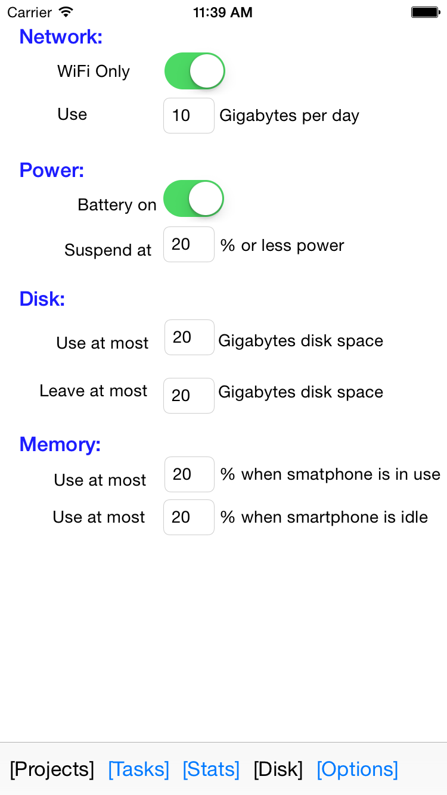
iOS App.
CS 732: Machine Learning
CS 732: Machine Learning
5
11

Slide 42
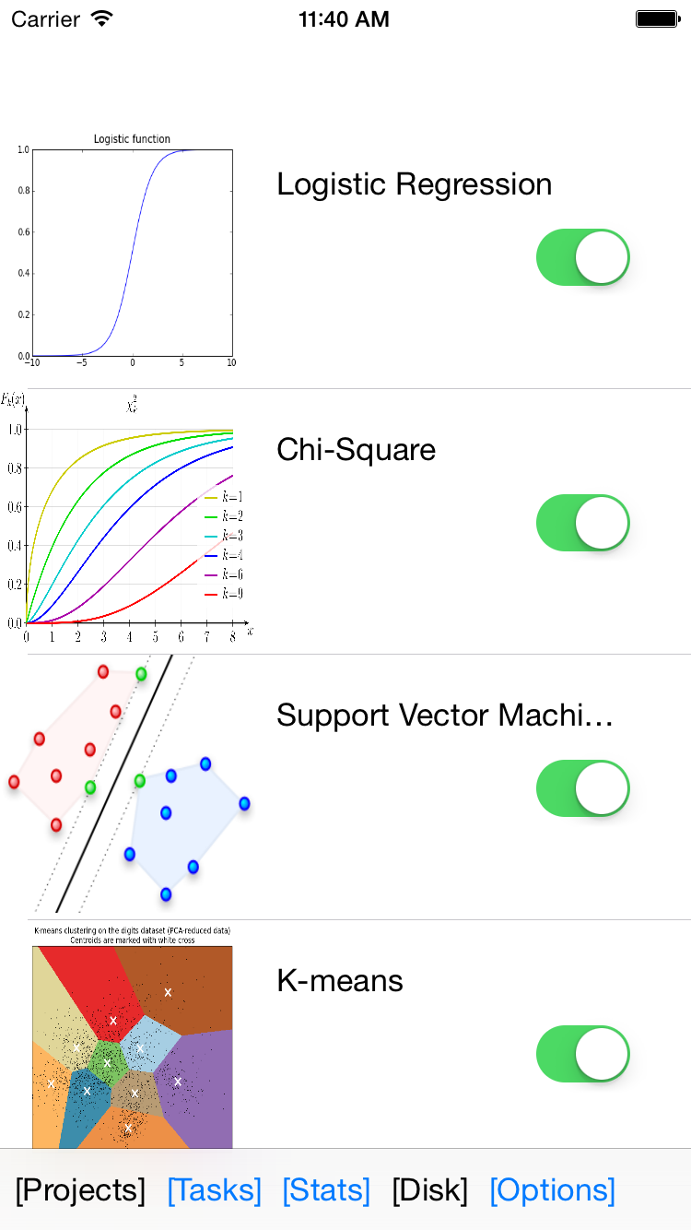
iOS App.
CS 732: Machine Learning
CS 732: Machine Learning
5
11

Slide 43
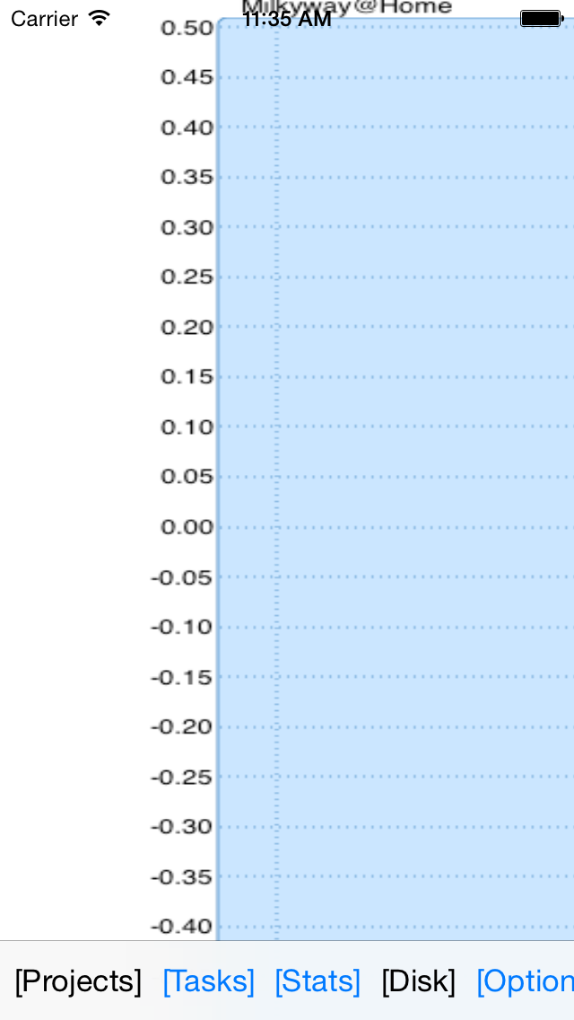
iOS App.
CS 732: Machine Learning
CS 732: Machine Learning
5
11

Slide 44
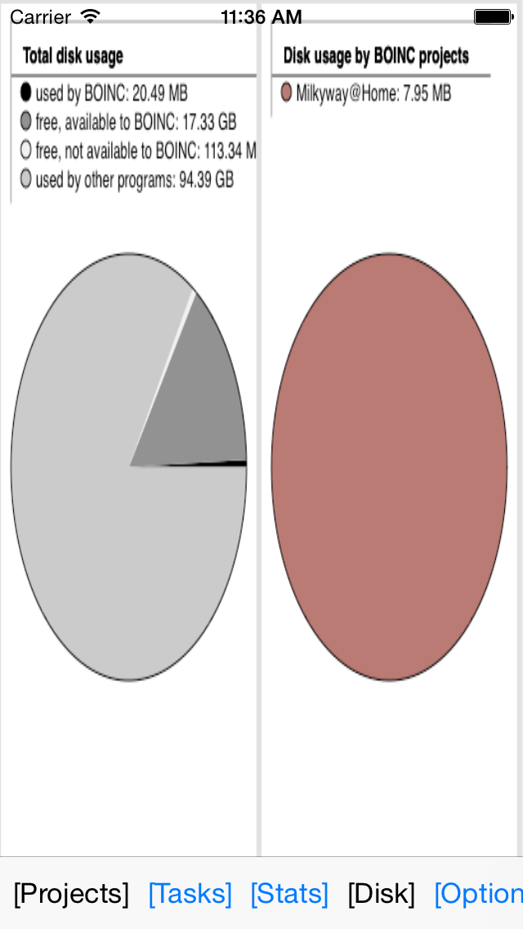
iOS App.
CS 732: Machine Learning
CS 732: Machine Learning
5
11

Slide 45
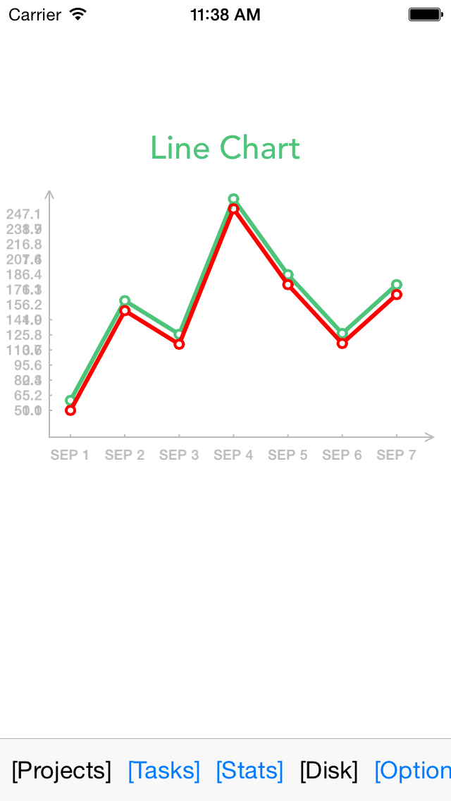
iOS App.
CS 732: Machine Learning
CS 732: Machine Learning
5
11

Slide 46
Metal
Apple new SDK for Swift/Objective-C
“The Metal framework supports GPU-accelerated advanced 3D graphics rendering and data-parallel computation workloads. Metal provides a modern and streamlined API for fine-grained, low-level control of the organization, processing, and submission of graphics and computation commands, as well as the management of the associated data and resources for these commands. A primary goal of Metal is to minimize the CPU overhead incurred by executing GPU workloads.”
Metal is an alternative to OpenGL for graphics processing, but for general data-parallel programming for GPUs it is an alternative to OpenCL and Cuda. This (simple) example shows how to use Metal with Swift for calculating the Sigmoid function (Sigmoid function is frequently occurring in machine learning settings, e.g. for Deep Learning and Kernel Methods/Support Vector Machines).
CS 732: Machine Learning
5

Slide 47
Metal
Function for setting up Metal
Sigmoid function in Shaders.metal
Prepare original input data – a Swift array
Prepare Sigmoid function to run on GPU
Create GPU input and output data
Configure GPU threads
Wrap up encoding setup and start processing, and wait until finished!
Get result data out from GPU and into Swift
CS 732: Machine Learning
5

Slide 48
Metal
// a. initialize Metal
var (device, commandQueue, defaultLibrary, commandBuffer, computeCommandEncoder) = initMetal()
// b. set up a compute pipeline with Sigmoid function and add it to encoder
let sigmoidProgram = defaultLibrary.newFunctionWithName("sigmoid")
var pipelineErrors = NSErrorPointer()
var computePipelineFilter = device.newComputePipelineStateWithFunction(sigmoidProgram!, error: pipelineErrors)
computeCommandEncoder.setComputePipelineState(computePipelineFilter!)
// a. calculate byte length of input data - myvector
// b. create a MTLBuffer - input data that the GPU and Metal produce
// c. set the input vector for the Sigmoid() function, e.g. inVector
// atIndex: 0 here corresponds to buffer(0) in the Sigmoid function
var myvectorByteLength = myvector.count*sizeofValue(myvector[0])
var inVectorBuffer = device.newBufferWithBytes(&myvector, length: myvectorByteLength, options: nil)
computeCommandEncoder.setBuffer(inVectorBuffer, offset: 0, atIndex: 0)
// Create the output vector for the Sigmoid() function, e.g. outVector
// atIndex: 1 here corresponds to buffer(1) in the Sigmoid function
var resultdata = [Float](count:myvector.count, repeatedValue: 0)
var outVectorBuffer = device.newBufferWithBytes(&resultdata, length: myvectorByteLength, options: nil)
computeCommandEncoder.setBuffer(outVectorBuffer, offset: 0, atIndex: 1)
CS 732: Machine Learning
5
Notes:
func initMetal() -> (MTLDevice, MTLCommandQueue, MTLLibrary, MTLCommandBuffer,
MTLComputeCommandEncoder){
// Get access to iPhone or iPad GPU
var device = MTLCreateSystemDefaultDevice()
// Queue to handle an ordered list of command buffers
var commandQueue = device.newCommandQueue()
// Access to Metal functions that are stored in Shaders.metal file, e.g. sigmoid()
var defaultLibrary = device.newDefaultLibrary()
// Buffer for storing encoded commands that are sent to GPU
var commandBuffer = commandQueue.commandBuffer()
// Encoder for GPU commands
var computeCommandEncoder = commandBuffer.computeCommandEncoder()
return (device, commandQueue, defaultLibrary!, commandBuffer, computeCommandEncoder)

Slide 49
Metal
// hardcoded to 32 for now
var threadsPerGroup = MTLSize(width:32,height:1,depth:1)
var numThreadgroups = MTLSize(width:(myvector.count+31)/32, height:1, depth:1)
computeCommandEncoder.dispatchThreadgroups(numThreadgroups,threadsPerThreadgroup: threadsPerGroup)
computeCommandEncoder.endEncoding()
commandBuffer.commit()
commandBuffer.waitUntilCompleted()
// a. Get GPU data
var data=NSData(bytesNoCopy: outVectorBuffer.contents(),length: myvector.count*sizeof(Float), freeWhenDone: false)
// b. prepare Swift array large enough to receive data from GPU
var finalResultArray = [Float](count: myvector.count, repeatedValue: 0)
// c. get data from GPU into Swift array
data.getBytes(&finalResultArray, length:myvector.count * sizeof(Float))
CS 732: Machine Learning
5

Slide 50
Metal
// Shaders.metal
#include <metal_stdlib>
using namespace metal;
kernel void sigmoid(const device float *inVector [[ buffer(0) ]],
device float *outVector [[ buffer(1) ]],
uint id [[ thread_position_in_grid ]]) {
// This calculates sigmoid for _one_ position (=id) in a vector per call on the GPU
outVector[id] = 1.0 / (1.0 + exp(-inVector[id]));
}
CS 732: Machine Learning
5

Slide 51
Part III
An Iterative MapReduce Approach to Frequent Subgraph Mining in Biological Datasets
Bismita Srichandan
Department of Computer Science
Georgia State University
College Park, MD 20742
Rajshekhar Sunderraman
Department of Computer Science
Georgia State University
Steven Hill
Department of Computer Science
University of Maryland
College Park, MD 20742
Presented by: Wadood Chaudhary

Slide 52
Section I Introduction
4

Slide 53
Motivation
Mining Frequent Patterns can help understand functions and relations, for example.
a protein-protein interaction network (PPI), a frequent pattern could uncover unknown functions of a protein.
In a social network, a frequent pattern could show a friend clique.
CS 732: Machine Learning
5

Slide 54
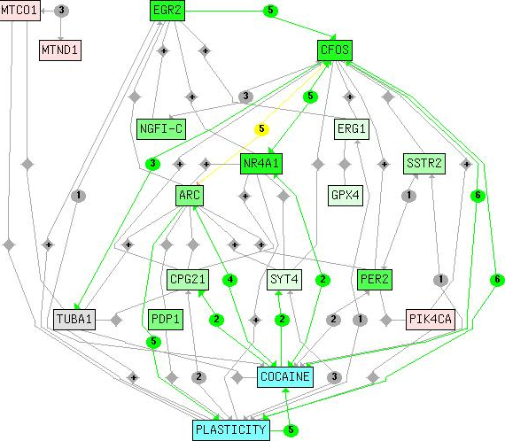
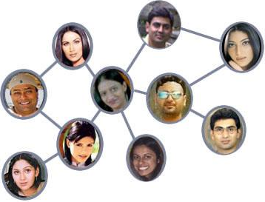
Subgraph Mining Applications
Computational Biology
( examples: Protein-protein interaction (PPI) networks)
CS 732: Machine Learning
Social Network Analysis
(examples: Facebook friends)
6

Slide 55
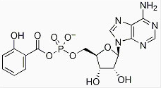
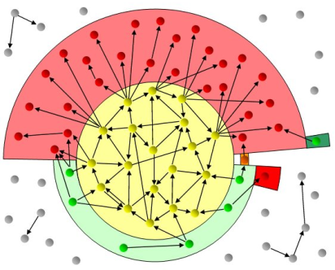
Applications
Chemical data analysis
(examples: Chemical compounds)
CS 732: Machine Learning
Communication networking
(examples: Device networks, road networks)
Image sources: Applications of Machine Learning
7

Slide 56
Challenges
Subgraph Mining is Computationally intensive
Relational databases are not efficient.
Memory based techniques are fast but…
Lacks scalability.
Main memory is bottleneck
“MapReduce is the answer!”
CS 732: Machine Learning
8

Slide 57
Key contributions
A novel method to extract the significant patterns from a set of labeled graphs using MapReduce.
Works for both directed and undirected graphs.
Use of the MapReduce programming model to achieve multifold scalability on a set of labeled graphs.
It is first implementation of transaction graphs using the MapReduce model.
CS 732: Machine Learning
9

Slide 58
Part II MapReduce MultiCore
10

Slide 59
Section II Related Work
10

Slide 60
Existing Systems Overview (1)
Memory based Systems
Subdue and its extensions were part of the earliest research by Cook et al. to discover the best compressing structure.
Inokuchi et al. [13] proposed an Apriori based algorithm to discover all frequent subgraphs.
Kuramochi et al. proposed FSG [15] which represents graphs as a sparse adjacency matrix and uses canonical labeling to determine subgraph isomorphism.
In a subsequent publication [16], Kuramochi et al. proposed algorithms based on horizontal and vertical pattern discovery which operates on a single graph.
Han et al. proposed the gSpan algorithm [21], which uses depth-ﬁrst search and generates less candidate items than FSG.
Huan et al. [12] proposed FFSM which shows better performance over gSpan.
Jiang et al. [14] tried to mine globally frequent subgraphs on a single labeled graph.
CS 732: Machine Learning
11

Slide 61
Existing Systems Overview (2)
Traditional Database approach
DB-Subdue [3] and HDB- Subdue [18] are the SQL versions of Subdue that follow a minimum description length (MDL) principle for graph compression.
DB-FSG [4] is a relational database approach applied on transaction graphs. OO-FSG [19] uses an object oriented database approach to ﬁnd the frequent sub-graphs in a set of labeled graphs.
CS 732: Machine Learning
12

Slide 62
Existing Systems Overview
Distributed Systems approach:
Wu et al. [20] proposed a parallel subgraph mining algorithm in which the motif network diameter and number of vertices are taken as standard for motif matching.
Liu et al. [17] proposed a method MRPF to ﬁnd motifs in prescription compatibility networks.
Fatta et al. [10] use a search tree partitioning strategy, along with dynamic load balancing.
CS 732: Machine Learning
13
Notes:
There are bunch of systems that support online storage. Simple systems out there which rely on well-know protocols like FTPs and WebDav but normally they do not have many features. You can just push your data and then retrieve it at later time. You are the sole owner of your data. Compare that to a class of more complex system where for example folders are shared or files are transferred more efficiently by supporting delta synch, which is that only information changed is pushed. And also it important to note that some of them may not have central servers. They maybe based on P2P like Bit Torrents or the new systems like SpaceMonkey which may be a combination. Also, a point to note files stored may or may not be encrypted.

Slide 63
Section IV MapReduce Frequent Subgraph Mining (FSG) Algorithm and Implementation
21

Slide 64
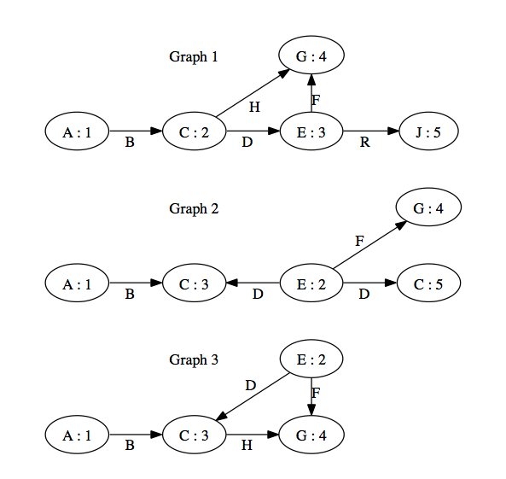
Definitions (Labeled Graphs)
Labeled Graphs are represented by a 4-tuple:
G =(V,E,L,l), where • V is a set of vertices
E ⊆ V × V is a set of edges, they can directed or undirected.
L is a set of labels
V ∪E → L, l is a function assigning labels to the vertices and the edges
CS 732: Machine Learning
22

Slide 65
Definitions (2)
Support =nSubGraph / nGraph
nGraph is the total number of graphs in the dataset
nSubGraph is the number of times a particular subgraph appears in the dataset.
Graph isomorphism
Two instances are isomorphic if the vertex and edge labels are same and the directions are the same.
Graph Direction
Graphs can be directed and undirected, and the node numbers help identify cases of repeated labels.
CS 732: Machine Learning
23

Slide 66
Subgraphs in Transaction setting
Counting the frequency in a transaction setting is a little diﬀerent than the single graph setting
Single Large Graphs
Frequency of a substructure is determined by the number of times the pattern appears in the whole graph.
Set of Graphs in a Transaction Setting
Calculate hash sum or other digest
Frequency of a substructure is determined by the number of graph transactions containing the pattern.
CS 732: Machine Learning
24

Slide 67
Mapper and Reducers
Mapper 1 for Gathering Subgraphs with Similar Graph ID
input key : offset of the input file for the string input value : string representing a subgraph of size-(k − 1) and graph id
output key : graph id output value : string representing the input subgraph
Reducer 1 for Constructing Subgraphs
input key : graph id input values : list of subgraphs of size-(k − 1) encoded with graph id
output key : encoded subgraph of size-k and graph id
output value : none
CS 732: Machine Learning
25

Slide 68
Mapper and Reducers
Mapper 1 for Gathering Subgraphs with Similar Graph ID
input key : offset of the input file for the string input value : encoded string representing subgraph of size-k and graph id
output key : label-only string encoding subgraph
output value : corresponding node ids and graph id
Reducer for Determining Frequent Subgraphs
input key : label-only string encoding subgraph of size-k input values : list of corresponding node ids and graph ids
output key : the encoded subgraph and graph id
output value : none
CS 732: Machine Learning
26

Slide 69
MapReduce Jobs
File System
Counting Reducer
Construction Mapper
CS 732: Machine Learning
Counting Mapper
Construction Reducer
Intermediate System
27

Slide 70
Algorithms (Frequent Subgraph for MapReduce)
MapReduce for Frequent Subgraph (FSG) is an iterative algorithm that relies on 2 MapReduce jobs.
The first job (denoted as Ak) constructs size-k subgraphs from size (k − 1) subgraphs.
The second job (denoted as Bk) checks if a subgraph meets the user defined support.
The algorithm starts with single edges, and runs until there are no longer any frequent subgraphs constructed.
CS 732: Machine Learning
28

Slide 71
Algorithm 1 Map Ak
Input: (offset, subgraph)
parse subgraph for graph id
EMIT: (graph id, subgraph)
CS 732: Machine Learning
29

Slide 72
Algorithm 2 Reduce Ak
Input (graph id, subgraphs s1, s2, s3, · · · )
Edges ← φ
newSubgraphs ← φ for all s ∈ subgraphs do
Retrieve all edges from s and add to Edges
end for
for all s ∈ subgraphs do Construct k-sized subgraphs from (k − 1)-sized s using edges from Edges that are eligible and add the new subgraph to newSubgraphs
end for for all s ∈ newSubgraphs do
EMIT: (encoding for subgraph, empty text)
end for
CS 732: Machine Learning
30

Slide 73
Algorithm 3 Map Bk
Input: (offset, encoded subgraph) parse encoded subgraph for label-only subgraph
EMIT: (label-only subgraph, subgraph)
CS 732: Machine Learning
31

Slide 74
Algorithm 4 Reduce Bk
Input: (label-only subgraph, subgraphs s1, s2, s3, · · · )
GraphIDs ← φ count ← 0 for all s ∈ subgraphs do
if s.graphid ̸∈ GraphIDs then count ← count + 1 GraphIDs ← GraphIDs ∪ s.graphid
end if
end for
if count ≥ user support then
for all s ∈ subgraphs do
EMIT: (subgraph, empty text)
end for
end if
CS 732: Machine Learning
32

Slide 75
Section V Illustrative Example
33

Slide 76
Toy Example (Support & Format)
User Support = 2
The output generated by the Ai and Bi steps are coded as three-part strings:
2_(A:B_C)_(1:3)
First part represents the graph id.
Second part represents a label-only subgraph, e.g., (A:B-C) = node A has an edge B to node C
Third part represents node id numbers, such as (1:3) standing for “node with id 1 has an edge to node with id 3.”
CS 732: Machine Learning
34

Slide 77
Transaction Graph used in the Example
CS 732: Machine Learning
35

Slide 78
Step A1..B1
No need of A1 since we are using single edges as the initial input.
^{Output of Step A1 and B1}
^{2 (A:B-C) (1:3)}
^{3 (A:B-C) (1:3)}
^{1 (A:B-C) (1:2)}
^{3 (C:H-G) (3:4)}
^{1 (C:H-G) (2:4)}
^{3 (E:D-C) (2:3)}
^{2 (E:D-C) (2:3)}
^{2 (E:D-C) (2:5)}
^{2 (E:F-G) (2:4)}
^{3 (E:F-G) (2:4)}
^{1 (E:F-G) (3:4)}
CS 732: Machine Learning
36

Slide 79
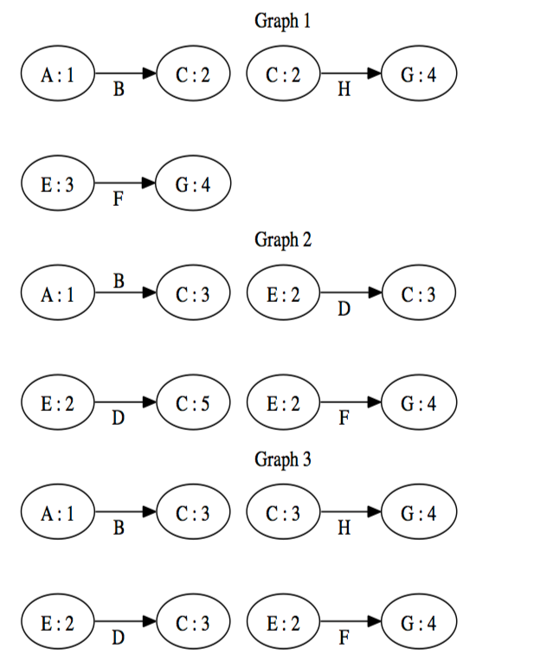
Result of Step A1..B1
At this step, all single edges that do not meet our support of 2 have been removed.
CS 732: Machine Learning
37

Slide 80
Step A2
The worker A2 reads input from the job of B1 and constructs all subgraphs of
size 2 without regard to support.
Output from Step A2
1 (Aˆ1:B-Cˆ1)(Cˆ1:H-Gˆ1) (1:2)(2:4)
1 (Cˆ1:H-Gˆ1)(Eˆ1:F-Gˆ1) (2:4)(3:4)
2 (Aˆ1:B-Cˆ1)(Eˆ1:D-Cˆ1) (1:3)(2:3)
2 (Eˆ1:D-Cˆ1,D-Cˆ2) (2:3,5)
2 (Eˆ1:D-Cˆ1,F-Gˆ1) (2:3,4) 2 (Eˆ1:D-Cˆ1,F-Gˆ1) (2:5,4) 3 (Aˆ1:B-Cˆ1)(Cˆ1:H-Gˆ1) (1:3)(3:4)
3 (Aˆ1:B-Cˆ1)(Eˆ1:D-Cˆ1) (1:3)(2:3)
3 (Cˆ1:H-Gˆ1)(Eˆ1:D-Cˆ1) (3:4)(2:3)
3 (Cˆ1:H-Gˆ1)(Eˆ1:F-Gˆ1) (3:4)(2:4)
3 (Eˆ1:D-Cˆ1,F-Gˆ1) (2:3,4)
CS 732: Machine Learning
38

Slide 81
Step B2
The worker for B2 reads input from A1..B1 to the job of A2.
Output from Step B2
1 (A:B-C)(C:H-G) (1:2)(2:4)
3 (A:B-C)(C:H-G) (1:3)(3:4)
2 (A:B-C)(E:D-C) (1:3)(2:3)
3 (A:B-C)(E:D-C) (1:3)(2:3)
1 (C:H-G)(E:F-G) (2:4)(3:4)
3 (C:H-G)(E:F-G) (3:4)(2:4)
2 (E:D-C,F-G) (2:3,4)
2 (E:D-C,F-G) (2:5,4)
3 (E:D-C,F-G) (2:3,4)
CS 732: Machine Learning
The output is a pruned group of subgraphs of size-2 meeting the support.
39

Slide 82
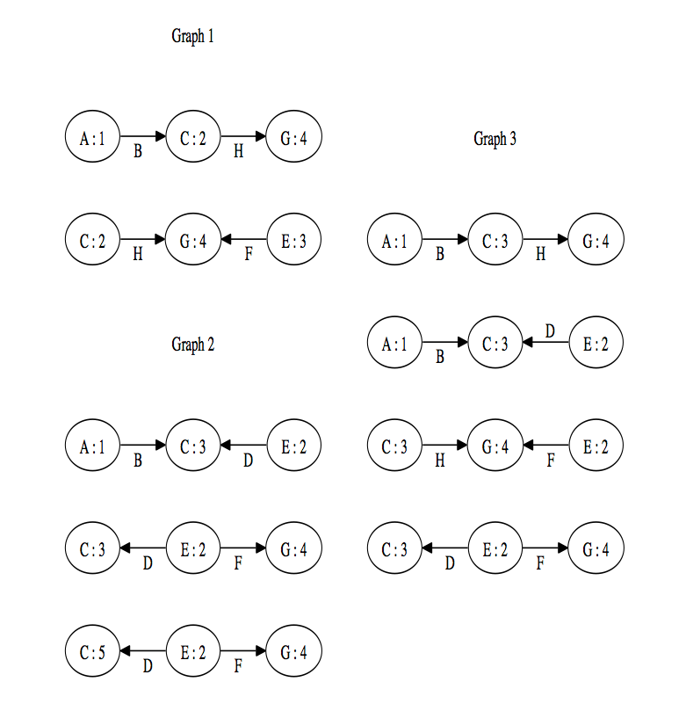
Result of Step A2..B2
At end of step A2..B2, all double edges that do not meet our support of 2 have been removed.
CS 732: Machine Learning
40

Slide 83
Step A3
Similar to A2, we read from the results of the preceding B step.
Output of A3
1 (Aˆ1:B-Cˆ1)(Cˆ1:H-Gˆ1)(Eˆ1:F-Gˆ1) (1:2)(2:4)(3:4)
2 (Aˆ1:B-Cˆ1)(Eˆ1:D-Cˆ1,D-Cˆ2) (1:3)(2:3,5) 2 (Aˆ1:B-Cˆ1)(Eˆ1:D-Cˆ1,F-Gˆ1) (1:3)(2:3,4) 2 (Eˆ1:D-Cˆ1,D-Cˆ2,F-Gˆ1) (2:3,5,4)
3 (Aˆ1:B-Cˆ1)(Cˆ1:H-Gˆ1)(Eˆ1:D-Cˆ1) (1:3)(3:4)(2:3)
3 (Aˆ1:B-Cˆ1)(Cˆ1:H-Gˆ1)(Eˆ1:F-Gˆ1) (1:3)(3:4)(2:4)
3 (Aˆ1:B-Cˆ1)(Eˆ1:D-Cˆ1,F-Gˆ1) (1:3)(2:3,4) 3 (Cˆ1:H-Gˆ1)(Eˆ1:D-Cˆ1,F-Gˆ1) (3:4)(2:3,4)
CS 732: Machine Learning
41

Slide 84
Step B3
This is the final result (represented in next slide) of our example:
Output of B3
1 (A:B-C)(C:H-G)(E:F-G) (1:2)(2:4)(3:4)
3 (A:B-C)(C:H-G)(E:F-G) (1:3)(3:4)(2:4)
2 (A:B-C)(E:D-C,F-G) (1:3)(2:3,4)
3 (A:B-C)(E:D-C,F-G) (1:3)(2:3,4)
CS 732: Machine Learning
42

Slide 85
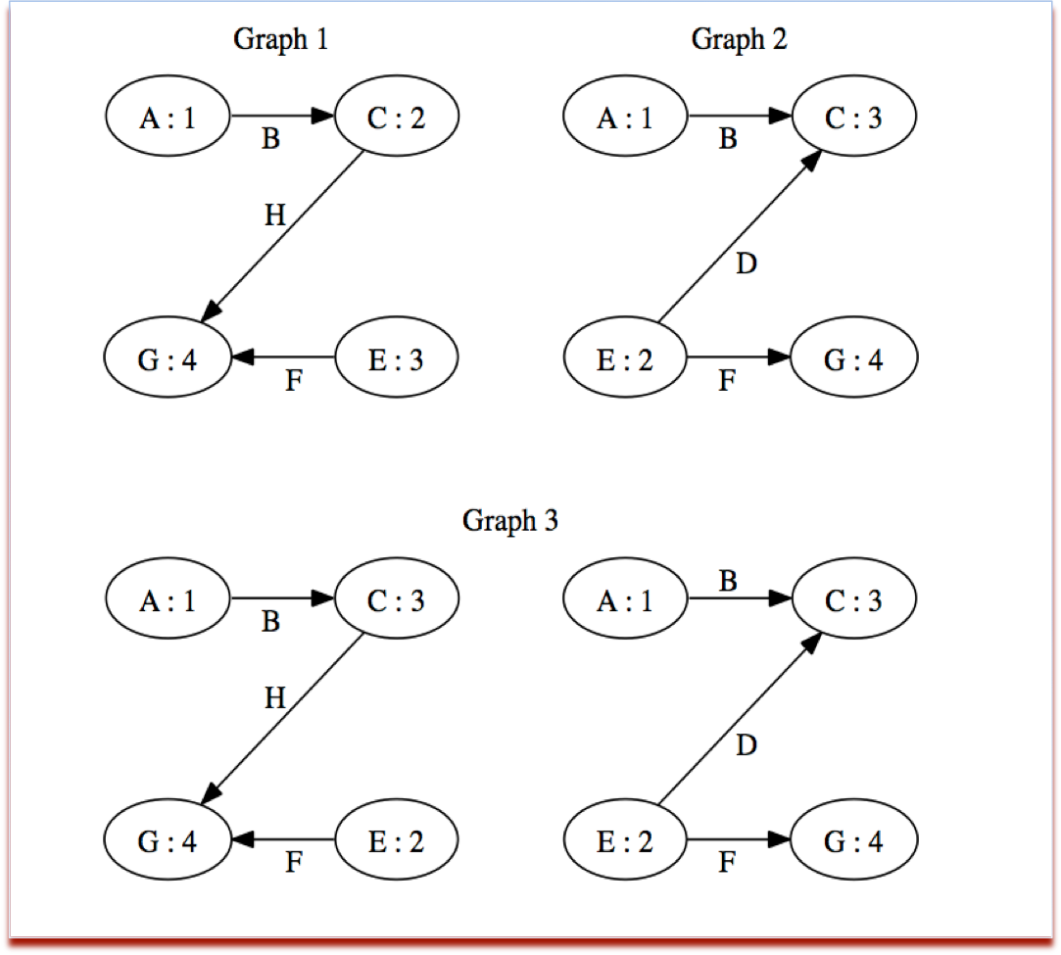
Final Result of Frequent SubGraph Mining (FSG) Program using MapReduce
At end of step A3..B3, all triple edges that do not meet our support of 2 have been removed.
CS 732: Machine Learning
43

Slide 86
Section VI Evaluation
44

Slide 87
Experiments (Hardware)
Hardware
Number of Machines = 4 machines.
Memory = 16 GB
Processors = 2-4 quad core processors.
Software
MapReduce = Apache Hadoop 2.1
OS = Linux
CS 732: Machine Learning
45

Slide 88
Synthetic Dataset
Size of Dataset
100,000 to 1,000,000 transaction graphs.
Graph Size:
Edges = 30-50
Vertices = 30-50
Minimum support values
1%, 4%, and 7%.
Substructure:
Maximum substructures= 4
CS 732: Machine Learning
CS 732: Machine Learning
46
46

Slide 89
Synthetic Datasets
Dataset size | Support | 2 Nodes | 4 Nodes
100K | 1% | 2471 | 1332
100K | 4% | 1718 | 1002
100K | 7% | 1203 | 721
400K | 1% | 2704 | 1559
400K | 4% | 2134 | 1217
400K | 7% | 1778 | 1018
1000K | 1% | 3702 | 2021
1000K | 4% | 3282 | 1809
1000K | 7% | 2786 | 1559
CS 732: Machine Learning
Jumping from 2 nodes to 4 scaled very well for both increases in datasets, as well as number of nodes (See next 3 slides).
47

Slide 90
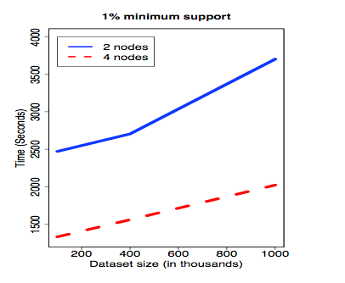
Performance of Synthetic Datasets
CS 732: Machine Learning
48

Slide 91
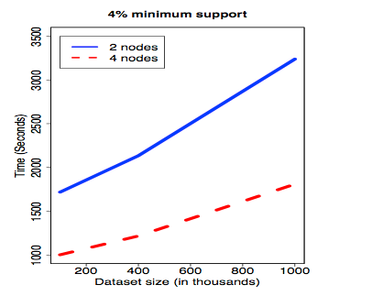
Performance of Synthetic Datasets
CS 732: Machine Learning
49

Slide 92
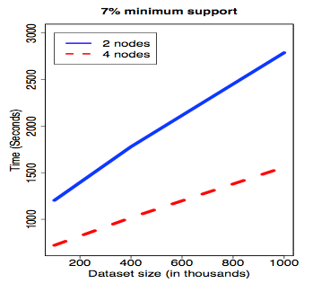
Performance of Synthetic Datasets
CS 732: Machine Learning
50

Slide 93
Biological Datasets
The real datasets were based on the biological activities of small molecules (Sourced from PubChem website).
The dataset is comprised of bioassay records for anti-cancer screen tests with different cancer cell lines.
The outcome of each cancer line is either active or inactive.
Results of Tests
Test results on cluster of size 2, and then on a cluster of size 4 are shown in next 6 slides.
CS 732: Machine Learning
51

Slide 94
Biological Datasets
Dataset | active: 2 | active: 4 | inactive: 2 | inactive: 4
MCF-7 | 833 | 587 | 1092 | 683
MOLT-4 | 922 | 556 | 1279 | 815
NCI-H23 | 815 | 516 | 1537 | 889
OVCAR-8 | 861 | 552 | 1257 | 844
P388 | 743 | 483 | 976 | 683
PC-3 | 857 | 546 | 1150 | 752
SF-295 | 936 | 528 | 1217 | 817
SN12C | 813 | 502 | 1474 | 883
SW-620 | 959 | 568 | 1454 | 898
UACC257 | 836 | 536 | 1333 | 883
Yeast | 710 | 607 | 1282 | 812
CS 732: Machine Learning
Performance on biological datasets using a support of 50% and clusters of size 2 and 4 (in seconds)
52

Slide 95
Biological Datasets
Dataset | Size | Tumor description
MCF-7 | 27770 | Breast
MOLT-4 | 39765 | Leukemia
NCI-H23 | 40353 | Non-Small Cell Lung
OVCAR-8 | 40516 | Ovarian
P388 | 41472 | Leukemia
PC-3 | 27509 | Prostate
SF-295 | 40271 | Central Nerv Sys
SN12C | 40532 | Colon
SW-620 | 40004 | Renal
UACC257 | 39988 | Melanoma
Yeast | 79601 | Yeast anticancer
CS 732: Machine Learning
53

Slide 96
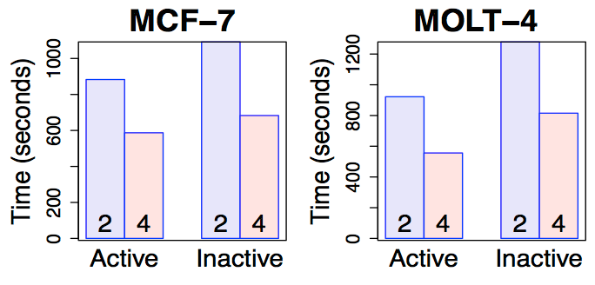
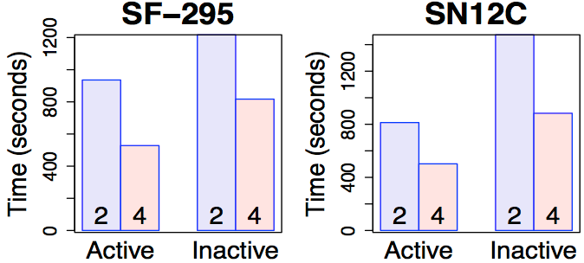
Results of Biological Datasets
CS 732: Machine Learning
54

Slide 97
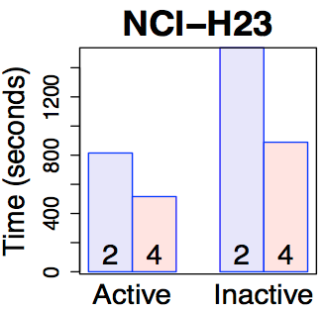
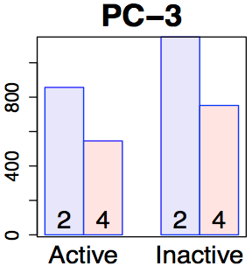
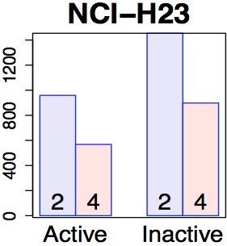
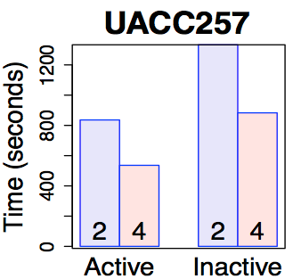
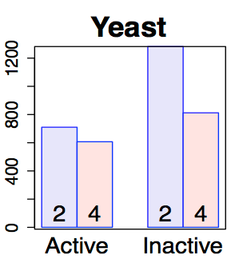
Results of Biological Datasets
CS 732: Machine Learning
55

Slide 98
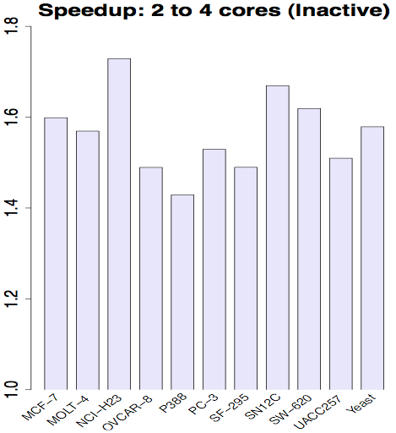
Performance on Biological Datasets
CS 732: Machine Learning
56

Slide 99
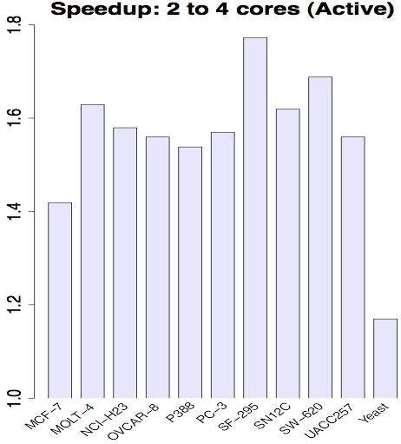
Performance on Biological Datasets
CS 732: Machine Learning
57

Slide 100
Section VII Evaluation
58

Slide 101
Evaluation Summary
Results on both the synthetic and real datasets performed substantially better than the database methods, which were the fastest methods for general purpose subgraph mining prior to this paper.
CS 732: Machine Learning
59

Slide 102
Section VIII Conclusion and Acknolwedgments
60

Slide 103
Conclusion
A new and more efficient approach for mining frequent subgraphs through MapReduce has been developed.
Using Hadoop, a scalable and efficient methodology which outperforms all previous methods.
Not only does this method performs better than previous methods, but it can handle undirected graphs in addition to directed.
CS 732: Machine Learning
61

Slide 104
Acknowledgements
[1] R. Agrawal and R. Srikant. Fast algorithms for mining association rules. In 20th International Conference on Very Large Data Bases (VLDB), pages 487–499. Morgan Kaufmann, September 1994.
[2] C. Borgelt and M. R. Berthold. Mining molecular fragments: Finding relevant substructures of molecules. In IEEE International Conference on Machine Learning (ICDM) Proceedings, pages 51–58. IEEE, December 2002.
[3] S. Chakravarthy, R. Beera, and R. Balachandran. Db-subdue: Database approach to graph mining. In 8th Pacific-Asia Conference in Knowledge Discovery and Machine Learning (PAKDD) Proceedings, pages 341–350. Springer, May 2004.
[4] S. Chakravarthy and S. Pradhan. Db-fsg: An sql-based approach for frequent subgraph mining. In 19th international conference on Database and Expert Systems Applications (DEXA) Proceedings, pages 684–692. Springer, September 2008.
[5] D. J. Cook and L. B. Holder. Substructure discovery
using minimum description length and background knowledge. Artificial Intelligence Research, 1(1):231–255, August 1993.
[6] D. J. Cook and L. B. Holder. Graph-based Machine Learning. IEEE Intelligent Systems, 15(2):32–41, May 2000.
[7] D. J. Cook, L. B. Holder, and S. Djoko. Knowledge discovery from structural data. Intelligent Information Systems, 5(3):229–248, November 1995.
CS 732: Machine Learning
62

Slide 105
Acknowledgements
[8] J. Dean and S. Ghemawat. Mapreduce: simplified data processing on large clusters. Communications of the ACM, 51(1):107–113, January 2008.
[9] L. Dehaspe, H. Toivonen, and R. D. King. Finding frequent substructures in chemical compounds. In 4th ACM SIGKDD International Conference on Knowledge Discovery and Machine Learning, pages 30–36. AAAI Press, August 1998.
[10] G. D. Fatta and M. Berthold. Dynamic load balancing for the distributed mining of molecular structures. IEEE Transactions on Parallel and Distributed System, 17(8):773–785, September 2006.
[11] L. B. Holder, D. J. Cook, and S. Djoko. Substucture discovery in the subdue system. In Workshop on Knowledge Discovery in Databases (KDD) Proceedings, pages 169–180. AAAI Workshop, July 1994.
[12] J. Huan, W. Wang, and J. Prins. Efficient mining of frequent subgraphs in the presence of isomorphism. In Third IEEE International Conference on Machine Learning (ICDM) Proceedings, pages 549–552. IEEE, November 2003
15] M. Kuramochi and G. Karypis. Frequent subgraph discovery. In IEEE International Conference on Machine Learning (ICDM) Proceedings, pages 313–320. IEEE Computer Society, December 2001.
[16] M. Kuramochi and G. Karypis. Finding frequent patterns in a large sparse graph. Machine Learning and Knowledge Discovery, 11(3):795–825, November 2005.
CS 732: Machine Learning
63

Slide 106
Acknowledgements
[17] Y. Liu, X. Jiang, H. Chen, J. Ma, and X. Zhang. Mapreduce-based pattern finding algorithm applied in motif detection for prescription compatibility network. In 8th International Symposium on Advanced Parallel Processing Technologies (APPT), pages 341 – 355. Springer, August 2009.
[18] S. Padmanabhan and S. Chakravarthy. Knowledge discovery from structural data. In 11th International Conference on Data Warehousing and Knowledge Discovery (DaWaK), pages 325 – 338. Springer, August 2009.
[19] B. Srichandan and R. Sunderraman. Oo-fsg: An object-oriented approach to mine frequent subgraphs. In Australasian Machine Learning Conference (AusDM) Proceedings, pages 221–228. CRPIT, December 2011.
[20] B. Wu and Y. Bai. An efficient distributed subgraph mining algorithm in extreme large graphs. In International conference on Artificial intelligence and computational intelligence: Part I (AICI) Proceedings, pages 107–115. Springer, October 2010.
[21] X. Yan and J. Han. gspan: graph-based substructure pattern mining. In IEEE International Conference on Machine Learning (ICDM) Proceedings, pages 721–724. IEEE, December 2002.
CS 732: Machine Learning
64

Slide 107
Thank You
65

